Slide 1
MaskedCLIP: Bridging the Masked and CLIP Space for Semi-Supervised Medical Vision-Language Pre-training
Lei Zhu¹, Jun Zhou¹, Rick Siow Mong Goh¹, Yong Liu¹
¹ Institute of High Performance Computing (IHPC), Agency for Science, Technology and Research (A*STAR), 1 Fusionopolis Way, #16-16 Connexis, Singapore 138632,Republic of Singapore

Slide 2
MaskedCLIP: Bridging the Masked and CLIP Space for SSVLP
Background and Motivation:
Foundation model has recently gained tremendous popularity in medical image analysis, where deep neural networks are pre-trained on diverse and large volume of medical image data to learn generalizable image features to boost downstream task performance.
State-of-the-art methods leverage either paired image-text data via vision-language pre-training or unpaired image data via self-supervised pre-training to learn foundation models. Yet, they fail to leverage the other type of data to learn richer and more comprehensive image features.
In this paper, we investigate a novel task termed semi-supervised vision-language pre-training, aiming to fully harness the potential of both paired and unpaired image data for foundation model learning.

Slide 3
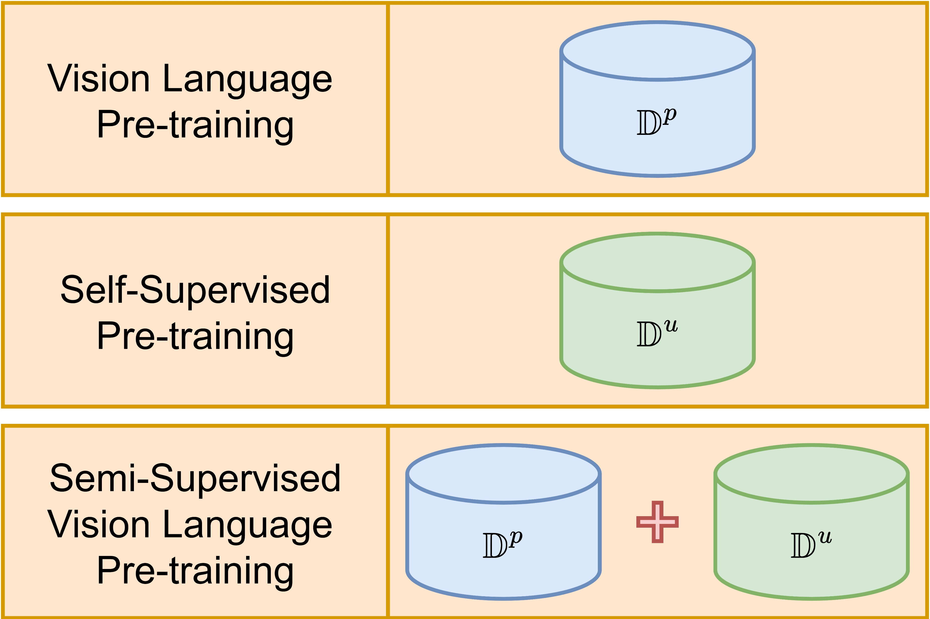
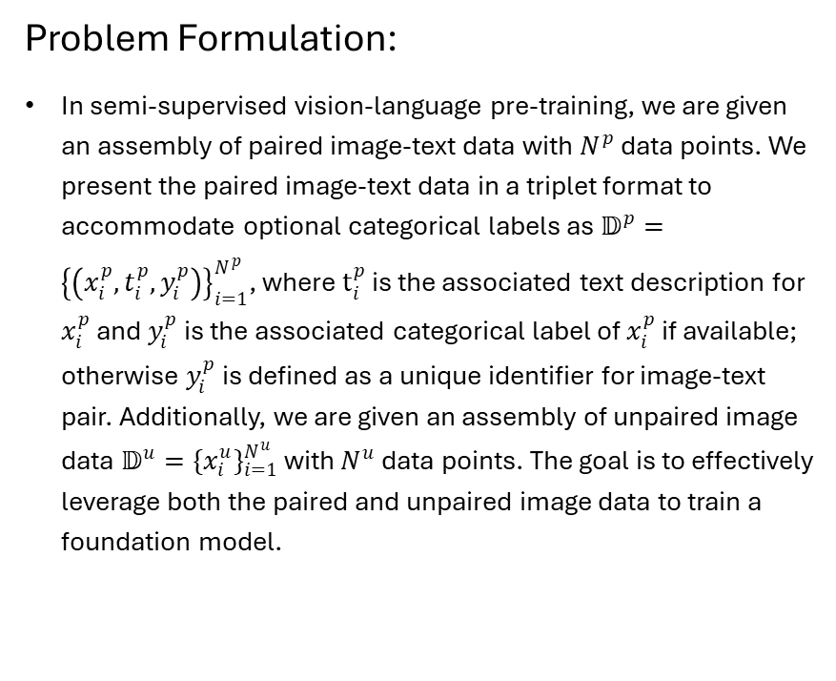
MaskedCLIP: Bridging the Masked and CLIP Space for SSVLP
Problem Formulation:
In semi-supervised vision-language pre-training, we are given an assembly of paired image-text data with $N^{p}$ data points. We present the paired image-text data in a triplet format to accommodate optional categorical labels as $𝔻^{p}={\left\{\left(x_{i}^{p},t_{i}^{p},y_{i}^{p}\right)\right\}}_{i=1}^{N^{p}}$, where $t_{i}^{p}$ is the associated text description for $x_{i}^{p}$ and $y_{i}^{p}$ is the associated categorical label of $x_{i}^{p}$ if available; otherwise $y_{i}^{p}$ is defined as a unique identifier for image-text pair. Additionally, we are given an assembly of unpaired image data $𝔻^{u}={\{x_{i}^{u}\}}_{i=1}^{N^{u}}$ with $N^{u}$ data points. The goal is to effectively leverage both the paired and unpaired image data to train a foundation model.
Figure 1. Comparison of different pre-training paradigms

Slide 4
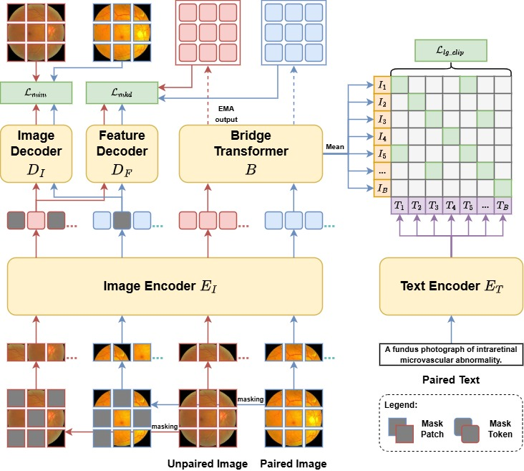
MaskedCLIP: Bridging the Masked and CLIP Space for SSVLP
MaskedCLIP: Synergistic Masked Space and CLIP Space Learning
(a) Bridger Transformer
Due to the natural semantic hierarchy of the general masked feature space and the semantic specific CLIP feature space, we proposed a bridge transformer to connect the two spaces so that the CLIP features can benefit from the general masked features for semantic feature extraction.
(b) Labeled-guided Contrastive Loss
We leverage the categorical label information when available and ensure image-text pairs with same categorical label are pulled together in CLIP feature space.
(c) Masked Knowledge Distillation
We propose to distill knowledge from CLIP feature space back to masked feature space with a knowledge distillation loss on momentum features of complete images in CLIP space to reconstructed masked features from masked space to distill semantic information to masked feature space, which also enhances CLIP in global semantic information learning by extracting semantic information from local image patches.
Figure 2. Architecture and dataflow of our proposed MaskedCLIP framework. Our framework consists of five modules, namely an image encoder, a bridge transformer, a text encoder, an image decoder, and a feature decoder to process both image and text data for synergistic masked image modeling and contrastive language-image pre-training. We employ the bridge transformer to connect the masked and CLIP feature space to resolve the feature incompatibility issue and the feature decoder to predict masked image features for masked knowledge distillation.

Slide 5
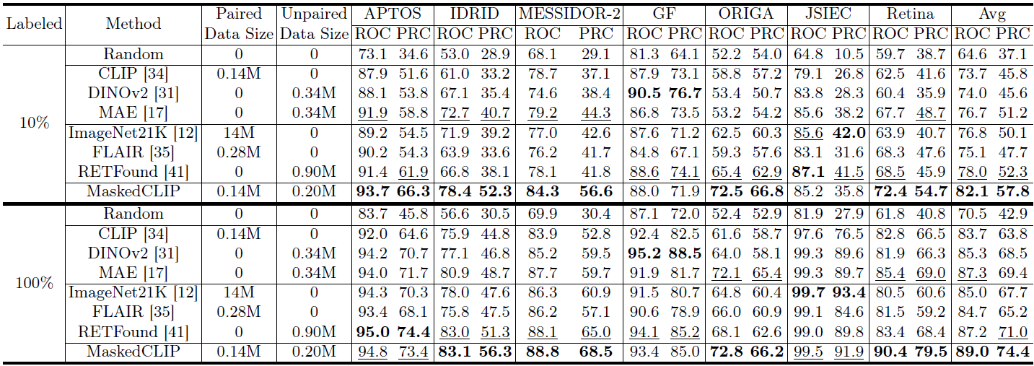
MaskedCLIP: Bridging the Masked and CLIP Space for SSVLP
Experiments:
Datasets
Pre-train: We assembly a pre-training dataset with 348,481 color fundus images, with 142,249 paired images and 206,232 unpaired images.
Fine-tune: We leverage 7 public datasets on retinal image analysis.
Comparison Methods:
No Pre-training
Random
Pre-training Method
MAE
DINO-v2
CLIP
Supervised Pre-training Weights on General Images
ImageNet21K
Medical Foundation Models
FLARE
RETFound
Table 1. Comparison with SoTA methods and foundation models on different downstream tasks. The best results are in bold, and the second-best results are underlined.

Slide 6
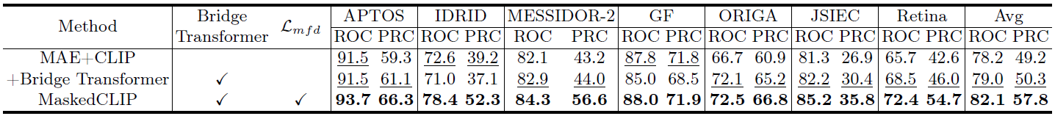
MaskedCLIP: Bridging the Masked and CLIP Space for SSVLP
Experiments:
Ablation Study
Table 2. Ablation study on different downstream tasks with 10% training data. The best results are in bold, and the second-best results are underlined.

Slide 7
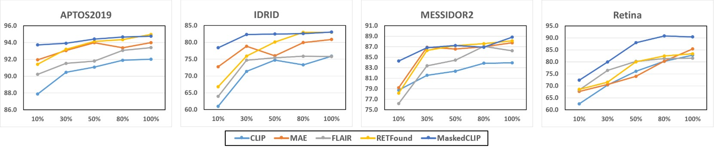
MaskedCLIP: Bridging the Masked and CLIP Space for SSVLP
Experiments:
More Label Efficiency Analysis
Figure 2. Label efficiency analysis on exemplary downstream tasks. The X axis shows the training data proportion, and the Y axis shows the ROC score.

Slide 8
MaskedCLIP: Bridging the Masked and CLIP Space for SSVLP
Conclusion:
In this paper, we introduce a novel task termed semi-supervised vision-language pre-training for learning foundation models.
We propose MaskedCLIP, a principally designed framework for semi-supervised vision-language pre-training.
We conduct extensive experiments to evaluate the effectiveness of our method on retinal image analysis, where it significantly outperforms existing methods across seven downstream tasks and demonstrates exceptional label efficiency.
Our study shows that rather than focusing exclusively on either paired or unpaired image data, a unified approach that leverages all available image data is key to develop more powerful foundation models.

Slide 9
Thanks for listening!

