Slide 1







Lamps:
Learning Anatomy from Multiple
Perspectives via Self-supervision in Chest
Radiographs
Ziyu Zhou^{*1,2}, Haozhe Luo^{*2,3}, Mohammad Reza Hosseinzadeh Taher², Jiaxuan Pang²,
Xiaowei Ding¹, Michael B. Gotway⁴ and Jianming Liang²
¹ Shanghai Jiao Tong University ² Arizona State University
³University of Bern ⁴Mayo Clinic
Notes:
Hello everyone, I’m Ziyu Zhou, phd student in Shanghai Jiao Tong University. It’s my pleasure to share our MICCAI workshop paper Lamps: learning anatomy from multiple perspectives via self-supervision in chest radiographs

Slide 2
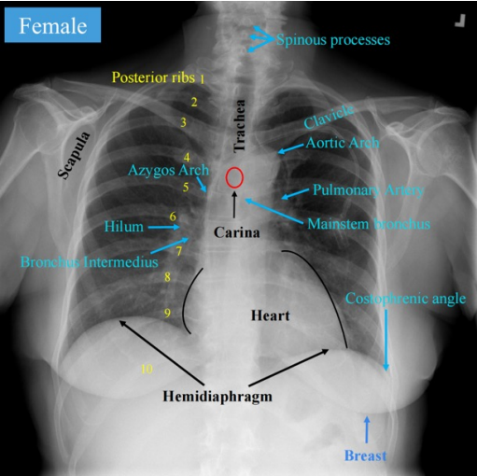
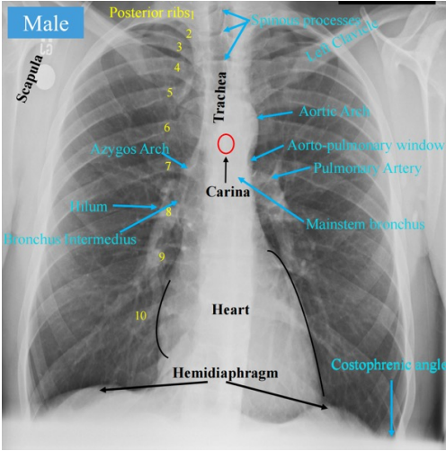
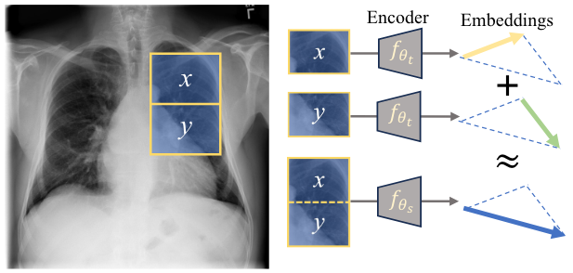
Background——Properties of human anatomy
Medical images acquired from standardized protocol
Compositionality
• Consistent anatomical structures
• Hierarchical nature of anatomy
• Continuous spatial layout
Notes:
Medical images acquired with the same imaging protocol have (click) consistent anatomical structures, and (click) The relative positions of organs and tissues remain stable due to the anatomical coherence of the human body. Besides, the medical image holds hierarchical (click) nature of anatomy. For example, the left lung has two lobes, the superior lobe and the inferior lobe. This calls for anatomical representation with compositionality: the embedding of the whole patch should be the sum of each local part.

Slide 3
Background
Medical images acquired from standardized protocol
Compositionality
Q: How to learn human anatomy from abundant unlabeled medical images?
• Consistent anatomical structures
• Hierarchical nature of anatomy
• Coherent spatial layout
Notes:
Our question comes to how to utilize the intrinsic properties in medical images?

Slide 4
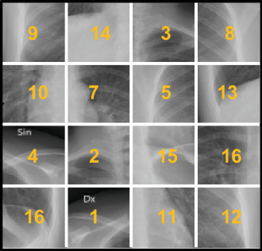
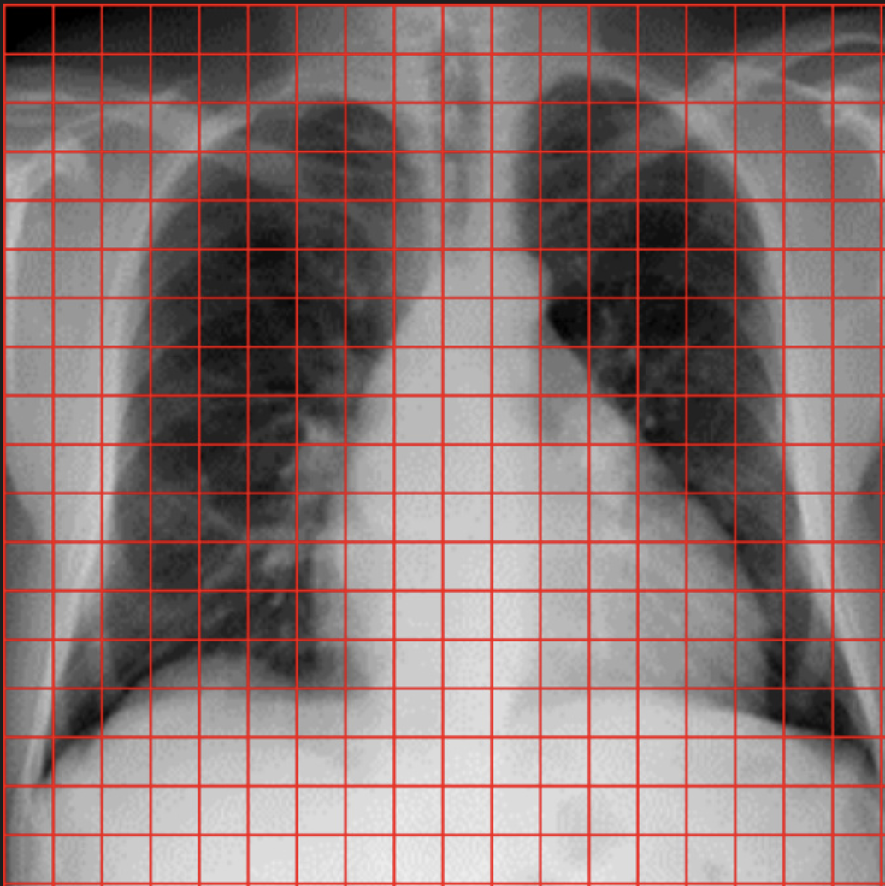
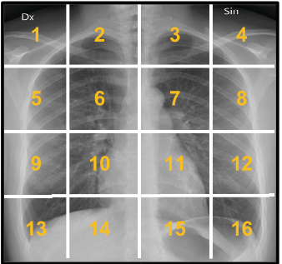








Method
Perspective #1: learning continuity from extrapolation
Perspective #1: learning consistent spatial layout from order correction
Predicted embeddings
Patch embeddings from student
Patch embeddings from student
3
…
9
14
8
…
10
5
7
13
Head #2
$$ℒ_{order}$$
…
…
Head #1
4
2
15
16
$$C_{1}$$
…
…
16
1
11
12
$$C_{2}$$
$$C_{2}$$
…
Patch embeddings from teacher
$$C_{1}$$
Patch embeddings from teacher
3
1
3
4
9
14
8
…
$$ℒ_{extrap}$$
2
Shuffle
5
7
10
5
6
8
7
13
$$ℒ_{consis}$$
…
…
…
9
10
11
12
4
2
15
16
…
13
14
15
16
16
1
11
12
$$C_{1}$$
Notes:
Our method learns human anatomy from three perspectives. The first perspective (click): learning continuity from extrapolation, we encourage the model to learn the anatomical context exterior the given structure—for example, given the heart, the model predicts the surrounding lung region. In this context, extrapolation refers to the model using information from a given image crop to predict semantically relevant details outside of that crop based on patterns learned from similar images. The second perspective (click): learning consistent spatial layout from order correction. In medical imaging (e.g., chest X-ray), the relative positions of organs and tissues are consistent due to anatomical coherence. As such, the relative patch order is a strong signal for patch-level supervision. For implementation, we predict the order of the shuffled patches, and align the corresponding patch embeddings between student and teacher.

Slide 5
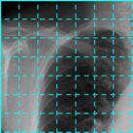
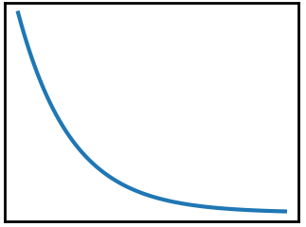
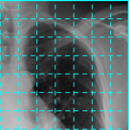
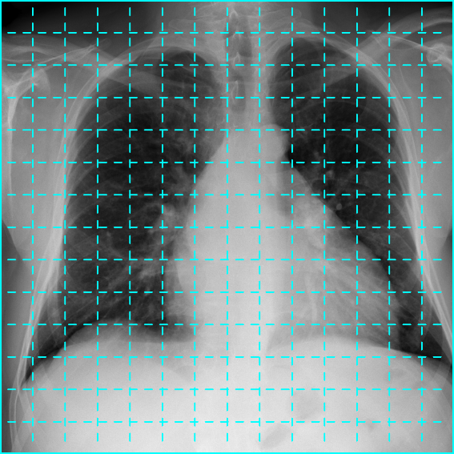
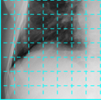
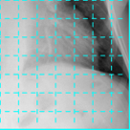
























Method
Perspective #3: learning hierarchy from composition/decomposition
I
Composer head
Composition
$$e_{s_{1}}$$
Head #3
$$r$$
$$P$$
$$e_{s_{2}}$$
$$e_{comp}$$
$$P_{1}$$
$$e_{s_{3}}$$
$$ℒ_{comp}$$
$$e_{s_{4}}$$
$$P_{2}$$
$$e_{t}$$
$$P$$
Crop ratio $r$
$$P_{3}$$
Decomposer head
Decomposition
$$e_{s}$$
Head #3
Training epoch
$$P_{4}$$
$$P_{1}$$
$$P_{2}$$
$${\{e_{{decomp}_{i}}\}}_{i=1}^{4}$$
$$ℒ_{decomp}$$
$$P_{3}$$
$$P_{4}$$
$$P=\{P_{1}, P_{2}, P_{3}, P_{4}\}$$
$${\{e_{t_{i}}\}}_{i=1}^{4}$$
Notes:
The third perspective: learning hierarchy from composition/decomposition. From a hierarchical view in anatomies, organs and tissues can be broken down into smaller components. In detail, to learn the anatomical structure in a hierarchical way, the initial
image is randomly cropped to P with a cropping ratio in a coarse-to-fine manner. P is divided into 4 sub-crops. To capture composition, the sub-crops are encoded by Student to get corresponding sub-crop embeddings, which are concatenated and input to a linear layer to aggregate the features. The embedding of P from teacher model is then aligned with the aggregated feature to capture the composition. And the decomposition is implemented in a symmetrical way.

Slide 6
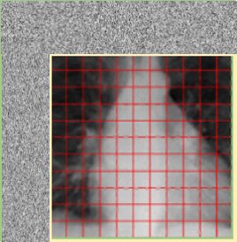
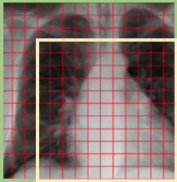
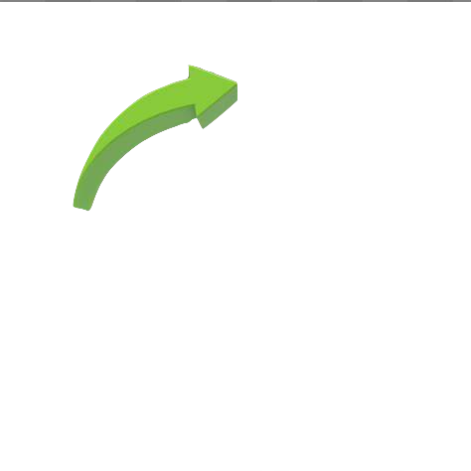










Method
Head #1
Perspective #1
Perspective #1: Learning from extrapolation
$$x^{′}$$
Student
Head #2
Perspective #2
?
$$f_{θ_{d}}$$
Head #3
Predict exterior contents
Perspective #1
Cycle = 0/3/6…
Methodology Novelty
$$τ(∙)$$
Perspective #3
Perspective #2: Learning from order correction
Lamps collaboratively
• Learns anatomy continuity from extrapolation,
• Learns anatomy layout from order correction,
• Learns hierarchies from composition/decomposition
by accruing knowledge from multiple perspectives via cyclic pretraining.
$$x$$
Cyclic
Pretraining
EMA
$$C_{θ}$$
$$ℒ_{perpective\#i}$$
Predict order
Perspective #3
Cycle = 2/5/8…
Perspective #2
Cycle = 1/4/7…
Stop gradient
Perspective #3: Learning from composition and decomposition
$$f_{θ_{comp}}$$
$$x^{′′}$$
Teacher
Perspective switch
Compose
$$τ(∙)$$
Data augmentation
Decompose
$$f_{θ_{decomp}}$$
Test for evaluations
Notes:
Training a model with a single objective gives only a limited understanding. Simply summing multiple losses can confuse the model, since different losses may push optimization in conflicting directions. To address this, we unify the three perspectives using cyclic pretraining, which not only reduces computational cost compared to co-training in a single epoch, but also avoids the need to generate heterogeneous data for different tasks. In the cyclic pattern, each perspective is trained once every three epochs.

Slide 7
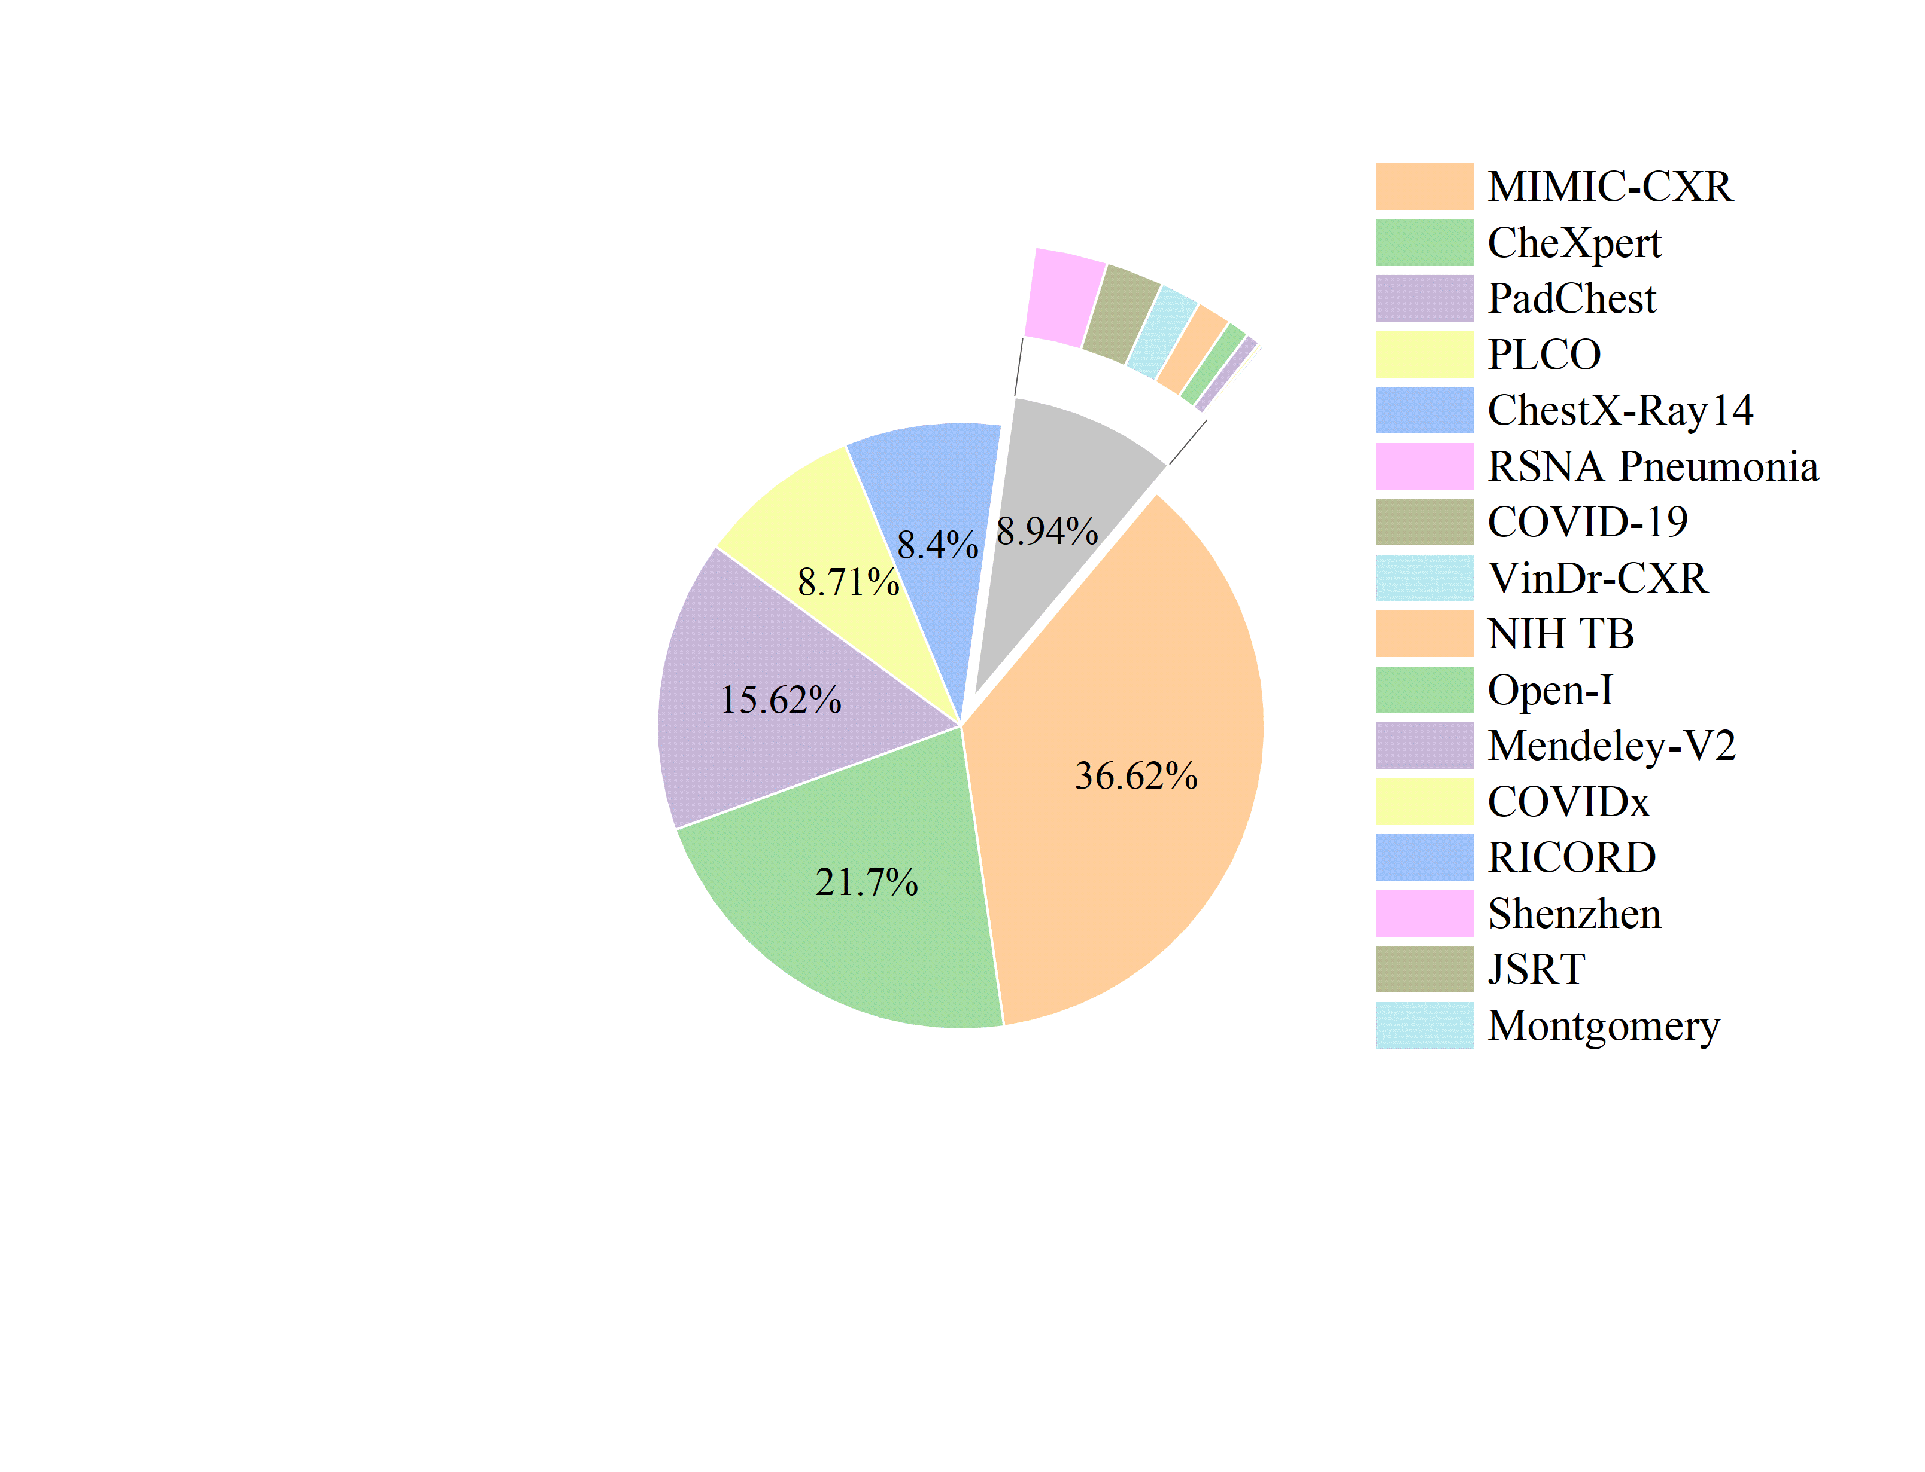
Background
Training on unlabeled data
Finetuning on target data
Pretraining: 16 datasets Total 1.04M images
Evaluation: 10 datasets Total 388K images
Classification
Segmentation
Landmark correspondence
Report generation
ChestX-Ray14
112k images
14 labels
RSNA
26.7k images
3 labels
CheXpert
223K images
14 labels
Shenzhen
662 images
2 labels
Chest-Landmark
1k images
54 landmarks
SIIM-ACR
12k images
Pneumothorax segmentation
COVID-QU-EX
4.4k images
Covid
segmentation
JSRT
247 images
5 organs
segmentation
VinDr-Rib
245 images
20 ribs
segmentation
IU-XRay
7470 images
3955 reports
Notes:
In self-supervised learning, we pretrain source models without using expert annotations. To demonstrate the scalability of our framework, we pretrain Lamps on both ChestXray14 and a large corpus of 1.04M images. Then fine-tune the pretrained model into a specific target dataset including segmentation, classification and report generation

Slide 8
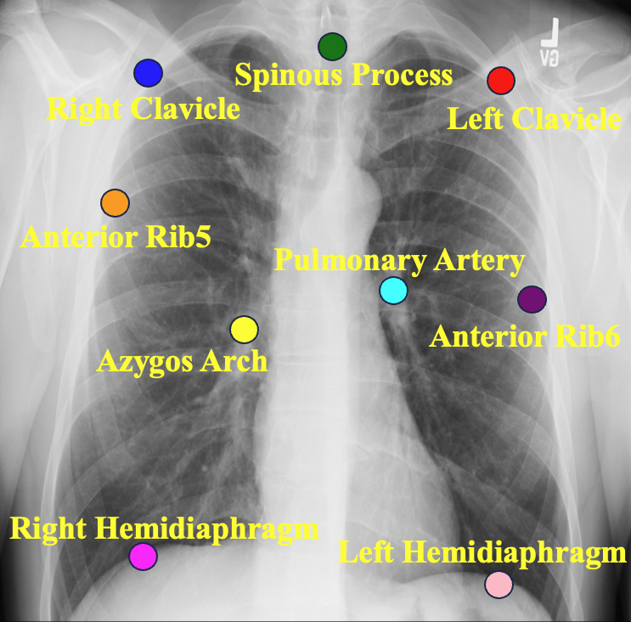
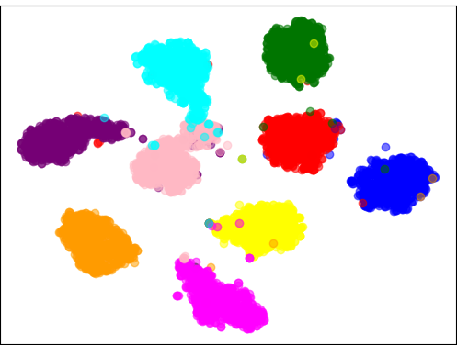
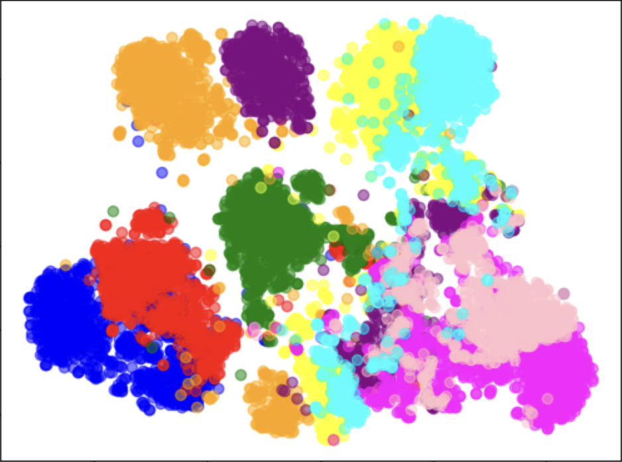
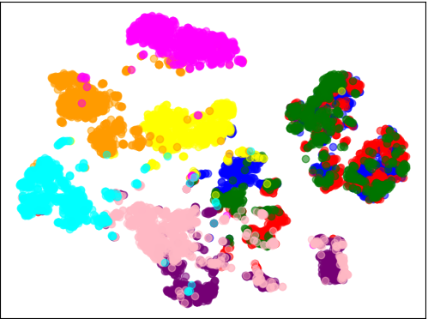
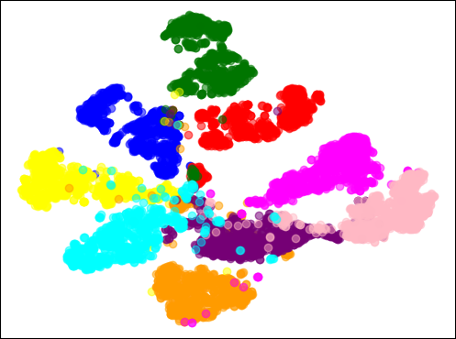
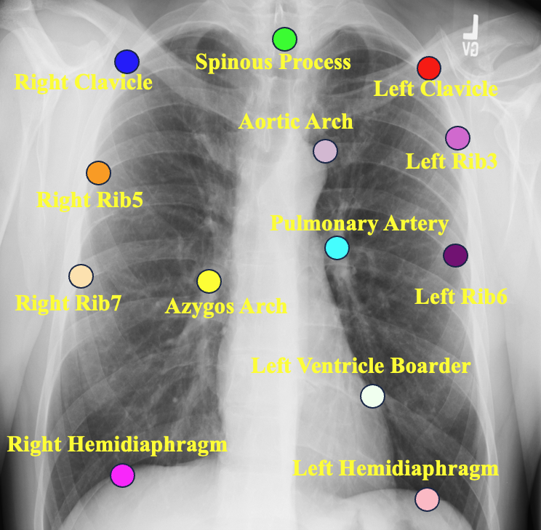
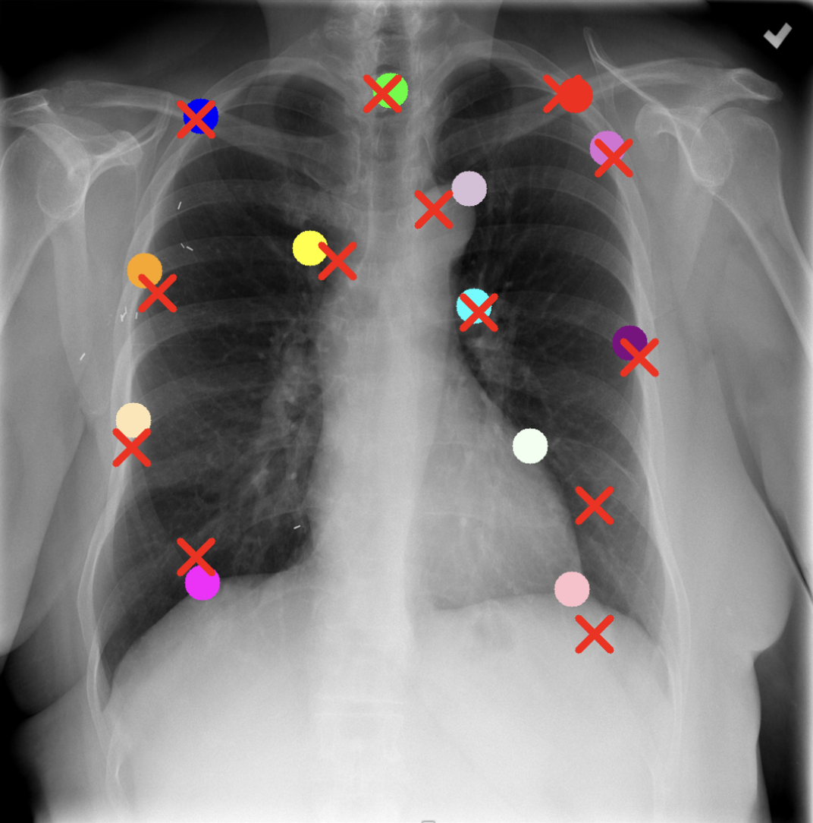
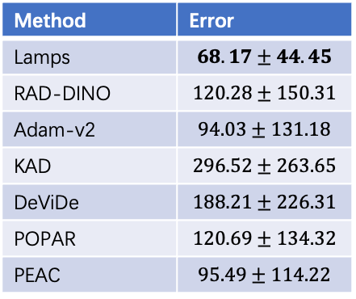
Evaluations——Emergent Properties
Emergent property 1: Lamps provides distinctive anatomical embeddings
Lamps (ours)
Ark
RAD-DINO
Adam-v2
Emergent property 2: Lamps provides unsupervised cross-patient anatomy correspondence
Query image
Key image
Method | Error
Lamps | $$68.17±44.45$$
RAD-DINO | $$120.28±150.31$$
Adam-v2 | $$94.03±131.18$$
KAD | $$296.52±263.65$$
DeViDe | $$188.21±226.31$$
POPAR | $$120.69±134.32$$
PEAC | $$95.49±114.22$$
Notes:
We test the emergent properties of Lamps that were not part of its training components. All of the testing properties use the pretrained weights in a zero-shot setting. We use t-SNE to visualize 9 distinct landmarks, and Lamps can generate distinct features while other pretrained model lead to ambiguous embeddings space. Secondly, (click) we utilize patch-level features to query the same anatomy across different patients in a zero-shot setting. And find our Lamps (click) can get an average error of 68 pixels cross 100 query images and 100 key images with resolution of 1024*1024.

Slide 9
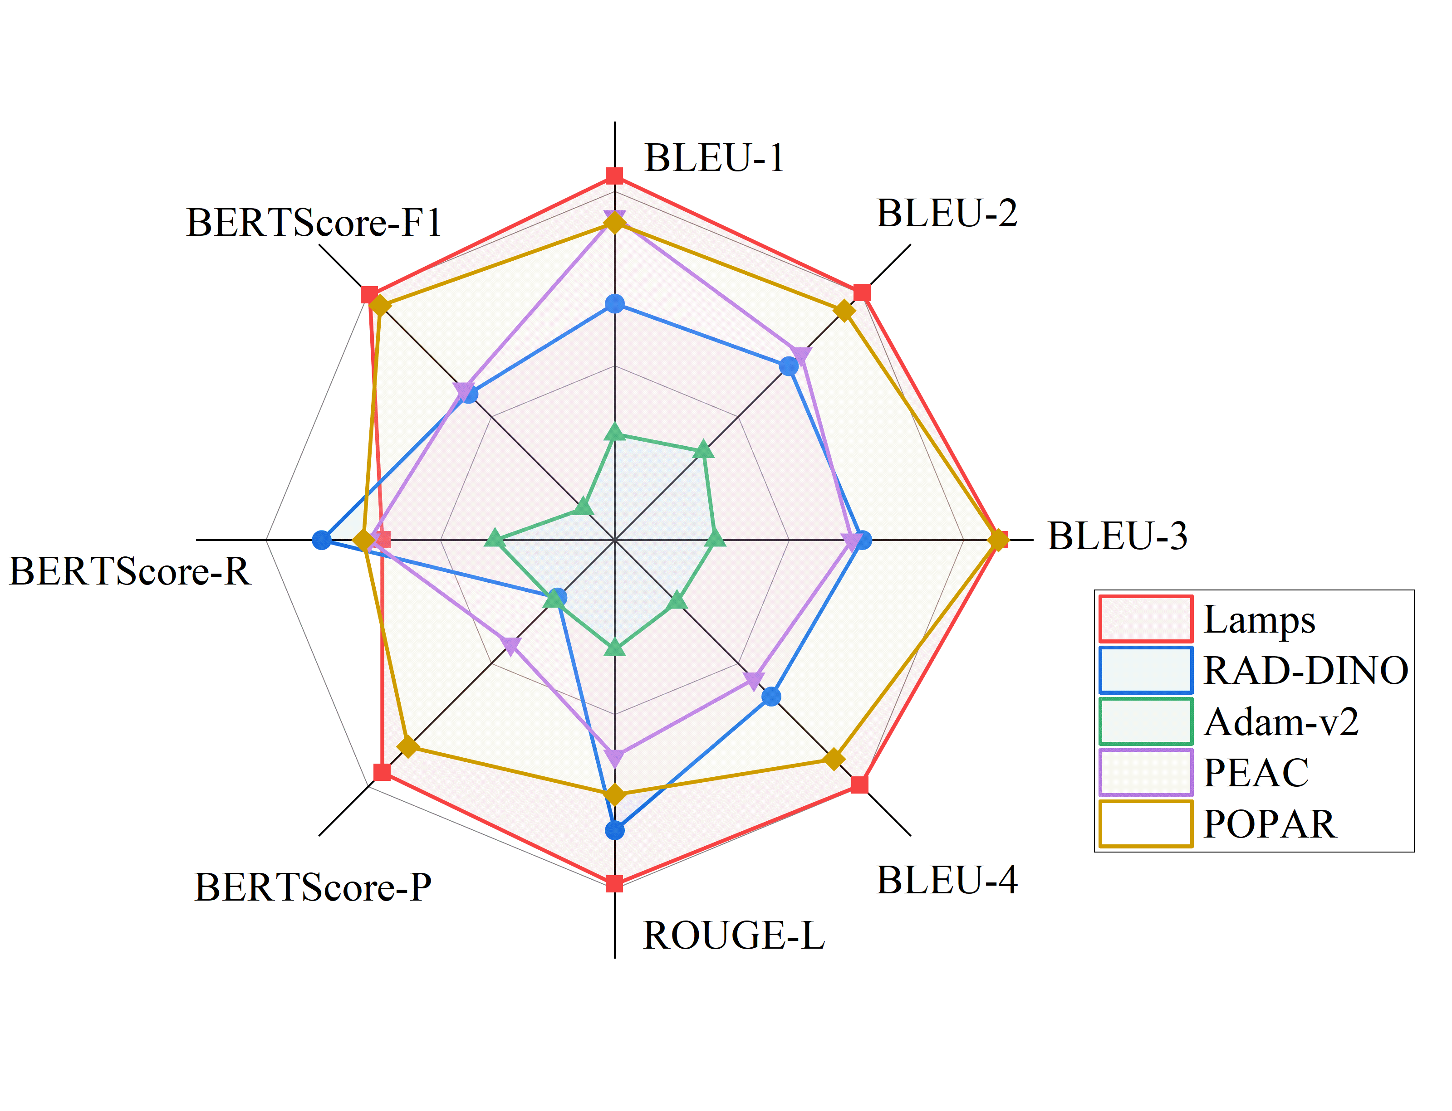
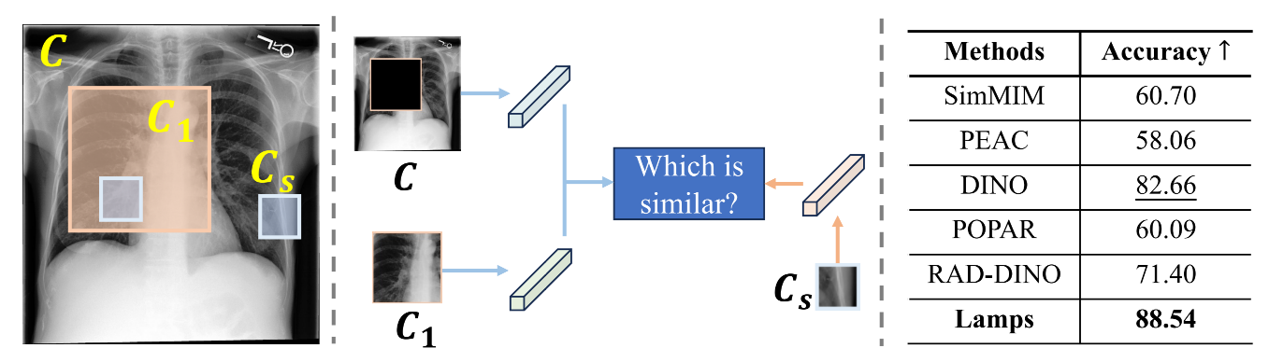
Evaluations
Emergent property 3: DNA-test
Transferability: report generation
0.45
0.40
0.35
Notes:
We define the DNA-test to evaluate whether a model can capture part–whole relationships in anatomy, which is key for hierarchical understanding. For example, it checks if the model can link a smaller part, like a lung lobe, to its larger structure, the whole lung. We compute the accuracy of the model distinguishing the smaller patches belong to which area. Lamps achieves the highest accuracy, demonstrating its superior ability to capture hierarchical anatomical relationships.
We investigate the generalizability of Lamps’s representations in report generation task. On the IU-XRay dataset, Lamps outperforms the SSL baselines, achieving the highest scores in 7 out of 8 metrics.

Slide 10
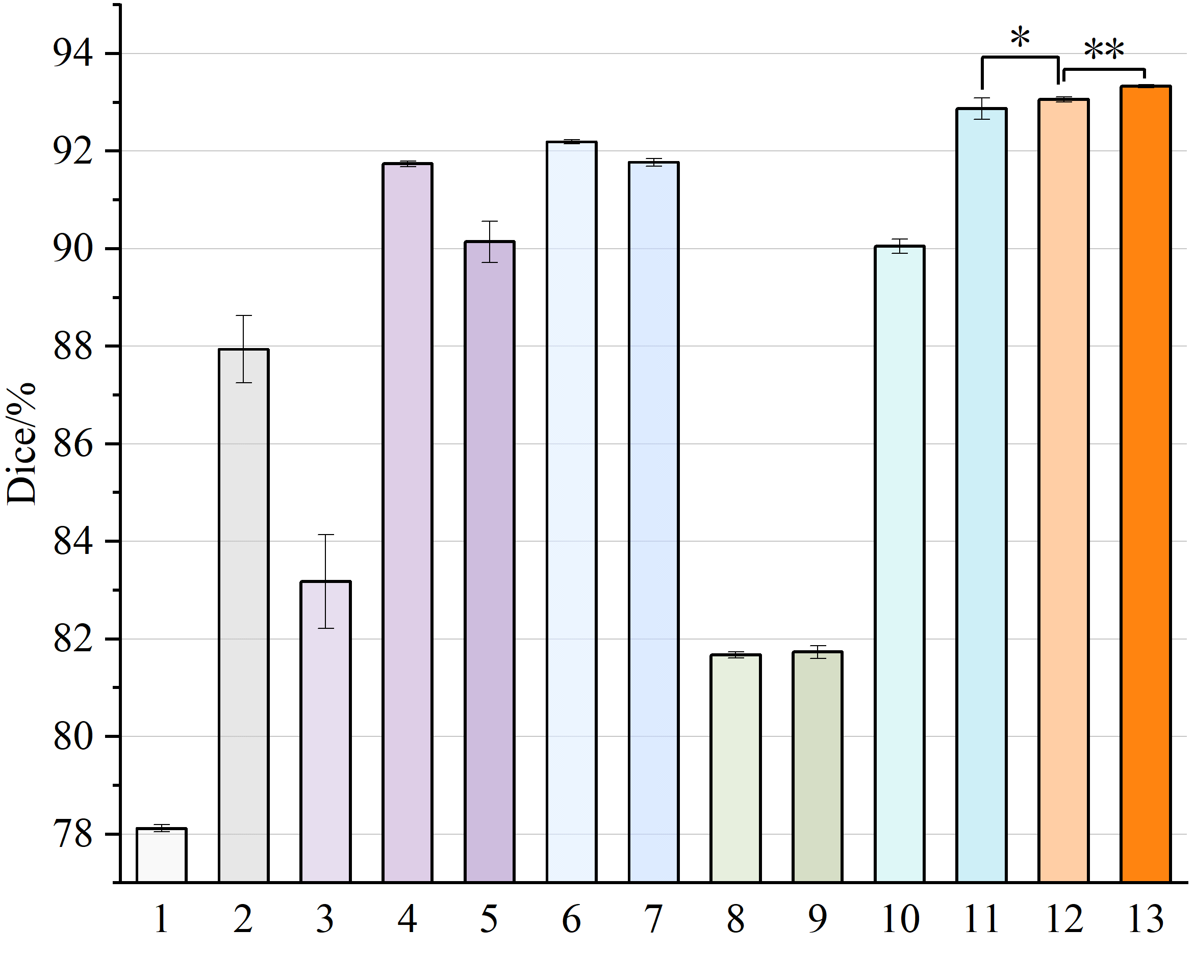
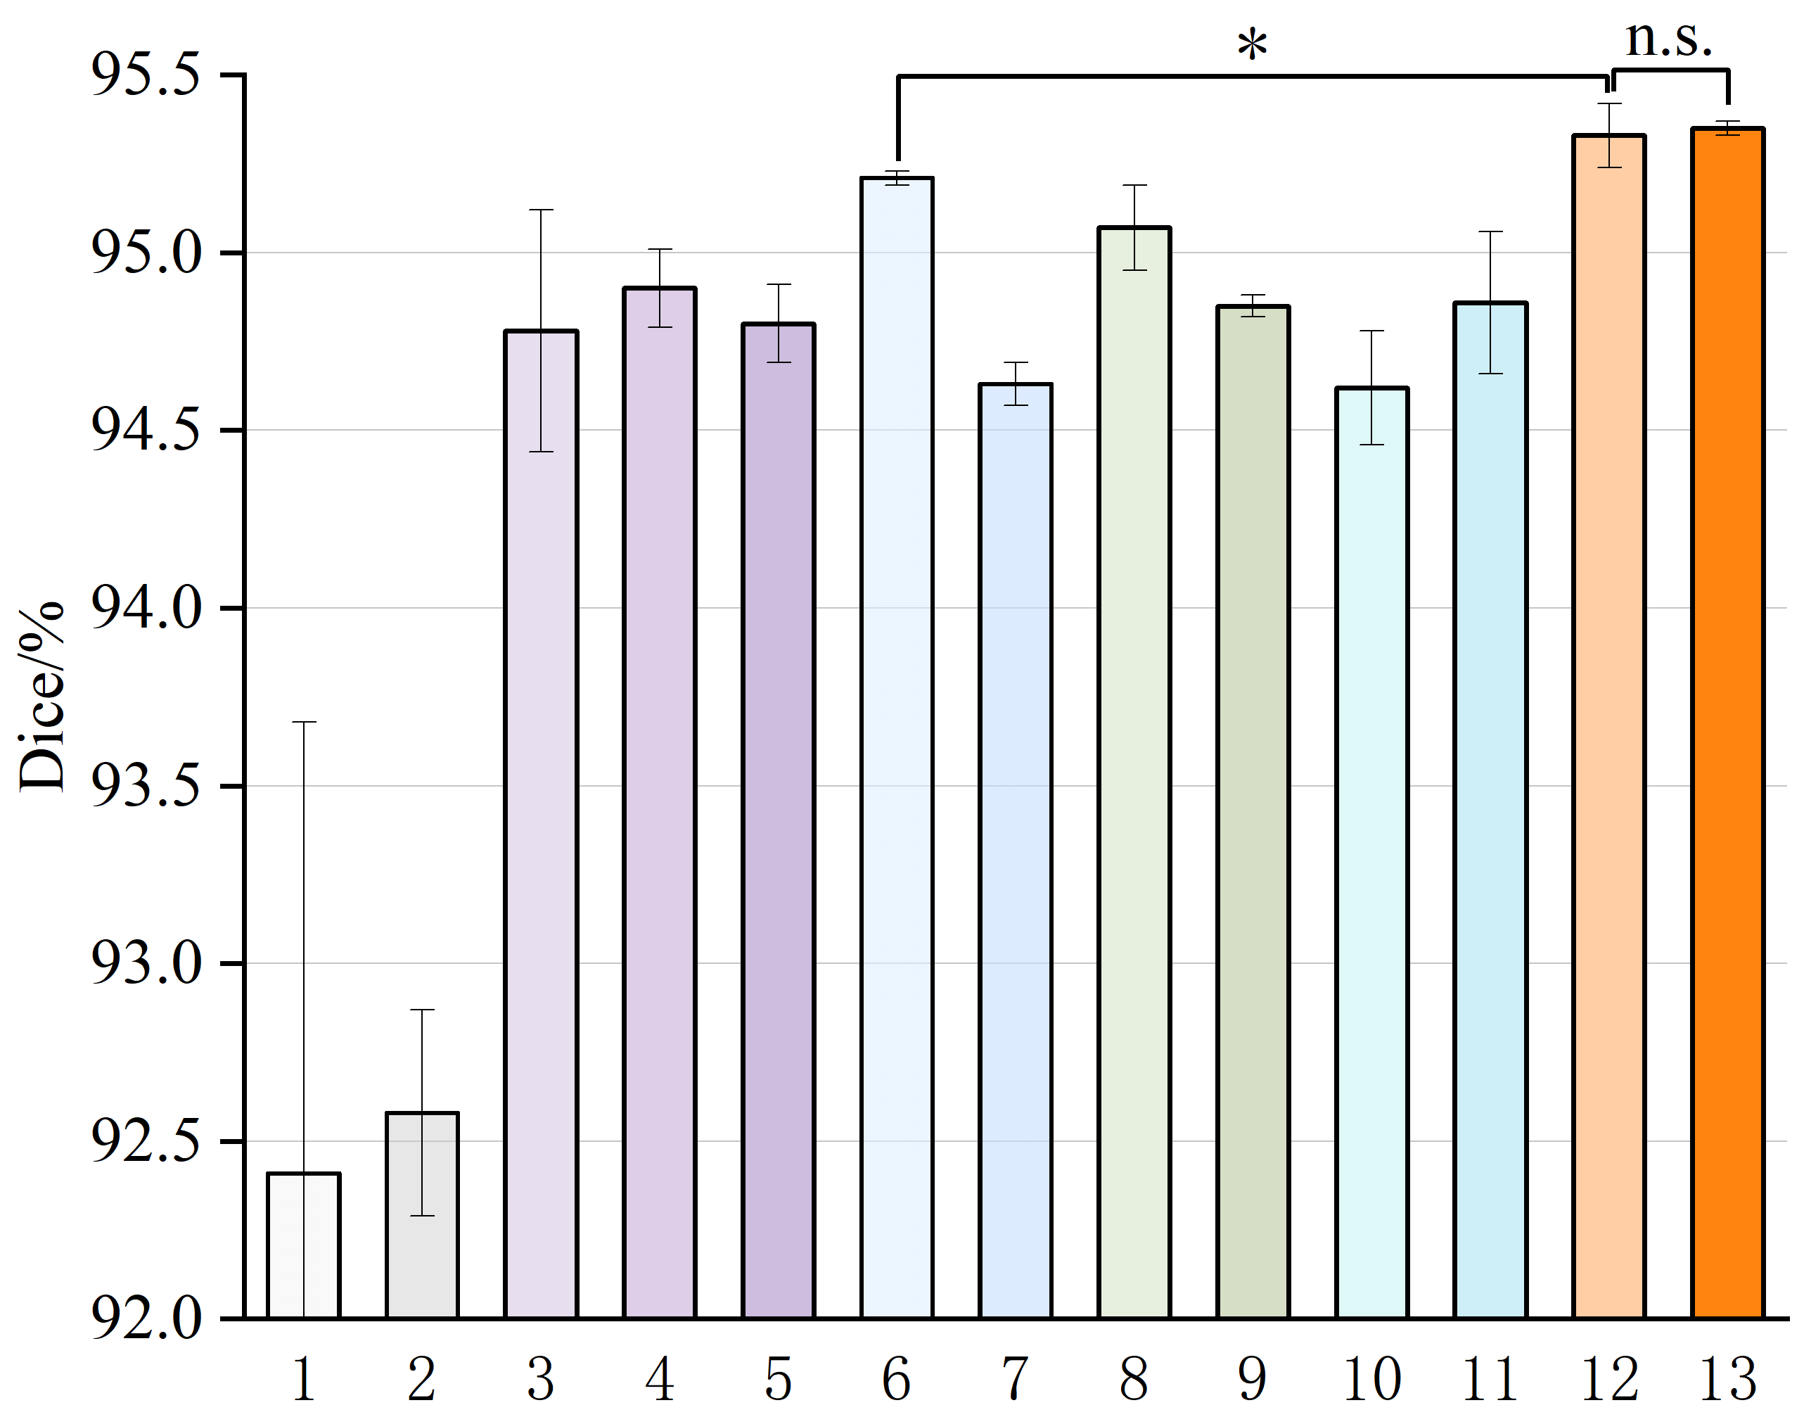
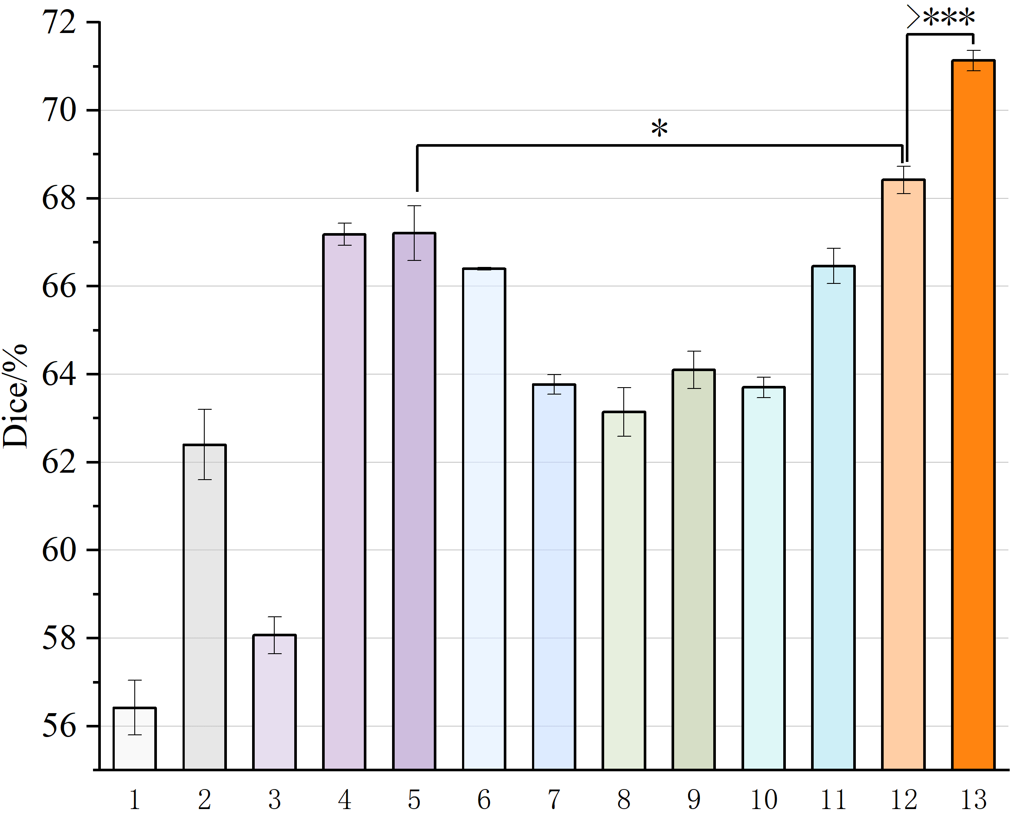
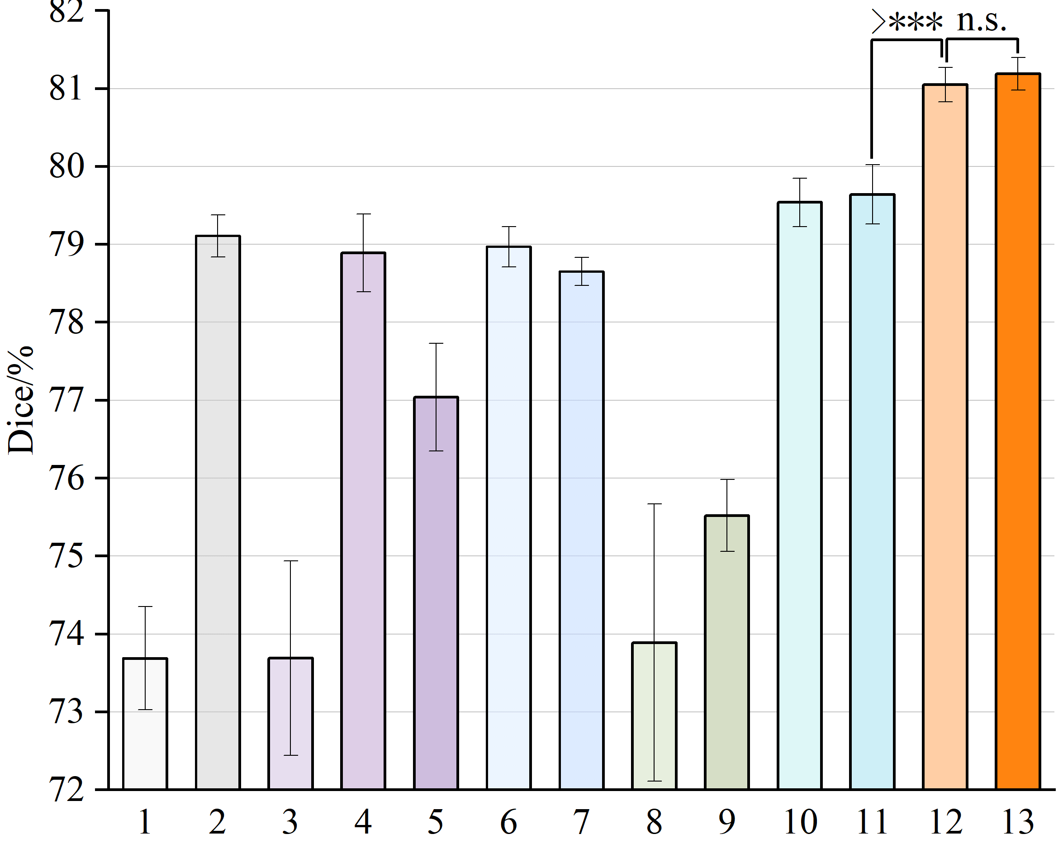
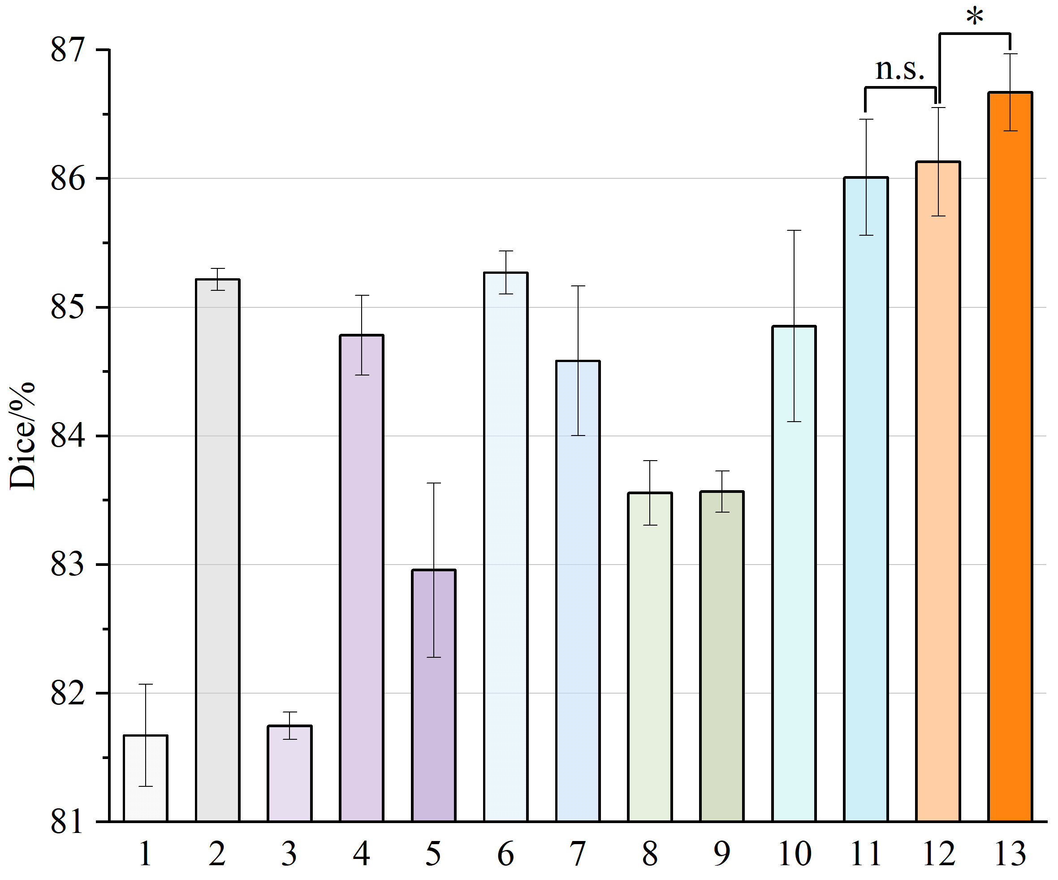
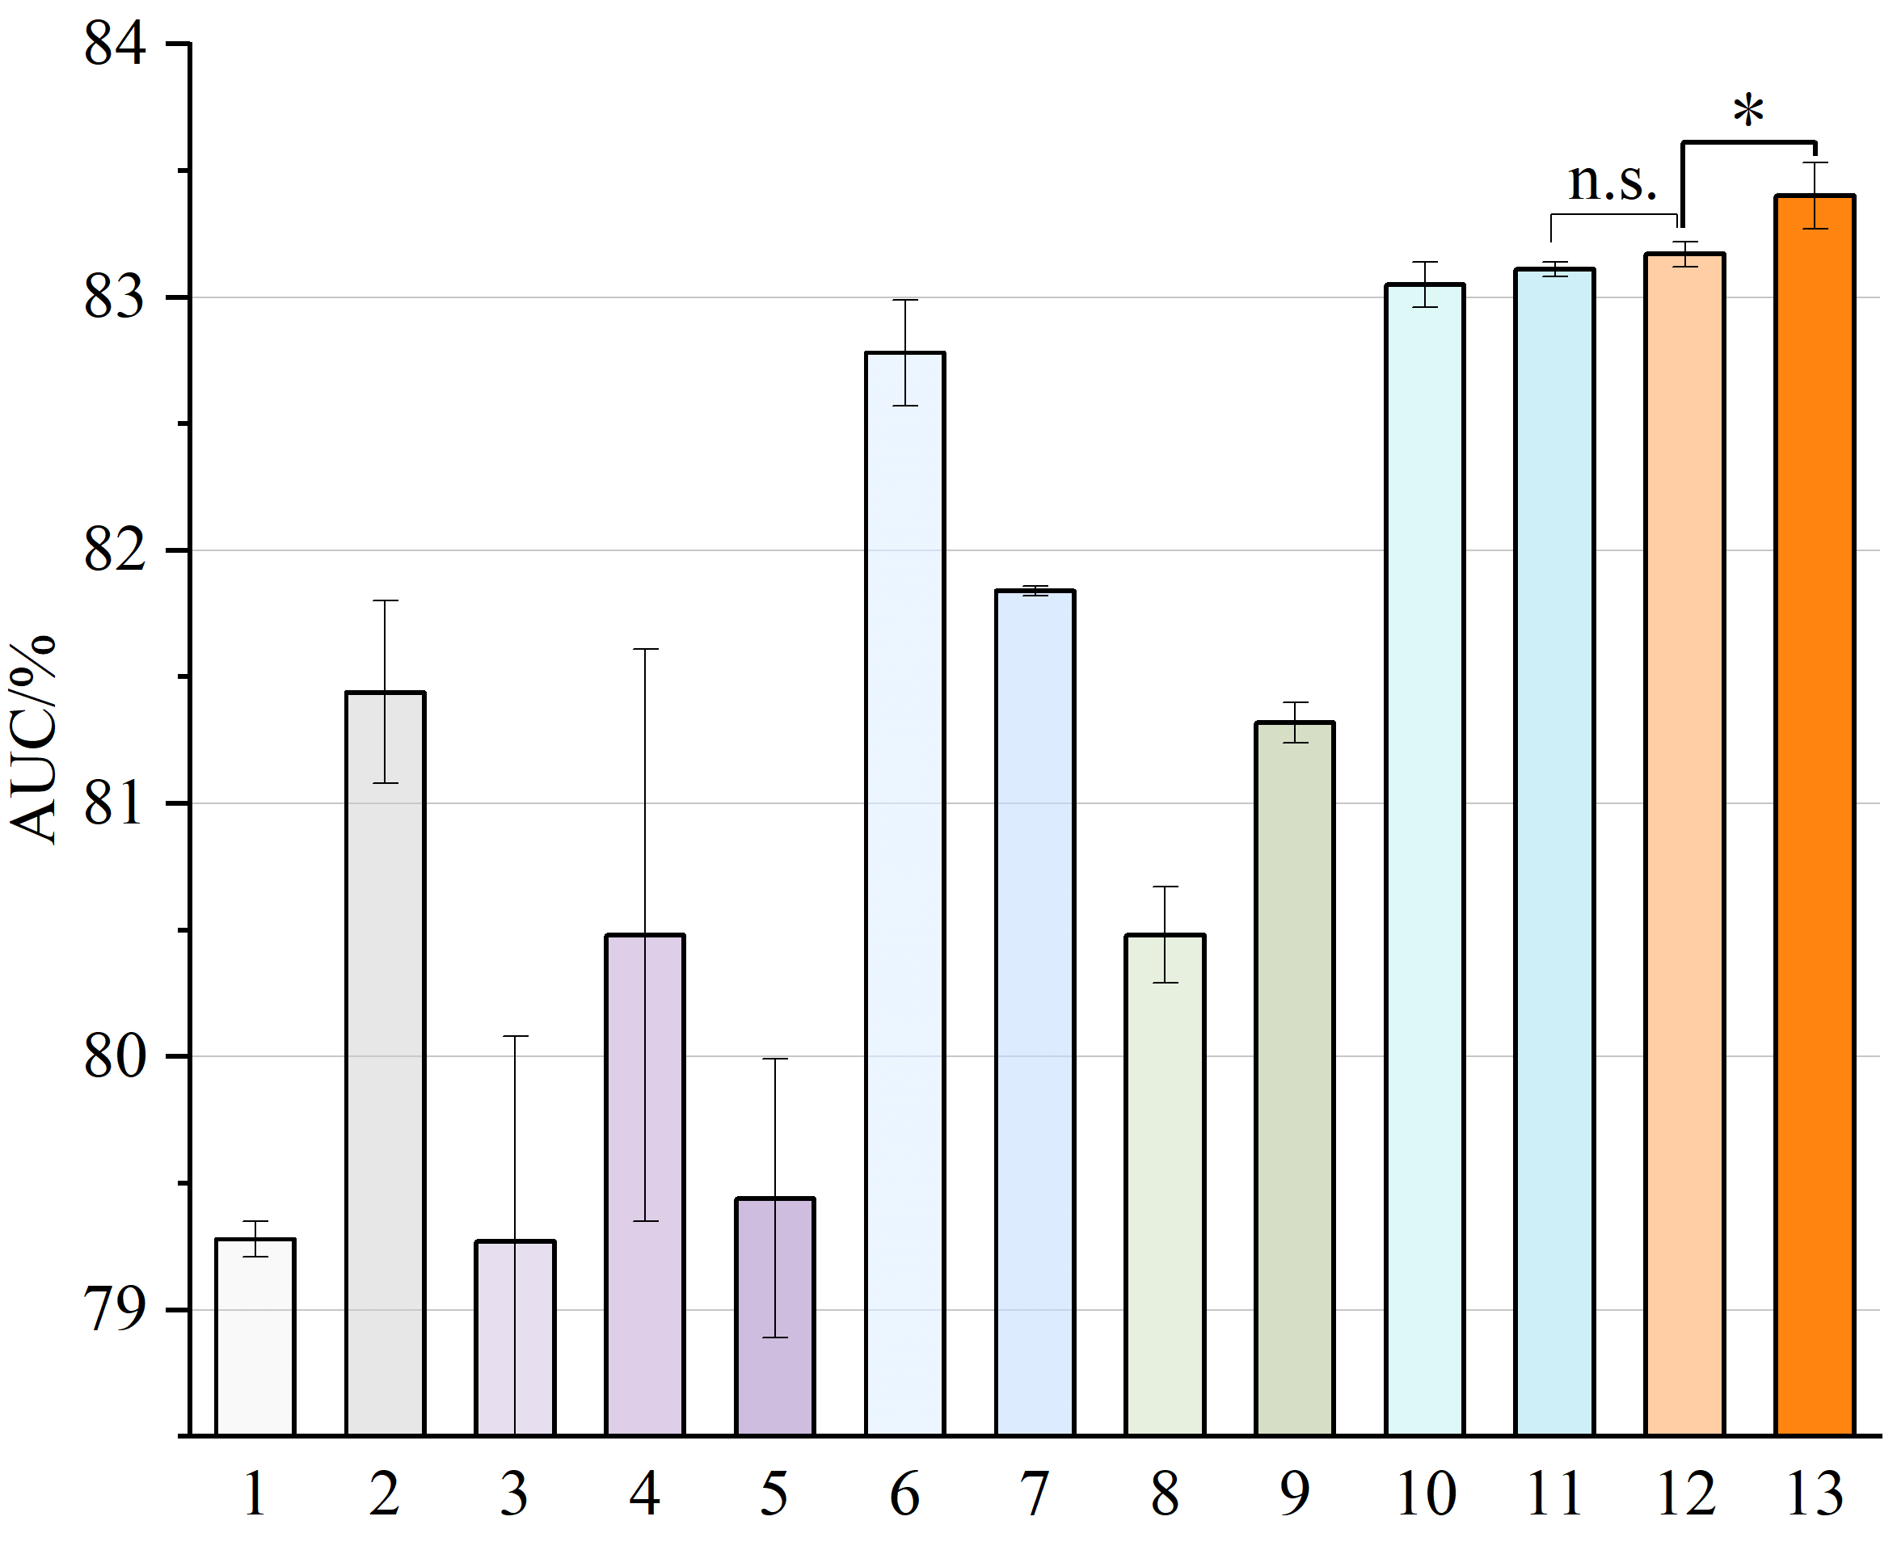
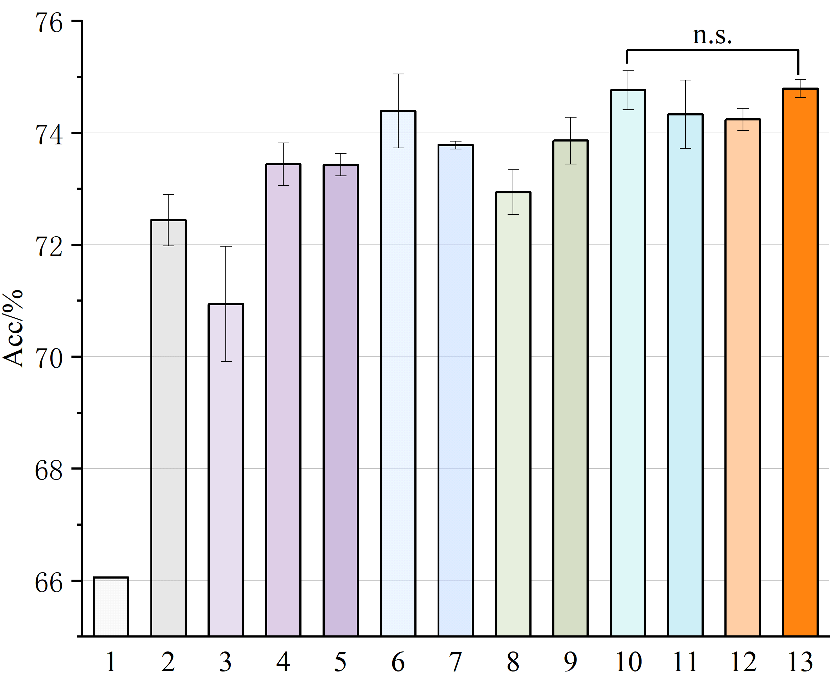
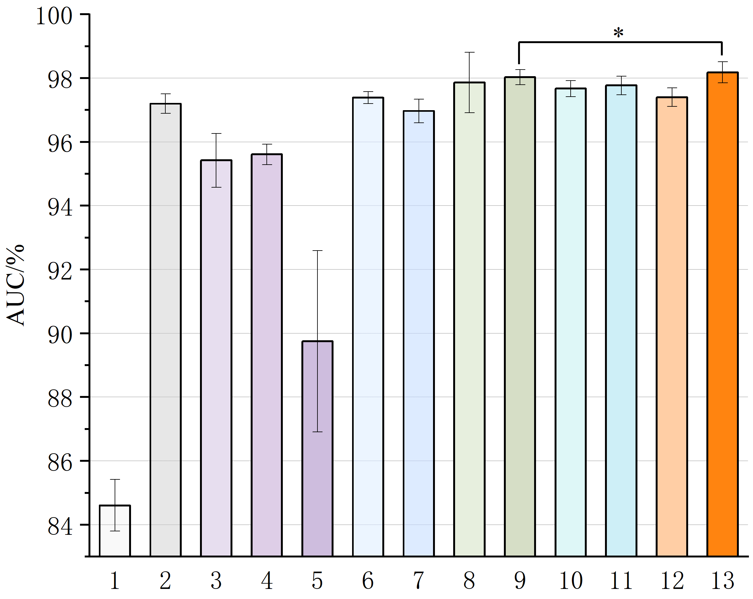
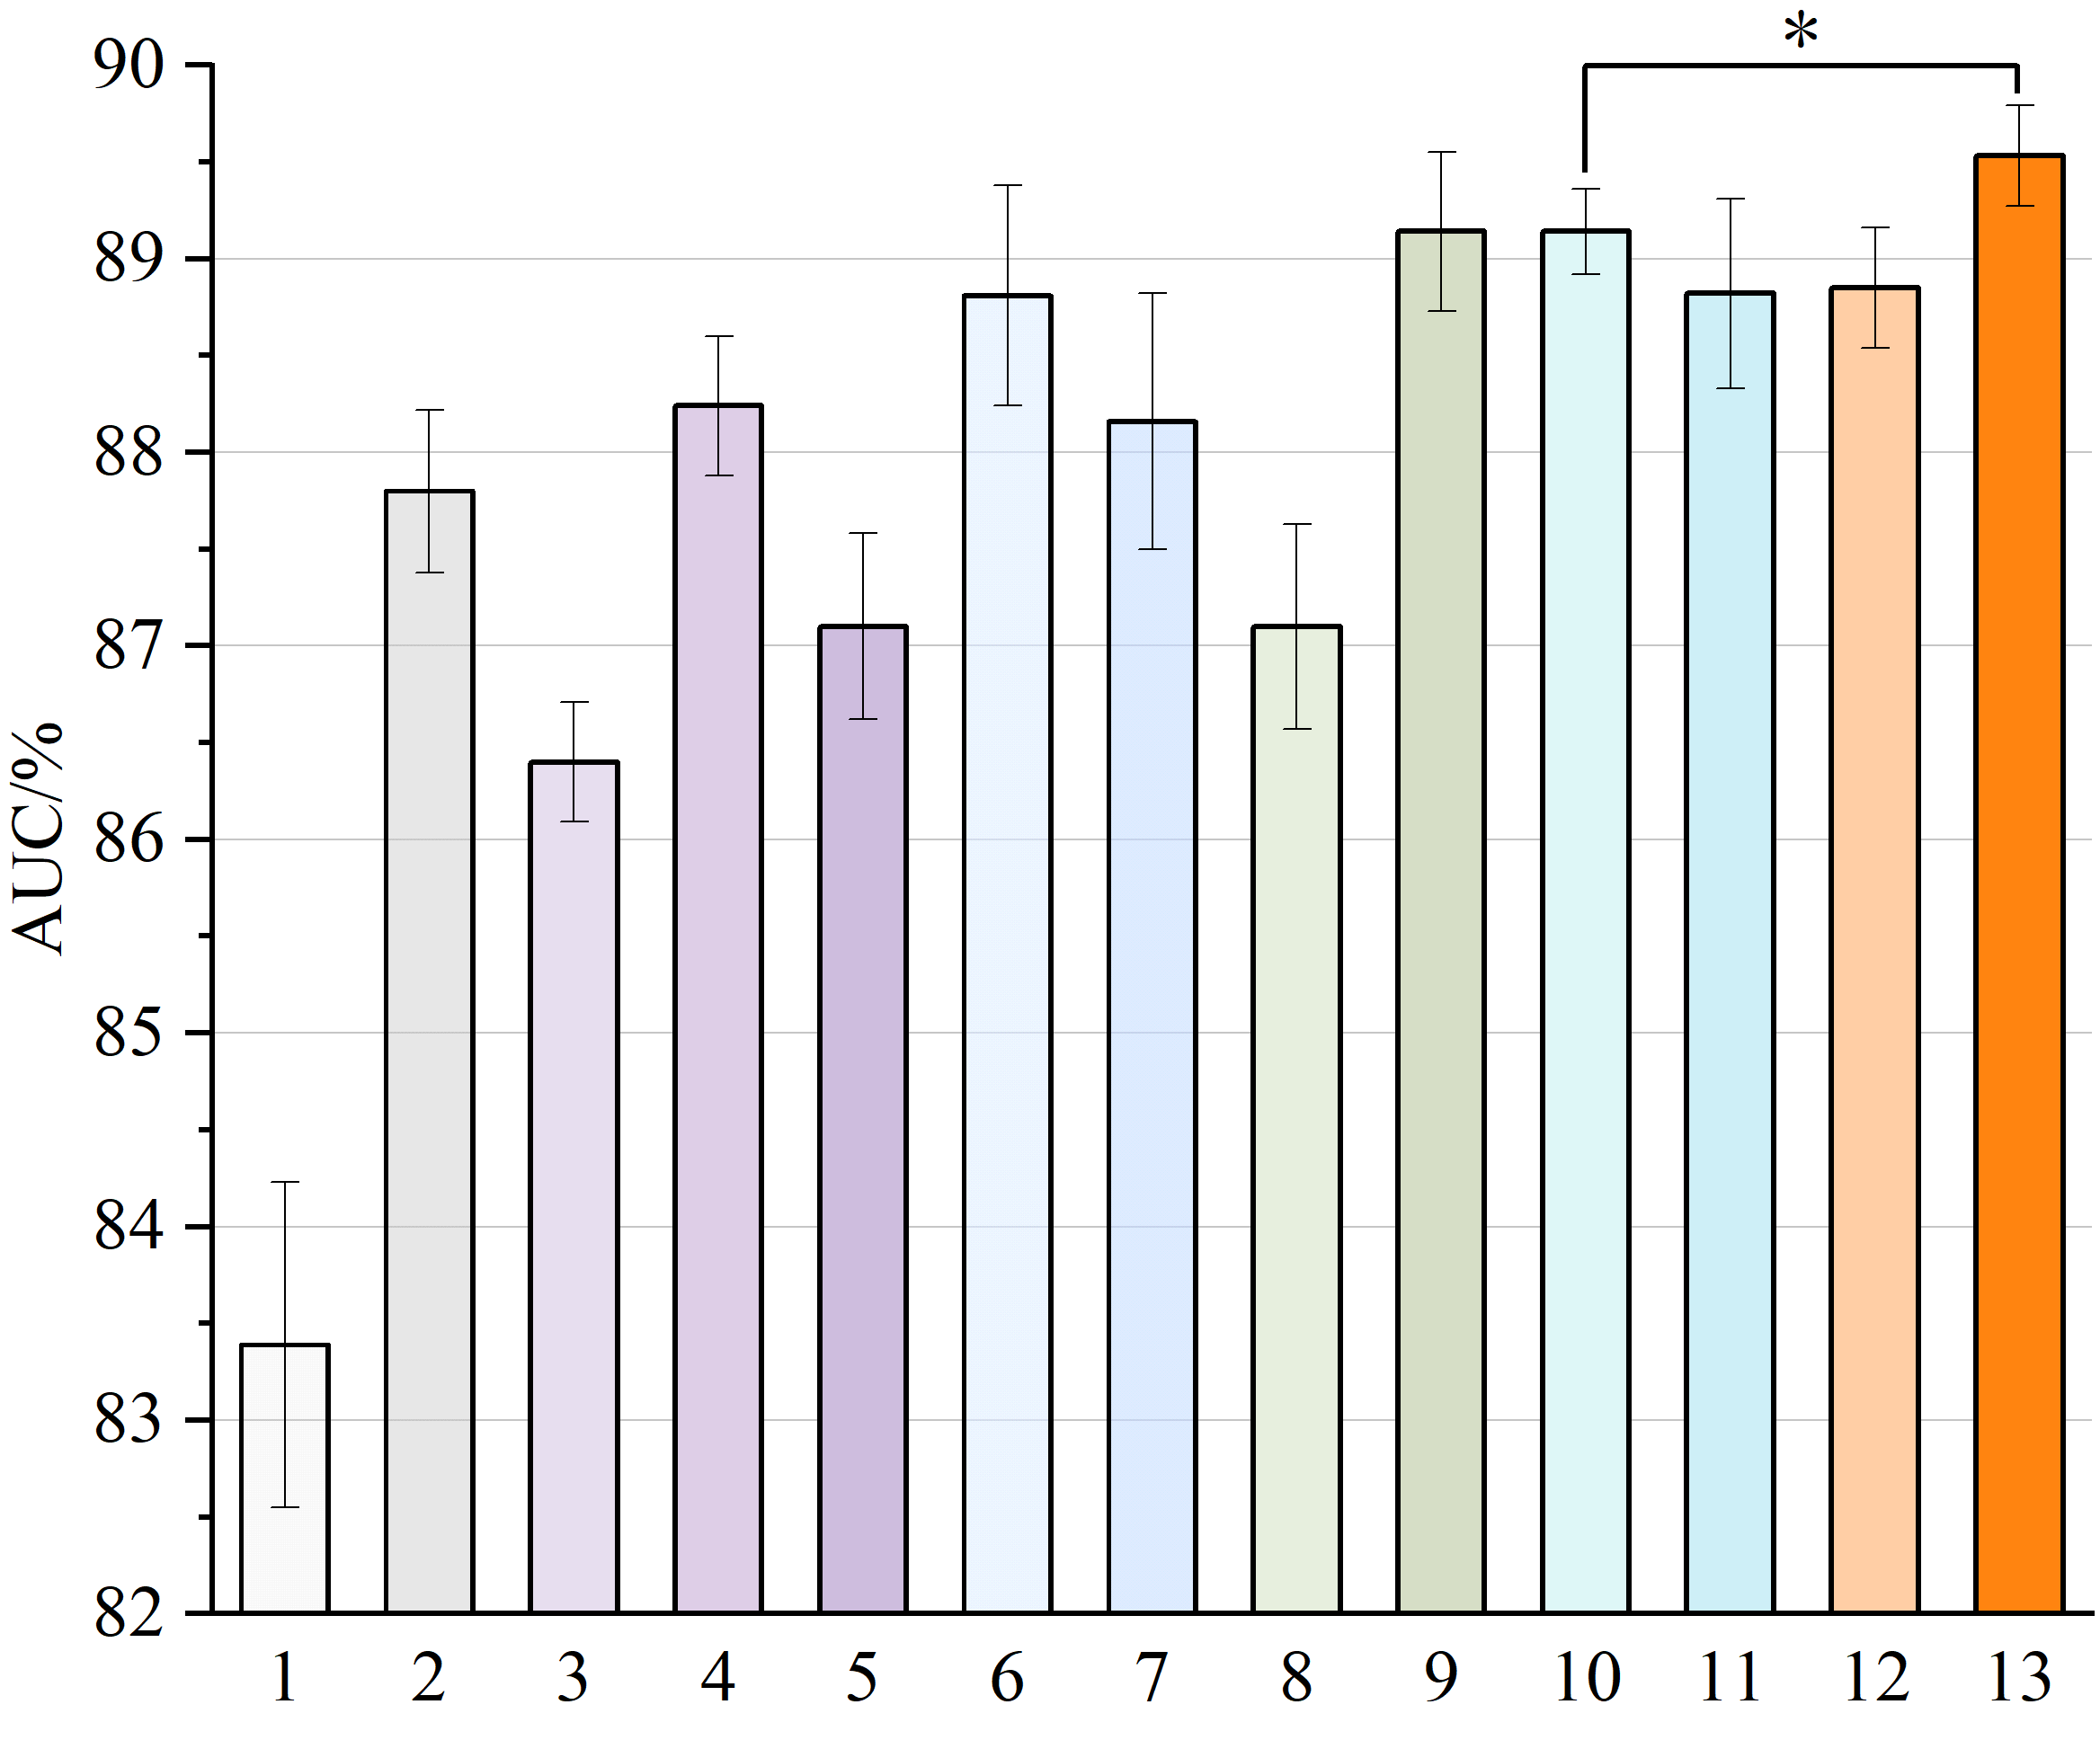

Evaluations—— Downstream Transferability
Clavicle segmentation [JSRT]
Heart segmentation [JSRT]
Ribs segmentation [VinDr-Rib]
Pneumothorax segmentation [SIIM]
Covid segmentation [COVID-QU-EX]
14 diseases classification [ChestX-ray14]
2 diseases classification [RSNA]
1
Random init.
Vision Language
Tuberculosis classification [Shenzhen]
14 diseases classification [CheXpert]
Supervised
8
KAD
2
ImageNet
9
DeViDe
Vision SSL
Large-scale
Ark
3
SelfPatch
10
4
Dino
11
Rad-DINO
5
BYOL
Ours
Lamps (ChestX-ray14)
6
PEAC
12
Lamps (large-scale)
7
POPAR
13
Statistical significance analysis
n.s. No significance
$∗$ p<0.05 $∗∗$ p<0.01
$∗∗∗$ p<0.001 $>∗∗∗$ p<0.0001
Notes:
We evaluate the generalizability of Lamps by full fine-tuning on a wide range of downstream tasks. Besides training from scratch and using a supervised ImageNet model, we compare two versions of Lamps—pretrained on 86K and on 1M chest X-rays—against 10 state-of-the-art baselines. The evaluation covers 3 organ segmentation tasks (clavicle, heart, rib), 2 disease segmentation tasks (Pneumothorax, COVID), and 4 disease classification tasks.

Slide 11
Contributions
Lamps:
Learning Anatomy from Multiple
Perspectives via Self-supervision in Chest
Radiographs
A novel approach for learning anatomical structures from multiple perspectives using unlabeled CXRs;
Notes:
In the end, we get some conclusions of our method. We put forward anovel approach for learning anatomical structures from multiple perspectives using unlabeled CXRs, including Learning anatomy continuity from extrapolation, Learning anatomy layout from order correction, Learning hierarchies from composition/decompositionby and accruing knowledge from multiple perspectives via cyclic pretraining.

Slide 12
Contributions
ACE:
Anatomically Consistent Embeddings in Composition and Decomposition
A novel approach for learning anatomical structures from multiple perspectives using unlabeled CXRs;
A new exploration of the emergent properties of pretrained models;
Notes:
We give A new exploration of the emergent properties of pretrained models including anatomical Localizability, correspondence and DNA-test.

Slide 13
Contributions
ACE:
Anatomically Consistent Embeddings in Composition and Decomposition
A novel approach for learning anatomical structures from multiple perspectives using unlabeled CXRs;
A new exploration of the emergent properties of pretrained models;
A new SSL pretraining method on large-scale data, showing exceptional transferability to various target tasks in medical image analysis.
Notes:
And we pretrain A new SSL model on large-scale data, showing exceptional transferability to various target tasks in medical image analysis.

Slide 14
Lamps:
Learning Anatomy from Multiple
Perspectives via Self-supervision in Chest
Radiographs
Ziyu Zhou^{*1,2}, Haozhe Luo^{*2,3}, Mohammad Reza Hosseinzadeh Taher², Jiaxuan Pang²,
Xiaowei Ding¹, Michael B. Gotway⁴ and Jianming Liang²
¹ Shanghai Jiao Tong University ² Arizona State University
³University of Bern ⁴Mayo Clinic
Notes:
Thank you for listening!

