Slide 1
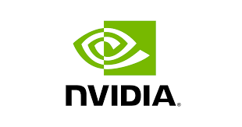


Improving Medical Visual Instruction Tuning with Labeled Datasets
Amin Dada, Amanda Butler Contreras, Constantin Seibold, Osman
Alperen Koraş, Julius Keyl, Aokun Chen, Cheng Peng, Alexander
Brehmer, Kaleb E Smith, Jiang Bian, Yonghui Wu, and Jens Kleesiek

Slide 2
Research Question
Can we obtain an effective medical visual instruction tuning dataset from clinical image data without the use of PubMed and proprietary LLMs?

Slide 3
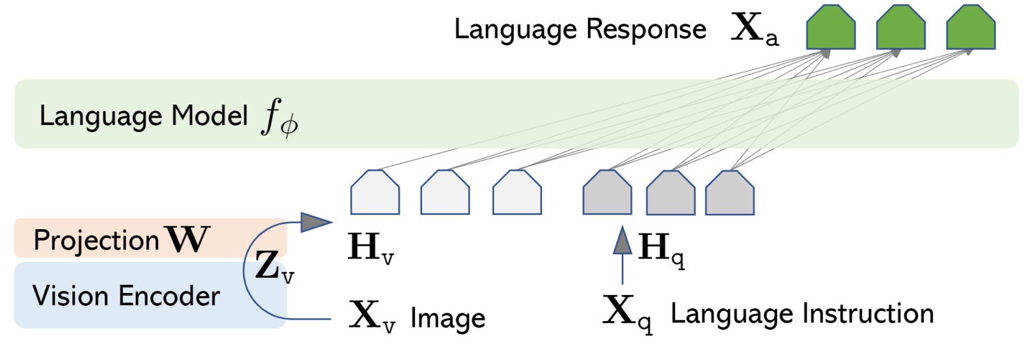
LLaVA
Liu, H., Li, C., Wu, Q., & Lee, Y. J. (2024). Visual instruction tuning. Advances in neural information processing systems, 36.

Slide 4
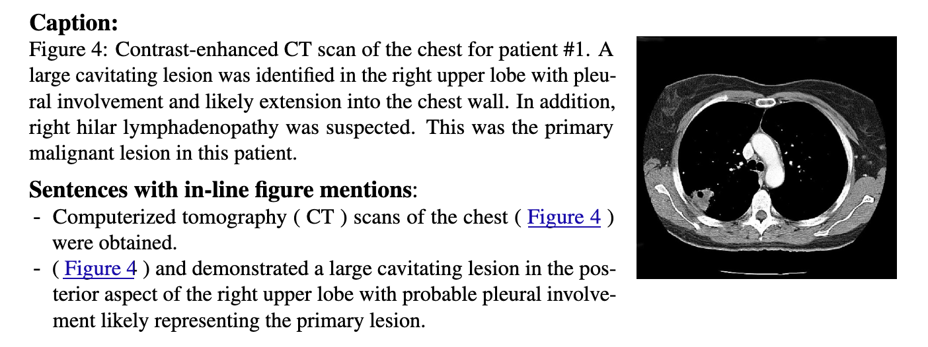
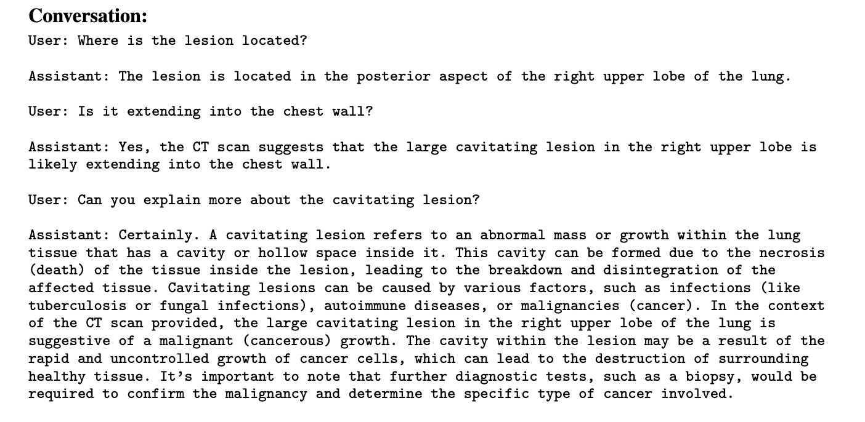
The Llava-Med Approach

Slide 5
Pros and Cons of PubMed
Large amount of data
High diversity
Existing open-source pipelines
Noisy
Less likely to common clinical cases
Contains non-clinical images

Slide 6
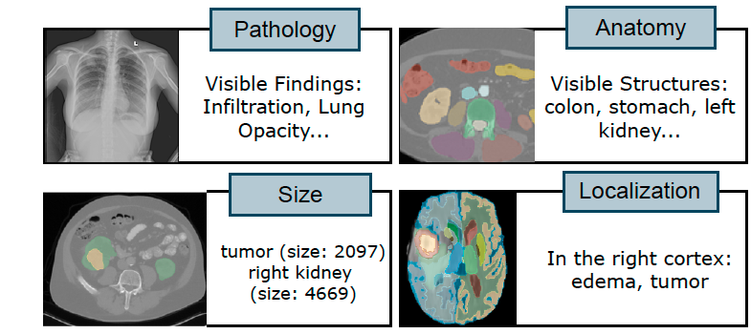
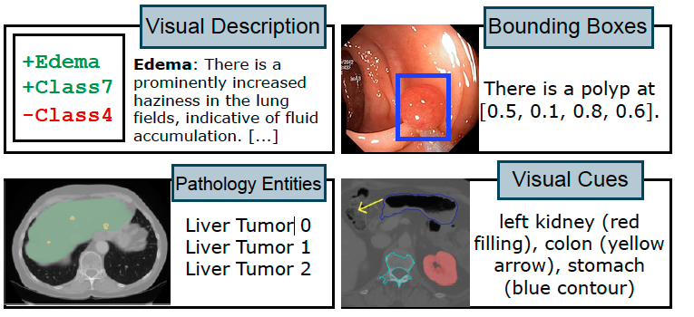
Imaging Datasets
What about imaging datasets?
Large amount of existing high-quality labels

Slide 7
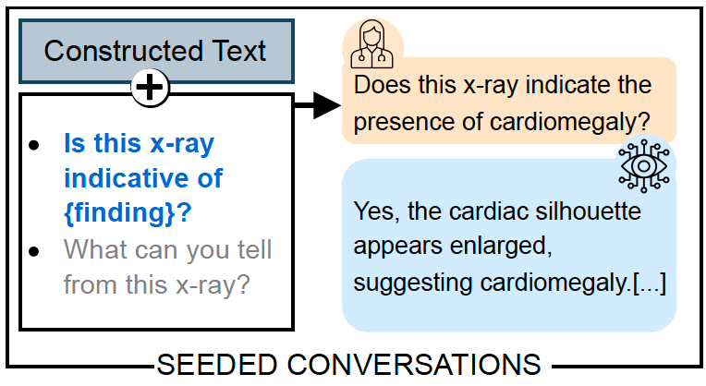
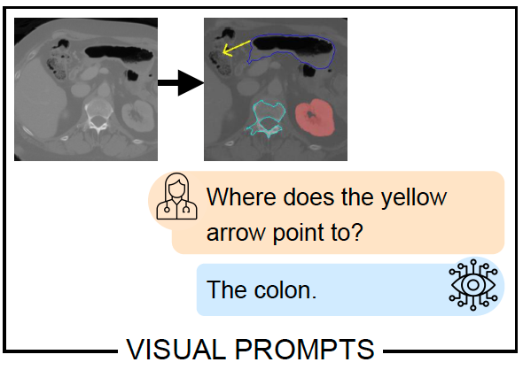
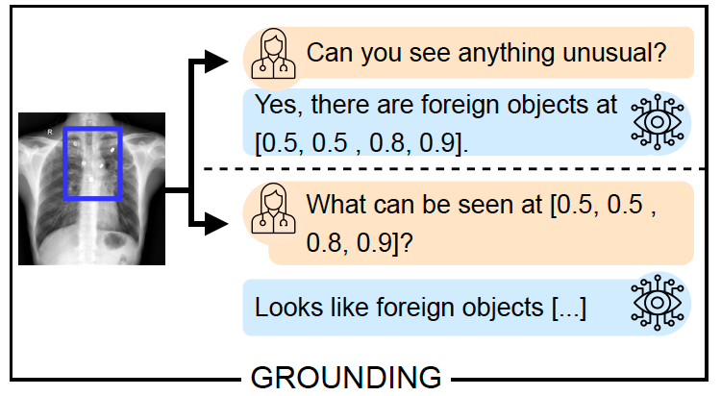
Visual Instruction Generation

Slide 8
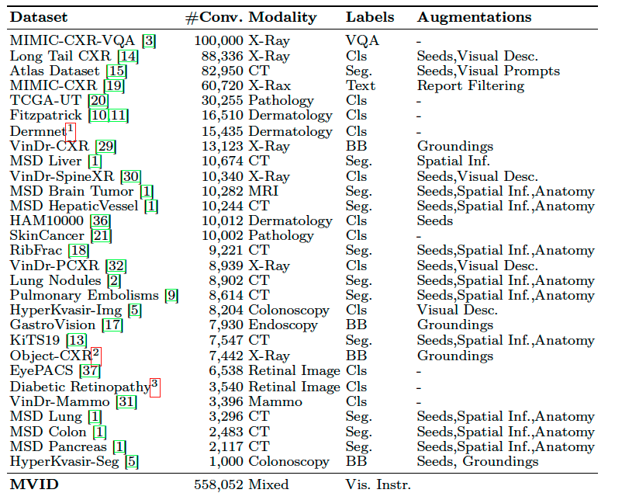
Medical Visual Instruction-Tuning Dataset (MVID)
Collected 29 existing labeled imaging datasets
Generated ~558k conversations with Llama3.1-70B

Slide 9
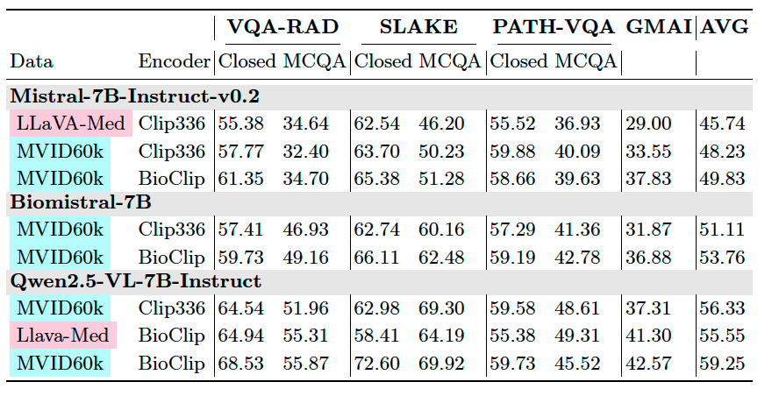
Results
Models trained on MVID are outperforming models trained on Llava-Med data

Slide 10
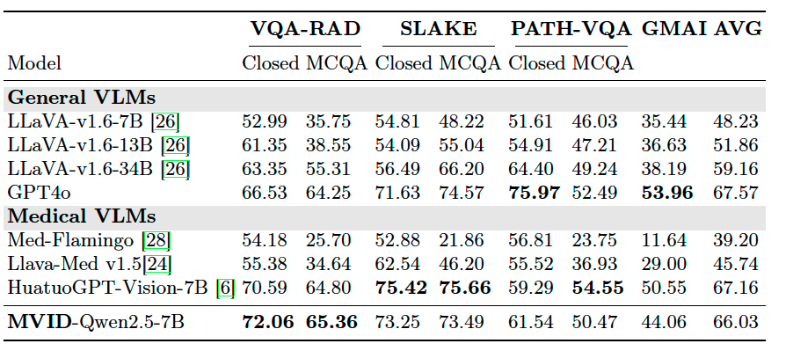
Results
Final model is competitive with GPT4o and HuatuoGPT

Slide 11
Conclusion
It is possible to train competitive VLMs based on labeled imaging datasets and open-weight LLMs.

