Slide 1

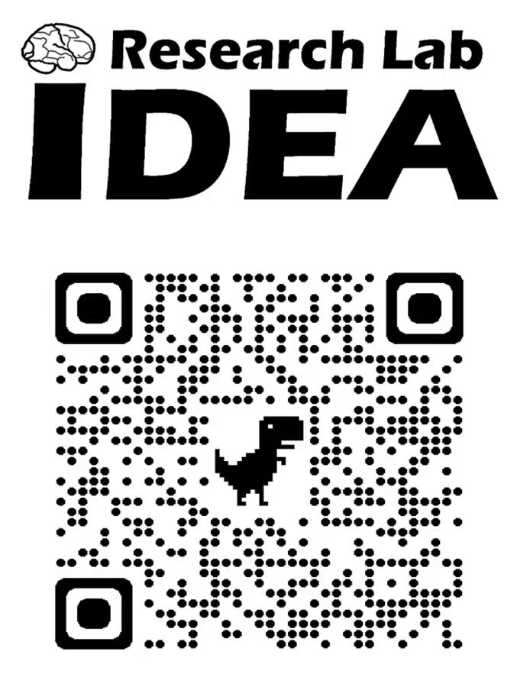




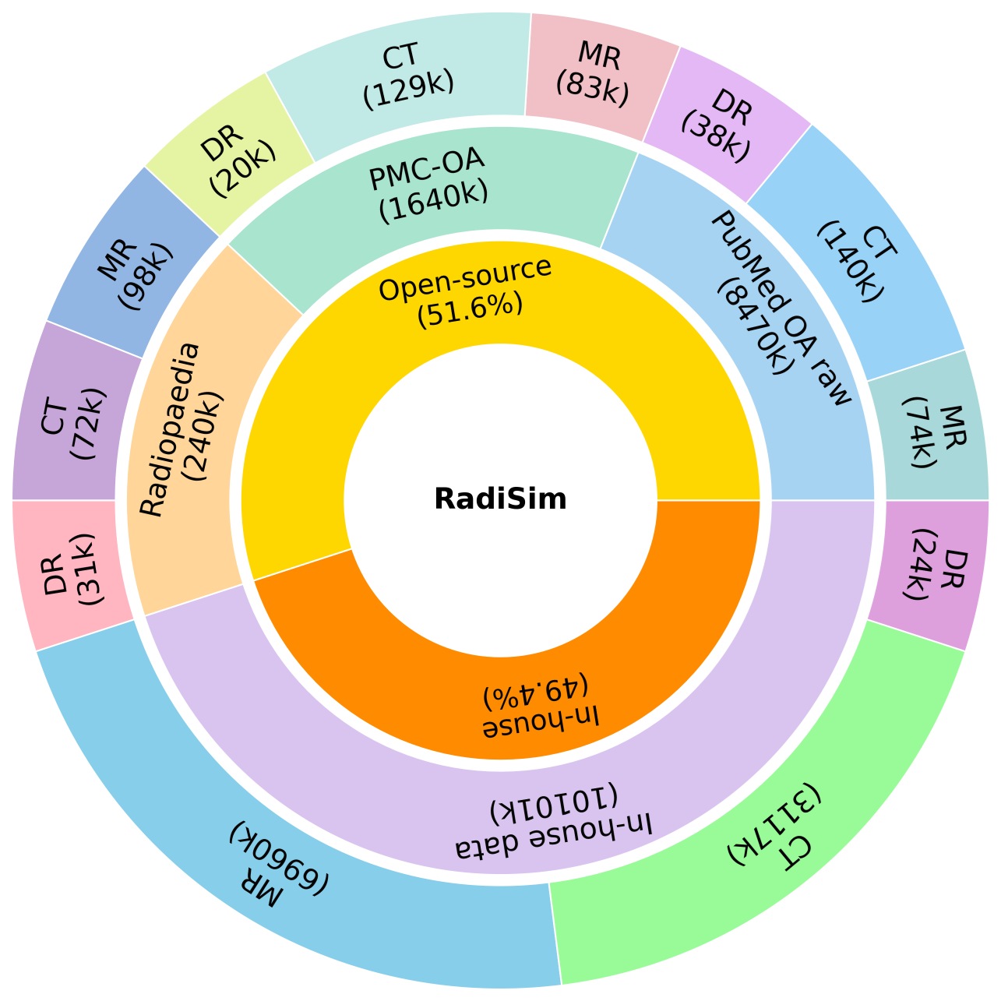
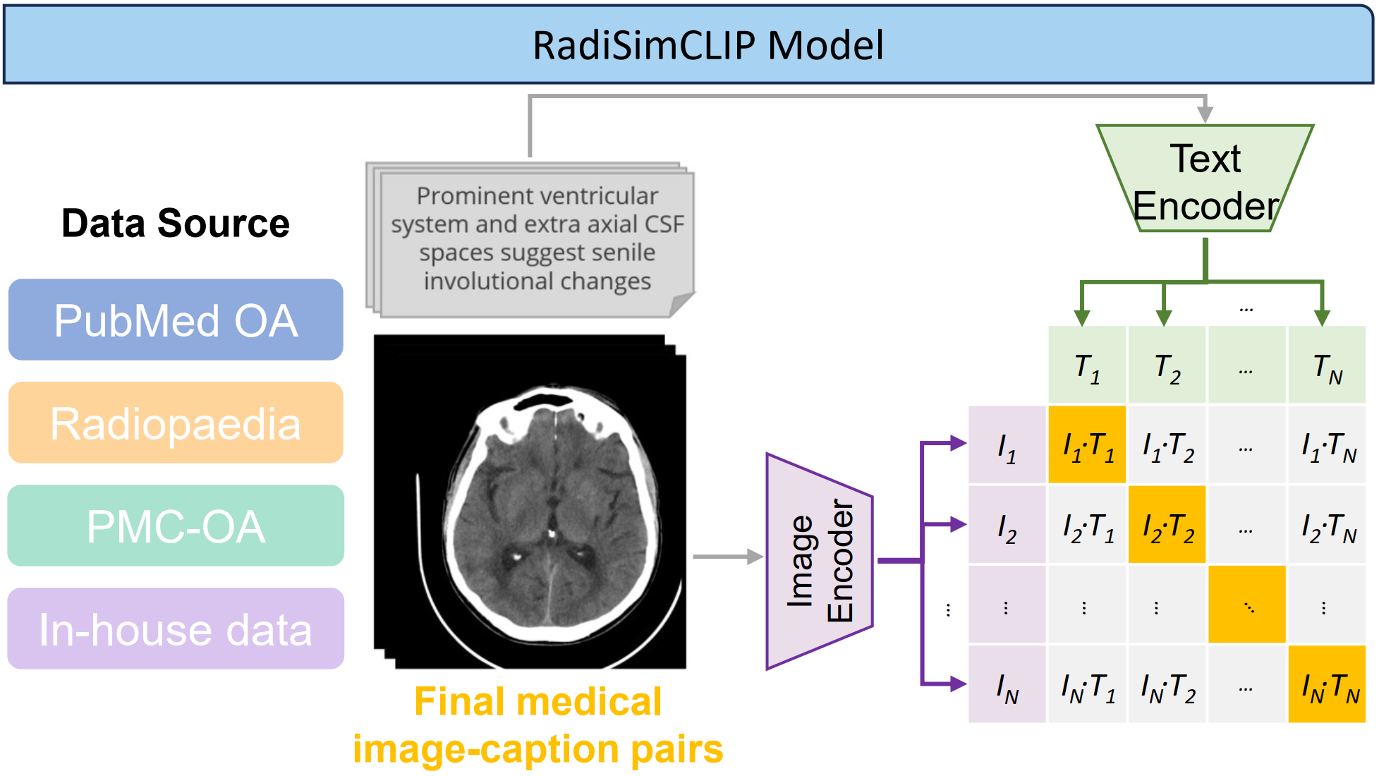
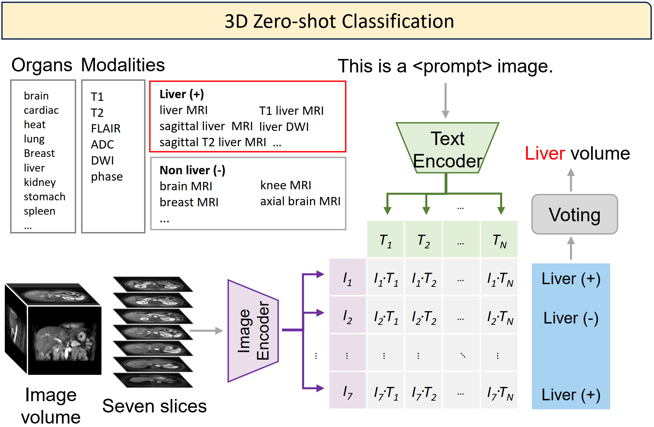
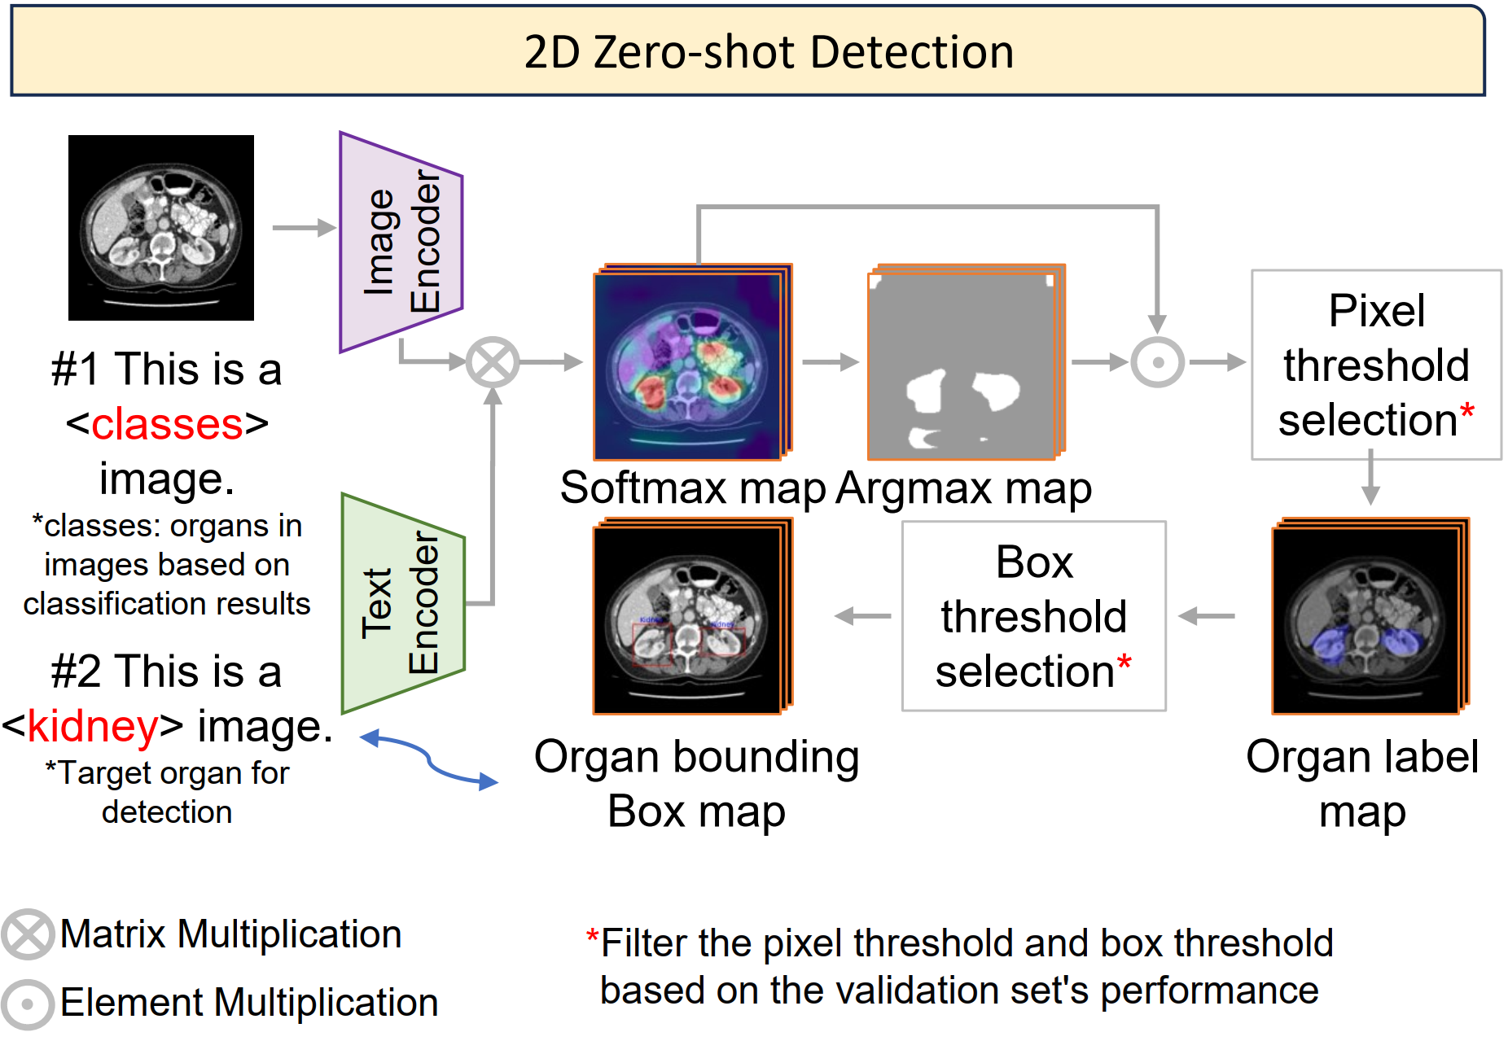
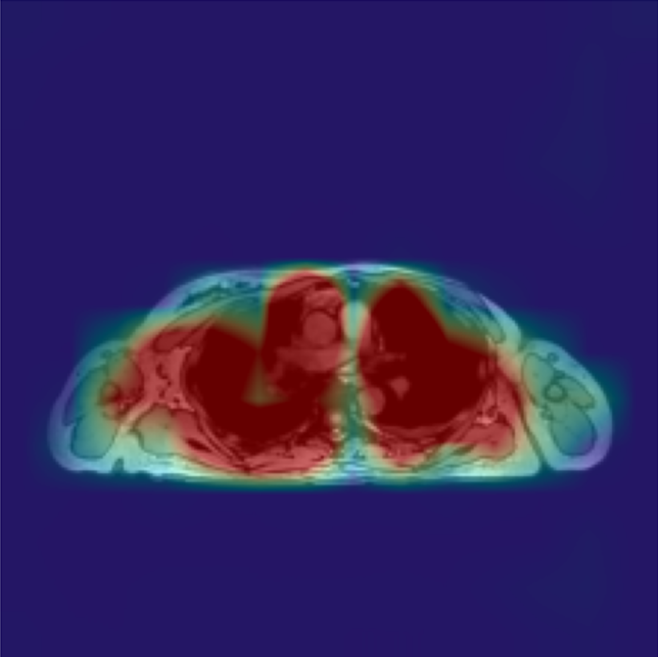
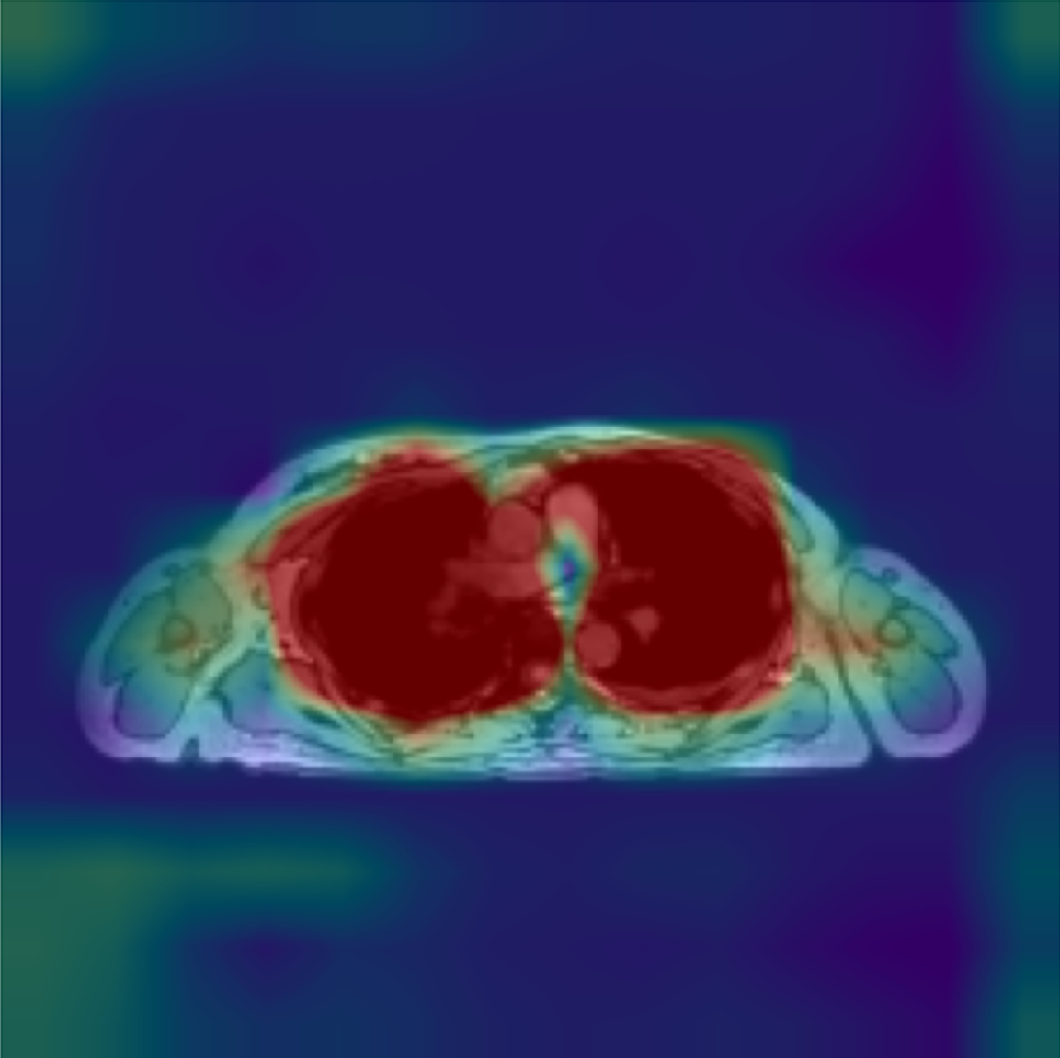
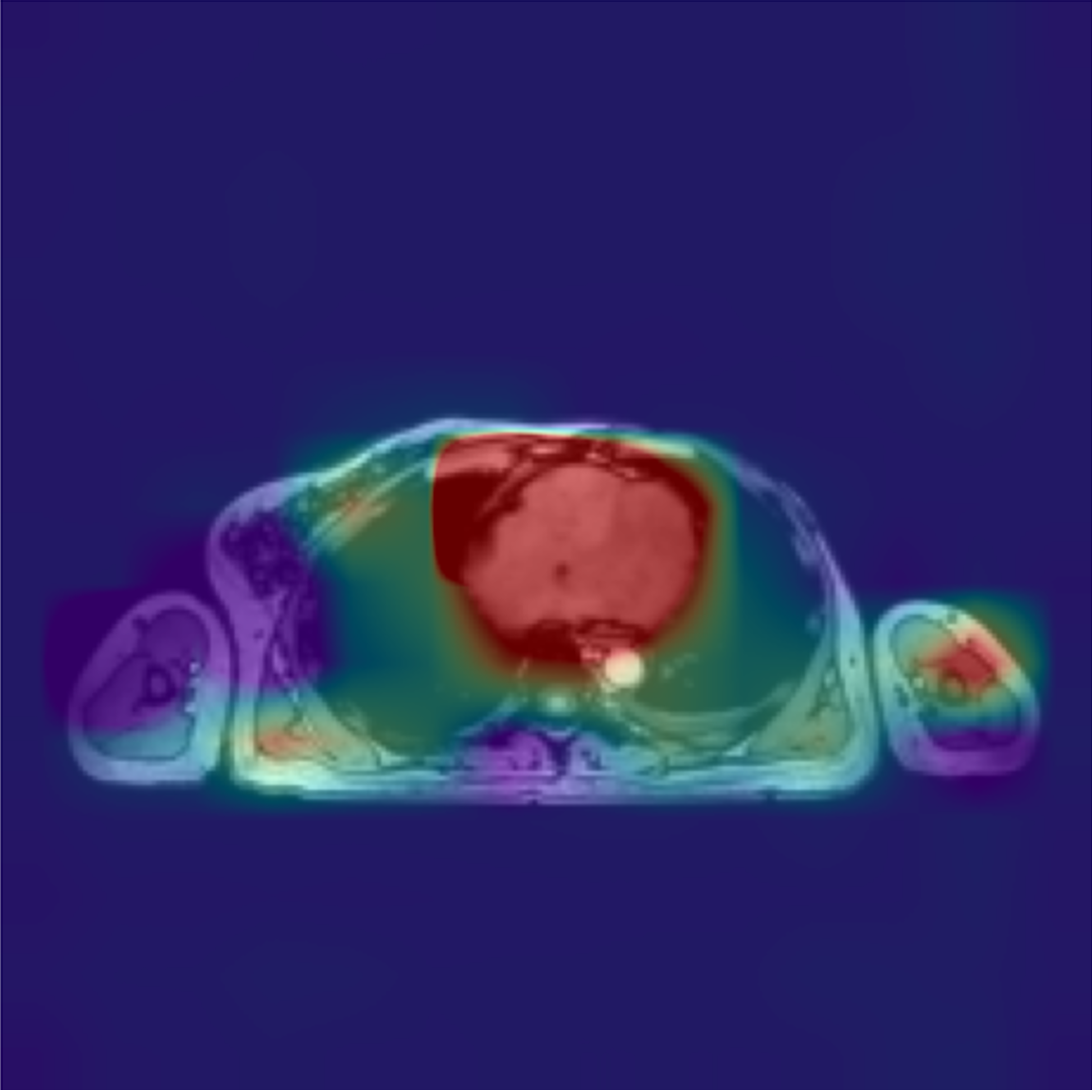
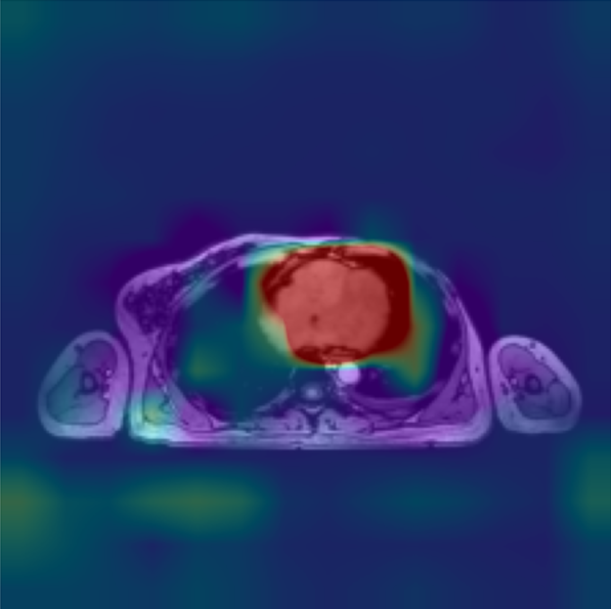
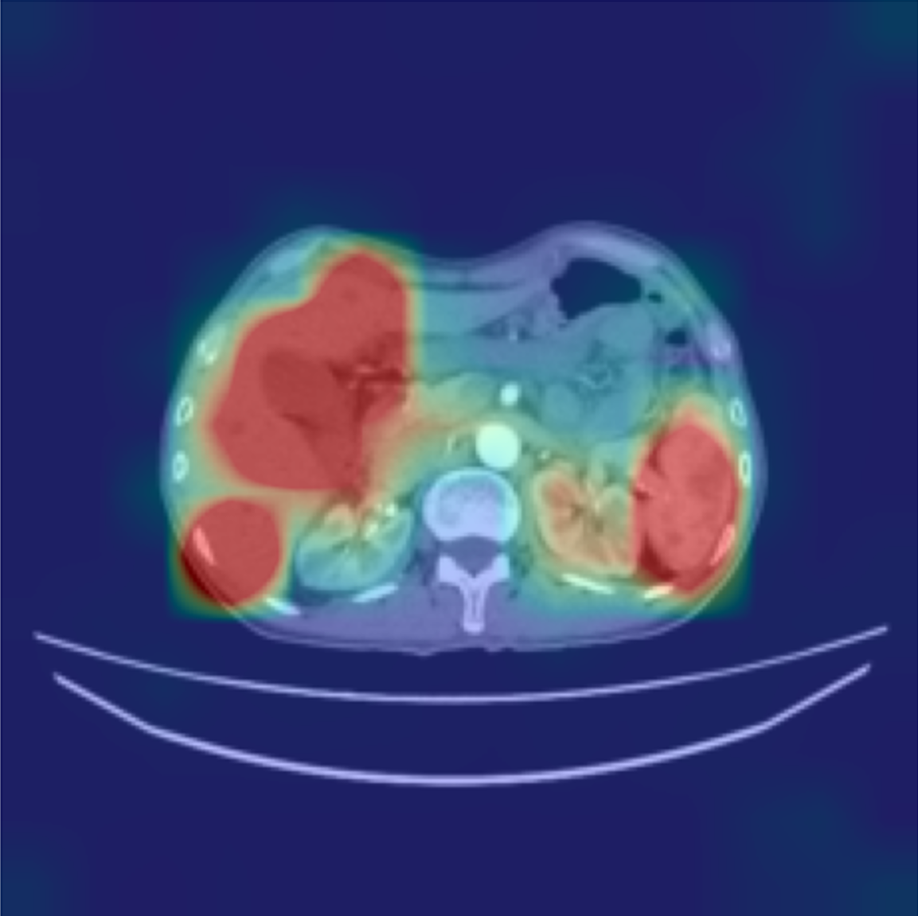
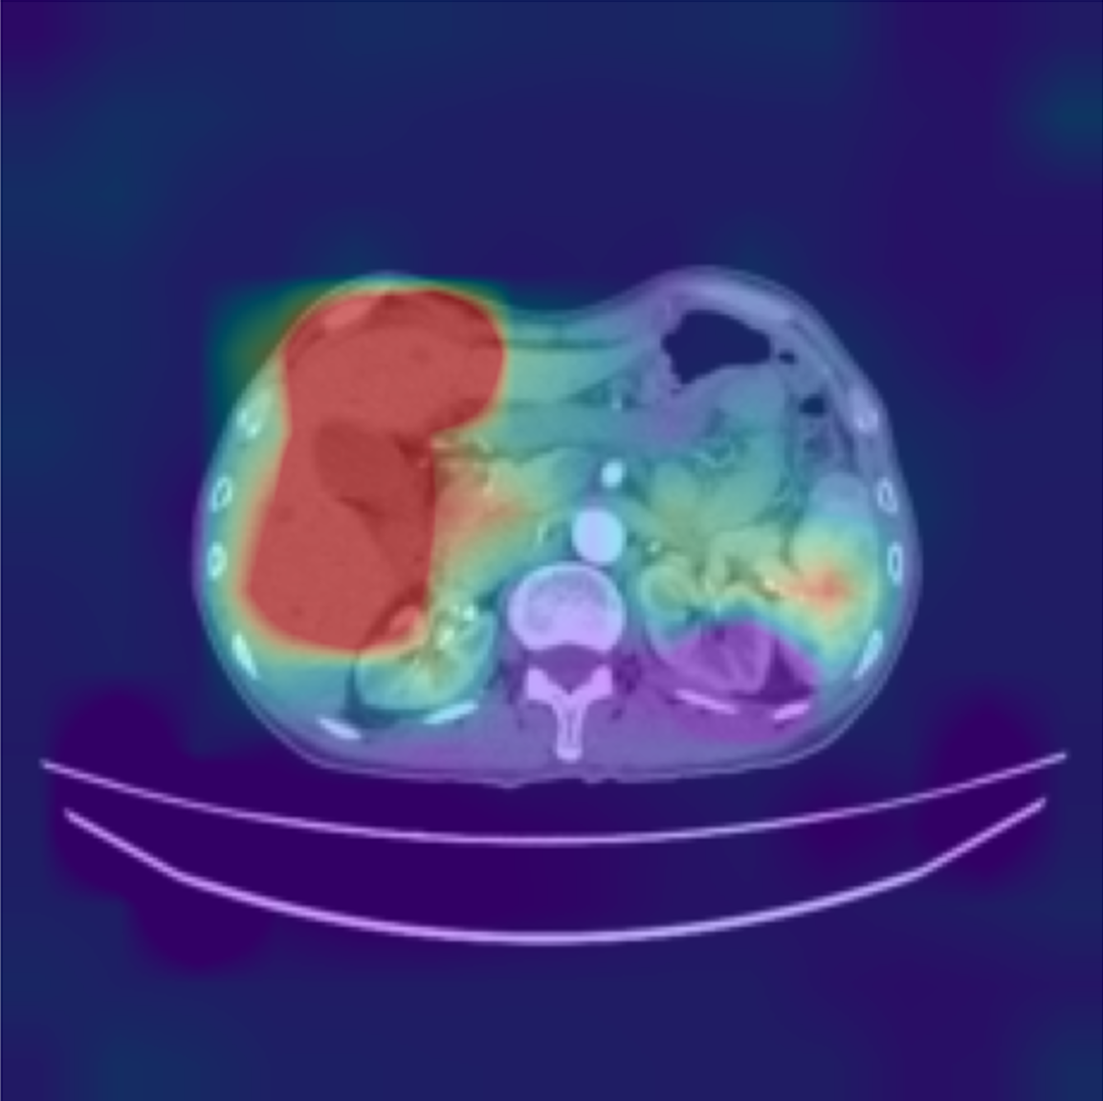
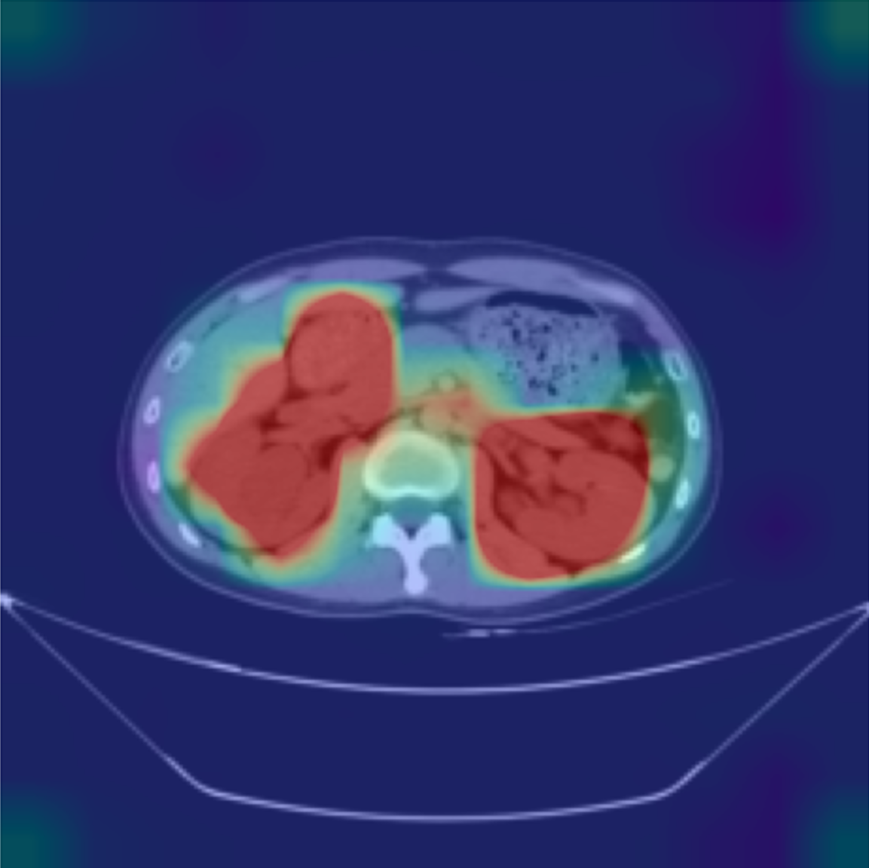
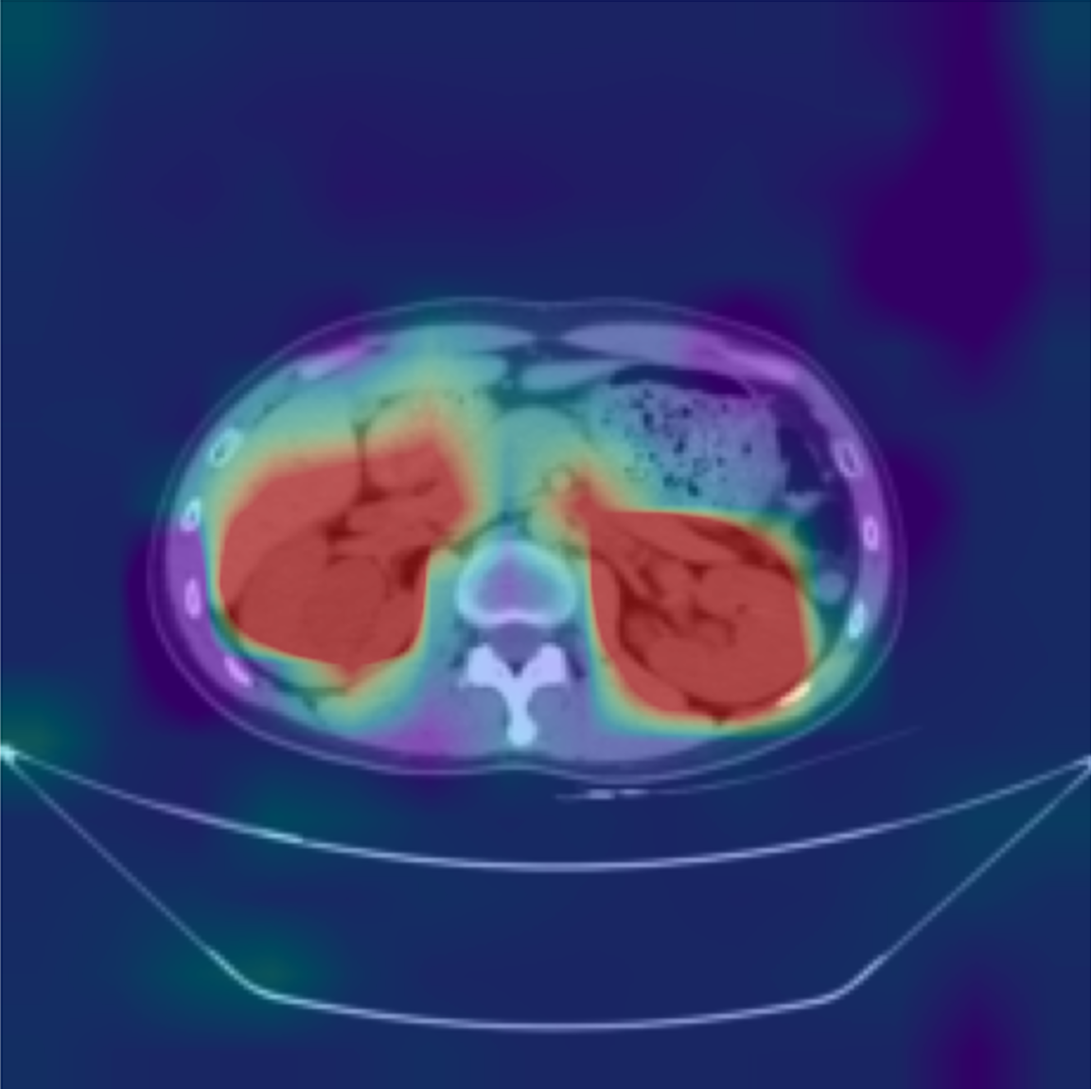
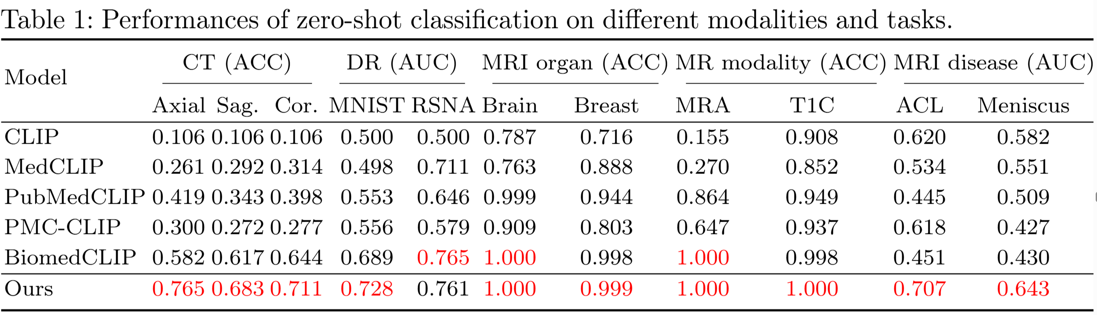
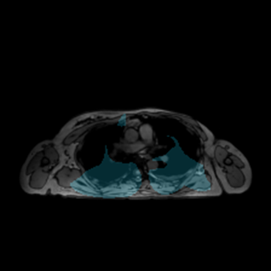
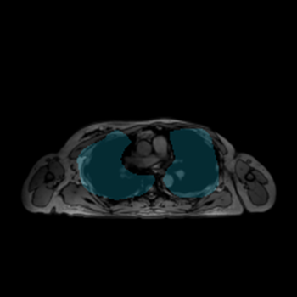
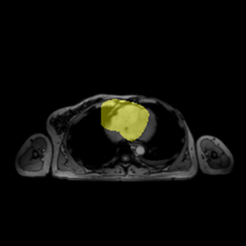
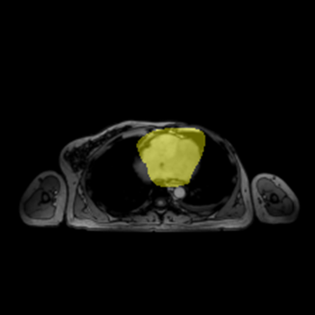
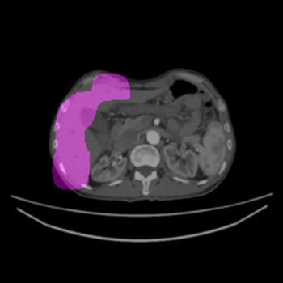
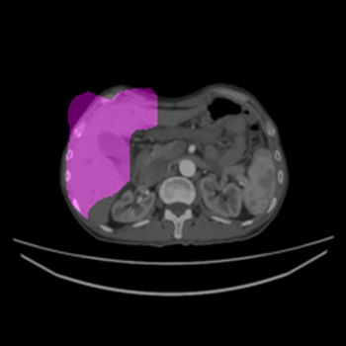
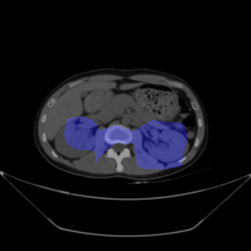
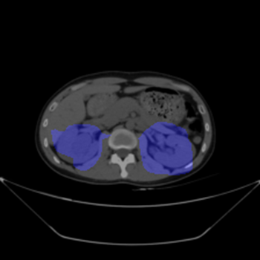
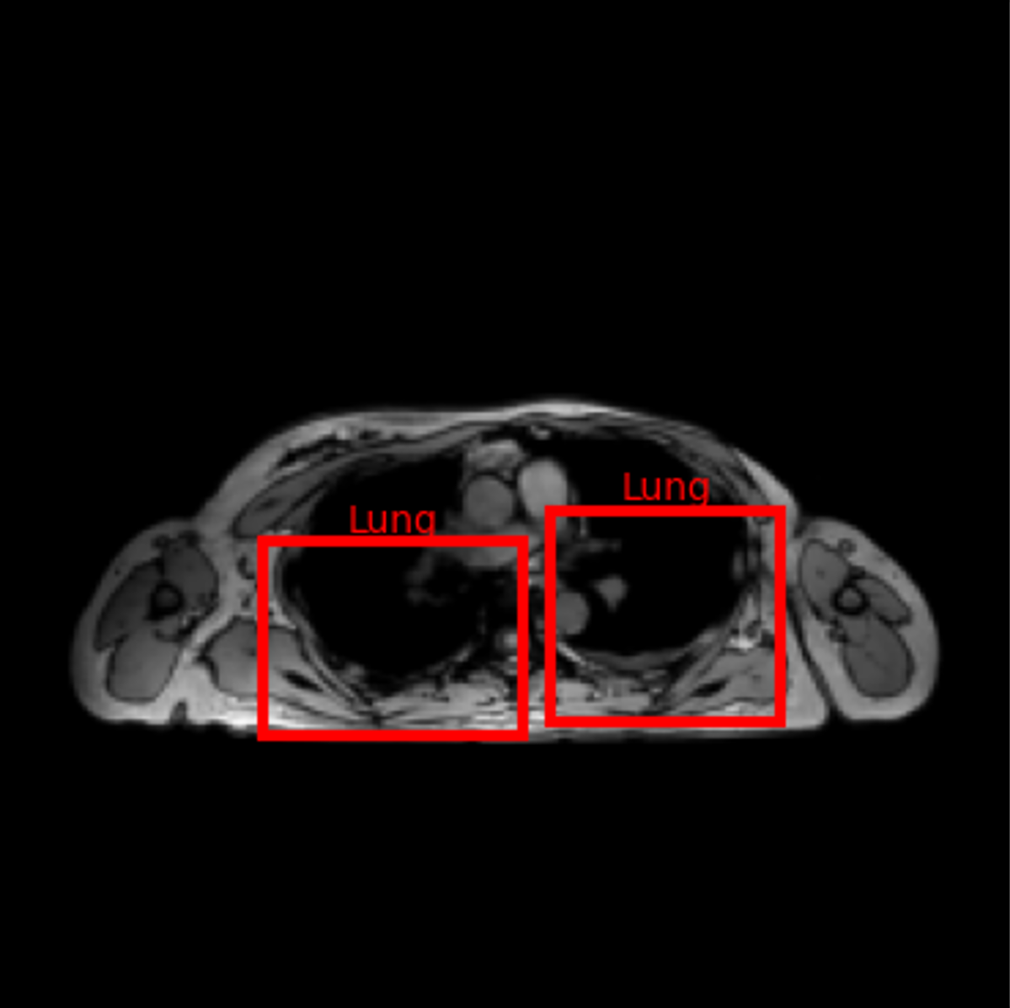
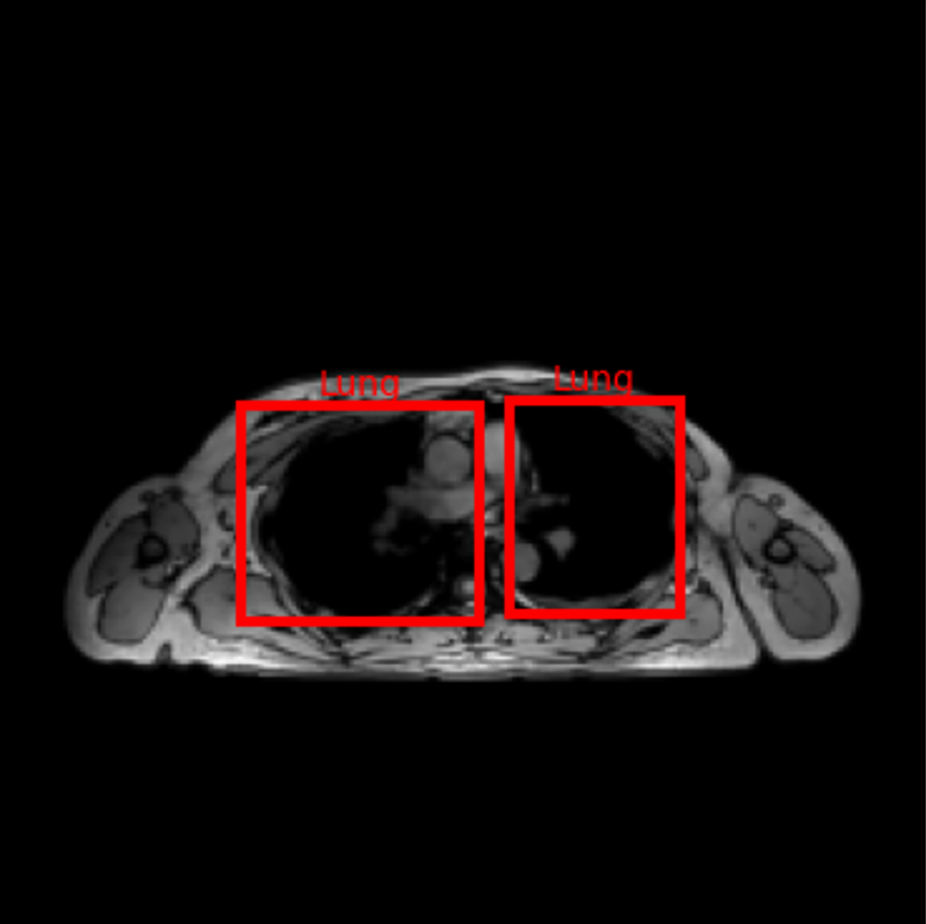
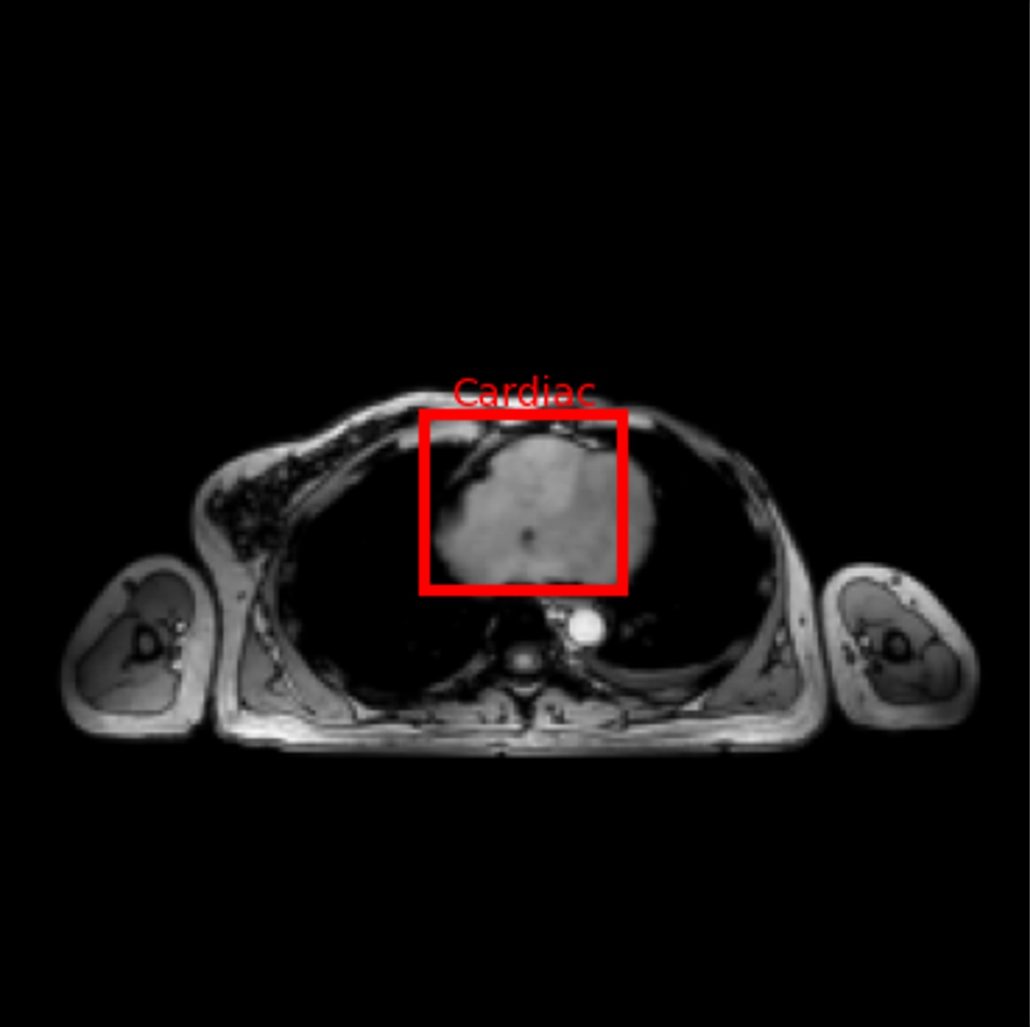
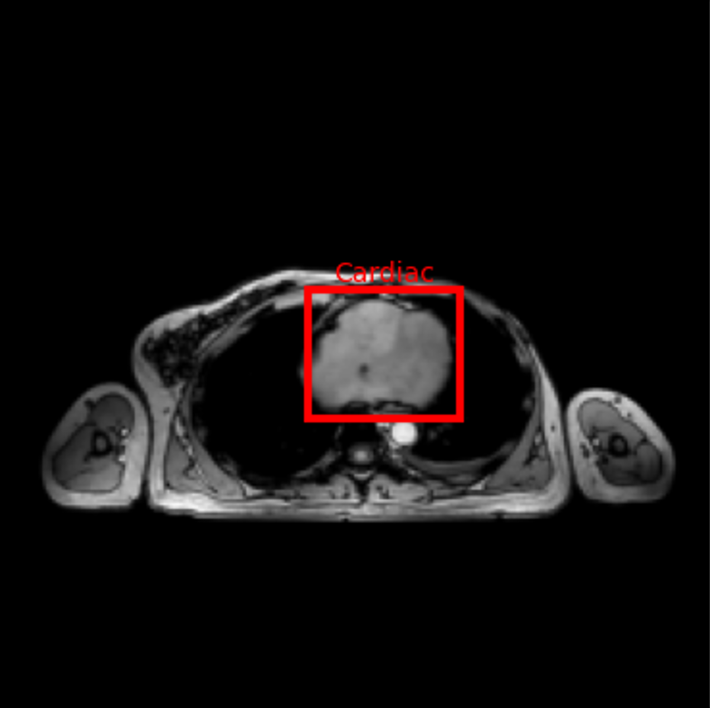
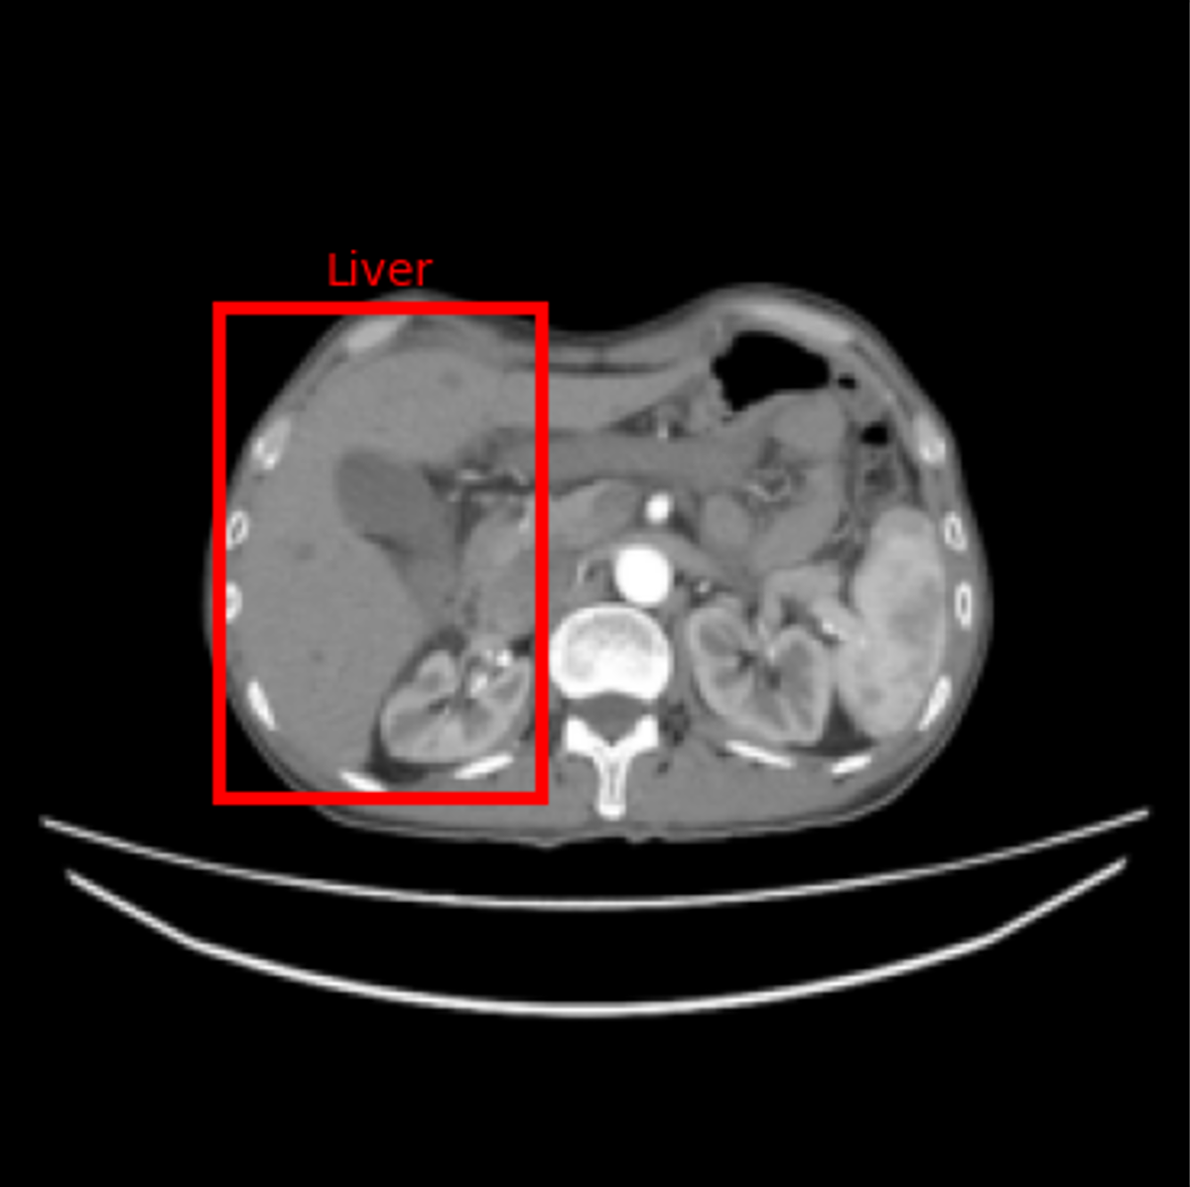
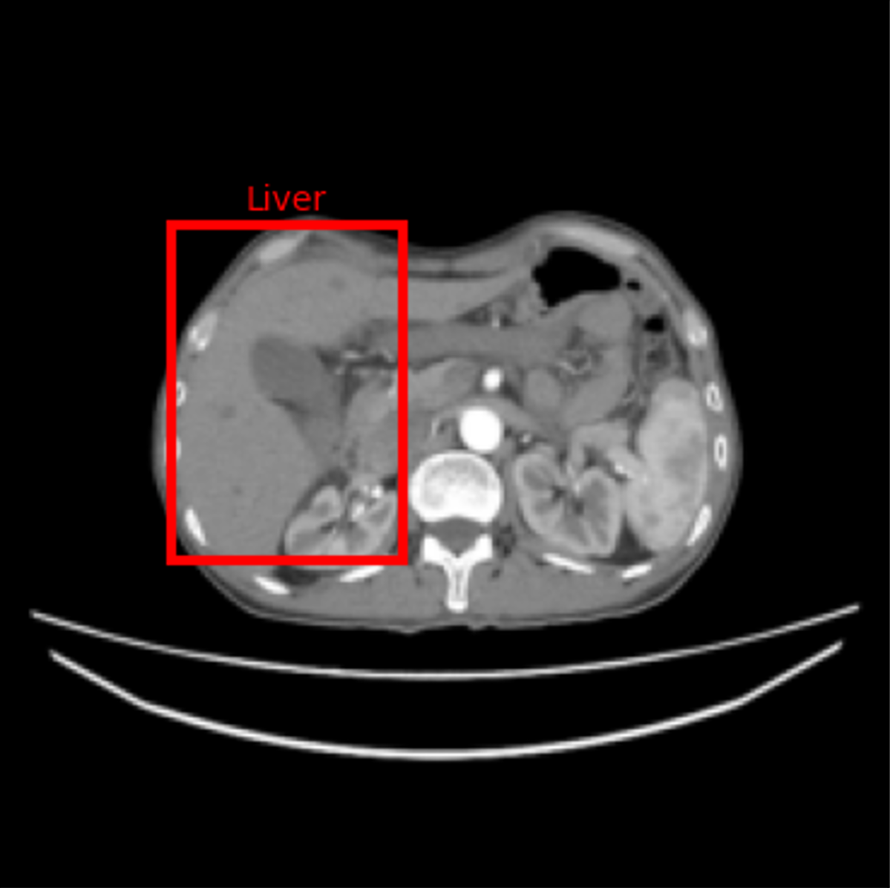
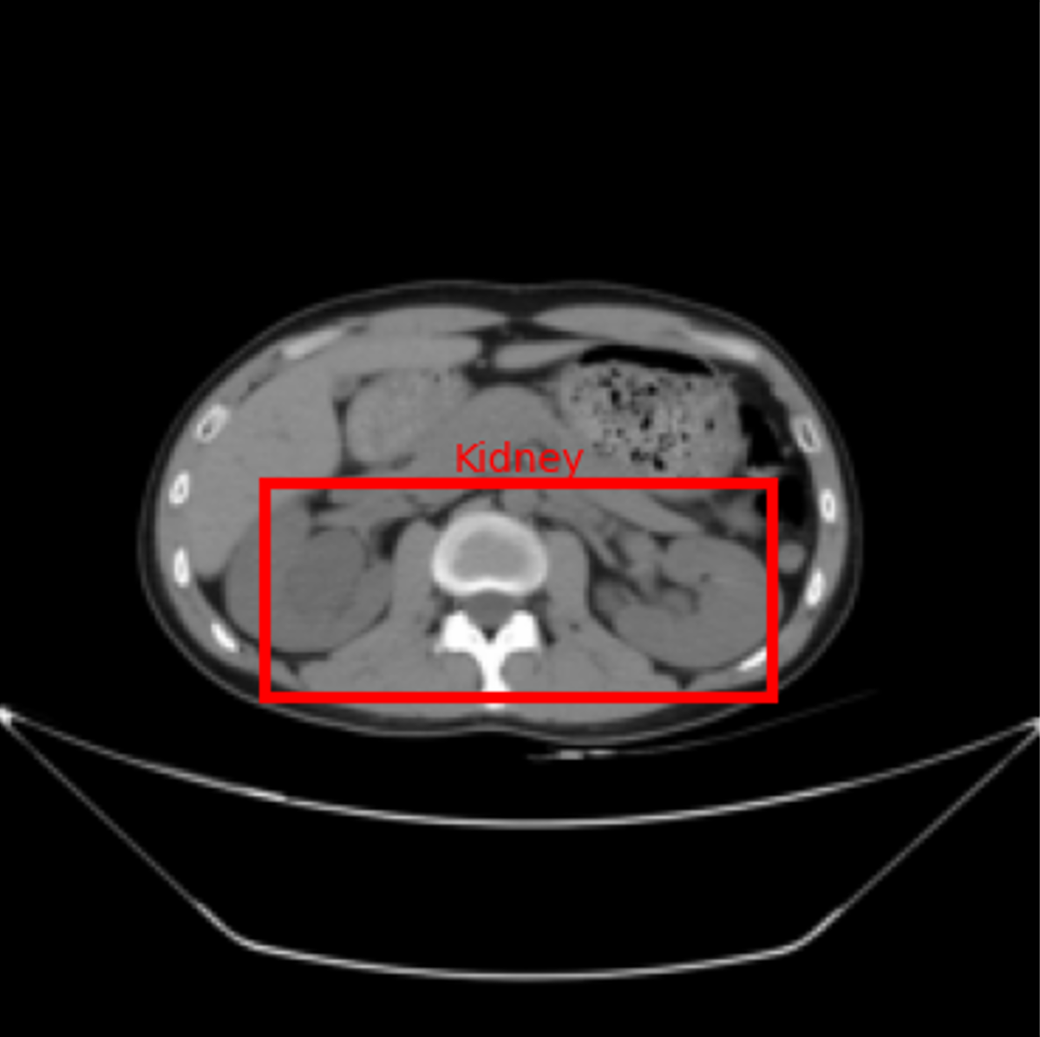
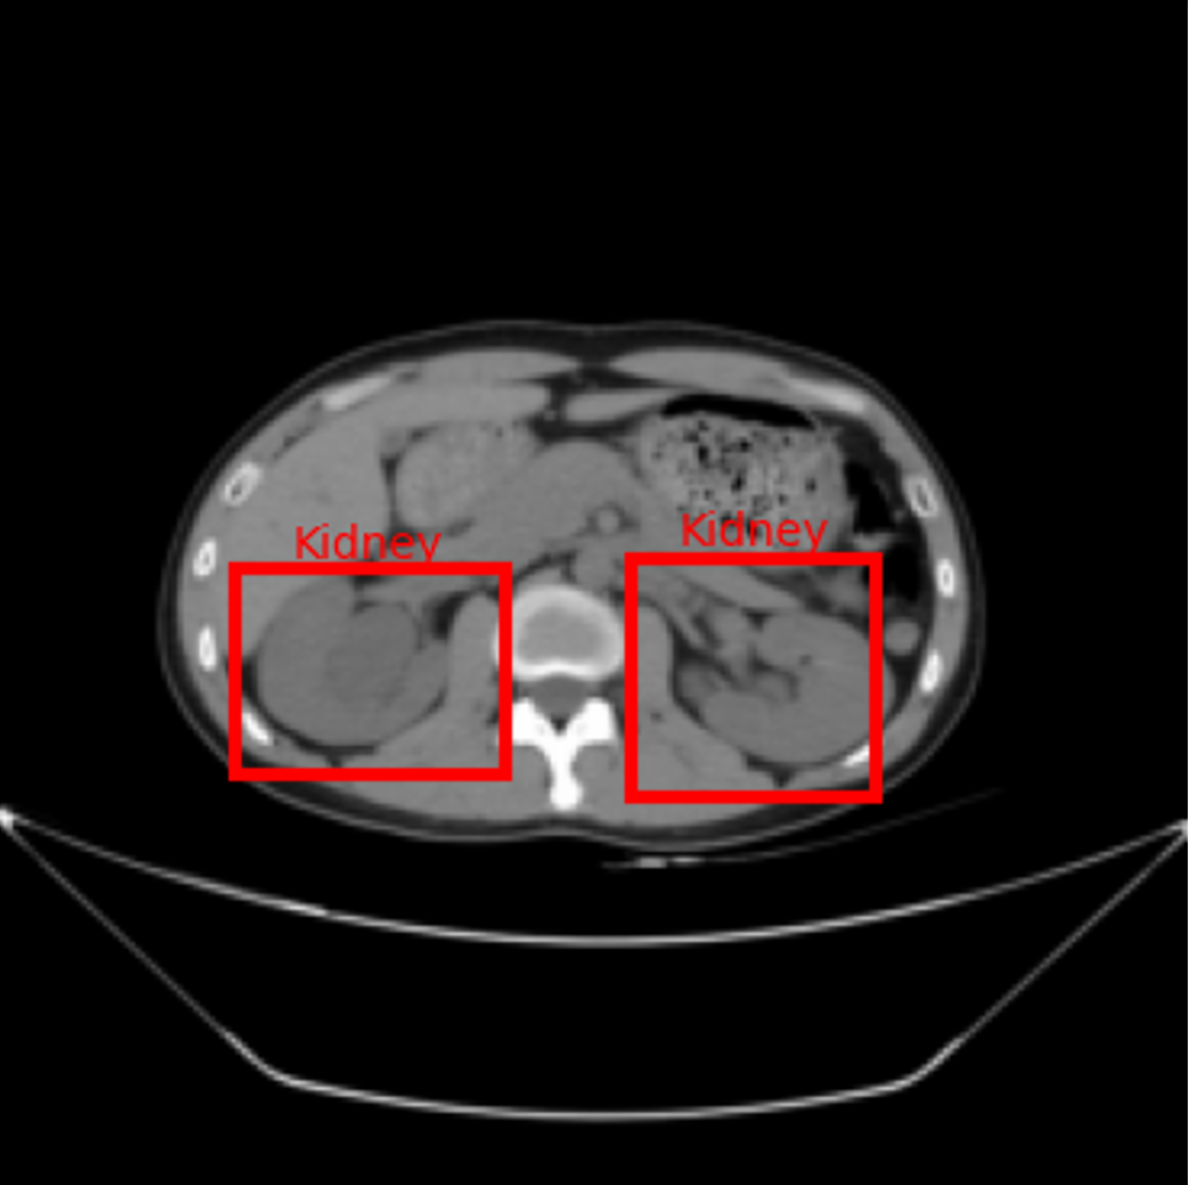
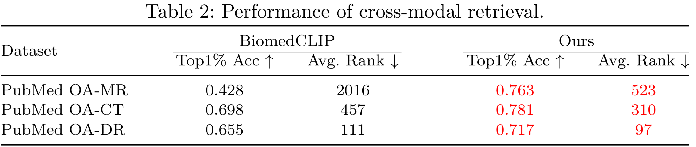
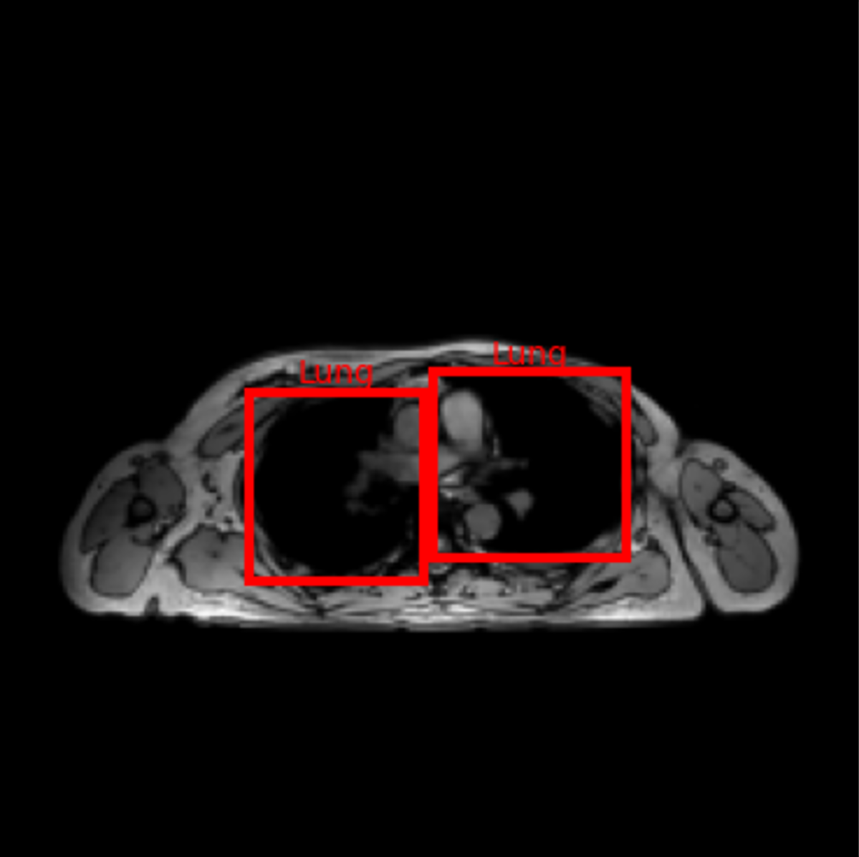
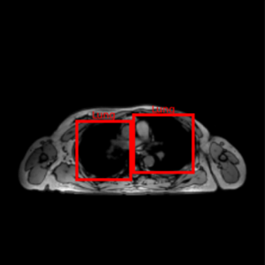

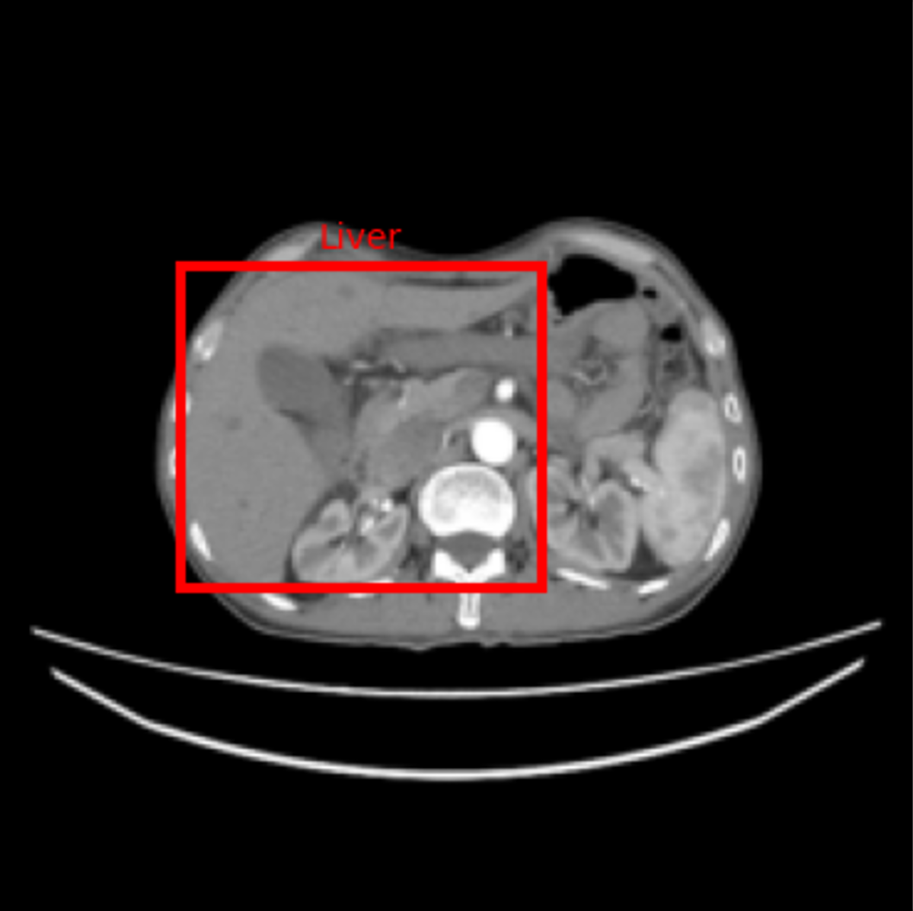
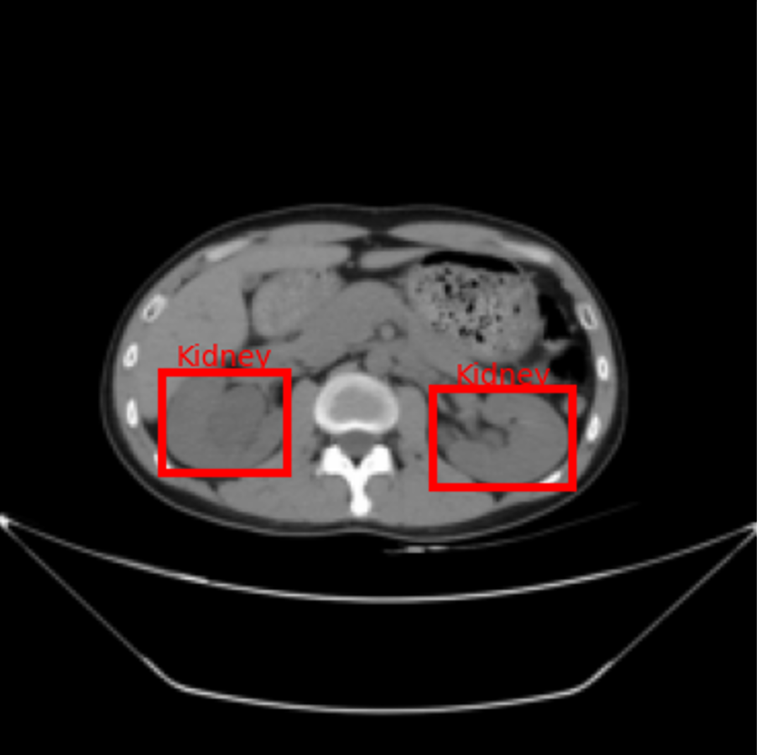
RadiSimCLIP: A Radiology Vision-Language Model Pretrained
on Simulated Radiologist Learning Dataset for
Zero-Shot Medical Image Understanding
Minhui Tan^{1,2,#}, Qingxia Wu^{3,4,#}, Boyang Zhang², Genqiang Ren², Jianlong Nie^{1,2},
Zhong Xue^{1,2}, Xiaohuan Cao^{1,2} , Dinggang Shen^{1,2,5}
¹ School of Biomedical Engineering, ShanghaiTech University, Shanghai, China
² Shanghai United Imaging Intelligence Co., Ltd., Shanghai, China
³ Beijing United Imaging Research Institute of Intelligent Imaging, Beijing, China
⁴ United Imaging Intelligence (Beijing) Co., Ltd, Beijing, China
⁵ Shanghai Clinical Research and Trial Center, Shanghai, China
xiaohuan.cao@uii-ai.com Dinggang.Shen@gmail.com
INTRODUCTION
Two Limitations of current medical vision-language models:
Limited training data: Lack of radiological diversity and semantic precision.
Insufficient evaluation: Rarely validated on fine-grained tasks.
DATASET
METHOD
RadiSim
10.6M image–text pairs
Covers CT, MRI, and DR modalities.
Built from in-house clinical data and curated open-source sources.
Named RadiSim (“Radiology + Simulate”) to highlight its goal of reflecting the diverse materials encountered during radiologist training.
Training Strategy:
CLIP-based Two-stage Pretraining
Stage 1: Pretraining on public data for general vision-language alignment.
Stage 2: Domain-specific adaptation on in-house radiology data.
Fig. 1: Overview of RadiSim.
Fig. 2: Overview of RadiSimCLIP training.
EXPERIMENTS
Evaluation Framework: Zero-shot Tasks for Multilevel Capabilities
Anatomical, Modality, and Disease Recognition
2D/3D Zero-shot Classification via image-text similarity (slice/ volume-level).
Spatial Interpretability
2D Zero-shot Detection via attention maps to localize organs without fine-tuning.
Vision-Language Semantic Alignment
Cross-modal Retrieval between images and clinical texts.
A
B
Fig. 3: Two typical downstream tasks: (A) 3D classification, and (B) 2D detection.
RESULTS
RadiSimCLIP achieves SOTA performance on 15/16 downstream tasks through a multi-level zero-shot evaluation framework.
Evaluation metrics: Accuracy (ACC), Area Under Curve (AUC), Top-1% accuracy, and Average Rank.
BiomedCLIP
Ours
BiomedCLIP
Ours
BiomedCLIP
Ours
BiomedCLIP
Ours
Softmax
map
Organ label
map
Organ bounding
box map
Organ bounding
box GT
The best results are in red.
Lung
Cardiac
Liver
Kidney
Fig. 4: Results of zero-shot detection across various organs in different datasets.
CONCLUSION
We have constructed RadiSim, a radiology-specific dataset with 10.6M multi-source image-text pairs.
RadiSimCLIP has achieved SOTA accuracy on zero-shot understanding across modalities, including 1) recognition via zero-shot classification, 2) pixel-level understanding through zero-shot detection, and 3) semantic alignment via cross-modal retrieval.

