Slide 1



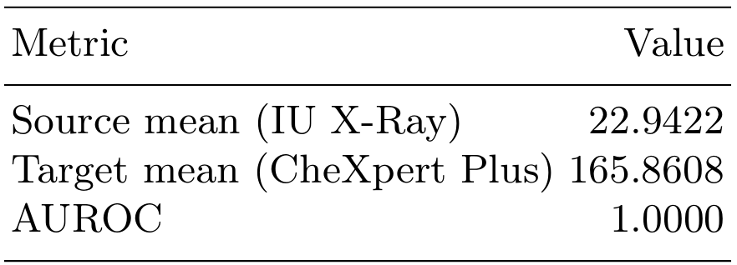
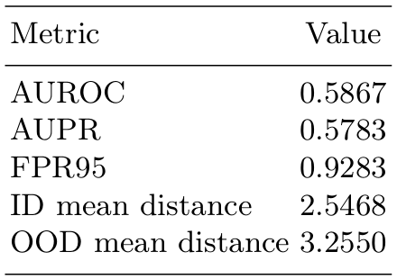
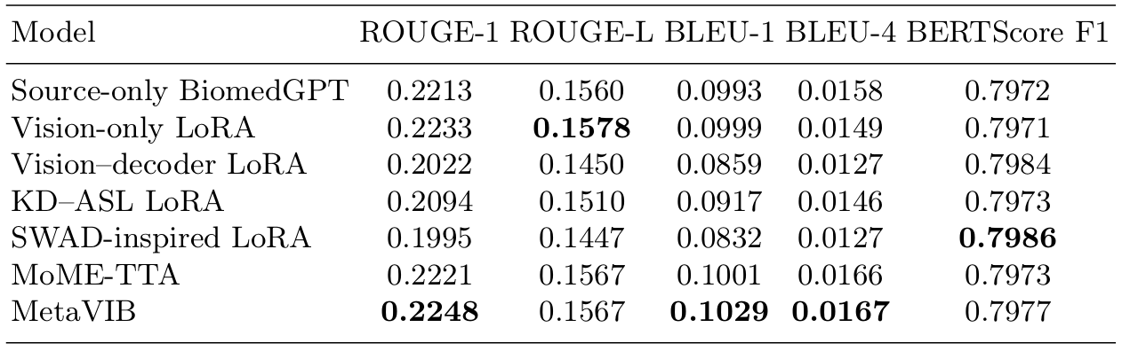
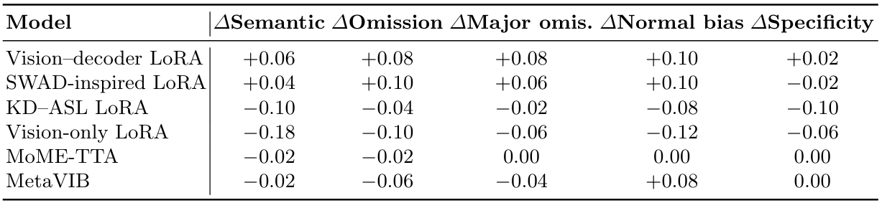
A Resource-Constrained Evaluation of Lightweight Adaptation for Cross-Dataset Chest X-ray Report Generation
Minji Kim¹, Seun Kim¹, Jang-Hwan Choi^{1,2♱}
¹Department of Artificial Intelligence, Ewha Womans University, Seoul, Korea,
²Department of Artificial Intelligence and Software, Ewha Womans University, Seoul, Korea
Introduction
Our Contribution
Challenge: Severe visual and linguistic domain shifts (IU X-Ray → CheXpert Plus) involves substantial differences is both visual characteristics and report-writing styles, making cross-dataset report generation clinically unreliable.
Conventional limits: Existing lightweight adaptation methods are mainly designed for classification and may not adequately adapt autoregressive language generation.
Motivation: Investigate whether lightweight adaptation can improve cross-domain report generation under limited computational resources, and diagnose why visual adaptation alone may be insufficient.
Benchmark lightweight adaptation strategies for cross-dataset chest X-ray report generation, including four LoRA-based variants, router-only MoME-TTA, and MetaVIB.
Quantify the IU X-Ray-to-CheXpert Plus visual domain gap using feature-space Mahalanobis distance and show strong separation in the BiomedGPT visual representation.
Adapt a classification-oriented TTA approach to an autoregressive report generation backbone and analyze the limitations of router-only inference-time adaptation.
Show that small improvements in lexical metrics do not necessarily correspond to clinically better reports, highlighting the need for evaluation protocols that capture omissions, unsupported findings, and target-domain report style.
Methods
Dataset & Experimental Setup
Source → Target: IU X-Ray → CheXpert Plus Base Model: BiomedGPT pretrained on IU X-Ray
Experiments were conducted under a limited-resource Google Colab setting
Visual Domain Shift Analysis
  Mahalanobis Distance
  Extract visual features from the pretrained BiomedGPT encoder.
  Estimate the IU X-Ray feature distribution and measure target-domain distance.
  Use AUROC to quantify source-target separability.
Frozen BiomedGPT Backbone
Only the lightweight modules below are trained
Table 1. Mahalanobis distance evaluation between IU X-Ray and CheXpert Plus.
LoRa-based Adaptation
MoME-TTA
MetaVIB
  ➔ Strong visual domain shift exists before adaptation.
  Vision-only: Adapt visual encoder features
  Vision-decoder: Adapt visual features + updates decoder cross-attention
  KD-ASL: Combine CE training with token-level knowledge distillation and pathology-level prediction
  SWAD-inspired: Average low-validation-loss LoRA checkpoints for improved robustness
  Unlabeled target-domain adaptation method.
  Freeze experts, and language modules, optimizing only an entropy-based router during inference.
  Only 0.009% of model parameters are trainable.
  Construct pseudo-domains within IU X-Ray using frontal/lateral views and feature clustering.
  Evaluates whether classification-oriented latent regularization transfers to autoregressive report generation.
Table 2. OOD Detection performance of MetaVIB.
  ➔ There is a substantial overlap between the pseudo-domains. This suggests that view-based pseudo-OOD construction provides only weak supervision for learning domain-robust representations.
➔ We provide a controlled diagnostic study of what currently fails and why, by comparing lightweight adaptation strategies for an IU X-Ray-pretrained BiomedGPT model transferred to CheXpert Plus.
Quantitative Evaluation
Generated reports are evaluated using NLG (Natural Language Generation) metrics such as ROUGE and BLEU.
Results
Exploratory Qualitative Evaluation
We conducted LLM-assisted review of 50 cases focusing on clinically relevant error patterns.
Vision-only LoRA: favorable lexical scores, but generated reports were often incomplete or generic.
Vision–decoder / SWAD-LoRA: lower lexical scores, but sometimes produced more clinically specific reports.
KD–ASL LoRA: reduced some unsupported findings, but improvements were inconsistent.
MoME-TTA & MetaVIB: showed limited qualitative differences from the source-only model.
Table 2. Quantitative comparison of BiomedGPT models with different adaptation strategies on the CheXpert Plus dataset. Bold values denote the best point estimatefor each metric.
Table S2. Change in qualitative scores relative to baseline (∆ = method − baseline).Positive values indicate improvement over baseline. For omission and normal template bias, positive $\Delta$ denotes fewer omissions or less bias relative to baseline.
  ➔ No lightweight adaptation method consistently improved report generation under severe domain shift.
  ➔ Standard NLG metrics did not consistently reflect clinical report quality.
Overall Findings
A severe visual domain gap was observed between IU X-Ray and CheXpert Plus with Mahalanobis AUROC reaching 1.00.
Nevertheless, LoRA, MoME-TTA, and MetaVIB produced only marginal improvements, suggesting that lightweight feature-level adaptation alone is insufficient under severe domain shift.
Visual alignment does not guarantee clinical adaptation, as target-domain reporting style and decoder-level clinical semantics remain largely unaddressed.
NLG metrics do not fully reflect clinical quality, highlighting a mismatch between lexical similarity and clinically faithful reporting.
These results suggest that classification-oriented adaptation objectives are not directly transferable to autoregressive medical report generation, where decoder-level language and clinical semantics are critical.
Future work should jointly address visual robustness, target-domain language, and decoder-level clinical semantics, while validating the performance–resource trade-off against full-model fine-tuning.

