Slide 1








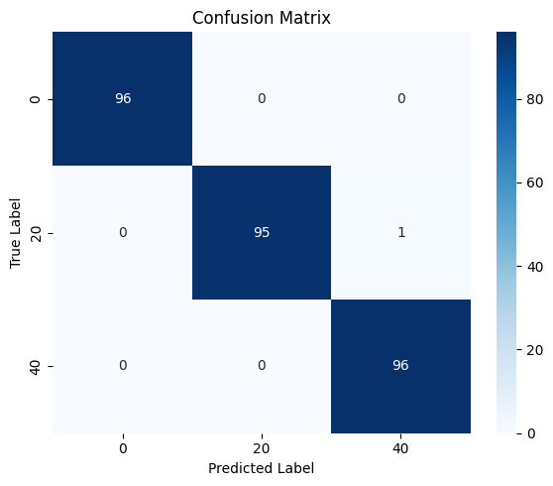
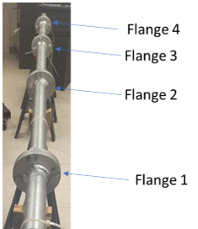
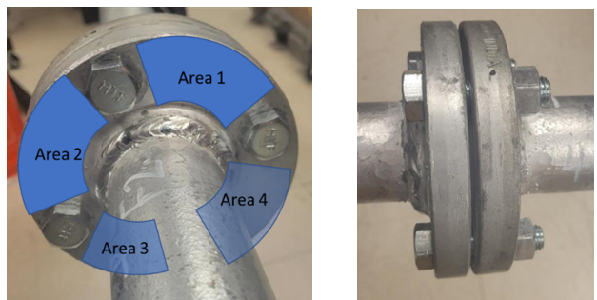

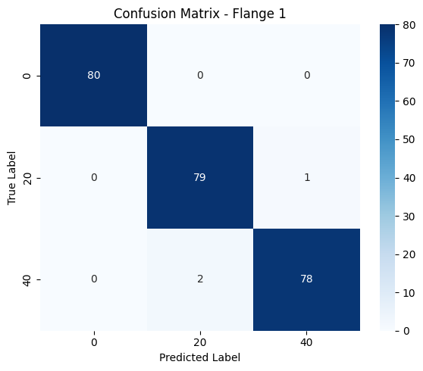
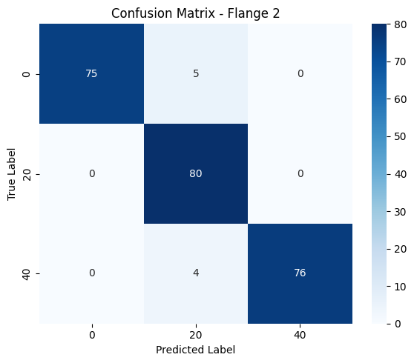
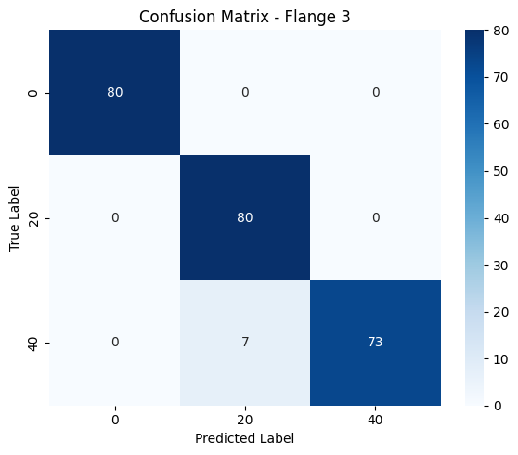

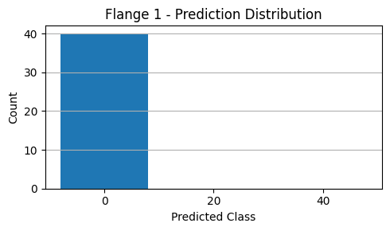
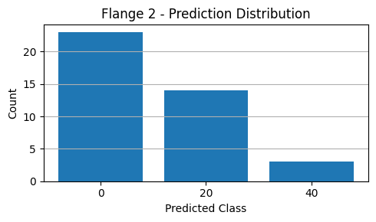
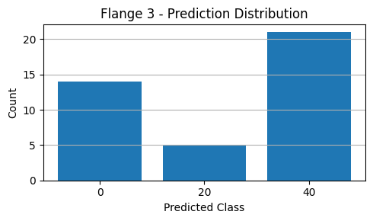
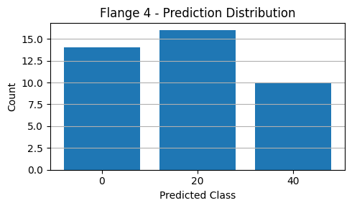
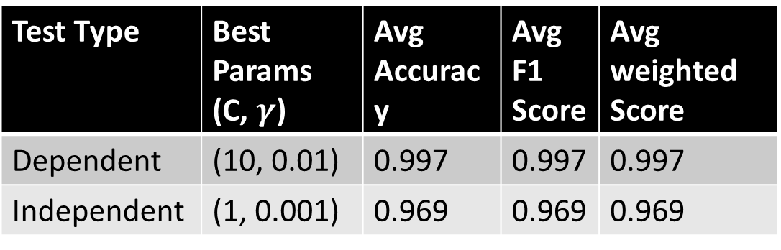
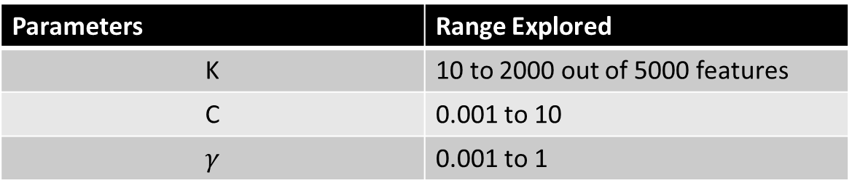

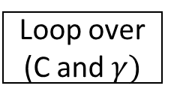
Project Title: Simplicity Beats Complexity: FFT + SVM for Flange Looseness Detection
Smart feature engineering was the key: The secret wasn’t more data. It was knowing what to do with it.
Choayeb Barchouchi, Graduate Student
Department of Mechanical Engineering, Cullen College of Engineering
Problem Statement
Results, Analysis and Discussion
When bolts loosen, structures fail, and the first warning may come as a sound. In critical environments like offshore rigs, pipelines, or naval vessels, early detection of flange looseness isn’t just maintenance, it’s prevention.
This competition asked a simple but high-stakes question: Can we classify bolt tightness from audio impacts accurately, quickly, and robustly?
Personally, this challenge wasn’t just classification. It was real-time classification. That means models must be fast enough for real-time deployment and lightweight for edge devices or embedded systems.
We faced three levels of evaluation:
Dependent Test — Performance on familiar data (70/30 split)
Independent Test — Generalization to new flanges
Experimental Test — Full autonomy with no labels, only judgment
And eventually, these evaluation stages will shape the design and focus of our solution.
Model Comparison: Performance & Practicality
Table 4: Classification Models Comparison (SVM VS CNN VS RNN)
Comparative Analysis of Feature Selection Methods on FFT & MFCC Inputs:
Table 5: Feature Reduction for FFT Comparison (ANOVA F VS PCA VS LDA) Table 6: Feature Reduction for MFCC Comparison (ANOVA F VS PCA VS LDA)
Results and Finding of Selected Best Model + Best Feature Reduction:
Dependent and Independent Classification:
Table 7: Evaluation Summary (Dependent Vs Independent Testing) Table 8: Independent Test (Per Flange Performance)
Fig 2: Dependent Test Confusion Matrix
Fig 3: Independent Test Confusion Matrix
Experimental Test:
Fig 4: Experimental Results Statistics
Model | Scale(# params) | Training Time | Memory Footprint | Peak Accuracy
SVM (Gaussian Kernel) | hundreds | 10sec | Low | 90%
CNN | hundreds of thousands | 1-2mins | High | 90%
Bi-LSTM | Tens of thousands | 30-3mins | High | 97%
SVM (RBF)
Method | K Range | Best Score | Best K | Model Training Time (s) | Memory Space (KB) | Accuracy Gain (%) | Time Gain | Memory Saved
ANOVA F | 10-5000 | 0.969 | 151 | 0.34 | 1.17 | 40% | 34× | 33×
PCA | 5-200 | 0.715 | 10 | 0.13 | 0.08 | 30% | 90× | 500×
LDA | 2500-3500 | 0.722 | 3100 | 5.72 | 24.22 | 15% | 2× | 1.61×
Method | K Range | Best Score | Best K | Model Training Time (s) | Memory Space (KB) | Accuracy Gain (%) | Time Gain | Memory Saved
ANOVA F | 500-2500 | 0.900 | 1000 | 1.92 | 7.81 | 23% | 2.6× | 2.5×
PCA | 10-100 | 0.883 | 23 | 0.18 | 0.18 | 22% | 28× | 110×
LDA | 500-3500 | 0.752 | 500 | 0.93 | 3.91 | 8% | 5.4× | 21.5×
Brief Literature Review
Previous work on bolt looseness detection has explored various signal processing and classification techniques, with a focus on extracting informative features from acoustic impacts:
FFT, STFT, MFCCs, and wavelets are commonly used for time-frequency analysis
Classifiers include KNN, Random Forests, and CNNs, with recent trends leaning toward deep learning
Patents highlight embedded DSP-based systems using vibro-acoustic sensing for flange monitoring
However, most approaches prioritize accuracy over speed and efficiency, leaving a gap in solutions suitable for real-time, low-resource deployment.
Test Type | Best Params (C, $γ$) | Avg Accuracy | Avg F1 Score | Avg weighted Score
Dependent | (10, 0.01) | 0.997 | 0.997 | 0.997
Independent | (1, 0.001) | 0.969 | 0.969 | 0.969
Flange # | Accuracy | F1 Score | Weighted Score
1 | 0.988 | 0.987 | 0.987
2 | 0.963 | 0.963 | 0.963
3 | 0.971 | 0.971 | 0.971
4 | 0.954 | 0.954 | 0.954
Experimental Setup and Collection of Data
The experimental pipeline system consists of four bolted flanges (Flange 1 to Flange 4) mounted along a steel pipe. Each flange was struck with a steel hammer across four designated zones (Areas 1–4) to capture spatial variation. The resulting acoustic impact signals were recorded using an iPhone microphone at a 48 kHz sampling rate.
For the dependent and independent tests, the organizers supplied a labeled dataset of 960 audio samples.
For the experimental task, we were able to extract our own unlabeled audio recordings from the same flange setup.
Flange | Torque 0 | Torque 20 | Torque 40 | Total
1 | 80 | 80 | 80 | 240
2 | 80 | 80 | 80 | 240
3 | 80 | 80 | 80 | 240
4 | 80 | 80 | 80 | 240
Total | 320 | 320 | 320 | 960
Flange | Samples Collected
1 | 40
2 | 40
3 | 40
4 | 40
Total | 160
Flange # | Flange 1 | Flange 2 | Flange 3 | Flange 4
Classification Results | 0 ft-lbs | 0 ft-lbs | 40 ft-lbs | 20 ft-lbs
Table 1: Task 1 and 2 data distribution
Table 2: Task 3 data distribution
Methods
This section outlines the complete pipeline, from signal processing and feature engineering to classification, and highlights the key innovations that drove my results.
Signal Processing & Feature Extraction:
Fast Fourier Transform: Utilized to convert time-domain signals into the frequency domain, capturing the spectral characteristics of each impact efficiently. Compared to MFCC and STFT, FFT offers a more straightforward and faster computation, making it suitable for real-time applications. In fact, FFT extraction was reported to be 3–5× faster than MFCC on average in audio processing task
Feature Selection: Applied ANOVA F-score to rank FFT bins by their discriminative power, reducing the feature set from thousands to a more manageable size (around 100 features) with improvement in performance.
Classification
Support Vector Machine with RBF Kernel: Chosen for its robustness and efficiency in handling high-dimensional data, providing a balance between complexity and performance. SVMs are less resource-intensive and require less training data than deep learning models, making them more practical for scenarios with limited computational resources.
Model Evaluation: A loop was performed over various values of k (number of top features), testing how the model performs using only the most informative bins (Ranged from 1% of the original features up to 30%). For each selected feature subset (k), I ran a grid search over SVM parameters (C and $γ)$ and Models were evaluated using a weighted score:
$$Score= ω.Accuracy+\left(1−ω\right).F1$$
This was he milestone for selecting the model that performs well globally while remaining balanced across all torque classes.
Fig 1: Fitting SVM Model Methodology
Conclusion
Findings:
FFT + ANOVA feature selection gave the best trade-off: 96.9% accuracy with minimal cost.
MFCC features performed decently with SVM + ANOVA (up to 90% accuracy) but required much more memory and compute time.
SVM classifier was fast, accurate, and robust across flanges with respect to other classification methods.
Future Work:
Port the model to a low-power embedded system for on-site torque detection.
Explore online learning or model updating for real-time adaptation.
Acknowledgements
Parameters | Range Explored
K | 10 to 2000 out of 5000 features
C | 0.001 to 10
$$γ$$ | 0.001 to 1
Thanks to Prof. Song and his graduate students for their guidance and support throughout the course. Special thanks to Midstream Integrity Services (MIS) for financial support, and to SMSL and AILMI at the University of Houston for their technical expertise and resources.
Evaluate Weighted Score
References
Raw Audio Signals
Peak Detection
Perform FFT Transformation
Loop Over K
ANOVA F for K
Loop over (C and $γ)$
Run SVM
+ 1st Eval
Save Best Params
A Fault Detection Method Based on Embedded Feature Extraction and SVM Classification for UAV Motors. Yildirim, Y., & Yildirim, M. (2023).
A new fault diagnosis method for rotating machinery based on adaptive multi-scale morphological filter and modified ensemble empirical mode decomposition. Jiang, W., & He, H. (2016).
Benchmarking Audio Signal Representation Techniques for Classification with Convolutional Neural Networks. Sharan, R. V., Xiong, H., & Berkovsky, S. (2021).
Fast Fourier Transform-based Support Vector Machine for Subcellular Localization Prediction. Acta Biochimica et Biophysica Sinica. Wang, Z., et al. (2007).
Signal Classification with an SVM-FFT Approach for Feature Extraction in Cognitive Radio. IEEE Conference on Cognitive Radio. Martinez Ramon, M., et al. (2009).

