Slide 1
SKOLMS 4.0
Online Warehouse Management System
Software Presentation

Slide 2

SKOLMS 4.0
Specially designed for Oil & Gas
Designed by Oil & Gas professional, SKOLMS have always taken into consideration Exploration constraints in designing each module.
The system can manage OCTG and any other related accessories and Oil & Gas equipment.

Slide 3
SKOLMS Benefits
Improving warehouse inventory control, inventory management & accuracy.
Minimizing inventory overstocks and costly stock-outs.
Control of inventory levels in real-time and linked to Procurement.
Access up-to-the-minute inventory information.
Minimizing manual administration and data entry.
Centralizing inventory control of data across facilities.
Generating statements convertible to Excel sheets

Slide 4

Salient Features
SKOLMS 4.0

Slide 5
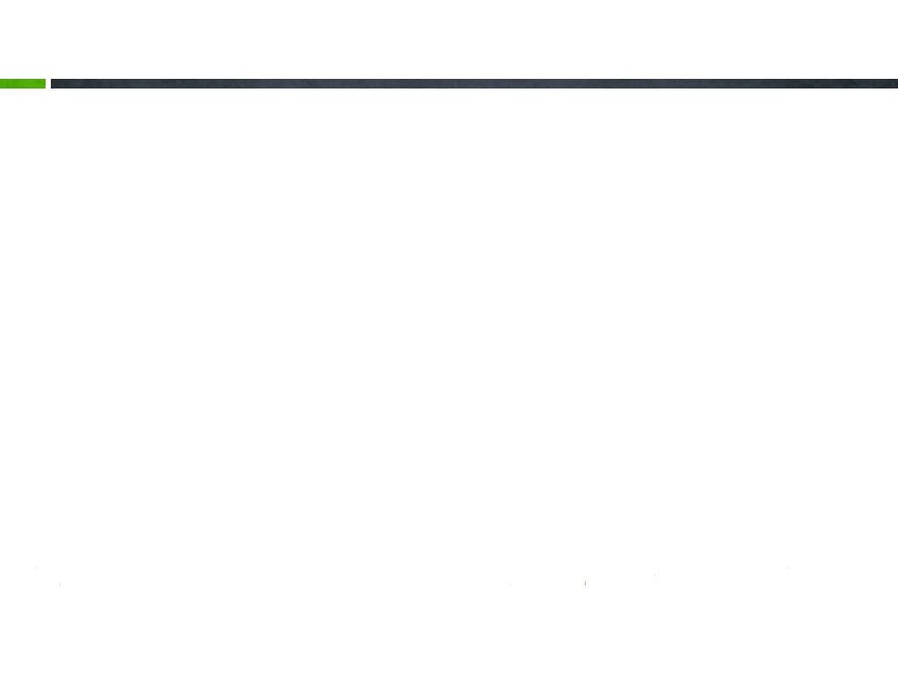

Access Anywhere, Anytime
SKOLMS is a fully Web based solution. No effort, no time and therefore no cost needed for system installation and configuration on your PC’s. A simple click via SKOLMS link and you will start browsing your stock.
SKOLMS is completely compatible with all major browsers like IE 8 and above, Chrome, Firefox and Opera.
SKOLMS use https protocol with 128 bits encryption for secure transactions.

Slide 6

Easy to Use
Its comprehensive and elegant Graphical User Interface (GUI) make it very easy to understand and use.
Training is no longer an issue. Anyone within your company can use it quite easily.

Slide 7

Incredibly Fast
SKOLMS is designed using special and most advanced techniques to provide you with incredibly fast tracking and retrieval of your data.
Slow internet or bandwidth limitation is no longer an issue, SKOLMS neither requires hours to enter your data nor significantly increases your bandwidth consumption.

Slide 8
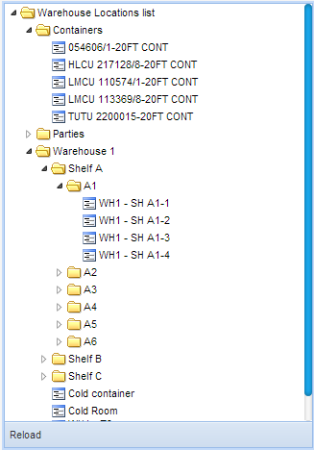
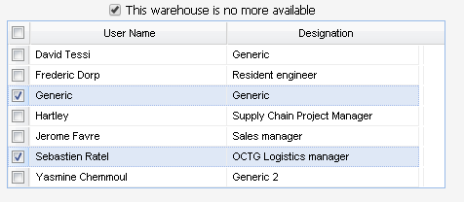
Multi Level Warehouse Structure
One of SKOLMS unique features is the facility to manage as many as desired warehouse structure levels.
SKOLMS also provides you facility to segregate your locations on the basis of their types.
Parent warehouses access by User Name is configured to minimize risk of errors during transactions.

Slide 9
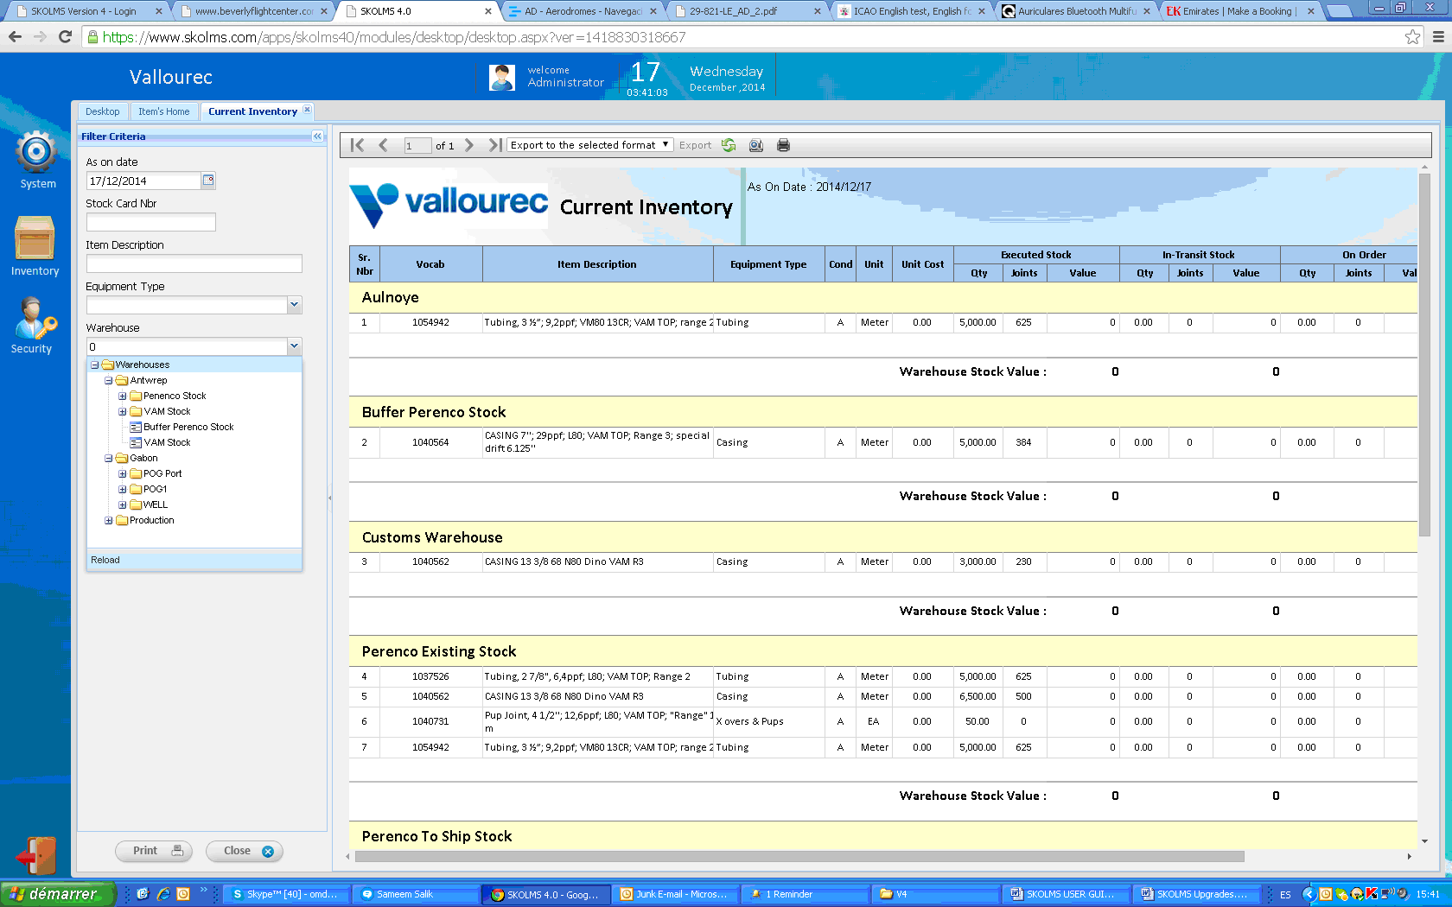
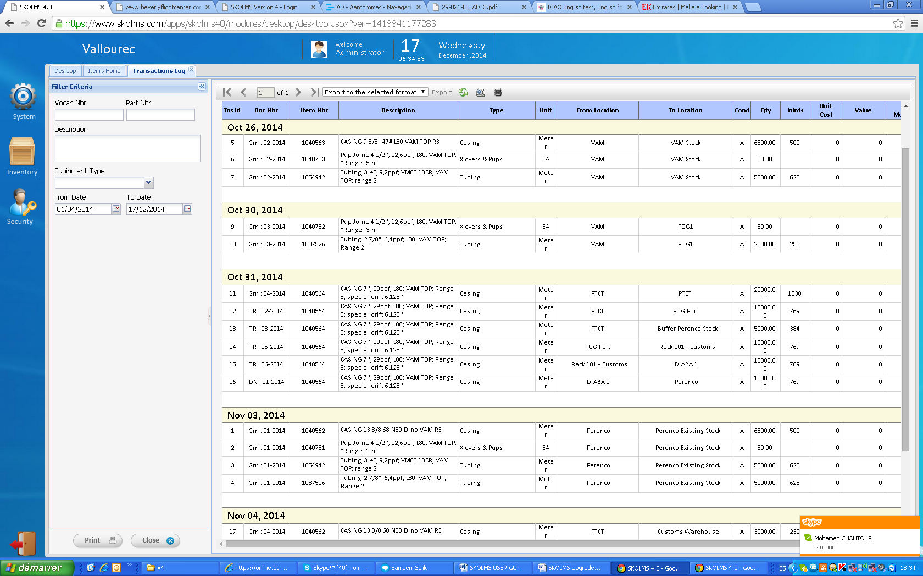
Reports Fit for Clients requirements
Stock by warehouse report generates a stock level report for today’s date or any other selected date.
Transactions Register generates a report with all transactions in the system or to any specific WELL.

Slide 10




Application Modules
SKOLMS 4.0

Slide 11

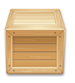

SKOLMS Modules
System Module
This module makes you quite independent. This module works as
the application’s master module where you can insert/modify or remove
your basic level data.
Inventory Module
This module works as a core module of the system as it records all your
stock transactions through Requisitions, Purchase Orders, Goods Receipt Notes, Goods Transfer Notes and Goods Delivery Notes. SKOLMS allows you also to upload all your attachments (invoices, cargo manifest etc) in all recognized formats (PDF, JPG,…).
Security Module
SKOLMS supports unlimited number of users and also simultaneous
working environment along with individual user level program access
feature, which makes the system quite secure.

Slide 12

Collaborative Planning
Collaborative Planning is a module under development to enable clients reducing buffer stocks on each project without taking the risk of going into a shortage.
The Simulation Report consolidate all data from WELLs requirements, Stock levels, Manufactured goods and items in shipment… to display a one (01) year look ahead for each item in the system.

Slide 13



Thank you, any questions?

