Slide 1

BIDXCHANGE · USER TRAINING
From opportunity to reviewed response
A practical walkthrough for your first bid
USER GUIDE / SEPTEMBER 2026
bidxapp.vercel.app
Notes:
Audience: new BidXchange users and team leads. Plan for a 20–25 minute walkthrough plus a 10-minute exercise. This September 21 workflow edition distinguishes existing features from role-controlled approval and submission records. Open https://bidxapp.vercel.app/ before presenting. Explain that BidXchange organizes company evidence, bid review and response drafts. A draft export is not approval or proof of submission.

Slide 2
THE WORKFLOW
Follow one bid through the workspace
01
02
03
Set up Company
Capture and review
Draft and export
Record company details and sources.
Verify current information.
Add the opportunity.
Create a pursuit and its requirements.
Create the response outline.
Complete, review and download it.
One source of company information. A separate review trail for each pursuit.
BIDXCHANGE / USER GUIDE
02 / 23
Notes:
Define an opportunity as the source bid or notice. A pursuit is your team's workspace for assessing and responding to that opportunity. Company facts can be reused, but applicability and proposal-use reviews belong to specific requirements. Use the workflow in this order during the first session.

Slide 3
01 · GET STARTED
Sign in and choose the right workspace
01
02
03
Open the app
Check your company
Know the demo
Go to bidxapp.vercel.app.
Sign in with your own account.
Confirm the selected organization before entering or editing information.
The public demo uses fictional data.
Real response documents require an authorized company workspace.
If your workspace or controls are missing, ask your organization administrator to check access.
BIDXCHANGE / USER GUIDE
03 / 23
Notes:
Do not display credentials while presenting. A signed-in account still needs active organization membership. Never use another person's account to gain a missing control. The demo is useful for navigation, but it is not a live company workspace and does not save company response packages.

Slide 4
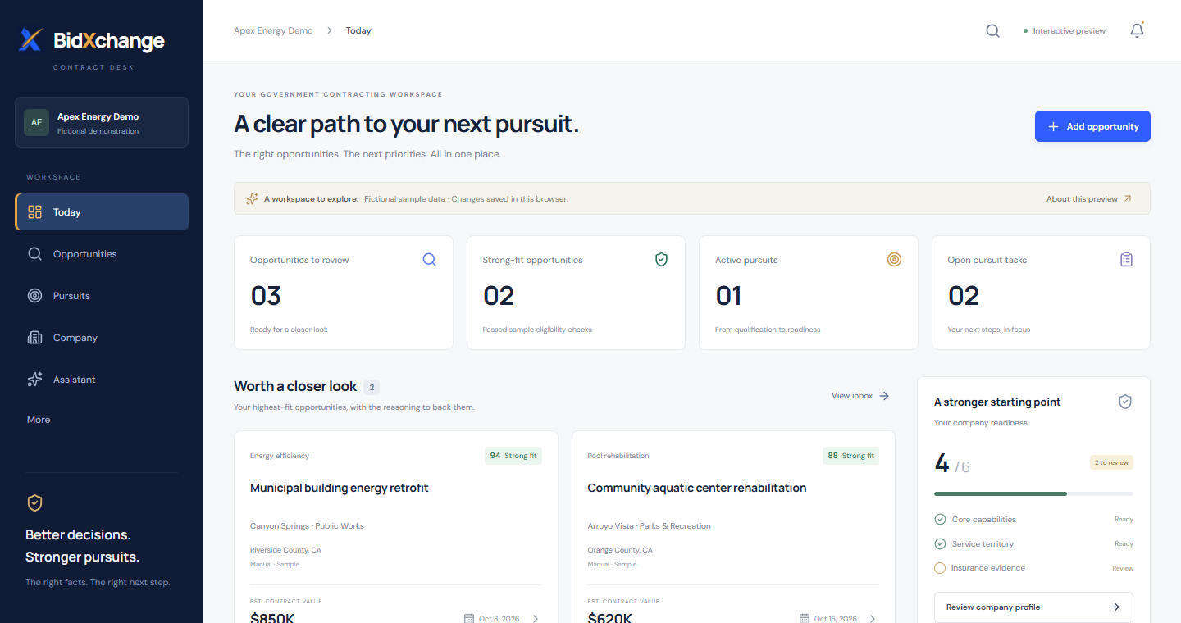
02 · FIND YOUR WAY
Learn the main navigation
Start with these areas
Today: open work and deadlines.
Company: reusable company facts.
Opportunities: source bids.
Pursuits: review and response work.
Assistant: questions and help.
Public demo screenshot · fictional company and sample data
BIDXCHANGE / USER GUIDE
04 / 23
Notes:
Point to the sidebar in the screenshot. In a live workspace, Today provides the task queue. Company is the foundation for document autofill. Opportunities and Pursuits are different stages. Documents, Reports and Settings are also available in navigation; this session focuses on the active bid-to-response workflow. Menu visibility and controls depend on access.

Slide 5
03 · COMPANY SETUP
Complete Company before drafting
01
02
03
Identity and contacts
Business credentials
Source every record
Legal and operating names.
Website, mailing address, phone and business email.
Authorized representative.
Record public identifiers, registrations and NAICS.
Add relevant licenses, capabilities and service areas.
Add an evidence reference.
Set an owner and effective or expiration dates where applicable.
Autofill uses only supported fields and current, verified, shareable facts. Always inspect the generated draft.
BIDXCHANGE / USER GUIDE
05 / 23
Notes:
An administrator manages company records. Use the Company setup prompts, including address, phone and email. Unknown values should remain unknown. UEI/CAGE identifiers can be recorded under registration. Do not paste passwords, tax identifiers or account credentials into shared records. Presence in the profile alone does not establish eligibility for a bid.

Slide 6
03 · COMPANY SETUP
Understand what makes a fact reusable
01
02
03
Capture
Verify
Review its use
Save the known information and source.
New or corrected records need verification.
An administrator verifies the source and dates.
Verification does not establish eligibility for a particular solicitation.
Relevant qualification claims need current approval for the specific pursuit requirement before autofill.
Editing a company record resets its verification. Expired and restricted records do not autofill shared responses.
BIDXCHANGE / USER GUIDE
06 / 23
Notes:
Separate three questions: is the recorded fact supported, may workspace members see it, and does it apply to this requirement? A record can be verified without being approved for proposal use. Basic current verified identity and registration facts populate automatically. Licenses, capabilities and certifications require current applicable evidence-use approval for the pursuit. The workflow never treats a company fact as a whole-document approval. Autofill also excludes role-restricted fact types. Qualifications require current approved proposal use for the specific pursuit. Empty, unsourced, expired and unverified facts do not become claims.

Slide 7
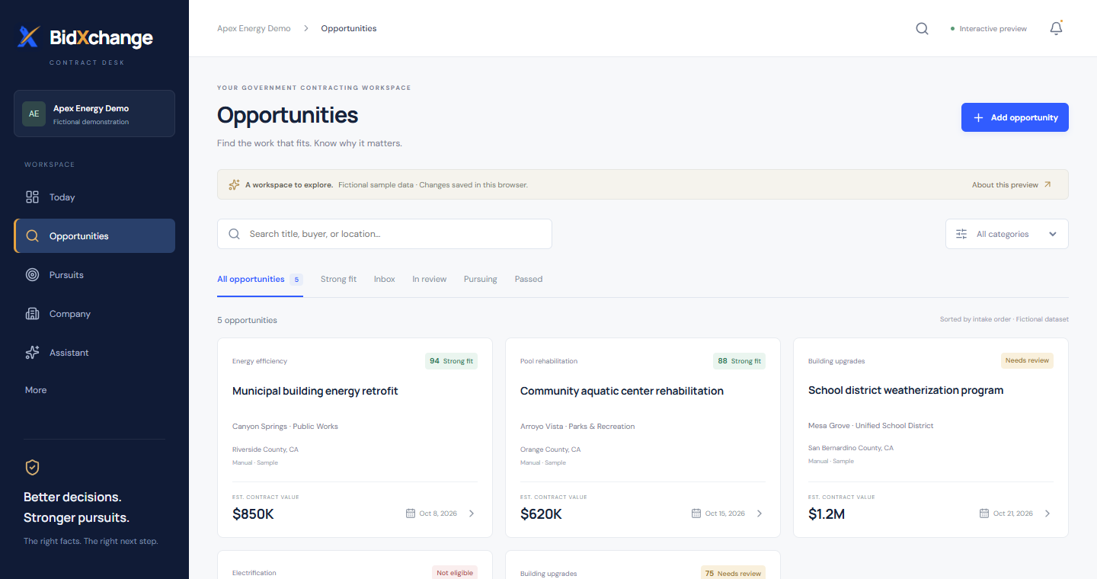
04 · OPPORTUNITIES
Capture the source opportunity
Use Add opportunity
Enter the opportunity title.
Provide a source URL or traceable source note.
Add buyer, solicitation number, scope and official deadline when known.
Save, then open the record.
Public demo screenshot · use the official notice as the source of truth
BIDXCHANGE / USER GUIDE
07 / 23
Notes:
The screenshot illustrates the opportunities area, not a production record. Manual opportunity entry is the reliable path covered by this training. A title and source reference are required. Unknown dates should not be guessed. When entering a deadline, follow the form's explicit-offset and time-zone instructions. Do not claim automatic discovery or continuous SAM.gov synchronization; connector activation is a separate rollout.

Slide 8
05 · PURSUITS
Create a pursuit for the bid
01
02
03
Open the opportunity
Start the workspace
Organize the work
Read the scope, source and deadline.
Check whether a pursuit already exists.
Choose Create planning workspace if needed.
Open the saved pursuit.
Use its requirements, evidence reviews, tasks, decision section and response packages.
Creating a planning workspace keeps the decision pending; it does not authorize a bid.
BIDXCHANGE / USER GUIDE
08 / 23
Notes:
Demonstrate this in an authorized training workspace, not with an unrelated production opportunity. Use the existing pursuit link when one is present to avoid parallel copies of the same work. Capture managers and administrators can create planning workspaces. All subsequent response commands must be issued from the selected pursuit so the assistant knows which bid is intended.

Slide 9
06 · REQUIREMENTS
Turn notice language into requirements
01
02
03
Identify the source
Find and inspect
Save the requirement
Record Notice title and version.
Add the Page or section.
Paste the relevant Source text.
Choose Find possible requirements.
Check each candidate against the full notice and its exceptions.
Confirm the wording and citation.
Assign a requirement owner.
Use Add requirement for anything missed.
The excerpt tool finds candidate lines; it does not certify a complete requirements register.
BIDXCHANGE / USER GUIDE
09 / 23
Notes:
Keep each obligation and its conditions together when pasting. Do not paste restricted company information into public-notice capture. The excerpt stays in the tab, while saved requirement wording and citations become shared workspace records. Review tables, attachments, cross-references and amendments manually. A missing candidate does not mean the notice contains no obligation.

Slide 10
07 · EVIDENCE REVIEW
Connect each requirement to evidence
01
02
03
Choose the evidence
Record the decision
Watch for change
In the requirement, review the relevant saved company record and its source.
Authorized reviewers set Applicability, Proposal use, and Reason and limits.
Approved for this requirement is scoped approval.
Previous approval needs review means reassess the current sources.
A task marked complete or a fact marked verified is not the same as approved proposal use.
BIDXCHANGE / USER GUIDE
10 / 23
Notes:
Administrators and executive approvers perform evidence-use reviews. Capture managers prepare the requirement register and coordinate follow-up. Requirement dispositions and bid intent are separate human decisions. Explain that changes to requirements, facts or dates can invalidate prior review context. Do not use a favorable label to infer pricing approval or submission authority.

Slide 11
08 · TEAM WORK
Assign work and record bid intent
01
02
03
Make follow-up explicit
Use Today
Record the decision
Add a task inside the pursuit.
Assign an active team member.
Set the due date and status.
Check open and overdue work.
Open the linked pursuit to act.
Refresh after completing tasks.
Authorized decision makers choose Pursue bid, Do not bid or Reopen review, with reasons and conditions.
A Pursue bid decision records intent. Final pricing, document approval and submission remain separate.
BIDXCHANGE / USER GUIDE
11 / 23
Notes:
Administrators and capture managers manage pursuit tasks. Administrators and executive approvers record bid/no-bid decisions. The decision is attributed and historical; a changed review context means it needs renewed attention. Task counts and statuses support coordination rather than certification. Keep restricted information out of shared reasons and task text.

Slide 12
09 · ASK BIDXCHANGE
Choose the assistant mode for the job
01
02
03
General questions
Workspace records
Document commands
“Explain how a bid bond works.”
“Help me write a professional follow-up email.”
General answers use no company records.
“Summarize this pursuit.”
“What tasks are overdue?”
Inspect the returned evidence and sources.
Open a pursuit first.
“Create a response outline for this solicitation”
The selected pursuit supplies the document context in either mode.
Questions are answered independently. Include needed context; never enter passwords or API keys.
BIDXCHANGE / USER GUIDE
12 / 23
Notes:
Live AI availability depends on workspace activation and usage limits. The assistant has no live web browsing. Workspace answers use authorized evidence. Document creation is an explicit application action that prepares a saved outline; it does not mean the model wrote a complete proposal. The public demo assistant is separate and cannot create company response records.

Slide 13
10 · CREATE THE DOCUMENT
Ask for a response, then open the draft
“Create a response outline for this solicitation”
01
02
03
Open the pursuit
Send the command
Open the result
Use the assistant within the bid's pursuit workspace.
Supports RFP, RFI, RFQ, bid, sources-sought and capability-statement outlines.
Capture/admin access is required.
Choose Open response workspace.
Find the saved response card and select Edit this draft.
This creates a contractor response outline. The buyer’s solicitation and submission instructions remain authoritative.
BIDXCHANGE / USER GUIDE
13 / 23
Notes:
The exact example command is supported. Also try Draft an RFI response or Prepare an RFQ for the selected pursuit. Without a selected pursuit the app points the user to Pursuits. The resulting outline contains requirement sections and type-specific completion prompts. Narrative and pricing still need qualified human preparation. Repeated transport retries reuse the same creation request rather than overwriting another draft.

Slide 14
11 · AUTOMATIC INFORMATION
Check the information that fills itself
01
02
03
Company
Bid
Preview and correct
Names and website.
Supported verified contact and registration fields.
Approved, shareable qualifications.
Buyer and solicitation.
Saved scope and deadline with time zone.
Notice URL, source references and requirements.
Open Automatically included: company and bid information.
Use Update company information to fix gaps.
Downloads refresh automatic values from current records; your written answers remain as saved.
BIDXCHANGE / USER GUIDE
14 / 23
Notes:
Restricted, expired, unverified and future-effective facts are not copied into shared documents. Basic profile names and website come from workspace settings; sourced company facts have separate verification requirements. Missing information is flagged rather than invented. Existing drafts benefit from current automatic sections, but old manually written narrative can still contain stale values and must be reviewed. Autofill is allowlisted; it is not every company field. Downloaded working drafts refresh permitted values, while frozen release snapshots and external final-file hashes remain immutable.

Slide 15
12 · WRITE AND REVIEW
Finish the draft before downloading
01
02
03
Write and save
Review the saved version
Read it end to end
Choose the response type and draft name.
Complete the overview and each requirement answer.
Save the draft.
Choose Review saved draft.
Inspect missing answers, placeholders and changed wording.
Use the direct edit links.
Open Read complete saved draft.
Check the company information, evidence, answers and internal checklist.
“Answers drafted” measures writing progress. It is not a compliance score or approval.
BIDXCHANGE / USER GUIDE
15 / 23
Notes:
TODO/TBD and bracketed drafting prompts are flagged. Ordinary references like [1] are not treated as placeholders. A written answer whose requirement changed is not counted as drafted against current wording. Review links focus the overview or affected answer. Save edits before relying on the saved preview and downloads. If the app asks for a fresh load after saving, use Open saved response packages.

Slide 16
13 · PDF AND WORD
Export a working copy for review
01
02
03
Save first
Choose the format
Review and hand off
Downloads use saved answers.
Finish the latest edit and open the saved response card.
Download saved draft PDF for a stable review copy.
Download saved draft Word for further editing.
Check the Draft markings and internal checklist.
Obtain the required approvals and follow the buyer's submission instructions.
Word edits do not sync back into BidXchange. A download does not submit anything to the buyer.
BIDXCHANGE / USER GUIDE
16 / 23
Notes:
Exports include an internal review checklist and are not automatically buyer-ready. Keep the saved application draft current if changes made in Word should be reflected there. PDF may reject unsupported glyphs; Word is the alternative. Later source changes do not update files already downloaded. BidXchange does not currently perform final document approval, electronic signature or procurement-portal submission for this workflow.

Slide 17
16 · REVIEW WORKFLOW
Read readiness without assuming approval
01
02
03
Review the saved records
Prepare a version
Know the state
Check sources, deadline and timezone.
Resolve cited requirements, evidence gaps, missing owners and stale answers.
Complete the submission checklist.
Unknown and missing items block approval.
Review final files and calculate their hashes.
Not ready → Needs review → internal review → final approval → authorized → submitted.
A count is not a compliance score.
Versioned approvals and submission recording require environment activation. Disabled controls explain what is unavailable.
BIDXCHANGE / USER GUIDE
17 / 23
Notes:
Availability: the release workflow is enabled for authenticated production workspaces, subject to role permissions. States are determined by records; they do not necessarily occur in this order. Needs review means a frozen context changed. Submitted means a human recorded submission; it does not verify buyer receipt. Sources may have obligations absent from the local register. Unknown forms, signatures or file limits cannot silently pass.

Slide 18
17 · HUMAN APPROVALS
Approve the exact response version
01
02
03
Pricing and compliance
Final and submission
If anything changes
Estimator, administrator or executive: pricing.
Administrator or executive: compliance.
Administrator or executive: final response approval, then submission authorization.
Record rationale and conditions.
Changed response, checklist, source or role requires fresh review.
Replacing an approval invalidates later gates.
Approvals are attributed review records. They are not legal signatures, buyer acceptance or automatic submission.
BIDXCHANGE / USER GUIDE
18 / 23
Notes:
Available only where versioned release workflow is activated. Every approval binds an immutable response snapshot, current source context and SHA-256 file manifest. A new upstream decision invalidates downstream decisions even if the upstream decision again says approved. Current implementation uses a UTC-day review boundary; next-day recording may require fresh review. The same authorized reviewer can perform multiple gates; no four-person separation of duties is enforced.

Slide 19
18 · SUBMISSION
Hand off, submit manually, keep the receipt
01
02
03
Export the handoff
Named human submits
Record what happened
Download the internal JSON packet.
Check the frozen version, checklist, approvers and final-file hashes.
Keep files in your approved storage.
Use the official buyer portal or delivery channel yourself.
Check file names, format, signatures, limits and deadline.
Confirm exact submitted files.
Record time, method, confirmation and receipt reference.
Append corrections or resubmissions.
File bytes and portal credentials stay outside this workflow. A receipt reference is a human report, not verified delivery.
BIDXCHANGE / USER GUIDE
19 / 23
Notes:
The workflow is enabled for authenticated workspaces with the required roles. The handoff is JSON and includes bounded immutable history, not file attachments. Hashing occurs in the browser, without uploading selected files. Submission requires explicit confirmation by the named active submitter after current authorization. If a receipt is unavailable, record that limitation. Append corrections; never overwrite original history. Recording after the deadline or a UTC review-date change is conservatively blocked unless recording a correction to an already recorded submission. Follow-up events support questions, clarifications, interviews, best-and-final-offer requests, award/loss/cancellation, debriefs and lessons learned.

Slide 20
19 · WORKSPACE GUIDE
Use help without adding another dashboard
01
02
03
Getting started
One next action
Reopen when needed
Open the optional 12-step guide.
Progress reflects visible saved records, not page visits.
Dismiss it when familiar.
Review the suggested action.
Deadline and unresolved review work come first.
Links open the exact record.
Choose Workspace guide in secondary navigation.
Read role restrictions and feature status.
Use HTML or PDF help.
Primary navigation stays Today, Opportunities, Pursuits, Company and Assistant.
BIDXCHANGE / USER GUIDE
20 / 23
Notes:
Guidance is optional and does not create records or grant permissions. Records and counts are scoped to the organization, current role and loaded pursuit. Global lists are bounded samples; a guide cannot certify an entire company or a complete solicitation. The HTML guide is the accessible reading alternative; the PDF uses tagged text but is not certified PDF/UA.

Slide 21
14 · ACCESS AND HANDOFFS
Know who owns the next action
01
02
03
Administrator
Capture manager
Executive / other members
Manage company records and access.
Capture bids and responses.
Perform authorized evidence and bid reviews.
Add opportunities and requirements.
Manage pursuit tasks.
Create, edit and export response drafts.
Executive approvers review evidence use and bid intent.
Other members work within assigned permissions; readers can inspect shared drafts.
If a control is absent, check your role and workspace. Access to a page does not grant authority to approve.
BIDXCHANGE / USER GUIDE
21 / 23
Notes:
This is a workflow-oriented role summary, not a promise of unrestricted access. Visibility depends on organization membership, classification and record policies. Restricted company facts are not made public by including a document in a shared workspace. Users who can read shared response packages can review/export them, while creating and editing drafts requires capture or administrator permission.

Slide 22
15 · TROUBLESHOOTING
Resolve the common stopping points
01
02
03
Information missing?
Source changed?
Assistant or export unavailable?
Complete Company and source fields.
Verify sourced records.
Review qualification use for the specific requirement.
Reload the pursuit.
Compare the new wording and evidence.
Reconcile retained answers and save again.
Check access and workspace activation.
Wait if a usage limit is reached.
For a PDF glyph error, try Word.
Do not recreate records blindly after a failure. Check whether the draft or pursuit already saved.
BIDXCHANGE / USER GUIDE
22 / 23
Notes:
If an export reports changed company or bid information, reload and retry after reviewing the change. Large or incomplete source registers can prevent export and should be reviewed by a capture manager. An unavailable feature may be permission- or rollout-dependent. Source PDF upload/extraction, scanner-backed attachments and automatic portal submission are not prerequisites for the manual workflow taught here and should not be presented as live automation.

Slide 23
16 · GUIDED EXERCISE
Practice once, then make it routine
01
02
03
Practice · 10 minutes
Build the response
Daily rhythm
Use an authorized training workspace.
Add a clearly labeled practice opportunity and source note.
Create its planning workspace.
Add two cited requirements and one task.
Ask for a response outline.
Replace placeholders, save and inspect the review.
Start in Today.
Review upcoming deadlines and changed sources.
Finish assigned work, then save and review the response.
Your first milestone: one traceable, saved response draft that another team member can review.
BIDXCHANGE / USER GUIDE
23 / 23
Notes:
Use synthetic information and label the record Training — not for submission. Do not invent an official citation; for this exercise cite the training brief and its numbered items. Have the trainee demonstrate the difference between missing data, verified evidence and approved use. Export a PDF or Word draft and identify its internal checklist. Coordinate cleanup of training records with the administrator. End by opening https://bidxapp.vercel.app/ and showing where the next real task will begin.

