Slide 1
Random Field Theory
Methods for Dummies 2009
Lea Firmin and Anna Jafarpour

Slide 2
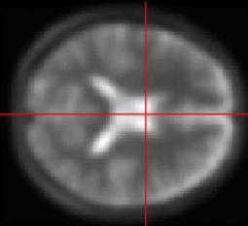
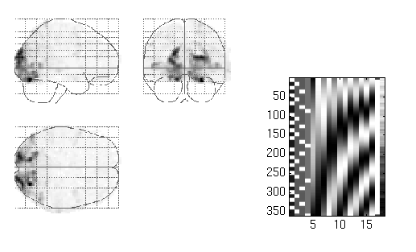
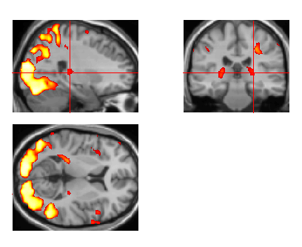
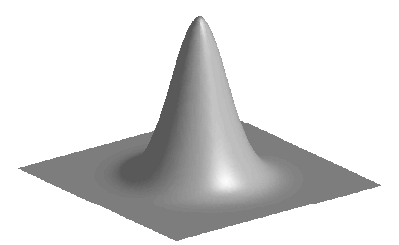
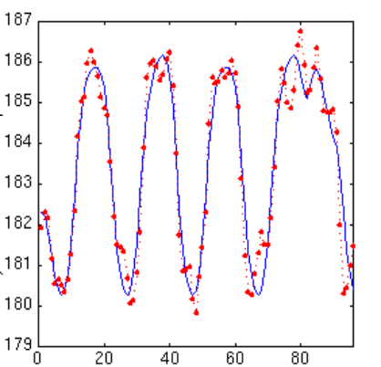
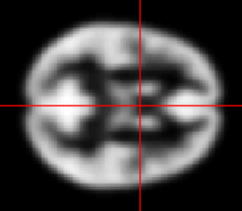
Image time-series
Spatial filter
Design matrix
Statistical Parametric Map
Realignment
Smoothing
General Linear Model
Statistical
Inference
RFT
Normalisation
Anatomical
reference
p <0.05
Parameter estimates
18/11/2009
RFT for dummies - Part I

Slide 3
Overview
What‘s this all about?
  Hypothesis testing
  Multiple comparison
First approach: Bonferroni correction
Problem: non-independent samples…
Improved approach: random field theory
Implementation in SPM8
18/11/2009
RFT for dummies - Part I
Notes:
We want to know if and where a significant activation or change in response to our experimental paradigm has occurred. Thus, we need to come up with some hypothesis and test it. As we are actually going through this process for every single voxel on our image, this brings us into the trouble of multiple comparison.

Slide 4
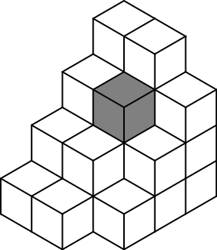
Single Voxel Level
A voxel (volumetric pixel) represents
  a value (BOLD signal, density)
  a location
on a regular grid in 3D space
Brain: tens of thousands…
18/11/2009
RFT for dummies - Part I

Slide 5
Single Voxel Level
Does the value of a specific voxel significantly differ from its value assumed under H₀?
Significant difference gives us
localizing and discriminatory
power
18/11/2009
RFT for dummies - Part I

Slide 6
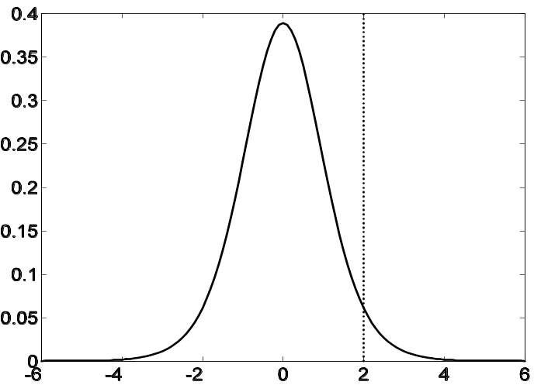
Single Voxel Level: Statistics
H₀ = (data randomly distributed, Gaussian distribution of noise, data variance pure noise)
Reject if: P(H₀) < α
α = P(type I error)
= P(t-value > t-value|H₀)
set t-value (thresholding)
18/11/2009
RFT for dummies - Part I
Notes:
We can make statistical inference via the rejection of a null hypothesis. Our null hypothesis is the following:
We reject it if we are pretty certain that it is false, usually we decided to reject it if the probability that our sample just comes from a null distribution is less than 5%.

Slide 7
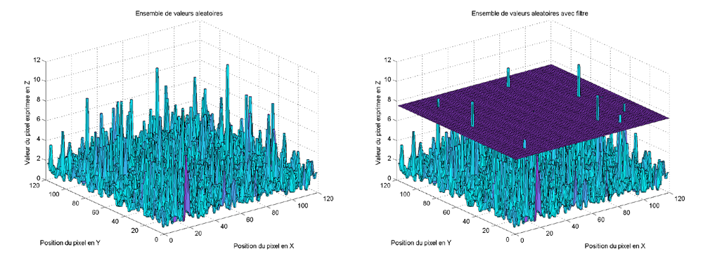
Threshold
Value above which a result is unlikely to have arisen by chance
High threshold: good specificity (few false positives), but risk of false negatives
Low threshold: good sensitivity (few false negatives), but risk of false positives
18/11/2009
RFT for dummies - Part I

Slide 8
Many voxels, many statistic values!
„If we do not know, where in the brain an effect occurs, our hypothesis refers to the whole volume of statistics in the brain.“
Single voxel level: α = P(t > t | H₀) usually 0.05
Family of 1000 voxels: expect 50 false positives at threshold t_{v}
H₀ can only be rejected if the whole observed volume of voxels is unlikely to have arisen from a null distribution, i.e. if no t-value above threshold is found
Required: threshold that can control family-wise error
18/11/2009
RFT for dummies - Part I

Slide 9
Multiple Comparison
Occurs when one considers a family of statistical inferences simultaneously (across voxels)
Also if multiple hypothesis are tested at each voxel (across contrasts)
Hypothesis tests that incorrectly reject the H₀ are more likely to occur, i.e. significant differences are more often accepted even if there are none (increase in type I error)
18/11/2009
RFT for dummies - Part I
Notes:
Explain z-score

Slide 10
Family-wise Error Rate
α = P(type I error at single voxel)
1 - α = P(no type I error single voxel)
for > 1 voxel: … P(A∩B) = P(A)×P(B) …
(1 - α)^{n} = P(no type I error at any voxel within the family)
1 - (1- α)^{n} = P(type error at any voxel within the family)
= P^{FWE}
where n = number of comparisons (voxels)
P^{FWE} > α → need for correction!
18/11/2009
RFT for dummies - Part I

Slide 11
Bonferroni Correction
For small α, P^{FWE} = 1 - (1- α)^{n} simplifies to
P^{FWE} ≤ n · α
(binomial expansion)
new α for single voxel level in order to get requested P^{FWE} :
α = P^{FWE} / n
18/11/2009
RFT for dummies - Part I
Notes:
If you perform n tests, each of them significant at a level of alpha, then the probability that at least one of them comes out significant is ≤ n times alpha

Slide 12
Problem
Fewer independent values in the statistic volume than there are voxels due to spatial correlation
Bonferroni correction thus too conservative α = P^{FWE} / n
remember: if α small, H₀ is more difficult to reject
18/11/2009
RFT for dummies - Part I

Slide 13
Spatial Correlation
Spatial preprocessing
  Realignment of images for an individual subject to correct for motion
  Normalize a subject‘s brain to a template to compare between subjects
Spatially extended nature of the hemodynamic response
Smoothing
18/11/2009
RFT for dummies - Part I

Slide 14
Smoothing
Averaging over one voxel and its neighbours (→ reduction of independent observations)
Usually weighted average using a (Gaussian) smoothing kernel
18/11/2009
RFT for dummies - Part I

Slide 15
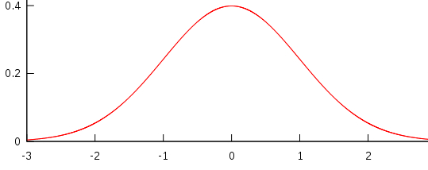
Smoothing kernel
FWHM
(Full Width at Half Maximum)
18/11/2009
RFT for dummies - Part I
Notes:
Smoothing: Each voxel`s new value is set to an average of itself and that voxels it`s neighborhood
The original pixel's value receives the heaviest weight and neighbouring pixels receive smaller weights as their distance to the original pixel increases.
Kernel defines the shape of the function that is used to take the average of the neighbouring points.
FWHM: measure to describe the width of the kernel, also used as a measure for the smoothness of a picture

Slide 16
How many independent observations?
no simple way to calculate
Bonferroni correction cannot be used
18/11/2009
RFT for dummies - Part I

Slide 17
Random Field Theory
Part II
Anna Jafarpour
18/11/2009
RFT for dummies - Part II
18/10/2009

Slide 18
Introduction
Random field theory (RFT) is a recent body of mathematics defining theoretical results for smooth statistical maps [1].
Random field is a list of random numbers whose values are mapped onto a space (of n dimensions). Values in a random field are usually spatially correlated in one way or another, in its most basic form this might mean that adjacent values do not differ as much as values that are further apart [2].
[1] Brett M., Penny W. and Keibel S. (2003) Human Brain Mapping. Chapter 14: An introduction to Random Field Theory.
[2] http://en.wikipedia.org/wiki/Random_field
18/11/2009
RFT for dummies - Part II
18/10/2009

Slide 19
Why we need RFT
aim
Correction of FEW means to control the probability of it.
Random field has the characteristic of data under Null Hypothesis.
  NULL hypothesis says :
  all activations were merely driven by chance
  each voxel value has a random number
18/11/2009
RFT for dummies - Part II
18/10/2009

Slide 20
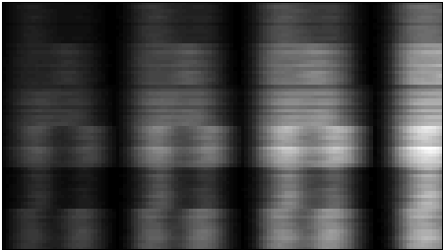
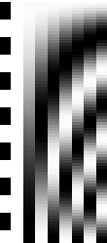

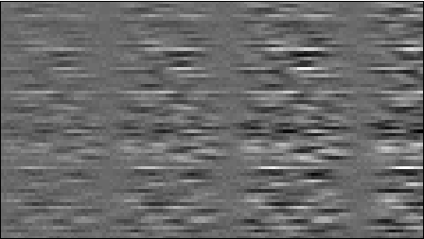

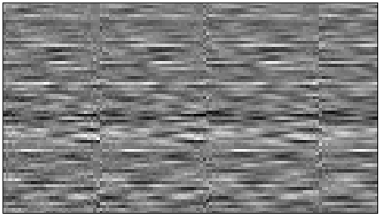
Estimated component fields
voxels
=
×
?
+
?
parameters
errors
scans
^
β
data matrix
design matrix
parameter
estimates
estimate
➲
➲
residuals
÷
=
estimated variance
Each row is
an estimated
component field
estimated
component
fields
18/11/2009
RFT for dummies - Part II

Slide 21
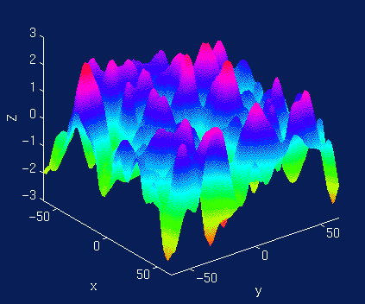
Random field and type 1 error
Let’s assume that there is no signal in the tested data. Then the error should be a random field. Now we try to find a proper threshold for it, which let us reject the null hypothesis erroneously with probability of α.
Random field and our data has properties in common:
We usually do not know the extent of spatial correlation in the underlying data before smoothing.
If we do not know the smoothness, we don’t worry!
It can be calculated using the observed spatial correlation in the images.
Let’s assume that the estimated
component fields is a random field:
18/11/2009
RFT for dummies - Part II
18/10/2009

Slide 22
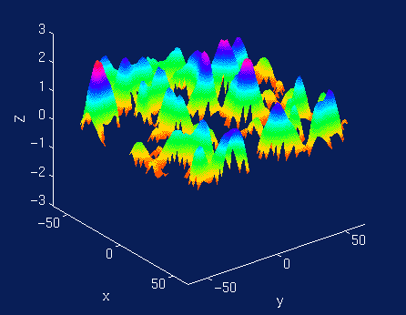
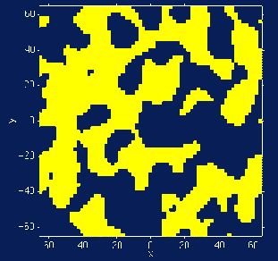
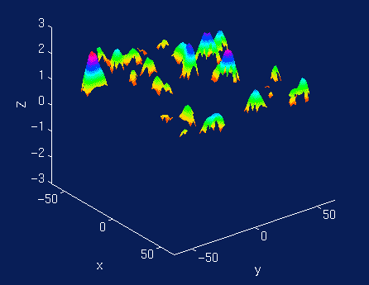
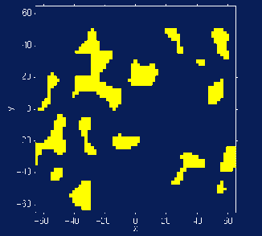
Euler characteristic (EC) helps
The Euler characteristic is a property of an image after it has been thresholded.
For our purposes, the EC can be thought of as the number of blobs in an image after thresholding.
Threshold: z = 0
Threshold: z =1
18/11/2009
RFT for dummies - Part II
18/10/2009

Slide 23
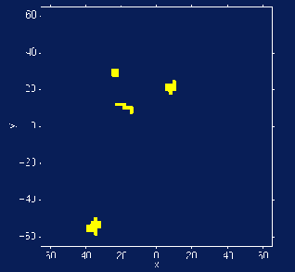

the average or expected EC: E[EC]
E [EC], corresponds (approximately) to the probability of finding an above threshold blob in our statistic image.
1
EC= 3
2
EC= 0
3
Threshold =3 (?)
EC= 2
m
EC= 4
E[EC]=
The probability of getting a z-score > threshold by chance
18/11/2009
RFT for dummies - Part II
18/10/2009

Slide 24

E[EC] = α
E[EC] is
  = The probability of getting a z-score > threshold by chance
  = probability of rejecting the null hypothesis erroneously (α)
We need thresholding the random field at E[EC] < 0.05 (α-level) for correction
Which Z-score has such E[EC] ?
  RFT calculates that!
  The result will be our threshold (the score) and any z-scores above that will be significant.
18/11/2009
RFT for dummies - Part II
18/10/2009

Slide 25
RFT calculates
  α = E[EC] = R (4 ln 2) (2π) ^{-3/2} z exp(-z²/2)
E[EC] depends on:
  z Chosen threshold z-score
  R Volume of search region
  R Spatial extent of correlation among values in the field; (it is described by FWHM)
What is R?
  R is the “ReSels”.
  “ReSel” is number of “resolution elements” in the statistical map. (SPM calculates it ☺)
18/11/2009
RFT for dummies - Part II
18/10/2009

Slide 26
SPM8 and RFT
18/11/2009
RFT for dummies - Part II
18/10/2009

Slide 27
Summery of FWE correction by RFT
RFT stages on SPM:
First SPM estimates the smoothness (spatial correlation) of our statistical map.
R is calculated and saved in RPV.img file.
Then it uses the smoothness values in the appropriate RFT equation, to give the expected EC at different thresholds.
This allows us to calculate the threshold at which we would expect 5% of equivalent statistical maps arising under the null hypothesis to contain at least one area above threshold.
18/11/2009
RFT for dummies - Part II
18/10/2009

Slide 28
SPM8 and RFT
We can use FWE correction in different ways on SPM8 [1]
  Using FWE correction on SPM, calculates the threshold over the whole brain image. We can specify the area of interest by masking the rest of the brain when we do the second level statistic analysis.
  Using uncorrected threshold, none, (usually p= 0.001). Then correcting for the area we specify. (Small Volume Correction (SVC))
[1] SPM manual, http://www.fil.ion.ucl.ac.uk/spm/doc/
18/11/2009
RFT for dummies - Part II
18/10/2009

Slide 29
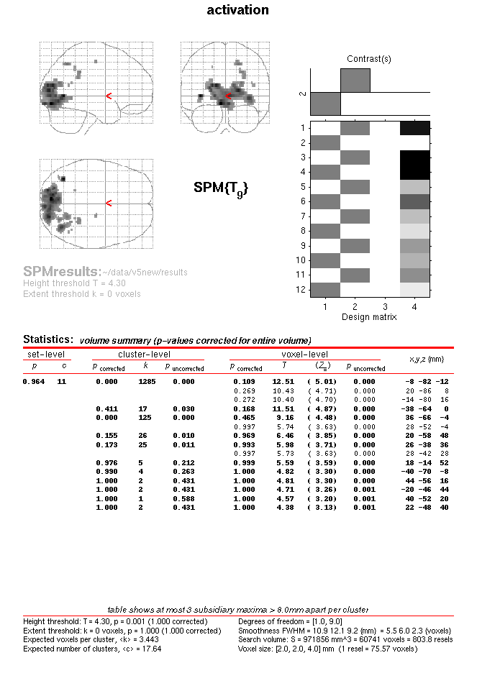
Example
18/11/2009
RFT for dummies - Part II
18/10/2009

Slide 30
18/11/2009
RFT for dummies - Part II
18/10/2009

Slide 31
Acknowledgement
The topic expert:
  Dr. Will Penny
The organisers:
  Maria Joao Rosa
  Antoinette Nicolle
Method for Dummies 2009
18/11/2009
RFT for dummies - Part II

Slide 32
Thank you ☺
18/11/2009
RFT for dummies - Part II
18/10/2009

