Slide 1
Games and Adversarial Search

Slide 2

Games: Outline of Unit
Part 1: Games as Search
Motivation
Game-playing AI successes
Game Trees
Evaluation Functions
Part II: Adversarial Search
The Minimax Rule
Alpha-Beta Pruning
CIS 421/521 | 2
Notes:
.

Slide 3
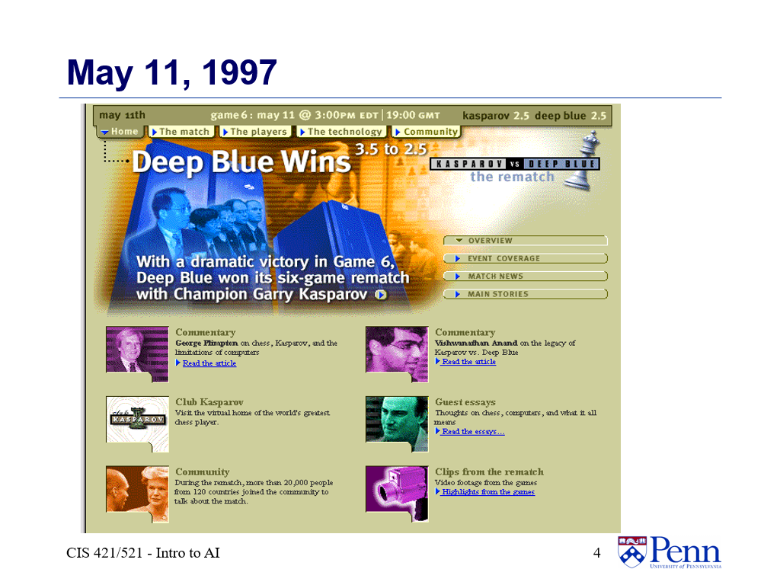
May 11, 1997
CIS 421/521 | 3
Notes:
.

Slide 4
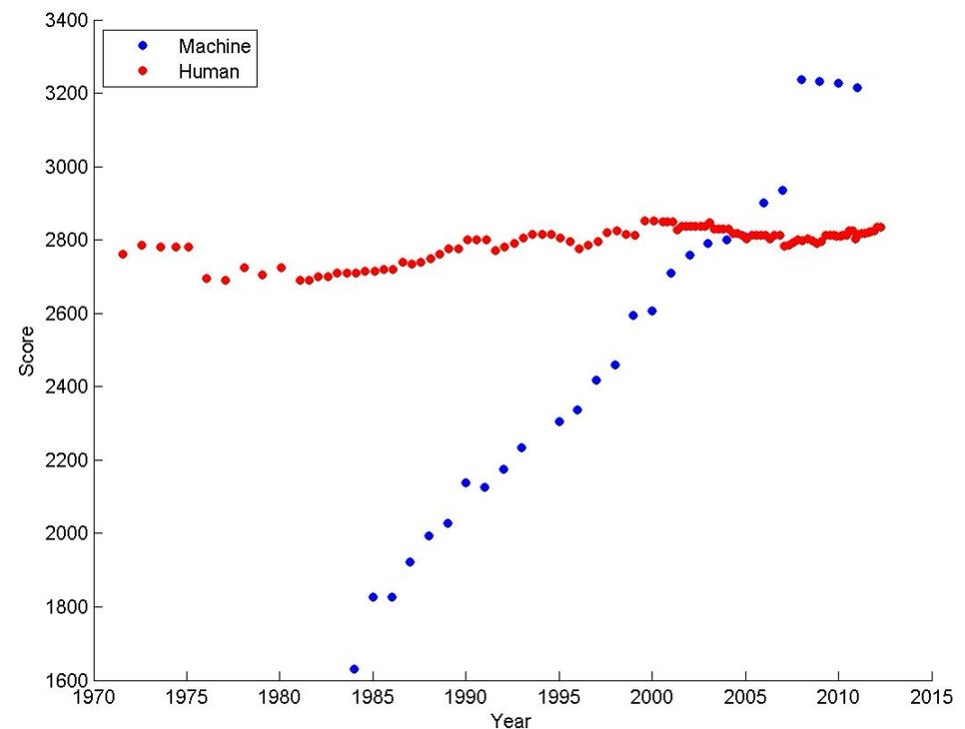
Ratings of human and computer chess champions
https://srconstantin.wordpress.com/2017/01/28/performance-trends-in-ai/
CIS 421/521 | 4
Notes:
.

Slide 5

May 11, 1997
Callout box
Bulleted list
Bulleted list level 2
Content font: Open Sans Size 20
Heading font: Open Sans Bold 34
Code block: Roboto Mono Size 20 with Gray background
Colors: Purple Yellow Cyan (accent) Light gray (background)
Callout box
CIS 421/521 | 5
Notes:
.

Slide 6
The Simplest Game Environment
Multiagent
Static: No change while an agent is deliberating.
Discrete: A finite set of percepts and actions.
Fully observable: An agent's sensors give it the complete state of the environment.
Strategic: The next state is determined by the current state and the action executed by the agent and the actions of one other agent.
CIS 421/521 | 7
Notes:
.

Slide 7
Key properties of our games
Two players alternate moves
Zero-sum: one player’s loss is another’s gain
Clear set of legal moves
Well-defined outcomes (e.g. win, lose, draw)
Examples:
Chess, Checkers, Go,
Mancala, Tic-Tac-Toe, Othello …
CIS 421/521 | 7
Notes:
.

Slide 8
More complicated games
Most card games (e.g. Hearts, Bridge, etc.) and Scrabble
Stochastic, not deterministic
Not fully observable: lacking in perfect information
Real-time strategy games, e.g. Warcraft
Continuous rather than discrete
No pause between actions, don’t take turns
Cooperative games
CIS 421/521 | 8
Notes:
.

Slide 9
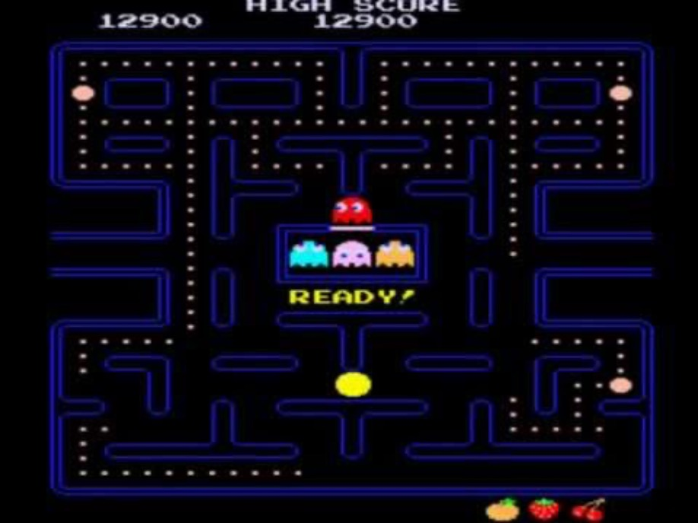
Pac-Man
https://youtu.be/-CbyAk3Sn9I
CIS 421/521 | 9
Notes:
.

Slide 10
Formalizing the Game setup
Two players: MAX and MIN; MAX moves first.
MAX and MIN take turns until the game is over.
Winner gets award, loser gets penalty.
Games as search:
Initial state: e.g. board configuration of chess
Successor function: list of (move,state) pairs specifying legal moves.
Terminal test: Is the game finished?
Utility function: Gives numerical value of terminal states. e.g. win (+∞), lose (-∞) and draw (0)
MAX uses search tree to determine next move.
CIS 421/521 | 10
Notes:
.

Slide 11
How to Play a Game by Searching
General Scheme
Consider all legal successors to the current state (‘board position’)
Evaluate each successor board position
Pick the move which leads to the best board position.
After your opponent moves, repeat.
Design issues
Representing the ‘board’
Representing legal next boards
Evaluating positions
Looking ahead
CIS 421/521 | 11
Notes:
.

Slide 12
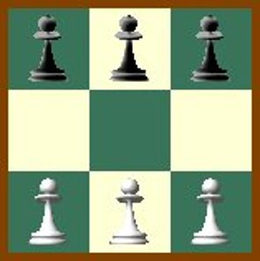
Hexapawn: A very simple Game
Hexapawn is played on a 3x3 chessboard
Only standard pawn moves:
A pawn moves forward one square onto an empty square
A pawn “captures” an opponent pawn by moving diagonally forward one square, if that square contains an opposing pawn. The opposing pawn is removed from the board.
CIS 421/521 | 12
Notes:
.

Slide 13
Hexapawn: A very simple Game
Hexapawn is played on a 3x3 chessboard
Player P₁ wins the game against P₂ when:
One of P₁’s pawns reaches the far side of the board, or
P₂ cannot move because no legal move is possible.
P₂ has no pawns left.
(Invented by Martin Gardner in 1962, with learning “program” using match boxes. Reprinted in “The Unexpected Hanging..)
CIS 421/521 | 13
Notes:
.

Slide 14
Hexapawn: Three Possible First Moves
⬤ | ⬤ | ⬤​
​ | ​ | ​
⬤​ | ⬤ | ⬤​
White moves​
⬤ | ⬤​ | ⬤​
⬤​ | ​ | ​
 | ⬤​ | ⬤​
⬤​ | ⬤​ | ⬤​
​ | ⬤​ | ​
⬤ | ​ | ⬤​
⬤​ | ⬤ | ⬤
​ | ​ | ⬤​
⬤​ | ⬤​ | ​
CIS 421/521 | 14
Notes:
.

Slide 15
Game Trees
Represent the game problem space by a tree:
Nodes represent ‘board positions’; edges represent legal moves.
Root node is the first position in which a decision must be made.
CIS 421/521 | 15
Notes:
.

Slide 16
Hexapawn: Simplified Game Tree for 2 Moves
⬤ | ⬤ | ⬤​
​ | ​ | ​
⬤​ | ⬤ | ⬤​
White to move​
⬤ | ⬤​ | ⬤​
⬤​ | ​ | ​
 | ⬤​ | ⬤​
⬤​ | ⬤​ | ⬤​
​ | ⬤​ | ​
⬤ | ​ | ⬤​
⬤​ | ⬤ | ⬤
​ | ​ | ⬤​
⬤​ | ⬤​ | ​
Black to move​
⬤
⬤
⬤
⬤ | ​ | ⬤​
⬤​ | ​ | ​
 | ⬤​ | ⬤​
⬤ |  | ⬤​
⬤​ | ⬤​ | ​
 | ⬤​ | ⬤​
⬤ | ⬤​ | ​
⬤​ | ​ | ​⬤
 | ⬤​ | ⬤​
​ | ⬤​ | ⬤​
​⬤ | ⬤​ | ​
⬤ | ​ | ⬤​
 | ⬤​ | ⬤​
​ | ⬤ | ​
⬤ | ​ | ⬤​
⬤ | ⬤​ | ​
​ | ⬤ | ​
⬤ | ​ | ⬤​
⬤​ | ⬤ | ⬤
​ | ⬤​ | ⬤​
⬤​ | ⬤​ | ​
White ​ to move​
CIS 421/521 | 16
Notes:
.

Slide 17
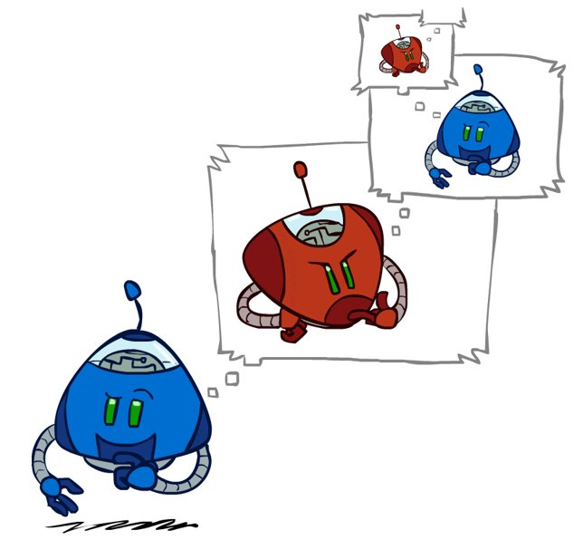
Adversarial Search
CIS 421/521 | 17
Notes:
.

Slide 18
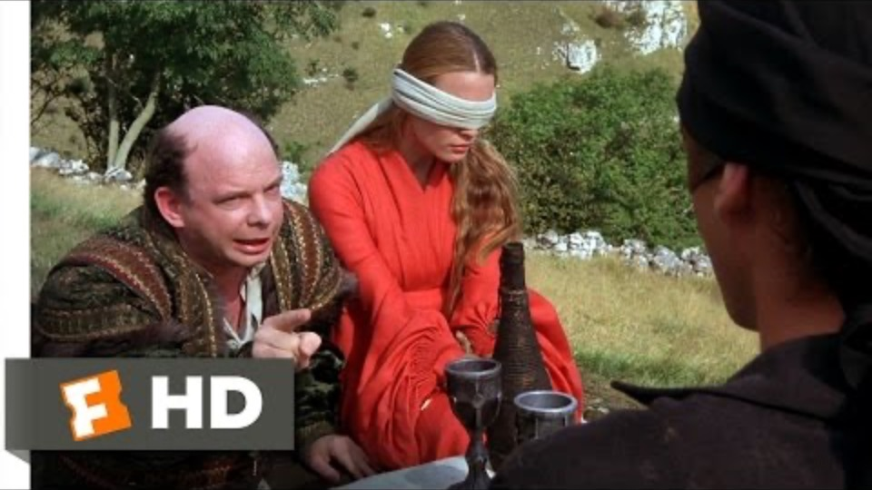
Battle of Wits
https://www.youtube.com/watch?v=rMz7JBRbmNo
CIS 421/521 | 18
Notes:
.

Slide 19
MAX & MIN Nodes : An egocentric view
Two players: MAX, MAX’s opponent MIN
All play is computed from MAX’s vantage point.
When MAX moves, MAX attempts to MAXimize MAX’s outcome.
When MAX’s opponent moves, they attempt to MINimize MAX’s outcome.
WE TYPICALLY ASSUME MAX MOVES FIRST:
Label the root (level 0) MAX
Alternate MAX/MIN labels at each successive tree level (ply).
Even levels represent turns for MAX
Odd levels represent turns for MIN
CIS 421/521 | 19
Notes:
.

Slide 20
Game Trees
Represent the game problem space by a tree:
Nodes represent ‘board positions’; edges represent legal moves.
Root node is the first position in which a decision must be made.
Evaluation function f assigns real-number scores to `board positions’ without reference to path
Terminal nodes represent ways the game could end, labeled with the desirability of that ending (e.g. win/lose/draw or a numerical score)
CIS 421/521 | 20
Notes:
.

Slide 21
Evaluation functions: f(n)
Evaluates how good a ‘board position’ is
Based on static features of that board alone
Zero-sum assumption lets us use one function to describe goodness for both players.
f(n)>0 if MAX is winning in position n
f(n)=0 if position n is tied
f(n)<0 if MIN is winning in position n
Build using expert knowledge,
Tic-tac-toe: f(n)=(# of 3 lengths open for MAX)- (# open for MIN)
CIS 421/521 | 21
Notes:
.

Slide 22
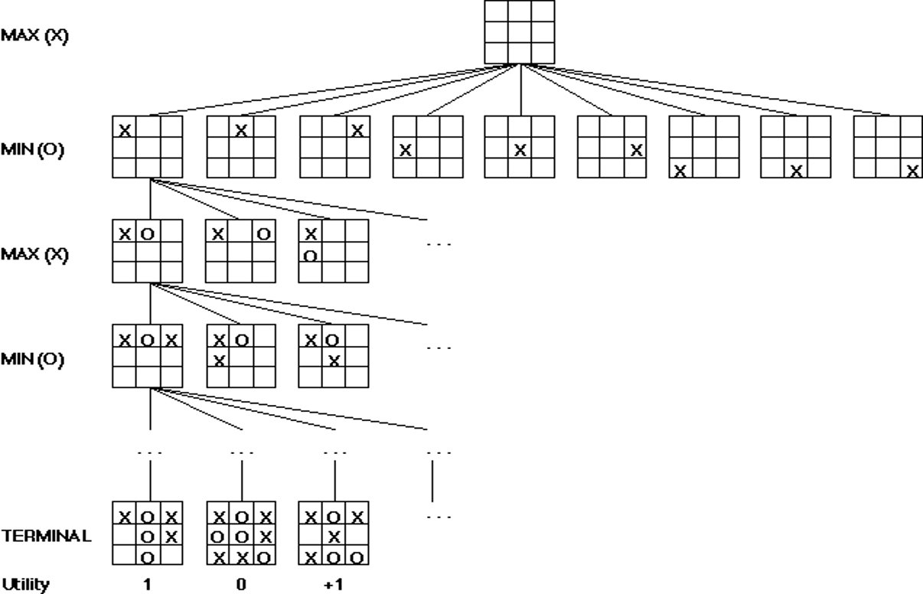
A Partial Game Tree for Tic-Tac-Toe
f(n)=# of potential three-lines for X –
# of potential three-line for O
f(n)=0 if n is a terminal tie
f(n)=+ ∞ if n is a terminal win
f(n)=- ∞ if n is a terminal loss
f(n)=8-5=3​
f(n)=2​
f(n)=3​
f(n)=2​
f(n)=4​
f(n)=2​
f(n)=3​
f(n)=2​
f(n)=3​
f(n)=6-5=1​
f(n)=0​
f(n)=1​
f(n)=6-3=3​
f(n)=6-4=2​
f(n)=6-2=4​
f(n)=# of potential three-lines for X –​
# of potential three-line for O ​
​
f(n)=0 if n is a terminal tie​
f(n)=+ ∞ if n is a terminal win​
f(n)=- ∞ if n is a terminal loss​
-∞​
​
0​
+ ∞​
CIS 421/521 | 22
Notes:
.

Slide 23

Chess Evaluation Functions
Claude Shannon argued for a chess evaluation function in a 1950 paper
Alan Turing defined function in 1948: f(n)=(sum of A’s piece values) -(sum of B’s piece values)
More complex: weighted sum of positional features:
Σ w_{i} feature_{i}(n)
Deep Blue had >8000 features
Pawn​ | 1.0​
Knight​ | 3.0​
Bishop​ | 3.25​
Rook​ | 5.0​
Queen​ | 9.0​
Pieces values for a simple Turing-style evaluation function often taught ​ to novice chess players​
Positive: rooks on open files, knights in​
closed positions, control of the center, ​
developed pieces​
​
Negative: doubled pawns, wrong-colored ​
bishops in closed positions, isolated pawns, pinned pieces​
Examples of more complex features​
CIS 421/521 | 23
Notes:
.

Slide 24
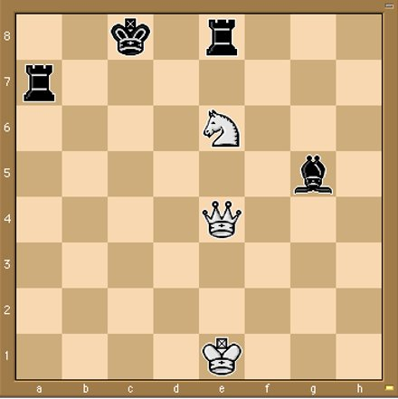
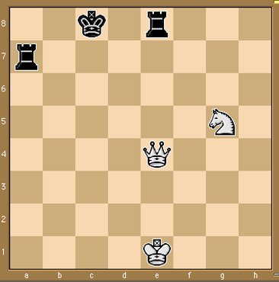
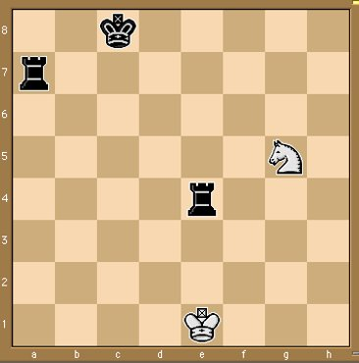
Some Chess Positions and their Evaluations
White to move​
f(n)=(9+3)-(5+5+3.25)​
=-1.25​
… Nxg5??​
f(n)=(9+3)-(5+5)​
=2​
Uh-oh: Rxg4+​
f(n)=(3)-(5+5)​
=-7​
And black may ​
force checkmate​
So, considering our opponent’s possible​
responses would be wise.​
CIS 421/521 | 24
Notes:
.

Slide 25
The Minimax Rule (AIMA 5.2)
CIS 421/521 | 25
Notes:
.

Slide 26
The Minimax Rule: “Don’t play hope chess”
Idea: Make the best move for MAX assuming that MIN always replies with the best move for MIN
Easily computed by a recursive process
The backed-up value of each node in the tree is determined by the values of its children:
For a MAX node, the backed-up value is the maximum of the values of its children (i.e. the best for MAX)
For a MIN node, the backed-up value is the minimum of the values of its children (i.e. the best for MIN)
CIS 421/521 | 26
Notes:
.

Slide 27
The Minimax Procedure
Until game is over:
Start with the current position as a MAX node.
Expand the game tree a fixed number of ply.
Apply the evaluation function to the leaf positions.
Calculate back-up values bottom-up.
Pick the move assigned to MAX at the root
Wait for MIN to respond
CIS 421/521 | 27
Notes:
.

Slide 28
MAX
2-ply Example: Backing up values
MIN
2
2
1
2
1
2
7
1
8
2
7
1
8
Evaluation function value​
2
7
1
8
2
This is the move​
selected by minimax​
2
1
2
7
1
8
CIS 421/521 | 28
Notes:
.

Slide 29
Adversarial Search (Minimax)
Minimax search:
A state-space search tree
Players alternate turns
Compute each node’s minimax value: the best achievable utility against a rational (optimal) adversary
Minimax values:​ computed recursively​
5
2
5
8
2
5
6
Terminal values:​ part of the game ​
CIS 421/521 | 29
Notes:
.

Slide 30
Minimax Implementation
def max-value(state):
if the state is a terminal state: return the state’s utility
initialize v = -∞
for each successor of state:
v = max(v, min-value(successor))
return v
def min-value(state):
if the state is a terminal state: return the state’s utility
initialize v = +∞
for each successor of state:
v = min(v, max-value(successor))
return v
CIS 421/521 | 31
Notes:
.

Slide 31
Minimax Implementation (Dispatch)
def value(state):
if the state is a terminal state: return the state’s utility
if the next agent is MAX: return max-value(state)
if the next agent is MIN: return min-value(state)
def max-value(state):
initialize v = -∞
for each successor of state:
v = max(v, value(successor))
return v
def min-value(state):
initialize v = +∞
for each successor of state:
v = min(v, value(successor))
return v
CIS 421/521 | 32
Notes:
.

Slide 32
Minimax Example
3
12
8
2
4
6
14
5
2
def max-value(state):
initialize v = -∞
for each successor of state:
v = max(v, min-value(successor))
return v
def min-value(state):
initialize v = +∞
for each successor of state:
v = min(v, max-value(successor))
return v
CIS 421/521 | 33
Notes:
.

Slide 33
Minimax Example
3
12
8
2
4
6
14
5
2
def max-value(state):
if the state is a terminal state: return the state’s utility
initialize v = -∞
for each successor of state:
v = max(v, min-value(successor))
return v
def min-value(state):
if the state is a terminal state: return the state’s utility
initialize v = +∞
for each successor of state:
v = min(v, max-value(successor))
return v
CIS 421/521 | 34
Notes:
.

Slide 34
What if MIN does not play optimally?
Definition of optimal play for MAX assumes MIN plays optimally:
Maximizes worst-case outcome for MAX.
(Classic game theoretic strategy)
But if MIN does not play optimally, MAX will do even better.
This theorem is not hard to prove
CIS 421/521 | 35
Notes:
.

Slide 35
Comments on Minimax Search
Depth-first search with fixed number of ply m as the limit.
O(b^{m}) time complexity – As usual!
O(bm) space complexity
Performance will depend on
the quality of the static evaluation function (expert knowledge)
depth of search (computing power and search algorithm)
Differences from normal state space search
Looking to make one move only, despite deeper search
No cost on arcs – costs from backed-up static evaluation
MAX can’t be sure how MIN will respond to his moves
Minimax forms the basis for other game tree search algorithms.
CIS 421/521 | 36
Notes:
.

Slide 36
Alpha-Beta Pruning (AIMA 5.3)
CIS 421/521 | 37
Notes:
.

Slide 37
Alpha-Beta Pruning
A way to improve the performance of the Minimax Procedure
Basic idea: “If you have an idea which is surely bad, don’t take the time to see how truly awful it is” ~ Pat Winston
>=2
We don’t need to compute the value at this node.​
No matter what this is, it won’t change the value of the root node.​
=2
<=1
2
7
1
?
CIS 421/521 | 38
Notes:
.

Slide 38
Alpha-Beta Pruning
During Minimax, keep track of two additional values:
α: MAX’s current lower bound on MAX’s outcome
β: MIN’s current upper bound on MIN’s outcome
MAX will never allow a move that could lead to a worse score (for MAX) than α
MIN will never allow a move that could lead to a better score (for MAX) than β
Therefore, stop evaluating a branch whenever:
When evaluating a MAX node: a value v ≥ β is backed-up
MIN will never select that MAX node
When evaluating a MIN node: a value v ≤ α is found
MAX will never select that MIN node
CIS 421/521 | 39
Notes:
.

Slide 39
Alpha-Beta Implementation
α: MAX’s best option on path to root
β: MIN’s best option on path to root
def max-value(state, α, β):
initialize v = -∞
for each successor of state:
v = max(v, value(successor, α, β))
if v ≥ β return v
α = max(α, v)
return v
def min-value(state , α, β):
initialize v = +∞
for each successor of state:
v = min(v, value(successor, α, β))
if v ≤ α return v
β = min(β, v)
return v
CIS 421/521 | 40
Notes:
.

Slide 40
Alpha-Beta Pruning Properties
This pruning has no effect on minimax value computed for the root!
Values of intermediate nodes might be wrong
Important: children of the root may have the wrong value
So the most naïve version won’t let you do action selection
Good child ordering improves effectiveness of pruning
With “perfect ordering”:
Time complexity drops to O(b^{m/2})
Doubles solvable depth!
Full search of, e.g. chess, is still hopeless…
This is a simple example of metareasoning (computing about what to compute)
max
min
10
10
0
CIS 421/521 | 41
Notes:
.

Slide 41
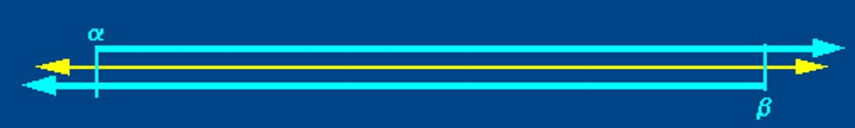

Alpha-Beta Pruning
Based on observation that for all viable paths utility value f(n) will be α <= f(n) <= β
Initially, α = -infinity, β=infinity
As the search tree is traversed, the possible utility value window shrinks as α increases, β decreases
CIS 421/521 | 42
Notes:
.

Slide 42
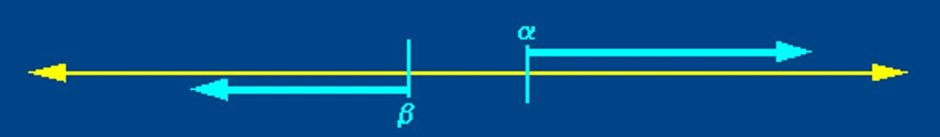
Alpha-Beta Pruning
Whenever the current ranges of alpha and beta no longer overlap, it is clear that the current node is a dead end
CIS 421/521 | 43
Notes:
.

Slide 43
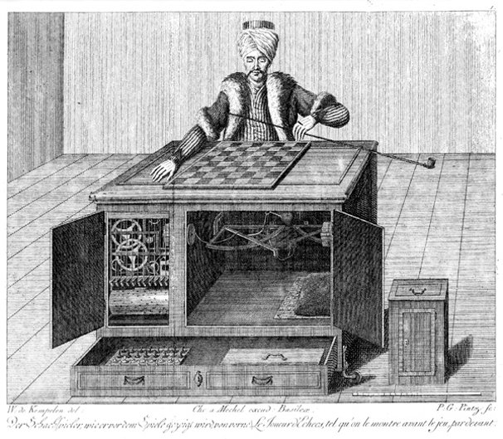
Games and Adversarial Search II
CIS 421/521 | 44
Notes:
.

Slide 44
Alpha-Beta Pruning (AIMA 5.3)
Some slides adapted from Richard Lathrop, USC/ISI, CS 271
CIS 421/521 | 45
Notes:
.

Slide 45
Review: The Minimax Rule
Idea: Make the best move for MAX assuming that MIN always replies with the best move for MIN
Start with the current position as a MAX node.
Expand the game tree a fixed number of ply.
Apply the evaluation function to all leaf positions.
Calculate back-up values bottom-up:
For a MAX node, return the maximum of the values of its children (i.e. the best for MAX)
For a MIN node, return the minimum of the values of its children (i.e. the best for MIN
Pick the move assigned to MAX at the root
Wait for MIN to respond and REPEAT FROM 1
CIS 421/521 | 46
Notes:
.

Slide 46
MAX
2-ply Example: Backing up values
MIN
2
2
1
2
1
2
7
1
8
2
7
1
8
Evaluation function value​
2
7
1
8
2
This is the move​
selected by minimax​
2
1
New point:
Actually calculated by DFS!
2
7
1
8
CIS 421/521 | 47
Notes:
.

Slide 47
Minimax Algorithm
function MINIMAX-DECISION(state) returns an action
inputs: state, current state in game
vMAX-VALUE(state)
return an action in SUCCESSORS(state) with value v
function MAX-VALUE(state) returns a utility value
if TERMINAL-TEST(state) then return UTILITY(state)
v  -∞
for a,s in SUCCESSORS(state) do
v  MAX(v, MIN-VALUE(s) )
return v
function MIN-VALUE(state) returns a utility value
if TERMINAL-TEST(state) then return UTILITY(state)
v  ∞
for a,s in SUCCESSORS(state) do
v  MIN(v, MAX-VALUE(s) )
return v
CIS 421/521 | 48
Notes:
.

Slide 48
Alpha-Beta Pruning
A way to improve the performance of the Minimax Procedure
Basic idea: “If you have an idea which is surely bad, don’t take the time to see how truly awful it is” ~ Pat Winston
Assuming left-to-right tree traversal:
We don’t need to compute the value at this node.​
No matter what this is, it won’t change the value of the root node.​
>=2
=2
<=1
2
7
1
?
CIS 421/521 | 49
Notes:
.

Slide 49
Alpha-Beta Pruning II
During Minimax, keep track of two additional values:
α: current lower bound on MAX’s outcome
β: current upper bound on MIN’s outcome
MAX will never choose a move that could lead to a worse score (for MAX) than α
MIN will never choose a move that could lead to a better score (for MAX) than β
Therefore, stop evaluating a branch whenever:
When evaluating a MAX node: a value v ≥ β is backed-up
MIN will never select that MAX node
When evaluating a MIN node: a value v ≤ α is found
MAX will never select that MIN node
CIS 421/521 | 50
Notes:
.

Slide 50
Alpha-Beta Pruning IIIa
Based on observation that for all viable paths utility value f(n) will be α <= f(n) <= β
Initially, α = -infinity, β=infinity
As the search tree is traversed, the possible utility value window shrinks as α increases, β decreases
CIS 421/521 | 51
Notes:
.

Slide 51

Alpha-Beta Pruning IIIb
Whenever the current ranges of alpha and beta no longer overlap (α ≥ β), it is clear that the current node is a dead end, so it can be pruned
CIS 421/521 | 52
Notes:
.

Slide 52
Alpha-beta Algorithm: In detail
Depth first search (usually bounded, with static evaluation)
only considers nodes along a single path from root at any time
α = current lower bound on MAX’s outcome (initially, α = −infinity)
β = current upper bound on MIN’s outcome
(initially, β = +infinity)
Pass current values of a and b down to child nodes during search.
Update values of a and b during search:
MAX updates α at MAX nodes
MIN updates β at MIN nodes
Prune remaining branches at a node whenever α ≥ β
β​
​
​
​
α​
CIS 421/521 | 53
Notes:
.

Slide 53
When to Prune
Prune whenever α ≥ β.
Prune below a Max node when its α value becomes ≥ the β value of its ancestors.
Max nodes update α based on children’s returned values.
Idea: Player MIN at node above won’t pick that value anyway, since MIN can force a worse value.
Prune below a Min node when its β value becomes ≤ the α value of its ancestors.
Min nodes update β based on children’s returned values.
Idea: Player MAX at node above won’t pick that value anyway; she can do better.
β​
​
​
​
α​
CIS 421/521 | 54
Notes:
.

Slide 54
Pseudocode for Alpha-Beta Algorithm
function ALPHA-BETA-SEARCH(state) returns an action
inputs: state, current state in game
vMAX-VALUE(state, - ∞ , +∞)
return an action in ACTIONS(state) with value v
CIS 421/521 | 55
Notes:
.

Slide 55
An Alpha-Beta Example
Do DF-search until first leaf
α, β, initial values
α=−∞
β =+∞
β​
​
​
​
α​
MAX
α, β, passed to kids
α=−∞
β =+∞
MIN
CIS 421/521 | 56
Notes:
.

Slide 56
An Alpha-Beta Example (continued)
α=−∞
β =+∞
β​
​
​
​
α​
MAX
α=−∞
β =3
<=3
MIN
MIN updates β, based on kids
3
CIS 421/521 | 57
Notes:
.

Slide 57
An Alpha-Beta Example (continued)
α=−∞
β =+∞
β​
​
​
​
α​
MAX
α=−∞
β =3
<=3
MIN
MIN updates β, based on kids.
No change.
3
12
CIS 421/521 | 58
Notes:
.

Slide 58
An Alpha-Beta Example (continued)
MAX updates , based α​ on kids.
α=3
β =+∞
β​
​
​
​
α​
MAX
3 is returned as node value.
α=−∞
β =3
3
MIN
3
12
8
CIS 421/521 | 59
Notes:
.

Slide 59
An Alpha-Beta Example (continued)
α=3
β =+∞
β​
​
​
​
α​
MAX
α, β passed to kids​
3
α=3
β =+∞
MIN
3
12
8
CIS 421/521 | 60
Notes:
.

Slide 60
An Alpha-Beta Example (continued)
α=3
β =+∞
β​
​
​
​
α​
MAX
MIN updates β, based on kids.
3
α=3
β =2
MIN
3
12
8
2
CIS 421/521 | 61
Notes:
.

Slide 61
An Alpha-Beta Example (continued)
α=3
β =+∞
β​
​
​
​
α​
MAX
α=3
β =2
3
α​ >= β, so prune.
MIN
X
X
3
12
8
2
CIS 421/521 | 62
Notes:
.

Slide 62
An Alpha-Beta Example (continued)
MAX updates α, based on kids.
No change.
α=3
β =+∞
β​
​
​
​
α​
MAX
2 is returned
as node value.
3
<=2
MIN
X
X
3
12
8
2
CIS 421/521 | 63
Notes:
.

Slide 63
An Alpha-Beta Example (continued)
α=3
β =+∞
β​
​
​
​
α​
MAX
α, β, passed to kids
3
<=2
α=3
β =+∞
MIN
X
X
3
12
8
2
CIS 421/521 | 64
Notes:
.

Slide 64
An Alpha-Beta Example (continued)
α=3
β =+∞
β​
​
​
​
α​
MAX
MIN updates β,
based on kids.
3
<=2
α=3
β =14
MIN
X
X
3
12
8
2
14
CIS 421/521 | 65
Notes:
.

Slide 65
An Alpha-Beta Example (continued)
α=3
β =+∞
β​
​
​
​
α​
MAX
MIN updates β,
based on kids.
3
<=2
α=3
β =5
MIN
X
X
3
12
8
2
14
5
CIS 421/521 | 66
Notes:
.

Slide 66
An Alpha-Beta Example (continued)
α=3
β =+∞
β​
​
​
​
α​
MAX
2 is returned as
Node value.
3
<=2
2
MIN
X
X
3
12
8
2
14
5
2
CIS 421/521 | 67
Notes:
.

Slide 67
An Alpha-Beta Example (continued)
Max now makes it’s best move, as computed by Alpha-Beta
β​
​
​
​
α​
MAX
3
<=2
2
MIN
X
X
3
12
8
2
14
5
2
Notes:
.

Slide 68
Alpha-Beta Algorithm Pseudocode
function ALPHA-BETA-SEARCH(state) returns an action
inputs: state, current state in game
vMAX-VALUE(state, - ∞ , +∞)
return an action in ACTIONS(state) with value v
function MAX-VALUE(state, , ) returns a utility value
if TERMINAL-TEST(state) then return UTILITY(state)
v  - ∞
for a in ACTIONS(state) do
v  MAX(v,MIN-VALUE(Result(s,a),  , ))
if v ≥  then return v
  MAX( ,v)
return v
CIS 421/521 | 69
Notes:
.

Slide 69
Alpha-Beta Algorithm II
function MIN-VALUE(state,  , ) returns a utility value
if TERMINAL-TEST(state) then return UTILITY(state)
v  + ∞
for a,s in SUCCESSORS(state) do
v  MIN(v,MAX-VALUE(s,  , ))
if v ≤  then return v
  MIN( ,v)
return v
CIS 421/521 | 70
Notes:
.

Slide 70
Effectiveness of Alpha-Beta Pruning
Guaranteed to compute same root value as Minimax
Worst case: no pruning, same as Minimax (O(b^{d}))
Best case: when each player’s best move is the first option examined, examines only O(b^{d/2}) nodes, allowing to search twice as deep!
CIS 421/521 | 71
Notes:
.

Slide 71
When best move is the first examined, examines only O(b^{d/2}) nodes….
So: run Iterative Deepening search, sort by value returned on last iteration.
So: expand captures first, then threats, then forward moves, etc.
O(b^{(d/2)}) is the same as having a branching factor of sqrt(b),
Since (sqrt(b))^{d} = b^{(d/2)}
e.g., in chess go from b ~ 35 to b ~ 6
For Deep Blue, alpha-beta pruning reduced the average branching factor from 35-40 to 6, as expected, doubling search depth
CIS 421/521 | 72
Notes:
.

Slide 72
Real systems use a few more tricks
Expand the proposed solution a little farther
Just to make sure there are no surprises
Learn better board evaluation functions
E.g., for backgammon
Learn model of your opponent
E.g., for poker
Do stochastic search
E.g., for go
CIS 421/521 | 73
Notes:
.

Slide 73
Next time: Expectimax and Utilities​
CIS 421/521 | 74
Notes:
.

