Slide 1
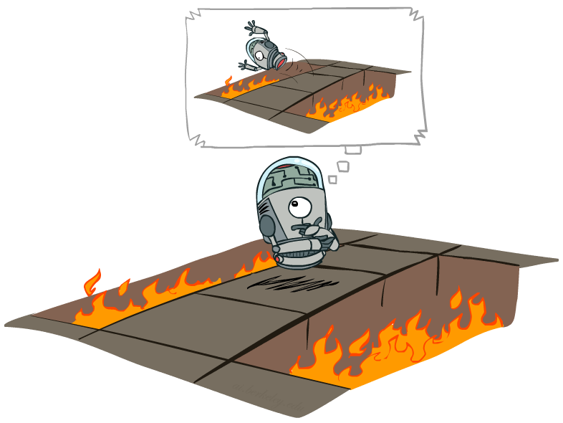
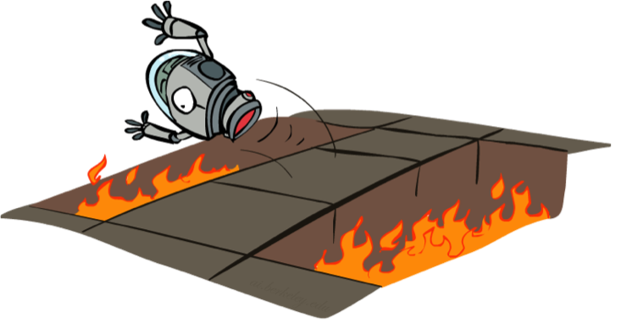
Reinforcement Learning
Slides courtesy of Dan Klein and Pieter Abbeel
University of California, Berkeley
[These slides were created by Dan Klein and Pieter Abbeel for CS188 Intro to AI at UC Berkeley. All CS188 materials are available at http://ai.berkeley.edu.]
Notes:
Figure out for a policy, what the values are.

Slide 2
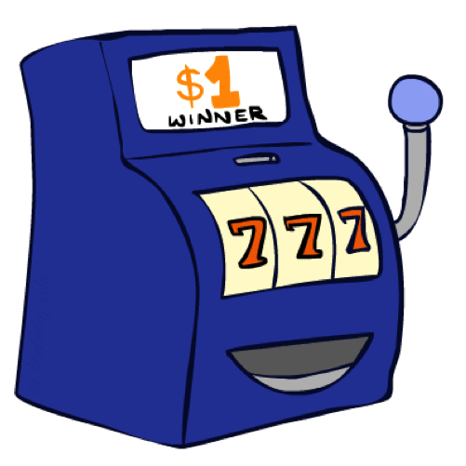
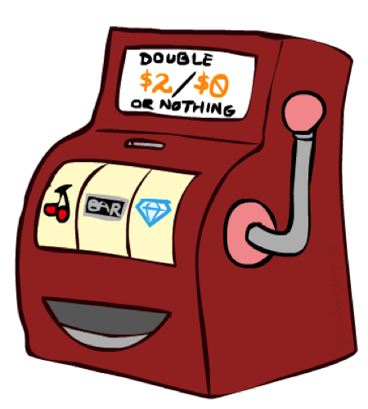

Double Bandits
Notes:
one-armed bandit A slot machine, as in It's amazing how many people think they can make money playing a one-armed bandit. This term refers to both appearance and function: the operating lever looks like an arm, and the machine in effect robs players, since it “wins” and keeps the player's money in an overwhelming majority of instances

Slide 3
Double-Bandit MDP
Actions: Blue, Red
States: Win, Lose
No discount
100 time steps
Both states have the same value
0.25 $0
0.75
$2
W
L
0.25
$0
$1
1.0
$1
1.0
0.75 $2

Slide 4
Offline Planning
Solving MDPs is offline planning
You determine all quantities through computation
You need to know the details of the MDP
You do not actually play the game!
No discount
100 time steps
Both states have the same value
0.25 $0
Value
0.75
$2
W
0.25
$0
Play Red
150
L
$1
1.0
$1
1.0
0.75 $2
Play Blue
100

Slide 5
Let’s Play!
$2
$2
$0
$2
$2
$2
$2
$0
$0
$0
Notes:
What actually happens? We actually won real fake money, instead of just thinking about it. We won $12 for 10 plays. Instead of our estimate of $15.

Slide 6
Online Planning
Rules changed! Red’s win chance is different.
?? $0
??
$2
W
L
??
$0
$1
1.0
$1
1.0
?? $2
Notes:
Now we aren’t given the probabilities. Red has a payoff but you don’t know what it is.
We don’t know the MDP! We can’t calculate its values. So what should we do? Give up and go home? No, let’s try it out by playing.

Slide 7
Let’s Play!
$0
$0
$0
$2
$0
$2
$0
$0
$0
$0
Notes:
Who wants to play red? Do we know that’s the optimal policy? What should we play? Red! Red! Red! When should we stop?
This is a different setting. Red is an MDP. It has a payoff. You don’t know what it is.
What you have to do is an optimal amount of discovery mixed in with not losing your money.

Slide 8
What Just Happened?
That wasn’t planning, it was learning!
Specifically, reinforcement learning
There was an MDP, but you couldn’t solve it with just computation
You needed to actually act to figure it out
Important ideas in reinforcement learning that came up
Exploration: you have to try unknown actions to get information
Exploitation: eventually, you have to use what you know
Regret: even if you learn intelligently, you make mistakes
Sampling: because of chance, you have to try things repeatedly
Difficulty: learning can be much harder than solving a known MDP
Notes:
Difficulty: In the original case, it was instantly obvious that you should always play red. Here your lack of knowledge makes it much more difficult to figure out the optimal policy.

Slide 9
Reinforcement Learning
Agent
State: s
Reward: r
Actions: a
Environment
Basic idea:
Receive feedback in the form of rewards
Agent’s utility is defined by the reward function
Must (learn to) act so as to maximize expected rewards
All learning is based on observed samples of outcomes!
Notes:
Basic idea: you have an agent who is acting as always. The agent has actions available to it, and chooses and action.
The environment then does what it always does. It resolves the action. It does this with some non-determinism like before. What the agent gets back from the environment is two things. One is the instantaneous reward. The reward can be a bonus or penalty. This is the thing that we want to learn to maximize. The other thing it gets back is a percept. In the simplest formulation this will be the state that it ends up in, later on we’ll see how to relax this.
In this setting, we won’t know what actions will produce what rewards before we try them. Therefore, we have to learn based on experience. This can be characterized as learning from samples.

Slide 10
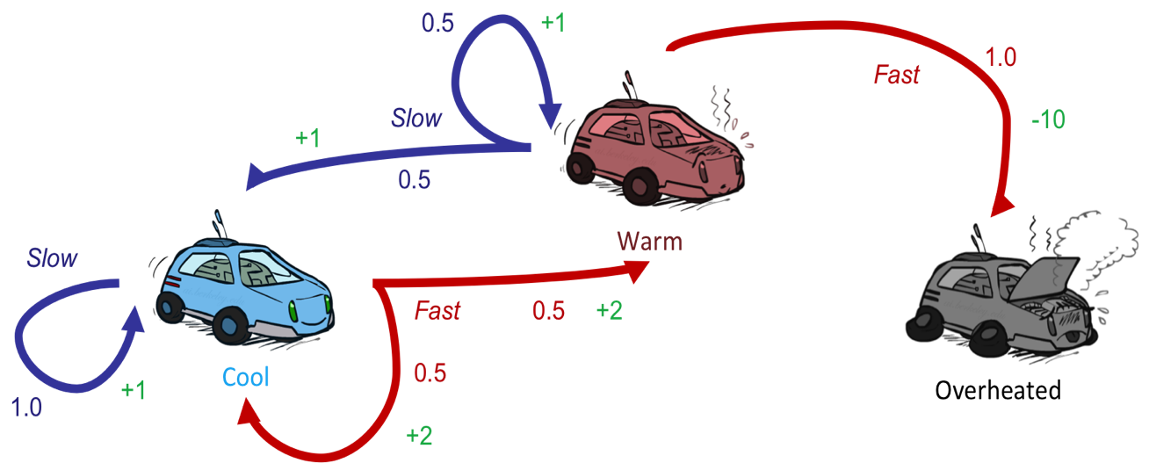
Reinforcement Learning
Still assume a Markov decision process (MDP):
A set of states s ∈ S
A set of actions (per state) A
A model T(s,a,s’)
A reward function R(s,a,s’)
Still looking for a policy π(s)
New twist: don’t know T or R
I.e. we don’t know which states are good or what the actions do
Must actually try actions and states out to learn
Notes:
How is this done?
In reinforcement learning, we still imagine that there’s a MDP. The goal is still to learn a policy.
The new twist is that we don’t know Tor R.

Slide 11
Offline (MDPs) vs. Online (RL)
Offline Solution
Online Learning
Notes:
Offline – in simulation or in your head, you can compute things off and know that it’s bad to jump into the pit.
In online learning, you actually need to take the action.

Slide 12

Model-Based Learning
Notes:
In model based learning, we try to figure out the model by learning the transition functions and the rewards. How does that work?

Slide 13




Model-Based Learning
Model-Based Idea:
Learn an approximate model based on experiences
Solve for values as if the learned model were correct
Step 1: Learn empirical MDP model
Count outcomes s’ for each s, a
Normalize to give an estimate of
Discover each when we experience (s, a, s’)
Step 2: Solve the learned MDP
For example, use value iteration, as before
Notes:
We are going to learn an approximate model based on our experiences. Then we’re going to solve for the values as if the learned model were correct.
So how do we do that?
Act for a while. Accumulate counts. Create probabilities. Observe rewards.

Slide 14
Example: Model-Based Learning
Input Policy π
Observed Episodes (Training)
Learned Model
Episode 1
Episode 2
T(s,a,s’).
T(B, east, C) = 1.00
T(C, east, D) = 0.75
T(C, east, A) = 0.25
…
R(s,a,s’).
R(B, east, C) = -1
R(C, east, D) = -1
R(D, exit, x) = +10
…
 | A
B | C | D
 | E
B, east, C, -1
C, east, D, -1
D, exit, x, +10
B, east, C, -1
C, east, D, -1
D, exit, x, +10
Episode 3
Episode 4
E, north, C, -1
C, east, D, -1
D, exit, x, +10
E, north, C, -1
C, east, A, -1
A, exit, x, -10
Assume: γ = 1
Notes:
Someone gives us a policy pi. We say, alright we’re going to do this.
(Here we’re setting the gamma to be one, just to make the example sample).
Ep 1 and 2 are the same.
Ep 3 and 4 are different.
We can then used these observations to compute a model.
The transition from B having selected East results in C 100% of the time.
The transiition from C having picked the action East results in D 75% of the time and A 25% of the time.
Now we have a transition function (probabilities) and the reward function. We now have an MDP. It’s the wrong MDP, but we can solve it.

Slide 15
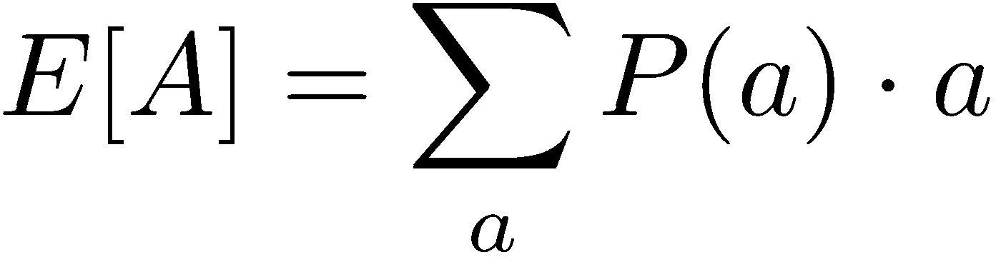
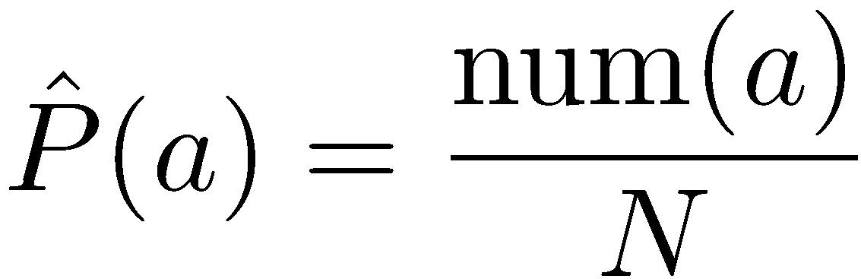
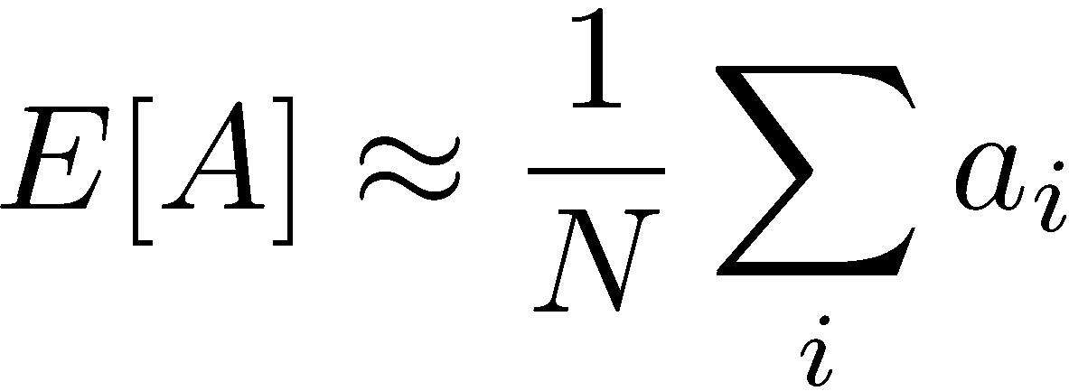
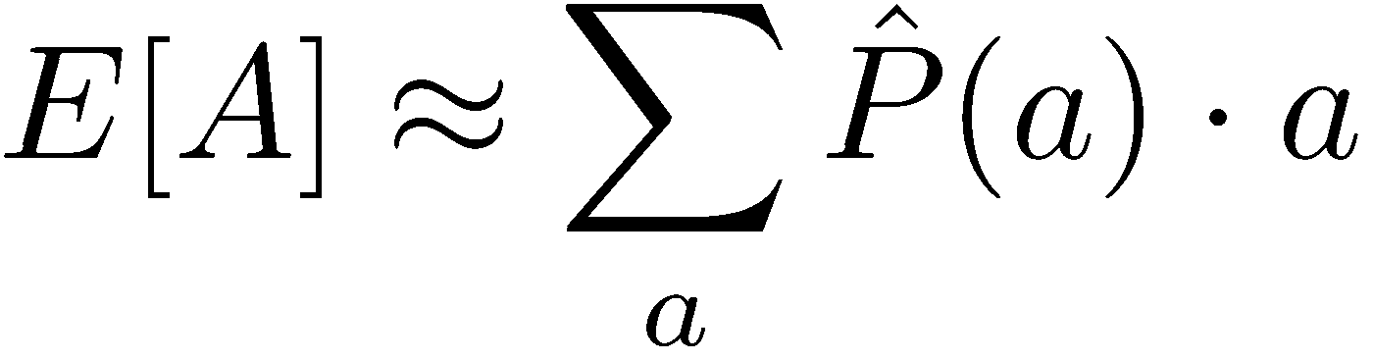
Example: Expected Age
Goal: Compute expected age of CIS 421/521 students
Known P(A)
=0.01 x 42 + …
Without P(A), instead collect samples [a₁, a₂, … a_{N}]
Unknown P(A): “Model Based”
Unknown P(A): “Model Free”
Why does this work? Because eventually you learn the right model.
Why does this work? Because samples appear with the right frequencies.
Notes:
In the model free version we don’t weight by the probability.
But in this case they’re equivalent, since they will appear with the right frequency.
It’s really just a matter of how and when you group things.
In the reinforcement learning there is going ot be a difference because we will take the structure into account. Things are going to depend on the other states around them.
But this gives a good high-level overview of what we mean by model-based v. model free.

Slide 16
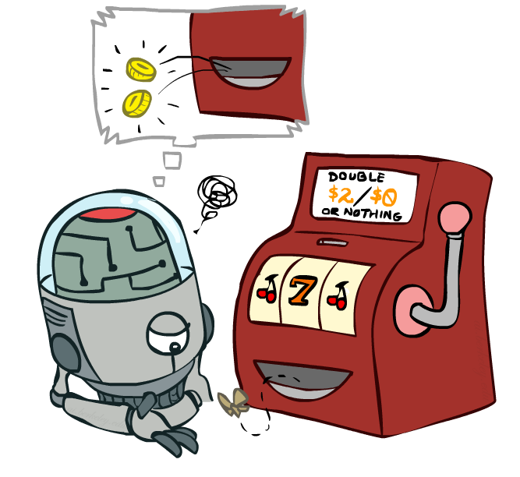
Model-Free Learning
Notes:
now we're going to talk about model free
learning and model free learning we
don't construct a model of the transition function
Instead, we take actions and every time we take an action we compare what we thought was going to happen to what actually did happen.
Whenever something is better or worse than what we expected we adjust our values up and down.
So what we track in a model free approach is the values of interest themselves not the transition functions or the rewards.

Slide 17
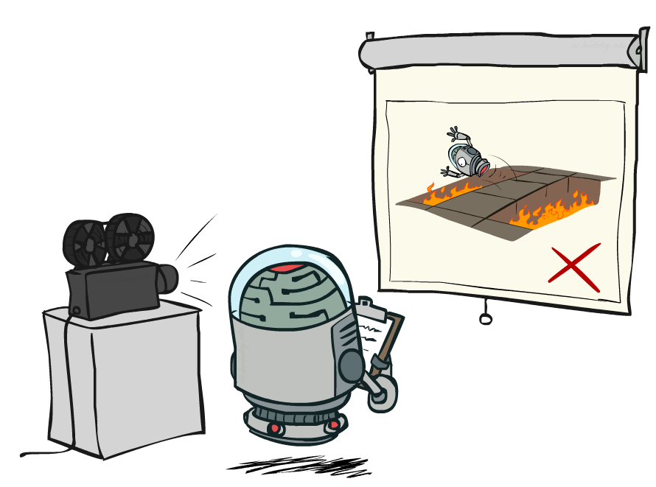
Passive Reinforcement Learning
Notes:
In passive reinfocement learning, someone else chooses the policy. And we observe what happens.
The passive case is this simplified task. We're not going to try to figure out how to act optimally.
We're going try to figure out essentially what policy evaluation did.
The input is a fixed policy. We want to evaluate it.

Slide 18
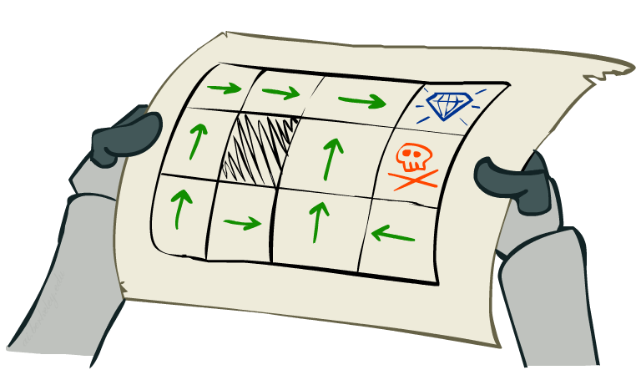
Passive Reinforcement Learning
Simplified task: policy evaluation
Input: a fixed policy π(s)
You don’t know the transitions T(s,a,s’)
You don’t know the rewards R(s,a,s’)
Goal: learn the state values
In this case:
Learner is “along for the ride”
No choice about what actions to take
Just execute the policy and learn from experience
This is NOT offline planning! You actually take actions in the world.

Slide 19
Direct Evaluation
Goal: Compute values for each state under π
Idea: Average together observed sample values
Act according to π
Every time you visit a state, write down what the sum of discounted rewards turned out to be
Average those samples
This is called direct evaluation

Slide 20
Example: Direct Evaluation
Input Policy π
Observed Episodes (Training)
Output Values
Episode 1
Episode 2
 | A
B | C | D
 | E
 | A
B | C | D
 | E
B, east, C, -1
C, east, D, -1
D, exit, x, +10
B, east, C, -1
C, east, D, -1
D, exit, x, +10
-10
+8
+4
+10
Episode 3
Episode 4
-2
E, north, C, -1
C, east, D, -1
D, exit, x, +10
E, north, C, -1
C, east, A, -1
A, exit, x, -10
Assume: γ = 1
Notes:
We’re given an input policy
We just want to evaluate it.
What utility did I receive from B? Not -1. That was the intentions reward. I want to compute the utility, which is from B until the end. So +8.
Write down what happened.
Why 4 for C? 9 + 9 + 9 - 11 = 16/4 = 4

Slide 21
Problems with Direct Evaluation
What’s good about direct evaluation?
It’s easy to understand
It doesn’t require any knowledge of T, R
It eventually computes the correct average values, using just sample transitions
What bad about it?
It wastes information about state connections
Each state must be learned separately
So, it takes a long time to learn
Output Values
 | A
B | C | D
 | E
-10
+8
+4
+10
-2
If B and E both go to C under this policy, how can their values be different?

Slide 22

Why Not Use Policy Evaluation?
s
Simplified Bellman updates calculate V for a fixed policy:
Each round, replace V with a one-step-look-ahead layer over V
This approach fully exploited the connections between the states
Unfortunately, we need T and R to do it!
Key question: how can we do this update to V without knowing T and R?
In other words, how to we take a weighted average without knowing the weights?
π(s)
s, π(s)
s, π(s),s’
s’

Slide 23
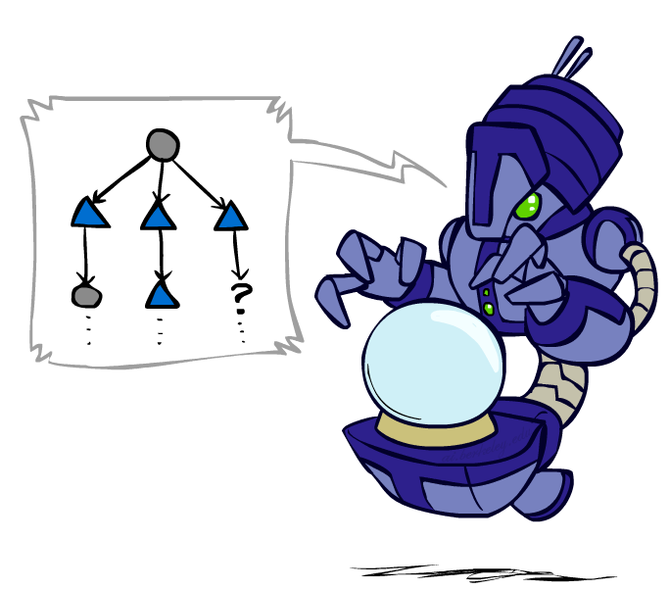
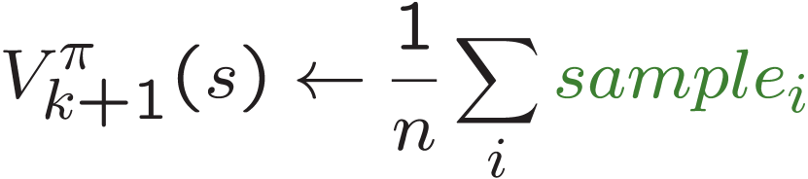
Sample-Based Policy Evaluation?
We want to improve our estimate of V by computing these averages:
Idea: Take samples of outcomes s’ (by doing the action!) and average
s
π(s)
s, π(s)
s, π(s),s’
s₁'
s₂'
s'
s₃'
Almost! But we can’t rewind time to get sample after sample from state s.
Notes:
Can we do sample based policy evaluation?
What’s wrong with this? We don’t get to do lots of actions from state s. We don’t get to rewind and re-do it to get multiple observations.

Slide 24
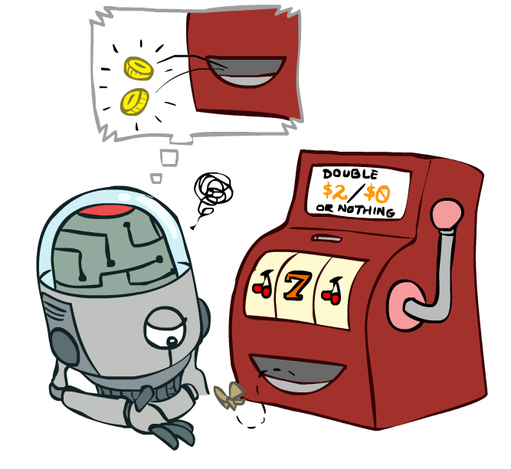
Temporal Difference Learning

Slide 25
Temporal Difference Learning
Big idea: learn from every experience!
Update V(s) each time we experience a transition (s, a, s’, r)
Likely outcomes s’ will contribute updates more often
Temporal difference learning of values
Policy still fixed, still doing evaluation!
Move values toward value of whatever successor occurs: running average
s
π(s)
s, π(s)
s’
Sample of V(s):
Update to V(s):
Same update:
Notes:
The reason this is called temporal difference learning is because we compare our current estimate of a value with what we actually see
Interprolation

Slide 26

Exponential Moving Average
Exponential moving average
The running interpolation update:
Makes recent samples more important:
Forgets about the past (distant past values were wrong anyway)
Decreasing learning rate (alpha) can give converging averages

Slide 27
Example: Temporal Difference Learning
States
Observed Transitions
B, east, C, -2
C, east, D, -2
 | A
B | C | D
 | E
 | 0
0 | 0 | 8
 | 0
 | 0
-1 | 0 | 8
 | 0
 | 0
-1 | 3 | 8
 | 0
Assume: γ = 1, α = 1/2

Slide 28
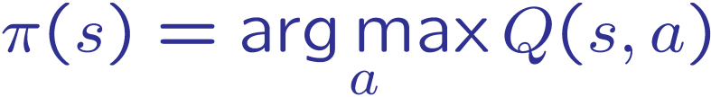
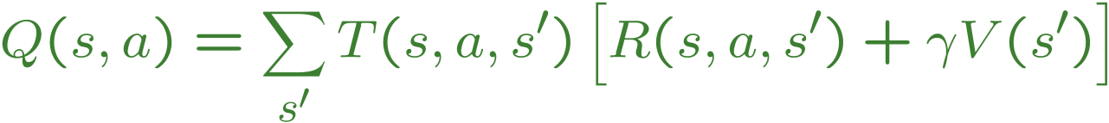
Problems with TD Value Learning
TD value leaning is a model-free way to do policy evaluation, mimicking Bellman updates with running sample averages
However, if we want to turn values into a (new) policy, we’re sunk:
Idea: learn Q-values, not values
Makes action selection model-free too!
s
a
s, a
s,a,s’
s’

Slide 29
Reinforcement Learning
Slides courtesy of Dan Klein and Pieter Abbeel
University of California, Berkeley
[These slides were created by Dan Klein and Pieter Abbeel for CS188 Intro to AI at UC Berkeley. All CS188 materials are available at http://ai.berkeley.edu.]
Notes:
Figure out for a policy, what the values are.

Slide 30
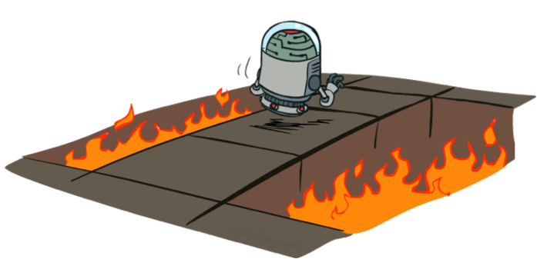
Active Reinforcement Learning
Full reinforcement learning: optimal policies (like value iteration)
You don’t know the transitions T(s,a,s’)
You don’t know the rewards R(s,a,s’)
You choose the actions now
Goal: learn the optimal policy / values
In this case:
Learner makes choices!
Fundamental tradeoff: exploration vs. exploitation
This is NOT offline planning! You actually take actions in the world and find out what happens…

Slide 31
Detour: Q-Value Iteration
Value iteration: find successive (depth-limited) values
Start with V₀(s) = 0, which we know is right
Given V_{k}, calculate the depth k+1 values for all states:
But Q-values are more useful, so compute them instead
Start with Q₀(s,a) = 0, which we know is right
Given Q_{k}, calculate the depth k+1 q-values for all q-states:

Slide 32

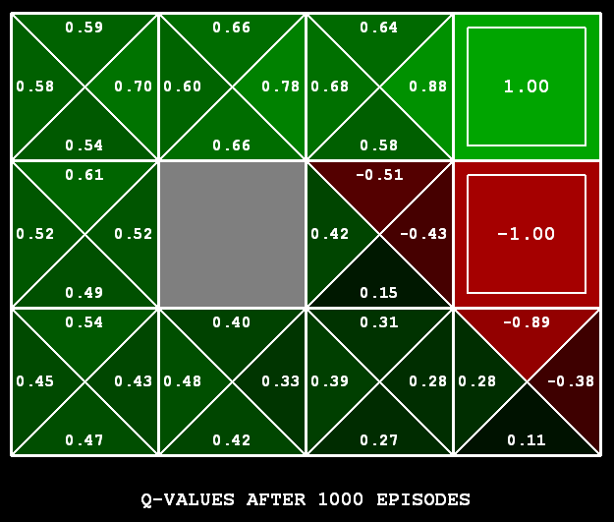
Q-Learning
Q-Learning: sample-based Q-value iteration
Learn Q(s,a) values as you go
Receive a sample (s,a,s’,r)
Consider your old estimate:
Consider your new sample estimate:
Incorporate the new estimate into a running average:

Slide 33

Q-Learning Properties
Amazing result: Q-learning converges to optimal policy -- even if you’re acting suboptimally!
This is called off-policy learning
Caveats:
You have to explore enough
You have to eventually make the learning rate
small enough
… but not decrease it too quickly
Basically, in the limit, it doesn’t matter how you select actions (!)

Slide 34
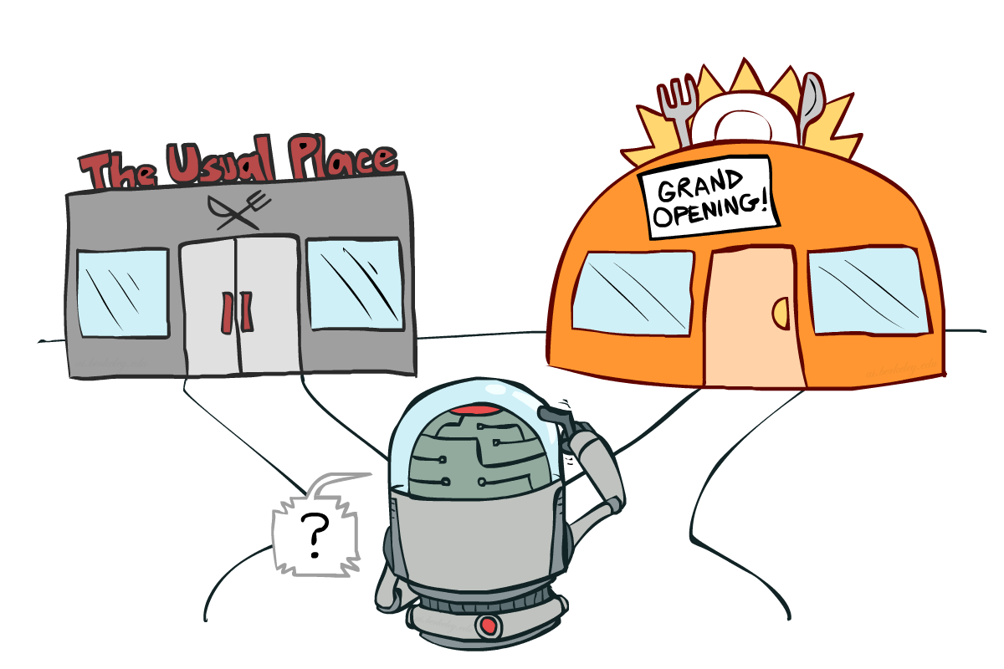
Exploration vs. Exploitation
Notes:
So what does q-learning require in order for us to learn an optimal policy.
It requires that you explore enough,.
One of the most important things in reinforcement learning is an inevitable trade off between exploration and exploitation.
You have to try some stuff. You have to make some mistakes.
Exploration may be disastrous. The food might be terrible. You may get food poisoning. But it may be your new favorite restaurant. If you don’t explore it, then you might miss out on your favorite restaurant until the end of time.

Slide 35

How to Explore?
Several schemes for forcing exploration
Simplest: random actions (ε-greedy)
Every time step, flip a coin
With (small) probability ε, act randomly
With (large) probability 1-ε, act on current policy
Notes:
Q-learning didn’t specify how to select actions.
This tells us how to selection actions to allow q-learning to do it’s magic.
The simplest way to act is called an Epsilon greedy policy. At every time step, with some (presumably small) probability, we choose something randomly.
With a presumably large probability, we act on our current policy.
A lot of random actions without not much progress.

Slide 36
How to Explore?
Several schemes for forcing exploration
Simplest: random actions (ε-greedy)
Every time step, flip a coin
With (small) probability ε, act randomly
With (large) probability 1-ε, act on current policy
Problems with random actions?
You do eventually explore the space, but keep thrashing around once learning is done
One solution: lower ε over time
Another solution: exploration functions
Notes:
Q-learning didn’t specify how to select actions.
This tells us how to selection actions to allow q-learning to do it’s magic.
The simplest way to act is called an Epsilon greedy policy. At every time step, with some (presumably small) probability, we choose something randomly.
With a presumably large probability, we act on our current policy.
A lot of random actions without not much progress.

Slide 37
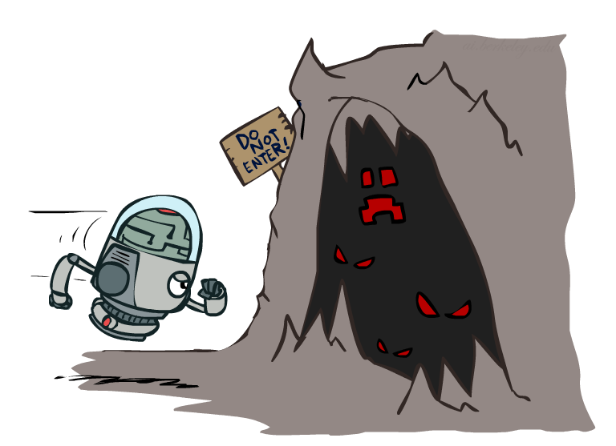

Exploration Functions
When to explore?
Random actions: explore a fixed amount
Better idea: explore areas whose badness is not
(yet) established, eventually stop exploring
Exploration function
Takes a value estimate u and a visit count n, and
returns an optimistic utility, e.g.
Note: this propagates the “bonus” back to states that lead to unknown states as well!
Regular Q-Update:
Modified Q-Update:
Notes:
When should you explore? We’ll we could try a fixed amount of randomness, or we could explore areas where the badness has not yet been established.
You should have optimism in the face of uncertainty! Go boldly into that dark cave.
We can quantify this by defining an exploration function F. It takes in a value estimate of the utility U and a count of how often we’ve visited N. For Q states N is the number of times we’ve tried that option out.
We take the utility, and we add a bonus k/n that decreases over time as we increase the number of samples. K lets us determine how much exploration to do.
Here’s our regular Q update. …
We can modify it by this term that boosts it with this function that gives us a reason to explore unknown states.

Slide 38
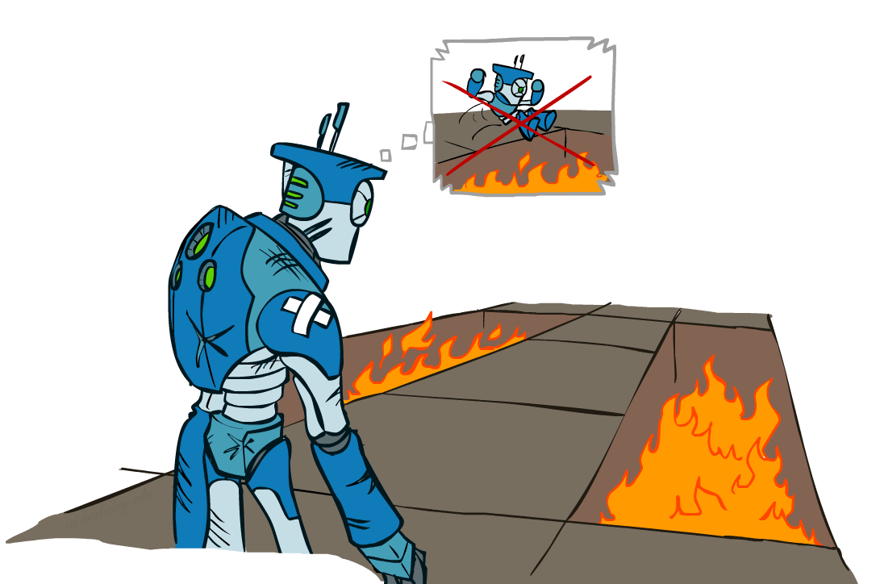
Regret
Even if you learn the optimal policy, you still make mistakes along the way!
Regret is a measure of your total mistake cost: the difference between your (expected) rewards, including youthful suboptimality, and optimal (expected) rewards
Minimizing regret goes beyond learning to be optimal – it requires optimally learning to be optimal
Example: random exploration and exploration functions both end up optimal, but random exploration has higher regret
Notes:
This brings us to the idea of regret. It’s one of those terms that has an everyday meaning, but it has a very specific meaning in this course.
You don’t get to be the wise optimal robot without making some mistakes in your youth. Here’s the wise old robot remembering when it was young and jumping into fire pits. You don’t learn an optimal policy without doing so.
Read 2nd bullet. Why expected? Because there’s some randomness to the world, which any optimal policy must account for.
Minimizing regret is like optimally learning to be optimal.

Slide 39
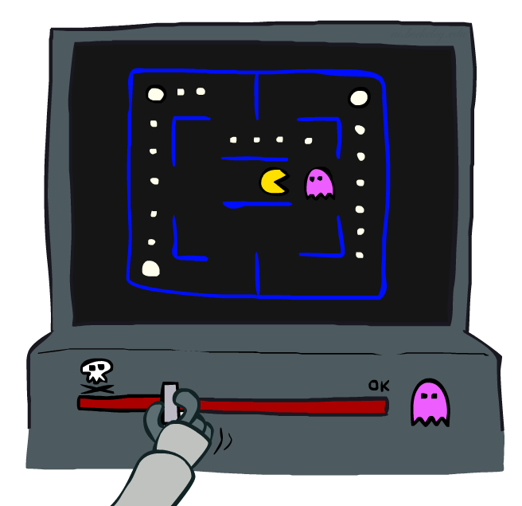
Approximate Q-Learning
Notes:
What do you do in a game like PacMan when there are so many states, that you can’t possibly learn about every one.
The basic idea is called approximate Q-Learning. When you learn that a ghost is bad, you should transfer that to other states that have ghosts.

Slide 40
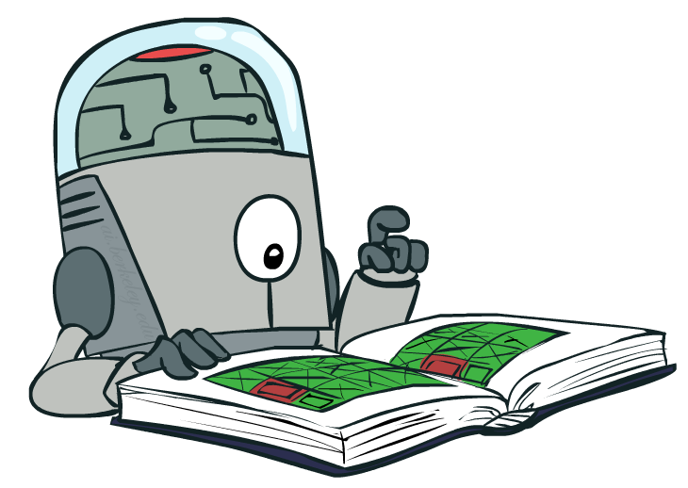
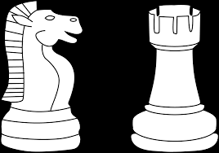
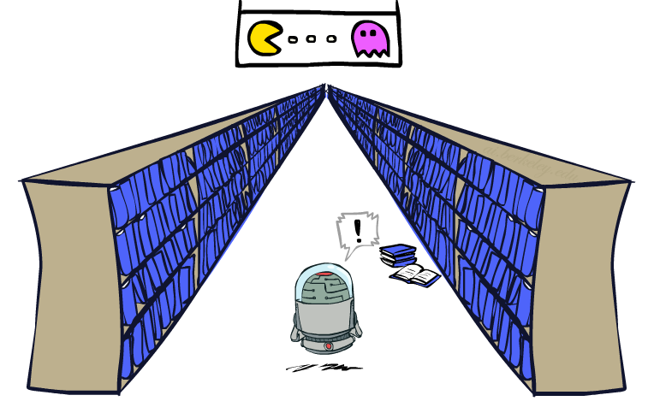
Generalizing Across States
Basic Q-Learning keeps a table of all q-values
In realistic situations, we cannot possibly learn about every single state!
Too many states to visit them all in training
Too many states to hold the q-tables in memory
Instead, we want to generalize:
Learn about some small number of training states from experience
Generalize that experience to new, similar situations
This is a fundamental idea in machine learning, and we’ll see it over and over again
Notes:
For ever cell and every action, you’ve got a table of values that you’re storing.
The problem is that for games like PackMan there are too many states to hold in memory, so many that you can’t hold them all in memory.
Instead, we want to generalize. This is a fundamental idea in machine learning.
You want to be able to generalize not just to save on time and storage, but because it’s better. You’re going to learn faster through generalization.

Slide 41
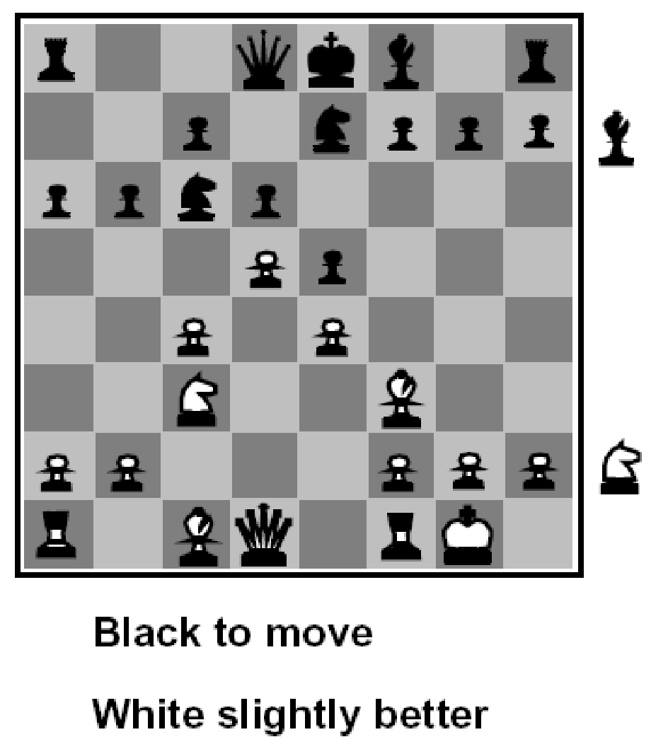
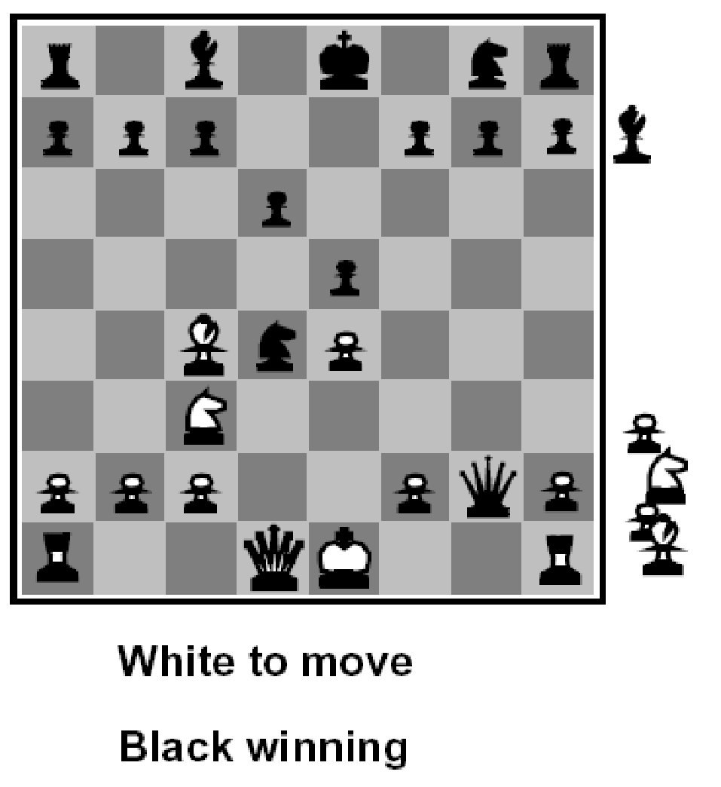
Flashback: Evaluation Functions
Evaluation functions score non-terminals in depth-limited search
Ideal function: returns the actual minimax value of the position
In practice: typically weighted linear sum of features:
e.g. f₁(s) = (num white queens – num black queens), etc.

Slide 42
Linear Value Functions
Using a feature representation, we can write a q function (or value function) for any state using a few weights:
Advantage: our experience is summed up in a few powerful numbers
Disadvantage: states may share features but actually be very different in value!
Notes:
This gives us linear value functions.
For state evaluation we had V(s), like what we did for Chess.
For reinforcement learning, we do Q(S,A), where we’re evaluating the actions as well as the state.
We’ll allow the learning algorithm to set the weights automatically.

Slide 43

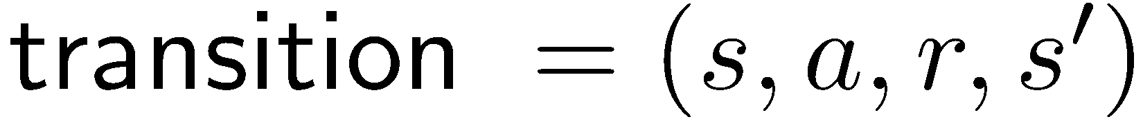
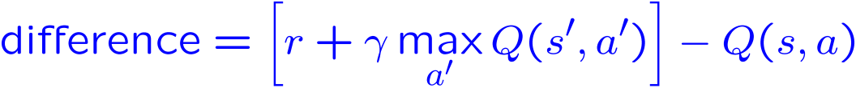
Approximate Q-Learning
Q-learning with linear Q-functions:
Intuitive interpretation:
Adjust weights of active features
E.g., if something unexpectedly bad happens, blame the features that were on: disprefer all states with that state’s features
Formal justification: online least squares
Exact Q’s
Approximate Q’s
Notes:
Here’s the magic equation for approximate q-learning.
I give you the state and the action, and out pops the value.
So how do we do learning with this type of Q function?
The first part of the learning algorithm doesn’t actually care where the Q value came from. It says, give me a transition so that I can learn.
We then take a difference. I thought that we were going to get Q(S,A0. I now think that I’m going to this reward, plus some discounted future reward. So the difference is essentially an ERROR TERM. It’s the difference between what we thought we would get and what we seemed to be about to get on the basis of the this one step ahead experience.
For an exact inference it’s this. This is just the algebraic re-write of taking alpha of one, and 1-alpha of the other.
Basically what we do is we keep our Q value around, and then nudge it in the direction of who we were wrong.
It would be really easy to update this value if we were storing Q values in a table. However, now we’re strong Q values as a linear sum, and the only parameters we can adjust are the weights.
If we determine that my Q value wasn’t high enough for this state, then we need to change the weights to make it higher.
The way that we do that is to increase the weights? Which ones? All of them, but in proportion to the feature value. If it’s negative we’re actually going to decrease its weight because of the sign change.
You compute how wrong you were, and you try to adjust the weights to fix it.
Intuitive interpretation is to adjust these sliders.

Slide 44
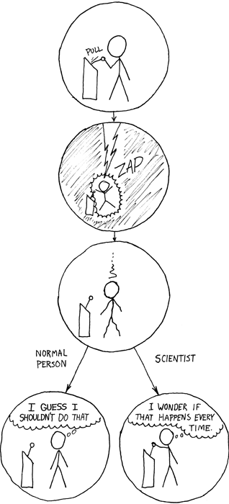
HW6
Homework 6: Reinforcement learning [100 points]
1. Q-Learning [35 Points]
Epsilon Greedy [20 points]
Bridge Crossing Revisited [10 points]
Q-Learning and Pacman [10 points]
Approximate Q-Learning [20 points]

Slide 45
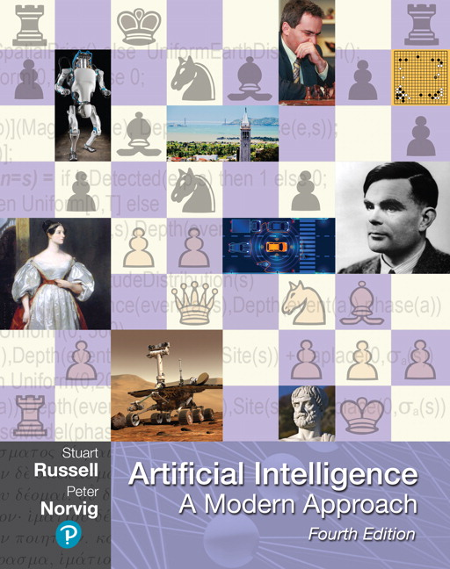
Reading
Chapter 22 – Reinforcement Learning Sections 22.1-22.5

