Slide 1
Probabilities and Language Models

Slide 2

Uncertainty
General situation:
Observed variables (evidence): Agent knows certain things about the state of the world (e.g., sensor readings or symptoms)
Unobserved variables (states): Agent needs to reason about other aspects (e.g. where an object is or what disease is present)
Model: Agent knows something about how the known variables relate to the unknown variables
Probabilistic reasoning gives us a framework for managing our beliefs and knowledge
Notes:
Consider the following example: You are the security guard stationed at a secret underground installation. You want to know whether it’s raining today, but your only access to the outside world occurs each morning when you see the director coming in with, or without, an umbrella. For each day t, the set Et thus contains a single evidence variable Umbrellat or Ut for short (whether the umbrella appears), and the set Xt contains a single state variable Raint or Rt for short (whether it is raining).

Slide 3
What Probabilities Are About
Like logical assertions, probabilities are about possible worlds. Instead of strictly ruling out possibilities (where a logical assertion is false), probabilities quantify how likely a particular possible world is.
In probability theory, the possible worlds are called the sample space, and they mutually exclusive and exhaustive.
A fully specified probability model associates a probability P(𝑤) with each possible world 𝑤.

Slide 4

Random Variables
A random variable is some aspect of the world about which we (may) have uncertainty
R = Is it raining?
U = Is the professor carrying an umbrella?
We denote random variables with capital letters
Notes:
We are going to deal with discrete random variables, rather than continuous ones. In continuous you deal with integrals rather than summations.

Slide 5
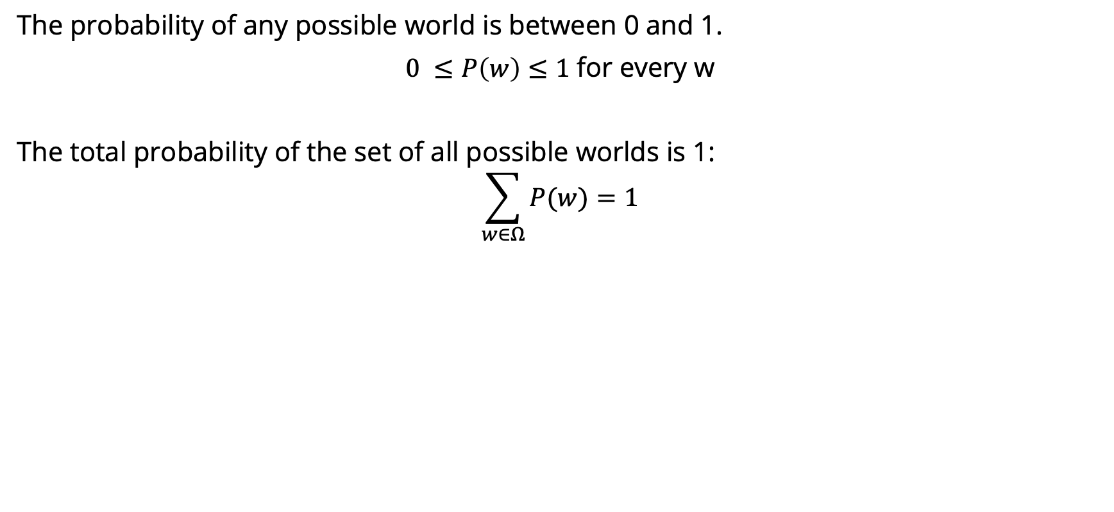
Axioms of Probability

Slide 6




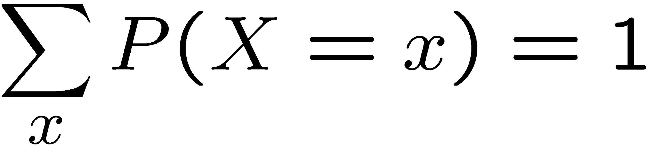
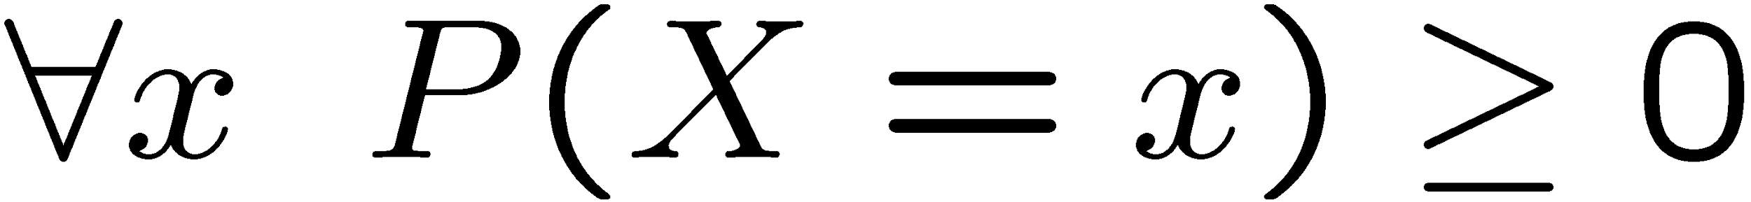
Probability Distributions
Unobserved random variables have distributions
A distribution is a TABLE of probabilities of values
A probability (lower case value) is a single number
Must have: and
Shorthand notation:
OK if all domain entries are unique
T | P
hot | 0.5
cold | 0.5
W | P
sun | 0.6
rain | 0.1
fog | 0.3

Slide 7




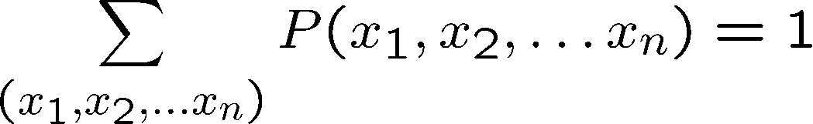
Joint Distributions
A joint distribution over a set of random variables:
specifies a real number for each assignment (or outcome):
Must obey:
Size of distribution if n variables with domain sizes d?
For all but the smallest distributions, impractical to write out!
T | W | P
hot | sun | 0.4
hot | rain | 0.1
cold | sun | 0.2
cold | rain | 0.3
Notes:
N*D? No.
D^N? Yes.
In the next lectures we’re going to see how to work with how to deal with large sets of variables.

Slide 8
Probabilistic Models
Distribution over T,W
A probabilistic model is a joint distribution over a set of random variables
Probabilistic models:
(Random) variables with domains
Assignments are called outcomes
Joint distributions: say whether assignments (outcomes) are likely
Normalized: sum to 1.0
Ideally: only certain variables directly interact
T | W | P
hot | sun | 0.4
hot | rain | 0.1
cold | sun | 0.2
cold | rain | 0.3

Slide 9
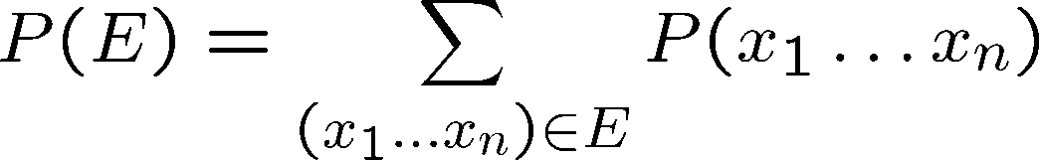
Events
An event is a set E of outcomes
From a joint distribution, we can calculate the probability of any event
Probability that it’s hot AND sunny?
Probability that it’s hot?
Probability that it’s hot OR sunny?
Typically, the events we care about are partial assignments, like P(T=hot)
T | W | P
hot | sun | 0.4
hot | rain | 0.1
cold | sun | 0.2
cold | rain | 0.3
Notes:
An event is a set of possible outcomes. We compute these by summing over all subsets of variables that are compatible with that event. These are subsets of variables.
Let’s say x1=true, then if you sum over all entries in the joint table with x1…xN, where the entry says x=1 is true then you get the probability that x=1 true.
Events don’t have to be as simple as x1=true. It could be x1=true and x2=false. Or more combinations of variables coule be involved.
Look at all of the entries that are consistent with the event.
Probability that it’s hot AND sunny? 0.4
Probability that it’s hot? 0.5
Probability that it’s hot OR sunny? 0.8

Slide 10
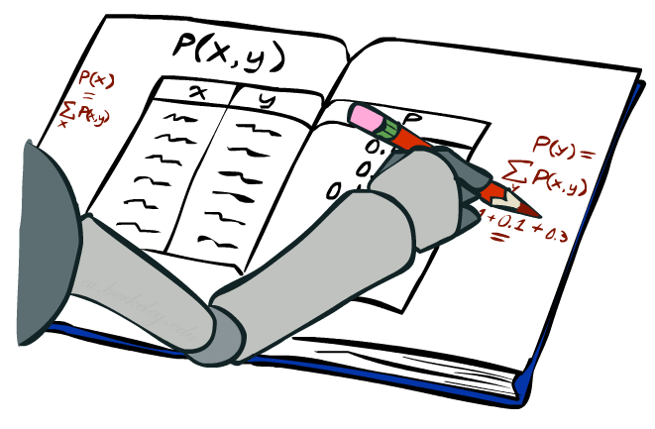
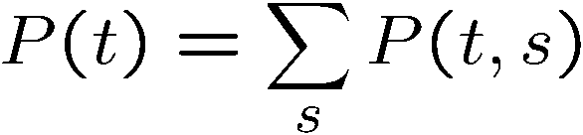
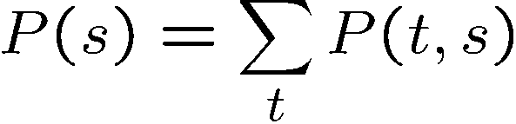
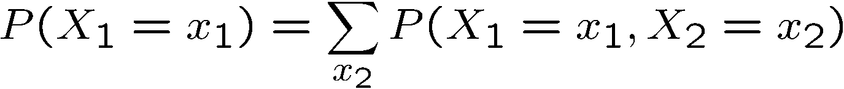
Marginal Distributions
Marginal distributions are sub-tables which eliminate variables
Marginalization (summing out): Combine collapsed rows by adding
T | P
hot | 0.5
cold | 0.5
T | W | P
hot | sun | 0.4
hot | rain | 0.1
cold | sun | 0.2
cold | rain | 0.3
W | P
sun | 0.6
rain | 0.4
Notes:
Marginalize distribution means you build a new table for a subset of random variables.
This is the general equation. You can apply it to any number of random variables. If you had 3 random varaibles, you could compute the marginals for
Just x1
Just x2
Just x3
x1 and x2
x2 and x3
x1 and x3

Slide 11
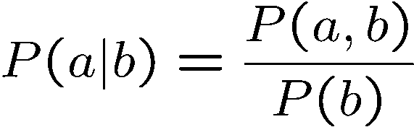
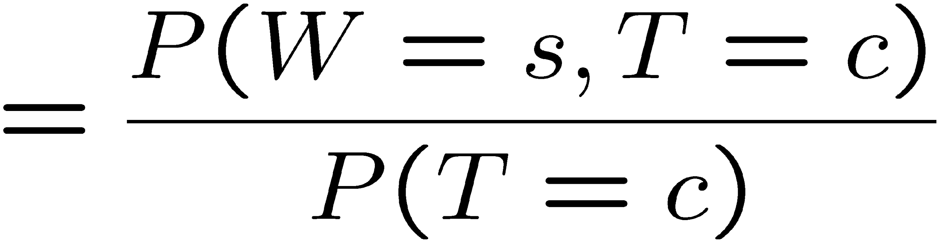
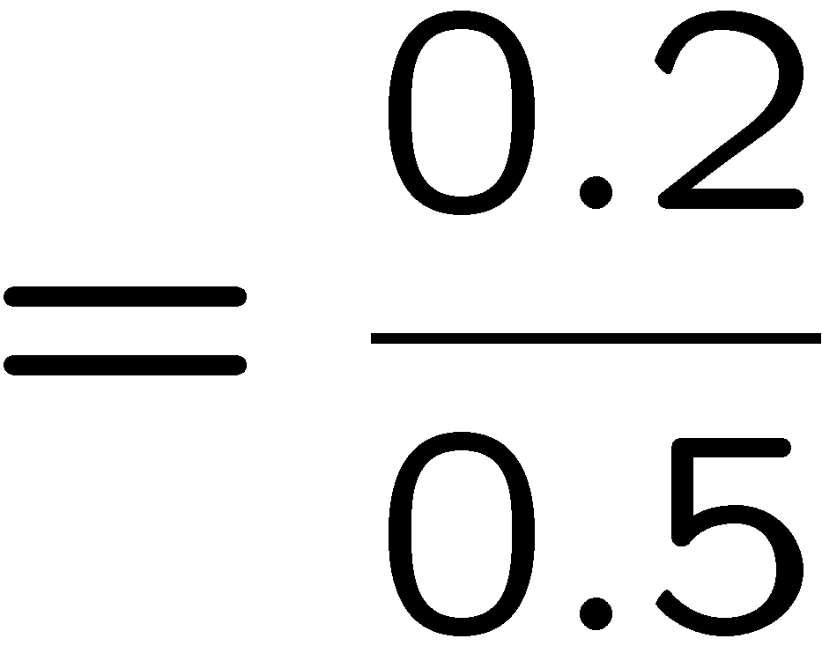



Conditional Probabilities
A simple relation between joint and conditional probabilities
In fact, this is taken as the definition of a conditional probability
P(a,b)
P(a)
P(b)
T | W | P
hot | sun | 0.4
hot | rain | 0.1
cold | sun | 0.2
cold | rain | 0.3
Notes:
This is the most important concept. Why because it tells us, if we measure something, what does it tell us about the things that we didn’t get to measure. That’s what conditional probabilities come in.
A conditional probability that random variable Capital A will take on value lowercase a, given that random variable Capital B takes on value lowercase b. This is given by the probability of seeing both a and b, divided by the probability of seeing b.
[Explain the Venn diagram.]
Write out the equation for P(sun|cold)

Slide 12



Conditional Distributions
Conditional distributions are probability distributions over some variables given fixed values of others
Conditional Distributions
Joint Distribution
W | P
sun | 0.8
rain | 0.2
T | W | P
hot | sun | 0.4
hot | rain | 0.1
cold | sun | 0.2
cold | rain | 0.3
W | P
sun | 0.4
rain | 0.6
Notes:
Before we saw how to go from a joint distribution to a marginal distribution. Now we’re going to see how to go from a joint distribution to a conditional.
A conditional distribution is a consequence of the joint distribution. We do that just like we did on the previous slide).
P(W|T) is a set of tables that can be extracted from the joint distribution P(T, W).

Slide 13

Probabilistic Inference
Probabilistic inference: compute a desired probability from other known probabilities (e.g. conditional from joint)
We generally compute conditional probabilities
P(on time | no reported accidents) = 0.90
These represent the agent’s beliefs given the evidence
Probabilities change with new evidence:
P(on time | no accidents, 5 a.m.) = 0.95
P(on time | no accidents, 5 a.m., raining) = 0.80
Observing new evidence causes beliefs to be updated
Notes:
What is probabilistic inference in general? It’s computing some desired probabilities (usually conditionals), given some input set of probabilities (by default, a large joint distribution).
The reason that this is interesting, is that our probability distributions change as we accrue more evidence.
Observing new evidence causes our beliefs to be updated. Evidence can cause the probabilities to go up or to go down.

Slide 14





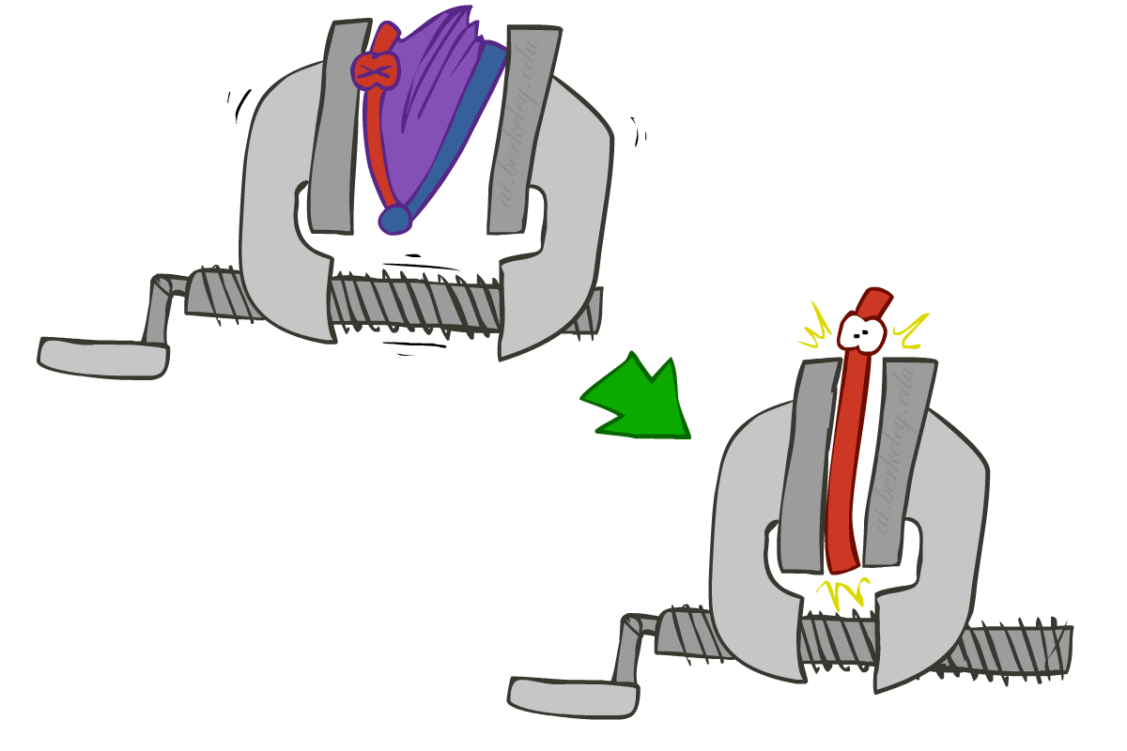
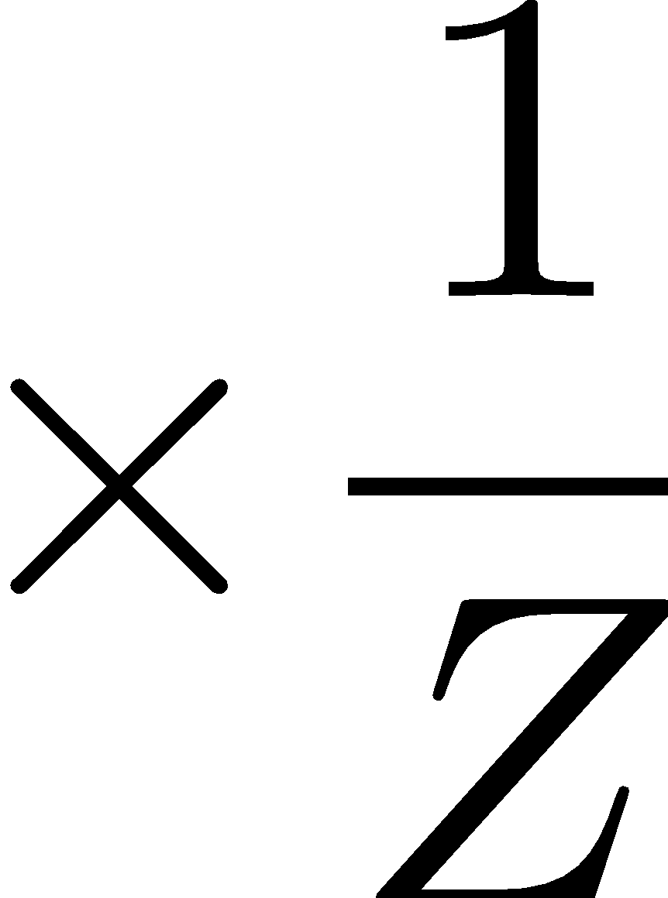
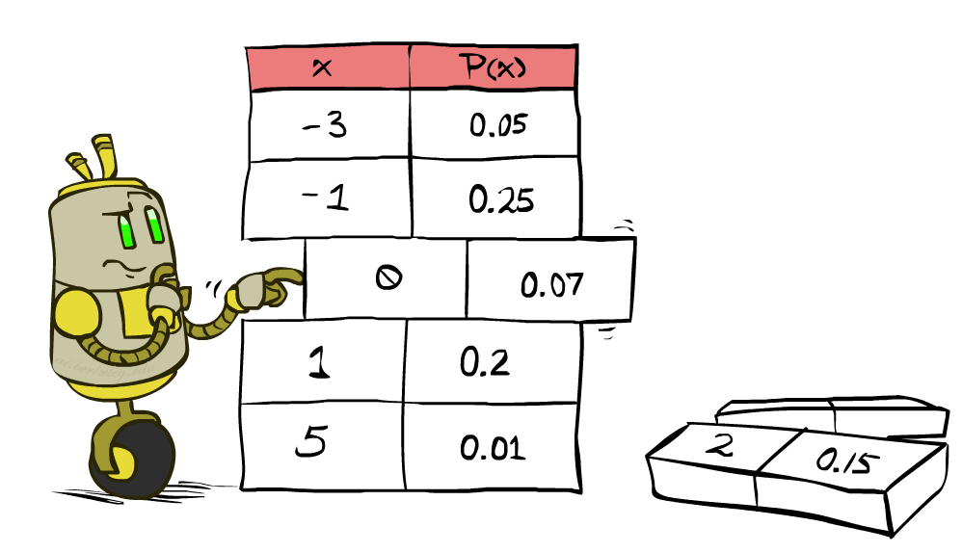


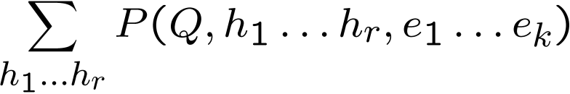
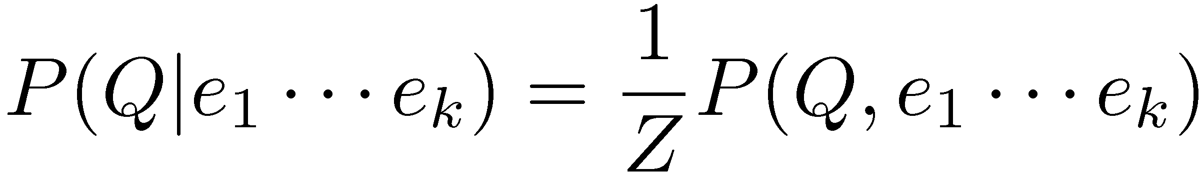
Inference by Enumeration
* Works fine with multiple query variables, too
General case:
Evidence variables:
Query* variable:
Hidden variables:
We want:
All variables
Step 1: Select the entries consistent with the evidence
Step 2: Sum out H to get joint of Query and evidence
Step 3: Normalize
Notes:
Here’s the first procedure that we’ll look at for Probabilistic Inference. It is called Inference by Enumeration
We can split up our variables into 3 sets:
1. some evidence variables – those are what we’ve observed.
2. The query variables – those are what we want to know about
3. The hidden variables – those appear in the joint distribution, but don’t appear in the previous 2.
Here are the 3 steps that we need to do:
Step 1: select all entries that are consistent with the Evidence.
Step 2: Sum out the hidden variables. Sum over all possible instantiations of the hidden variables. That leaves us with the joint distribution between the query variable and the evidence variables.
That’s something like P(a, c) = sum over b P(a,b,c).
That’s the same as P(q, e) = sum over h P(q,h,e).
Step 3: Normalize to get the conditional probability.

Slide 15
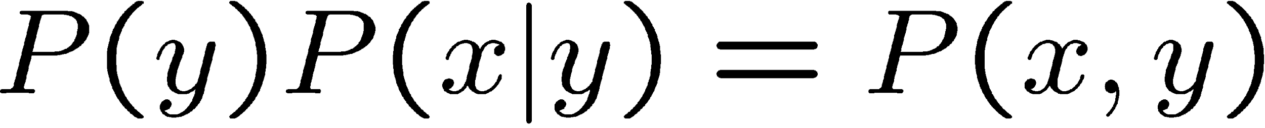


The Product Rule
Example:
D | W | P
wet | sun | 0.1
dry | sun | 0.9
wet | rain | 0.7
dry | rain | 0.3
D | W | P
wet | sun | 0.08
dry | sun | 0.72
wet | rain | 0.14
dry | rain | 0.06
R | P
sun | 0.8
rain | 0.2
Notes:
How do recover the full joint distribution?
P(wet, sun) =. P(sun) * P(wet | sun) = 0.8 * 0.1 = 0.08
P(dry, sun) =. P(sun) * P(dry| sun) = 0.8 * 0.9 = 0.72
…
We can compute every entry that way.

Slide 16
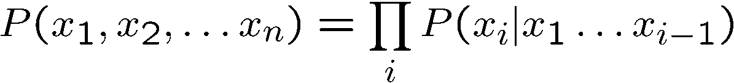
The Chain Rule
More generally, can always write any joint distribution as an incremental product of conditional distributions
Why is this always true?
Notes:
Can we apply the product rule to more than two variables? Yes! It’s called the chain rule.
Here’s the chain rule for 3 variables, x1, x2, x3. It’s the maginal of x1, times the conditional of x2 given x1, times the conditional of x3 given x1 and x2.
We can generalize this to any number of x1 to x_n as ….
i = 1 P(x1)
I = 2 p(x2|x1)
I = 3 p(x3|x1, x2)
…
I = n p(x_n|x1, x2, …. Xn-1)
Then you take the product of all of those. You can take any ordering and still apply this chain rule. There are n! ways of writing the joint over the ordering of n variables.
Why is this always true? [Write out the equations for P(x1,x2,x3) replacing each conditional with its joint over marginal equivalent and show how the cancel.).
P(x1) * P(x2|x1) * p(x3|x2,x1) rewrites as P(x1) * P(x2,x1)/P(x1) * p(x3,x2,x1)/p(x2,x1).
Show the cancelation of each numerator and the next term’s denominator.
That leaves p(x3,x2,x1).
If you want, you can prove this by induction.

Slide 17


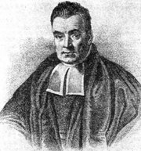
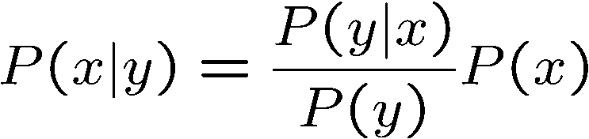
Bayes’ Rule
Two ways to factor a joint distribution over two variables:
Dividing, we get:
Why is this at all helpful?
Lets us build one conditional from its reverse
Often one conditional is tricky but the other one is simple
Foundation of many systems we’ll see later (e.g. ASR, MT)
In the running for most important AI equation!
Notes:
We start with the product rule. Just like the chain rule you can write the variables in any order.
Next we divide by p(y) to get this formula for the conditional probability.
Why is this helpful? Sometimes one conditional is much trickier to get than it is to get other conditionals.
Very imporant for AI in the 1990s. In fact Fred Jelinek, my former boss at JHU, dubbed it the fundamental equation of machine translation.
Generalizations of this will be what we study in the next few lectures.

Slide 18

https://www.youtube.com/watch?v=M8MJFrdfGe0
Notes:
https://www.youtube.com/watch?v=M8MJFrdfGe0

Slide 19
Probabilistic Language Models

Slide 20
Probabilistic Language Models
One goal: assign a probability to a sentence
Autocomplete for texting
Machine Translation
Spelling Correction
Speech Recognition
Other Natural Language Generation tasks: summarization, question-answering, dialog systems
Notes:
minuet = a slow, stately ballroom dance

Slide 21
Probabilistic Language Modeling
Goal: compute the probability of a sentence or sequence of words
Related task: probability of an upcoming word
A model that computes either of these is called a language model or LM

Slide 22
Probabilistic Language Modeling
Goal: compute the probability of a sentence or sequence of words
P(W) = P(w₁,w₂,w₃,w₄,w₅…w_{n})
Related task: probability of an upcoming word
P(w₅|w₁,w₂,w₃,w₄)
A model that computes either of these
P(W) or P(w_{n}|w₁,w₂…w_{n-1}) is called a language model.
Better: the grammar But language model or LM is standard

Slide 23
How to compute P(W)
How to compute this joint probability:
P(the, underdog, Philadelphia, Eagles, won)
Intuition: let’s rely on the Chain Rule of Probability

Slide 24
The Chain Rule

Slide 25
The Chain Rule
Recall the definition of conditional probabilities
p(B|A) = P(A,B)/P(A) Rewriting: P(A,B) = P(A)P(B|A)
More variables:
P(A,B,C,D) = P(A)P(B|A)P(C|A,B)P(D|A,B,C)
The Chain Rule in General
P(x₁,x₂,x₃,…,x_{n}) = P(x₁)P(x₂|x₁)P(x₃|x₁,x₂)…P(x_{n}|x₁,…,x_{n-1})

Slide 26
Joint probability of words in sentence

Slide 27
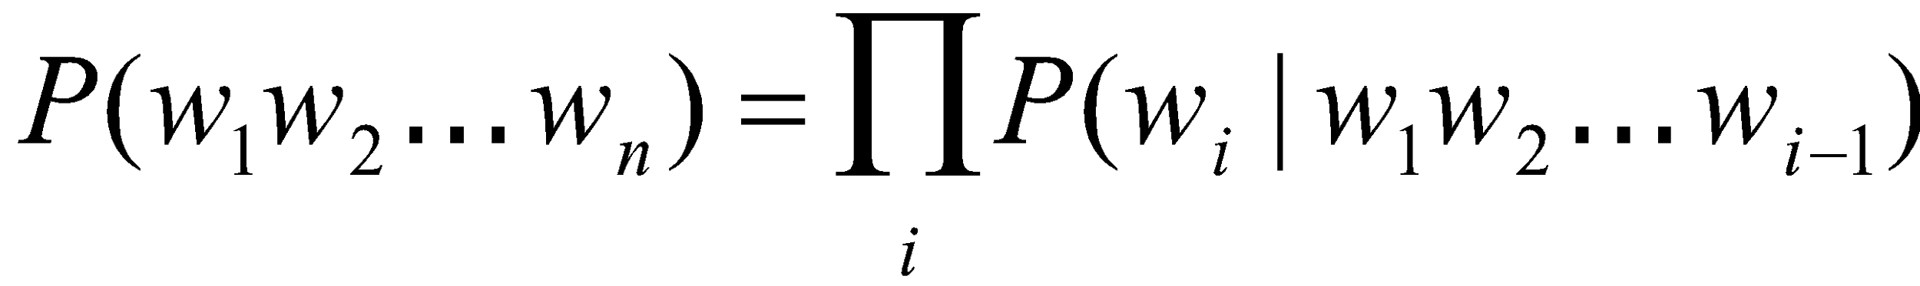
Joint probability of words in sentence
P(“the underdog Philadelphia Eagles won”) =
P(the) × P(underdog|the) × P(Philadelphia|the underdog) × P(Eagles|the underdog Philadelphia) x P(won|the underdog Philadelphia Eagles)

Slide 28
How to estimate these probabilities
Could we just count and divide?

Slide 29
How to estimate these probabilities
Could we just count and divide? Maximum likelihood estimation (MLE)
Why doesn’t this work?
P(won|the underdog team) = Count(the underdog team won)
Count(the underdog team)
Notes:
Sentences may not appear
Need a lrage data set
Many ways of combining words into sentences
Never going to have enough data to estimate the probability of a whole sentence

Slide 30
Simplifying Assumption = Markov Assumption

Slide 31
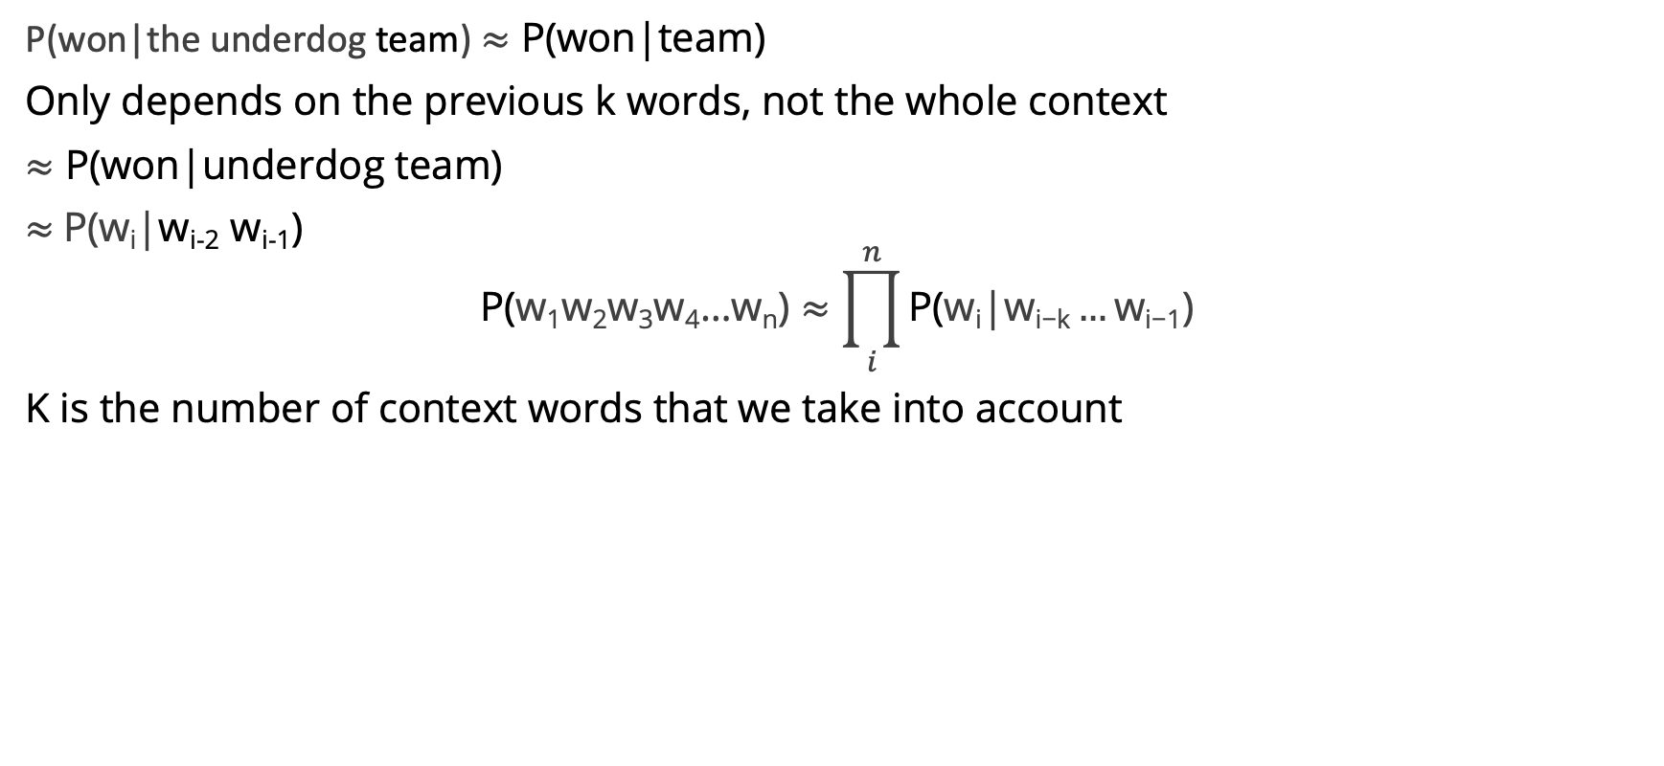
Simplifying Assumption = Markov Assumption

Slide 32
How much history should we use?
unigram | no history
bigram | 1 word as history
trigram | 2 words as history
4-gram | 3 words as history

Slide 33
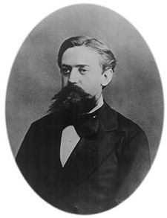
Historical Notes
1913 | Andrei Markov counts 20k letters in Eugene Onegin
1948 | Claude Shannon uses n-grams to approximate English
1956 | Noam Chomsky decries finite-state Markov Models
1980s | Fred Jelinek at IBM TJ Watson uses n-grams for ASR, think about 2 other ideas for models: (1) MT, (2) stock market prediction
1993
 | Jelinek left IBM to found CLSP at JHU Peter Brown and Robert Mercer move to Renaissance Technology
Andrei Markov
Notes:
In a series of extremely influential papers starting with Chomsky (1956) and including Chomsky (1957) and Miller and Chomsky (1963), Noam Chomsky argued that “finite-state Markov processes”, while a possibly useful engineering heuristic, were incapable of being a complete cognitive model of human grammatical knowl- edge. These arguments led many linguists and computational linguists to ignore work in statistical modeling for decades.

Slide 34
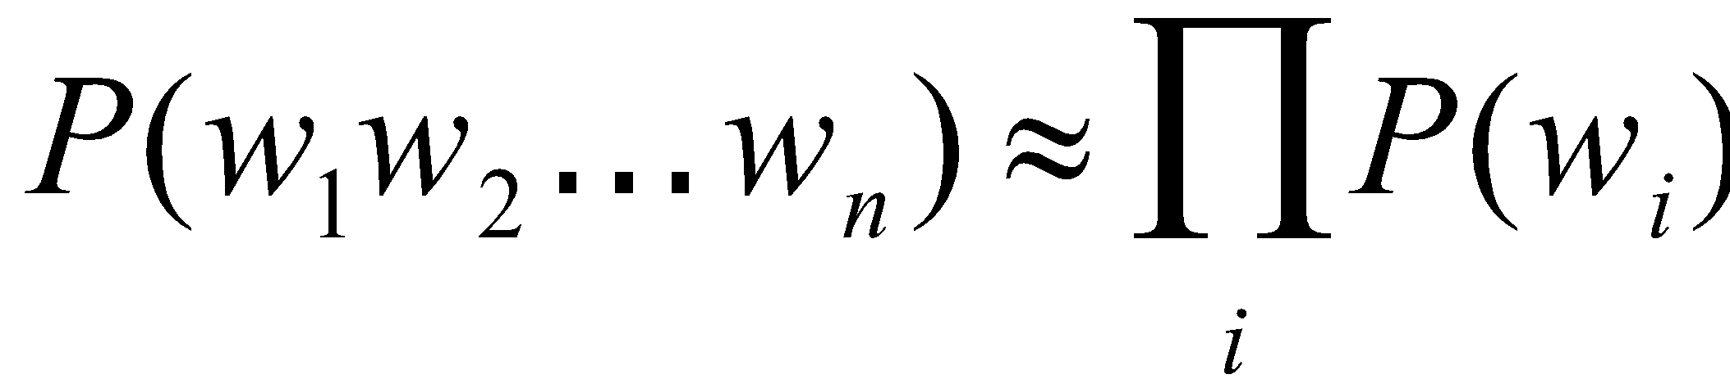
Simplest case: Unigram model
Some automatically generated sentences from a unigram model
fifth an of futures the an incorporated a a the inflation most dollars quarter in is mass
thrift did eighty said hard 'm july bullish
that or limited the

Slide 35
Bigram model
Condition on the previous word:
texaco rose one in this issue is pursuing growth in a boiler house said mr. gurria mexico 's motion control proposal
without permission from five hundred fifty five yen
outside new car parking lot of the agreement reached
this would be a record november

Slide 36
N-gram models
We can extend to trigrams, 4-grams, 5-grams
In general this is an insufficient model of language
because language has long-distance dependencies:
“The computer(s) which I had just put into the machine room on the fifth floor is (are) crashing.”
But we can often get away with N-gram models

Slide 37
Language Modeling
Estimating N-gram Probabilities

Slide 38
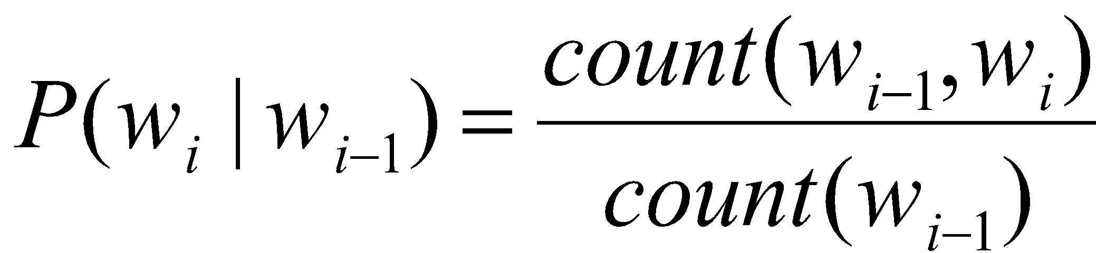
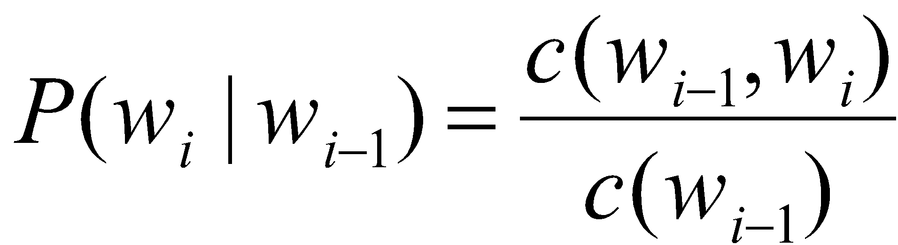
Estimating bigram probabilities
The Maximum Likelihood Estimate

Slide 39

An example
<s> I am Sam </s>
<s> Sam I am </s>
<s> I do not like green eggs and ham </s>

Slide 40
Problems for MLE
Zeros
P(memo|denied the) = 0
And we also assign 0 probability to all sentences containing it!
Train | Test
denied the allegations | denied the memo
denied the reports
denied the claims
denied the requests

Slide 41
Problems for MLE
Out of vocabulary items (OOV)
<unk> to deal with OOVs
Fixed lexicon L of size V
Normalize training data by replacing any word not in L with <unk>
Avoid zeros with smoothing

Slide 42
Practical Issues
We do everything in log space
Avoid underflow
(also adding is faster than multiplying)

Slide 43
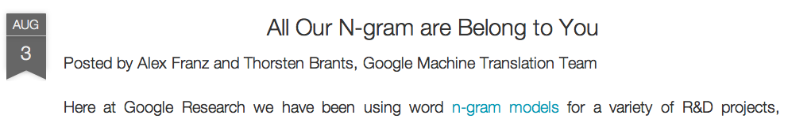
Google N-Gram Release, August 2006
…

Slide 44
Google N-Gram Release
serve as the incoming 92
serve as the incubator 99
serve as the independent 794
serve as the index 223
serve as the indication 72
serve as the indicator 120
serve as the indicators 45
serve as the indispensable 111
serve as the indispensible 40
serve as the individual 234
http://googleresearch.blogspot.com/2006/08/all-our-n-gram-are-belong-to-you.html

