Slide 1

Reminders
1 week until the American election. I voted. Did you? If you haven’t returned your PA mail-in ballot yet, drop it off at one of these locations: https://www.votespa.com/Voting-in-PA/pages/drop-box.aspx
Today is the last day to vote early! https://www.votespa.com/Voting-in-PA/Pages/Early-Voting.aspx
The extra credit for voting / civic engagement is now available (due before 8pm on election day). If you’re a foreign student, you have two options: 1) Visit Independence Hall in Philadelphia 2) Watch a documentary about the history of voting in the USA.
Midterm is due tomorrow before 8am Eastern.
You can opt in to having a partner on future HWs. Partners will be randomly assigned, and you’ll get a new partner each HW assignment.

Slide 2
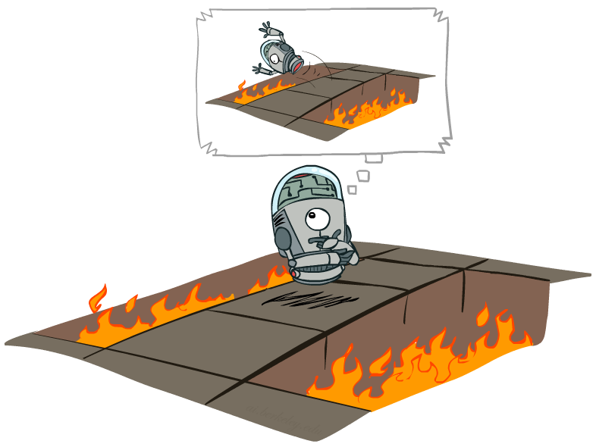
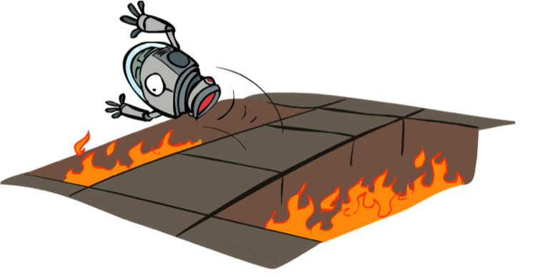
Reinforcement Learning
Slides courtesy of Dan Klein and Pieter Abbeel
University of California, Berkeley
[These slides were created by Dan Klein and Pieter Abbeel for CS188 Intro to AI at UC Berkeley. All CS188 materials are available at http://ai.berkeley.edu.]
Notes:
Figure out for a policy, what the values are.

Slide 3
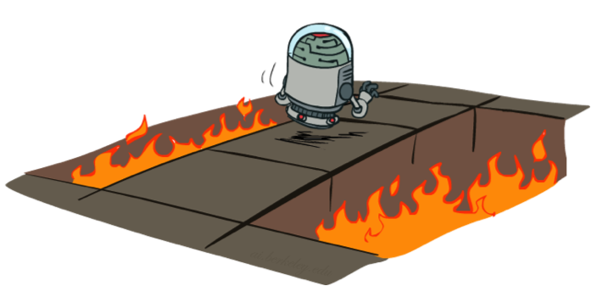
Active Reinforcement Learning
Full reinforcement learning: optimal policies (like value iteration)
You don’t know the transitions T(s,a,s’)
You don’t know the rewards R(s,a,s’)
You choose the actions now
Goal: learn the optimal policy / values
In this case:
Learner makes choices!
Fundamental tradeoff: exploration vs. exploitation
This is NOT offline planning! You actually take actions in the world and find out what happens…

Slide 4
Detour: Q-Value Iteration
Value iteration: find successive (depth-limited) values
Start with V₀(s) = 0, which we know is right
Given V_{k}, calculate the depth k+1 values for all states:
But Q-values are more useful, so compute them instead
Start with Q₀(s,a) = 0, which we know is right
Given Q_{k}, calculate the depth k+1 q-values for all q-states:

Slide 5

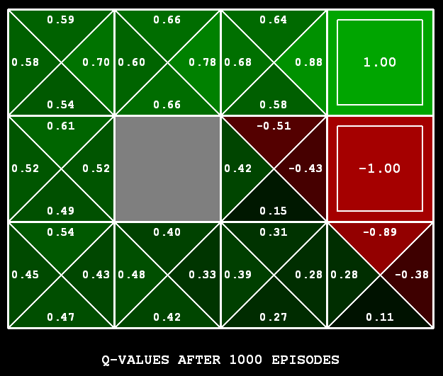
Q-Learning
Q-Learning: sample-based Q-value iteration
Learn Q(s,a) values as you go
Receive a sample (s,a,s’,r)
Consider your old estimate:
Consider your new sample estimate:
Incorporate the new estimate into a running average:

Slide 6

Q-Learning Properties
Amazing result: Q-learning converges to optimal policy -- even if you’re acting suboptimally!
This is called off-policy learning
Caveats:
You have to explore enough
You have to eventually make the learning rate
small enough
… but not decrease it too quickly
Basically, in the limit, it doesn’t matter how you select actions (!)

Slide 7
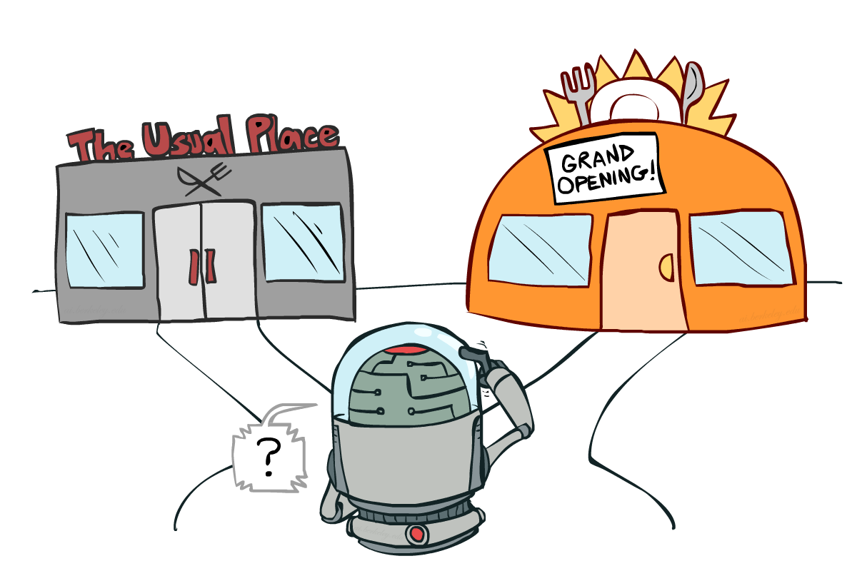
Exploration vs. Exploitation
Notes:
So what does q-learning require in order for us to learn an optimal policy.
It requires that you explore enough,.
One of the most important things in reinforcement learning is an inevitable trade off between exploration and exploitation.
You have to try some stuff. You have to make some mistakes.
Exploration may be disastrous. The food might be terrible. You may get food poisoning. But it may be your new favorite restaurant. If you don’t explore it, then you might miss out on your favorite restaurant until the end of time.

Slide 8

How to Explore?
Several schemes for forcing exploration
Simplest: random actions (ε-greedy)
Every time step, flip a coin
With (small) probability ε, act randomly
With (large) probability 1-ε, act on current policy
Notes:
Q-learning didn’t specify how to select actions.
This tells us how to selection actions to allow q-learning to do it’s magic.
The simplest way to act is called an Epsilon greedy policy. At every time step, with some (presumably small) probability, we choose something randomly.
With a presumably large probability, we act on our current policy.
A lot of random actions without not much progress.

Slide 9
How to Explore?
Several schemes for forcing exploration
Simplest: random actions (ε-greedy)
Every time step, flip a coin
With (small) probability ε, act randomly
With (large) probability 1-ε, act on current policy
Problems with random actions?
You do eventually explore the space, but keep thrashing around once learning is done
One solution: lower ε over time
Another solution: exploration functions
Notes:
Q-learning didn’t specify how to select actions.
This tells us how to selection actions to allow q-learning to do it’s magic.
The simplest way to act is called an Epsilon greedy policy. At every time step, with some (presumably small) probability, we choose something randomly.
With a presumably large probability, we act on our current policy.
A lot of random actions without not much progress.

Slide 10
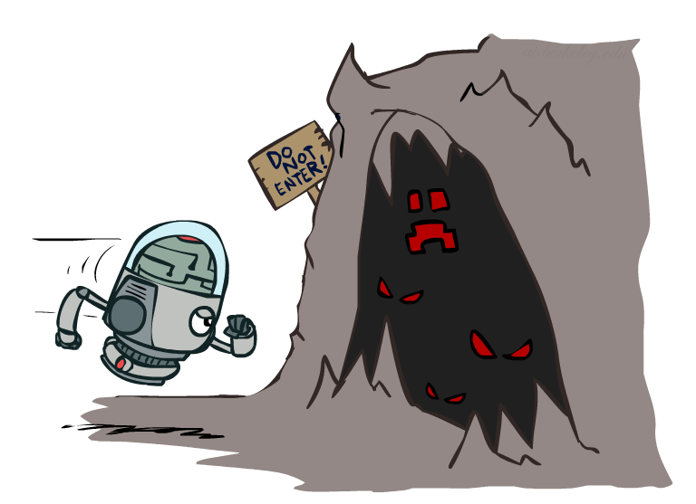

Exploration Functions
When to explore?
Random actions: explore a fixed amount
Better idea: explore areas whose badness is not
(yet) established, eventually stop exploring
Exploration function
Takes a value estimate u and a visit count n, and
returns an optimistic utility, e.g.
Note: this propagates the “bonus” back to states that lead to unknown states as well!
Regular Q-Update:
Modified Q-Update:
Notes:
When should you explore? We’ll we could try a fixed amount of randomness, or we could explore areas where the badness has not yet been established.
You should have optimism in the face of uncertainty! Go boldly into that dark cave.
We can quantify this by defining an exploration function F. It takes in a value estimate of the utility U and a count of how often we’ve visited N. For Q states N is the number of times we’ve tried that option out.
We take the utility, and we add a bonus k/n that decreases over time as we increase the number of samples. K lets us determine how much exploration to do.
Here’s our regular Q update. …
We can modify it by this term that boosts it with this function that gives us a reason to explore unknown states.

Slide 11
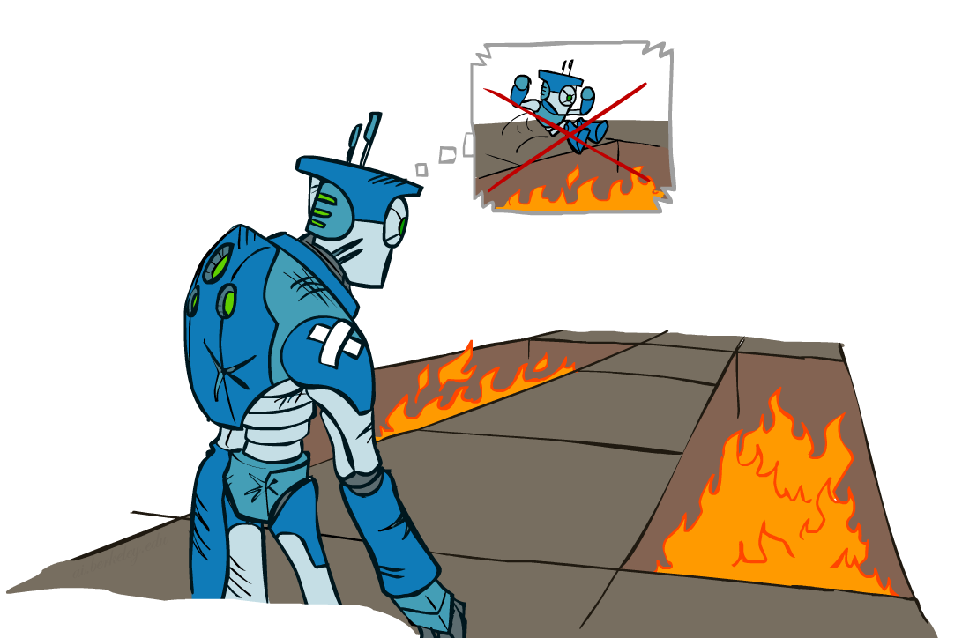
Regret
Even if you learn the optimal policy, you still make mistakes along the way!
Regret is a measure of your total mistake cost: the difference between your (expected) rewards, including youthful suboptimality, and optimal (expected) rewards
Minimizing regret goes beyond learning to be optimal – it requires optimally learning to be optimal
Example: random exploration and exploration functions both end up optimal, but random exploration has higher regret
Notes:
This brings us to the idea of regret. It’s one of those terms that has an everyday meaning, but it has a very specific meaning in this course.
You don’t get to be the wise optimal robot without making some mistakes in your youth. Here’s the wise old robot remembering when it was young and jumping into fire pits. You don’t learn an optimal policy without doing so.
Read 2nd bullet. Why expected? Because there’s some randomness to the world, which any optimal policy must account for.
Minimizing regret is like optimally learning to be optimal.

Slide 12
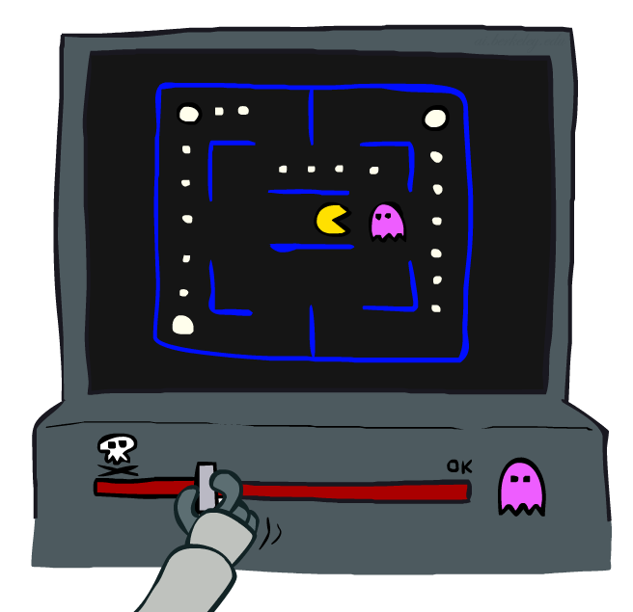
Approximate Q-Learning
Notes:
What do you do in a game like PacMan when there are so many states, that you can’t possibly learn about every one.
The basic idea is called approximate Q-Learning. When you learn that a ghost is bad, you should transfer that to other states that have ghosts.

Slide 13

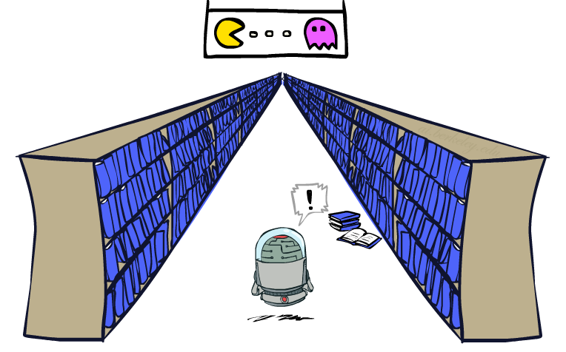
Generalizing Across States
Basic Q-Learning keeps a table of all q-values
In realistic situations, we cannot possibly learn about every single state!
Too many states to visit them all in training
Too many states to hold the q-tables in memory
Instead, we want to generalize:
Learn about some small number of training states from experience
Generalize that experience to new, similar situations
This is a fundamental idea in machine learning, and we’ll see it over and over again
Notes:
For ever cell and every action, you’ve got a table of values that you’re storing.
The problem is that for games like PackMan there are too many states to hold in memory, so many that you can’t hold them all in memory.
Instead, we want to generalize. This is a fundamental idea in machine learning.
You want to be able to generalize not just to save on time and storage, but because it’s better. You’re going to learn faster through generalization.

Slide 14
Flashback: Evaluation Functions
Evaluation functions score non-terminals in depth-limited search
Ideal function: returns the actual minimax value of the position
In practice: typically weighted linear sum of features:
e.g. f₁(s) = (num white queens – num black queens), etc.

Slide 15
Linear Value Functions
Using a feature representation, we can write a q function (or value function) for any state using a few weights:
Advantage: our experience is summed up in a few powerful numbers
Disadvantage: states may share features but actually be very different in value!
Notes:
This gives us linear value functions.
For state evaluation we had V(s), like what we did for Chess.
For reinforcement learning, we do Q(S,A), where we’re evaluating the actions as well as the state.
We’ll allow the learning algorithm to set the weights automatically.

Slide 16

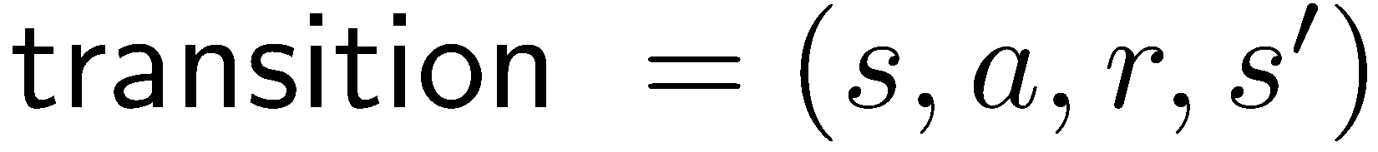
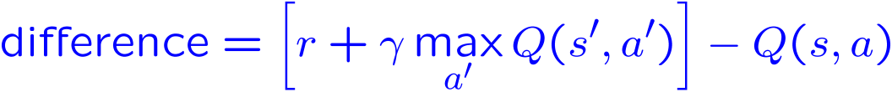
Approximate Q-Learning
Q-learning with linear Q-functions:
Intuitive interpretation:
Adjust weights of active features
E.g., if something unexpectedly bad happens, blame the features that were on: disprefer all states with that state’s features
Formal justification: online least squares
Exact Q’s
Approximate Q’s
Notes:
Here’s the magic equation for approximate q-learning.
I give you the state and the action, and out pops the value.
So how do we do learning with this type of Q function?
The first part of the learning algorithm doesn’t actually care where the Q value came from. It says, give me a transition so that I can learn.
We then take a difference. I thought that we were going to get Q(S,A0. I now think that I’m going to this reward, plus some discounted future reward. So the difference is essentially an ERROR TERM. It’s the difference between what we thought we would get and what we seemed to be about to get on the basis of the this one step ahead experience.
For an exact inference it’s this. This is just the algebraic re-write of taking alpha of one, and 1-alpha of the other.
Basically what we do is we keep our Q value around, and then nudge it in the direction of who we were wrong.
It would be really easy to update this value if we were storing Q values in a table. However, now we’re strong Q values as a linear sum, and the only parameters we can adjust are the weights.
If we determine that my Q value wasn’t high enough for this state, then we need to change the weights to make it higher.
The way that we do that is to increase the weights? Which ones? All of them, but in proportion to the feature value. If it’s negative we’re actually going to decrease its weight because of the sign change.
You compute how wrong you were, and you try to adjust the weights to fix it.
Intuitive interpretation is to adjust these sliders.

Slide 17
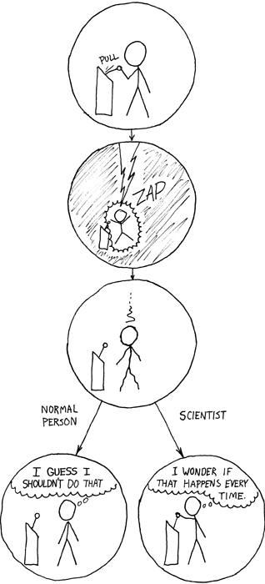
HW6
Homework 6: Reinforcement learning [100 points]
1. Q-Learning [35 Points]
Epsilon Greedy [20 points]
Bridge Crossing Revisited [10 points]
Q-Learning and Pacman [10 points]
Approximate Q-Learning [20 points]

Slide 18
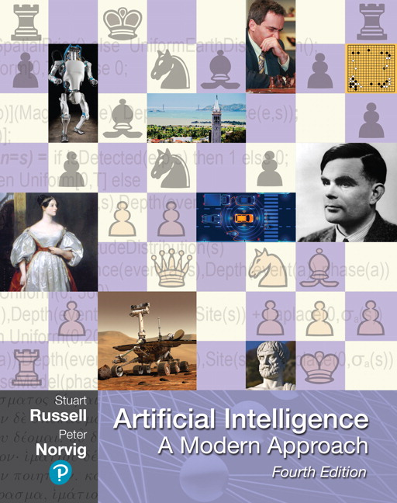
Reading
Chapter 22 – Reinforcement Learning Sections 22.1-22.5

