Slide 1
Reminders
HW7 and quiz due on Wednesday
Sign up for HW8 partners by the end of Tuesday
Two more homework assignments left in the semester:
HW8 – Perceptrons
HW9 – Neural Networks

Slide 2

Bayes’ Nets – Wrap Up
Read AIMA Chapter 13 “Probabilistic Reasoning” (Sections 13.1, 13.2 and 13.3)
Slides courtesy of Dan Klein and Pieter Abbeel – University of California, Berkeley
[These slides were created by Dan Klein and Pieter Abbeel for CS188 Intro to AI at UC Berkeley. All CS188 materials are available at http://ai.berkeley.edu.]
Notes:
Full joint probability table with 2^n entries to a bunch of conditional probabilities.

Slide 3


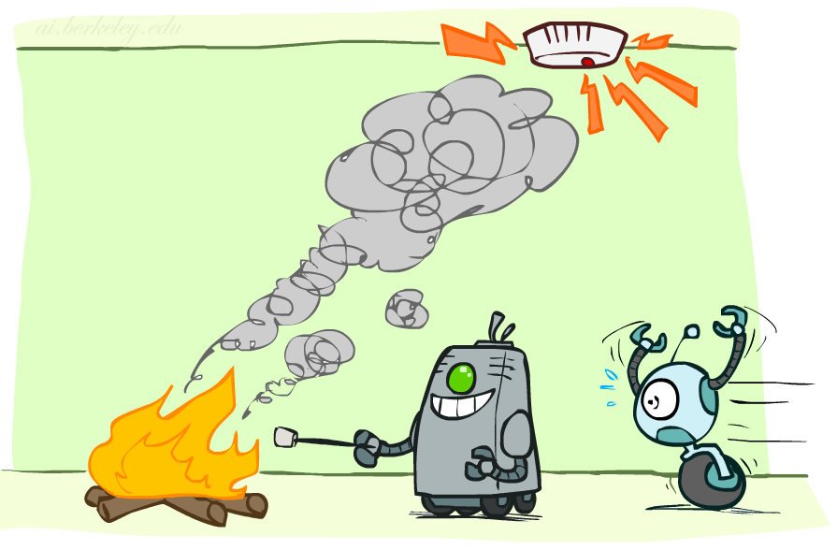

Review: Conditional Independence
X and Y are independent if
X and Y are conditionally independent given Z
(Conditional) independence is a property of a distribution
Example:

Slide 4
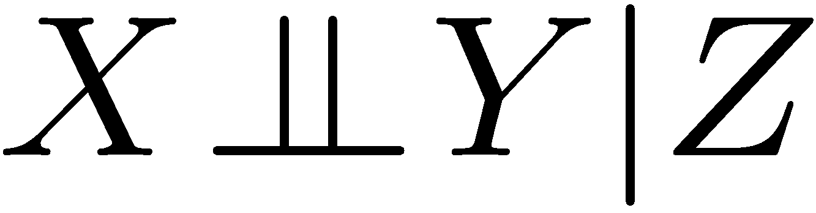
Review: Conditional Independence
Unconditional (absolute) independence very rare, and it doesn’t help us make inferences about other variables.
Conditional independence is our most basic and robust form of knowledge about uncertain environments.
X is conditionally independent of Y given Z
if and only if:
or, equivalently, if and only if
Notes:
How do we prove that? Let’s prove that the first one implies the second.
1) First, let’s start with the definition of the conditional… P(x|z,y) = P(z,y,z) / P(y,z)
2) Now we want to incorporate our assumption, since that’s critical to what we want to prove. So let’s re-write the numerator as P(z)* P(z,y|z) which is just the definition of the joint. Keep the denominator for now.
3) Let’s use our assumption, to rewrite the numerator as P(z) * (Px|z) * P(y|z). Then we can re-write the denominator as P(z)*P(y|z), and cancel terms to find that P(X|Z,Y) = P(X|Z).
Also equivalent: For All x,y,z: P(y|z,x) = P(y|z)

Slide 5
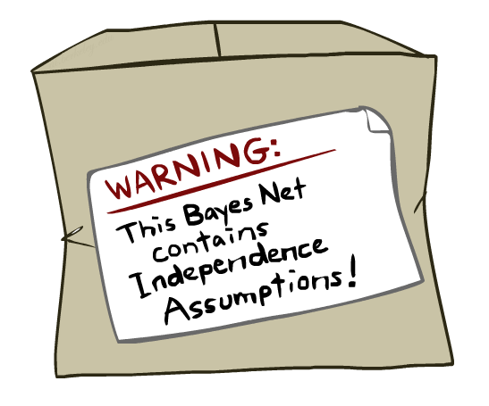
Review: Bayes Nets Assumptions
Assumptions we are required to make to define the Bayes net when given the graph:
Beyond the “chain rule → Bayes net” conditional independence assumptions
There are often additional conditional independences
They can be read off the graph
Important for modeling: understand assumptions made when choosing a Bayes net graph
Notes:
We encode some conditional independencies explicitly.
However, there are almost always some additional conditional independence assumptions that are present. And they can be read off the graph.

Slide 6
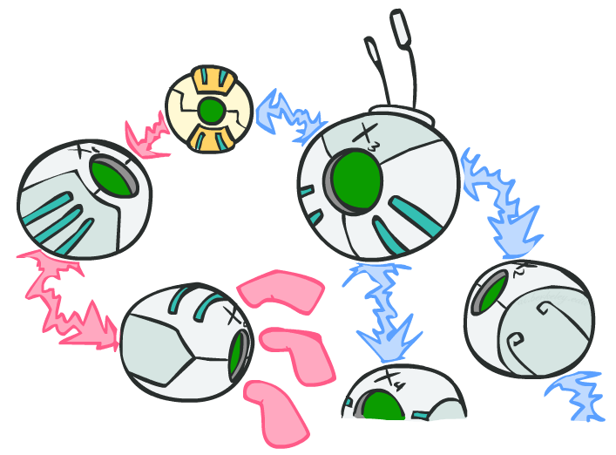
D-separation: Outline
Notes:
Study independence properties for triples
Analyze complex cases in terms of member triples
D-separation: a condition / algorithm for answering such queries
D is for Descendants.

Slide 7
D-separation: Outline
Study independence properties for triples
Analyze complex cases in terms of member triples
D-separation: a condition / algorithm for answering such queries

Slide 8
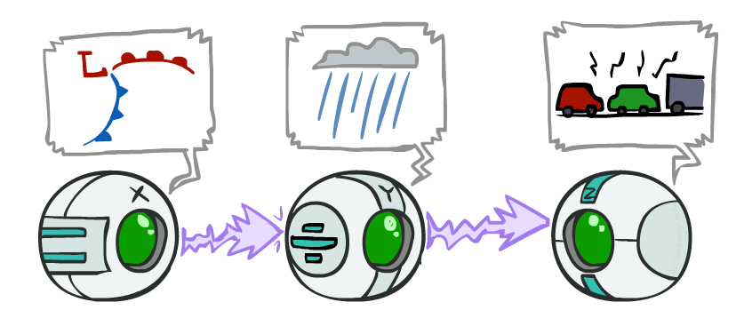
Review: Causal Chains
This configuration is a “causal chain”
Guaranteed X independent of Z ? No!
One example set of CPTs for which X is not independent of Z is sufficient to show this independence is not guaranteed.
Example:
Low pressure causes rain causes traffic,
high pressure causes no rain causes no
traffic
In numbers:
P( +y | +x ) = 1, P( -y | - x ) = 1,
P( +z | +y ) = 1, P( -z | -y ) = 1
X: Low pressure Y: Rain Z: Traffic
Notes:
The numbers show a deterministic chain. It renders X and Z not independent. X is always == Z.

Slide 9
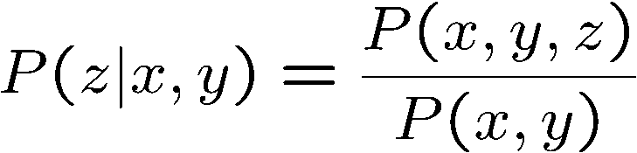
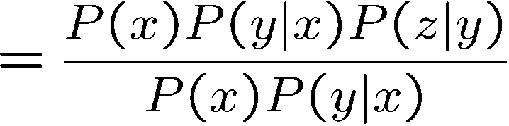

Review: Causal Chains
This configuration is a “causal chain”
Guaranteed X independent of Z given Y?
Evidence along the chain “blocks” the influence
X: Low pressure Y: Rain Z: Traffic
Yes!
Notes:
Show what cancels out.
The assumptions that are available to us are given by P(X,Y,X) = P(X) P(Y|X) P(Z|Y)

Slide 10
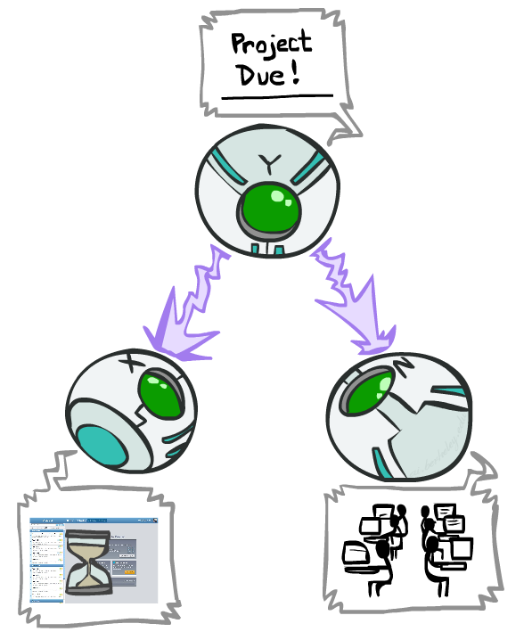
Review: Common Cause
This configuration is a “common cause”
Guaranteed X independent of Z ? No!
One example set of CPTs for which X is not independent of Z is sufficient to show this independence is not guaranteed.
Example:
Project due causes both forums busy
and office hours to be full
In numbers:
P( +x | +y ) = 1, P( -x | -y ) = 1,
P( +z | +y ) = 1, P( -z | -y ) = 1
Y: Project due
X: Forums busy
Z: Office hours full
Notes:
If X is always equal to Y and Z is always equal to Y, then they’re not independent.

Slide 11
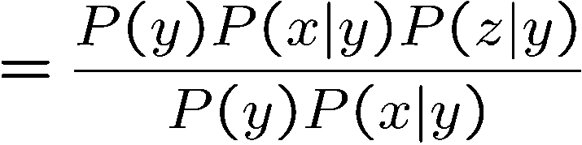
Review: Common Cause
This configuration is a “common cause”
Guaranteed X and Z independent given Y?
Observing the cause blocks influence between effects.
Y: Project due
X: Forums busy
Z: Office hours full
Yes!

Slide 12
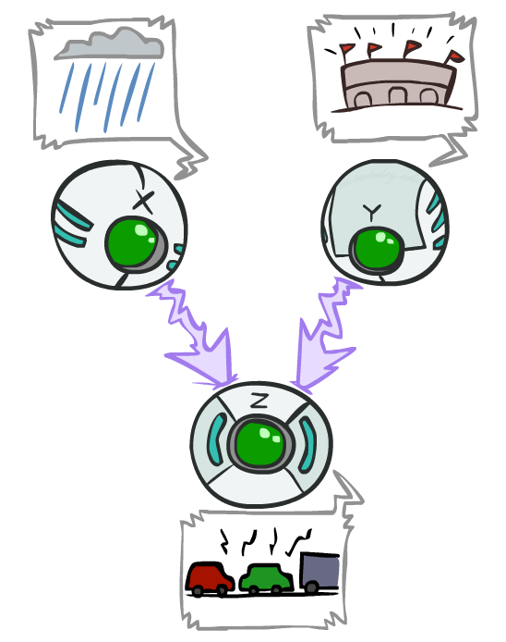
Review: Common Effect
Last configuration: two causes of one effect (v-structures)
Are X and Y independent?
Yes: the ballgame and the rain cause traffic, but they are not correlated
Still need to prove they must be (try it!)
Are X and Y independent given Z?
No: seeing traffic puts the rain and the ballgame in competition as explanation.
This is backwards from the other cases
Observing an effect activates influence between possible causes.
X: Raining
Y: Ballgame
Z: Traffic
Notes:
Special case where observing the thing in the middle make things depend on each other. You have two causes. One of the causes must be true. Observing one of the causes to be true, means that the second cause doesn’t have to be true. Seeing one explains away the need for the other.
From the Bayes net we know that:
P(C,B,Z) = P(Y) P(B) P(Z | B, C)
we can sum over E on both sides:
Σ_ Z P(C,B,E) = Σ_Z P(C) P(B) P(Z | B, C)
we can rearrange the righthand side to move the sub to what it scopes over:
Σ_Z P(C,B,E) = P(C) P(B) Σ_Z P(E | B, C)
the term Σ_Z P(Z | B, C) = 1, so we are left with:
P(C,B) = P(C) P(B)
which is the definition of independence.
Alternately we can use the independence assumptions that are encoded in all Bayes Nets.
X_i _||_ X_1 … X_i-1 – parents(X_i) | parents (X_i).
An ordering we could take here is X, Y, Z, so
X _||_ Y | empty set.

Slide 13
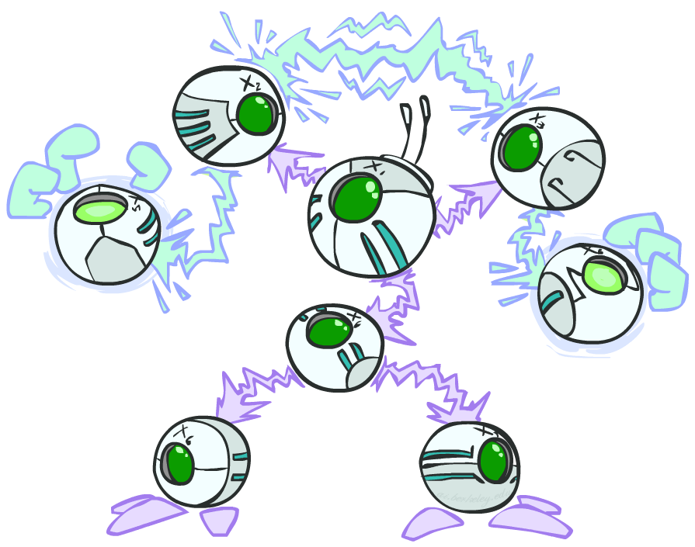
Are two variables in a BN independent?
General question: in a given BN, are two variables independent (given some evidence)?
Solution: analyze the graph
Any complex example can be broken
into repetitions of the three canonical cases
Notes:
Break the graph down to triples. Check if there is influence running along those triples. Analyze the graph. check everywhere in the graph where influence can run between two variables, or see if it is blocked.

Slide 14

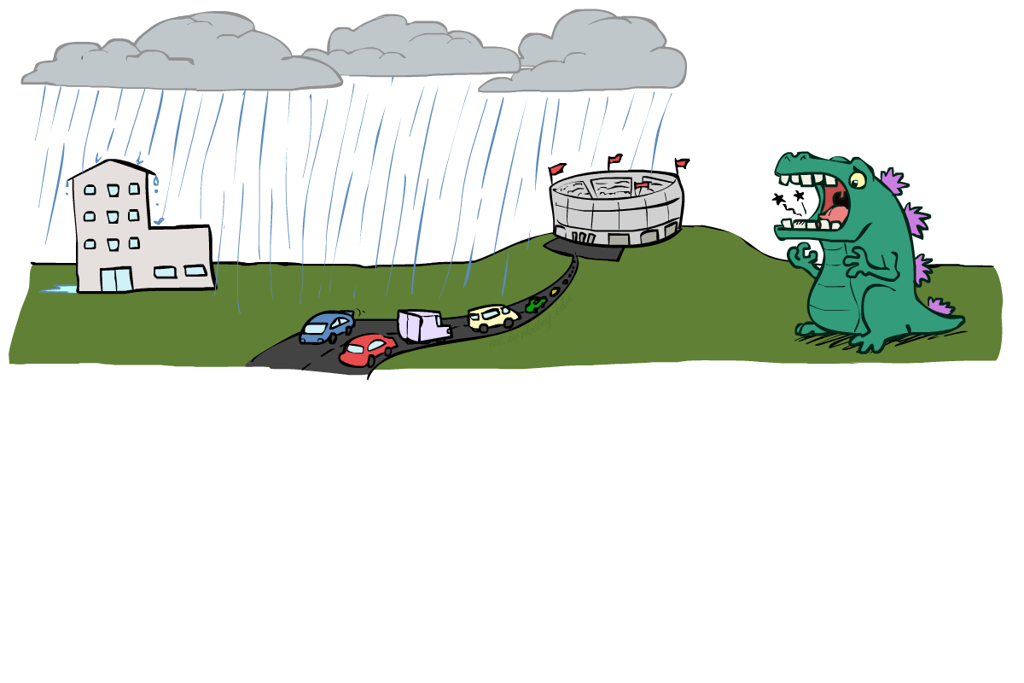
Reachability
L
Recipe: shade evidence nodes, look for paths in the resulting graph
Attempt 1: if two nodes are connected by an undirected path not blocked by a shaded node, they are conditionally independent
Almost works, but not quite
Where does it break?
Answer: the v-structure at T doesn’t count as a link in a path unless “active”
R
B
D
T
Notes:
First attempt: check whether there’s a path between two variables. Check whether it’s been blocked by some evidence. If not, then they are conditionally independent.
Too simple.
Observing T lets the influence run between R and B.

Slide 15
Active / Inactive Paths
Question: Are X and Y conditionally independent given evidence variables {Z}?
Yes, if X and Y “d-separated” by Z
Consider all (undirected) paths from X to Y
No active paths = independence!
A path is active if each triple is active:
Causal chain A → B → C where B is unobserved (either direction)
Common cause A ← B → C where B is unobserved
Common effect (aka v-structure)
A → B ← C where B or one of its descendants is observed
All it takes to block a path is a single inactive segment
Active Triples
Inactive Triples
Notes:
WRITE THIS on the board. It’s useful for the next few slides. First one is a causal change. When the middle variable isn’t active, then there’s influence between the first and the third. However, once you observe the middle variable, it blocks the influences between them and makes them independent.
Second is the common cause. Same story.
Third is the common effect. This is the odd one out.
What does it mean to be an active triple or inactive triple in the larger context?
If every triple along a path is active, then we have an active path.
If one or more triples is in active, then the whole path is inactive.

Slide 16
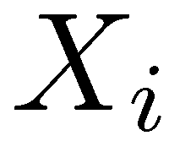
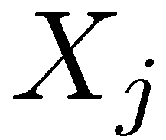

D-Separation
?
Query:
Check all (undirected!) paths between and
If one or more active, then independence not guaranteed
Otherwise (i.e. if all paths are inactive),
then independence is guaranteed
Notes:
Is it guaranteed to be true for Xi and Xj are independent given these variables and given this BN structure.
Just not guaranteed. It could be there or not. (If every distribution becomes a uniform distribution given the parent variables, then no dependencies)

Slide 17


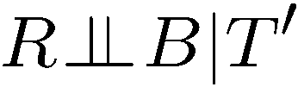
Example
Yes
R
B
No
No
T
T’
Notes:
T’: traffic report
For two and 3, the entire path is active, so no guarantee

Slide 18
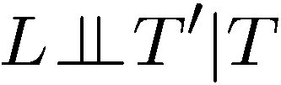


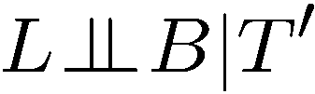

Example
L
Yes
R
B
Yes
No
D
T
No
Yes
T’

Slide 19

Structure Implications
Given a Bayes net structure, can run d-separation algorithm to build a complete list of conditional independences that are necessarily true of the form
This list determines the set of probability distributions that can be represented

Slide 20

Computing All Independences
Y
X
Z
Y
X
Z
X
Z
Y
Y
X
Z

Slide 21

Inference
Inference: calculating some useful quantity from a joint probability distribution
Examples:
Posterior probability
Most likely explanation:
Notes:
Answer some useful query about a probability distribution.
Two use cases.
1. Determine the posterior probability of some query given some evidence.
2. Pick the most likely instantiation of the query variable given that evidence.
We’ll focus on the first one, but the second can be answered in a very similar way. You’ll change summations with maxes.

Slide 22





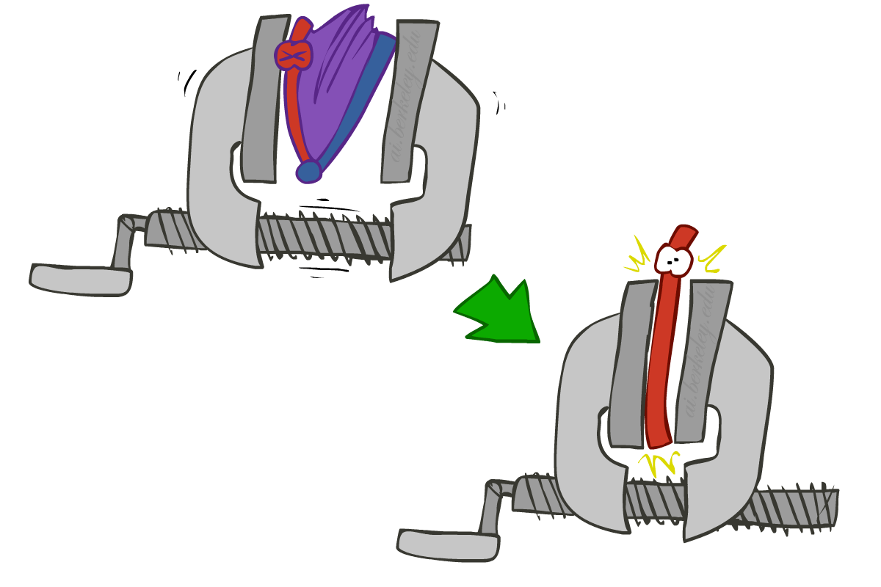
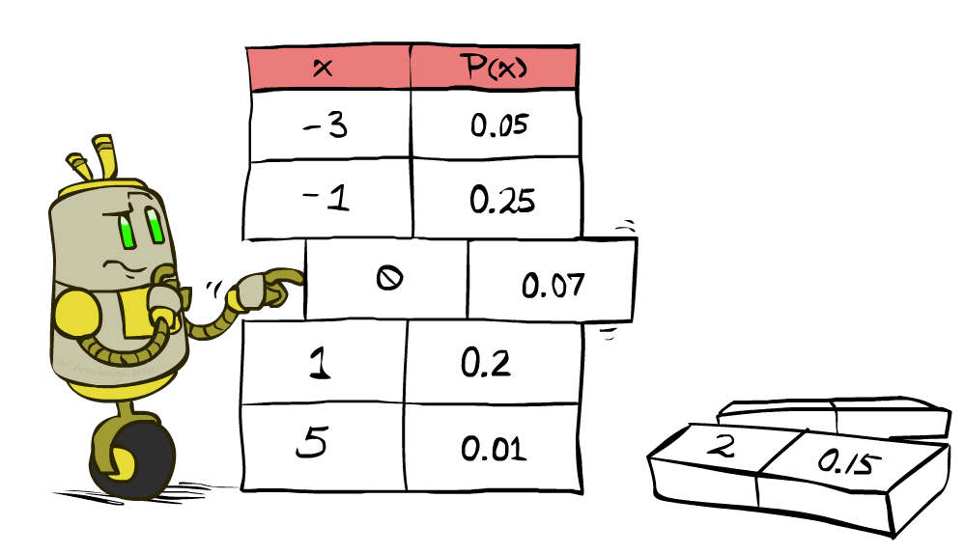


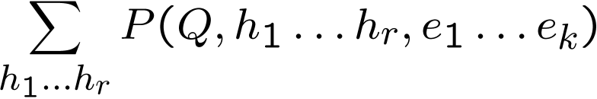
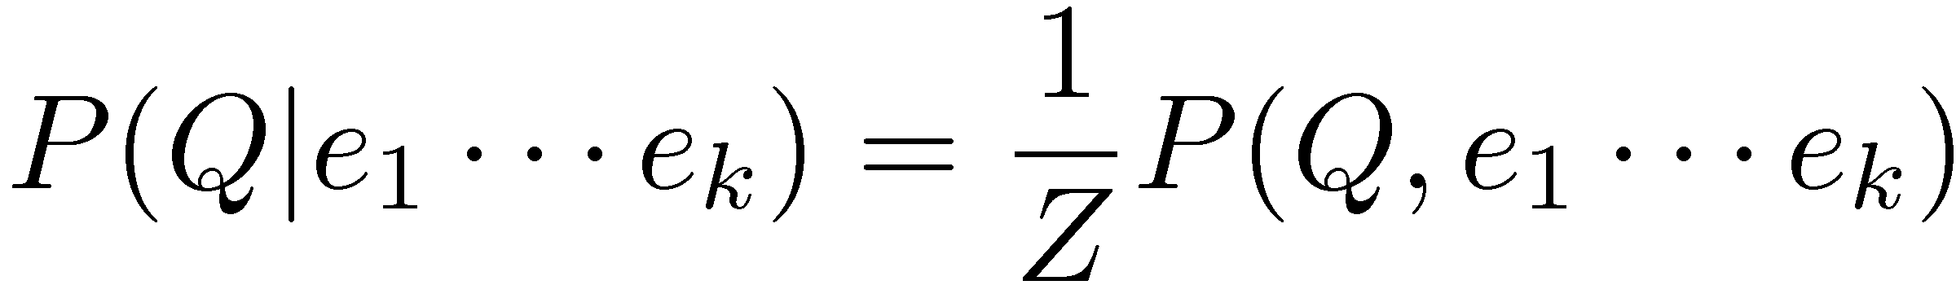
Inference by Enumeration
* Works fine with multiple query variables, too
General case:
Evidence variables:
Query* variable:
Hidden variables:
We want:
All variables
Step 1: Select the entries consistent with the evidence
Step 2: Sum out H to get joint of Query and evidence
Step 3: Normalize
Notes:
Inference by enumeration is something that we looked at before.
Evidence, query and hidden variables.
Hidden variables will be summed out. Then you’ve got the joint between the query and the evidence variables. That’s not what we want, so we normalize over the query variable.

Slide 23
Inference by Enumeration in Bayes’ Net
Given unlimited time, inference in BNs is easy
Reminder of inference by enumeration by example:
B
E
A
J
M
Notes:
Query: Distribution for Burglary given +j and +m
Step 1: The conditional is proportional to the joint between these variables. We’ll re-scale by the sum of the entires.
Step 2: Sum over the hidden variables.
Step 3: Definition of the joint distribution given the Bayes Net.
Finally, spell out the sum.
B is capital because that’s still a variable. We’re building a table for it.
What’s wrong with this? We have a nice compact rep with the BN. But we then build this full joint in the sum. This gets very expensive. It’s exponential in the number of non-evidence variables.

Slide 24
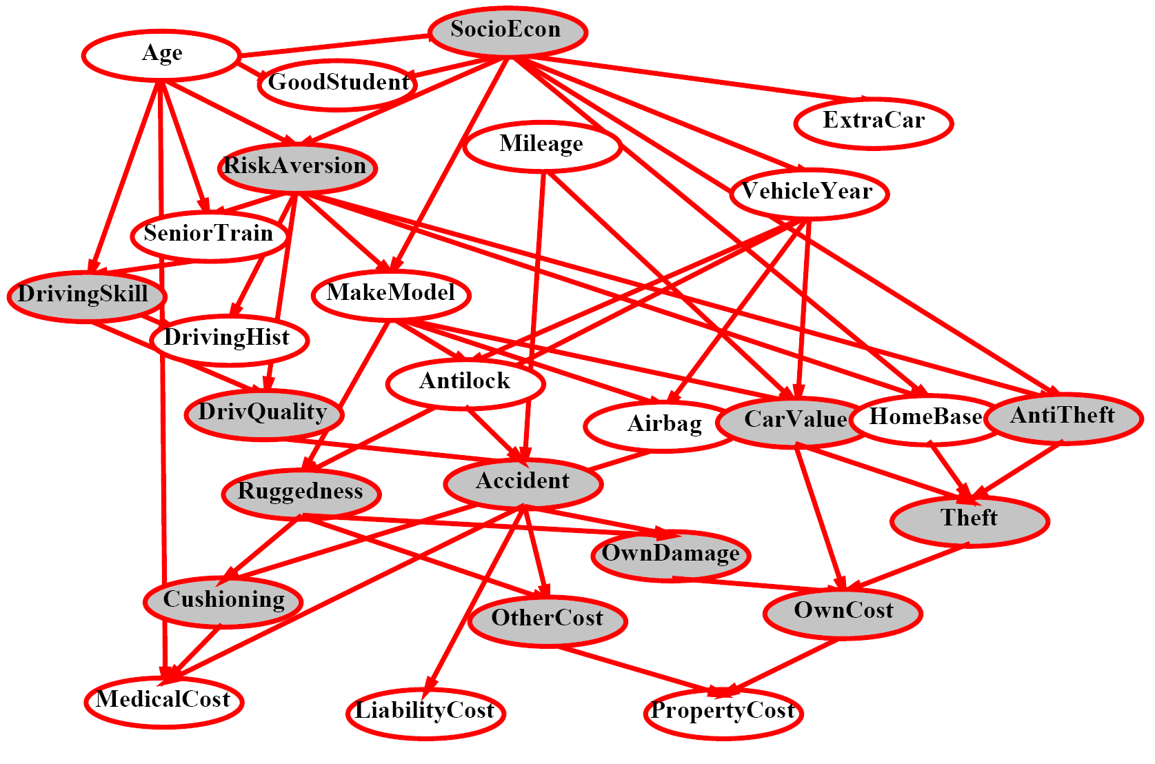
Inference by Enumeration?
Notes:
Shaded = observed.
Non-shaded= unobserved. 13 of those, so 2^13 items to compute. 2^13 = 8,192 Too big for a simple query like this.

Slide 25
Inference by Enumeration vs. Variable Elimination
Why is inference by enumeration so slow?
You join up the whole joint distribution before you sum out the hidden variables
Advanced technique: Variable Elimination
Interleave joining and marginalizing
Still NP-hard, but usually much faster than inference by enumeration
See the textbook for a description.
First we’ll need some new notation: factors

Slide 26
Next time: Naïve Bayes
Read AIMA Section 19.1
Slides courtesy of Dan Klein and Pieter Abbeel --- University of California, Berkeley
[These slides were created by Dan Klein and Pieter Abbeel for CS188 Intro to AI at UC Berkeley. All CS188 materials are available at http://ai.berkeley.edu.]
Notes:
Please retain proper attribution, including the reference to ai.berkeley.edu. Thanks!

