Slide 1
Alpha-Beta Pruning
Many of today’s slides are courtesy of Dan Klein and Pieter Abbeel of University of California, Berkeley

Slide 2

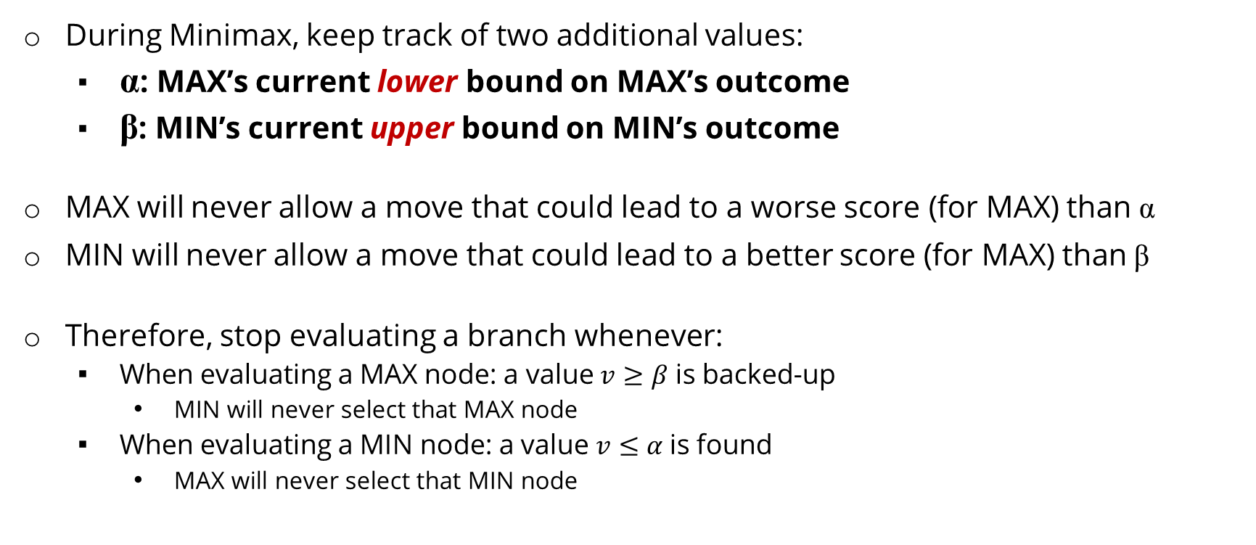
Alpha-Beta Pruning
During Minimax, keep track of two additional values:
α: MAX’s current lower bound on MAX’s outcome
β: MIN’s current upper bound on MIN’s outcome
MAX will never allow a move that could lead to a worse score (for MAX) than α
MIN will never allow a move that could lead to a better score (for MAX) than β
Therefore, stop evaluating a branch whenever:
When evaluating a MAX node: a value $v≥β$ is backed-up
MIN will never select that MAX node
When evaluating a MIN node: a value $v≤α$is found
MAX will never select that MIN node
CIS 521 | 5
Notes:
.

Slide 3
Alpha-Beta Pruning
α=3
β =+∞
3
3
2
2
3
8
12
2
X
X
14
5
2
α: MAX’s best option on path to root
β: MIN’s best option on path to root
Notes:
.

Slide 4
Alpha-Beta Pruning Example
α=-∞
β =+∞
-∞
Notes:
.

Slide 5
Alpha-Beta Pruning Example
α=-∞
β =+∞
-∞
α=-∞
β =+∞
+∞
Notes:
.

Slide 6
Alpha-Beta Pruning Example
α=-∞
β =+∞
-∞
α=-∞
β =3
3
3
Notes:
.

Slide 7
Alpha-Beta Pruning Example
α=-∞
β =+∞
-∞
α=-∞
β =3
3
3
12
Notes:
.

Slide 8
Alpha-Beta Pruning Example
α=-∞
β =+∞
-∞
α=-∞
β =3
3
3
12
8
Notes:
.

Slide 9
Alpha-Beta Pruning Example
α=-∞
β =+∞
-∞
α=3
β =3
3
3
12
8
Notes:
.

Slide 10
Alpha-Beta Pruning Example
α=3
β =+∞
-∞
α=3
β =3
3
3
12
8
Notes:
.

Slide 11
Alpha-Beta Pruning Example
α=3
β =+∞
3
α=3
β =3
α=-∞
β =+∞
3
+∞
3
12
8
Notes:
.

Slide 12
Alpha-Beta Pruning Example
α=3
β =+∞
3
α=3
β =3
α=-∞
β =+∞
3
+∞
3
8
12
Notes:
.

Slide 13
Alpha-Beta Pruning Example
α=3
β =+∞
3
α=3
β =3
α=-∞
β =+∞
3
+∞
3
8
12
2
Notes:
.

Slide 14
Alpha-Beta Pruning Example
α=3
β =+∞
3
α=3
β =3
α=-∞
β =2
3
2
3
8
12
2
Notes:
.

Slide 15
Alpha-Beta Pruning Example
α=3
β =+∞
3
α=3
β =3
α=-∞
β =2
3
2
3
8
12
2
Notes:
.

Slide 16
Alpha-Beta Pruning Example
α=3
β =+∞
3
α=3
β =3
α=-∞
β =2
α=-∞
β =+∞
3
2
+∞
3
8
12
2
Notes:
.

Slide 17
Alpha-Beta Pruning Example
α=3
β =+∞
3
α=3
β =3
α=-∞
β =2
α=-∞
β =14
3
2
14
3
8
12
2
14
Notes:
.

Slide 18
Alpha-Beta Pruning Example
α=3
β =+∞
3
α=3
β =3
α=-∞
β =2
α=-∞
β =5
3
2
5
3
8
12
2
14
5
Notes:
.

Slide 19
Alpha-Beta Pruning Example
α=3
β =+∞
3
α=3
β =3
α=-∞
β =2
α=-∞
β =2
3
2
2
3
8
12
2
14
5
2
Notes:
.

Slide 20
Alpha-Beta Pruning Example
α=3
β =+∞
3
α=3
β =3
α=-∞
β =2
α=2
β =2
3
2
2
3
8
12
2
14
5
2
Notes:
.

Slide 21
Alpha-Beta Pruning Example
α=3
β =3
3
α=3
β =3
α=-∞
β =2
α=2
β =2
3
2
2
3
8
12
2
14
5
2
Notes:
.

