Slide 1
Maximum Expected Utility

Slide 2
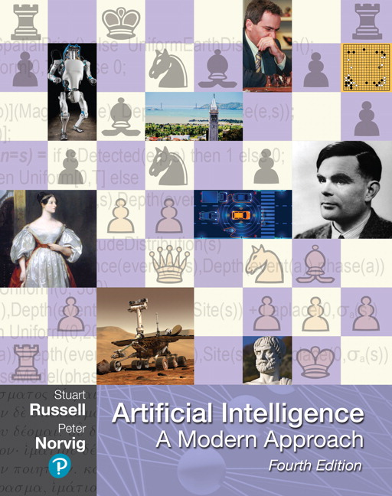

Utilities
AIMA Chapter 16.1-16.3
CIS 521 | 25
Notes:
Everything in minimax and expectimax has referenced the notion of Utilties. The idea that there are values that you can go around either maximizing or minimizing or taking the average of.
What are these numbers? Where do they come from? How do we even know that they exist?

Slide 3
Maximum Expected Utility
Why should we average utilities? Why not minimax?
Principle of maximum expected utility:
A rational agent should choose the action that maximizes its expected utility, given its knowledge
Questions:
Where do utilities come from?
How do we know such utilities even exist?
How do we know that averaging even makes sense?
What if our behavior (preferences) can’t be described by utilities?
CIS 521 | 26
Notes:
If we have utilities, why should we ever average them?
The answer is vampire bunnies. Worst case reasoning only works if your model is able to assign very low probabilities to very bad events. You need probabilistic reasoning and averages.
This is going to lead us down the path of probabilistic reasoning.
Are humans so complex that they can’t be boiled down to these probabilities?

Slide 4
x²
0
40
20
30
0
1600
400
900
For worst-case minimax reasoning, terminal function scale doesn’t matter
We just want better states to have higher evaluations (get the ordering right)
We call this insensitivity to monotonic transformations
For average-case expectimax reasoning, we need magnitudes to be meaningful
CIS 521 | 27
Notes:
Minimax is really about the ordering of the states. A Monotonic transformation is a way of transforming a set of numbers into another set that preserves the order of the original set
In expectiax, the right tree would give me average of 20 and 25, so I would take the right branch. What about in the right tree? That would give me 800 and 650, so I would take the left branch.
The magnitudes are very important here.

Slide 5

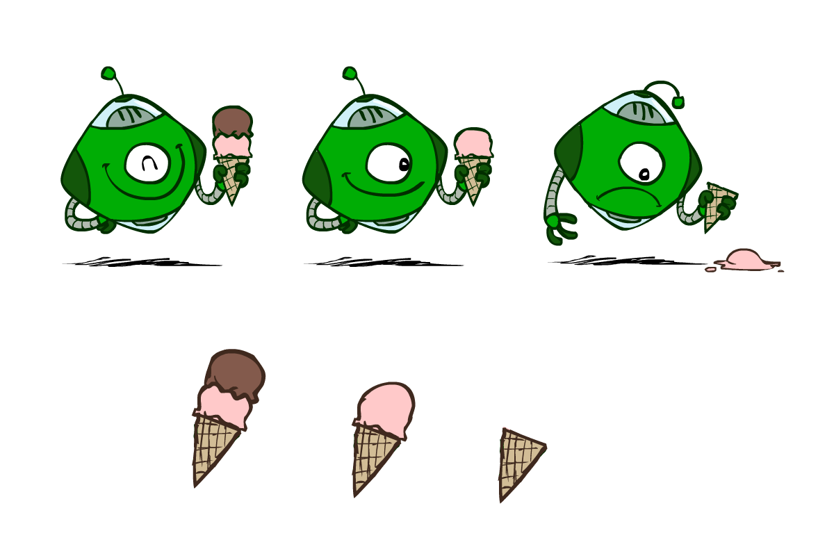
Utilities are functions from outcomes (states of the world) to real numbers that describe an agent’s preferences
Where do utilities come from?
In a game, may be simple (+1/-1)
Utilities summarize the agent’s goals
Theorem: any “rational” preferences can be summarized as a utility function
We hard-wire utilities and let behaviors emerge
Why don’t we let agents pick utilities?
Why don’t we prescribe behaviors?
CIS 521 | 28

Slide 6

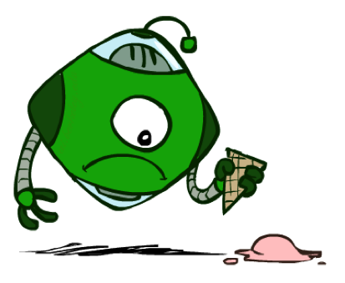

Utilities: Uncertain Outcomes
Getting ice cream
Get Single
Get Double
Oops
Whew!
CIS 521 | 29
Notes:
The robot has to choose not only between utilities, but also uncertain outcomes.

Slide 7
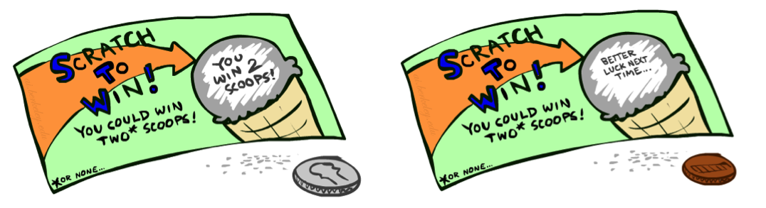
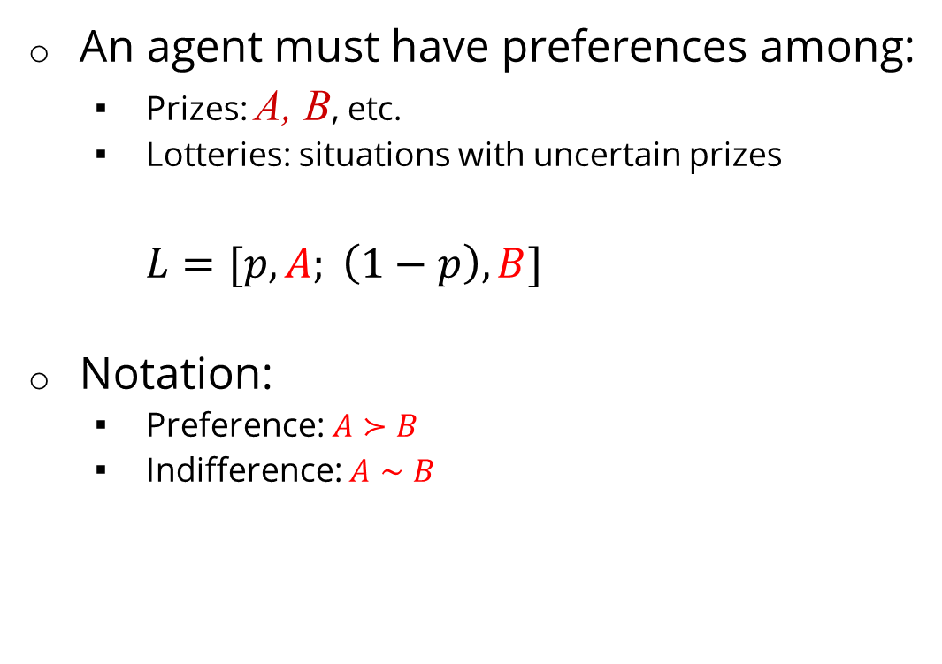

An agent must have preferences among:
Prizes: A, B, etc.
Lotteries: situations with uncertain prizes
$L=[p,A; \left(1−p\right),B]$
Notation:
Preference: $A≻B$
Indifference: $A∼B$
A Prize
A Lottery
A
$p$ $1−p$
A B
CIS 521 | 30
Notes:
A prize is a given outcome.
Lotteries are mixtures with probabilities attached.

Slide 8
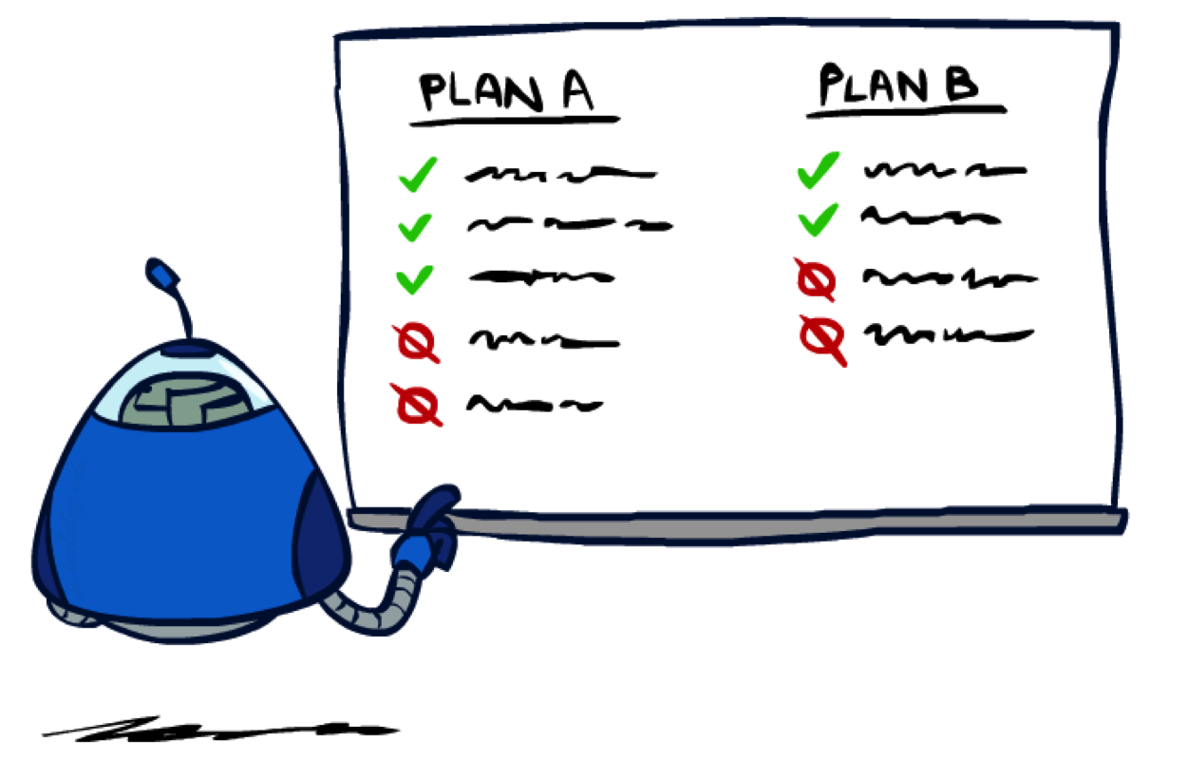
CIS 521 | 31
Notes:
Are there good preferences and bad preferences? What do we need in order to decide is an agent is rational?

Slide 9
We want some constraints on preferences before we call them rational, such as:
For example: an agent with intransitive preferences can
be induced to give away all of its money
If B > C, then an agent with C would pay (say) 1 cent to get B
If A > B, then an agent with B would pay (say) 1 cent to get A
If C > A, then an agent with A would pay (say) 1 cent to get C
Axiom of Transitivity: $(A≻B)∧(B≻C)⇒(A≻C)$
CIS 521 | 32
Notes:
Apple, banana, carrot
Some things don’t make sense.
... This is a defect in behavior.

Slide 10
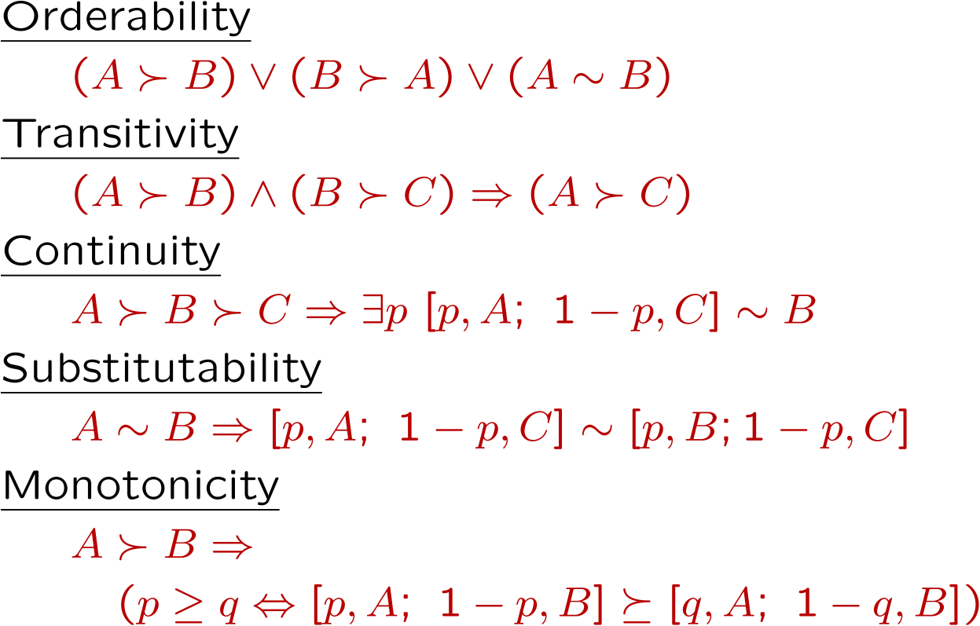

The Axioms of Rationality
Theorem: Rational preferences imply behavior describable as maximization of expected utility
CIS 521 | 33
Notes:
Orderability. You have to like A better or B better or be indifferent.
Transitivity, we just saw.
Continuity. More subtle. If you like A better than C and B is somewhere in the middle. Then there has to be some lottery between A and C, where you’re indifferent with B.
Substitutability. If they’re exchangeable on their own then they are exchangeable in a lottery.
Monotonicity. Also reasonable. If A is better than B, and you have a lottery between A and B, then you would prefer more A in the mix.
If you accept these actions, then rational preferences that obey these, then all of your behavior is describable by maximizing utilities.

Slide 11
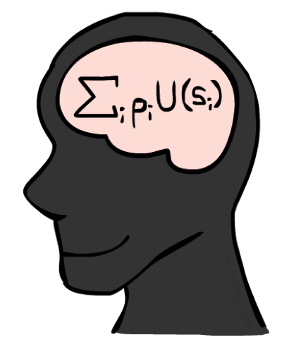
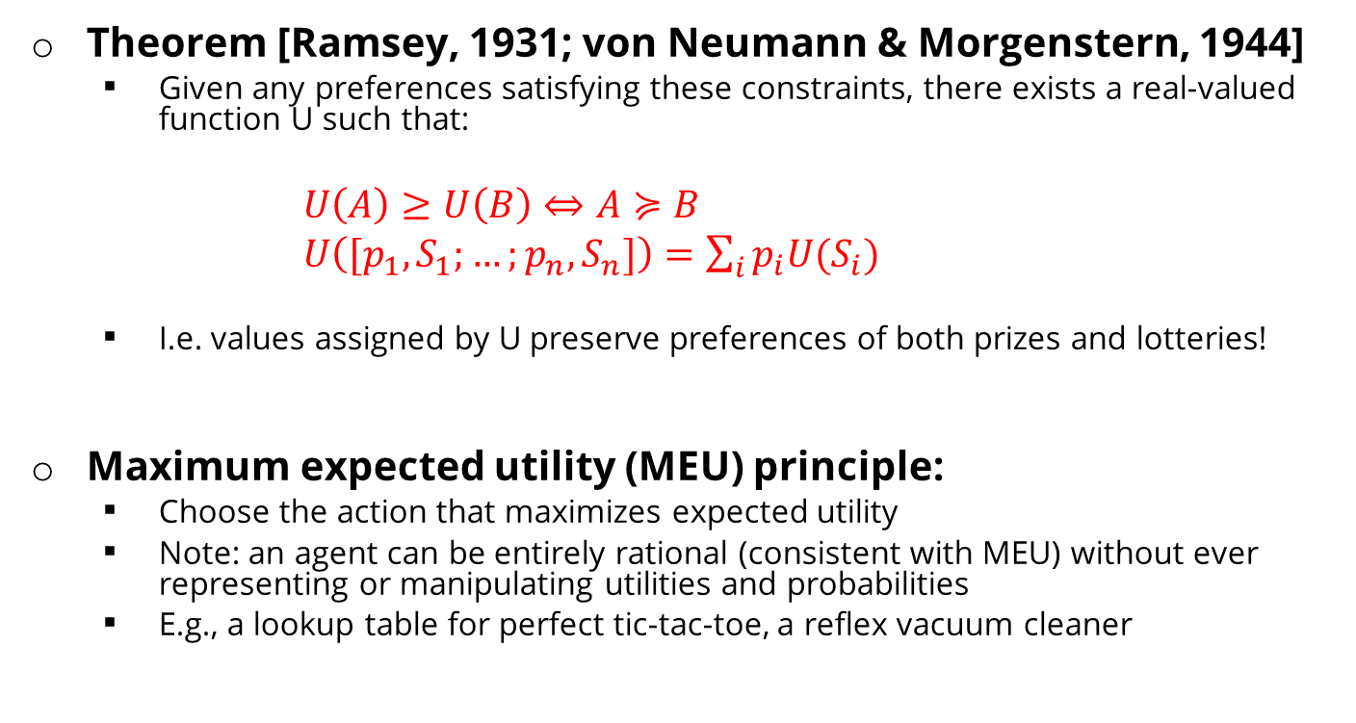
MEU Principle
Theorem [Ramsey, 1931; von Neumann & Morgenstern, 1944]
Given any preferences satisfying these constraints, there exists a real-valued function U such that:
$U\left(A\right)≥U\left(B\right)⇔A≽B$
$U\left([p_{1},S_{1};…;p_{n},S_{n}]\right)=\sum_{i}{p_{i}U(S_{i})}$
I.e. values assigned by U preserve preferences of both prizes and lotteries!
Maximum expected utility (MEU) principle:
Choose the action that maximizes expected utility
Note: an agent can be entirely rational (consistent with MEU) without ever representing or manipulating utilities and probabilities
E.g., a lookup table for perfect tic-tac-toe, a reflex vacuum cleaner
CIS 521 | 34
Notes:
Here’s the theorem.
There exists a real valued function U with the following properties.
U captures your ordinal preferences.
Utility of a lottery is the expectation of the elements of the lottery.
This means the utility captures your preference not only between prizes, but between lotteries!
It’s amazing! It means your utilities are preserved under expectation.
You want your BEHAVIORS to be consistent to the MEU Princple.

Slide 12
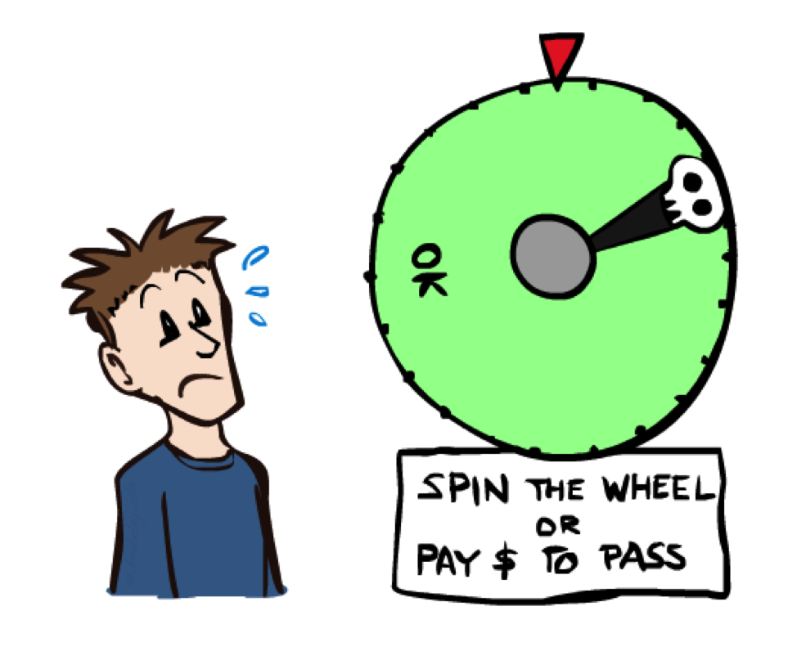
CIS 521 | 35
Notes:
You can be represented with utilities! And MEU.

Slide 13

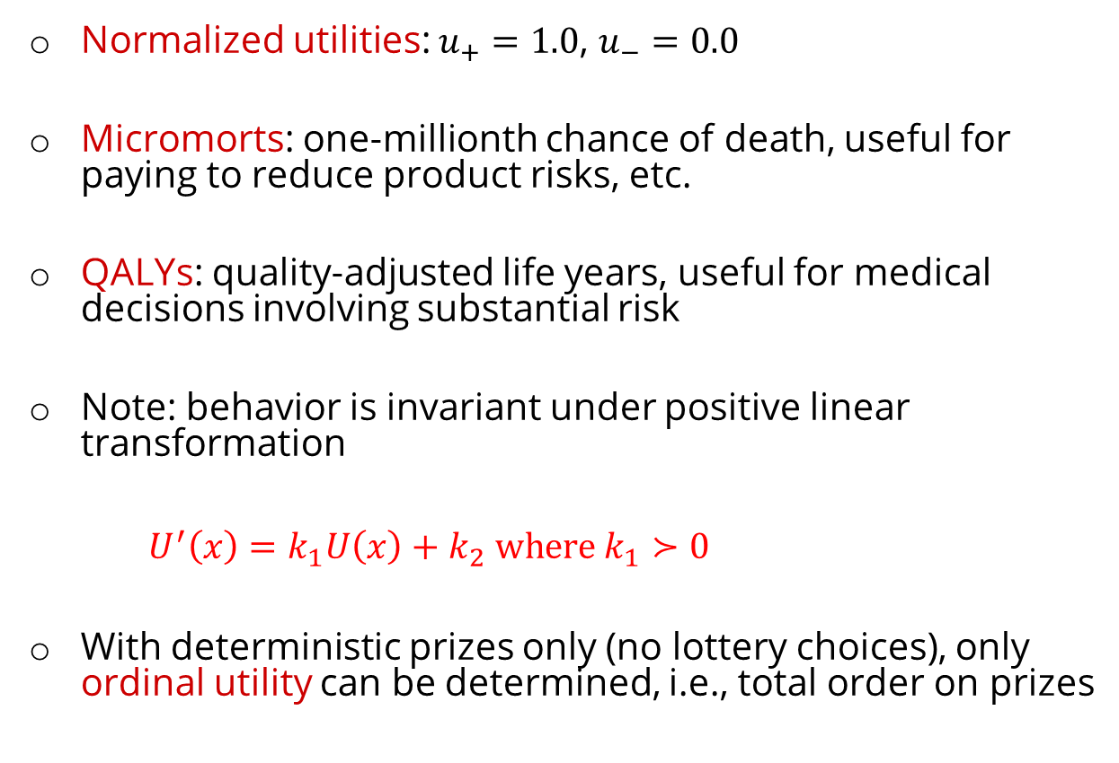
Utility Scales
Normalized utilities: $u_{+}=1.0$, $u_{−}=0.0$
Micromorts: one-millionth chance of death, useful for paying to reduce product risks, etc.
QALYs: quality-adjusted life years, useful for medical decisions involving substantial risk
Note: behavior is invariant under positive linear transformation
$U^{′}\left(x\right)=k_{1}U\left(x\right)+k_{2} where k_{1}≻0$
With deterministic prizes only (no lottery choices), only ordinal utility can be determined, i.e., total order on prizes
CIS 521 | 36
Notes:
These are kind of morbid. Reason about product recalls, where you’re talking about chance of death.
How do I actually get the real valued numbers that you assign to U?
I need to ask you questions about lotteries….

Slide 14
Micromort examples
Death from | Micromorts per exposure
Scuba diving | 5 per dive
Skydiving | 7 per jump
Base-jumping | 430 per jump
Climbing Mt. Everest | 38,000 per ascent
1 micromort
Train travel | 6000 miles
Jet | 1000 miles
Car | 230 miles
Walking | 17 miles
Bicycle | 10 miles
Motorbike | 6 miles
CIS 521 | 37
Notes:
Willingness to pay[edit]
An application of micromorts is measuring the value that humans place on risk: for example, one can consider the amount of money one would have to pay a person to get him or her to accept a one-in-a-million chance of death (or conversely the amount that someone might be willing to pay to avoid a one-in-a-million chance of death). When put thus, people claim a high number but when inferred from their day-to-day actions (e.g., how much they are willing to pay for safety features on cars) a typical value is around $50 (in 2009).^{[31][32]} However utility functions are often not linear, i.e. the more a person has already spent on their safety the less they are willing to spend to further increase their safety. Therefore, the $50 valuation should not be taken to mean that a human life (1 million micromorts) is valued at $50,000,000. Furthermore, the local linearity of any utility curve means that the micromort is useful for small incremental risks and rewards, not necessarily for large risks.^{[32]}

Slide 15


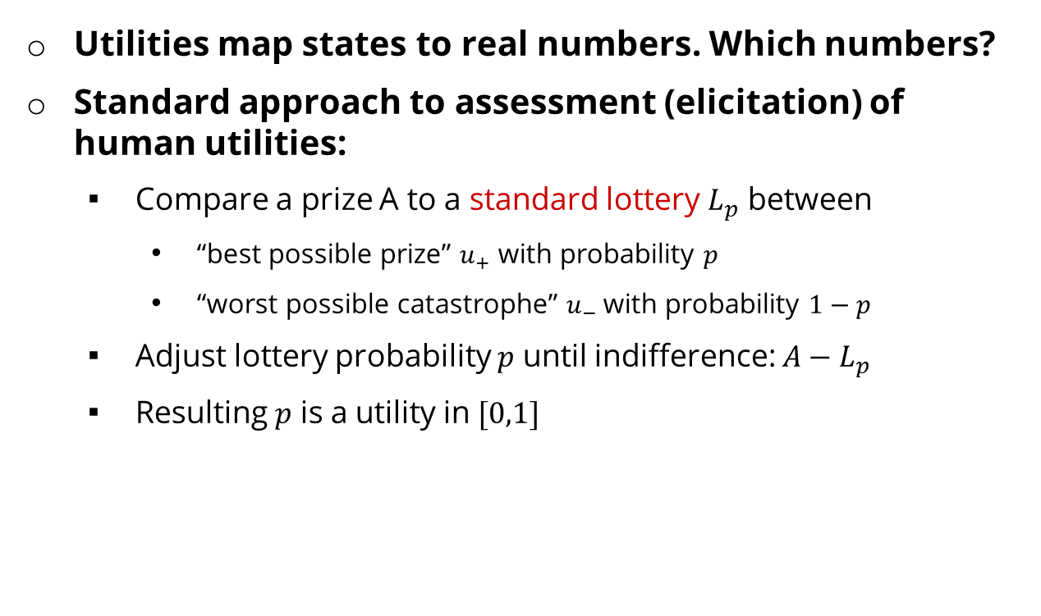
Utilities map states to real numbers. Which numbers?
Standard approach to assessment (elicitation) of human utilities:
Compare a prize A to a standard lottery $L_{p}$ between
“best possible prize” $u_{+}$ with probability $p$
“worst possible catastrophe” $u_{−}$with probability $1−p$
Adjust lottery probability $p$ until indifference: ${A−L}_{p}$
Resulting $p$ is a utility in $[0,1]$
Pay $30
0.999999 0.000001
No change
Instant death
CIS 521 | 38
Notes:
Elicit preferences.
Slide the value until the person becomes indifferent. That’s the way that I can assign a number to U.
How much do you NOT want to pay $30? No change is better than paying $30, instant death is worse. Example: Buy a bike helment to reduce your microports by 1.
Once I find that magical probability that makes you indifferent, then I know U.
If we made it worse, pay $3m be in debt forever.

Slide 16
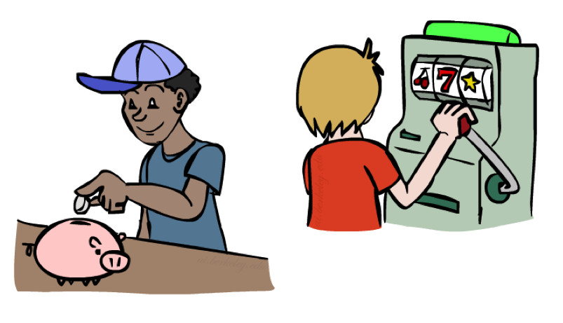
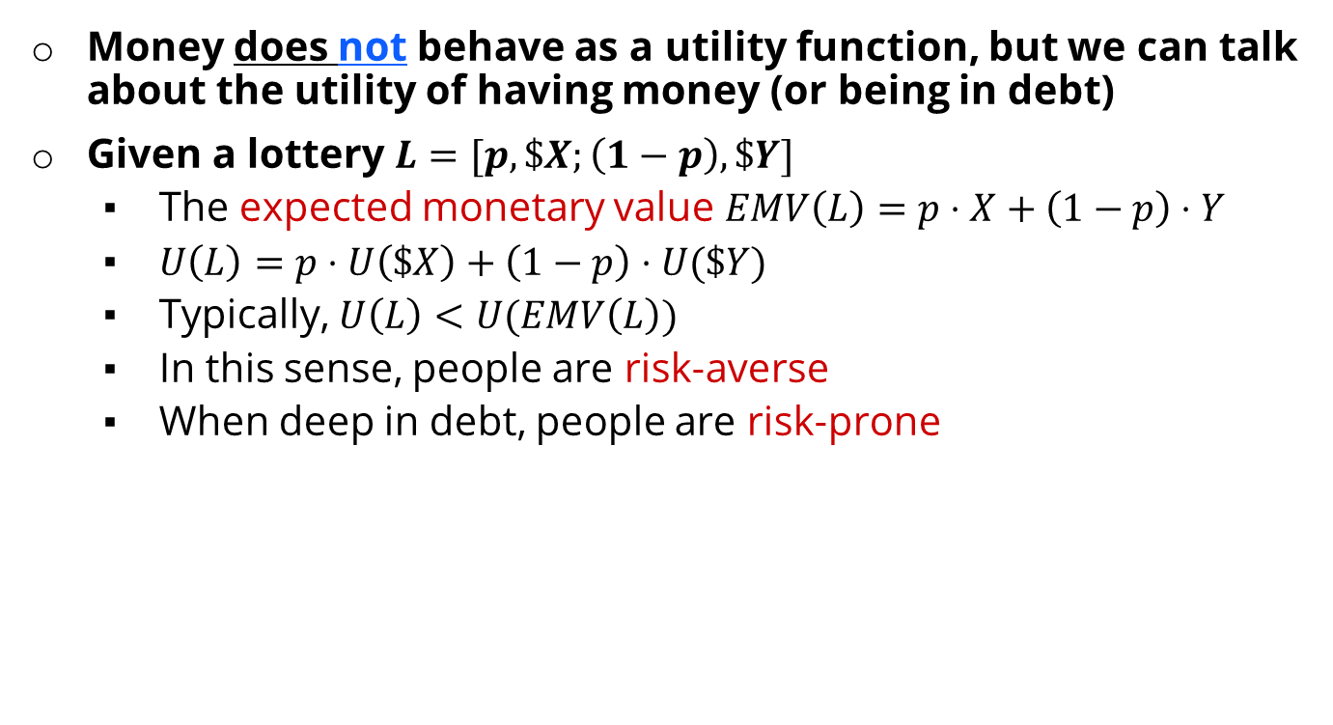
Money
Money does not behave as a utility function, but we can talk about the utility of having money (or being in debt)
Given a lottery $L=[p, \$X;\left(1−p\right), \$Y]$
The expected monetary value $EMV\left(L\right)=p⋅X+\left(1−p\right)⋅Y$
$U\left(L\right)=p⋅U\left(\$X\right)+\left(1−p\right)⋅U(\$Y)$
Typically, $U\left(L\right)<U(EMV\left(L\right))$
In this sense, people are risk-averse
When deep in debt, people are risk-prone
CIS 521 | 39
Notes:
How about money? Can we use money as a utility scale? No! It’s not a good utility scale. We can talk about the utility of money, but it itself isn’t a good utility scale. Why not?
Imagine a lottery where you get X dollars or Y dollars.
Obviously, how good this is depends on X, Y and p.
Typically a utility of a lottery over money is worth less than its equivalent monetary value.
You’d rather have a smaller amount that is guaranteed.
How many of you would like a million dollars?
How many of you would like a billion dollars? How much more? 1000x more? Maybe not?
Let’s say I gave you a billion. Now how much do you want a million? Not much.
Diminishing returns. I’m told after your first billion, your second billion has less utility.
Same thing in the negative. Once you’re $1b in debt, whatever, you’re too big.

Slide 17
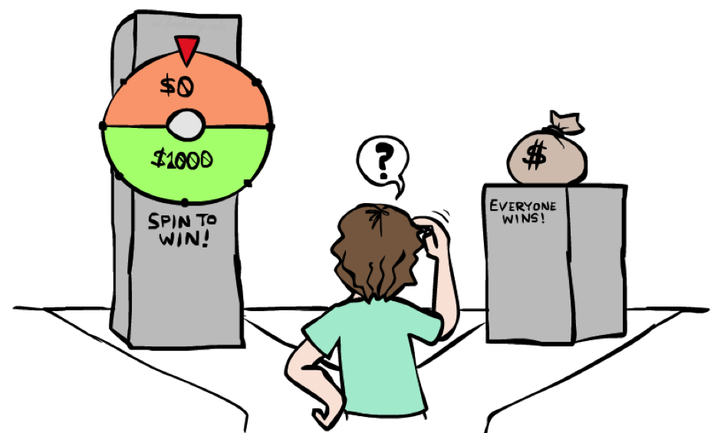
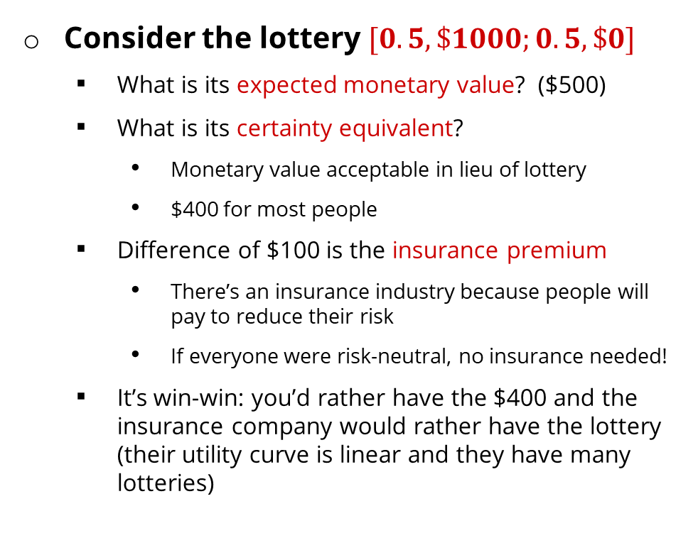
Example: Insurance
Consider the lottery $[0.5, \$1000;0.5, \$0]$
What is its expected monetary value? ($500)
What is its certainty equivalent?
Monetary value acceptable in lieu of lottery
$400 for most people
Difference of $100 is the insurance premium
There’s an insurance industry because people will pay to reduce their risk
If everyone were risk-neutral, no insurance needed!
It’s win-win: you’d rather have the $400 and the insurance company would rather have the lottery (their utility curve is linear and they have many lotteries)
CIS 521 | 40
Notes:
Lottery example = $1000 computer, 50% chance that you’ll get it stolen, in which case you are left with $0.
Certainty equivalent. That’s how much money you would be willing to trade this lottery for. Trade uncertainty for certainty.
Certainty equivalent. How much would you trade this lottery for? How many would trade this for $10? How about $900? How about $400?
Because of these preferences there are things like insurance.
Is insurance just a scam? No, it’s win-win!

Slide 18

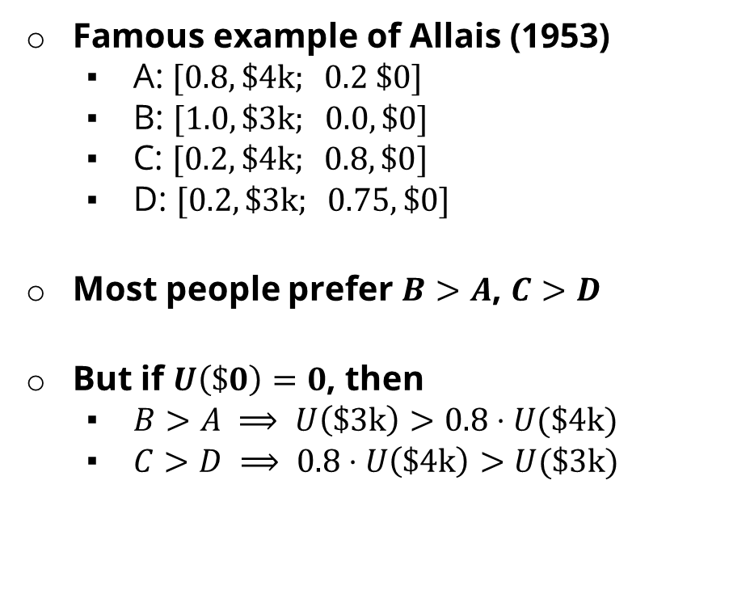
Example: Human Rationality?
Famous example of Allais (1953)
A: $[0.8, \$\text{4}\text{k}; 0.2 \$0]$
B: $[1.0, \$3\text{k}; 0.0, \$0]$
C: $[0.2, \$\text{4}\text{k}; 0.8, \$0]$
D: $[0.2, \$3\text{k}; 0.75, \$0]$
Most people prefer $B>A$, $C>D$
But if $U\left(\$0\right)=0$, then
$B>A ⟹ U\left(\$3\text{k}\right)>0.8⋅U(\$4\text{k})$
$C>D ⟹ 0.8⋅U\left(\$\text{4}\text{k}\right)>U(\$\text{3}\text{k})$
CIS 521 | 41
Notes:
Are humans perfectly rational? Here’s a classic experiment
B is the clear winner.
C is the winner.
Most people prefer C over D.
Multiply C and D by 4 and get the opposite conclusion 0.2*4 = 0.8, 0.25*4 = 1, so 0.8 U($4k) > 1.0 * U($3k)
So what the heck? You’re making irrational preferences? Are you irrational or did I do something wrong?
There’s a lot going on.
Prize B said 100% chance of 3k. 0 is actually important.
What do you get if you choose A, and you win $0? You get the feeling of stupidity.

