Slide 1
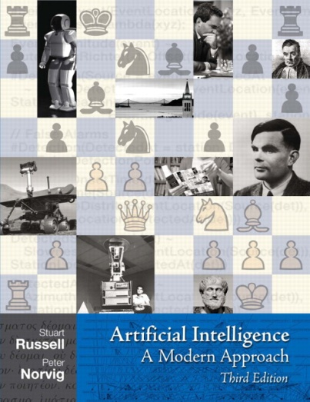
Probability
Read AIMA Chapter 13 "Quantifying Uncertainty" (13.1-13.5)

Slide 2
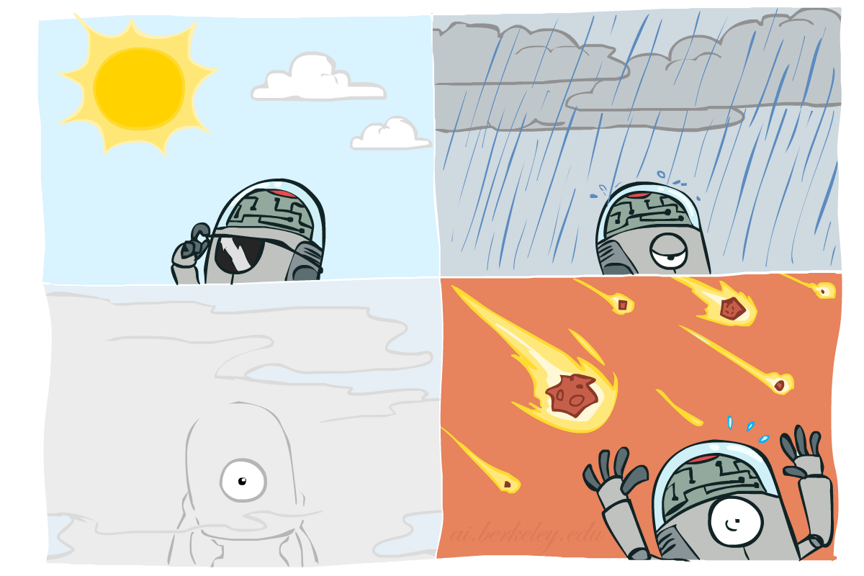
Probability
Slides courtesy of Dan Klein and Pieter Abbeel – University of California, Berkeley
[These slides were created by Dan Klein and Pieter Abbeel for CS188 Intro to AI at UC Berkeley. All CS188 materials are available at http://ai.berkeley.edu.]
Notes:
Please retain proper attribution, including the reference to ai.berkeley.edu. Thanks!

Slide 3

Today
Probability
Random Variables
Joint and Marginal Distributions
Conditional Distribution
Product Rule, Chain Rule, Bayes’ Rule
Inference
Independence
Notes:
Hopefully this is a refresher for many of you.

Slide 4
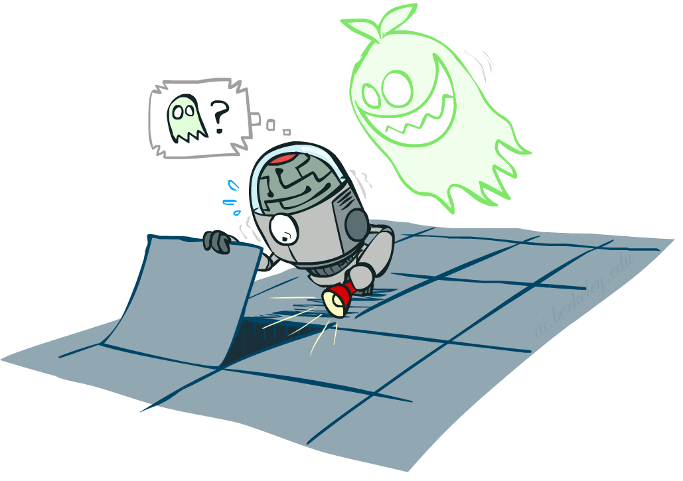
Uncertainty
General situation:
Observed variables (evidence): Agent knows certain things about the state of the world (e.g., sensor readings or symptoms)
Unobserved variables: Agent needs to reason about other aspects (e.g. where an object is or what disease is present)
Model: Agent knows something about how the known variables relate to the unknown variables
Probabilistic reasoning gives us a framework for managing our beliefs and knowledge

Slide 5
Random Variables
A random variable is some aspect of the world about which we (may) have uncertainty
R = Is it raining?
T = Is it hot or cold?
D = How long will it take to drive to work?
L = Where is the ghost?
We denote random variables with capital letters
Like variables in a CSP, random variables have domains
R in {true, false} (often write as {+r, -r})
T in {hot, cold}
D in [0, ∞)
L in possible locations, maybe {(0,0), (0,1), …}
Notes:
We are going to deal with discrete random variables, rather than continuous ones. In continuous you deal with integrals rather than summations.

Slide 6
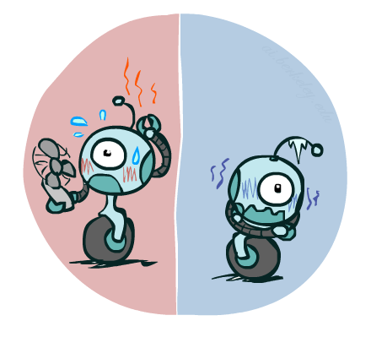


Probability Distributions
Associate a probability with each value
Temperature:
Weather:
W | P
sun | 0.6
rain | 0.1
fog | 0.3
meteor | 0.0
T | P
hot | 0.5
cold | 0.5
Notes:
Possible variable in the domain. For weather we probably don’t want to include a variable with probability 0.

Slide 7


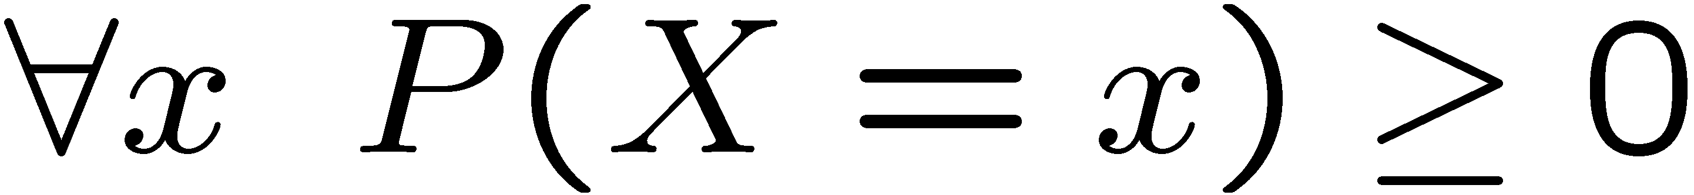
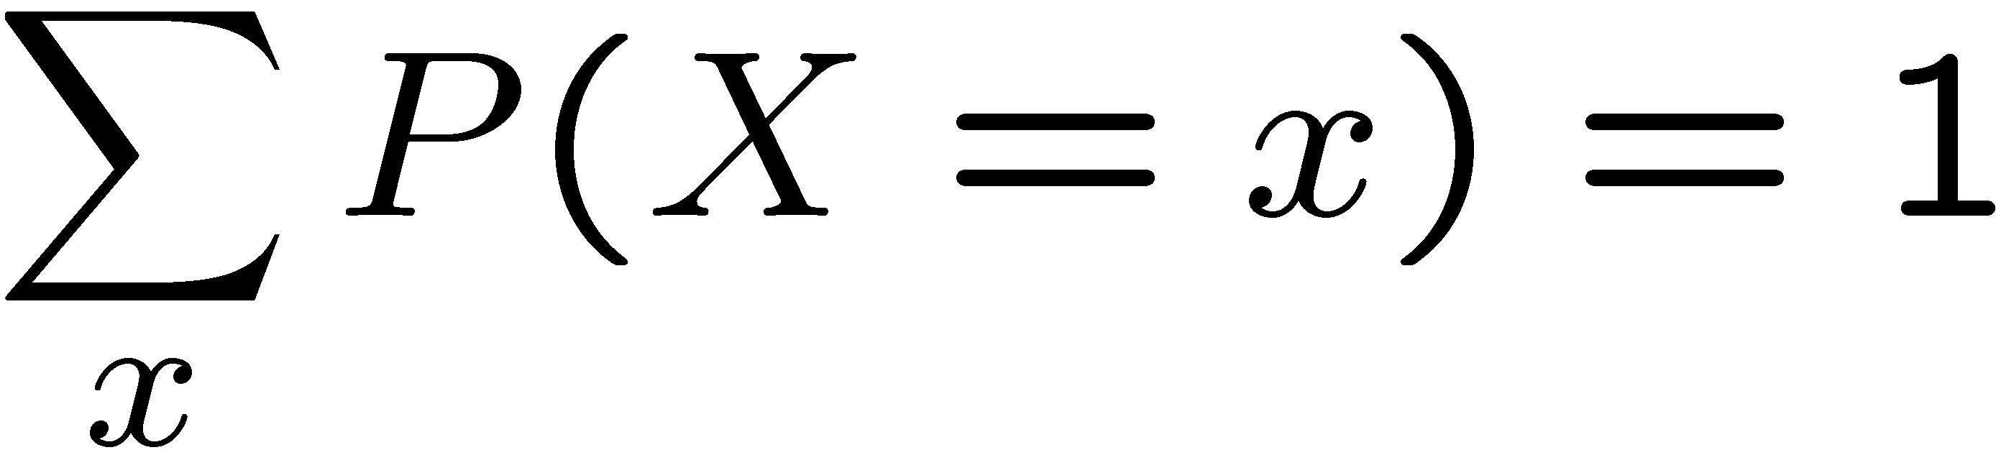
Probability Distributions
Unobserved random variables have distributions
A distribution is a TABLE of probabilities of values
A probability (lower case value) is a single number
Must have: and
Shorthand notation:
OK if all domain entries are unique
T | P
hot | 0.5
cold | 0.5
W | P
sun | 0.6
rain | 0.1
fog | 0.3
meteor | 0.0

Slide 8




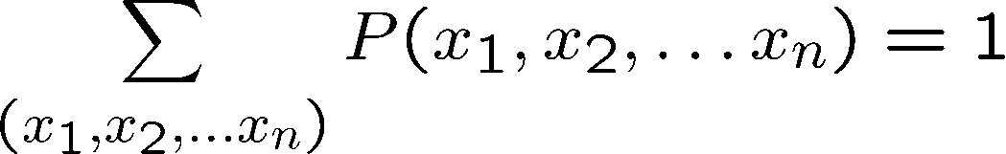
Joint Distributions
A joint distribution over a set of random variables:
specifies a real number for each assignment (or outcome):
Must obey:
Size of distribution if n variables with domain sizes d?
For all but the smallest distributions, impractical to write out!
T | W | P
hot | sun | 0.4
hot | rain | 0.1
cold | sun | 0.2
cold | rain | 0.3
Notes:
N*D? No.
D^N? Yes.
In the next lectures we’re going to see how to work with how to deal with large sets of variables.

Slide 9
Probabilistic Models
Distribution over T,W
A probabilistic model is a joint distribution over a set of random variables
Probabilistic models:
(Random) variables with domains
Assignments are called outcomes
Joint distributions: say whether assignments (outcomes) are likely
Normalized: sum to 1.0
Ideally: only certain variables directly interact
T | W | P
hot | sun | 0.4
hot | rain | 0.1
cold | sun | 0.2
cold | rain | 0.3

Slide 10
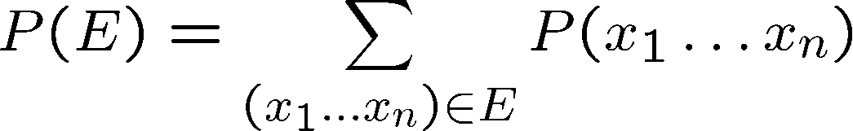
Events
An event is a set E of outcomes
From a joint distribution, we can calculate the probability of any event
Probability that it’s hot AND sunny?
Probability that it’s hot?
Probability that it’s hot OR sunny?
Typically, the events we care about are partial assignments, like P(T=hot)
T | W | P
hot | sun | 0.4
hot | rain | 0.1
cold | sun | 0.2
cold | rain | 0.3
Notes:
An event is a set of possible outcomes. We compute these by summing over all subsets of variables that are compatible with that event. These are subsets of variables.
Let’s say x1=true, then if you sum over all entries in the joint table with x1…xN, where the entry says x=1 is true then you get the probability that x=1 true.
Events don’t have to be as simple as x1=true. It could be x1=true and x2=false. Or more combinations of variables coule be involved.
Look at all of the entries that are consistent with the event.
Probability that it’s hot AND sunny? 0.4
Probability that it’s hot? 0.5
Probability that it’s hot OR sunny? 0.2

Slide 11
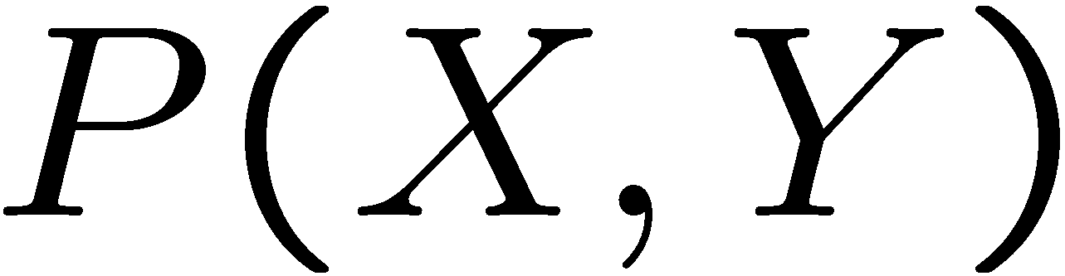
Quiz: Events
P(+x, +y) ?
P(+x) ?
P(-y OR +x) ?
X | Y | P
+x | +y | 0.2
+x | -y | 0.3
-x | +y | 0.4
-x | -y | 0.1
Notes:
P(+x, +y) ? 0.2
P(+x) ? 0.5
P(-y OR +x) ? 0.6

Slide 12
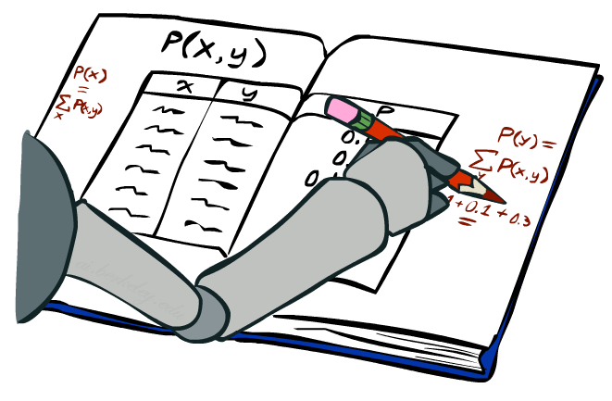
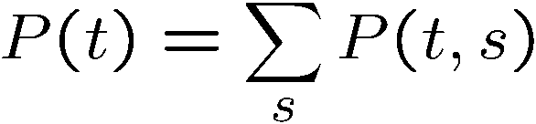
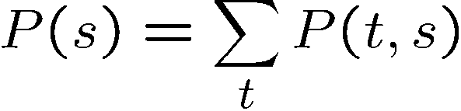
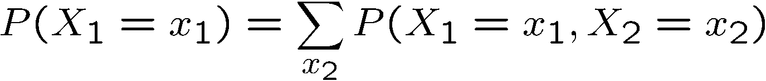
Marginal Distributions
Marginal distributions are sub-tables which eliminate variables
Marginalization (summing out): Combine collapsed rows by adding
T | P
hot | 0.5
cold | 0.5
T | W | P
hot | sun | 0.4
hot | rain | 0.1
cold | sun | 0.2
cold | rain | 0.3
W | P
sun | 0.6
rain | 0.4
Notes:
Marginalize distribution means you build a new table for a subset of random variables.
This is the general equation. You can apply it to any number of random variables. If you had 3 random varaibles, you could compute the marginals for
Just x1
Just x2
Just x3
x1 and x2
x2 and x3
x1 and x3

Slide 13
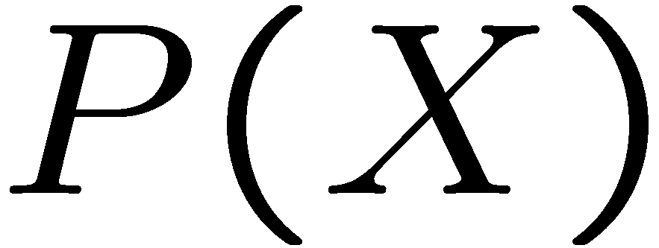
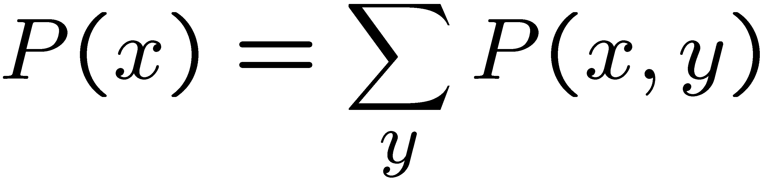
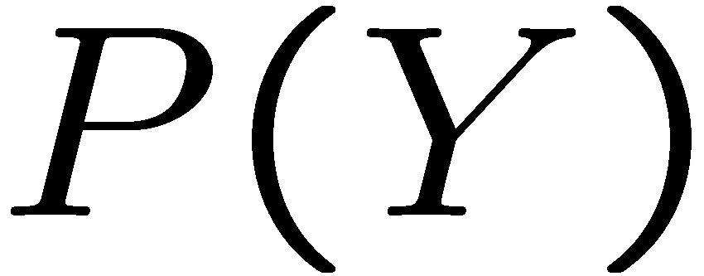
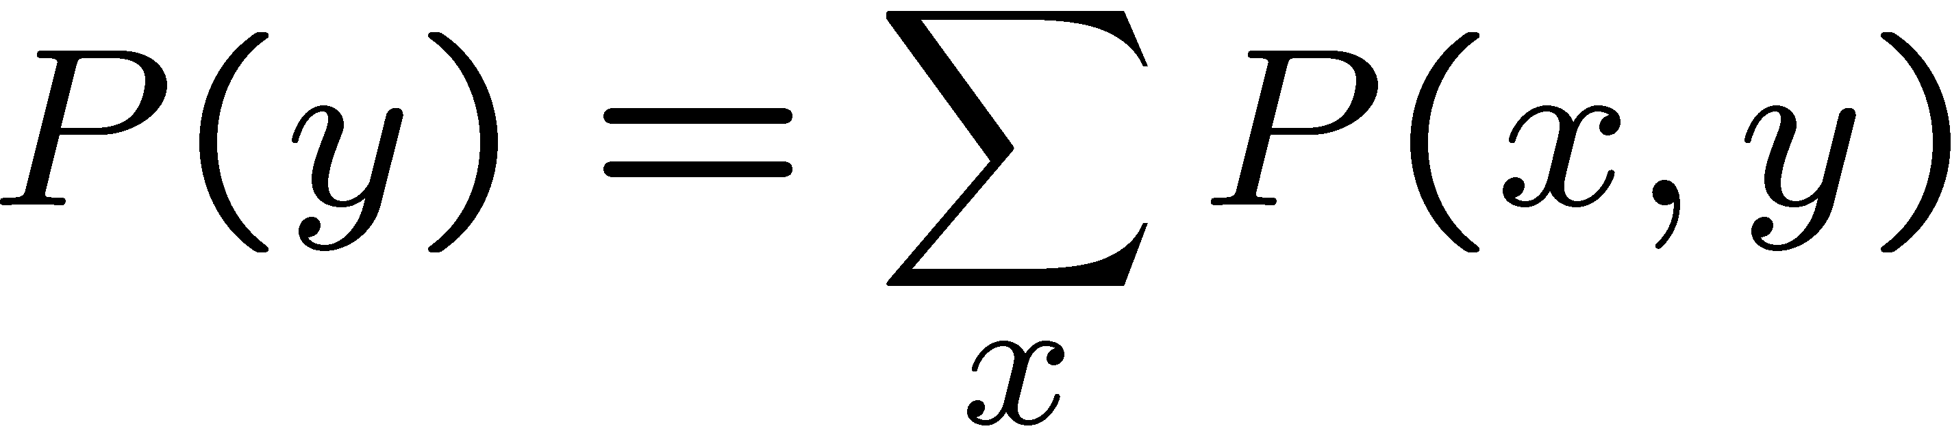
Quiz: Marginal Distributions
X | P
+x
-x
X | Y | P
+x | +y | 0.2
+x | -y | 0.3
-x | +y | 0.4
-x | -y | 0.1
Y | P
+y
-y
Notes:
+x 0.5
-x 0.5
+y 0.6
-y 0.4
Good sanity check is to make sure that the numbers sum to 1.

Slide 14
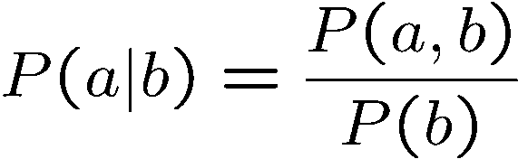
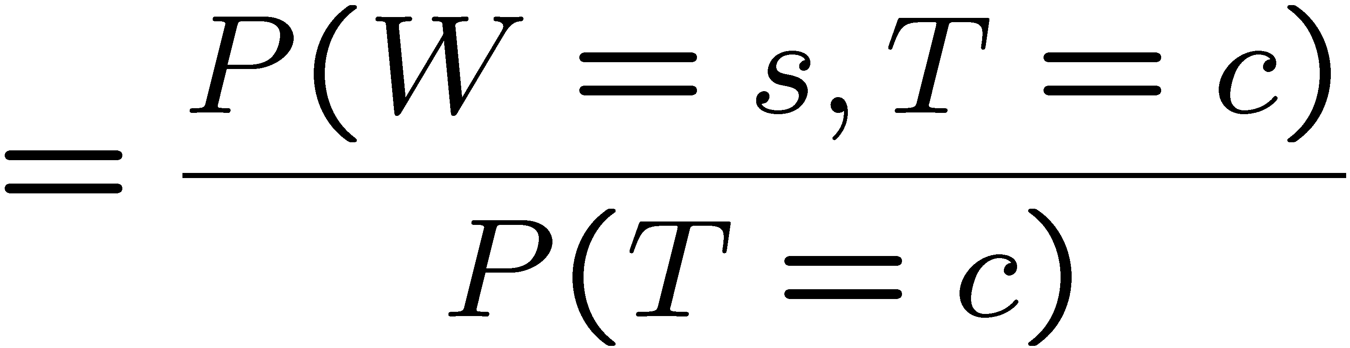
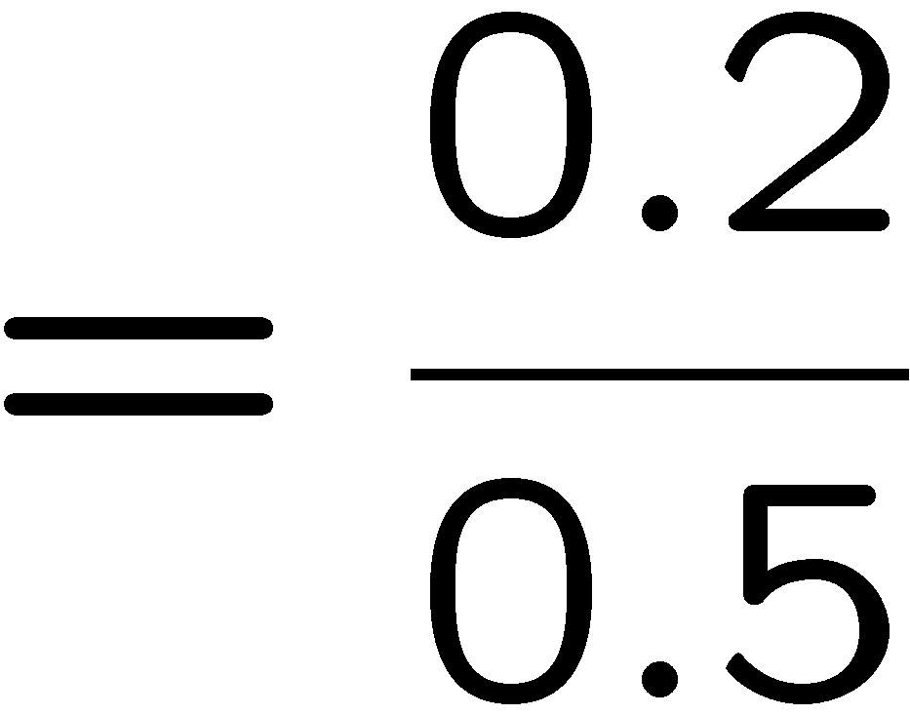



Conditional Probabilities
A simple relation between joint and conditional probabilities
In fact, this is taken as the definition of a conditional probability
P(a,b)
P(a)
P(b)
T | W | P
hot | sun | 0.4
hot | rain | 0.1
cold | sun | 0.2
cold | rain | 0.3
Notes:
This is the most important concept. Why because it tells us, if we measure something, what does it tell us about the things that we didn’t get to measure. That’s what conditional probabilities come in.
A conditional probability that random variable Capital A will take on value lowercase a, given that random variable Capital B takes on value lowercase b. This is given by the probability of seeing both a and b, divided by the probability of seeing b.
[Explain the Venn diagram.]
Write out the equation for P(sun|cold)

Slide 15
Quiz: Conditional Probabilities
P(+x | +y) ?
P(-x | +y) ?
P(-y | +x) ?
X | Y | P
+x | +y | 0.2
+x | -y | 0.3
-x | +y | 0.4
-x | -y | 0.1
Notes:
P(+x | +y) = 0.2 / 0.6 = 1/3
P(-x | +y) ? = 0.4 / 0.6 = 2/3 ( = 1 – P(+x|+y) = 2/3
P(-y | +x) ? P(-y, +x) / P(+x) = 0.3 / 0.5 = 0.6

Slide 16



Conditional Distributions
Conditional distributions are probability distributions over some variables given fixed values of others
Conditional Distributions
Joint Distribution
W | P
sun | 0.8
rain | 0.2
T | W | P
hot | sun | 0.4
hot | rain | 0.1
cold | sun | 0.2
cold | rain | 0.3
W | P
sun | 0.4
rain | 0.6
Notes:
Before we saw how to go from a joint distribution to a marginal distribution. Now we’re going to see how to go from a joint distribution to a conditional.
A conditional distribution is a consequence of the joint distribution. We do that just like we did on the previous slide).
P(W|T) is a set of tables that can be extracted from the joint distribution P(T, W).

Slide 17

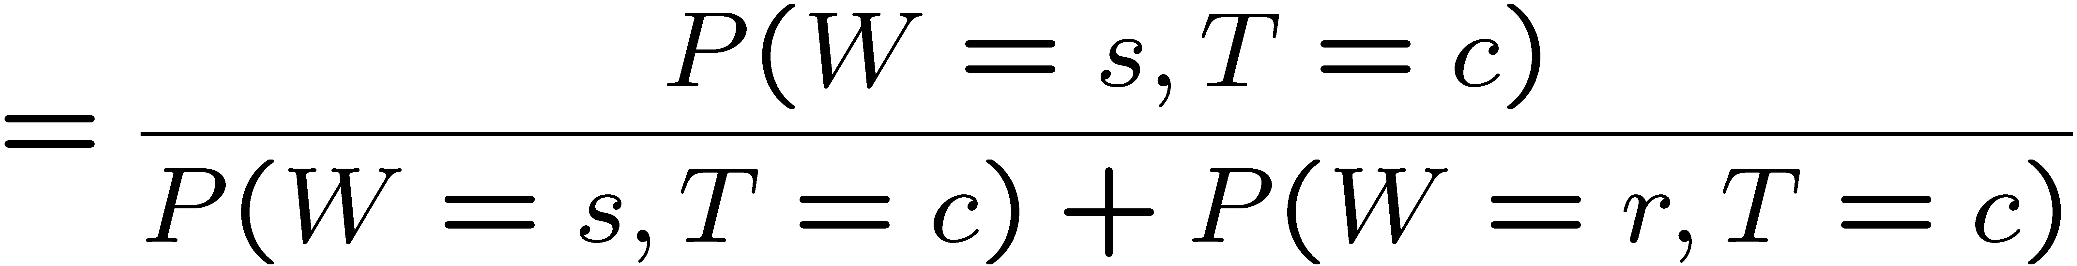
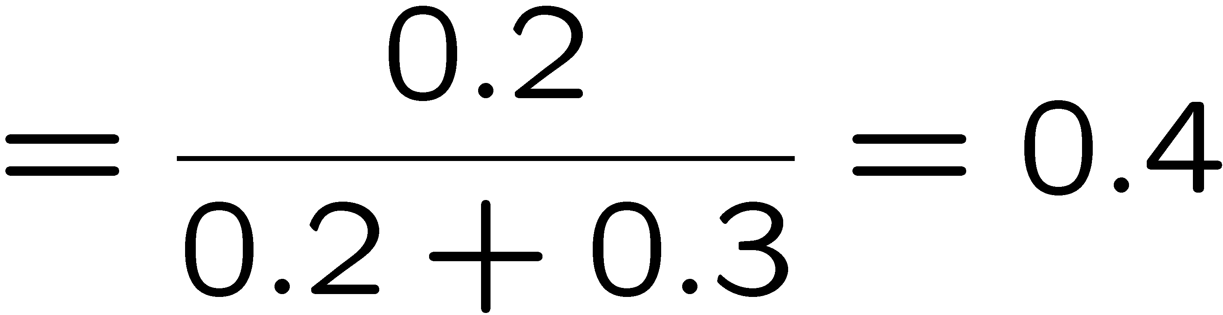
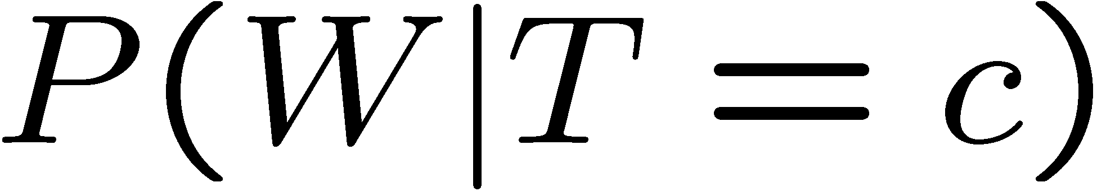
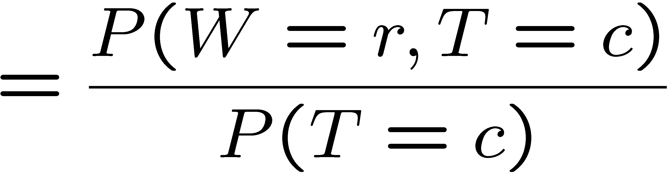

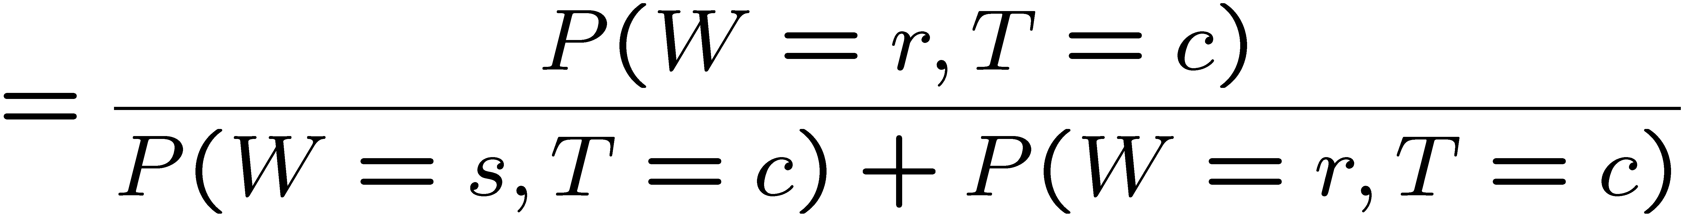
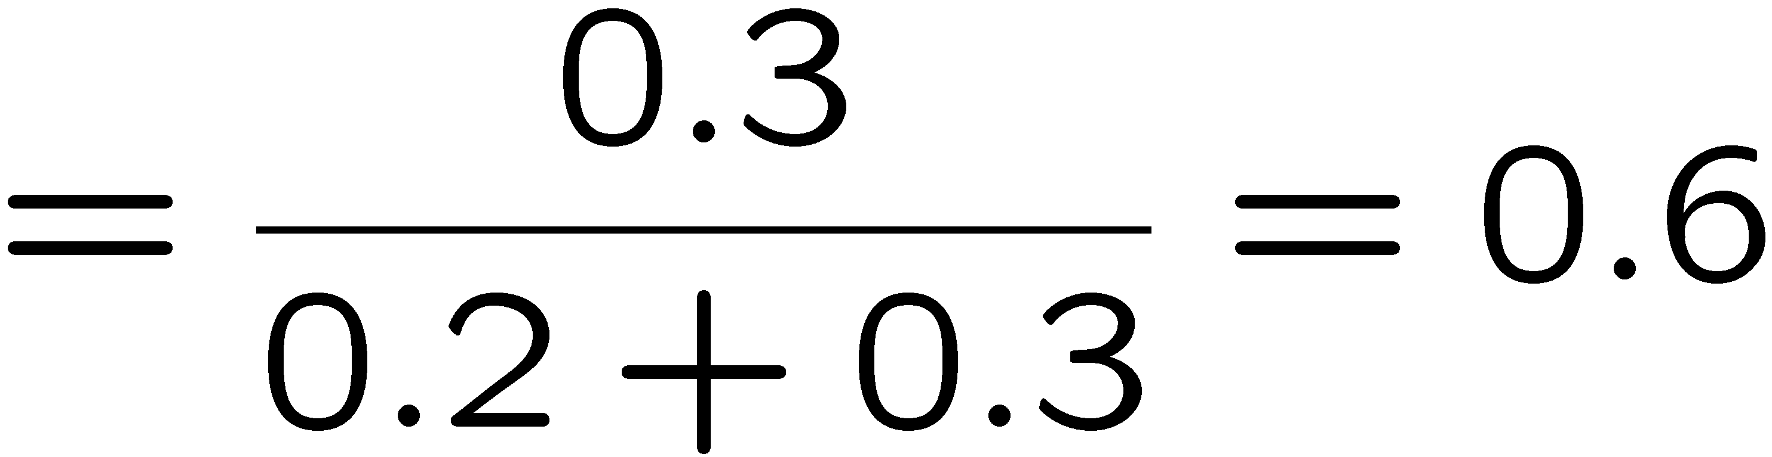
Normalization Trick
T | W | P
hot | sun | 0.4
hot | rain | 0.1
cold | sun | 0.2
cold | rain | 0.3
W | P
sun | 0.4
rain | 0.6
Notes:
CCB – start here
Another way of arriving at a conditional distribution from a joint distribution is called the Normalization trick. It can be faster, and is a bit more mechanical than before. The idea is to go from a full joint to a conditional in a very structured way.
First, let’s look at what happens when we do what we did before. We need two entries in the conditional probability weather, given temperature is cold.
p(sunny |cold)
p(rain| cold).
[Write these on the board.]
Now, let’s take a careful look at what is happening here. What entries are we using in the two equations? All the entries which are consistent with T=c. The way that they show up is that ALL OF THEM SHOW UP IN THE DENOMINATOR. The one on the top is the one that is consistent with the row that we’re computing.
Another way of looking at this is to look up all entries that are consistent with T=c, and then use them in a particular way. We just need the one entry that’s consistent with what we’re doing, and then we need all of them for the denominator.

Slide 18
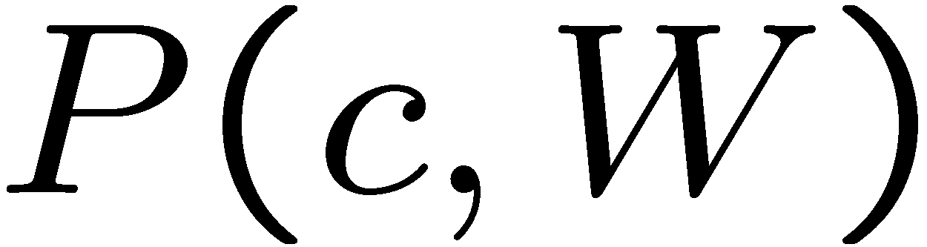
Normalization Trick
SELECT the joint probabilities matching the evidence
NORMALIZE the selection
(make it sum to one)
T | W | P
hot | sun | 0.4
hot | rain | 0.1
cold | sun | 0.2
cold | rain | 0.3
T | W | P
cold | sun | 0.2
cold | rain | 0.3
W | P
sun | 0.4
rain | 0.6
Notes:
So let’s look at that in a different way.
First, select all of the entries that are consistent with T=c.
Then we need the one that’s consistent with what we’re computing (W=sun or W=rain), and then divide by the sum of all of the values that we selected.
That’s called normalization. We just want to make it sum to one by dividing by the sum of all the entries that we selected from the joint table.
This can make it easier to compute.

Slide 19
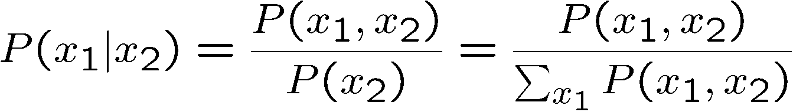
Normalization Trick
SELECT the joint probabilities matching the evidence
NORMALIZE the selection
(make it sum to one)
T | W | P
hot | sun | 0.4
hot | rain | 0.1
cold | sun | 0.2
cold | rain | 0.3
T | W | P
cold | sun | 0.2
cold | rain | 0.3
W | P
sun | 0.4
rain | 0.6
Why does this work? Sum of selection is P(evidence)! (P(T=c), here)

Slide 20
Quiz: Normalization Trick
P(X | Y=-y) ?
SELECT the joint probabilities matching the evidence
NORMALIZE the selection
(make it sum to one)
X | Y | P
+x | +y | 0.2
+x | -y | 0.3
-x | +y | 0.4
-x | -y | 0.1
Notes:
P(X | Y=-y)
Select
+x, -y, 0.3
-x, -y, 0.1
Normalize
+x = 0.3 / 0.4 = 0.75
-x = 0.1 / 0.4 = 0.25

Slide 21
To Normalize
(Dictionary) To bring or restore to a normal condition
Procedure:
Step 1: Compute Z = sum over all entries
Step 2: Divide every entry by Z
Example 1
All entries sum to ONE
Example 2
W | P
sun | 0.2
rain | 0.3
Normalize
W | P
sun | 0.4
rain | 0.6
T | W | P
hot | sun | 20
hot | rain | 5
cold | sun | 10
cold | rain | 15
T | W | P
hot | sun | 0.4
hot | rain | 0.1
cold | sun | 0.2
cold | rain | 0.3
Normalize
Z = 0.5
Z = 50
Notes:
What does this term mean? …
In Example 2, the numbers are too large to be probabilities, but normalization corrects this.

Slide 22
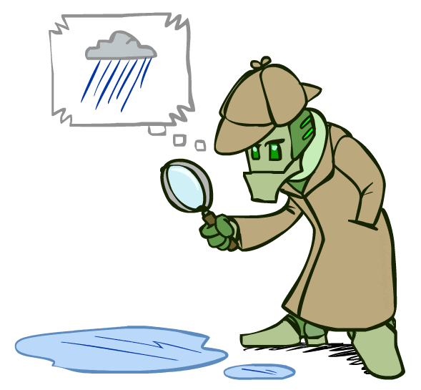
Probabilistic Inference
Probabilistic inference: compute a desired probability from other known probabilities (e.g. conditional from joint)
We generally compute conditional probabilities
P(on time | no reported accidents) = 0.90
These represent the agent’s beliefs given the evidence
Probabilities change with new evidence:
P(on time | no accidents, 5 a.m.) = 0.95
P(on time | no accidents, 5 a.m., raining) = 0.80
Observing new evidence causes beliefs to be updated
Notes:
What is probabilistic inference in general? It’s computing some desired probabilities (usually conditionals), given some input set of probabilities (by default, a large joint distribution).
The reason that this is interesting, is that our probability distributions change as we accrue more evidence.
Observing new evidence causes our beliefs to be updated. Evidence can cause the probabilities to go up or to go down.

Slide 23





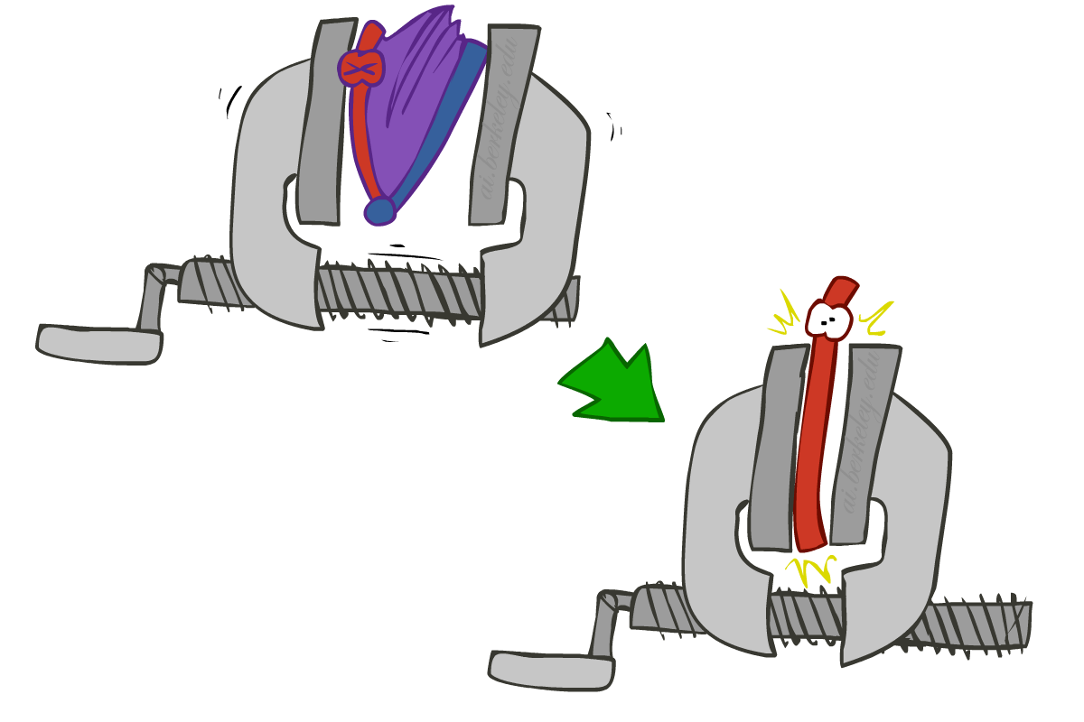
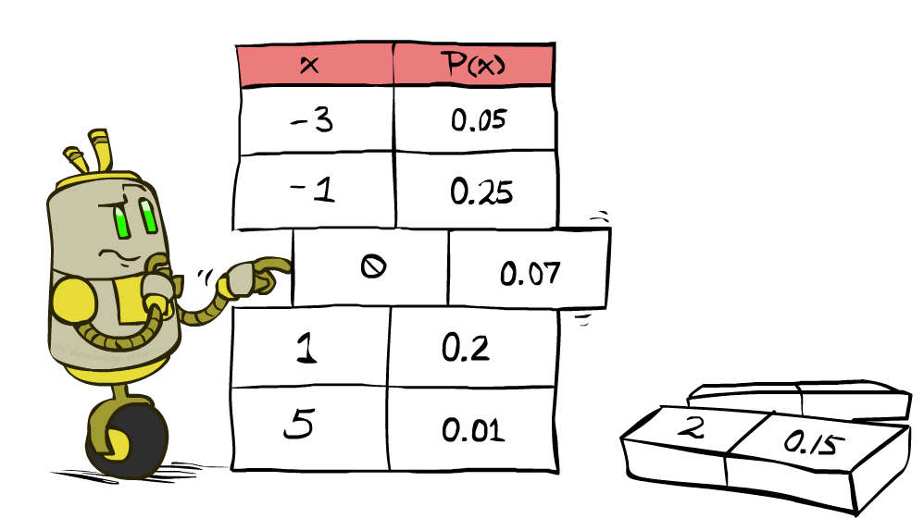


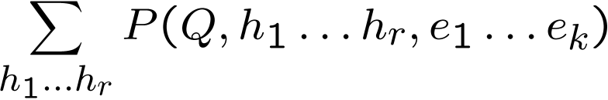
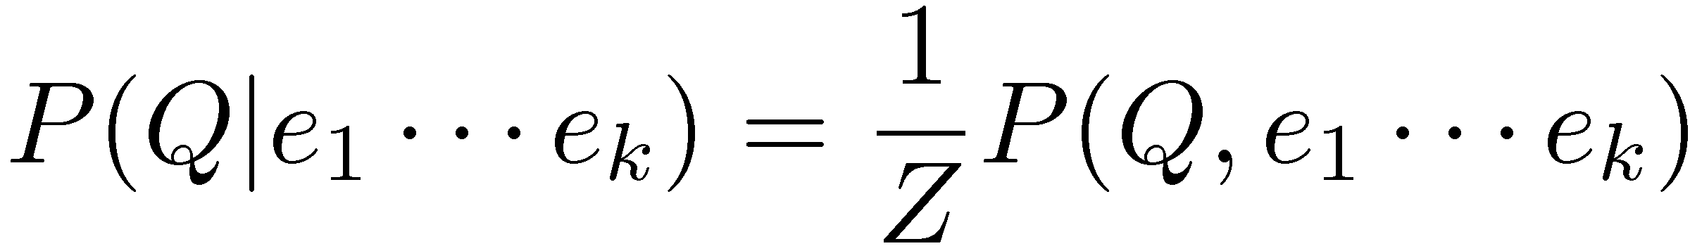
Inference by Enumeration
* Works fine with multiple query variables, too
General case:
Evidence variables:
Query* variable:
Hidden variables:
We want:
All variables
Step 1: Select the entries consistent with the evidence
Step 2: Sum out H to get joint of Query and evidence
Step 3: Normalize
Notes:
Here’s the first procedure that we’ll look at for Probabilistic Inference. It is called Inference by Enumeration
We can split up our variables into 3 sets:
1. some evidence variables – those are what we’ve observed.
2. The query variables – those are what we want to know about
3. The hidden variables – those appear in the joint distribution, but don’t appear in the previous 2.
Here are the 3 steps that we need to do:
Step 1: select all entries that are consistent with the Evidence.
Step 2: Sum out the hidden variables. Sum over all possible instantiations of the hidden variables. That leaves us with the joint distribution between the query variable and the evidence variables.
That’s something like P(a, c) = sum over b P(a,b,c).
That’s the same as P(q, e) = sum over h P(q,h,e).
Step 3: Normalize to get the conditional probability.

Slide 24
Inference by Enumeration
P(W)?
P(W | winter)?
P(W | winter, hot)?
S | T | W | P
summer | hot | sun | 0.30
summer | hot | rain | 0.05
summer | cold | sun | 0.10
summer | cold | rain | 0.05
winter | hot | sun | 0.10
winter | hot | rain | 0.05
winter | cold | sun | 0.15
winter | cold | rain | 0.20
Notes:
Work through these on the board.

Slide 25
Inference by Enumeration
Obvious problems:
Worst-case time complexity O(d^{n})
Space complexity O(d^{n}) to store the joint distribution
Notes:
Size of distribution if n variables with domain sizes d

Slide 26
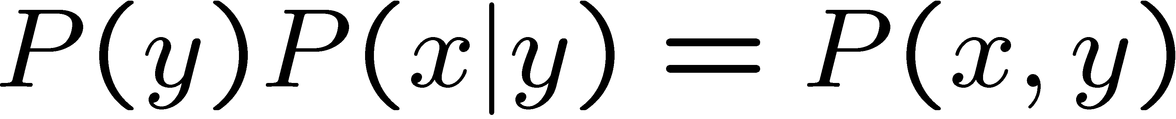
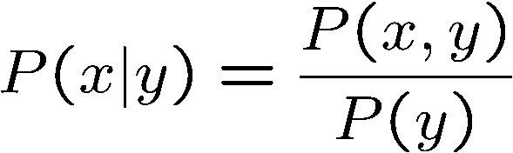
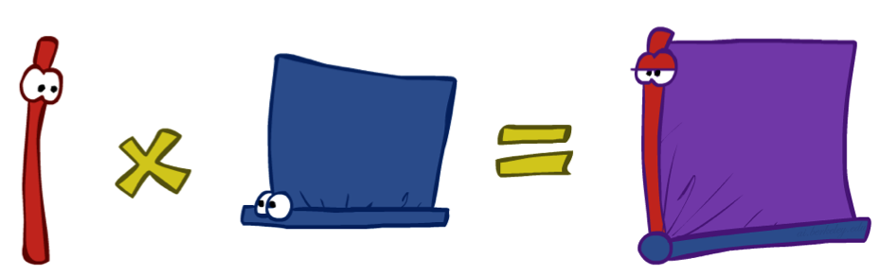
The Product Rule
Sometimes have conditional distributions but want the joint
Notes:
The product rule is directly derived from our definition of the conditional probability.
Just multiply both sides by the marginal.
What’s interesting here is that this is our first encounter of how to arrive at a joint distribution not by specifying the full distribution in advance, but by specifying the marginal and the joint distribution. This implicitly gives us a joint.

Slide 27


The Product Rule
Example:
D | W | P
wet | sun | 0.1
dry | sun | 0.9
wet | rain | 0.7
dry | rain | 0.3
D | W | P
wet | sun | 0.08
dry | sun | 0.72
wet | rain | 0.14
dry | rain | 0.06
R | P
sun | 0.8
rain | 0.2
Notes:
How do recover the full joint distribution?
P(wet, sun) =. P(sun) * P(wet | sun) = 0.8 * 0.1 = 0.08
P(dry, sun) =. P(sun) * P(dry| sun) = 0.8 * 0.9 = 0.72
…
We can compute every entry that way.

Slide 28
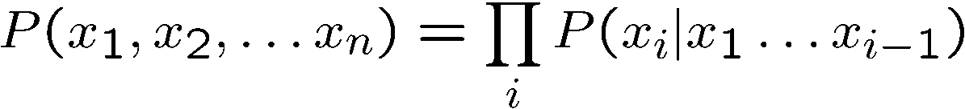
The Chain Rule
More generally, can always write any joint distribution as an incremental product of conditional distributions
Why is this always true?
Notes:
Can we apply the product rule to more than two variables? Yes! It’s called the chain rule.
Here’s the chain rule for 3 variables, x1, x2, x3. It’s the maginal of x1, times the conditional of x2 given x1, times the conditional of x3 given x1 and x2.
We can generalize this to any number of x1 to x_n as ….
i = 1 P(x1)
I = 2 p(x2|x1)
I = 3 p(x3|x1, x2)
…
I = n p(x_n|x1, x2, …. Xn-1)
Then you take the product of all of those. You can take any ordering and still apply this chain rule. There are n! ways of writing the joint over the ordering of n variables.
Why is this always true? [Write out the equations for P(x1,x2,x3) replacing each conditional with its joint over marginal equivalent and show how the cancel.).
P(x1) * P(x2|x1) * p(x3|x2,x1) rewrites as P(x1) * P(x2,x1)/P(x1) * p(x3,x2,x1)/p(x2,x1).
Show the cancelation of each numerator and the next term’s denominator.
That leaves p(x3,x2,x1).
If you want, you can prove this by induction.

Slide 29
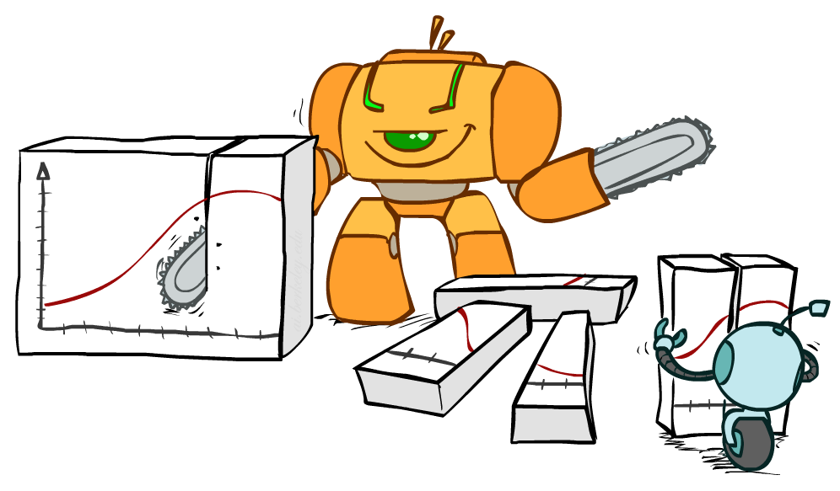
Bayes Rule
Notes:
Now let’s look at what we’ll often be doing. We’ll be given a distribution, not as a full joint distribution but in some other format.
And we want to slice and dice that to get to the representation that we really want.

Slide 30


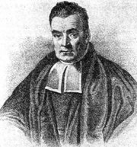
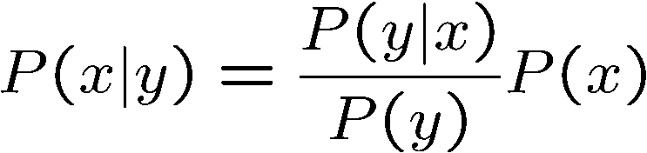
Bayes’ Rule
Two ways to factor a joint distribution over two variables:
Dividing, we get:
Why is this at all helpful?
Lets us build one conditional from its reverse
Often one conditional is tricky but the other one is simple
Foundation of many systems we’ll see later (e.g. ASR, MT)
In the running for most important AI equation!
Notes:
We start with the product rule. Just like the chain rule you can write the variables in any order.
Next we divide by p(y) to get this formula for the conditional probability.
Why is this helpful? Sometimes one conditional is much trickier to get than it is to get other conditionals.
Very imporant for AI in the 1990s. In fact Fred Jelinek, my former boss at JHU, dubbed it the fundamental equation of machine translation.
Generalizations of this will be what we study in the next few lectures.

Slide 31
Inference with Bayes’ Rule
Example: Diagnostic probability from causal probability:
Example:
M: meningitis, S: stiff neck
Note: posterior probability of meningitis still very small
Note: you should still get stiff necks checked out! Why?
Example
givens
Notes:
What’s the probability that meningitis is the cause, given that we have the effect of a stiff neck? The equation equation works out to be 0.007944 or a bit less than 1%.
This can be used to make decisions? Should a person with a stiff neck go to the doctor? It depends on the probabilities and the utilities. What’s the utility of living with undiagnosed meningitis? What’s the utility of knowing that you don’t have it after going to the doctor and getting a clean bill of health? What’s the utility of living without meningitis, if you go and get it treated?
The cost of undiagnosed meningitis may be high, versus the cost of going to the doctor which may just take a little bit of time.
Meningitis is an inflammation of the membranes (meninges) surrounding your brain and spinal cord.
The swelling from meningitis typically triggers symptoms such as headache, fever and a stiff neck.
Most cases of meningitis in the United States are caused by a viral infection, but bacterial, parasitic and fungal infections are other causes. Some cases of meningitis improve without treatment in a few weeks. Others can be life-threatening and require emergent antibiotic treatment.

Slide 32
Quiz: Bayes’ Rule
Given:
What is P(W | dry) ?
D | W | P
wet | sun | 0.1
dry | sun | 0.9
wet | rain | 0.7
dry | rain | 0.3
R | P
sun | 0.8
rain | 0.2
Notes:
P(W | dry)
Table:
W. P(W|dry)
Sun
Rain
p(sun|dry) = p(dry|sun)*P(sun) / P(dry) … to compute the denominator we need to computer P(dry|sun) * P(sun) + P(dry|rain) * P(rain)
0.9*0.8 / 0.9*0.8 + 0.3*0.2.
P(ran|dry) will just be 1-P(sun|dry).

