Slide 1
Announcements
EC3 deadline has been extended by 1 week

Slide 2

Perceptrons
Read AIMA - Section 18.6.3
And Chapter 1
Of Nielsen’s “Neural Networks and Deep Learning”
Slides Courtesy of Dan Klein and Pieter Abbeel --- University of California, Berkeley
[These slides were created by Dan Klein and Pieter Abbeel for CS188 Intro to AI at UC Berkeley. All CS188 materials are available at http://ai.berkeley.edu.]

Slide 3
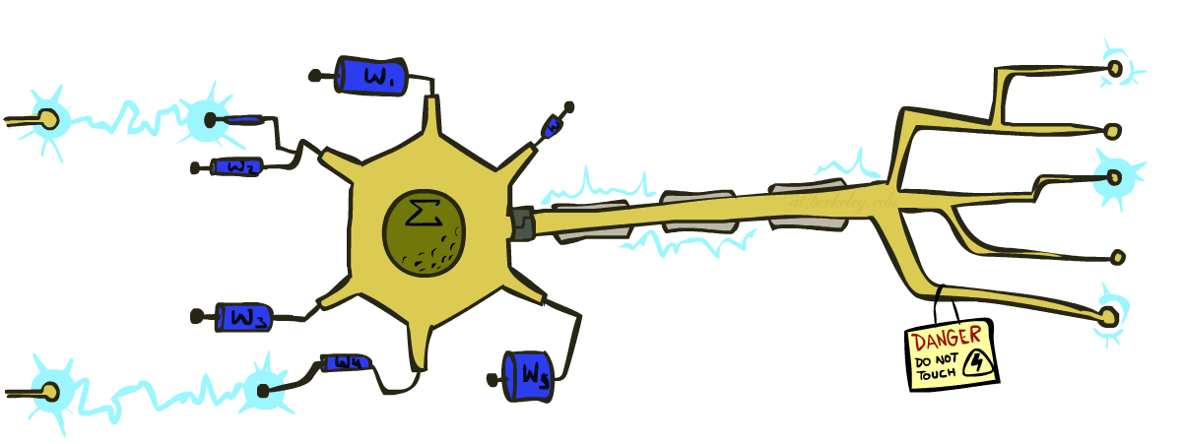
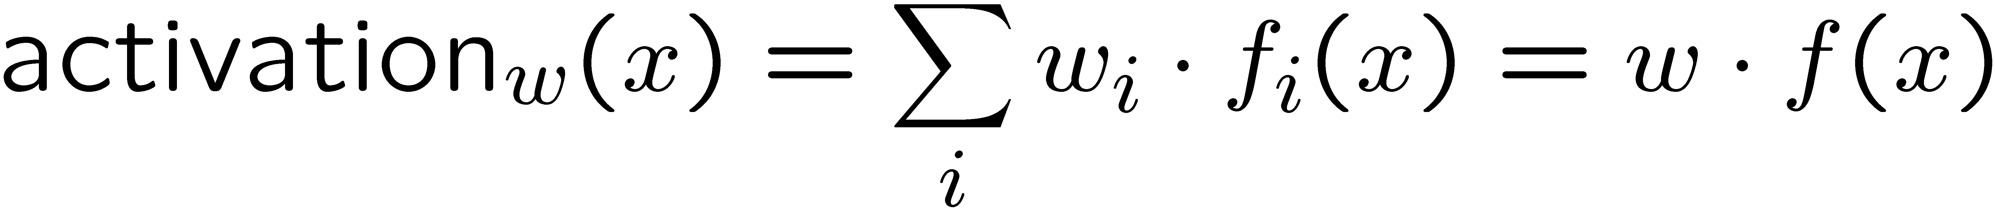
Recap: Linear Classifiers
Inputs are feature values
Each feature has a weight
Sum is the activation
If the activation is:
Positive, output +1
Negative, output -1
w₁
f₁
Σ
w₂
>0?
f₂
w₃
f₃
Notes:
The activation for some weight vector w given some input x is the Sum for each weight w_i in the weight vector with the corresponding entry in the feature vector representing x, f_i(x).
We also write this as w * f(x), which is the inner product of the weight vector and the feature vector.
Depending on whether the sum is positive, or the sum is negative, we output a positive class label or a negative class label (for the binary classification case).
This is the generic picture that represents the perceptron..
This is called the “dot product” or sometimes the “inner product”

Slide 4

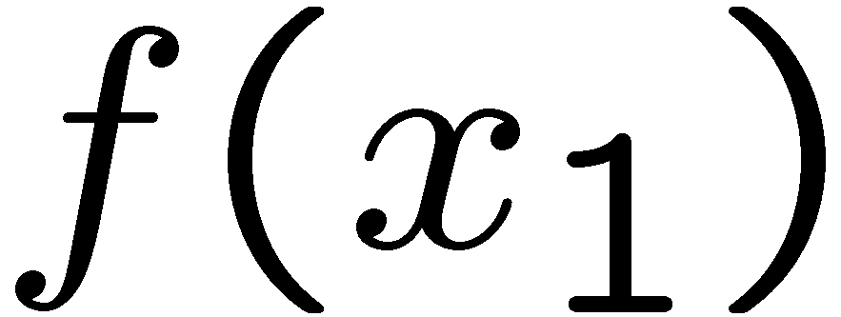
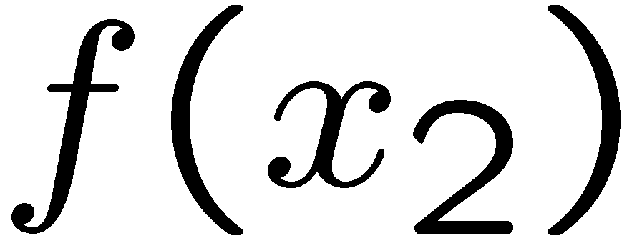
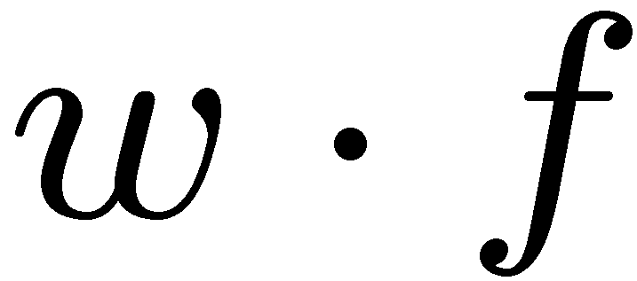
Recap: Weights
Binary case: compare features to a weight vector
Learning: figure out the weight vector from examples
# free : 4
YOUR_NAME :-1
MISSPELLED : 1
FROM_FRIEND :-3
...
# free : 2
YOUR_NAME : 0
MISSPELLED : 2
FROM_FRIEND : 0
...
# free : 0
YOUR_NAME : 1
MISSPELLED : 1
FROM_FRIEND : 1
...
Dot product positive means the positive class
Notes:
The feature values for inputs are fixed, but we can choose different weight vectors. Depending on the weight vector that we pick, we will get a different classifier.
Let’s look at an example, with the following weight vector. The first entry is a weight based on how often the word free appears. We get a high value for that. The next one is whether your name appears. This weight vector will lower the value. If there are misspelled words, the activation will go up. If the email comes from a friend then the activation will go up.
The weight vector always represents the positive class, so what is it in this case? It’s SPAM.
The weight vector lives in the same vector space as the feature vectors. Here’s are two feature vectors representing two emails that we want to classify.
For linear classification, we have a separating hyperplane. Separation is orthogonal to w. ((Draw this at a right angle to w)). Everything on the same side as w is the positive class Everything on the other side is the negative class.
For x2, the angle between w and f(x2) > 90 degrees, so it is negative.
If we compute the inner product then we’ll get a negative class when the angle is > 90 degrees like f(x_2).

Slide 5
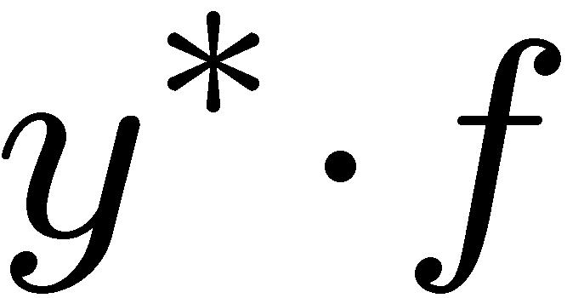
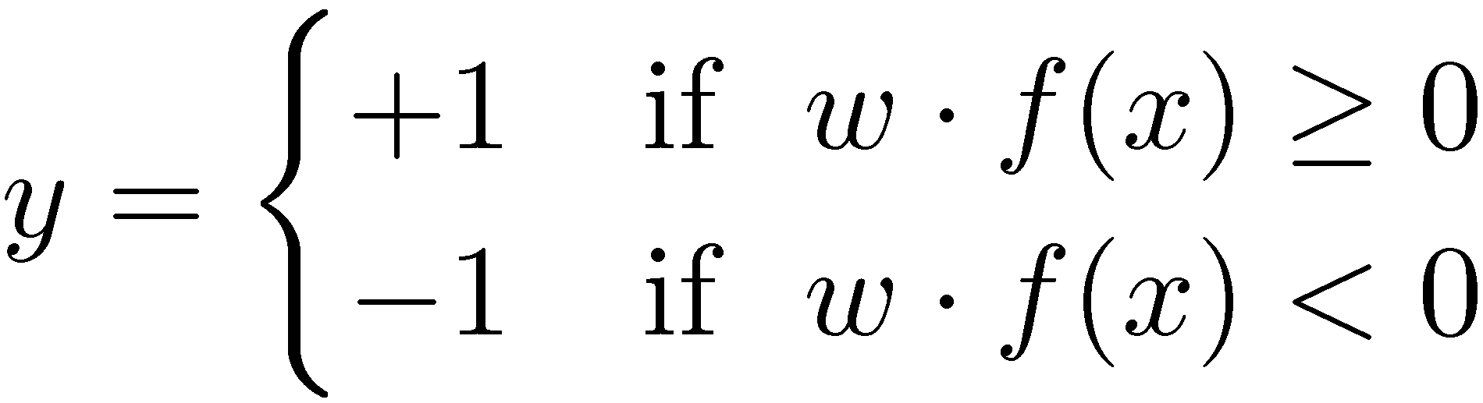

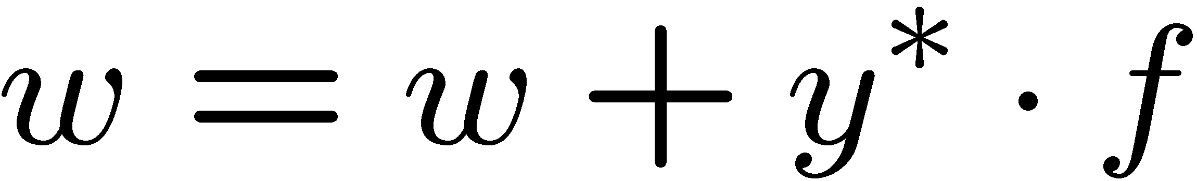
Recap: Learning a Binary Perceptron
Start with weights = 0
For each training instance:
Classify with current weights
If correct (i.e., y=y*), no change!
If wrong: adjust the weight vector by adding or subtracting the feature vector. Subtract if y* is -1.
Notes:
Mathematically what does it look like? You start with zero weights, and then for each thing you classify by running this computation here: w*f(x) and checking whether that inner product is positive or negative. You classify x as positive if the inner product is >= 0, and negative if it is <0.
You then check the correct label y* in the training example. The training example will tell you whether it should be positive or negative. If you’re correct, then no change.
If you’re wrong, then we will make an adjustment. For the picture here, f(x) get’s a positive classification. Let’s say that the training data tells us that it should be negative. Then we need to somehow adjust this. We need to rotate w and f apart, so that they hopefully now have a negative inner product.
F is fixed. W is the thing that we can change. We want to change is so that it is less aligned with f. If we want to make it less aligned with f, then we add the negative of f to w. ((draw it)). If we add the negative of F to W, then we get a new W ((draw it), and our decision boundary changes ((Draw it as at a right angle to the new W)).
The f is now of the other side of the decision boundary than it was before, which is our goal).
So here’s the update that we use if the update is wrong: we add y* (+1 or -1) * f to w

Slide 6
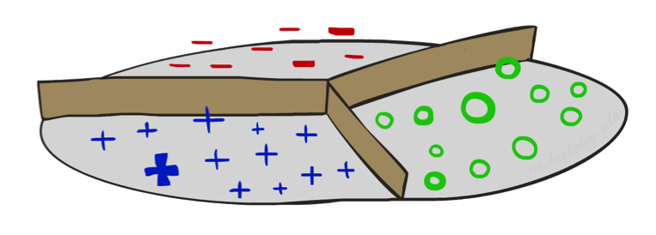
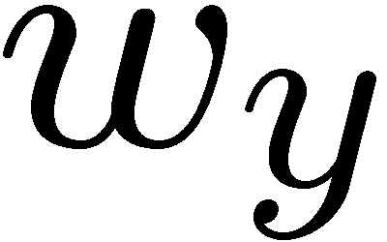

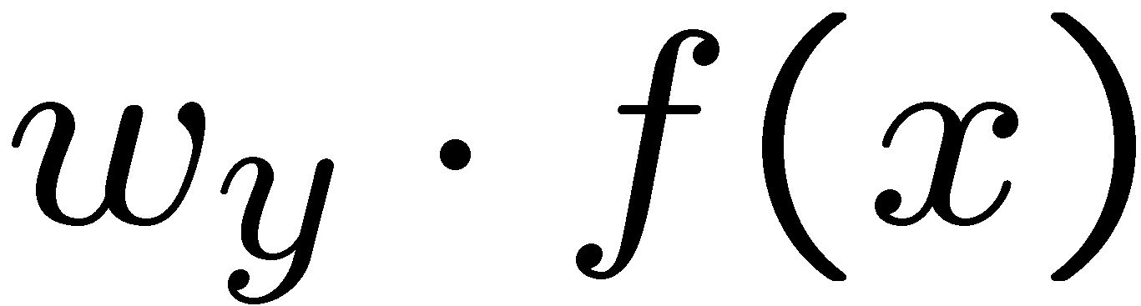
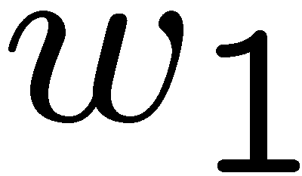
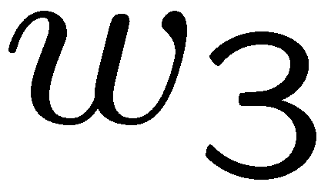
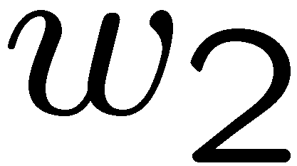
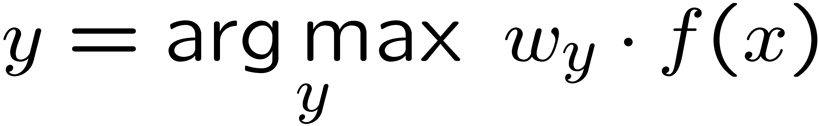
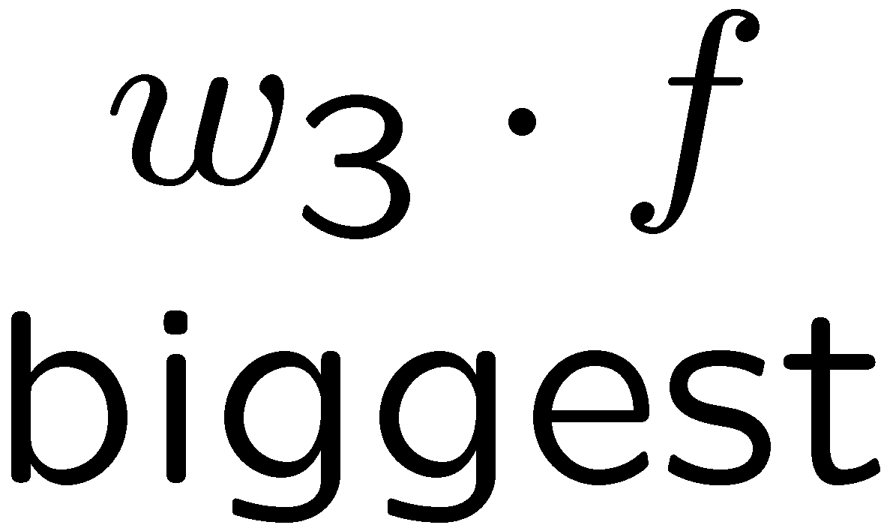
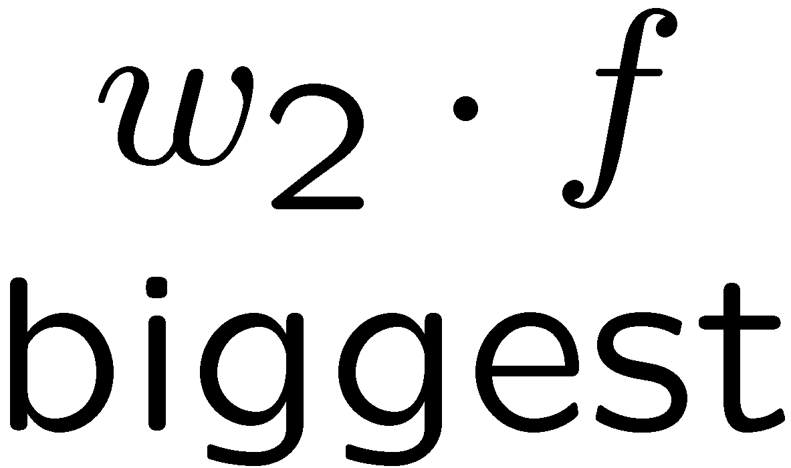
Multiclass Decision Rule
If we have multiple classes:
A weight vector for each class:
Score (activation) of a class y:
Prediction highest score wins
Binary = multiclass where the negative class has weight zero
Notes:
Here we’ll look at 3 classes on the slides, but this applies to any number of classes.
We have weight vector for each class.
If these are equal length, then the decision boundaries will be at the place that bisects the weight vectors (typically they won’t be equal length, which makes things a bit more complicated, but not much).
Now there is a w for each class (we index the classes by y). We compute w_y * f(x) for each class Y. Whichever one is the highest becomes our prediction for what class X should have.

Slide 7

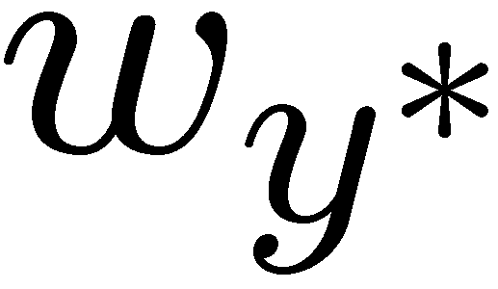
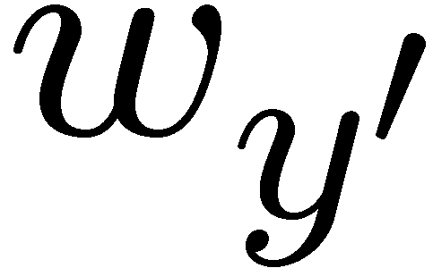
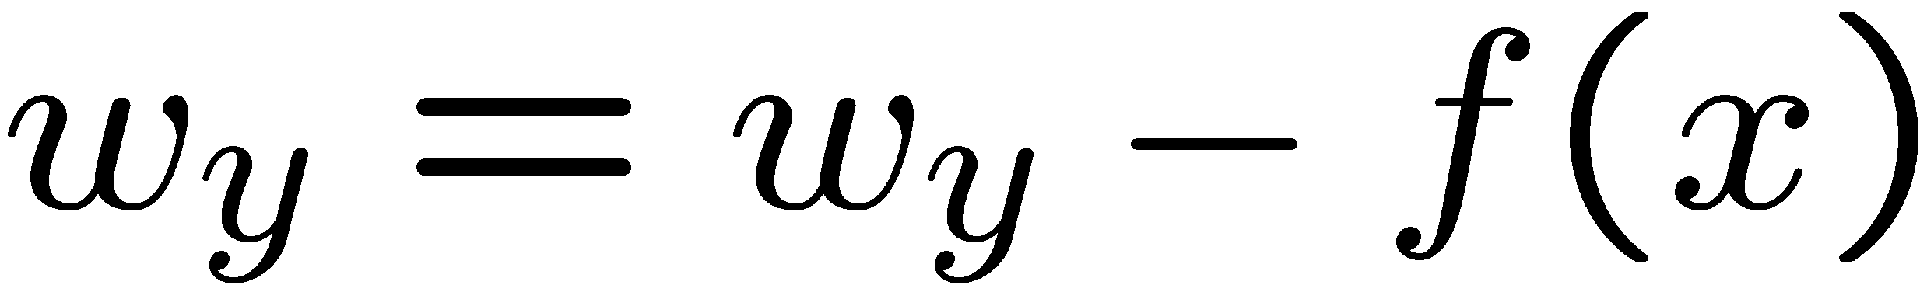
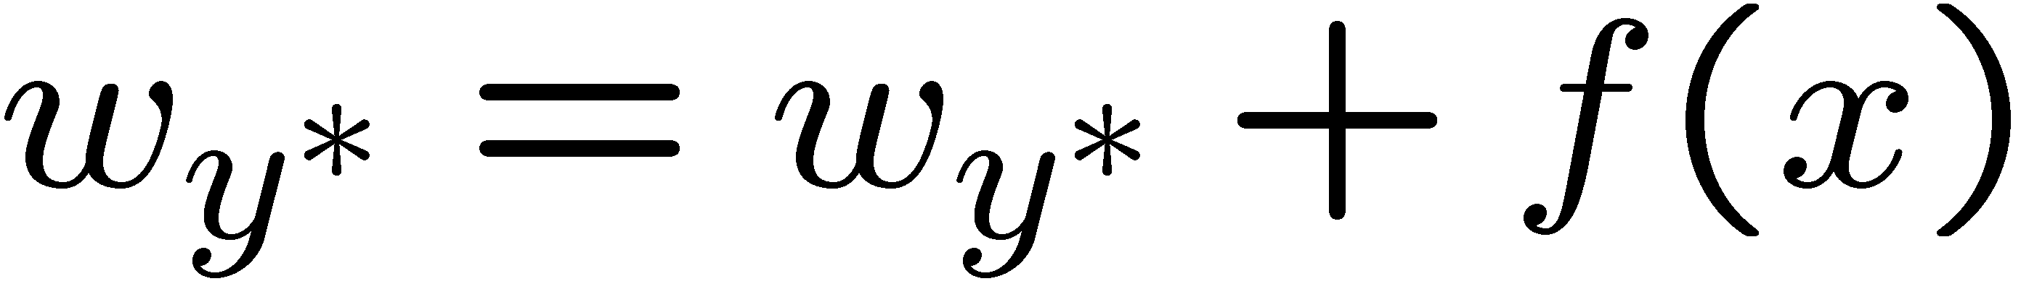
Learning: Multiclass Perceptron
Start with all weights = 0
Pick up training examples one by one
Predict with current weights
If correct, no change!
If wrong: lower score of wrong answer, raise score of right answer

Slide 8
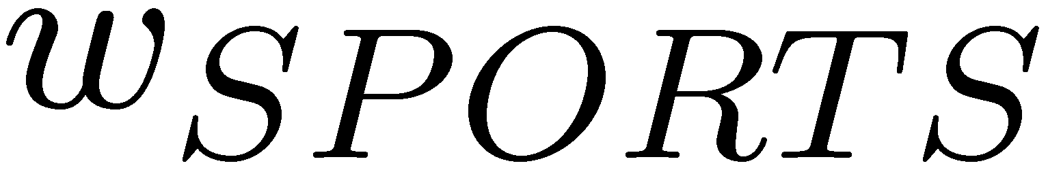
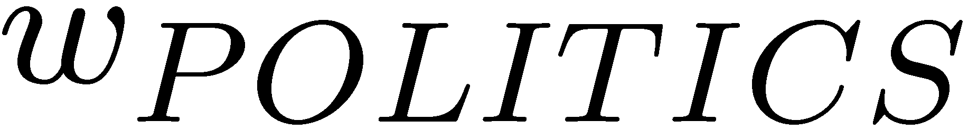
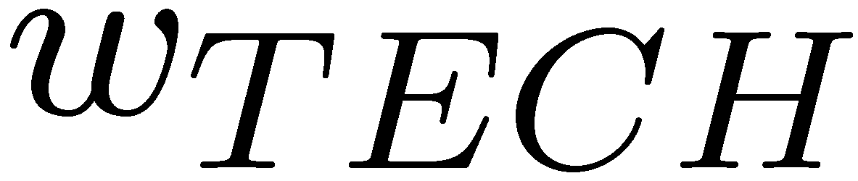
Example: Multiclass Perceptron
“win the vote”
“win the election”
“win the game”
BIAS : 1
win : 0
game : 0
vote : 0
the : 0
...
BIAS : 0
win : 0
game : 0
vote : 0
the : 0
...
BIAS : 0
win : 0
game : 0
vote : 0
the : 0
...
Notes:
Here are the initial weight vectors for each of our three classes. Now we have 3 inputs that we want to classify.
Let’s compute the values for each of the classes. It’s the inner product. Since sports has the bias term of 1, it wins. However, Let’s say that y* is poiitics.
We add f(x) to politics, which gives us a new w_politics of (1, 1, 0, 1, 1).
We subtract f(x) from sports, so we get a new w_sports of (0, -1, 0, -1, -1).
So that’s our first training example.
Let’s compute the score for “win the election”. The feature vector is 1, 1, 0, 0, 1.
For the inner products we get -2 for w_sports, 3 for w_politics and 0 for w_tech.
So the highest score is politics. That’s the correct label, so we don’t need to do any updates.
For win the game our f(x) is (1, 1, 1, 0, 1).
For the inner products we get -2 for w_sports, 3 for w_politics and 0 for w_tech.
Now we have to update by subtracting this f(x) from the politics weight vector, and add it to the sports weight vector.
Subtracting it out fom w_politics gives us new w_politics of (0, 0, -1, 1, 0).
We add f(x) tp sports, so we get a new w_sports of (1, 0, 1, -1, 0).
Then we go back to the first example. We keep looping until at some point, we run through all examples and nothing changes. If that’s the case then nothing will change in the future.

Slide 9
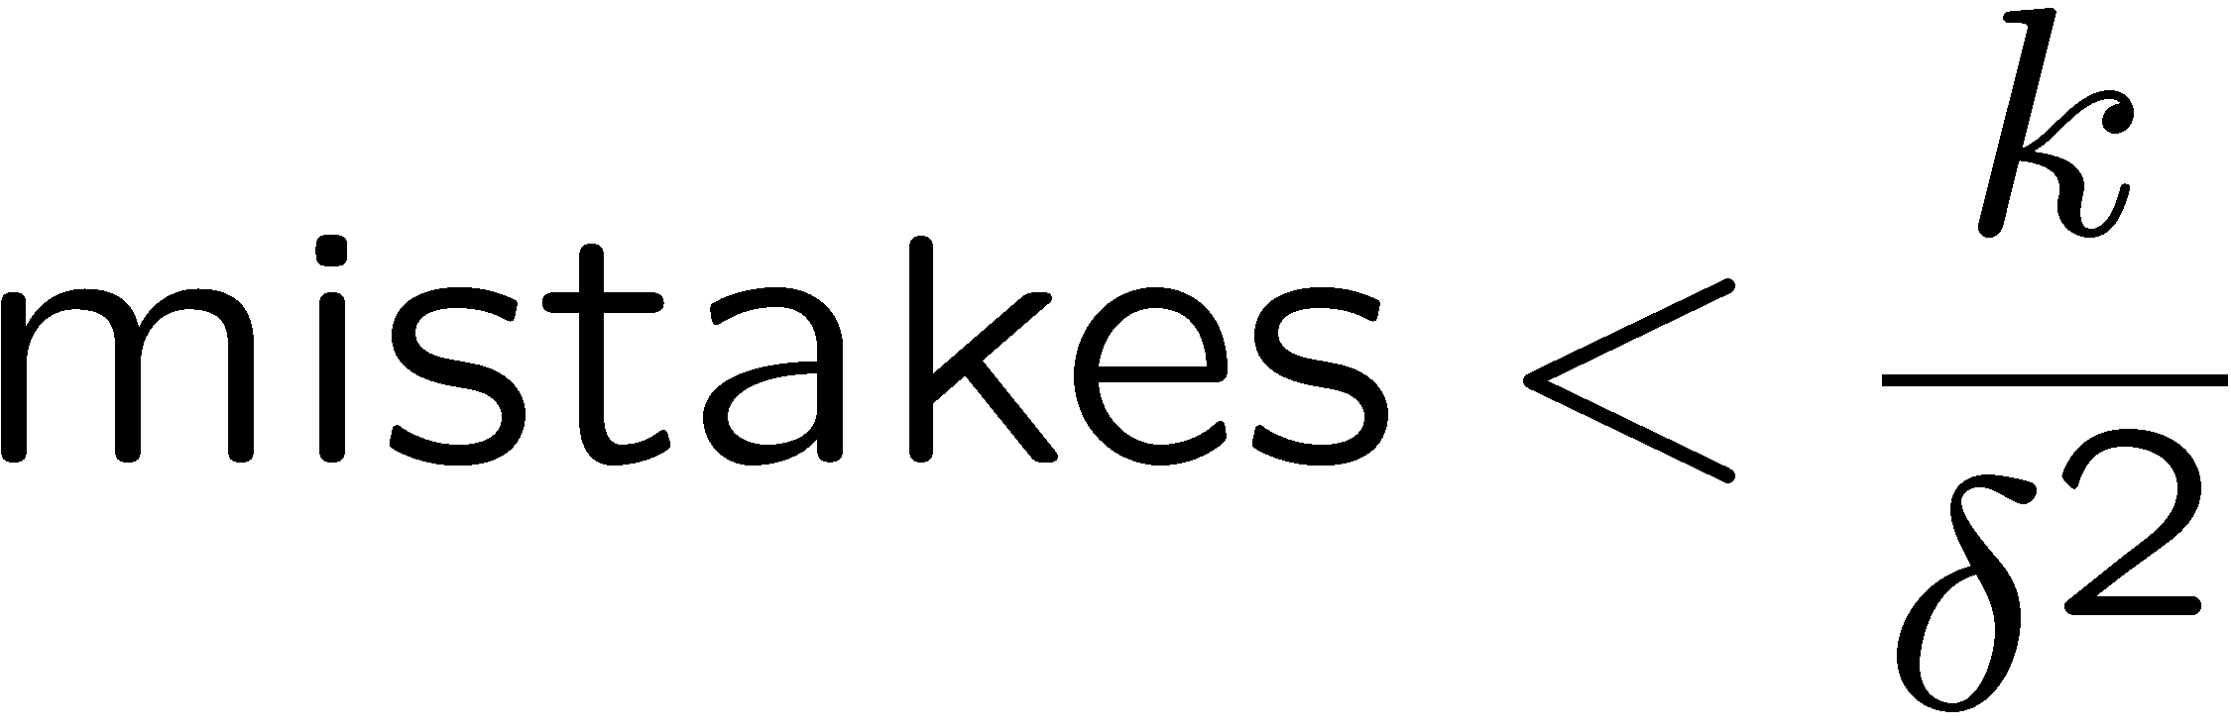
Properties of Perceptrons
Separable
Separability: true if some parameters get the training set perfectly correct
Convergence: if the training is separable, perceptron will eventually converge (binary case)
Mistake Bound: the maximum number of mistakes (binary case) related to the margin or degree of separability
Non-Separable
Notes:
You need to do at most this many passes.
K is the number of features. The more features that you have the longer it will take to converge.
Delta squared is the margin. If you have a separable data set, then you can compute the margin (the distance between the positive and negative class). If that margin (delta) is large, then it’s an easy cases, since there are many decision boundaries. If it’s small, then you have to be very precise before you find a separating hyperplane.

Slide 10
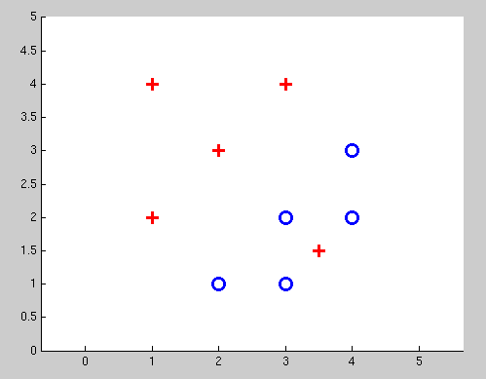
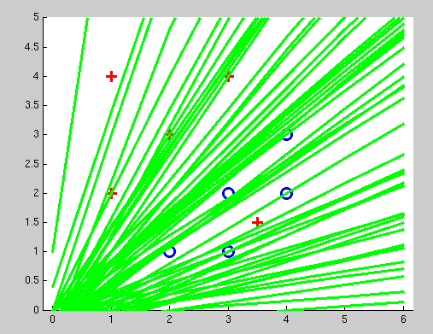
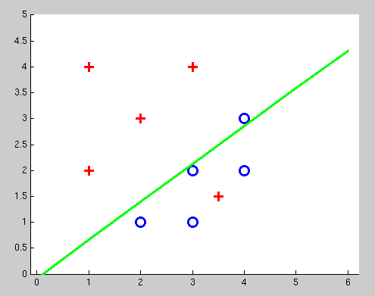
Examples: Perceptron
Non-Separable Case

Slide 11
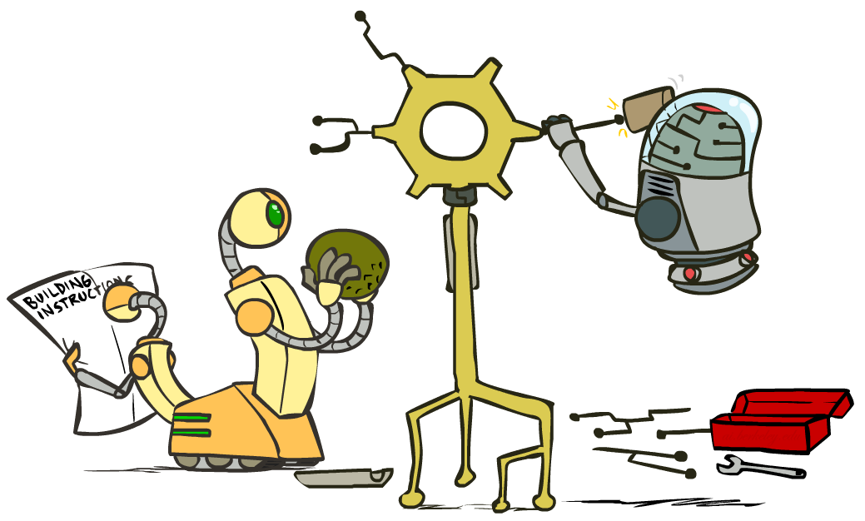
Improving the Perceptron

Slide 12
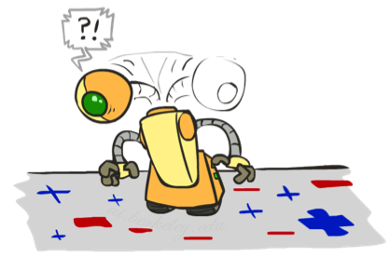
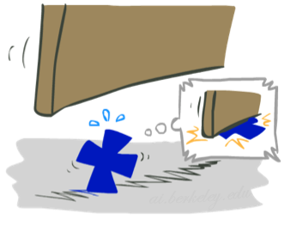

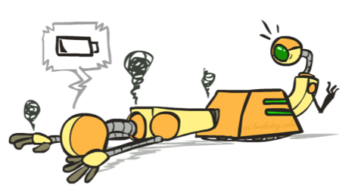




Problems with the Perceptron
Noise: if the data isn’t separable, weights might thrash
Averaging weight vectors over time can help (averaged perceptron)
Mediocre generalization: finds a “barely” separating solution
Overtraining: test / held-out accuracy usually rises, then falls
Overtraining is a kind of overfitting
Notes:
3. Overtraining is easy to fix. Use held-out data to avoid overtraining via “early stopping”.
Next, we will turn to an algorithm that helps the first two problems. It will help us find a better decision boundary, and it will help us avoid thrashing around.

Slide 13
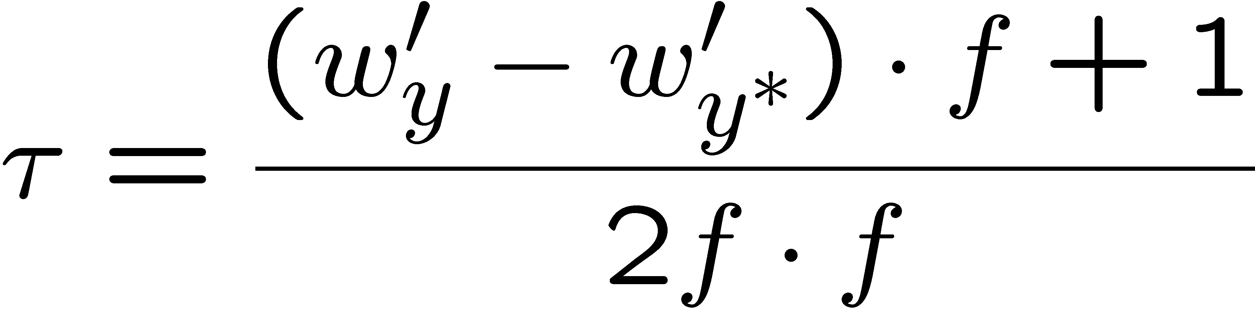
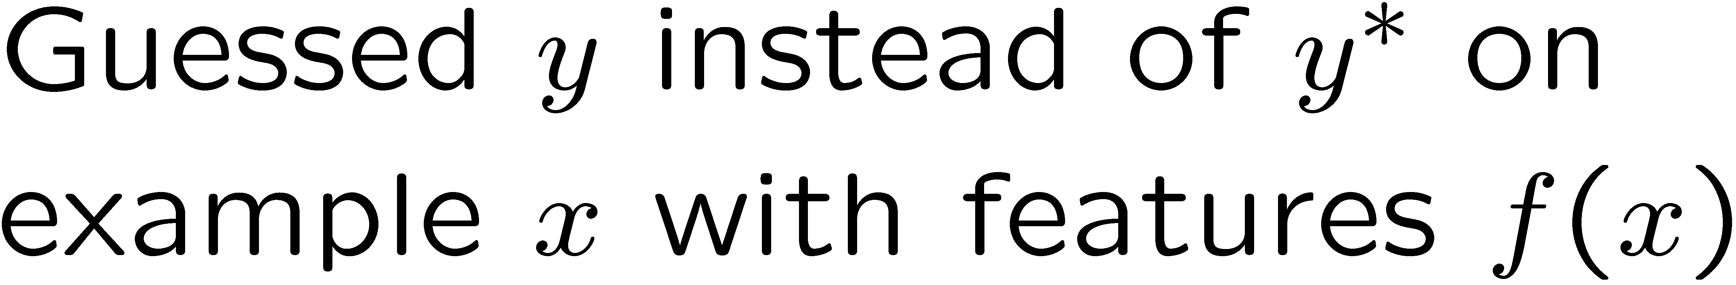
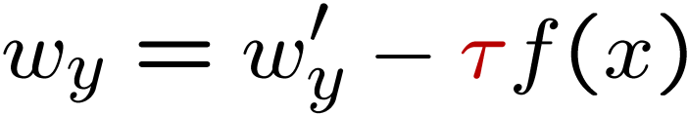
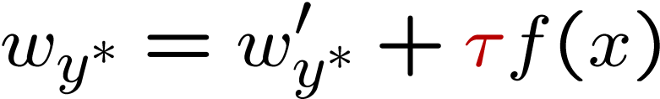
Fixing the Perceptron
Idea: adjust the weight update to mitigate these effects
MIRA = Margin Infused Relaxed Algorithm
Choose an update size that fixes the current mistake…
… but, minimizes the change to w
The +1 helps to generalize
Notes:
MIRA does the following when you make an error:
You re-scale your features by some value Tau. This is like the alpha that we saw in Q-learning. It is a learning rate in some sense. Unlike in Q-learning where this was set heuristically, we are going to have a principled way of setting Tau.
Let’s take a look at it pictorially. We wanted to classify the current thing as y*, but we came up with y as our prediction. What we normally do is subtract out f from wy, and add it to w*, and that would be the perceptron update.
Now we’re going to allow some scaling via tau. Not too much, not too little.
So here’s the equation that we use to choose an update size. We want to pick a new update that has the weight vector for each class (w_y’) to be as close as possible to w_y. You could make that true by just setting w_y’ to be w_y.
But there’s a constraint. We want the w_y to be better for the current item f(x). That’s the second term. And not only do we want it to be better than our previous prediction, and we want it to be correct by a margin of at least +1. This is saying that y* has to be getting a higher score than y +1.
The plus one gives us some margin.
Now we need to solve this. The next slide shows the optimization problem.

Slide 14
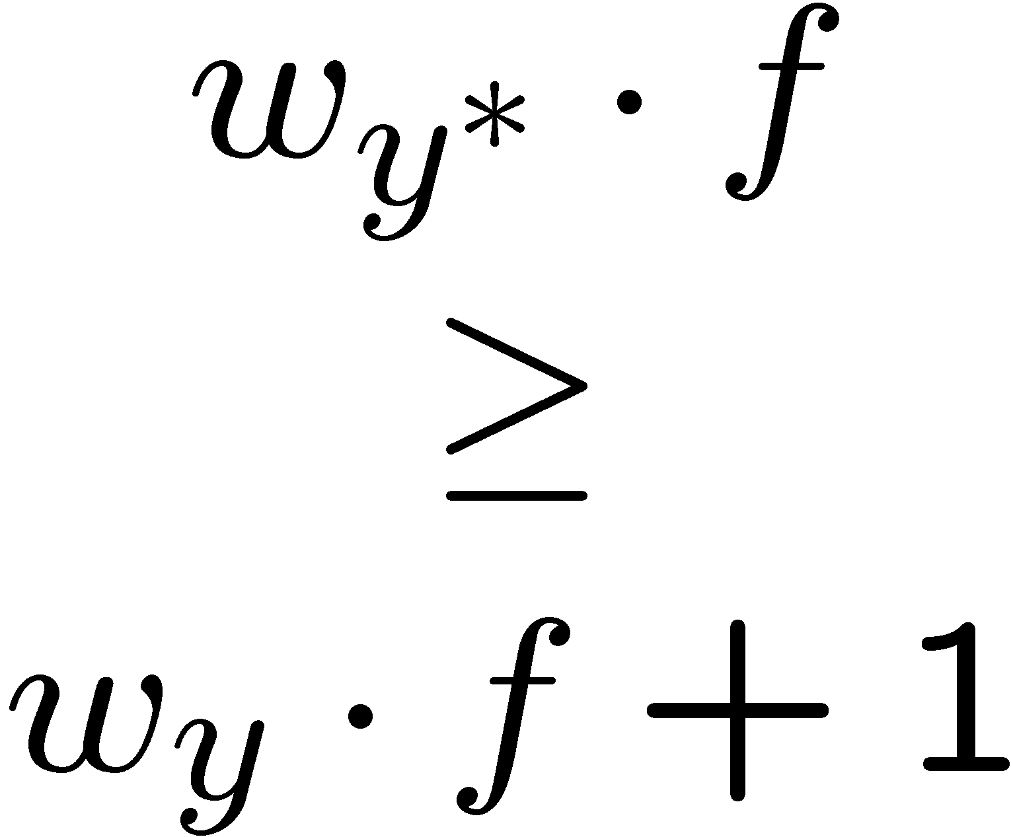
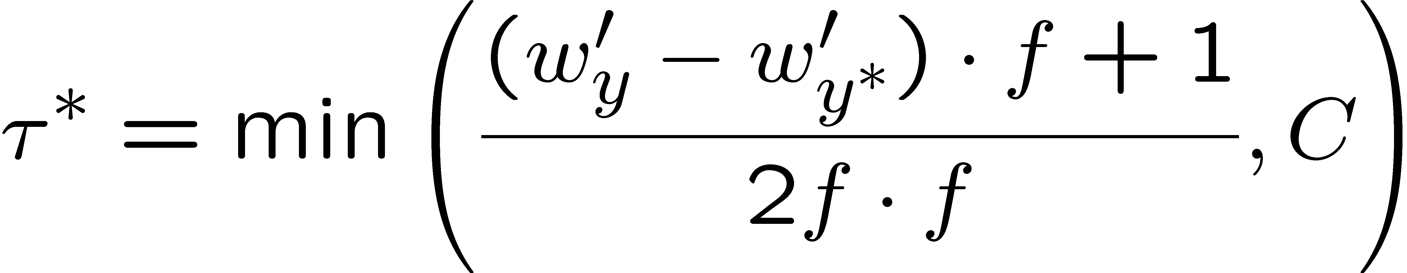

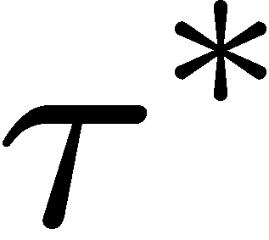

Maximum Step Size
In practice, it’s also bad to make updates that are too large
Example may be labeled incorrectly
You may not have enough features
Solution: cap the maximum possible value of τ with some constant C
Corresponds to an optimization that assumes non-separable data
Usually converges faster than perceptron
Usually better, especially on noisy data

Slide 15
Linear Separators
Which of these linear separators is optimal?

Slide 16
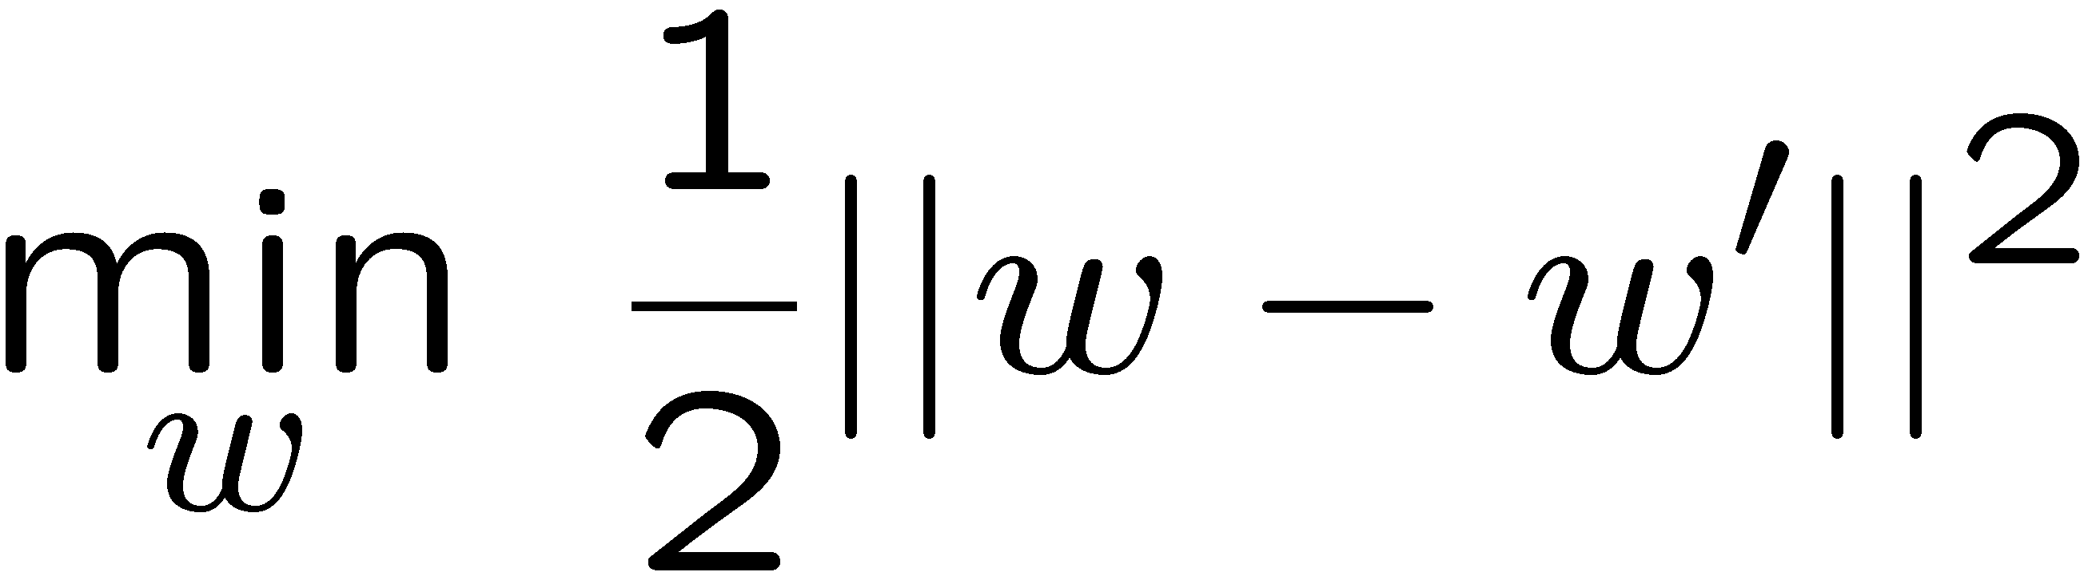
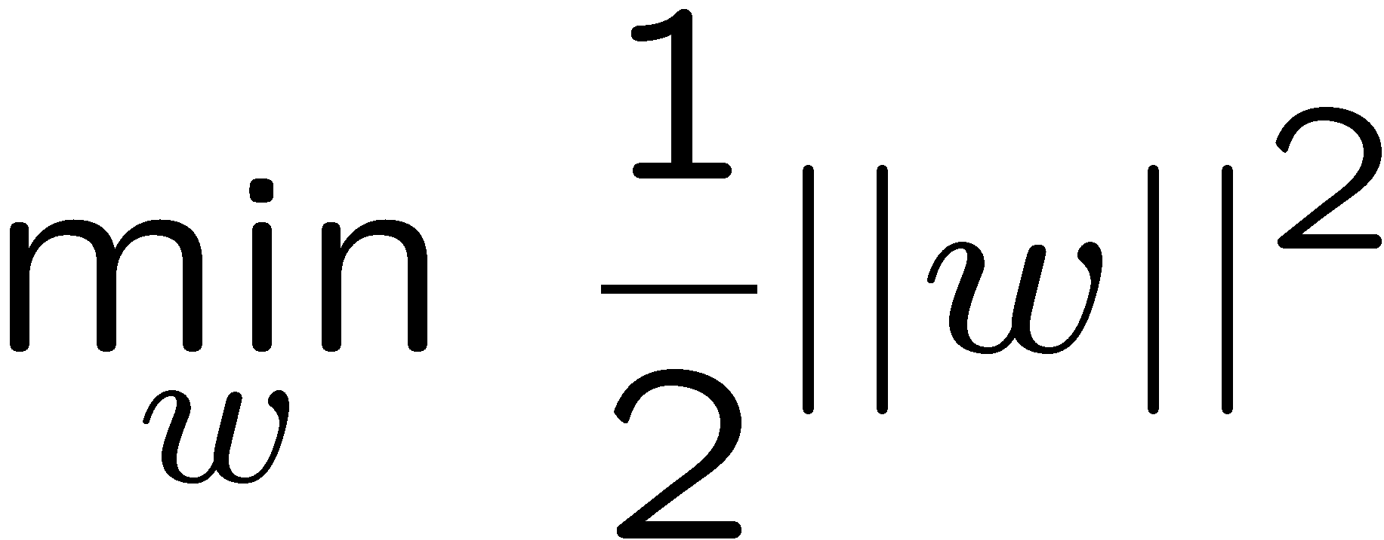
Support Vector Machines
Maximizing the margin: good according to intuition, theory, practice
Only support vectors matter; other training examples are ignorable
Support vector machines (SVMs) find the separator with max margin
Basically, SVMs are MIRA where you optimize over all examples at once
MIRA
SVM

Slide 17
Non-Linear Separators
Data that is linearly separable works out great for linear decision rules:
But what are we going to do if the dataset is just too hard?
How about… mapping data to a higher-dimensional space:
0
x
0
x
x²
0
x
This and next few slides adapted from Ray Mooney, UT

Slide 18
Non-Linear Separators
General idea: the original feature space can always be mapped to some higher-dimensional feature space where the training set is separable:
Φ: x → φ(x)

Slide 19
Classification: Comparison
Naïve Bayes
Builds a model training data
Gives prediction probabilities
Strong assumptions about feature independence
One pass through data (counting)
Perceptrons / MIRA:
Makes less assumptions about data
Mistake-driven learning
Multiple passes through data (prediction)
Often more accurate

