Slide 1
Announcements
HW 6 on reinforcement learning is due tonight
The order of the “Perceptron” and “Generate a Novel” homeworks have been swapped to better align with lecture schedule.
Perceptron HW is due Nov 12
Generate a Novel HW is due Nov 19

Slide 2
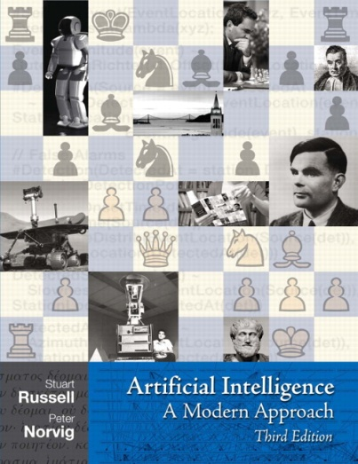
Naïve Bayes and Perceptrons
Read AIMA Section 20.1
Read AIMA Section 18.6.3
Read Chapter 1
Of Nielsen’s “Neural Networks and Deep Learning”
Slides courtesy of Dan Klein and Pieter Abbeel --- University of California, Berkeley
[These slides were created by Dan Klein and Pieter Abbeel for CS188 Intro to AI at UC Berkeley. All CS188 materials are available at http://ai.berkeley.edu.]
Notes:
Please retain proper attribution, including the reference to ai.berkeley.edu. Thanks!

Slide 3
Machine Learning
Up until now: how use a model to make optimal decisions
Machine learning: how to acquire a model from data / experience
Learning parameters (e.g. probabilities)
Learning structure (e.g. BN graphs)
Learning hidden concepts (e.g. clustering)
Today: model-based classification with Naive Bayes and Perceptrons

Slide 4
Review: Spam Classification
Input: an email
Output: spam/ham
Setup:
Get a large collection of example emails, each labeled “spam” or “ham”
Note: someone has to hand label all this data!
Want to learn to predict labels of new, future emails
Features: The attributes used to make the ham / spam decision
Words: FREE!
Text Patterns: $dd, CAPS
Non-text: SenderInContacts
…
Dear Sir.
First, I must solicit your confidence in this transaction, this is by virture of its nature as being utterly confidencial and top secret. …
TO BE REMOVED FROM FUTURE MAILINGS, SIMPLY REPLY TO THIS MESSAGE AND PUT "REMOVE" IN THE SUBJECT.
99 MILLION EMAIL ADDRESSES
FOR ONLY $99
Ok, Iknow this is blatantly OT but I'm beginning to go insane. Had an old Dell Dimension XPS sitting in the corner and decided to put it to use, I know it was working pre being stuck in the corner, but when I plugged it in, hit the power nothing happened.

Slide 5




Review: Digit Recognition
Input: images / pixel grids
Output: a digit 0-9
Setup:
Get a large collection of example images, each labeled with a digit
Note: someone has to hand label all this data!
Want to learn to predict labels of new, future digit images
Features: The attributes used to make the digit decision
Pixels: (6,8)=ON
Shape Patterns: NumComponents, AspectRatio, NumLoops
…
0
1
2
1
??

Slide 6
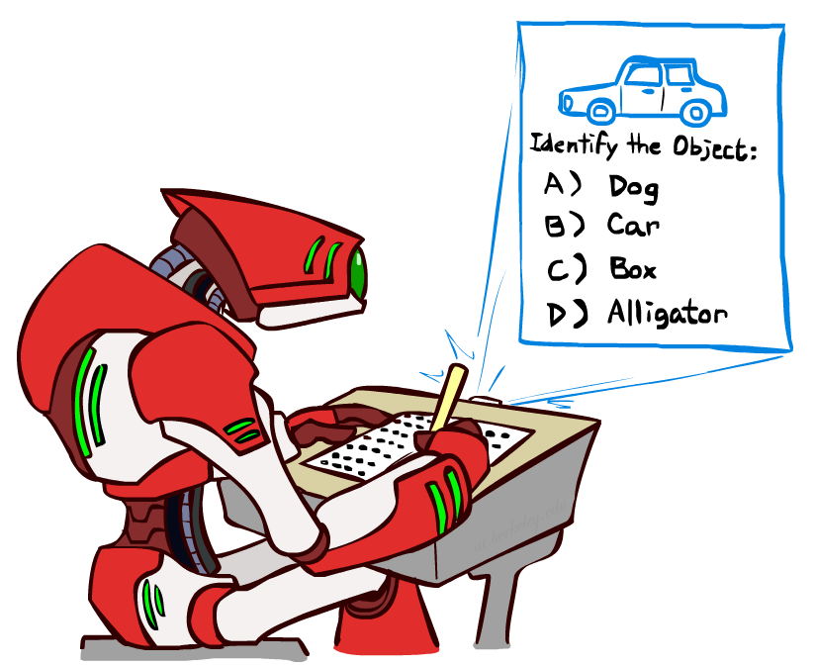
Review Other Classification Tasks
Classification: given inputs x, predict labels y
Examples:
Spam detection (input: document,
classes: spam / ham)
OCR (input: images, classes: characters)
Medical diagnosis (input: symptoms,
classes: diseases)
Automatic essay grading (input: document,
classes: grades)
Fraud detection (input: account activity,
classes: fraud / no fraud)
Customer service email routing
… many more
Classification is an important commercial technology!

Slide 7

Review: Model-Based Classification
Model-based approach
Build a model (e.g. Bayes’ net) where both the label and features are random variables
Instantiate any observed features
Query for the distribution of the label conditioned on the features
Challenges
What structure should the BN have?
How should we learn its parameters?

Slide 8


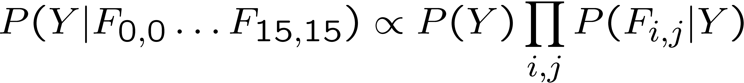
Naïve Bayes for Digits
Naïve Bayes: Assume all features are independent effects of the label
Simple digit recognition version:
One feature (variable) F_{ij} for each grid position <i,j>
Feature values are on / off, based on whether intensity
is more or less than 0.5 in underlying image
Each input maps to a feature vector, e.g.
Here: lots of features, each is binary valued
Naïve Bayes model:
What do we need to learn?
Y
F₁
F₂
F_{n}

Slide 9

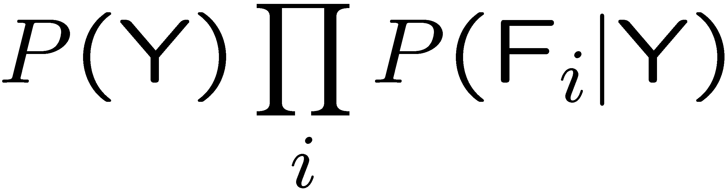
General Naïve Bayes
A general Naive Bayes model:
We only have to specify how each feature depends on the class
Total number of parameters is linear in number of features
Model is very simplistic, but often works anyway
Y
|Y| labels
F₁
F₂
F_{n}
|Y| x |F|^{n} values
n x |F| x |Y| parameters

Slide 10
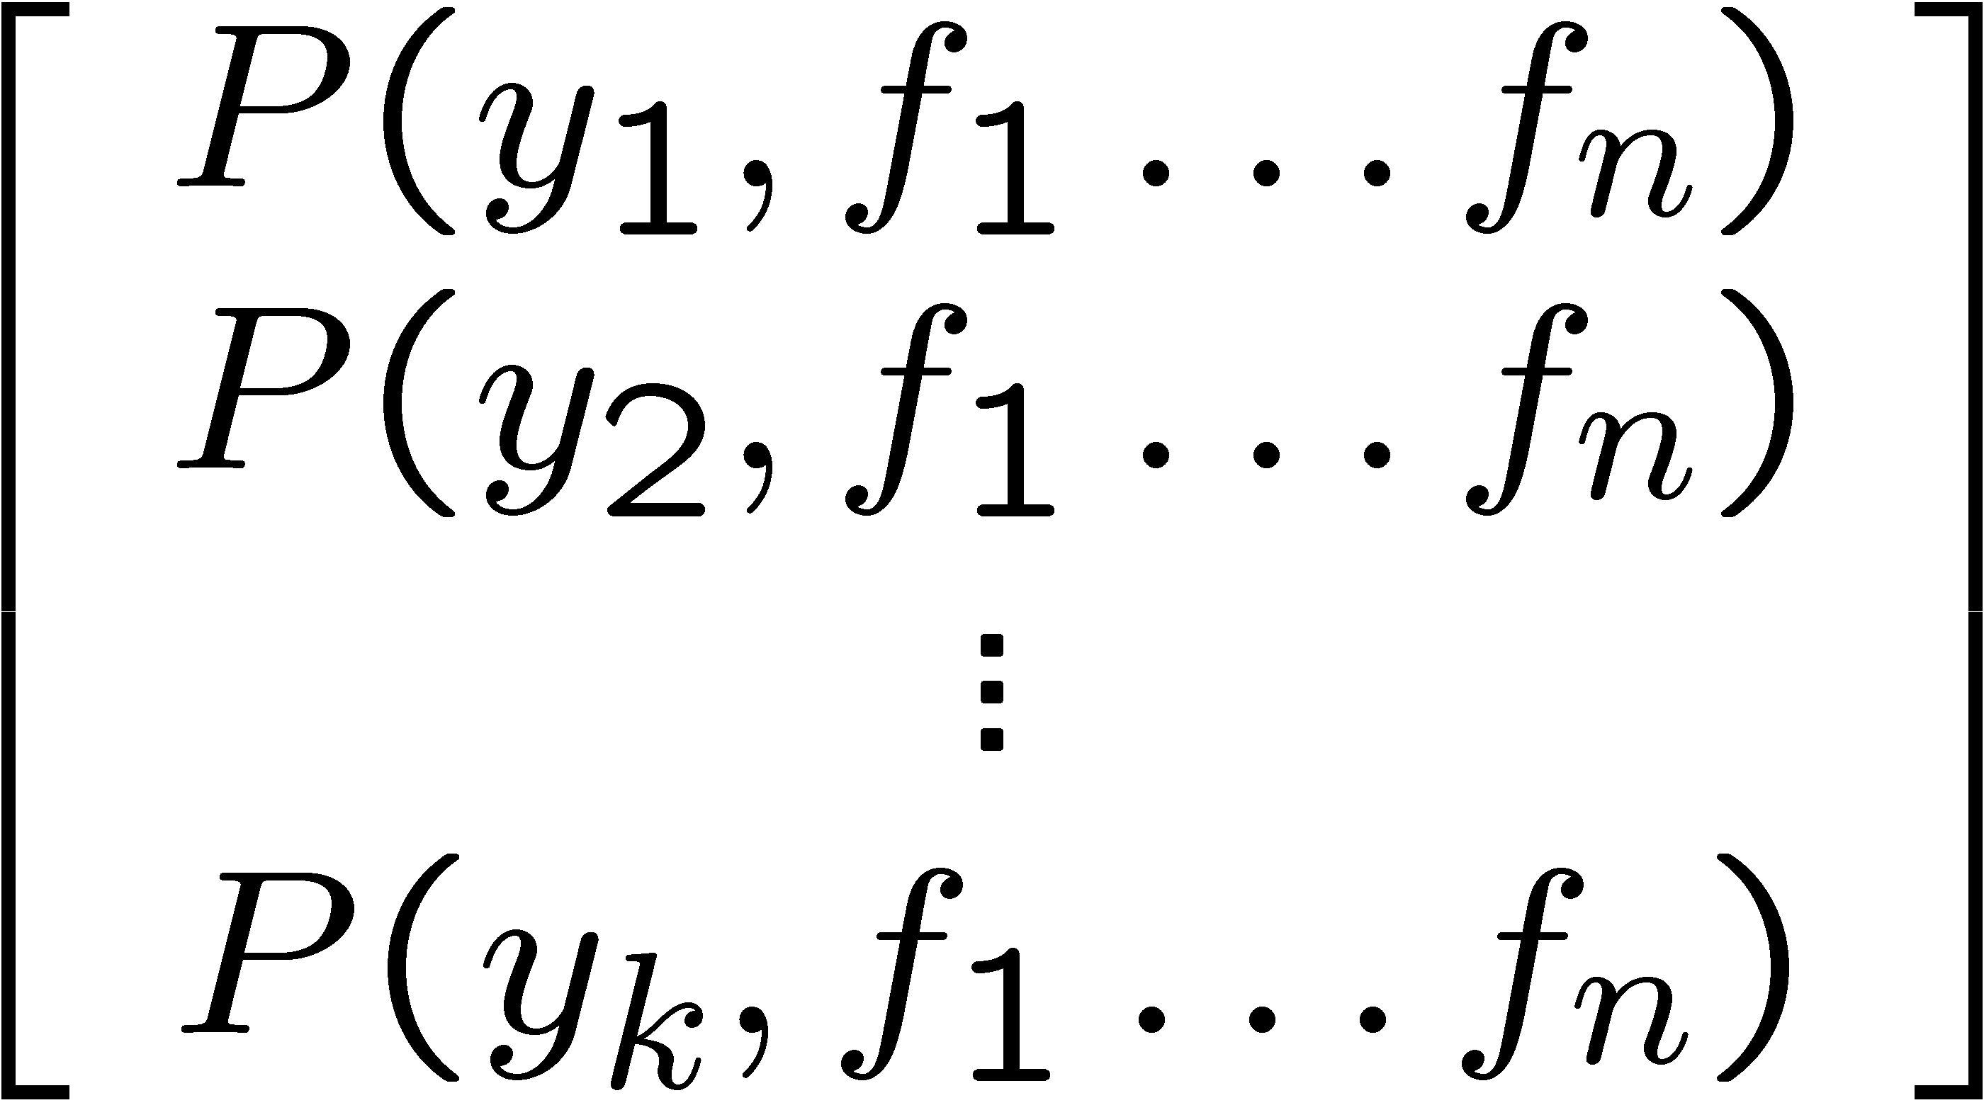
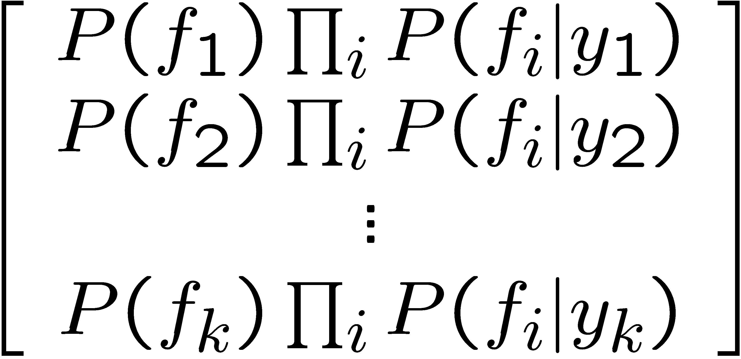

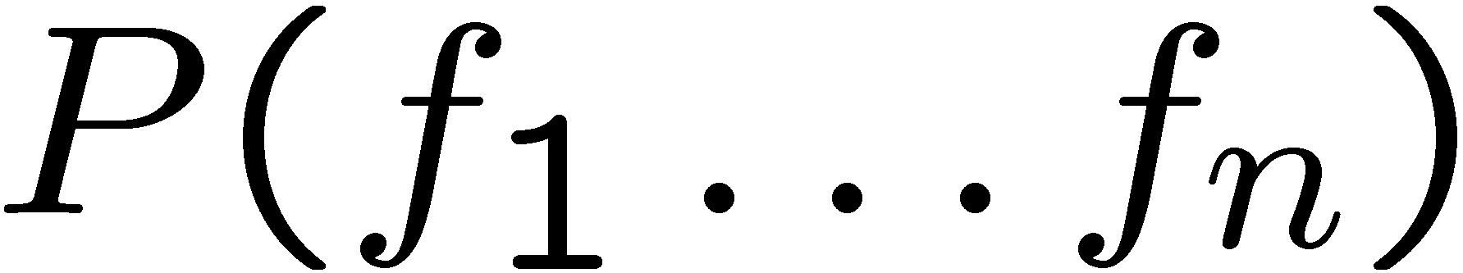
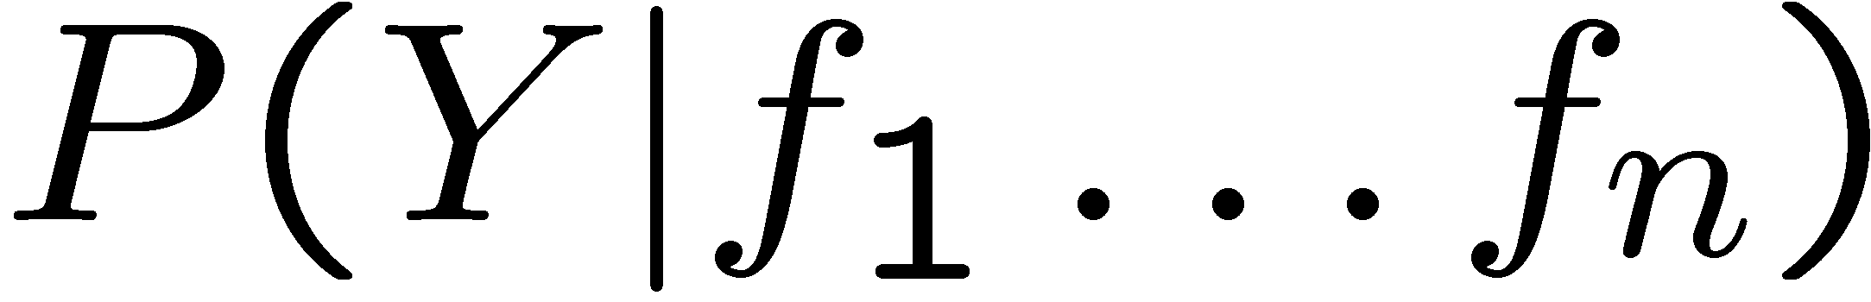
Inference for Naïve Bayes
Goal: compute posterior distribution over label variable Y
Step 1: get joint probability of label and evidence for each label
Step 2: sum to get probability of evidence
Step 3: normalize by dividing Step 1 by Step 2
+

Slide 11
General Naïve Bayes
What do we need in order to use Naïve Bayes?
Inference method (we just saw this part)
Start with a bunch of probabilities: P(Y) and the P(F_{i}|Y) tables
Use standard inference to compute P(Y|F₁…F_{n})
Nothing new here
Estimates of local conditional probability tables
P(Y), the prior over labels
P(F_{i}|Y) for each feature (evidence variable)
These probabilities are collectively called the parameters of the model and denoted by θ
Up until now, we assumed these appeared by magic, but…
…they typically come from training data counts: we’ll look at this soon

Slide 12
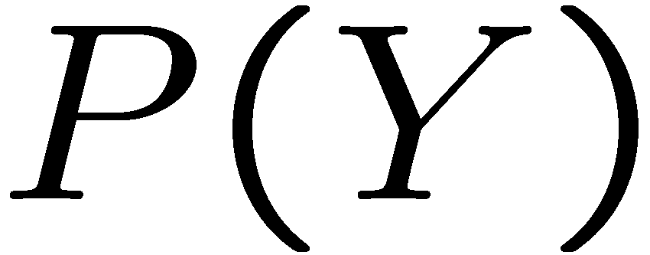


Example: Conditional Probabilities
1 | 0.1
2 | 0.1
3 | 0.1
4 | 0.1
5 | 0.1
6 | 0.1
7 | 0.1
8 | 0.1
9 | 0.1
0 | 0.1
1 | 0.01
2 | 0.05
3 | 0.05
4 | 0.30
5 | 0.80
6 | 0.90
7 | 0.05
8 | 0.60
9 | 0.50
0 | 0.80
1 | 0.05
2 | 0.01
3 | 0.90
4 | 0.80
5 | 0.90
6 | 0.90
7 | 0.25
8 | 0.85
9 | 0.60
0 | 0.80

Slide 13
A Spam Filter
Naïve Bayes spam filter
Data:
Collection of emails, labeled spam or ham
Note: someone has to hand label all this data!
Split into training, held-out, test sets
Classifiers
Learn on the training set
(Tune it on a held-out set)
Test it on new emails
Dear Sir.
First, I must solicit your confidence in this transaction, this is by virture of its nature as being utterly confidencial and top secret. …
TO BE REMOVED FROM FUTURE MAILINGS, SIMPLY REPLY TO THIS MESSAGE AND PUT "REMOVE" IN THE SUBJECT.
99 MILLION EMAIL ADDRESSES
FOR ONLY $99
Ok, Iknow this is blatantly OT but I'm beginning to go insane. Had an old Dell Dimension XPS sitting in the corner and decided to put it to use, I know it was working pre being stuck in the corner, but when I plugged it in, hit the power nothing happened.

Slide 14
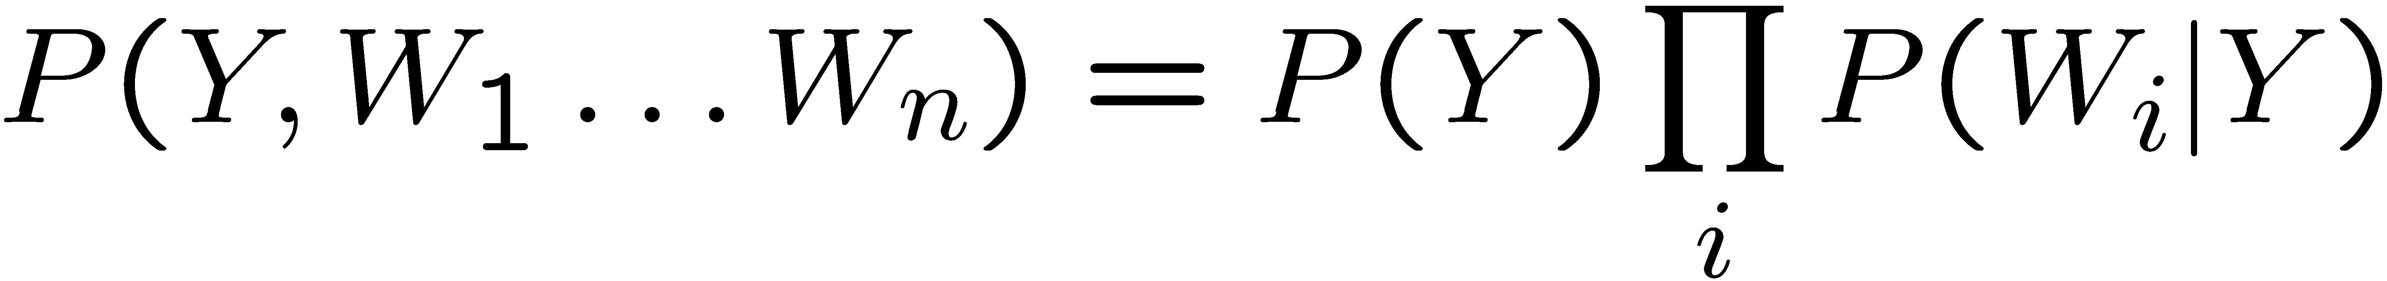
Naïve Bayes for Text
Bag-of-words Naïve Bayes:
Features: W_{i} is the word at positon i
As before: predict label conditioned on feature variables (spam vs. ham)
As before: assume features are conditionally independent given label
New: each W_{i} is identically distributed
Generative model:
“Tied” distributions and bag-of-words
Usually, each variable gets its own conditional probability distribution P(F|Y)
In a bag-of-words model
Each position is identically distributed
All positions share the same conditional probs P(W|Y)
Why make this assumption?
Called “bag-of-words” because model is insensitive to word order or reordering
Word at position i, not i^{th} word in the dictionary!

Slide 15

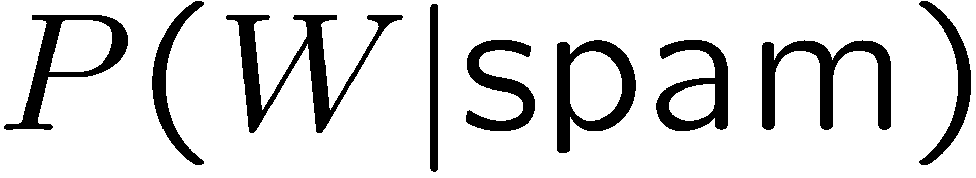
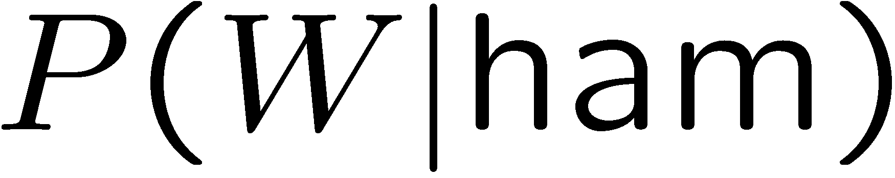
Example: Spam Filtering
Model:
What are the parameters?
Where do these tables come from?
ham : 0.66
spam: 0.33
the : 0.0156
to : 0.0153
and : 0.0115
of : 0.0095
you : 0.0093
a : 0.0086
with: 0.0080
from: 0.0075
...
the : 0.0210
to : 0.0133
of : 0.0119
2002: 0.0110
with: 0.0108
from: 0.0107
and : 0.0105
a : 0.0100
...

Slide 16
Spam Example
Word | P(w|spam) | P(w|ham) | Tot Spam | Tot Ham
(prior) | 0.33333 | 0.66666 | -1.1 | -0.4
Gary | 0.00002 | 0.00021 | -11.8 | -8.9
would | 0.00069 | 0.00084 | -19.1 | -16.0
you | 0.00881 | 0.00304 | -23.8 | -21.8
like | 0.00086 | 0.00083 | -30.9 | -28.9
to | 0.01517 | 0.01339 | -35.1 | -33.2
lose | 0.00008 | 0.00002 | -44.5 | -44.0
weight | 0.00016 | 0.00002 | -53.3 | -55.0
while | 0.00027 | 0.00027 | -61.5 | -63.2
you | 0.00881 | 0.00304 | -66.2 | -69.0
sleep | 0.00006 | 0.00001 | -76.0 | -80.5
P(spam | w) = 98.9

Slide 17
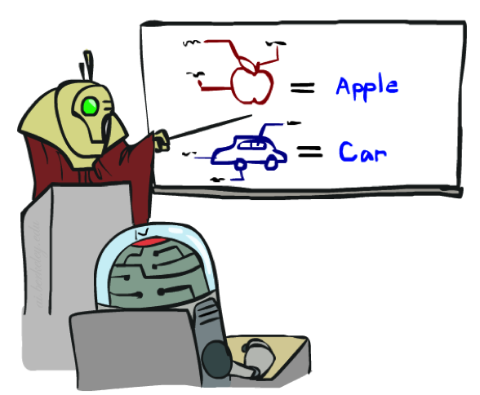

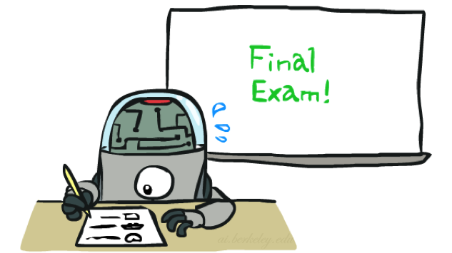
Training and Testing

Slide 18


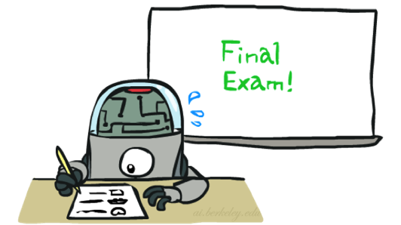
Important Concepts
Data: labeled instances, e.g. emails marked spam/ham
Training set
Held out set
Test set
Features: attribute-value pairs which characterize each x
Experimentation cycle
Learn parameters (e.g. model probabilities) on training set
(Tune hyperparameters on held-out set)
Compute accuracy of test set
Very important: never “peek” at the test set!
Evaluation
Accuracy: fraction of instances predicted correctly
Overfitting and generalization
Want a classifier which does well on test data
Overfitting: fitting the training data very closely, but not generalizing well
We’ll investigate overfitting and generalization formally in a few lectures
Training
Data
Held-Out
Data
Test
Data

Slide 19



Generalization and Overfitting

Slide 20
Overfitting
30
25
20
Degree 15 polynomial
15
10
5
0
-5
-10
-15
0
2
4
6
8
10
12
14
16
18
20

Slide 21












Example: Overfitting
2 wins!!

Slide 22
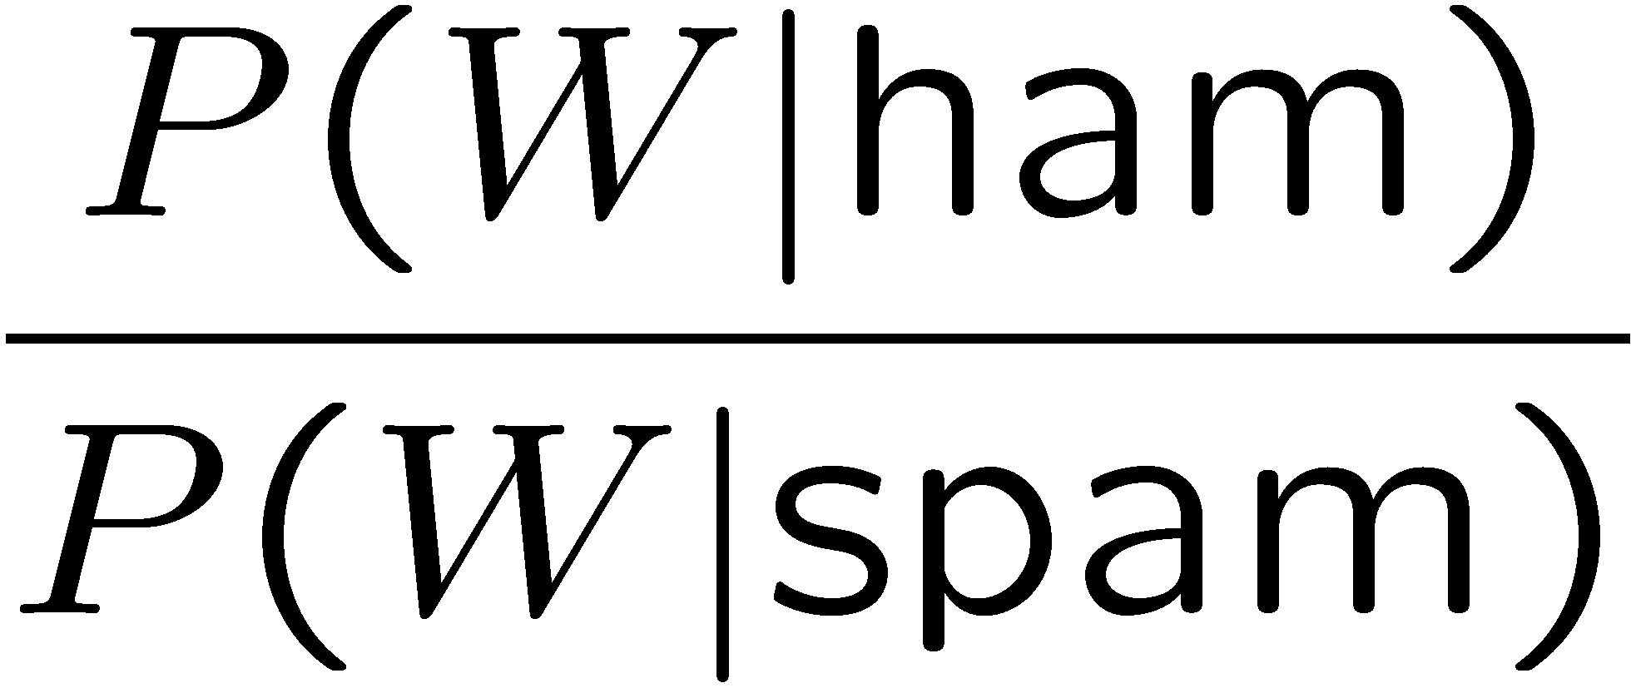
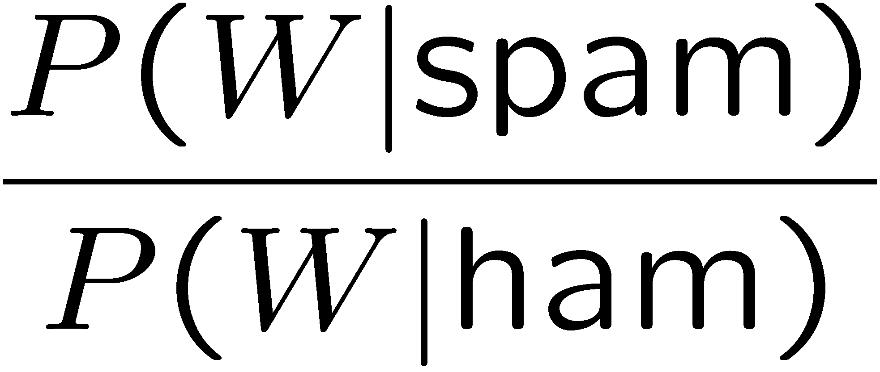
Example: Overfitting
Posteriors determined by relative probabilities (odds ratios):
south-west : inf
nation : inf
morally : inf
nicely : inf
extent : inf
seriously : inf
...
screens : inf
minute : inf
guaranteed : inf
$205.00 : inf
delivery : inf
signature : inf
...
What went wrong here?

Slide 23
Generalization and Overfitting
Relative frequency parameters will overfit the training data!
Just because we never saw a 3 with pixel (15,15) on during training doesn’t mean we won’t see it at test time
Unlikely that every occurrence of “minute” is 100% spam
Unlikely that every occurrence of “seriously” is 100% ham
What about all the words that don’t occur in the training set at all?
In general, we can’t go around giving unseen events zero probability
As an extreme case, imagine using the entire email as the only feature
Would get the training data perfect (if deterministic labeling)
Wouldn’t generalize at all
Just making the bag-of-words assumption gives us some generalization, but isn’t enough
To generalize better: we need to smooth or regularize the estimates

Slide 24
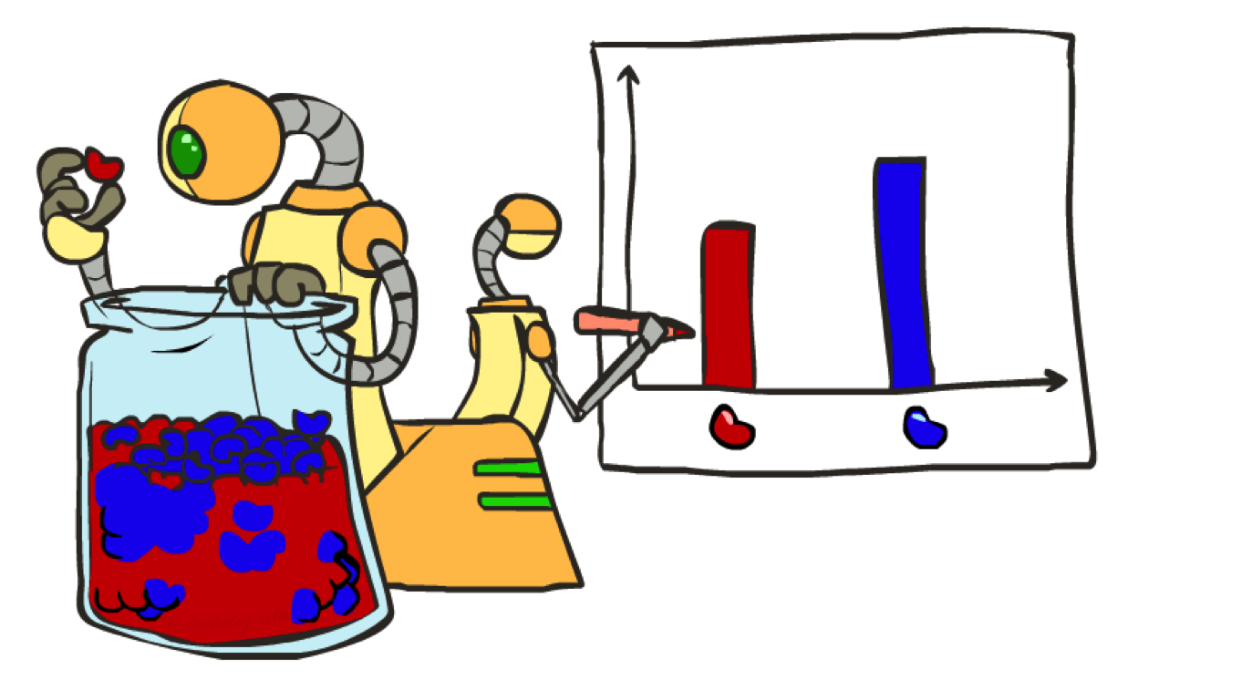
Parameter Estimation

Slide 25
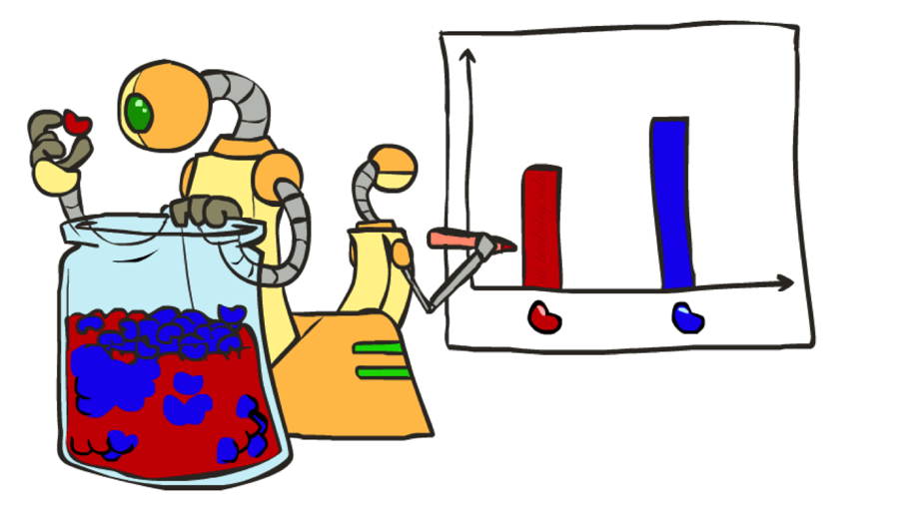
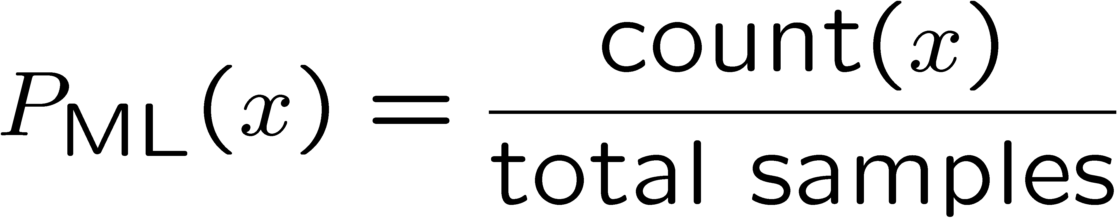

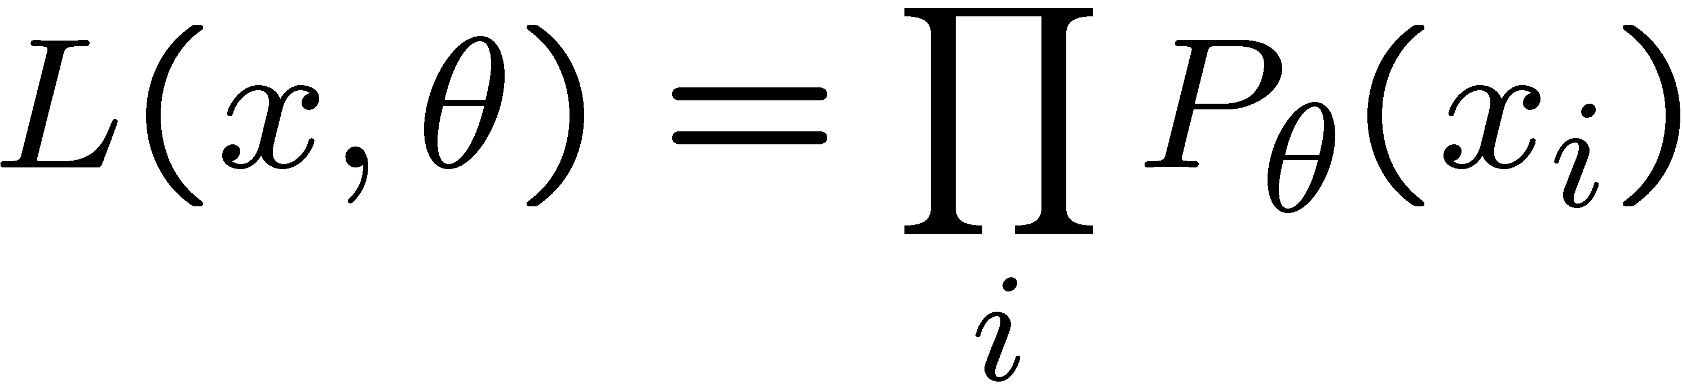
Parameter Estimation
Estimating the distribution of a random variable
Elicitation: ask a human (why is this hard?)
Empirically: use training data (learning!)
E.g.: for each outcome x, look at the empirical rate of that value:
This is the estimate that maximizes the likelihood of the data
r
b
b
b
r
r
b
b
b
r
r
b
b
b
b
r
r
b

Slide 26
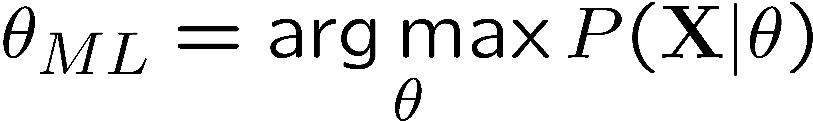
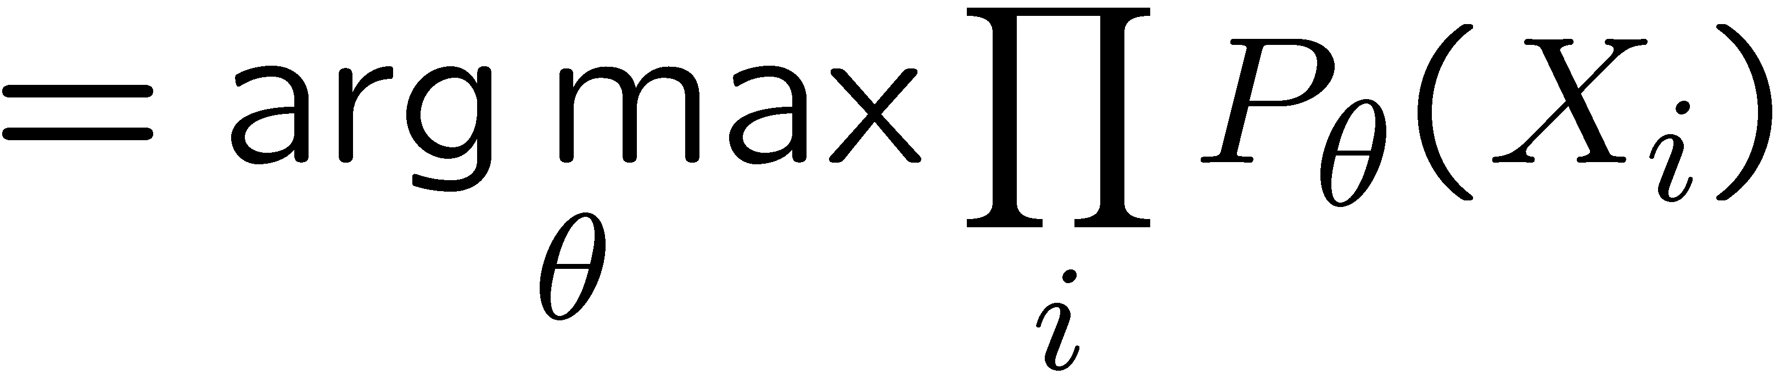
Maximum Likelihood
Relative frequencies are the maximum likelihood estimates

Slide 27

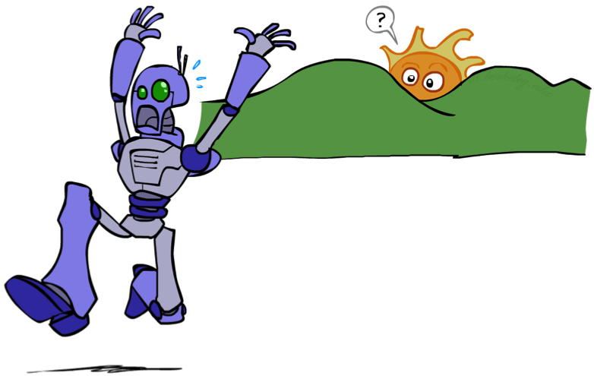
Unseen Events

Slide 28
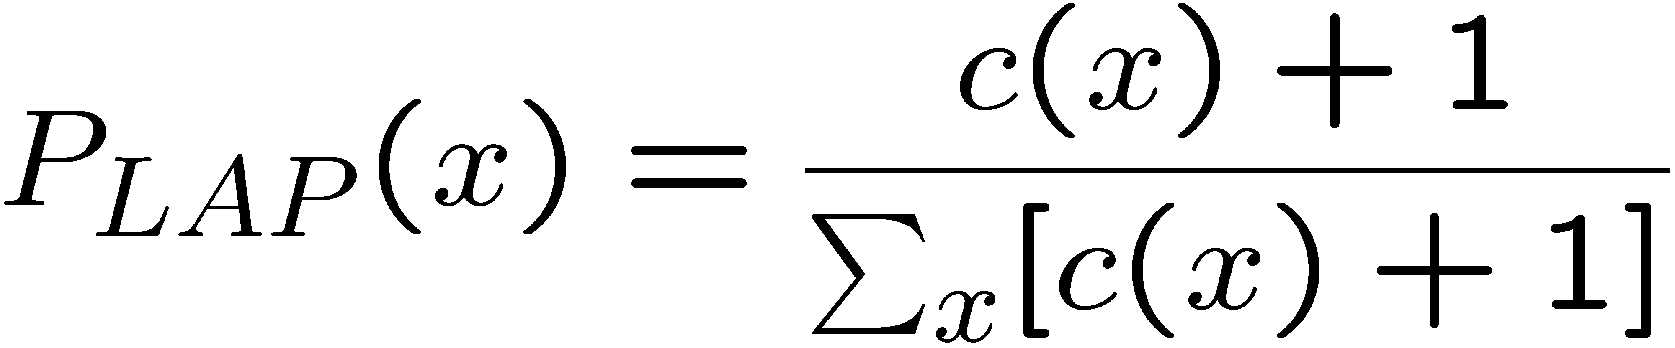
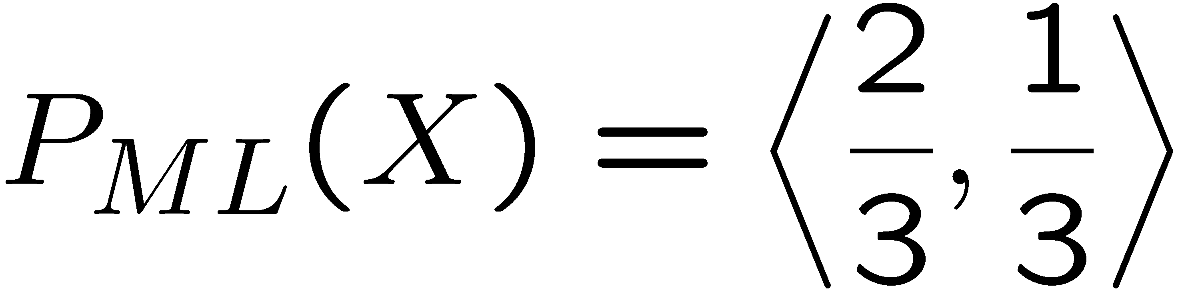
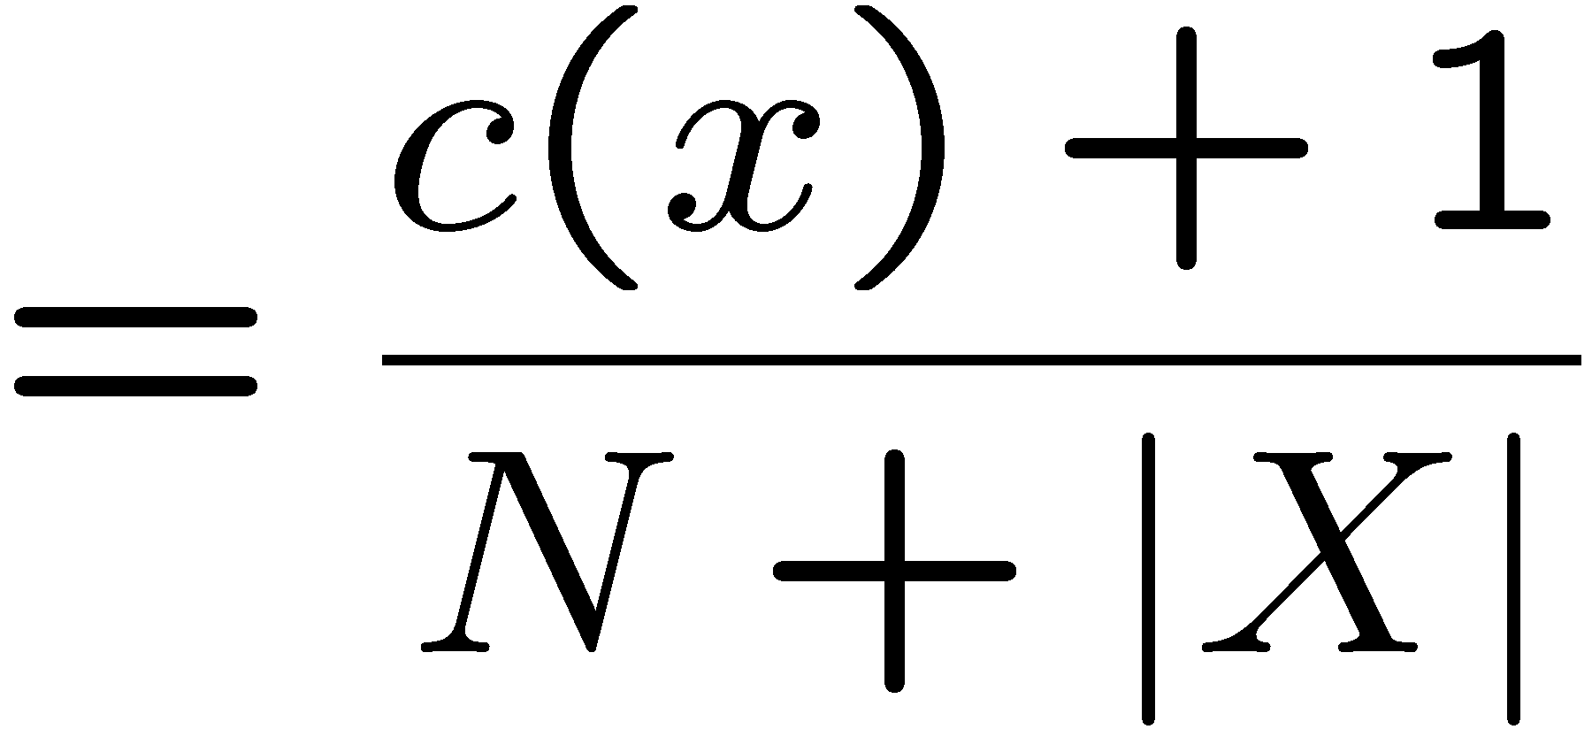
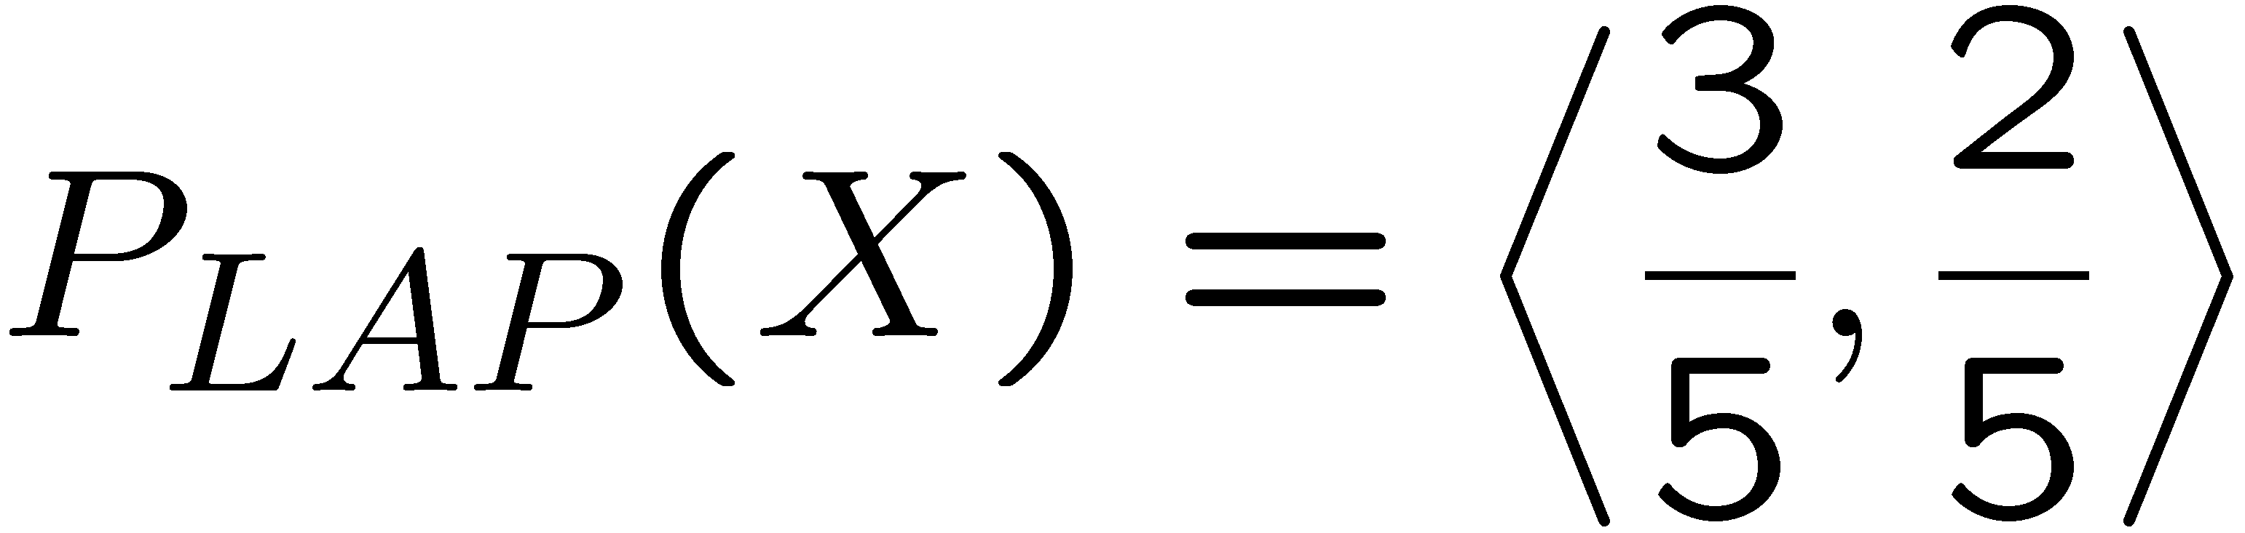
Laplace Smoothing
Laplace’s estimate:
Pretend you saw every outcome once more than you actually did
Can derive this estimate with Dirichlet priors
r
r
b

Slide 29
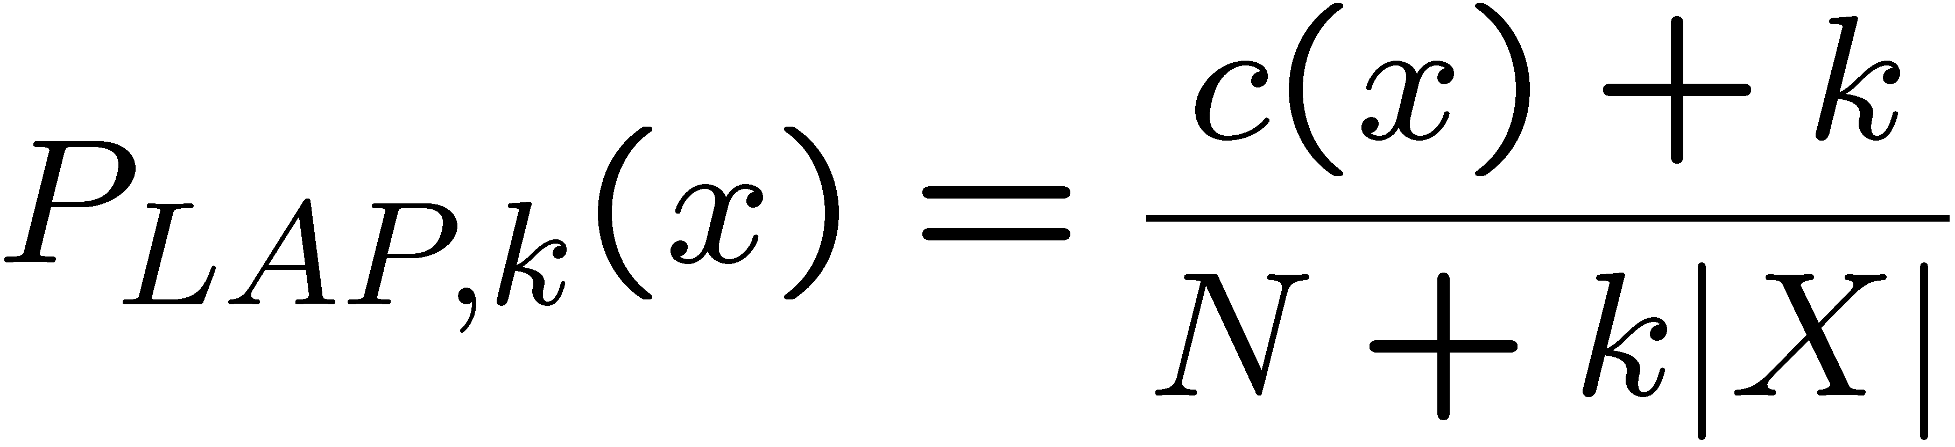
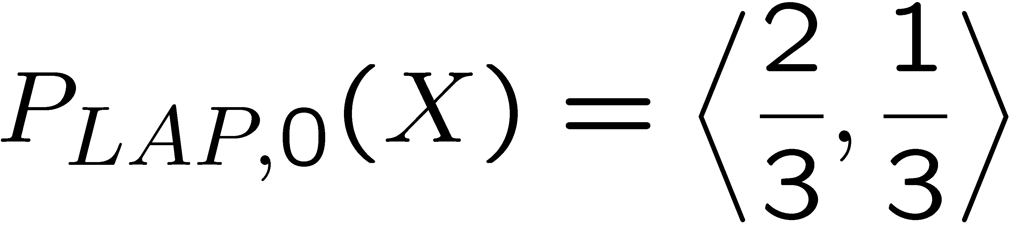
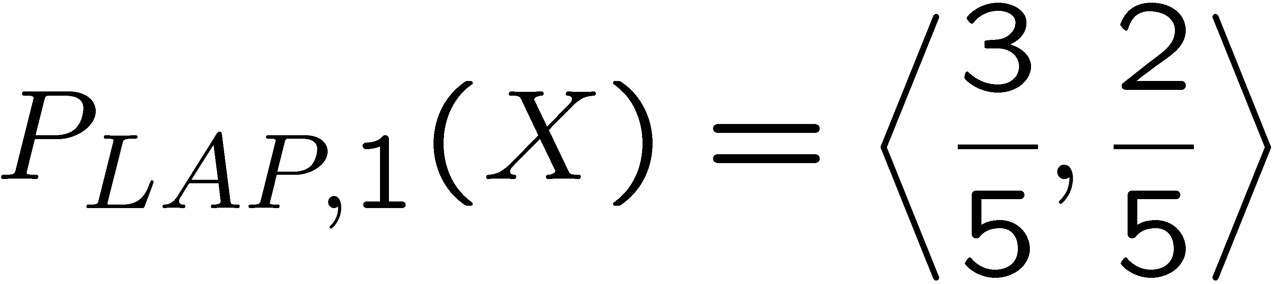
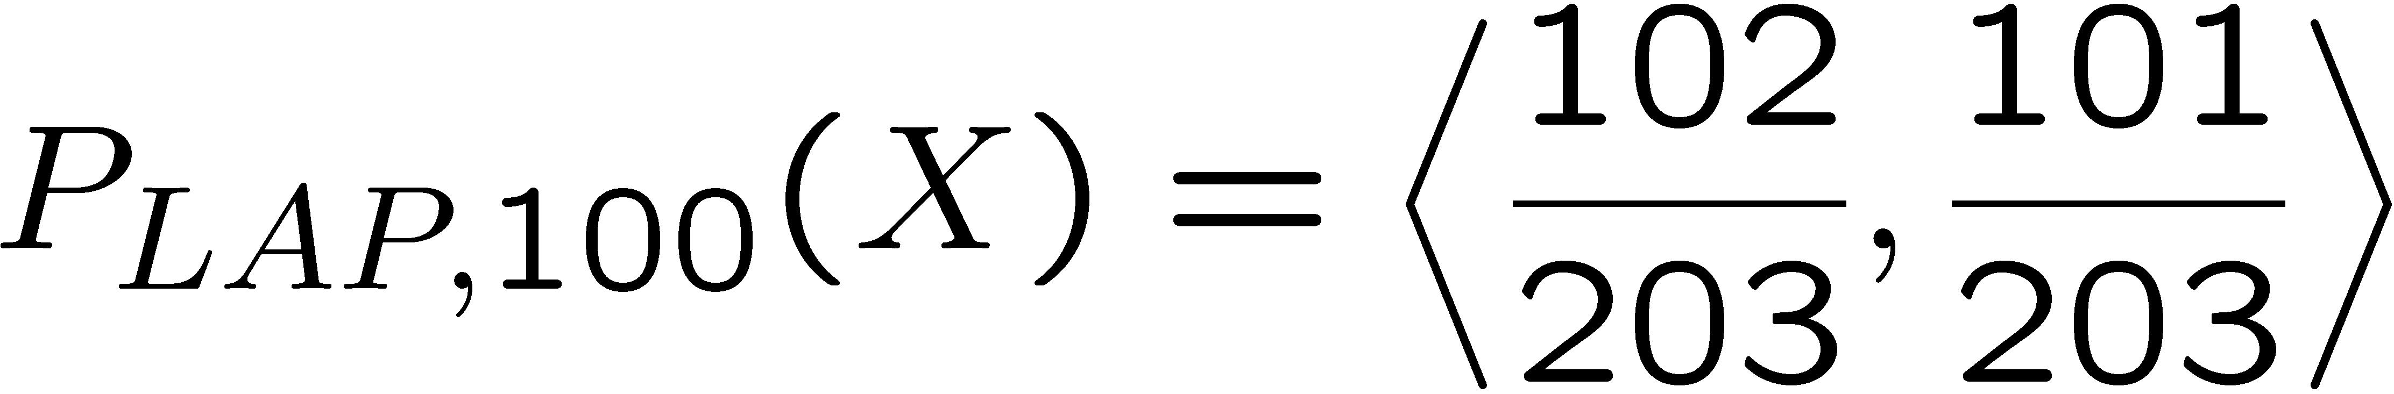
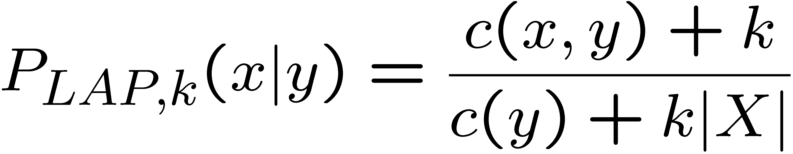
Laplace Smoothing
Laplace’s estimate (extended):
Pretend you saw every outcome k extra times
What’s Laplace with k = 0?
k is the strength of the prior
Laplace for conditionals:
Smooth each condition independently:
r
r
b

Slide 30
Estimation: Linear Interpolation*
In practice, Laplace often performs poorly for P(X|Y):
When |X| is very large
When |Y| is very large
Another option: linear interpolation
Also get the empirical P(X) from the data
Make sure the estimate of P(X|Y) isn’t too different from the empirical P(X)
What if α is 0? 1?
For even better ways to estimate parameters, take CIS 530 next semester. ☺

Slide 31
Real NB: Smoothing
For real classification problems, smoothing is critical
New odds ratios:
helvetica : 11.4
seems : 10.8
group : 10.2
ago : 8.4
areas : 8.3
...
verdana : 28.8
Credit : 28.4
ORDER : 27.2
<FONT> : 26.9
money : 26.5
...
Do these make more sense?
Notes:
None of these are infinity.

Slide 32
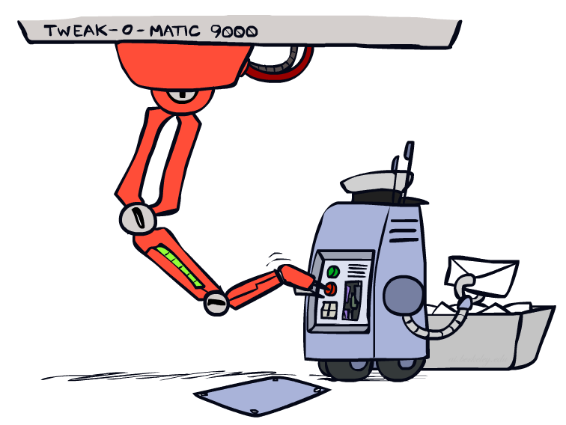
Tuning

Slide 33








Tuning on Held-Out Data
Now we’ve got two kinds of unknowns
Parameters: the probabilities P(X|Y), P(Y)
Hyperparameters: e.g. the amount / type of smoothing to do, k, α
What should we learn where?
Learn parameters from training data
Tune hyperparameters on different data
Why?
For each value of the hyperparameters, train and test on the held-out data
Choose the best value and do a final test on the test data

Slide 34
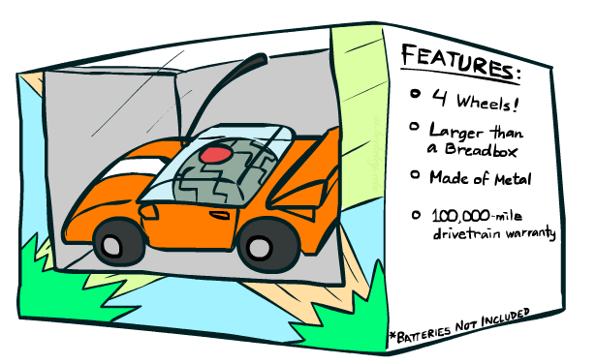
Features

Slide 35
Errors, and What to Do
Examples of errors
Dear GlobalSCAPE Customer,
GlobalSCAPE has partnered with ScanSoft to offer you the latest version of OmniPage Pro, for just $99.99* - the regular list price is $499! The most common question we've received about this offer is - Is this genuine? We would like to assure you that this offer is authorized by ScanSoft, is genuine and valid. You can get the . . .
. . . To receive your $30 Amazon.com promotional certificate, click through to
http://www.amazon.com/apparel
and see the prominent link for the $30 offer. All details are there. We hope you enjoyed receiving this message. However, if you'd rather not receive future e-mails announcing new store launches, please click . . .

Slide 36
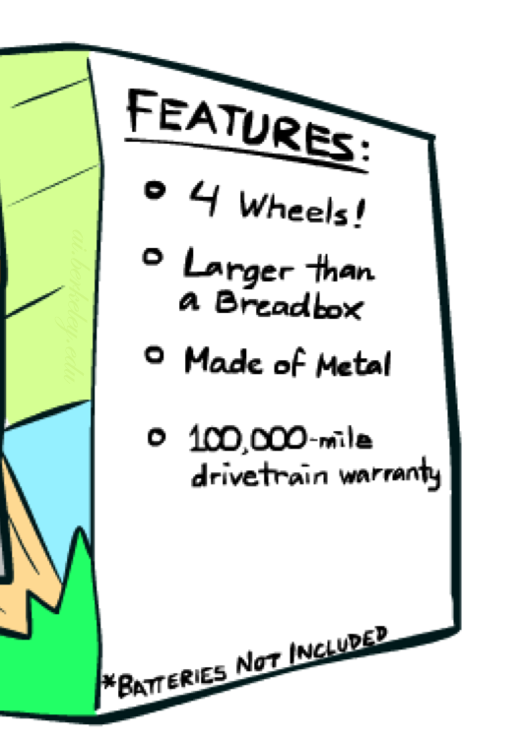
What to Do About Errors?
Need more features– words aren’t enough!
Have you emailed the sender before?
Have 1K other people just gotten the same email?
Is the sending information consistent?
Is the email in ALL CAPS?
Do inline URLs point where they say they point?
Does the email address you by (your) name?
Can add these information sources as new variables in the NB model
Next class we’ll talk about classifiers which let you easily add arbitrary features more easily

Slide 37
Baselines
First step: get a baseline
Baselines are very simple “straw man” procedures
Help determine how hard the task is
Help know what a “good” accuracy is
Weak baseline: most frequent label classifier
Gives all test instances whatever label was most common in the training set
E.g. for spam filtering, might label everything as ham
Accuracy might be very high if the problem is skewed
E.g. calling everything “ham” gets 66%, so a classifier that gets 70% isn’t very good…
For real research, usually use previous work as a (strong) baseline

Slide 38
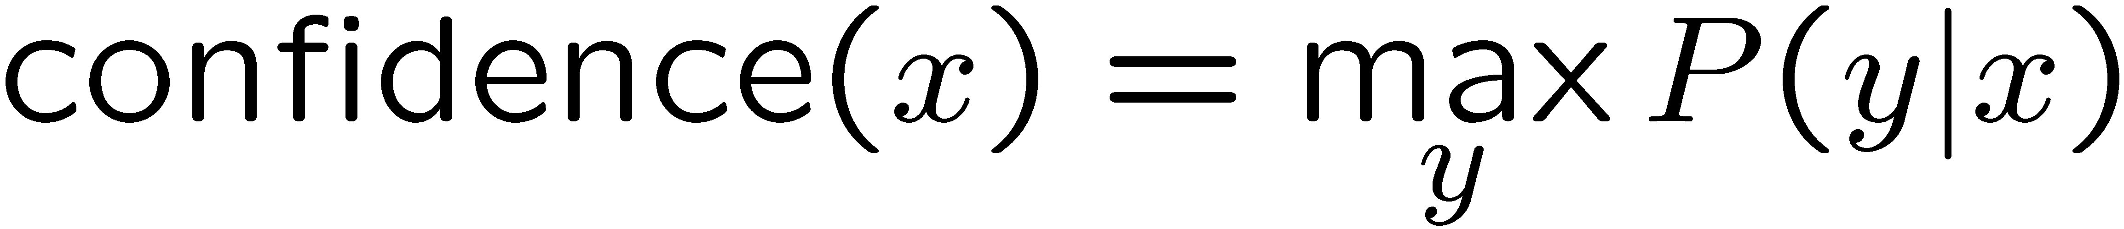

Confidences from a Classifier
The confidence of a probabilistic classifier:
Posterior over the top label
Represents how sure the classifier is of the classification
Any probabilistic model will have confidences
No guarantee confidence is correct
Calibration
Weak calibration: higher confidences mean higher accuracy
Strong calibration: confidence predicts accuracy rate
What’s the value of calibration?

Slide 39
Summary
Bayes rule lets us do diagnostic queries with causal probabilities
The naïve Bayes assumption takes all features to be independent given the class label
We can build classifiers out of a naïve Bayes model using training data
Smoothing estimates is important in real systems
Classifier confidences are useful, when you can get them

Slide 40
Perceptrons
Read AIMA - Section 18.6.3
And Chapter 1
Of Nielsen’s “Neural Networks and Deep Learning”
Slides Courtesy of Dan Klein and Pieter Abbeel --- University of California, Berkeley
[These slides were created by Dan Klein and Pieter Abbeel for CS188 Intro to AI at UC Berkeley. All CS188 materials are available at http://ai.berkeley.edu.]

Slide 41
Error-Driven Classification

Slide 42
Errors, and What to Do
Examples of errors
Dear GlobalSCAPE Customer,
GlobalSCAPE has partnered with ScanSoft to offer you the latest version of OmniPage Pro, for just $99.99* - the regular list price is $499! The most common question we've received about this offer is - Is this genuine? We would like to assure you that this offer is authorized by ScanSoft, is genuine and valid. You can get the . . .
. . . To receive your $30 Amazon.com promotional certificate, click through to
http://www.amazon.com/apparel
and see the prominent link for the $30 offer. All details are there. We hope you enjoyed receiving this message. However, if you'd rather not receive future e-mails announcing new store launches, please click . . .

Slide 43
What to Do About Errors
Problem: there’s still spam in your inbox
Need more features – words aren’t enough!
Have you emailed the sender before?
Have 1M other people just gotten the same email?
Is the sending information consistent?
Is the email in ALL CAPS?
Do inline URLs point where they say they point?
Does the email address you by (your) name?
Naïve Bayes models can incorporate a variety of features, but tend to do best in homogeneous cases (e.g. all features are word occurrences)

Slide 44
Linear Classifiers
Notes:
2d: line
3d: plane
Many-d: hyperplane.

Slide 45
Feature Vectors
Hello,
Do you want free printr cartriges? Why pay more when you can get them ABSOLUTELY FREE! Just
# free : 2
YOUR_NAME : 0
MISSPELLED : 2
FROM_FRIEND : 0
...
SPAM
or
+
PIXEL-7,12 : 1
PIXEL-7,13 : 0
...
NUM_LOOPS : 1
...
“2”

Slide 46
Some (Simplified) Biology
Very loose inspiration: human neurons

Slide 47
Linear Classifiers
Inputs are feature values
Each feature has a weight
Sum is the activation
If the activation is:
Positive, output +1
Negative, output -1
w₁
f₁
Σ
w₂
>0?
f₂
w₃
f₃
Notes:
The activation for some weight vector w given some input x is the Sum for each weight w_i in the weight vector with the corresponding entry in the feature vector representing x, f_i(x).
We also write this as w * f(x), which is the inner product of the weight vector and the feature vector.
Depending on whether the sum is positive, or the sum is negative, we output a positive class label or a negative class label (for the binary classification case).
This is the generic picture that represents the perceptron..
This is called the “dot product” or sometimes the “inner product”

Slide 48
Weights
Binary case: compare features to a weight vector
Learning: figure out the weight vector from examples
# free : 4
YOUR_NAME :-1
MISSPELLED : 1
FROM_FRIEND :-3
...
# free : 2
YOUR_NAME : 0
MISSPELLED : 2
FROM_FRIEND : 0
...
# free : 0
YOUR_NAME : 1
MISSPELLED : 1
FROM_FRIEND : 1
...
Dot product positive means the positive class
Notes:
The feature values for inputs are fixed, but we can choose different weight vectors. Depending on the weight vector that we pick, we will get a different classifier.
Let’s look at an example, with the following weight vector. The first entry is a weight based on how often the word free appears. We get a high value for that. The next one is whether your name appears. This weight vector will lower the value. If there are misspelled words, the activation will go up. If the email comes from a friend then the activation will go up.
The weight vector always represents the positive class, so what is it in this case? It’s SPAM.
The weight vector lives in the same vector space as the feature vectors. Here’s are two feature vectors representing two emails that we want to classify.
For linear classification, we have a separating hyperplane. Separation is orthogonal to w. ((Draw this at a right angle to w)). Everything on the same side as w is the positive class Everything on the other side is the negative class.
For x2, the angle between w and f(x2) > 90 degrees, so it is negative.
If we compute the inner product then we’ll get a negative class when the angle is > 90 degrees like f(x_2).

Slide 49
Decision Rules
Notes:
The goal is to move the decision boundary so that the decisions are usually correct.
2d: line
3d: plane
Many-d: hyperplane.

Slide 50
Binary Decision Rule
In the space of feature vectors
Examples are points
Any weight vector is a hyperplane
One side corresponds to Y=+1
Other corresponds to Y=-1
money
2
+1 = SPAM
1
BIAS : -3
free : 4
money : 2
...
0
-1 = HAM
0
1
free
Notes:
Here’s a simple 2-dim example to give some intuition.
Let’s say our weight vector looks like this.
We want to find the set of points where w*f(x) = 0. That’s the boundary.
Here’s the point for free, money ((draw point) ).
What does the bias term do? It allows us to shift the boundary away from the origin. In this case the Bias is -3. So w*featrures=3.

Slide 51
Weight Updates

Slide 52
Learning: Binary Perceptron
Start with weights = 0
For each training instance:
Classify with current weights
If correct (i.e., y=y*), no change!
If wrong: adjust the weight vector
Notes:
Loop through every training example.
Try to classify that point with the current weights.
If the prediction is correct (e.g. y = y*) then you don’t make any change.
If the prediction is wrong, then let’s nudge the weight vector. This is just like with Q-learning where we nudged things in the direction of the correct value. Since it’s just one sample, we don’t want to dramatically change. So this is what we want to do with the perceptron too.

Slide 53
Learning: Binary Perceptron
Start with weights = 0
For each training instance:
Classify with current weights
If correct (i.e., y=y*), no change!
If wrong: adjust the weight vector by adding or subtracting the feature vector. Subtract if y* is -1.
Notes:
Mathematically what does it look like? You start with zero weights, and then for each thing you classify by running this computation here: w*f(x) and checking whether that inner product is positive or negative. You classify x as positive if the inner product is >= 0, and negative if it is <0.
You then check the correct label y* in the training example. The training example will tell you whether it should be positive or negative. If you’re correct, then no change.
If you’re wrong, then we will make an adjustment. For the picture here, f(x) get’s a positive classification. Let’s say that the training data tells us that it should be negative. Then we need to somehow adjust this. We need to rotate w and f apart, so that they hopefully now have a negative inner product.
F is fixed. W is the thing that we can change. We want to change is so that it is less aligned with f. If we want to make it less aligned with f, then we add the negative of f to w. ((draw it)). If we add the negative of F to W, then we get a new W ((draw it), and our decision boundary changes ((Draw it as at a right angle to the new W)).
The f is now of the other side of the decision boundary than it was before, which is our goal).
So here’s the update that we use if the update is wrong: we add y* (+1 or -1) * f to w

Slide 54
3Blue1Brown
Need a refresher on linear algebra topics like vector addition and matrix multiplication?
I recommend the wonderful YouTube series by Grant Sanderson. His channel is called 3Blue1Brown.
Grant gives intuitive visual tutorials to a ton of math concepts
Here is his “Essence of Linear Algebra” series:
https://www.youtube.com/playlist?list=PLZHQObOWTQDPD3MizzM2xVFitgF8hE_ab

Slide 55
Examples: Perceptron
Separable Case
Notes:
Here’s the perceptron in action.
Initially we have the weight vector with this hyperplane as its decision boundary.
We have a negative point that we get wrong, so we shift the decision boundary. At first we do this way too much.
Next we get another example, which we get wrong. We nudge again way too much (this has to do with learning rate, which we’ll get to later).
Eventually it lands here.
If your data is separable (there exists a hyperplane that separates your cases), then the perceptron will find a decision boundary that gets everythign right.
Can there be more than one such decision boundary? YES! Many!

Slide 56
Multiclass Decision Rule
If we have multiple classes:
A weight vector for each class:
Score (activation) of a class y:
Prediction highest score wins
Binary = multiclass where the negative class has weight zero
Notes:
Here we’ll look at 3 classes on the slides, but this applies to any number of classes.
We have weight vector for each class.
If these are equal length, then the decision boundaries will be at the place that bisects the weight vectors (typically they won’t be equal length, which makes things a bit more complicated, but not much).
Now there is a w for each class (we index the classes by y). We compute w_y * f(x) for each class Y. Whichever one is the highest becomes our prediction for what class X should have.

Slide 57
Learning: Multiclass Perceptron
Start with all weights = 0
Pick up training examples one by one
Predict with current weights
If correct, no change!
If wrong: lower score of wrong answer, raise score of right answer

Slide 58
Example: Multiclass Perceptron
“win the vote”
“win the election”
“win the game”
BIAS : 1
win : 0
game : 0
vote : 0
the : 0
...
BIAS : 0
win : 0
game : 0
vote : 0
the : 0
...
BIAS : 0
win : 0
game : 0
vote : 0
the : 0
...
Notes:
Here are the initial weight vectors for each of our three classes. Now we have 3 inputs that we want to classify.
Let’s compute the values for each of the classes. It’s the inner product. Since sports has the bias term of 1, it wins. However, Let’s say that y* is poiitics.
We add f(x) to politics, which gives us a new w_politics of (1, 1, 0, 1, 1).
We subtract f(x) from sports, so we get a new w_sports of (0, -1, 0, -1, -1).
So that’s our first training example.
Let’s compute the score for “win the election”. The feature vector is 1, 1, 0, 0, 1.
For the inner products we get -2 for w_sports, 3 for w_politics and 0 for w_tech.
So the highest score is politics. That’s the correct label, so we don’t need to do any updates.
For win the game our f(x) is (1, 1, 1, 0, 1).
For the inner products we get -2 for w_sports, 3 for w_politics and 0 for w_tech.
Now we have to update by subtracting this f(x) from the politics weight vector, and add it to the sports weight vector.
Subtracting it out fom w_politics gives us new w_politics of (0, 0, -1, 1, 0).
We add f(x) tp sports, so we get a new w_sports of (1, 0, 1, -1, 0).
Then we go back to the first example. We keep looping until at some point, we run through all examples and nothing changes. If that’s the case then nothing will change in the future.

Slide 59
Properties of Perceptrons
Separable
Separability: true if some parameters get the training set perfectly correct
Convergence: if the training is separable, perceptron will eventually converge (binary case)
Mistake Bound: the maximum number of mistakes (binary case) related to the margin or degree of separability
Non-Separable
Notes:
You need to do at most this many passes.
K is the number of features. The more features that you have the longer it will take to converge.
Delta squared is the margin. If you have a separable data set, then you can compute the margin (the distance between the positive and negative class). If that margin (delta) is large, then it’s an easy cases, since there are many decision boundaries. If it’s small, then you have to be very precise before you find a separating hyperplane.

Slide 60
Examples: Perceptron
Non-Separable Case

Slide 61
Improving the Perceptron

Slide 62
Problems with the Perceptron
Noise: if the data isn’t separable, weights might thrash
Averaging weight vectors over time can help (averaged perceptron)
Mediocre generalization: finds a “barely” separating solution
Overtraining: test / held-out accuracy usually rises, then falls
Overtraining is a kind of overfitting
Notes:
3. Overtraining is easy to fix. Use held-out data to avoid overtraining via “early stopping”.
Next, we will turn to an algorithm that helps the first two problems. It will help us find a better decision boundary, and it will help us avoid thrashing around.

Slide 63
Fixing the Perceptron
Idea: adjust the weight update to mitigate these effects
MIRA*: choose an update size that fixes the current mistake…
… but, minimizes the change to w
The +1 helps to generalize
* Margin Infused Relaxed Algorithm
Notes:
MIRA does the following when you make an error:
You re-scale your features by some value Tau. This is like the alpha that we saw in Q-learning. It is a learning rate in some sense. Unlike in Q-learning where this was set heuristically, we are going to have a principled way of setting Tau.
Let’s take a look at it pictorially. We wanted to classify the current thing as y*, but we came up with y as our prediction. What we normally do is subtract out f from wy, and add it to w*, and that would be the perceptron update.
Now we’re going to allow some scaling via tau. Not too much, not too little.
So here’s the equation that we use to choose an update size. We want to pick a new update that has the weight vector for each class (w_y’) to be as close as possible to w_y. You could make that true by just setting w_y’ to be w_y.
But there’s a constraint. We want the w_y to be better for the current item f(x). That’s the second term. And not only do we want it to be better than our previous prediction, and we want it to be correct by a margin of at least +1. This is saying that y* has to be getting a higher score than y +1.
The plus one gives us some margin.
Now we need to solve this. The next slide shows the optimization problem.

Slide 64
Minimum Correcting Update
min not τ=0, or would not have made an error, so min will be where equality holds
Notes:
Now we need to solve the problem.
We have a mistake. We predicted y, we should have predicted y*. We need to find the Tau to see how much we should adjust the weights for the current intput item.
So here’s the decision problem. (two equations from previous slide). The problem doesn’t say that it has to be the same as the thing on the left.
If all the thing we care about is y and y*, then only the weight vectors for those two will change. So we don’t have to pay attention to weights for all the other classes.
The minimal way to change them is by adding some scaled version of f(x). Anything else that you add, is going to make the change bigger without affecting these decisions.
Therefore we get this new optimization problem. Min Tau.
If we just minimized Tau, it would be Tau = 0. We need the same constraint as before.
That’s a linear constraint in tau. So Tau has to be bigger than something. We get the value of Tau where the value of the second item holds true with equlity.
That’s our closed form calculation. Here.(3rd part). Plugging in the updates from the box in the upper righthand corner.
The moving things around so that we get Tau on one side.

Slide 65
Maximum Step Size
In practice, it’s also bad to make updates that are too large
Example may be labeled incorrectly
You may not have enough features
Solution: cap the maximum possible value of τ with some constant C
Corresponds to an optimization that assumes non-separable data
Usually converges faster than perceptron
Usually better, especially on noisy data

Slide 66
Linear Separators
Which of these linear separators is optimal?

Slide 67
Support Vector Machines
Maximizing the margin: good according to intuition, theory, practice
Only support vectors matter; other training examples are ignorable
Support vector machines (SVMs) find the separator with max margin
Basically, SVMs are MIRA where you optimize over all examples at once
MIRA
SVM

Slide 68
Classification: Comparison
Naïve Bayes
Builds a model training data
Gives prediction probabilities
Strong assumptions about feature independence
One pass through data (counting)
Perceptrons / MIRA:
Makes less assumptions about data
Mistake-driven learning
Multiple passes through data (prediction)
Often more accurate

