Slide 1
Assurance Tool Open Evidential Tool Bus (O-ETB) consolidated integration workshops
Rance DeLong
The Open Group
February-May 2025

Slide 2
The Goal Structuring Notation
a Goal Structure (goal decomposition)
shows how goals are broken down into sub-goals,
and eventually supported by evidence (solutions)
whilst making clear the strategies adopted, the
rationale for the approach (assumptions, justifications)
and the context in which goals or strategies are stated
A/J

Slide 3
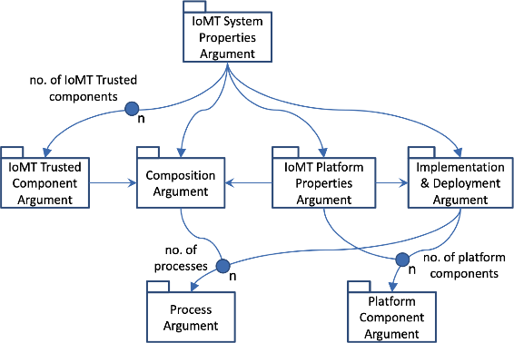
Notional modular AC Pattern for IoMT System Properties

Slide 4
Six-Step Method
Summary of Tim Kelly’s goal structuring method:
+ Arguing Safety – A Systematic Approach to Managing Safety Cases, Sept 1998
+ Managing Complex Safety Cases, April 2003
See: Internal/WPs/WP3/AssuranceWork/References

Slide 5
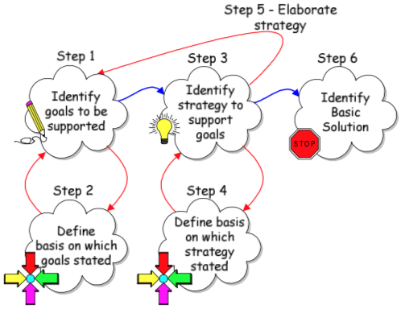
Six-step method for GSN construction
Step 1 – Identify goals
Step 2 – Define basis on which goals stated
Step 3 – Identify strategy to support goals
Step 4 – Define basis on which strategy stated
Step 5 – Elaborate strategy and loop back to Step 1
OR
Step 6 – Identify basic solution

Slide 6
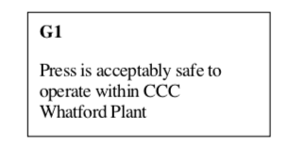
Step 1: Identify Goals to be supported by the AC
States the objectives of the argument
Recommended form: <noun phrase><verb phrase>
A statement that can be evaluated T/F as a predicate
Top-level requirements
Functional and/or non-functional properties
Mandatory standards and regulations compliance

Slide 7
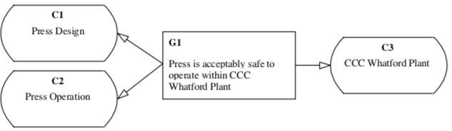
Step 2: Basis of goals stated
Elaborate and clarify context of each goal as necessary

Slide 8
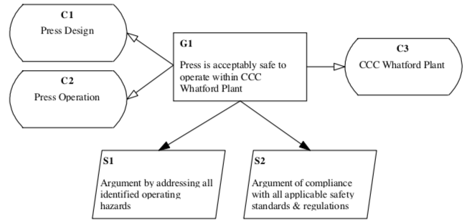
Step 3: Identify Strategy to support goals
For each goal
Example with two strategies (two legs of the AC)

Slide 9
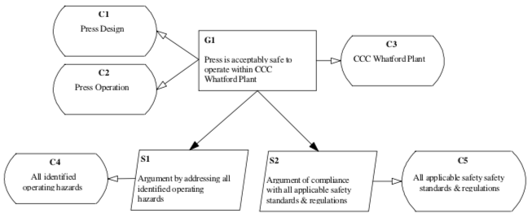
Step 4: Basis of strategy applied
Is further Context information or Justification needed?
C4 could refer to Hazard Log for press
C5 could refer to documents or contracts that specify applicable standards and regulations

Slide 10
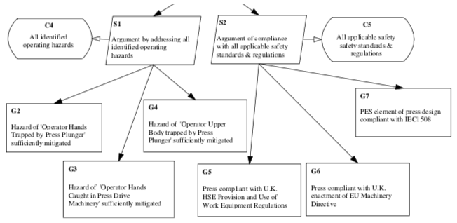
Step 5: Elaborate Strategy
Identified context may clarify or guide strategy elaboration

Slide 11
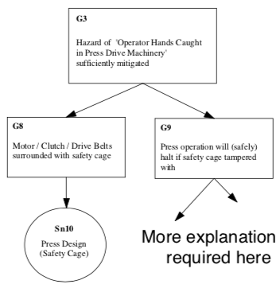
Step 6: Identify basic solution OR Refine
For a case of typical complexity, iterative refinement is performed until direct reference to evidence is possible
Evidence is a direct Solution to a low-level goal, e.g. G8 is solved by direct reference to the design in Sn10.

Slide 12
Complete Simple GSN Example

Slide 13
Architecture-guided Assurance Approach
Bate, Kelly, Architectural considerations in the certification of modular sysems, 2003
(See: Internal/WPs/WP3/AssuranceWork/References)

Slide 14
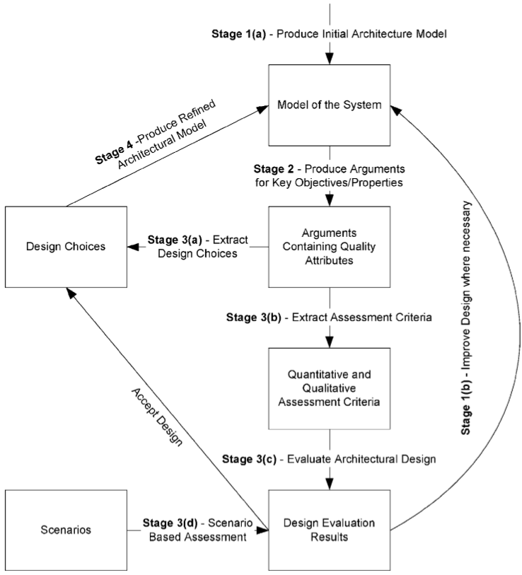
IoMT systems are modular and the AC should be modular
Develop assurance argument hand-in-hand with developing design
Mutually beneficial
Integrated result
Highlight trade-offs
Assurance can influence design choices
Choices that are not practically assurable may be avoided

Slide 15
Information Collection for IoMT Assurance
Outline questionnaire for Methodology, Tool and Use Case partners

Slide 16
Toward systematic assurance for IoMT
Identify key security/safety + other key properties (Goals)
Identify the assurance strategies (Strategy), as AC patterns
Identify the evidence categories and metrics (solution type)
Identify the evidence generating assurance activities and tools (Solutions), referencing these in strategies (patterns)
Model the HW components, architecture and comp rules
Model the SW components, architecture and comp rules
Identify key dependencies of SW on HW platform
Demonstrate (once-and-for-all) validity of comp rules with obligations on components
Demonstrate that the HW composition satisfies SW’s deps
Demonstrate that the composed HW+SW satisfies requirements

Slide 17
AC: start with basics then refine iteratively
Preliminary goal structure
Well-formed high-level goals from system/generic requirements (true/false)
Well-formed and justifiable strategies for generic goals
Generic evidence categories and generating assurance activity/analysis tool
Interim goal structure
Based on a specific design or specific architectural pattern
Refine decomposition of goal structure according to design/arch
Preliminary assessment of adequacy of assurance activities, design tradeoffs
Solidification of AC patterns
Complete assurance case
Based on final design and configuration-controlled implementation
All assurance activities (including verification and validation) performed and results validated against goal expectations
All evidence results referenced within AC and available for inspection
Resulting AC for concrete system is sound and complete
Implemented AC pattern catalog covers used strategies and evidence categories

Slide 18
References
Tim Kelly on assurance cases, including 6-step method
Internal>WPs>WP3>AssuranceWork>References
Draft Assurance Glossary
Internal>WPs>WP3>AssuranceWork>Glossary-snapshot
O-ETB User Manual (including current in-progress version)
Internal>WPs>WP3>AssuranceWork>User-Manual (old path)
Assurance>docs>User-Manual (new path in MedSecurance GitHub repo)
“Inputs and Outputs” of O-ETB
Description of formats for model, evidence, argument patterns, tool agents and other “inputs” is being developed by TOG as part of a collaborative effort with UPC to characterize the inputs and outputs of O-ETB.
To be documented in the O-ETB User Manual
To be summarized later in this PPT presentation

Slide 19
Assurance steps in an AC
Identify key security/safety + other key properties (Goals)
Identify the assurance strategies (Strategy), as AC patterns
Identify the evidence categories and metrics (solution type)
Identify the evidence generating assurance activities and tools (Solutions), referencing these in strategies (patterns)
Model the HW components, architecture and comp rules
Model the SW components, architecture and comp rules
Identify key dependencies of SW on HW platform
Demonstrate (once-and-for-all) validity of comp rules with obligations on components
Demonstrate that the HW composition satisfies SW’s deps
Demonstrate that the composed HW+SW satisfies requirements

Slide 20
AC: start with basics then refine iteratively
Preliminary goal structure
Well-formed high-level goals from system/generic requirements (true/false)
Well-formed and justifiable strategies for generic goals
Generic evidence categories and generating assurance activity/analysis tool
Interim goal structure
Based on a specific design or specific architectural pattern
Refine decomposition of goal structure according to design/arch
Preliminary assessment of adequacy of assurance activities, design tradeoffs
Solidification of AC patterns
Complete assurance case
Based on final design and configuration-controlled implementation
All assurance activities (including verification and validation) performed and results validated against goal expectations
All evidence results referenced within AC and available for inspection
Resulting AC for concrete system is sound and complete
Implemented AC pattern catalog covers used strategies and evidence categories

Slide 21
Assurance Tool Open Evidential Tool Bus (O-ETB) Input/Output Data Formats
Rance DeLong
The Open Group
April 2025
* Contains updated procedure for adding new evidence categories and tool agents.

Slide 22
O-ETB Data Topics
O-ETB Database and MedSecurance Information Exchange
Knowledge Base (KB)
MODELS – chosen data from models available for AC argument patterns
PATTERNS – AC Argument Patterns files
EVIDENCE – categories.pl declares categories, methods and agents
AGENTS – agent or agent calling Prolog code (can be minimal, generic)
REPOSITORY
CASES – internal representation of assurance cases
EVIDENCE – representation of evidence instance records
Tool Agents – standard invocation and EVIDENCE update
Certification Assurance Package (CAP)
Assurance Case text
Assurance Case HTML

Slide 23
Use Case Workshop Assurance Tool New Features
Rance DeLong
9 May 2025

Slide 24
Relevant NEW Features of O-ETB (1)
command line options when invoking etb executable
--command – Batch Mode command (implemented as replacement for etb server concept)
--model – load a model specification from user-specified directory
--patterns – load a patterns file
--procs – load an arbitrary user-specified procs file
(--model, --patterns and –procs options are processed before --command option)
O-ETB commands (interactive or proc/script)
load_agent(<file>) – loads user-specified agent module file. Such a file is not included in the O-ETB source configuration/dependency.
load_patterns(<file>) – loads user-specified patterns file. Can be reloaded during an interactive session if changes are made to the file. May use :- include(FILE) directives.
load_procs(<file>) – loads user-specified procs file. Can be reloaded during an interactive session if changes are made to the file. May use :- include(FILE) directives.
etb_reset, etb_reset(<opt>) – resets the portion of ETB indicated by <opt> or all if invoked without the <opt> which is currently one of {all, cap, repos, cases, evidence} corresponding to makefile targets
show_evidence, show_evidence(<opt>) – show evidence records, <opt> is one of {summary, all}
attach_evidence, detach_evidence, detach_repos
Makefile – expanded clean options: clean (all), clean_cap (cap), clean_repos (repos), clean_cases (cases), clean_evidence (evidence) corresponding to etb_reset command options

Slide 25
NEW Features of O-ETB (2)
Knowledge Base (KB) organization and user contributions
Minimize or eliminate O-ETB/src changes -> user KB additions
The KB has a baseline that is maintained in the source repo
Local additions may be made then later supplement the baseline
This supersedes previous directions on how to add evidence categories
Addition of new evidence categories and corresponding agent identification are done in a single KB file and do not need to change the source repo KB baseline or other O-ETB source files
KB/EVIDENCE directory contains categories.pl file
The list of currently defined categories is generated from this file
Dynamic type checking of categories in the persistent EVIDENCE repo use this list
KB/AGENTS directory contains the (Prolog) agent interfaces (may by minimal to invoke a full agent in any language
Examples developed by Mirek, Marcos, Kostas and Daniel – thank you!
Exhibit the new features in running examples

Slide 26
Updated O-ETB Source Repository structure
O-ETB
KB
REPOSITORY
CAP
BUILD
TEST
src
doc
…
MODELS
PATTERNS
EVIDENCE
AGENTS
CASES
EVIDENCE
CPI 1
CPI 2
…
CPI p
categories.pl
CID 1
CID 2
…
CID m
EC 1
EC 2
…
EC n

Slide 27
Updated O-ETB Dynamic database structure
CASES organised according to assurance case identifier
EVIDENCE organised according to evidence category
CAP organised according to certification project identifier or individual files/dirs
KB contains MODELS, PATTERNS, EVIDENCE, AGENTS …
O-ETB
KB
REPOSITORY
CAP
…
MODELS
PATTERNS
EVIDENCE
AGENTS
CASES
EVIDENCE
CPI 1
CPI 2
…
CPI p
categories.pl
CID 1
CID 2
…
CID m
EC 1
EC 2
…
EC n

Slide 28
KB: Evidence Categories
To define a new category:
Add to KB/EVIDENCE/categories.pl
evidence_category(CatName, CatDesc, CatType, CatValidationMethod).
CatDesc is an atom
CatType is reserved for future formal type-checking and inference purposes
CatValidationMethod is an atom referencing …
validation_method(ValName, ValDesc, ValidationAgent).
ValName is an atom
ValDesc is a single-quoted string (an atom)
ValidationAgent is an atom
validation_agent(AgentName, AgentArgs, AgentResult).
AgentName is an atom
AgentArgs is a term
AgentResult is a term Where term is an atom, compound or list E.g. compound is name( term, term, … )
Provide an Agent in src/agents (to be changed to KB/AGENTS) for the tool/process that performs method
Using existing agents as examples, create a Prolog file with name <tool name>_agent.pl
OR if preferred to write the full agent in another language, make <tool name>_agent.pl a minimal Prolog file to launch the actual agent (again following existing examples)
O-ETB uses validation_agent declarations to dynamically load agent code
O-ETB/KB/EVIDENCE/categories.pl
% Knowledge base of evidence categories, validation methods and validation agents
% evidence_category(CatName, CatDescription, CatType, CatValidationMethod)
evidence_category(axiom, _, _, fact_check).
evidence_category(certificate, _, _, cert_check).
evidence_category(ichecker, _, _, invariant_check).
evidence_category(contract, _, _, contract_check).
evidence_category(property, _, _, property_check).
evidence_category(unknown, _, _, _).
% validation_method(ValName, ValDescription, ValidationAgent)
validation_method(fact_check, 'Evidence is validated by declared premises', axiom_agent).
validation_method(cert_check, 'Certificate exists and is valid', certificate_agent).
validation_method(invariant_check, 'Invariant is valid for artefact', ichecker_agent).
validation_method(contract_check, 'Contract consistency and refinement is valid', ocra_agent).
validation_method(property_check, 'Behavior property is valid for artefact', nusmv_agent).
% validation_agent(AgentName, AgentArgs, AgentResult)
% AgentArgs / AgentResult are: <term> ::= <atom> | <compound term> | <list>
validation_agent(axiom_agent, _, _).
validation_agent(certificate_agent, _, _).
validation_agent(ichecker_agent, _, _).
validation_agent(ocra_agent, _, _).
validation_agent(nusmv_agent, _, _).

Slide 29
O-ETB Database and MedSecurance Information Exchange

Slide 30
O-ETB Source Repository structure
O-ETB
KB
REPOSITORY
CAP
BUILD
TEST
src
doc
…
MODELS
PATTERNS
EVIDENCE
AGENTS
CASES
EVIDENCE
CPI 1
CPI 2
…
CPI p
categories.pl
CID 1
CID 2
…
CID m
EC 1
EC 2
…
EC n

Slide 31
O-ETB Dynamic database structure
CASES organised according to assurance case identifier
EVIDENCE organised according to evidence category
CAP organised according to certification project identifier
KB contains MODELS, PATTERNS, EVIDENCE, AGENTS …
O-ETB
KB
REPOSITORY
CAP
…
MODELS
PATTERNS
EVIDENCE
AGENTS
CASES
EVIDENCE
CPI 1
CPI 2
…
CPI p
categories.pl
CID 1
CID 2
…
CID m
EC 1
EC 2
…
EC n

Slide 32
Structured Data Information Exchange
MedSecurance Modeling Languages & Tools Realm
Interchange and Translation Realm
O-ETB KB Realm (Prolog Representation)
Arch
System Model
Extract and render in agreed formats
Props
Translate to Prolog format
policy.pl
Contracts
Behaviour Model
<behaviour model>.pl
Analysis Tools
Platform Components
A/G Reas. Tool
Tool Agents
platform.pl
Platform Configuration
Ontology
Recon-ciliation
O-ETB Glossary
configuration.pl maybe “none”

Slide 33
Methodology Information
MedSecurance Methodology Realm
Abstracted Methodology and Pattern Realm
O-ETB KB AC Patterns and Workflows
AC Patterns (hand-implemented)
TVRA Method
Risk Mitigation Strategies
patterns_IoMT.pl
Adapt MILS arch-based
patterns
ISO/IEC & MDCG Requirements
patterns_MILS.pl
ISO/TS 215 81001-2-1 Assurance cases
patterns_ISO_81001.pl
Vulnerabilities, Weaknesses, Attack Patterns
Workflows (hand-translated) TBD
Other requirements TBD

Slide 34
O-ETB Knowledge Base (KB)

Slide 35
About the KB
The KB contents are provided by the O-ETB developer, by the O-ETB user, and by evidential tool developers
The KB is read by the O-ETB, not written
The KB determines what the O-ETB mechanism can do
Generally, the KB provides O-ETB with knowledge about:
Relevant details about the entity for which assurance is being gathered and organized (System/Component/Aspect MODELS)
PATTERNS – goals & strategies involving methods and tools to utilize different kinds of evidence for assurance of various entities
The scope of the KB includes MODELS, PATTERNS, EVIDENCE categories, AGENTS and miscellaneous other facts and rules

Slide 36
KB: MODELS (1) System & Properties
Current aspects of the model of the system being assured include:
Architectural model – the components and the connections defining their composition, info flows
Configurations – specification of relevant and changeable system and platform options
Properties – behavior specifications of system and/or components
Information required by the AC argument patterns

Slide 37
KB: MODELS (2) System & Properties
System model contents relevant to assurance strategies embodied in patterns
Currently: model(Policy, Platform, Configuration):
Policy enumerates components and their connections
Components are assumed to be isolated* except for connections
Platform enumerates the hardware nodes and network
Configuration contains any SW/Platform config options
Model is stored in KB as model_spec( model(…) )
Properties are LTL formulas to be established for a model
* non-interfering

Slide 38
KB: MODELS (3) Platform
Details about the configuration of the platform layer that underlies the application layer of the system
Information that shows that the execution environment provided to the software architecture:
Satisfies the assumptions of the software architecture
Provides the needed functionality and performance to enable the software architecture to deliver fulfill its functional and non-functional requirements
Sufficient information about hardware resources to make sound capacity/performance predictions

Slide 39
KB: MODELS (4) Platform
<platform specification> ::=
platform( <platform id>, <nodes>, <switches>, <physical links>, <plat attrs> ).
<nodes> ::= [ ] | [ <node> { , <node> }* ]
<node> ::= node( <node id> , <memories> , <processors> ,
<devices> , <node ports> , <node attrs> )
<memories> ::= [ ] | [ <memory> { , <memory> }* ]
<processors> ::= [ ] | [ <processor> { , < processor> }* ]
<devices> ::= [ ] | [ <device> { , <device> }* ]
<node ports> ::= [ ] | [ <node port> { , <node port> }* ]
<node attrs> ::=
<memory> ::= memory( <memory id>, <mem attrs> )
<mem attr> ::=
<processor> ::= processor(<processor id>, <proc attrs> )
<device> ::= device( <device id>, <dev ports>, <dev attrs> )
<node port> ::= port( <port id>, <port attrs> )
<node attr> ::=
<switches> ::= [ ] | [ <switch> { , <switch> }* ]
<switch> ::= switch( <switch id> , <sw ports> , <sw attrs> )
<sw ports> ::= [ ] | [ <sw port> { , <sw port> }* ]
<sw port> ::= port( <port id>, <port attrs> )
<physical links> ::= [ <phylink> { , <phylink> }* ]
<plat attrs> ::= [ <plat attr> { , <plat attr> }* ]
<plat attr> ::= specfilename( <file identifier> ) |
Platform specification grammar →
Platform spec may be needed when assuring performance attributes or distributed behaviour
This format may be extended to provide information needed by new AC argument patterns

Slide 40
KB: MODELS (5) Arch (policy)
policy(iomt_spec1,
[process('P1',
[port(p, [], [])],
[],
[processor(x, [family(cpu), frequency('2GHz'), schedule(70)]),
memory(z, [family(ram), size(1)])]),
process('P2',
[port(p, [], [])],
[],
[processor(x, [family(cpu), frequency('2GHz'), schedule(80)]),
memory(z, [family(ram), size(5)])])],
[object(o1,
[],
[memory(u, [family(ram), size(3)])]),
object(o2,
[],
[memory(u, [family(ram), size(6)])])],
[ipc_flow(p1p2, ['P1', p], ['P2', p], [], [])],
[po_flow(p1o1, 'P1', o1, [], []),
po_flow(p2o2, 'P2', o2, [], [])],
[specfilename('x.spec')],
[deployment(not_same(['P1', 'P2']))
]).
------------------------------------------------------------------------------------------------
<policy specification> ::=
policy( <policy id>, <processes>, <objects>, <ipc_flows>, <po flows>,
<attributes>, <constraints> )
<processes> ::= [ <process> … ]
<process> ::= process( <process id>, <process ports>,
<process attrs>, <process constraints> )
< process port> ::=
< process attr> ::=
< process constraint> ::=
Constraints on behaviour of entities or interactions among entities
(process/subject, object, flows)
Example policy shown here →
Policy is an information flow view of the architecture as processes and flows between processes or between a process and a passive object
Policy specification grammar → (partial)

Slide 41
KB: MODELS (6) Configuration
Details about the configuration of the system or the platform that are relevant to the assurance argument
E.g. selection of configuration options, modes, etc.
Can be: configuration(none).

Slide 42
Example KB/MODELS/2.0/ configuration, platform, policy
configuration(none).
platform(iomt_platform1,
[node(node1,
[memory(ram, [family(ram), size(16), alignment(4)]),
memory(disk, [family(disk), size(1024)])],
[processor(cpu0, [family(cpu),frequency('2GHz'), schedule(100)]),
processor(cpu1, [family(cpu),frequency('2GHz'), schedule(100)]),
processor(cpu2, [family(cpu),frequency('2GHz'), schedule(100)]),
processor(cpu3, [family(cpu),frequency('2GHz'), schedule(100)])],
[device(es,
[port(pt1, [type(pt1)])],
[family(tsn_card), schedule(100)])],
[],
[os(linux)]),
node(node2,
[memory(ram, [family(ram), size(16), alignment(1)]),
memory(disk, [family(disk), size(1024)])],
[processor(cpu0, [family(cpu),frequency('2GHz'), schedule(100)]),
processor(cpu1, [family(cpu),frequency('2GHz'), schedule(100)]),
processor(cpu2, [family(cpu),frequency('2GHz'), schedule(100)]),
processor(cpu3, [family(cpu),frequency('2GHz'), schedule(100)])],
[device(es,
[port(pt1, [type(pt1)])],
[family(tsn_card), schedule(100)])],
[],
[os(linux)])],
[switch(sw0,
[port(pt1, []),
port(pt2, [])],
[])],
[phylink(f1, [node1, es, pt1], [sw0, pt1],
[length('2m'), media(copper)]),
phylink(f2, [node2, es, pt1], [sw0, pt2],
[length('2m'), media(copper)])],
[specfilename('...')]).
policy(iomt_spec1,
[process('P1',
[port(p, [], [])],
[],
[processor(x, [family(cpu), frequency('2GHz'), schedule(70)]),
memory(z, [family(ram), size(1)])]),
process('P2',
[port(p, [], [])],
[],
[processor(x, [family(cpu), frequency('2GHz'), schedule(80)]),
memory(z, [family(ram), size(5)])])],
[object(o1,
[],
[memory(u, [family(ram), size(3)])]),
object(o2,
[],
[memory(u, [family(ram), size(6)])])],
[ipc_flow(p1p2, ['P1', p], ['P2', p], [], [])],
[po_flow(p1o1, 'P1', o1, [], []),
po_flow(p2o2, 'P2', o2, [], [])],
[specfilename('x.spec')],
[deployment(not_same(['P1', 'P2']))
]).
configuration
platform
policy

Slide 43
KB: PATTERNS (1)
Fragments of assurance argumentation pertaining to a hardware, software or environment entity that are reusable for other similar entities
Patterns are parameterized to enable flexible application and concretization
An evidence node (GSN “solution”) in an AC pattern represents an instance of a specified evidence category and indicates the specific result value needed in the instance to support the goal

Slide 44
KB: PATTERNS (2) Pattern Language
ac_pattern('IoMT_system',
[arg('App_Spec', application_plane:specification),
arg('Platform_Spec', platform_plane:platform)
],
goal(g0, 'The IoMT system satisfies its required properties',
[context('The system is defined by the specifications \c
of its application plane and its platform plane ')],
[strategy('The IoMT system depends on the synergy between \c
the platform and the application planes', [],
[goal(g1, 'The application plane behaves according to its \c
specification and required properties', [],
[ac_pattern_ref('application_plane', ['App_Spec'])] ),
goal(g2, 'The platform plane guarantees the properties \c
on which the application plane depends', [],
[ac_pattern_ref('platform_plane', ['Platform_Spec'])])
]
)
]
)
).
Pattern Id
Using language constructs:
ac_pattern(Id, Args, Goal)
goal(Id, Claim, [Context], [Support])
strategy(Claim, [Context], [Goal])
strategy(Claim, Iterator, [Context], [Goal])
ac_pattern_ref(Id, Args)
Goal Id
Args
Goal
Claim
Context
Context
Support
ac_pattern('application_plane',
[arg('App_Spec', application_plane:specification)],
goal(g0,
'The application plane guarantees that the {App_Spec} is met',
[context('The IoMT system model describes \c
the application plane and the architecture, properties and \c
local specification of the plane')],
[ac_pattern_ref('application_plane_interface', ['App_Spec']),
goal(g1, 'Compositional behaviour of separate components \c
demonstrated to meet the local specification', [],
[ strategy('no. of processes',
iterate('Process', application_plane:process, processes('App_Spec')), [],
[ ac_pattern_ref('application_plane_process', ['Process', 'App_Spec'])])]),
goal(g2, 'Compositional behaviour of compositions \c
demonstrated to meet the local specification', [],
[ ac_pattern_ref('application_plane_composition',
['App_Spec'])])
])).
Goal
ac_pattern('platform_plane',
[arg('P', platform_plane:platform)],
goal(g0, 'The platform plane guarantees that the platform properties \c
and the application plane assumptions are met',
[context('The IoMT system model describes the plane')],
[strategy('Argument over the desired behavior and requirements \c
of each IoMT platform node',
iterate('N', platform_plane:node, nodes('P')),
[],
[ac_pattern_ref('platform_plane_node', ['P', 'N'])]),
ac_pattern_ref('platform_plane_TS_network', ['P'])
])).
Iterator
Iterator

Slide 45
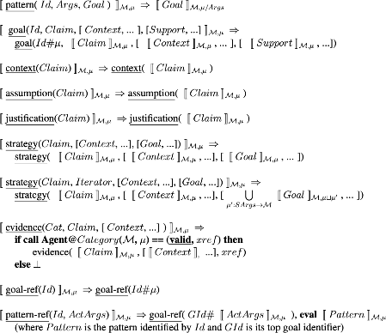
KB: PATTERNS (3) Instantiation rewrite rules
A ⇒ C is a rewrite rule where A represents the sentential form to be rewritten and C the resultant sentential form.
⟦ 𝓩 ⟧𝓜,𝜇 denotes the instantiation of an assurance case element 𝓩 with respect to the model 𝓜 and using the mapping of formal parameters 𝜇.
Underlined symbols (e.g. context) are terminal symbols of the pattern language.
Symbols with an initial capital (e.g. Claim) are logical variables that represent a term of type suggested by the normal meaning of the symbol.
Bold symbols (e.g. eval or if then else) represent operational semantics.
Iterator is of the form: iterate(Name, Category, X) where X is one of: list(Values), expand(Aarg), subjects(PolArg), ss_flows(PolArg), nodes(PolArg), modes(Subject), transitions(Subject)
See Reference Manual for more info

Slide 46
KB: Evidence Categories (1)
Define categories and how instances are generated and validated
Legacy categories include: axiom, certificate, ichecker, & ocra
New categories will correspond to the tools and analyses that are employed as part of the MedSecurance methodology and reflected in the MedSecurance argument PATTERNS
To define a new category and link it to an Agent:
Add to KB/EVIDENCE/categories.pl statementd of the form:
evidence_category(CatName, CatDesc, EvidenceType, ValMethodName).
validation_method(ValMethodName, ValDescription, ValidationAgent).
validation_agent(AgentName, AgentArgs, AgentResult)
CatDesc and ValDescription are single-quoted free text
EvidenceType is reserved for future formal type-checking and inference purposes (use _ for now)
Provide an Agent in src/agents for the tool or process that performs method
Create a Prolog file with name <tool name>_agent.pl using existing agents as examples
OR if preferred to write the full agent in another language, make <tool name>_agent.pl a minimal Prolog file to launch the actual agent (again following existing examples)
O-ETB uses declared validation agents to dynamically load agents (without src change)
Establishes category and links to Validation Method
Links Validation Method to an Agent for process or tool
Agent Name & I/O formats

Slide 47
KB: Evidence Categories (2)
To define a new category:
Add to KB/EVIDENCE/categories.pl
evidence_category(CatName, CatDesc, CatType, CatValidationMethod).
CatDesc is an atom
CatType is reserved for future formal type-checking and inference purposes
CatValidationMethod is an atom referencing …
validation_method(ValName, ValDesc, ValidationAgent).
ValName is an atom
ValDesc is a single-quoted string (an atom)
ValidationAgent is an atom
validation_agent(AgentName, AgentArgs, AgentResult).
AgentName is an atom
AgentArgs is a term
AgentResult is a term Where term is an atom, compound or list E.g. compound is name( term, term, … )
Provide an Agent in src/agents (to be changed to KB/AGENTS) for the tool/process that performs method
Using existing agents as examples, create a Prolog file with name <tool name>_agent.pl
OR if preferred to write the full agent in another language, make <tool name>_agent.pl a minimal Prolog file to launch the actual agent (again following existing examples)
O-ETB uses validation_agent declarations to dynamically load agent code
O-ETB/KB/EVIDENCE/categories.pl
% Knowledge base of evidence categories, validation methods and validation agents
% evidence_category(CatName, CatDescription, CatType, CatValidationMethod)
evidence_category(axiom, _, _, fact_check).
evidence_category(certificate, _, _, cert_check).
evidence_category(ichecker, _, _, invariant_check).
evidence_category(contract, _, _, contract_check).
evidence_category(property, _, _, property_check).
evidence_category(unknown, _, _, _).
% validation_method(ValName, ValDescription, ValidationAgent)
validation_method(fact_check, 'Evidence is validated by declared premises', axiom_agent).
validation_method(cert_check, 'Certificate exists and is valid', certificate_agent).
validation_method(invariant_check, 'Invariant is valid for artefact', ichecker_agent).
validation_method(contract_check, 'Contract consistency and refinement is valid', ocra_agent).
validation_method(property_check, 'Behavior property is valid for artefact', nusmv_agent).
% validation_agent(AgentName, AgentArgs, AgentResult)
% AgentArgs / AgentResult are: <term> ::= <atom> | <compound term> | <list>
validation_agent(axiom_agent, _, _).
validation_agent(certificate_agent, _, _).
validation_agent(ichecker_agent, _, _).
validation_agent(ocra_agent, _, _).
validation_agent(nusmv_agent, _, _).

Slide 48
KB: Agents (1)
Category validation methods are mapped to their agents
validation_method(MethodName, ValidationAgent)
E.g. validation_method(model_checking , 'Symbolic model verification', 'nusmv_agent')
Agent arguments and outputs are defined in
validation_agent('nusmv_agent', AgentArgs, AgentResult)
Args and Results are a term
Consisting of an atom – simple encoding of option to Agent, or
A compound term – can pack in more structured information, or
A list of terms
There is flexibility here to tailor to the category and tool
e.g. [ model_file('model.smv’), property_file('prop.ltl’), expect(qed), evid(10312) ] – is a list of terms that self-identify
e.g. mc_inputs('model.smv', 'prop.ltl', qed) – positional arguments

Slide 49
KB: Agents (2)
The tool agent
Link through a Prolog procedure KB/AGENTS/<tool name>_agent.pl
(previously in src directory)
Agent (Prolog) can be full-featured or a simple linkage to the agent
The entry in AGENTS can perform all of the agent functions directly in Prolog following examples such as ocra_agent.pl
Or, this can be a minimal Prolog procedure (e.g., ichecker_agent) to execute the tool through a very simple interface or to execute a more comprehensive agent coded in any convenient language
The Agent may be thought of as a simple wrapper around the tool:
Marshal arguments for tool and present as expected by tool
Execute the tool with arrangements to get the result
Compare the result from the tool to the expected result from O-ETB
Determine appropriate evidence state transition
Update evidence record according to the new state
Return exit status to O-ETB (synchronous invocation)
Clean up and exit

Slide 50
KB: Agents (3) ichecker_agent.pl example
ichecker_validate(_Claim, _Context, AArgs, XRef, Status) :-
format('~n*** running ichecker agent...', []),
% get the evidence placeholder
atomic_list_concat(['evidence/ichecker/', XRef], Repository),
% get the actual arguments
member( arg(_, model:id, ModelId), AArgs),
member( arg(_, property:id, PropertyId), AArgs),
% copy the BIP model to the evidence repository
atomic_list_concat( [ 'models/', ModelId, '/system.bip' ], BipFilename),
copy_file(BipFilename, Repository),
% copy the property to the evidence repository
atomic_list_concat( [ 'models/', ModelId, '/properties/', PropertyId, '.pro'], PropertyFilename),
copy_file(PropertyFilename, Repository),
% copy the invariant specification to the evidence repository
atomic_list_concat( [ 'models/', ModelId, '/system-invariants.inv'], InvFilename),
copy_file(InvFilename, Repository),
% run ichecker
atomic_list_concat( [ PropertyId, '.pro'], PropertyId_Pro),
process_create('/home/bozga/bip2dev/IFinder/ujf.verimag.bip.ifinder/bin/ichecker.sh',
[ '-p', 'system', '-r', 'main', '-i', 'system-invariants.inv', '-s', PropertyId_Pro ],
[ cwd(Repository), stdout(pipe(Out)) ]),
% interpret output
read_stream_to_codes(Out, Codes), close(Out),
(string_codes('valid\n', Codes) -> Status = 'valid' ; Status = 'invalid'),
% done
!.
% default behavior, when the above fails...
ichecker_validate(_Claim, _Context, _AArgs, _XRef, 'ongoing') :- true.
Top level procedure is <tool name>_validate
Marshal the arguments
Move files to the evidence repository
Construct command to execute ifinder tool
Execute tool in separate process, arranging to receive output result
Interpret the output
Decide Status== valid/invalid
Return Status
In case of unexpected failure of procedure, return Status==ongoing

Slide 51
KB: Agents (4) developing and debugging
Initial development of an agent does not require running O-ETB
Setup a directory structure to reflect EVIDENCE repo
Path to relevant EC and ER provided to Agent
Setup standalone directory structure
O-ETB / REPOSITORY / EVIDENCE / EC2 / ER1
Initial contents of ER1 == pending.
Paths to input files or input structures are provided to the Agent
Agent constructs tool invocation command
Agent copies input files to EC2 as Aux1 … as needed
Agent arranges to get tool output, e.g. redirect stdout or establish a pipe, etc. or files written to EC2 as Auxn
Agent runs tool, collects result, interprets result
Agent decides next state of evidence: valid. OR invalid. OR ongoing.
Agent rewrites ER1/state with new status and optional additional information in Aux files*
Run Agent test and check ER1, Aux1 and Auxn, repeat for other cases
When satisfied, register the agent in O-ETB through categories.pl and AGENTS
Instantiate a pattern involving an evidence node of EC2 evidence class
Give the O-ETB update command after agent has run asynchronously
Export updated assurance case
O-ETB
REPOSITORY
EVIDENCE
EC 1
EC 2
…
EC n
ER 1
ER 2
…
ER m
Aux 1
…
* An alternative to Aux files would be a proposed centralized DB, using a TBD protocol

Slide 52
KB: WORKFLOWS
Definition of Evidence Categories
Mapping to validation methods and to evidential tools through Agents
Categories in Manual belong to “Evidence Classes”
Tool Agents
Invoke evidential tools, interpret tool outputs and update EVIDENCE repository
Process Agents
Initiate processes, gather process results and update EVIDENCE repository
O-ETB doesn’t distinguish tool/process agents, but a planned future addition of “workflow programs” for long-running processes
Process Agent actions may include notifications requiring action by humans or other agents

Slide 53
Other KB Information
Evidence class – a broad collection of evidence categories for conceptual grouping, e.g. specification, configuration, verification & validation, safety analysis, fault detection-isolation-and-recovery (FDIR), performability, standards compliance, risks (hazards), administrative authorization
Evidence type – reserved for future type checking and inference
Evidence category – a particular type of evidence whose value is produced by a given tool for specified input types: evidence_category(ECname, Agent)
Evidence agent – interface to an evidential tool or workflow process that generates an evidence record: evidence_agent(Agent, AgentArgs, AgentResult)

Slide 54
O-ETB REPOSITORY
O-ETB
REPOSITORY
CASES
EVIDENCE
CID 1
CID 2
…
CID m
EC 1
EC 2
…
EC n

Slide 55
CASES repository
Constructed by the O-ETB core workflow
Updated by O-ETB in response to evidence status changes
Has subdirectories named with case identifier (CID)
Each CID directory contains the file repository.pl which contains the details of the incremental construction of the assurance case
You do not need to understand this if not doing O-ETB development
O-ETB
REPOSITORY
CASES
EVIDENCE
CID 1
CID 2
…
EC 1
EC 2
…
EC n
CID m
repository.pl

Slide 56
EVIDENCE repository
Constructed by the O-ETB core workflow
Updated by O-ETB and by Tool & Process Agents
Has subdirectories named for evidence categories (EC)
Evidence Records (ER) are created by O-ETB and updated by corresponding tool/workflow as files under EC directories
Location of passed to Agents
You only need to understand this if creating an Agent for a tool or workflow process
O-ETB
REPOSITORY
CASES
EVIDENCE
CID 1
CID 2
…
EC 1
EC 2
…
EC n
CID m
ER 1-1
ER 1-2
…

Slide 57
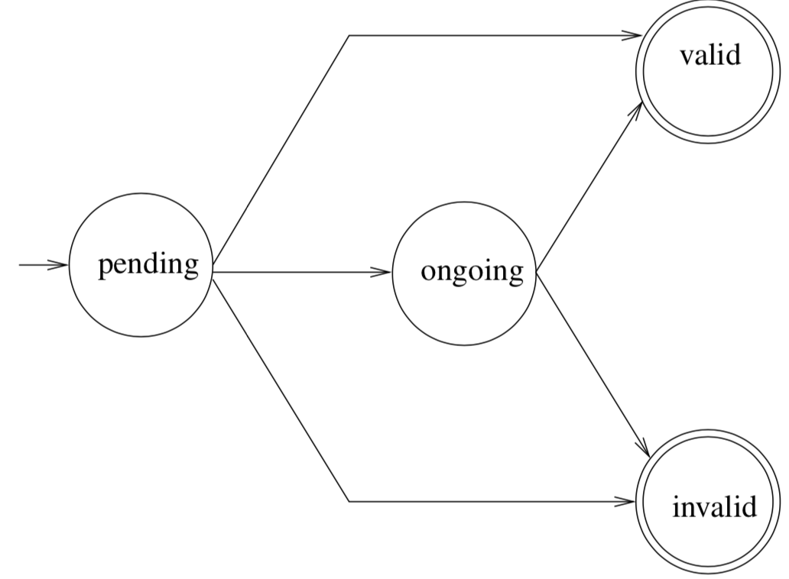
EVIDENCE Record status
Evidence states and agent updates
State is stored in first line of an evidence record
Initially, new evidence created as pending
Tool/process agent for evidence category is invoked if identified
Agent accepts handoff my moving into ongoing state
Agent invokes assurance activity to provide definite valid/invalid result or postpones as ongoing
→ pending (record is created; agent to be started)
pending → ongoing (agent accepts record handoff)
ongoing → ongoing (deferred or long-running activities)
pending → valid (agent immediately determines valid)
pending → invalid (agent immediately determines invalid)
ongoing → valid (agent records valid tool/process result)
ongoing → invalid (agent records invalid tool/process result)
You only need to understand this if creating an Agent for a tool or workflow process
agent records success
activity incomplete
create evidence record
agent accepts handoff
agent reports incomplete
agent records failure

Slide 58
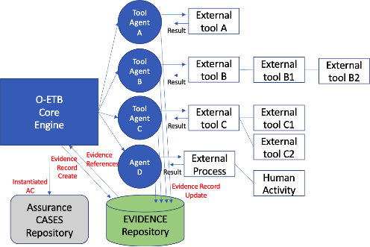
O-ETB Agents interact with external tools and processes and update evidence records

Slide 59
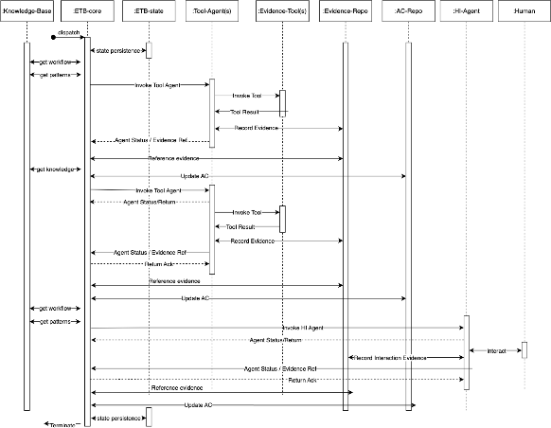
O-ETB sequence

Slide 60
O-ETB Certification Assurance Package (CAP)
O-ETB
CAP
CPI 1
CPI 2
…
CPI p

Slide 61
Certification Assurance Package (CAP)
O-ETB
CAP
CPI 1
CPI 2
…
CPI p
Contains output of O-ETB export functions intended to be consumed by assurance engineers and certification evaluators as part of a certification activity
Distinct certification projects can be grouped as subdirectories within CAP with project ids (CPI)
The O-ETB export functions can be extended or tailored to meet specific certification requirements
Certification type specifications should be provided in the KB and referenced by export functions

Slide 62
CAP Assurance Case Representations
“html” Directory of files, e.g.:
“text” Structured text file, e.g.:
iso_system_example
MS_generic_risk_based_g1_1.dot
MS_generic_risk_based_g1_1.html
MS_generic_risk_based_g1_1.svg
MS_residual_risk1_g1_1_2.dot
MS_residual_risk1_g1_1_2.html
MS_residual_risk1_g1_1_2.svg
MS_residual_risk1_g1_1_3.dot
MS_residual_risk1_g1_1_3.html
MS_residual_risk1_g1_1_3.svg
index.html
list.html
iso_system_example.txt
goal g1_1 : G1: {hit-spec} Safety - Health IT is safe to use in defined care setting
- context : Con1: Care Setting - Care setting definition and description
- context : Con2: {hit-spec} - HIT specification
strategy : S1: Risk Management - Argument based on adherence to ISO 80001-1 risk management process standard
- justification : J1: Effective Process - ISO 80001-1 is an internationally published standard
away goal -> g1_1_2
away goal -> g1_1_3
goal g1_1_2 : G1.1: Residual risk - risk to node {node1} of {hit-spec} is tolerated
- context : Con3: Risk Criteria - Criteria used to classify, evaluate and accept risk
- context : Con4: Tolerable Risk - Risk meeting criteria (acceptable) or outweighed by clinical benefit (accepted)
strategy : for every identified hazard
goal g1_1_1_4 : Risk of hazard {a-hazard} is acceptable/accepted in node {node1}
evidence hazard_log : {node1} Hazard log identifies {a-hazard} risk assessment
pending reference -> 10001
goal g1_1_1_5 : Risk of hazard {b-hazard} is acceptable/accepted in node {node1}
evidence hazard_log : {node1} Hazard log identifies {b-hazard} risk assessment
pending reference -> 10002
goal g1_1_3 : G1.1: Residual risk - risk to node {node2} of {hit-spec} is tolerated
- context : Con3: Risk Criteria - Criteria used to classify, evaluate and accept risk
- context : Con4: Tolerable Risk - Risk meeting criteria (acceptable) or outweighed by clinical benefit (accepted)
strategy : for every identified hazard
goal g1_1_1_6 : Risk of hazard {a-hazard} is acceptable/accepted in node {node2}
evidence hazard_log : {node2} Hazard log identifies {a-hazard} risk assessment
pending reference -> 10003
goal g1_1_1_7 : Risk of hazard {b-hazard} is acceptable/accepted in node {node2}
evidence hazard_log : {node2} Hazard log identifies {b-hazard} risk assessment
pending reference -> 10004

Slide 63
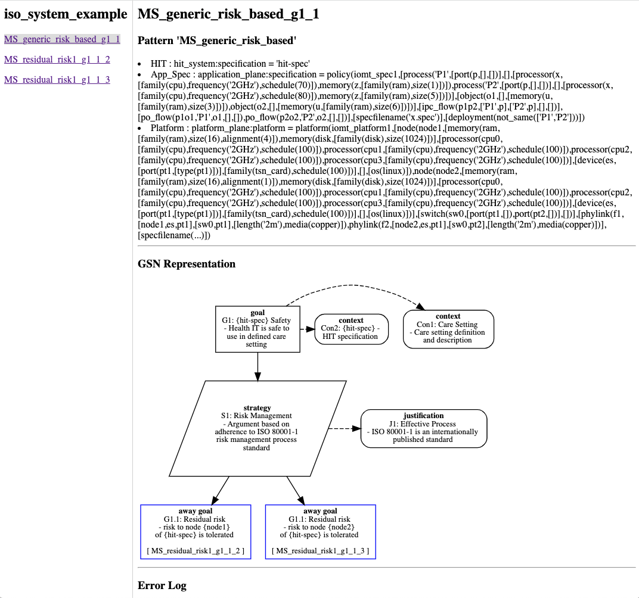
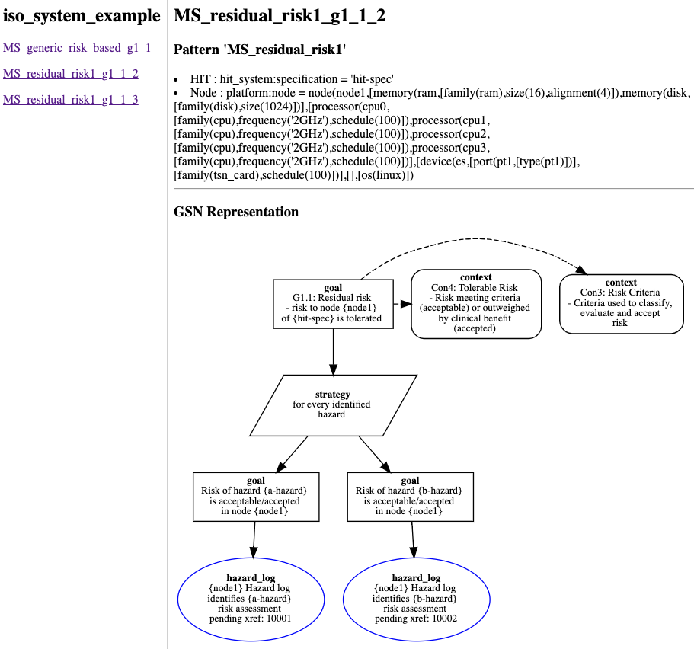
HTML display

Slide 64
End

