Slide 1

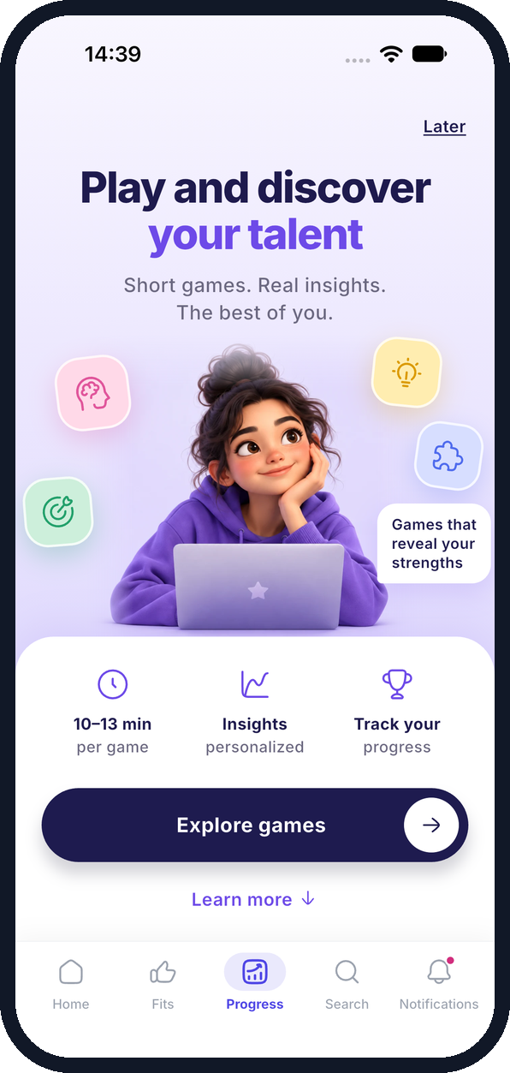
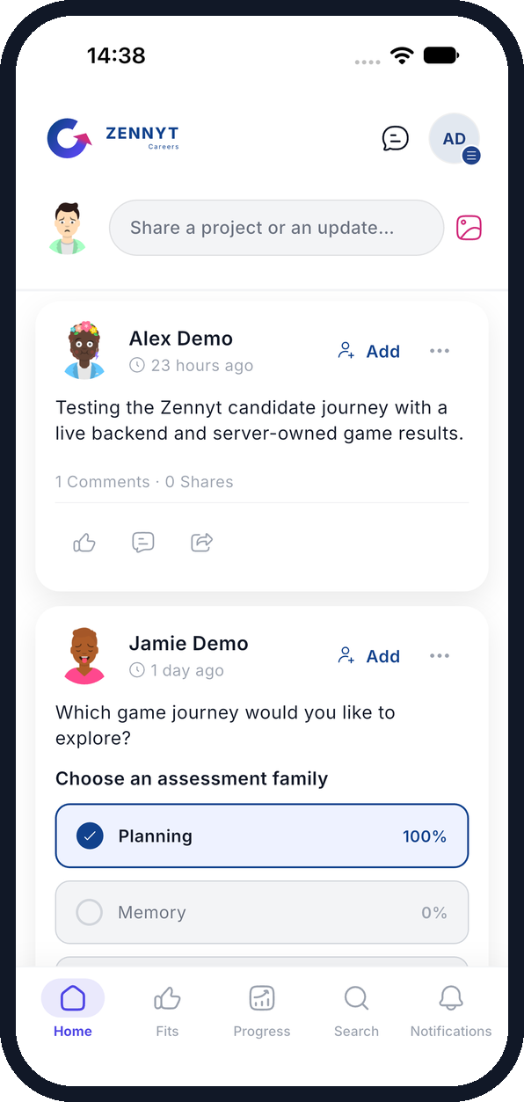
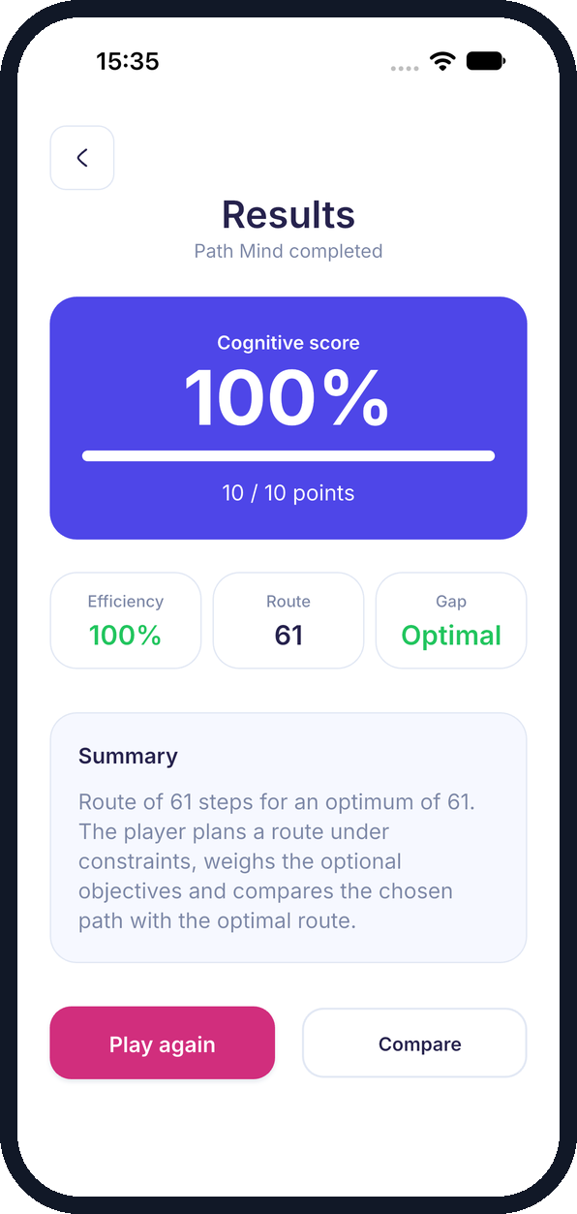

ZENNYT
Summer internship defense · 2026
Building the cognitive games of the Zennyt career platform
Mohamed Slimane · Full Stack Mobile Developer
1 June – 30 August 2026
Supervisors: Mehdi Mtir, Abdelmonem Aisa
Notes:
Good morning. I'm Mohamed Slimane, and this summer I worked at Zennyt as a Full Stack Mobile Developer from June to the end of August, supervised by Mehdi Mtir and Abdelmonem Aisa. Zennyt is a career platform; my part was its cognitive games: what the candidate plays on the phone, and how those plays become trustworthy results on the server. This deck follows the report; each slide's footer points to the matching chapter.

Slide 2




The internship at a glance
3
14
6
2,372
months on the product
mini-games
languages
automated tests passing
1 June – 30 August 2026
across 9 cognitive families
EN · FR · ES · DE · IT · NL
843 backend + 1,529 Flutter
Today
1
2
3
4
5
Context & objectives
Architecture & stack
My contribution: the games
Testing & results
Lessons & next steps
Report · Abstract, Ch. 1
Notes:
In numbers: three months on the product, fourteen mini-games grouped into nine cognitive families, an interface in six languages, and at the end of the internship 2,372 automated tests passing between the backend and the Flutter app. I'll go through the context, the architecture and stack, then spend most of the time on my contribution, the games, before the test results and what I take away.

Slide 3
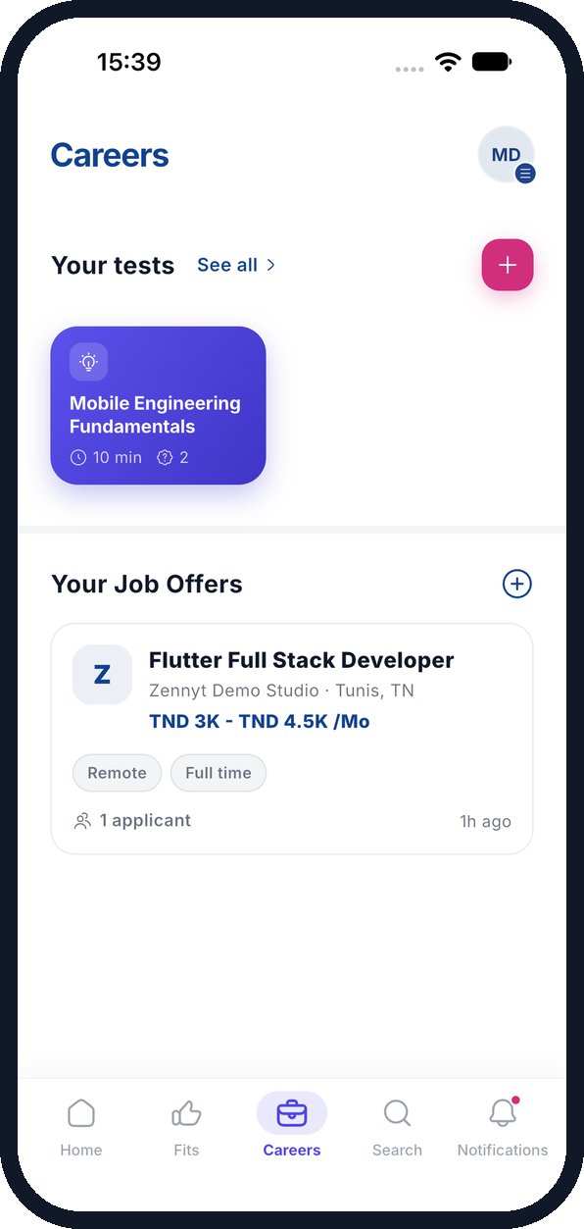



One platform, three audiences
Zennyt is a mobile career platform where profiles, job offers, assessments and conversations meet.
Candidates
Build a profile, explore offers, play cognitive games, take technical tests and chat with recruiters.
Recruiters
Publish offers, author technical tests and review applicants with a Fit Score.
Staff
Game Studio and Platform Console manage assessment content and platform operations.
Candidate · Home feed
Recruiter · Careers dashboard
Report · Ch. 2 Project context
Notes:
Zennyt serves three audiences. Candidates maintain a profile, browse offers, play the cognitive games and take technical tests. Recruiters publish offers, author tests and review applicants, with a Fit Score that mixes hard skills and game results. Staff use two web consoles, Game Studio and Platform Console, to manage assessment content. On the right: the candidate home feed and the recruiter dashboard from the walkthrough I ran.

Slide 4


The challenge: trustworthy game results
Objectives
Why it is hard
The phone captures every action and timing precisely
01
02
Implement interactive Flutter game journeys
Connect raw measurements to server-side scoring
The backend validates the session and applies the scoring rule
03
04
The result stays consistent across games, languages and screens
Manage sessions, tutorials and lifecycle states
Reusable result screens in six languages
Report · Ch. 1 Problem and objectives
Notes:
The core problem: a cognitive game is only useful to a recruiter if its result can be trusted. That means the phone has to capture inputs and timings precisely, the backend has to validate the session and own the scoring rule, and the experience has to stay coherent across very different games, six languages and many screen sizes. My four objectives followed from that: build the Flutter journeys, connect raw measurements to server scoring, handle sessions, tutorials and lifecycle, and ship reusable, localized result screens.

Slide 5
A modular monolith behind two clients
Spring Boot modular monolith
Flutter mobile
Identity
Games
Recruitment
PostgreSQL
Candidate · recruiter
accounts · profiles
sessions · scoring
offers · Fit Score
Context-owned state
Engagement
Analytics
Referral
social · messages
event projections
invitations · wallet
React staff apps
Python help
Game Studio · Console
FastAPI · LangChain
Support
Shared infrastructure
help · tickets
security · domain events · work queue
Help calls carry the user JWT + a service secret
Each context: API → application → pure domain → infrastructure, enforced by ArchUnit. Contexts talk through domain events; contracts start in OpenAPI.
Report · Ch. 4 System design and architecture
Notes:
The platform is a Spring Boot modular monolith with seven business contexts, serving a Flutter app and two React staff consoles, backed by PostgreSQL, plus a Python help service reached through an authenticated gateway. Games, in magenta, is the context I worked in. Every context is layered API, application, domain, infrastructure, and ArchUnit tests keep the domain free of Spring and JPA. Contexts communicate through domain events, which is how a game result reaches the recruitment Fit Score projections. Changes start with the OpenAPI contract, and server interfaces are generated from it.

Slide 6












Technology stack by layer
Mobile
Backend
Administration
Help service
Riverpod state
go_router navigation
Flame game runtime
Dio + STOMP client
Secure storage, Hive
Spring Boot modular monolith
Spring Data JPA
Spring Security, OAuth2
OpenAPI Generator
TanStack Start
Game Studio
Platform Console
LangChain
Chroma retrieval
Authenticated AI gateway
Quality & runtime JUnit · ArchUnit · Flutter test · OpenAPI contract-parity tests · Compose · Maven
Report · Ch. 5 Technologies
Notes:
The stack, by layer. On mobile, Flutter and Dart with Riverpod for state, go_router for navigation and Flame for the Optimal Path grid game; Dio for REST and a STOMP client for real-time messaging. The backend is Java and Spring Boot over PostgreSQL, secured with Spring Security and OAuth2, with interfaces generated from OpenAPI. The staff apps use React, TypeScript, TanStack Start and Tailwind in a Bun and Turborepo workspace. The help service is Python with FastAPI, LangChain and Chroma. Quality is enforced by JUnit, ArchUnit, Flutter tests and contract-parity checks.

Slide 7







My focus: 9 families, 14 mini-games
Planifik
Move Fast
Memory Quest
Optimal Path · Task Scheduling · Predictive Puzzle
Move Fast Core
I Investigate
Decision
Emotional Regulation
Continuous Attention
I Decide
Emotional Radar · Reflective Pause · Strategic Choices
I Continue
Visuomotor Coordination
Visuospatial Memory
Decision Behavioral
I Coordinate
I Place
BART · IST
Report · Ch. 7 Personal contribution
Notes:
This is the catalogue I worked across: nine families and fourteen mini-games. Each family groups related tasks and defines when its session is complete. They measure very different things: planning in Planifik, response speed in Move Fast, working memory in Memory Quest, risk behaviour in BART and information sampling in IST, sustained attention with a long Rosvold X/AX protocol, visuomotor tracking and so on. That variety is exactly why a shared measurement model and shared components mattered.

Slide 8



The client measures, the server decides
1. Record
›
2. Route
›
3. Check
›
4. Score
›
5. Show
Flutter captures actions, answers and timings
The mini-game ID selects the measurement schema
Session owner, mini-game and payload are validated
A domain service computes the score; the attempt is stored
The result screen shows the score and its breakdown
On the phone
On the server
On the phone
The client never chooses an authoritative score
Invalid metrics, foreign sessions, incompatible mini-games and duplicate results are rejected. Technically invalid runs are kept for audit, never counted.
Report · Ch. 7 Measurement and scoring pipeline
Notes:
This is the heart of my contribution. The phone records raw observations: actions, answers, timings. The mini-game identifier acts as a discriminator that selects the expected measurement schema. The backend checks the session belongs to the player and to that mini-game, validates the payload, and a domain service computes the score before the attempt is stored and published. The app then shows the returned score and breakdown. Move Fast is a good example: the payload separates practice trials from measured trials, and accuracy and speed are computed on the server. The one rule that never bends: the client never sends the score.

Slide 9
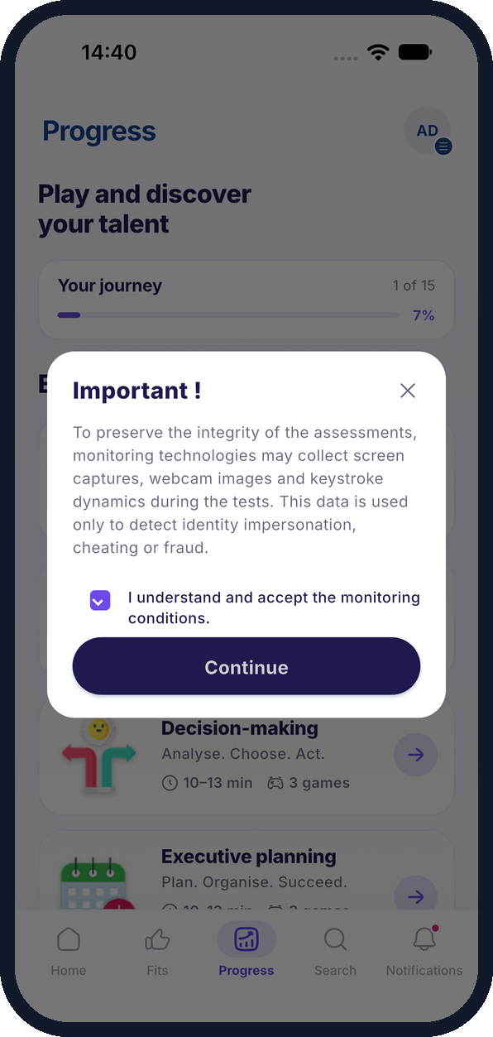
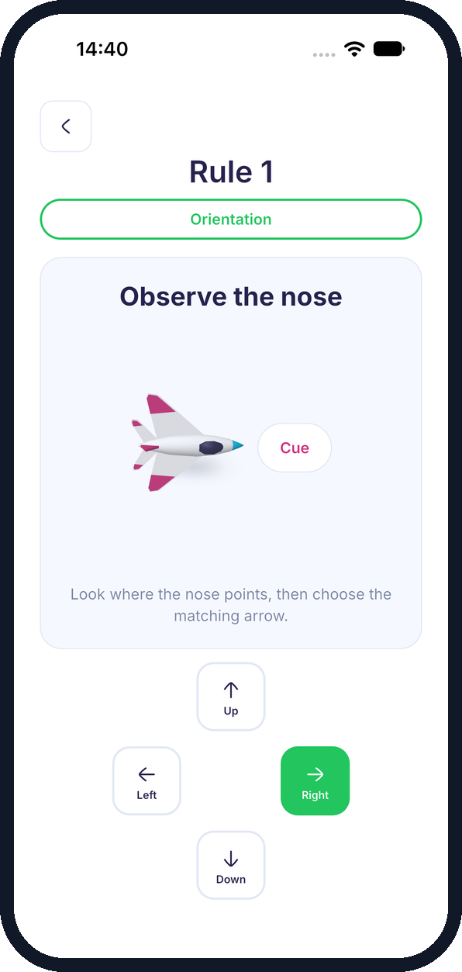
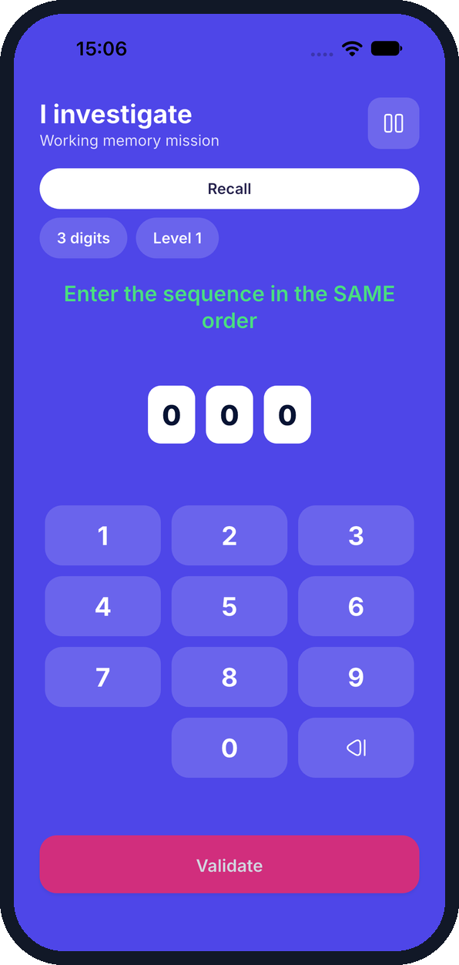
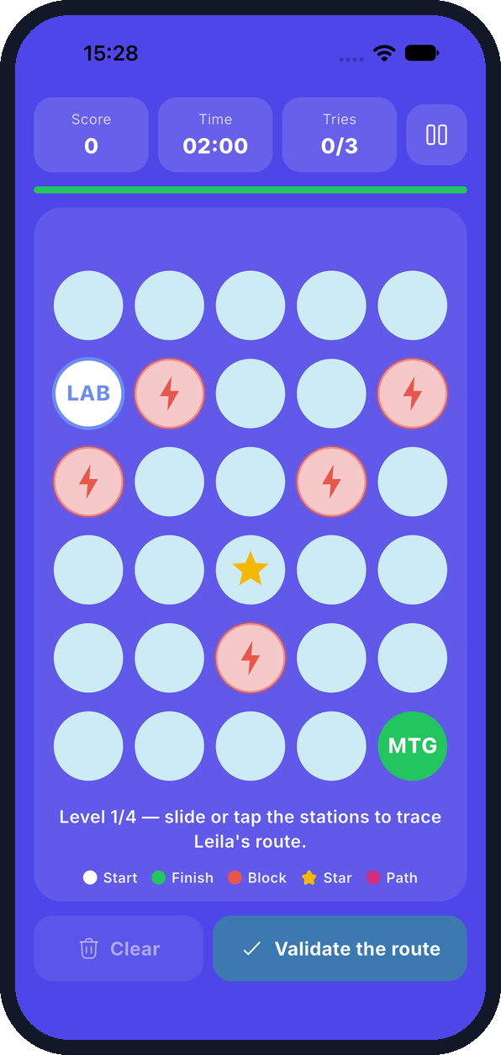
One shared journey for every game
1 Consent
2 Instructions
3 Gameplay
4 Planning
5 Results
Monitoring conditions accepted
Move Fast rule with a cue
Memory Quest digit recall
Optimal Path route board
Server score: 10 / 10
Report · Ch. 7 Interaction and result design · App. A
Notes:
Every game follows the same journey, built from shared components: introduction and consent, a tutorial or practice round, the gameplay itself, then results and a return to the Progress hub. Navigation guards catch accidental exits and pause and lifecycle handling protect a run in progress. The interactions differ a lot, from Move Fast's timed directional answers to Memory Quest's recall keypad and Optimal Path's route grid built with Flame, but the frame around them is shared. The last screen is a real server result: Optimal Path, four levels, 10 out of 10.

Slide 10
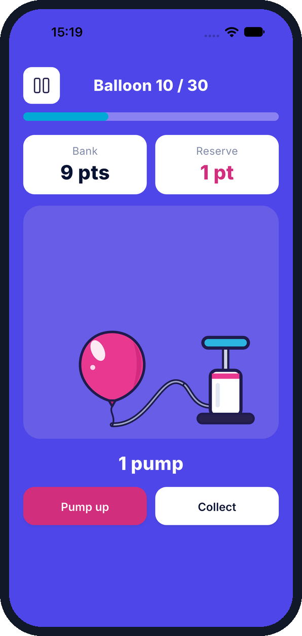
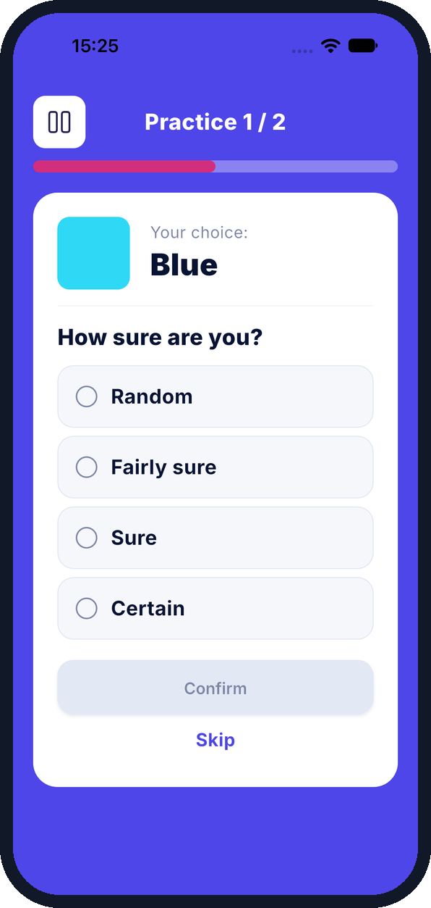
Replay: the server rebuilds the run
BART
Pumps and cash-outs per balloon → the server reconstructs explosions and earnings
IST
Sampled boxes and choices → the server rebuilds what was visible at decision time
I Place
Placement actions are replayed against the controlled layout
Controlled content
Runtime snapshots freeze the published settings when a session starts; assigned forms bind scenario games to a controlled bank.
BART · balloon 10 of 30
IST · colour choice + confidence
Report · Ch. 7 Replay and validation
Notes:
For action-based games, the phone does not send outcomes, it sends the actions, and the server replays them. In BART the app records each pump and collect; the backend reconstructs which balloons exploded and what was earned. In IST it records which boxes were opened and the final choice, so the server knows exactly what information was available. I Place replays placements against a controlled layout. Combined with runtime snapshots and assigned forms, a session is always scored against the content it was actually given.

Slide 11
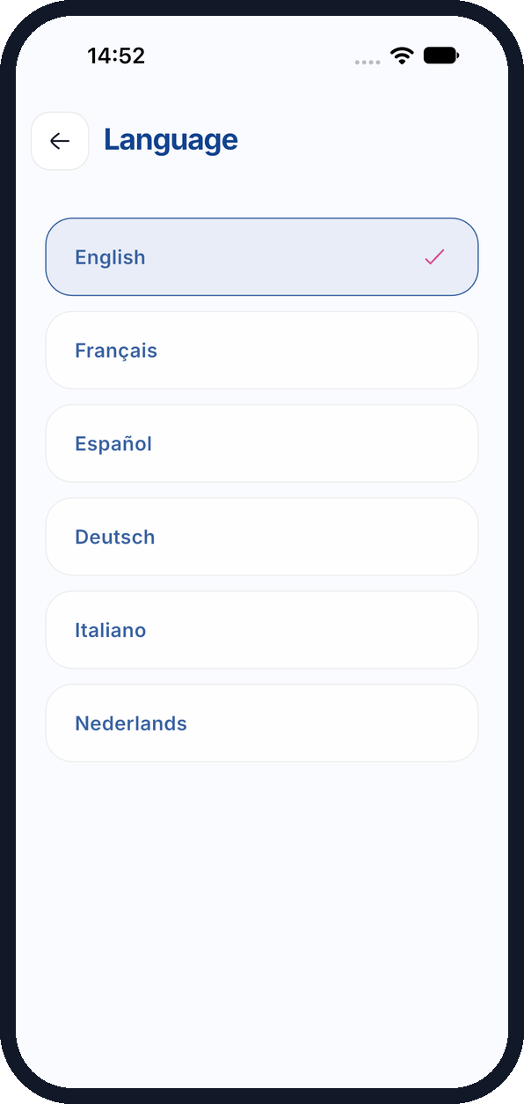
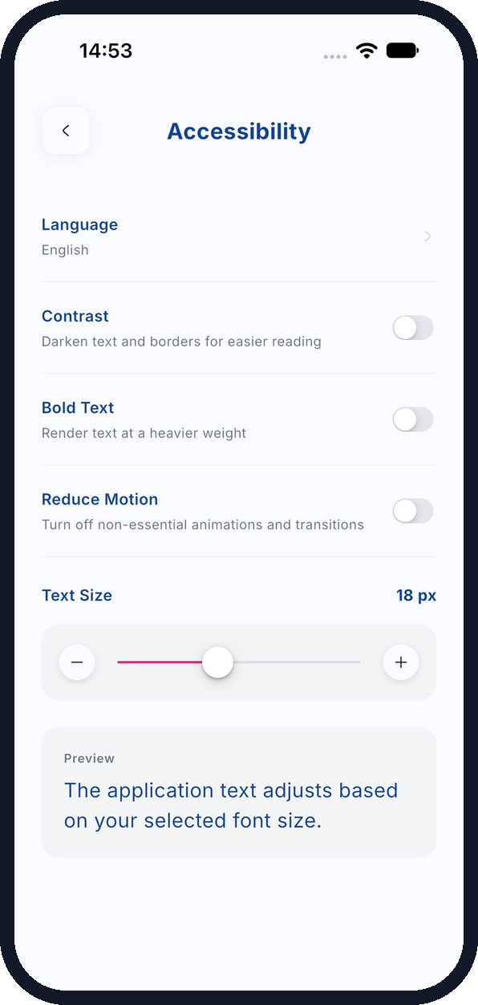

Six languages, adjustable reading
English
Français
Español
Deutsch
Italiano
Nederlands
Localization keys everywhere
Instructions, controls, errors and accessibility labels; ICU plurals for counts.
Layouts that absorb long strings
Shared game layouts keep German and Dutch readable on small screens.
Reading preferences
Text size, contrast, bold text and reduced motion.
Language picker
Accessibility settings
Report · Ch. 7 Localization and accessibility
Notes:
Every game string goes through localization keys, in six languages: instructions, controls, errors and the accessibility labels. ICU plural rules handle counts, and the shared layouts were designed so longer translations, German or Dutch, don't break the game screens. On top of that, users can change text size, contrast, bold text and motion, and the game screens respect those preferences.

Slide 12
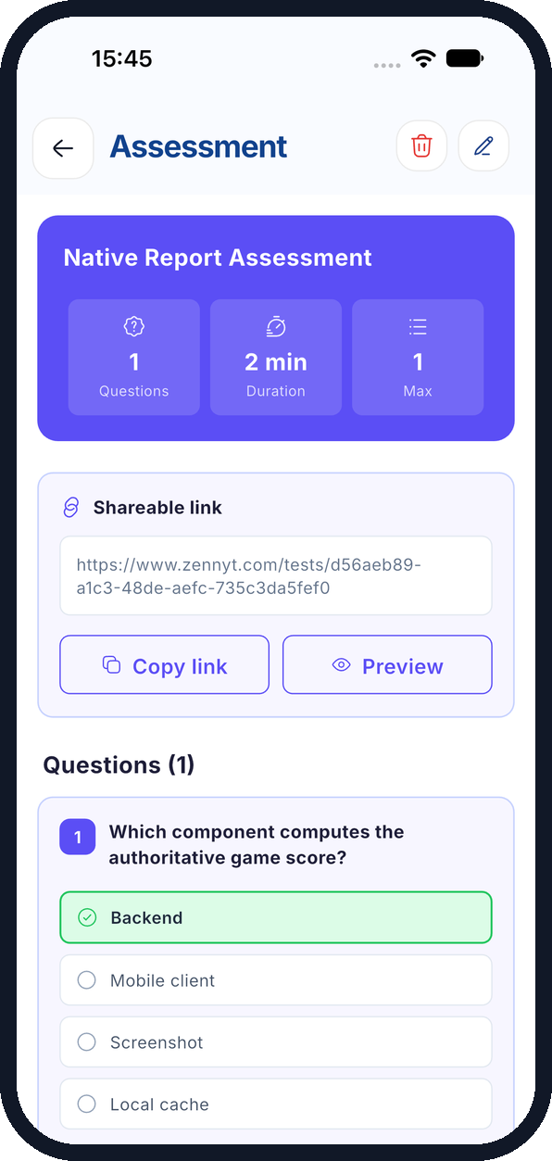
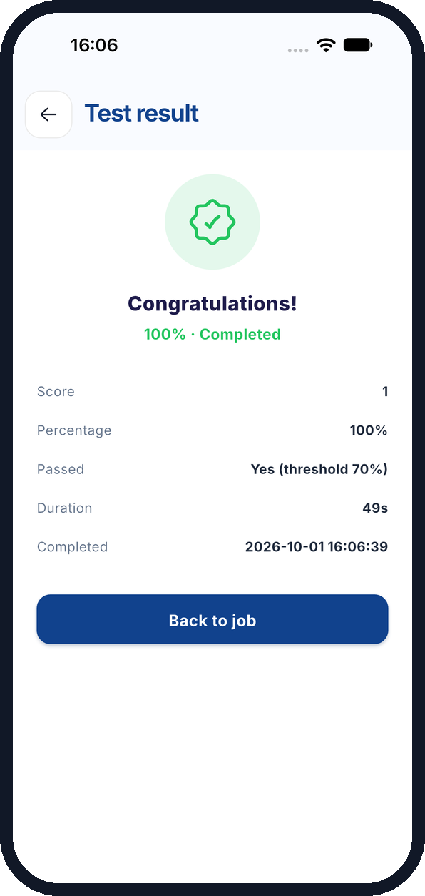
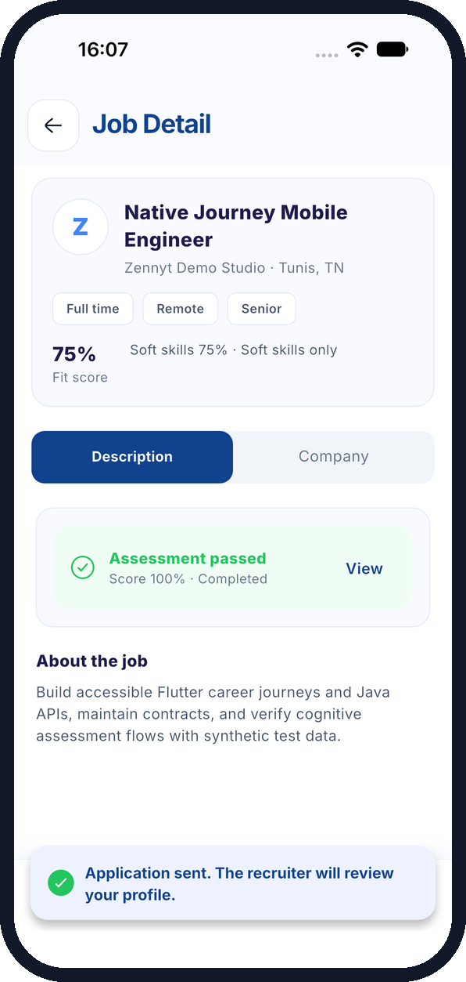
From recruiter test to application
Beyond the games, I tested the full recruiter-to-candidate path on a real iPhone build.
1
Recruiter creates a test and publishes an offer
2
Candidate accepts consent and answers shuffled questions
3
Server grades the attempt: 100%
4
Candidate applies with the passed-test banner
Careers dashboard
Test and answer options
Server result: 100%
Application sent
Report · Ch. 6, Ch. 8 Walkthrough · App. A
Notes:
I also exercised the platform end to end, on the native iPhone app driven by XCTest. The recruiter created a technical test and published an offer. The candidate opened the offer, accepted consent, answered shuffled questions that never include the answer key, and the server graded it at 100 percent, visible to both sides. The candidate then applied, with the passed-assessment banner on the offer. One caveat I'll come back to: attaching the test from the offer form failed, so it was attached through the API.

Slide 13

Automated suites are green
843
1,529
218 / 221
backend Maven tests passed
Flutter tests passed
API checks passed
0 failed · 41 skipped
0 failed · 0 skipped
2 failed · 1 blocked
Test environment
Not yet covered
Spring Boot dev backend and local PostgreSQL; Flutter iPhone app driven by XCTest with game mocks off; synthetic accounts, offers and posts.
Email and OTP delivery, push, call media, real payments and payouts, multi-device. The AI help gateway returned HTTP 503.
Report · Ch. 8 Testing and results
Notes:
On the automated side, everything is green: 843 backend tests through Maven with 41 skipped, and 1,529 Flutter tests, with no failures. I also ran 221 distinct API checks covering all fourteen mini-game submissions plus authentication, recruitment, tests, matching, messaging, community and support, including negative tests for ownership, invalid measurements and duplicates. 218 passed, 2 failed and 1 was blocked. Those failures are the defects on the next slides. To be transparent about scope: external services like email, push, call media and real payments still need integration testing.

Slide 14
Walkthrough: 1 passed, 6 partial
Use case | Workflow | Status | Principal observation
UC-01 | Cognitive assessment | Partial | Planning result saved natively; memory payload failed
UC-02 | Offer management | Partial | Offer published; optional test picker failed
UC-03 | Technical assessment | Passed | Native completion; result read back by both parties
UC-04 | Communication | Partial | Message persisted; call media and delivery unverified
UC-05 | Community | Partial | Post and comment persisted; self-friend action visible
UC-06 | Preferences and help | Partial | Preferences persisted; AI service unavailable
UC-07 | Referrals and plans | Partial | Local state verified; real payouts not exercised
Partial: the core path persisted, but a dependent step or external service failed or was not verified.
Report · Ch. 8 Candidate and recruiter walkthrough
Notes:
For the use cases, the honest picture is one fully passed and six partial. Partial here means the main path worked and was persisted, but some step failed or depended on an external service I couldn't exercise. The technical assessment flow passed completely. For games, the planning result saved but Memory Quest failed to save; offers published but the test picker failed; messaging worked but call media wasn't verified, and so on.

Slide 15


Five defects found and documented
Area
What happened
Fix direction
Memory Quest
Client sends mode instead of memoryQuestMode; the digit exercise keeps the default mode, so the result is not saved
Align the payload with the contract; add a parity test
Decision forms
Another candidate could read a player's assigned form
Add an ownership check on the read endpoint
Assessment picker
Offer form resolves /assessments/pick as an assessment ID → HTTP 400
Match the static route before /{id}
Localization
Notification content appeared in French during an English session
Render notifications in the session locale
Community
An author's own post offered to add the author as a friend
Hide relationship actions on own content
Report · Ch. 8 Issues identified
Notes:
Testing surfaced five concrete defects, each reproduced and documented. The most serious is the Decision forms one, highlighted: another candidate could read a player's assigned form, so the read endpoint needs an ownership check. Memory Quest fails to save because the client sends 'mode' instead of 'memoryQuestMode', which a contract-parity test would catch. The assessment picker route collides with the ID route. Notifications ignored the session language, and an author could befriend themselves from their own post. Fixing these is the immediate next priority.

Slide 16
What I take away
“Treat a game as a complete feature: instructions, interaction, measurement, validation, scoring and feedback must stay consistent from Flutter to the backend.”
Next steps
1
Fix the five defects, starting with the ownership check
2
Integration-test external services: email/OTP, push, calls, payments
Skills developed
Mobile ↔ backend integration
Game protocols as typed payloads
3
Bring the AI help service online and re-run the walkthrough
Async state across screens
Notes:
The main lesson of the internship: a game is not a screen, it's a complete feature. Instructions, interaction, measurement, validation, scoring and feedback all have to agree between the Flutter app and the backend, and the bugs I found were almost all places where two of them drifted apart. Technically, I learned to connect mobile interactions to backend rules, to turn game protocols into typed payloads, and to manage state across asynchronous screens. The next steps are clear: fix the five defects, starting with the security one, complete integration testing of the external services, and re-run the walkthrough with the AI help service online.

Slide 17
Thank you
Questions and discussion
Mohamed Slimane · Full Stack Mobile Developer · Zennyt
Notes:
Thank you for your attention. I'm happy to take questions, on the games, the architecture or the testing.

