Slide 1
Device Development
Priority Mobile 3
Future platforms

Slide 2
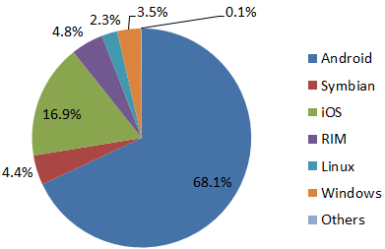
Mobile Platform Market Penetration

Slide 3
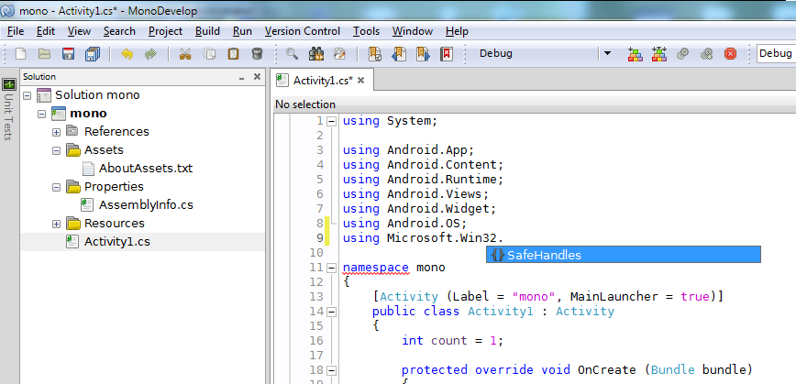
Android
Has a .net implimentation. However …
It only supports C#
It does not support Windows Forms
There are currently 13 versions of android and they are all non-compatible
There is no direct port from our current code base

Slide 4
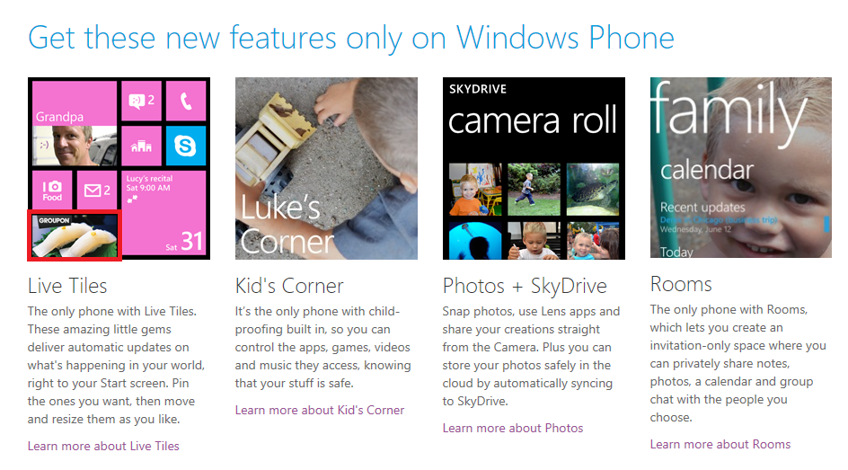
Windows Phone
A Brand new O/S designed to compete in the consumer market against IOS and Android
Consumer oriented (see below!)
Deployment only via Windows App store
It does not support Windows Forms
There is no direct port from our current code base

Slide 5
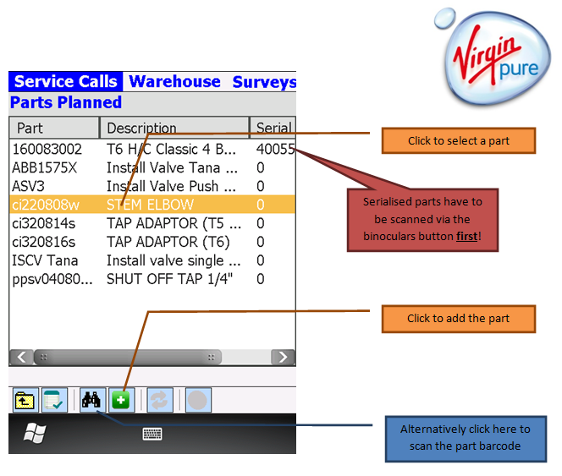
PDA 3 – An industrial Application
Both Field Service and PoD applications require barcode support.

Slide 6
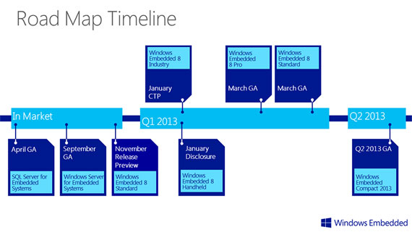
Having replaced Windows Mobile with Windows phone in the consumer market,
Microsoft are now launching Windows Embedded to replace Windows Mobile
In the industrial Market.
“NETCF 3.9 is a big step forward for performance, however, the APIs that you’ve used in NETCF 3.5 stay the same. As a result, you can move existing .NETCF source code and investments forward to NETCF 3.9. “

Slide 7
Hardware Platforms
Windows CE
with Built in Barcode Wedge

Slide 8

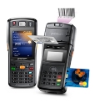
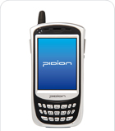
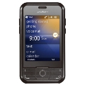
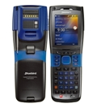
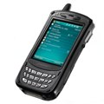
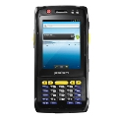
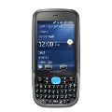
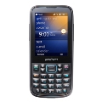

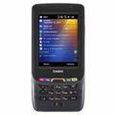
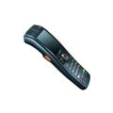
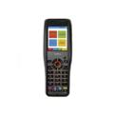
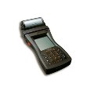
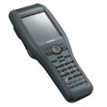
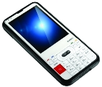

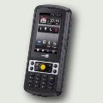
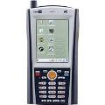
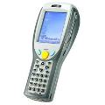
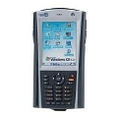
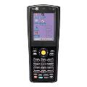

Slide 9

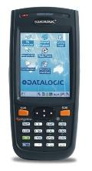
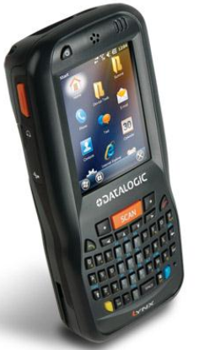
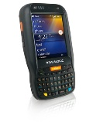
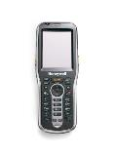
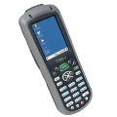
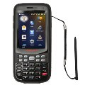
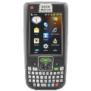
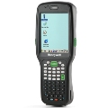

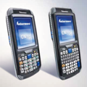
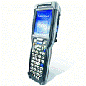
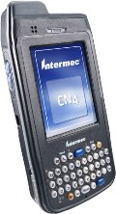
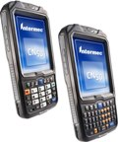
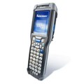
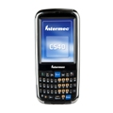

Slide 10

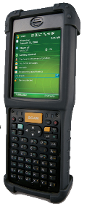
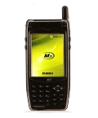
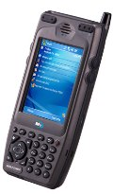
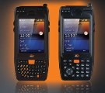
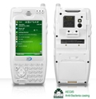
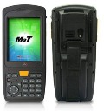

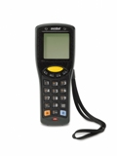
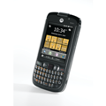
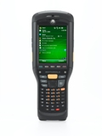
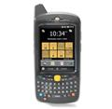
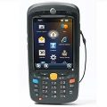
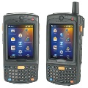








Slide 11





















Slide 12
Hardware Platforms
Android devices
with Built in Barcode Wedge

Slide 13

Note: while both these devices are apparently able to run Android the manufacturers chose to show a picture of the device running CE on their website.

Slide 14

Device Sales by O/S
Device sales by usage

Slide 15

Consumer devices: Recommended Model: Web based applications.

Slide 16
Development Plan
2013
Proposals

Slide 17
Development Plan 2013
SFDC 3
New faster UI
2d Barcode Scanning (GSM)
XML Form settings, on the server not the device
GUI interface to visually create new implementations
Feature enhancements to take advantage of v4 PriProc
A “standard” install with generic Priority Loadings
PDA 3
MS-SQL web component (Current is Oracle)
New PoD Application (Roddas)
Framework developments
Merchant Services Support (Card-reader? Good luck finding that w/Android!)
Mobile Printing Support
CMS
Has become a kludge as a result of the integration of 4 separate projects
Need componentalisation and a general tidy-up
Installers to speed up deployment

Slide 18
Implementations Planned for 2013:
Clear Image - PDA – February 2013
GSM – SFDC – March 2013
Roddas – PDA - April 2013
Roddas – SFDC - April 2013
Washington Mills – SFDC – May 2013?
And Possibly
ATG – PDA – June 2013?

