Slide 1


Slide 2

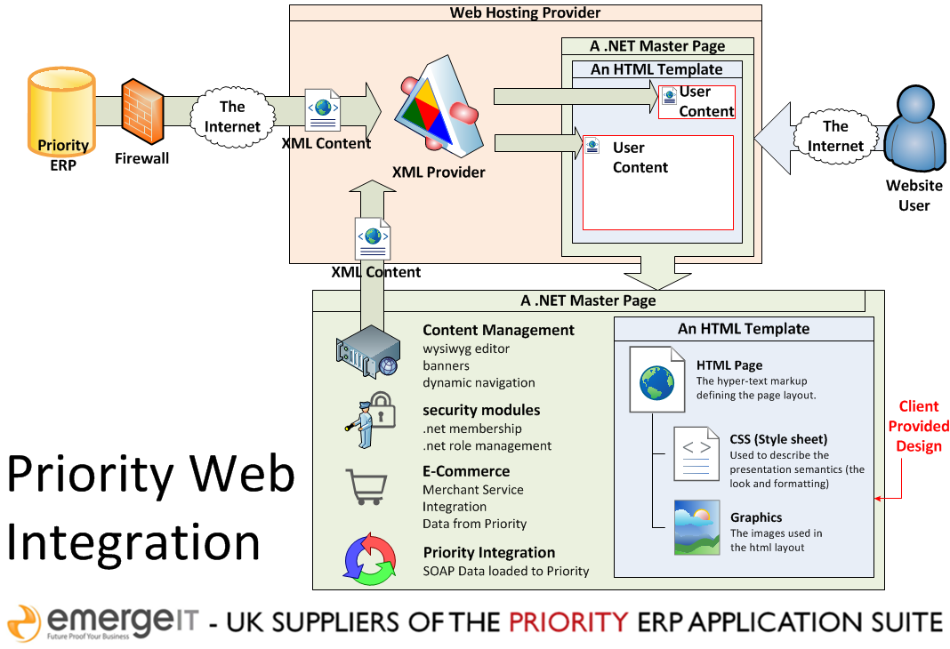
Introducing new web content management tools for Priority...

Slide 3
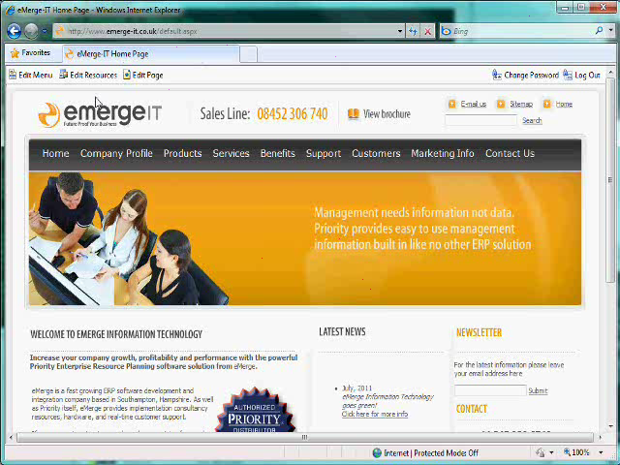
Managing your internet presence in-house...
Once you have logged into your eMerge CMS you can easily add new pages with the page editing tools in the top left
Let’s add a page under the marketing tab
Picture to fill this blue space
Picture to fill this blue space

Slide 4
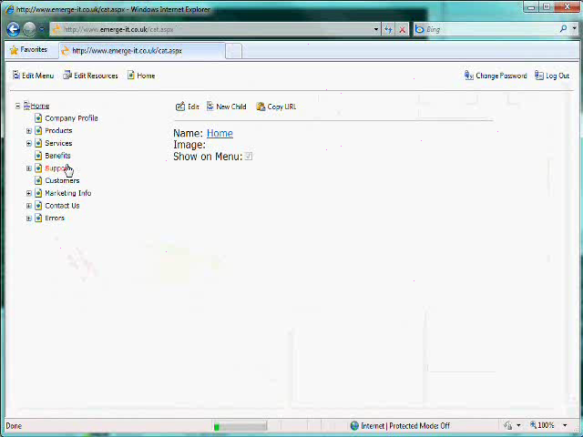
Creating a new page...
We select the section where we are going to add a page
And click to add a child node
Picture to fill this blue space
Picture to fill this blue space

Slide 5
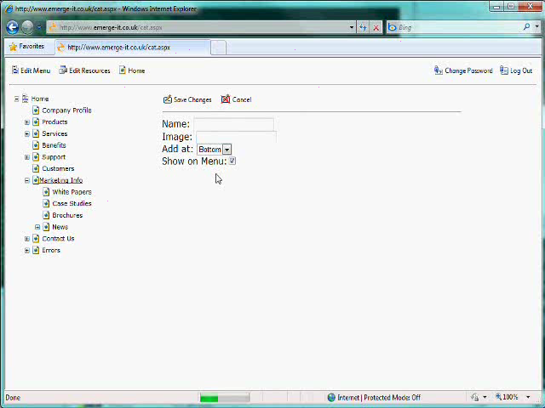
What’s in a name..?
Enter a name for our page
We can add the new page at the top or bottom of the list of marketing pages
Select whether to show the page on the home page menu or not
And save the changes
Picture to fill this blue space
Picture to fill this blue space

Slide 6
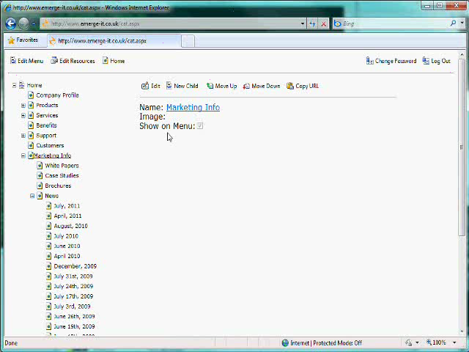
Not where we want it..?
Use the move up and move down options to move a page node within it’s parent section
Whole sections nodes can also be moved up and down, as your content changes
Changes to the page ordering are automatically rendered in our dynamic home page menus
Picture to fill this blue space
Picture to fill this blue space

Slide 7
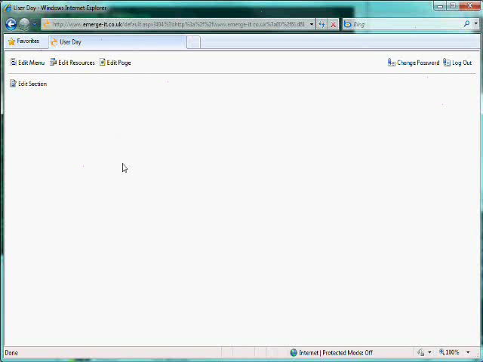
Adding content to our new page..?
Click “Edit Section” to open the page edit tool
The tool can be opened to full screen to make editing easier
The fully featured editor contains all the text styling tools users of desktop programs such as Word would expect
Picture to fill this blue space
Picture to fill this blue space

Slide 8
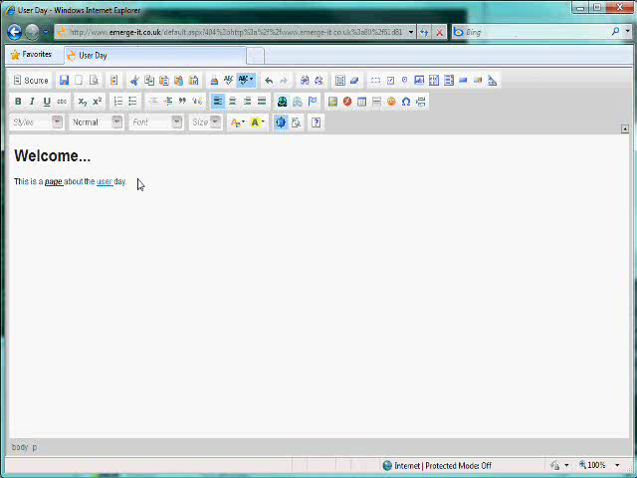
How about images and documents..?
Click to add an image
Resources for our website are stored in the resource library
The resource library can store any sort of document you want to display or download
Links to resources can be copied from the library
We can upload new resources to our website directly from our desktop
Picture to fill this blue space
Picture to fill this blue space

Slide 9
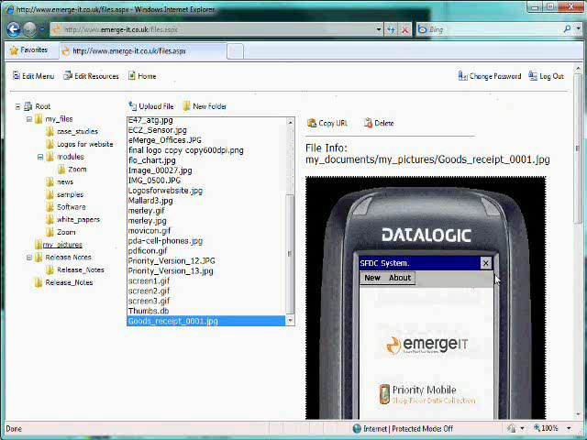
“Does my image look too big in this”..?
We simply “copy URL” of our uploaded image and paste into the editor
The editor allows us to preview our image
We can add a text description of our image to help search engines index our content
The editor also allows inline picture resizing
We use the same process to add page links
Picture to fill this blue space
Picture to fill this blue space

Slide 10
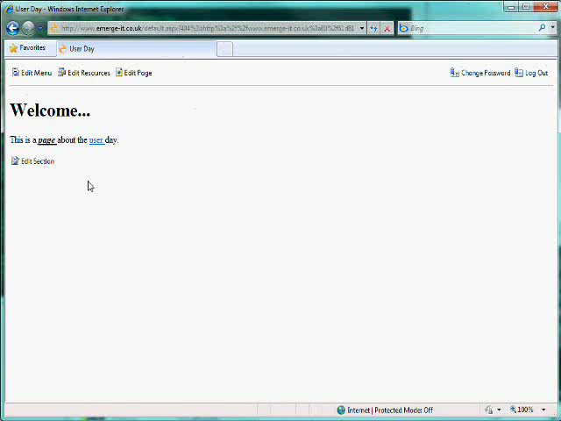
Keeping down design costs with reusable master pages...
To select the template we wish to use for this page we select “Edit Page”
Master pages determine the “look-and-feel” of the webpage
Additionally we can set page descriptions and keywords to help our search engine visibility
Our new page has automatically been added to the web navigation
Picture to fill this blue space
Picture to fill this blue space

Slide 11
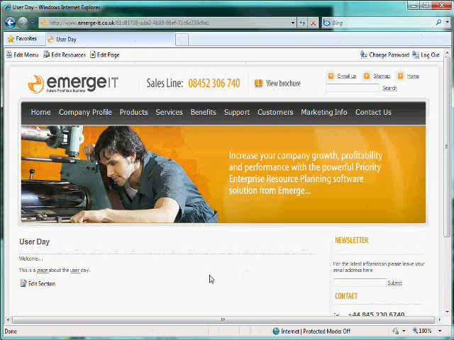
Feature rich for the best customer experience...
All of our content is automatically searchable using the search controls
Changes to our content are automatically reflected in the site map tool
Picture to fill this blue space
Picture to fill this blue space

Slide 12
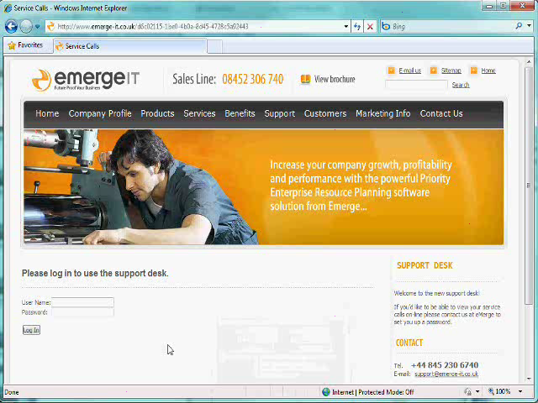
Linking to your Priority Data...
Using the same mobile controls as the PDA and SFDC, your website can display real time Priority Data
Web based data capture into Priority enables a wide range of self service possibilities for your customers
In the example we show how customers can log in to create and edit their own service calls
Picture to fill this blue space
Picture to fill this blue space

Slide 13
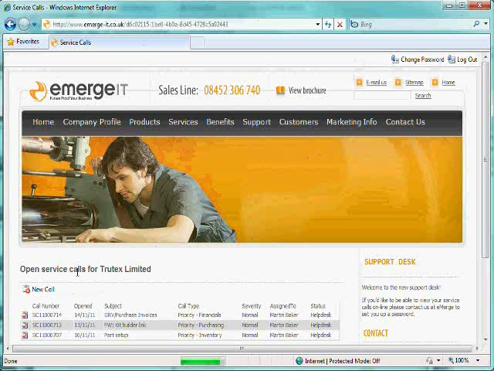
Posting to Priority in real-time...
Once securely logged in our customer can have access to their Priority data
Self care systems can greatly improve the quality of the data you hold about your customer - and save data-entry time for your operators.
Here we see a new service call being created
Picture to fill this blue space
Picture to fill this blue space

Slide 14
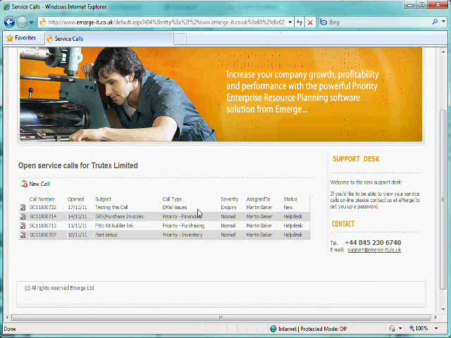
Editing Priority data...
In the example we see how you can get customers to update their own Priority data
The eMerge content management system can connect to and update any Priority data you wish to make available
This includes capturing sales order data directly to Priority from your website
Picture to fill this blue space
Picture to fill this blue space

Slide 15
Priority Mobile...
Thanks for your time today :
  Shop Floor
  GSM
  Web based
Simon Barnett
SimonBarnett@emerge-it.co.uk

