Slide 1


Slide 2

Priority PDA module overview
Developed in conjunction with organisations who use field service engineers, carrying out on-site installs, repairs or maintenance.
Allows on-site service jobs to be sent in real time directly to the engineers PDA.
The service engineer is then able to record details of the job carried out which are then sent back to the office in real time.
Fully integrated with Priority financials allowing invoicing and job costing to be carried out within the standard Priority process.

Slide 3
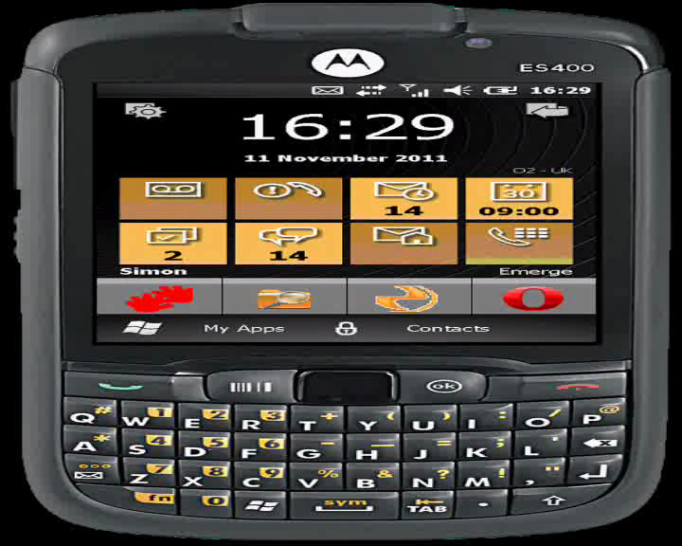
PDA Configuration
A PDA application short cut is placed on the front screen of the device allowing easy start-up.
Service users and warehouses setup within Priority are assigned to the PDA.
The frequency that the PDA synchronises with Priority to automatically collect call data can be configured.

Slide 4
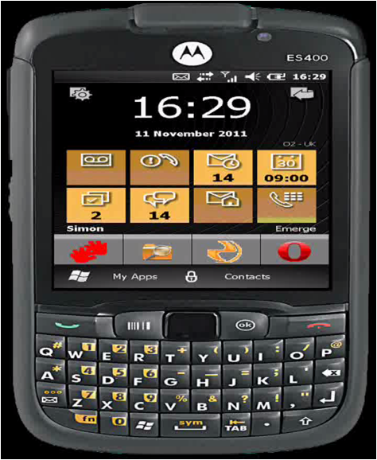
Motorola ES400
The Motorola ES400 is our recommended device for the PDA application.
The device runs Windows mobile enterprise version.
Due to the rigidity and hardwearing design of the device, the working life is expected to be somewhere in the region of six years.
Giving a much greater return on investment over the standard consumer devices such as the iphone.

Slide 5
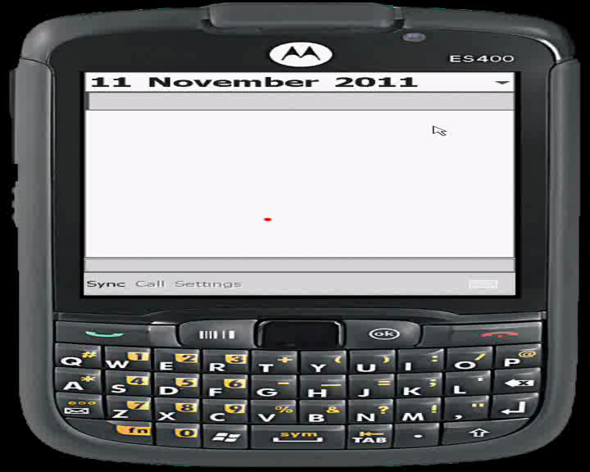
Checking the calendar…
The engineer is also able to check the calendar for calls assigned both for today and in the future, to give visibility of work load.

Slide 6
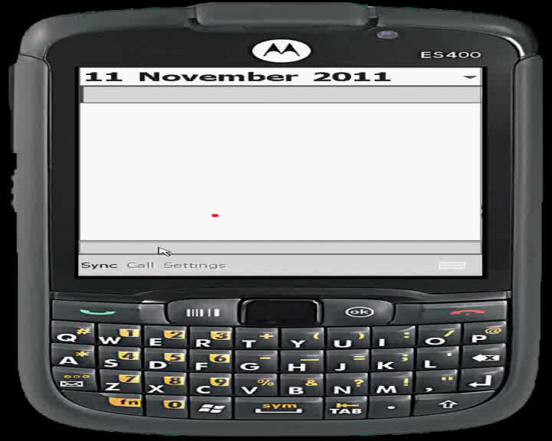
Assign reporting information to the PDA
Additionally data and information can be downloaded to the PDA on demand.
Synchronise the PDA with malfunction, resolution codes, statuses and warehouses already set up within Priority.
This allows detailed reporting of the service operation to be carried out, giving better information to develop preventative maintenance and training programs.
These codes can be amended and added to, as required by staff back in the office and will always be available for use by the engineer.

Slide 7
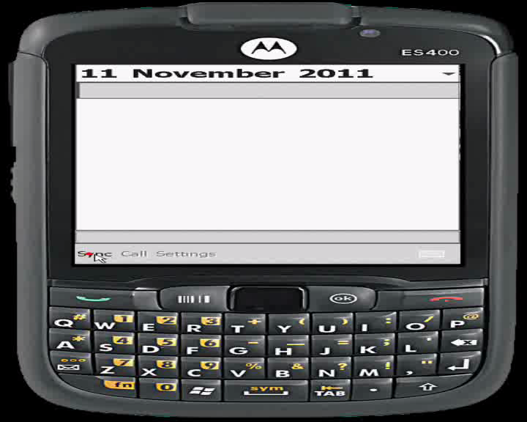
Downloading service calls
A service call is created at the office within Priority, the engineer assigned and the call is scheduled with a time and date.
The engineer will then receive the call on his PDA, along with customer, address and all of the other details entered.
The engineer will then update the call status to en-route, which will start to track the amount of time spent on the service call within Priority.
This will also notify the office of the engineers status.

Slide 8
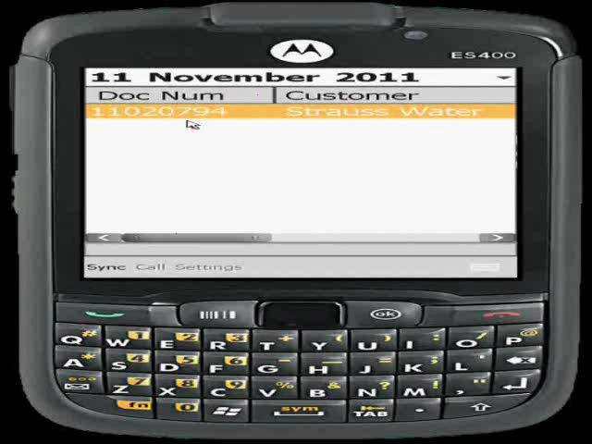
Capturing the call data
Once with the customer, the engineer updates the status to On-site and carries out the required work.
When the work has been carried out, the engineer is then able to select the appropriate malfunction and resolution codes from the pre-defined drop down list.
The engineer is also able to enter free text information via his PDA, which can give more call specific information. This text is also transferred back into Priority.

Slide 9
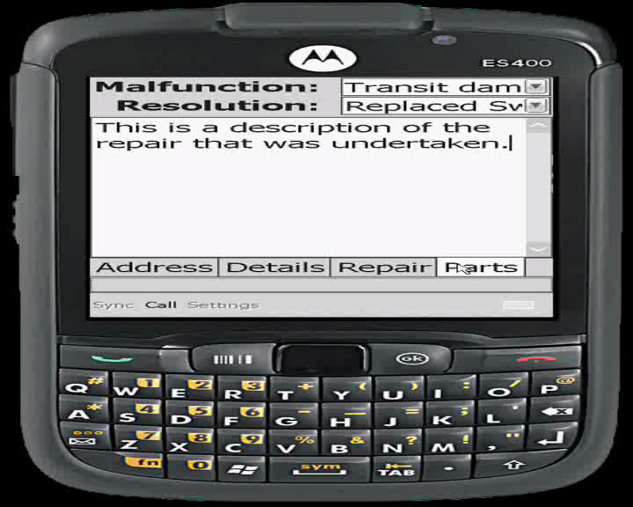
Issuing parts used to the call
The engineers Van is essentially his warehouse. The application enables you to monitor inventory within the van.
Parts and quantities used are issued by the engineer to the service call via the PDA, enabling accurate tracking of costs for the service call. With stock levels automatically reducing.
The application supports Kanban for non-inventory controlled parts, such as nuts and bolts.
Service managers have access through standard Priority warehouse screens to view in real time what stock of parts each engineers van has available.

Slide 10
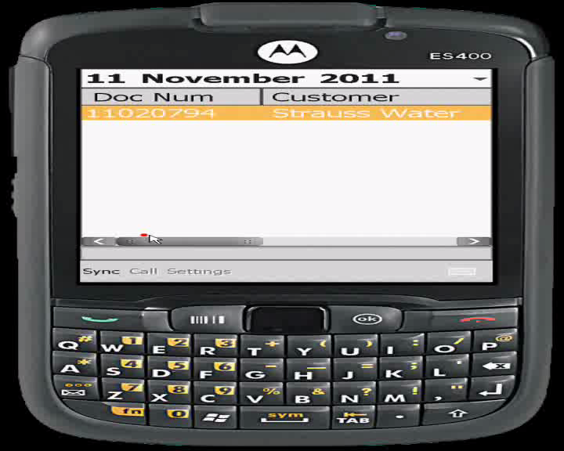
Complete the call
Once the work has been carried out the engineer updates the status to completed. This will advise the office that this particular call is finished. The complete status also ends the time recording against the call.
If for any reason the call is not finished but the engineer has to leave site the status of incomplete can be selected. This leaves the call open for him to return to it, or if required a different engineer can be assigned to carry out more work.
All costs relating to the call are now within Priority, allowing for comparisons to be made between planned and actual times and quantities.
This provides crucial information for determining annual service contract prices.

Slide 11
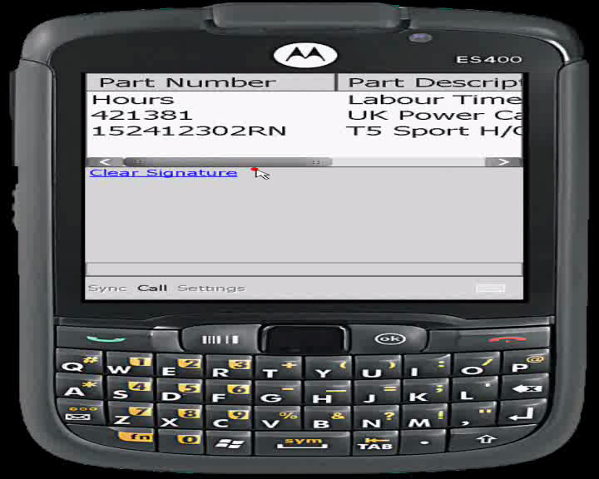
Customers signature
Finally the engineer obtains the customers signature on the PDA as proof of completion of the work.
By using the clear signature feature, the engineer is able to ensure a legible signature is received.
The signatures are then passed back into priority where they can be added to reports, invoices etc.

Slide 12
PDA Application
Thanks for your time this morning.
Jason Aspden
jasonaspden@emerge-it.co.uk

Slide 13
Web Content Management...
I will now hand back over to Simon who will take you through the new Priority Web integration tools.

