Slide 1
The Priority Mobile Service
A technical discussion

Slide 2
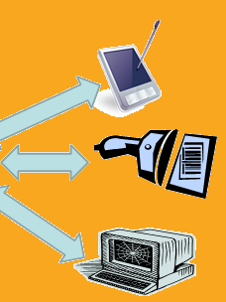
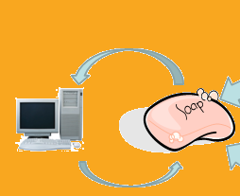
What is the Mobile (SOAP) Service?
S(imple) O(bject) A(pplication) P(rotocol)

Slide 3
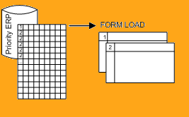

What does the service do?
Making normal Priority Form Loadings
Into Remote Form Loadings
The normal process is to populate a loading table and run a
Priority loading interface
The service allows this process to be called remotely
Transactional SOAP “Bubbles” group
loadings received at the same time with a BUBBLEID column
SOAP Bubble data is automatically deleted when all data in that
transaction has LOADED= ‘Y’

Slide 4
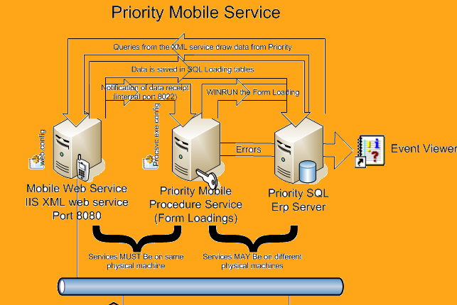

Slide 5
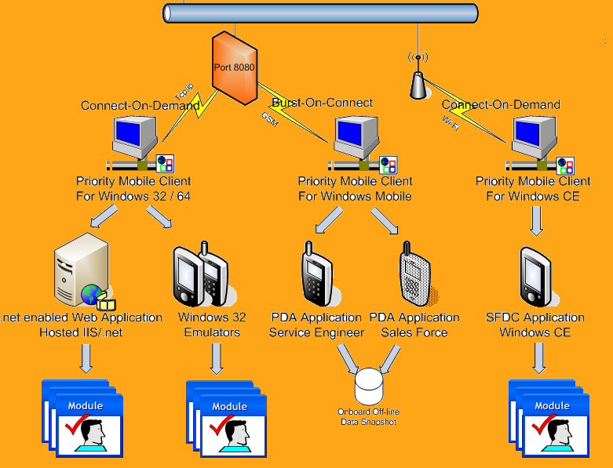

Slide 6
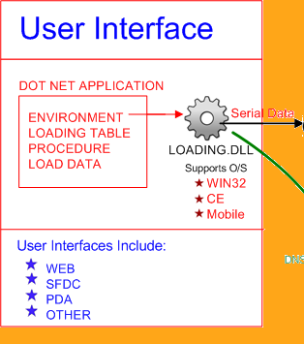
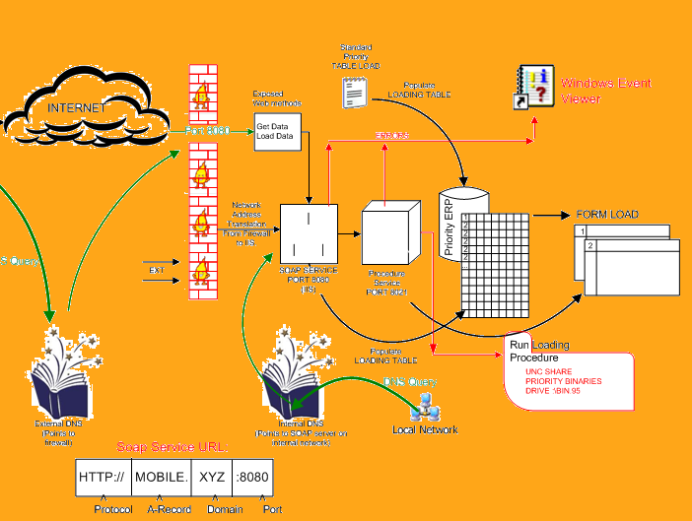

Slide 7
Installation of the Mobile (SOAP) service

Slide 8
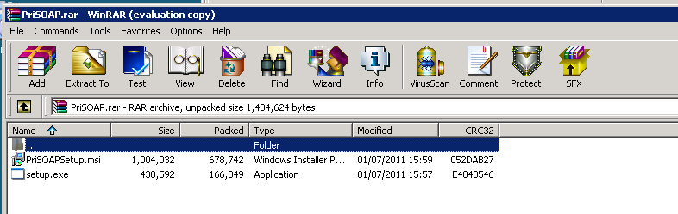
Priority Mobile Service (SOAP) Install
Download and Install the latest version of Mobile from:
ftp://simon.emerge-it.co.uk/
Priority Mobile/
Server/
PriSOAP/
PriSOAPSetup/
Debug/
PriSoap.RAR
Note that installation uses the %windir%\tabula.ini to configure
Connections! Make sure this file points to the correct Priority Install

Slide 9
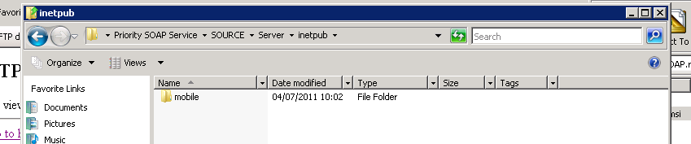
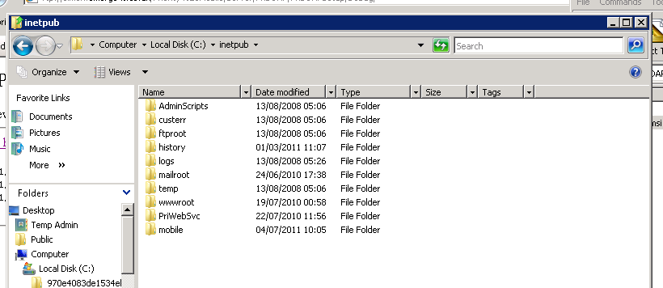
Copy the web files to your \Inetpub folder

Slide 10
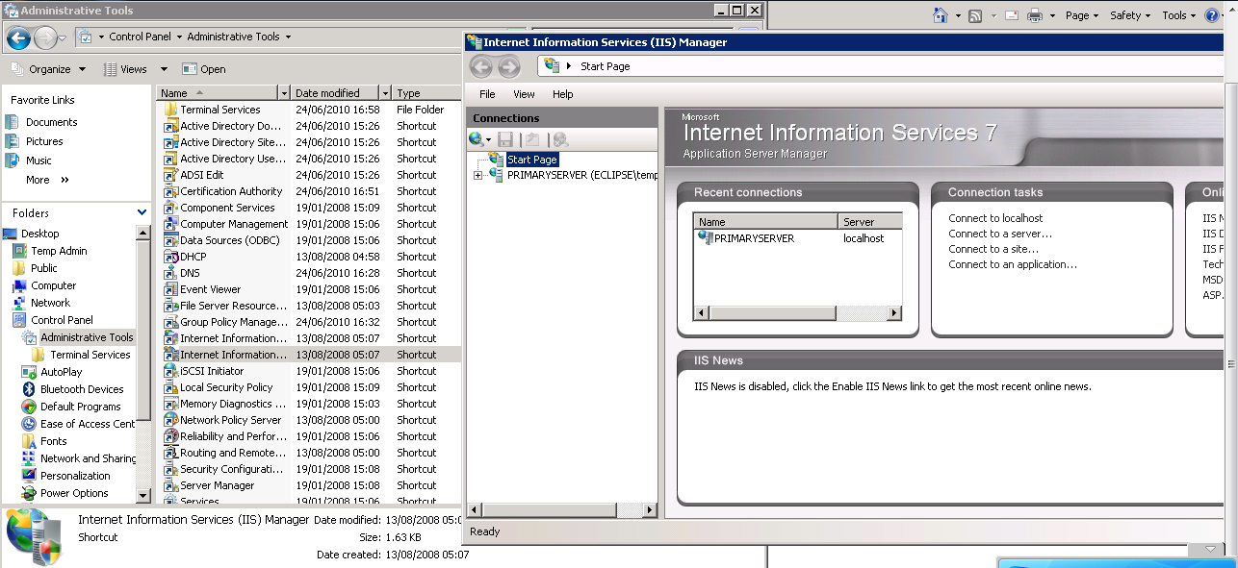
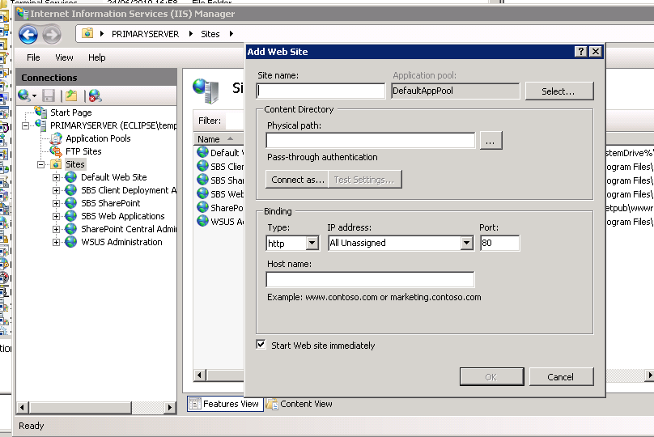
Create the “mobile“ website
Site Name - mobile
Physical Path - C:\inetpub\mobile
Port – 8080
Host Name – Leave blank and unassigned -this will then allow any
in-bound connection on Port 8080 to be handled by the website.

Slide 11
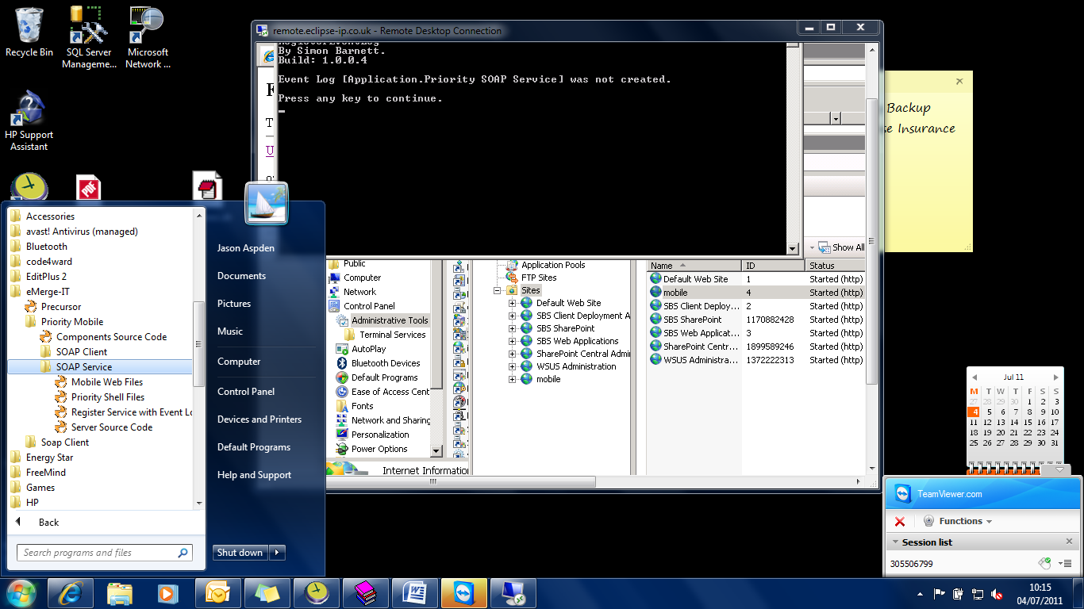
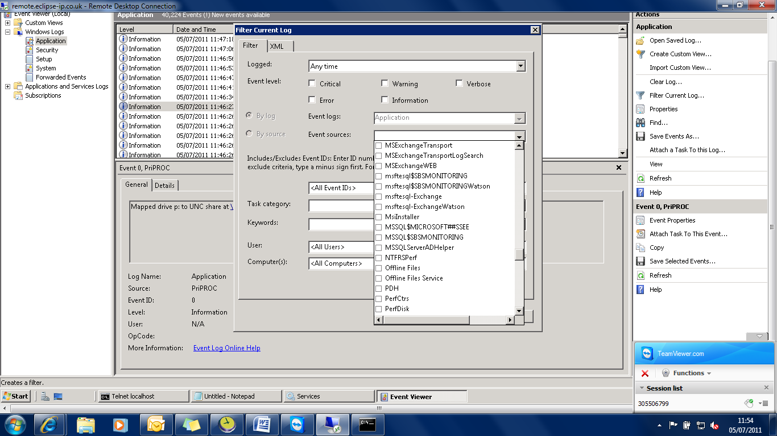
Configure Windows Event Logging
Note: You must be an administrator
to perform this action!

Slide 12
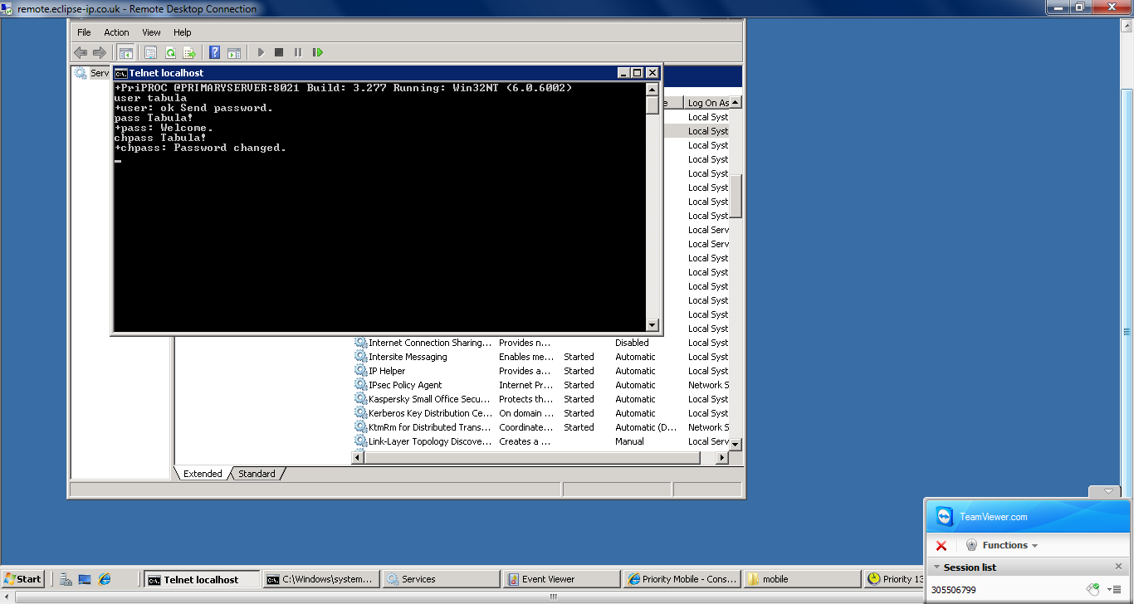
Configure the SOAP Service for first use
telnet localhost 8021
Inetpub c:\inetpub\mobile\connections.config
Net use

Slide 13
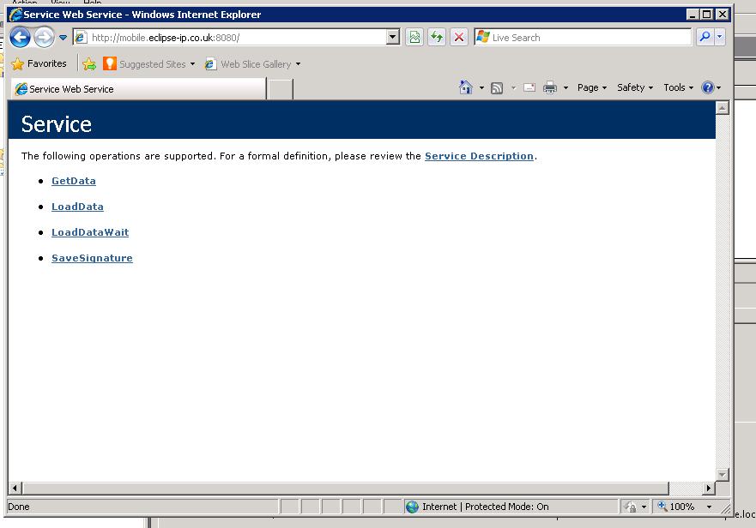
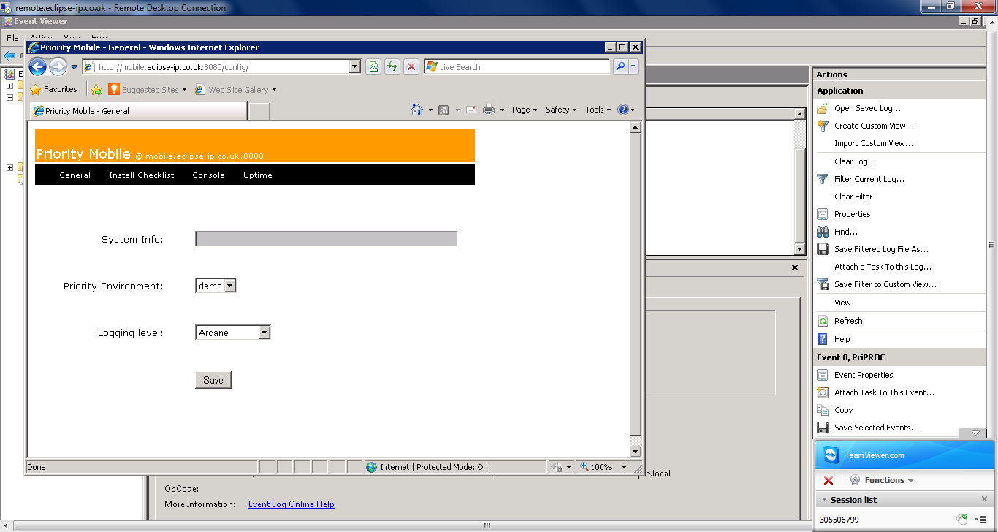
Open the service
@ http://localhost:8080
Configure the service from /config

Slide 14
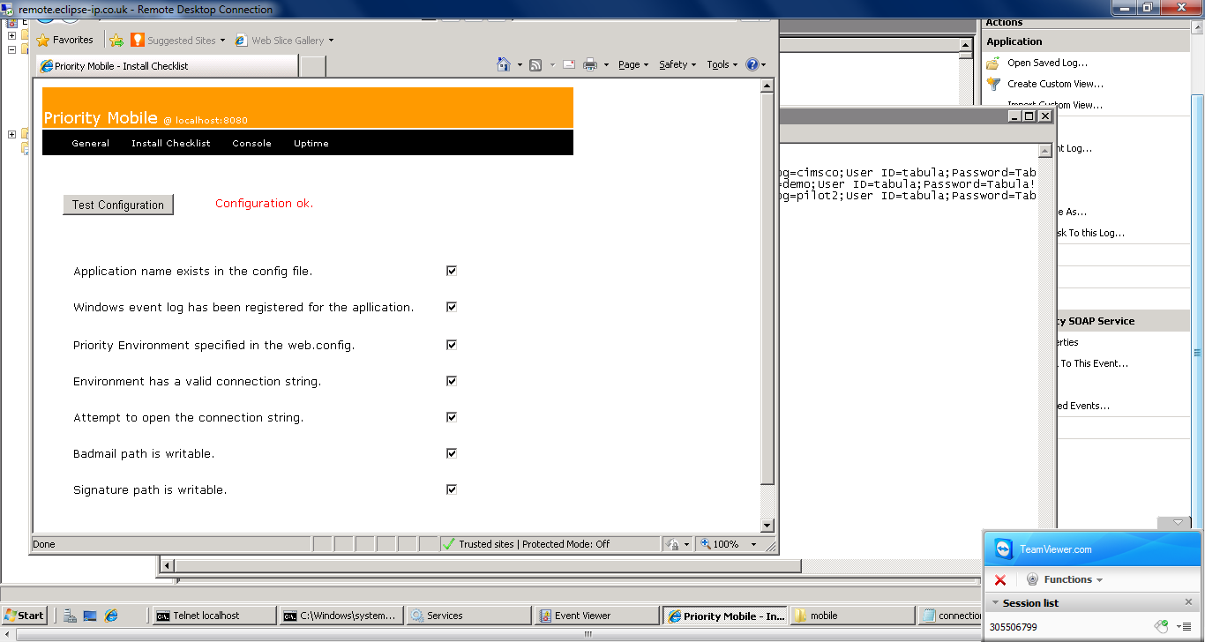
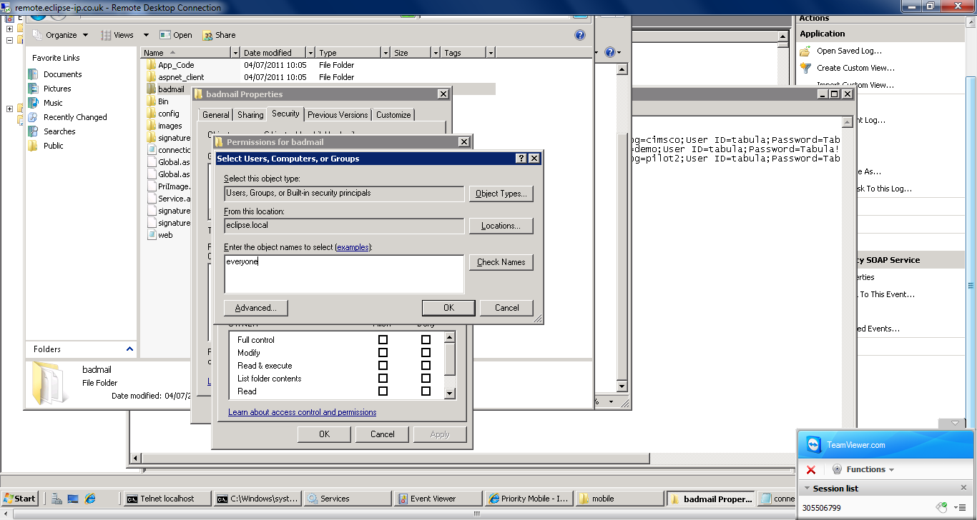
Run the installation
checklist
Note: Write permissions for
\badmail and signatures are
required

Slide 15
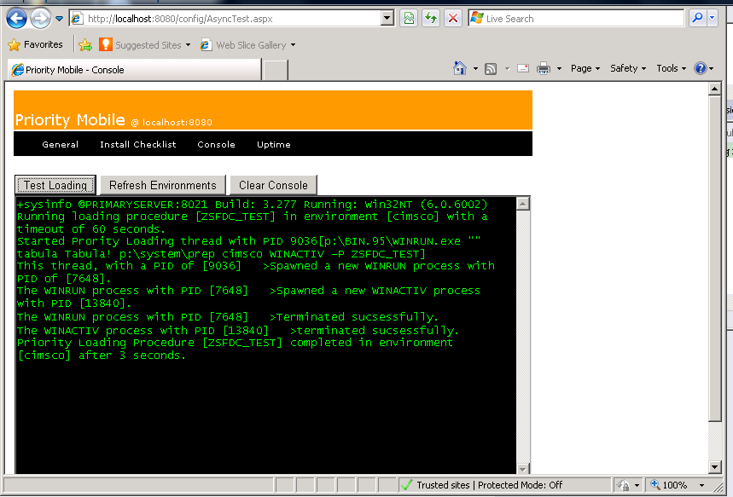
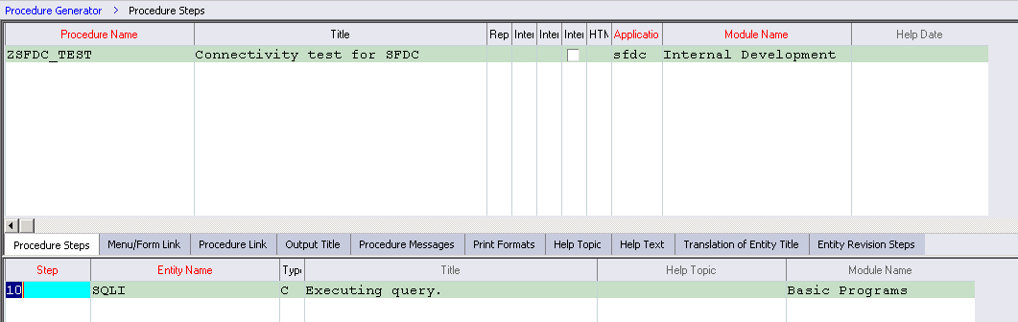
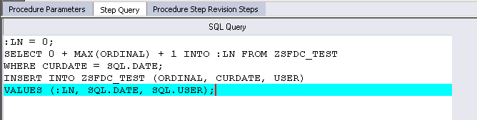
Checking everything works
Create Table – ZSFDC_TEST
CREATE TABLE ZSFDC_TEST 'Connectivity Test' 1
USER (INT,13,'UserID')
CURDATE (DATE,14,'Date')
ORDINAL (INT,13,'Line number')
UNIQUE (CURDATE,USER,ORDINAL)
;

Slide 16
The .NET Loading control
Any .NET application can include the .NET loading control
Even if that application is physically remote from the ERP

Slide 17
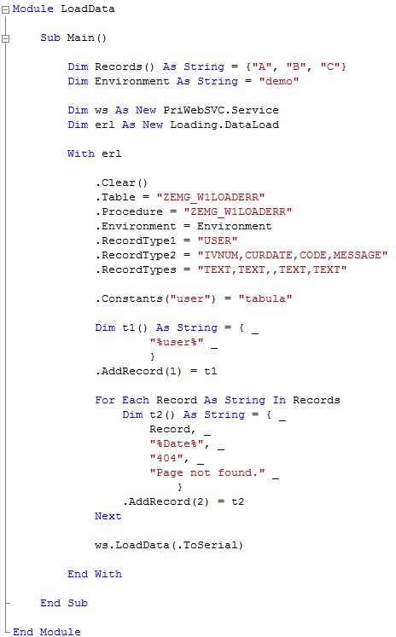
Install the loading control
Example requires .NET Visual Studio Installed
ftp://simon.emerge-it.co.uk/
/Components
/LoadData
/Version3
/win32
/setup
/v3Loading
/Debug

Slide 18
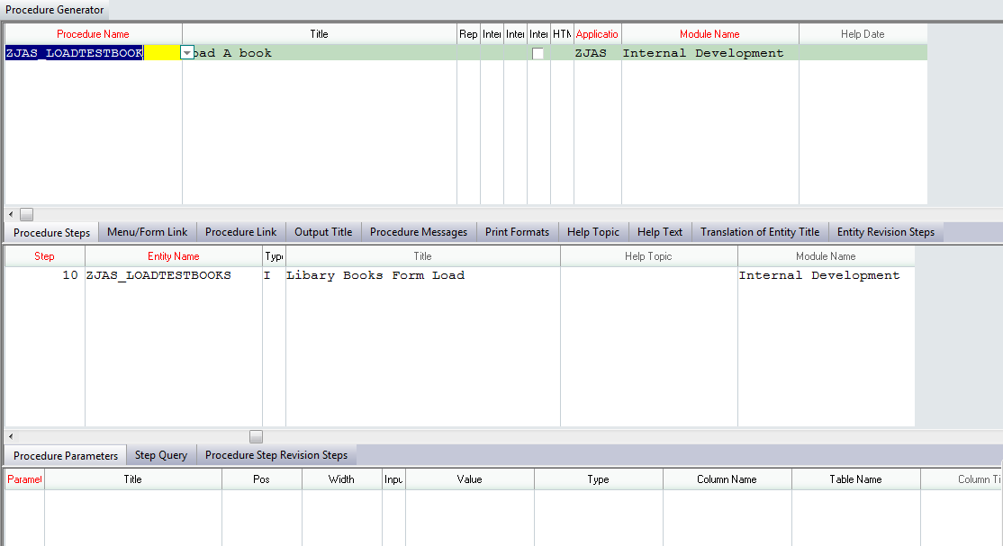
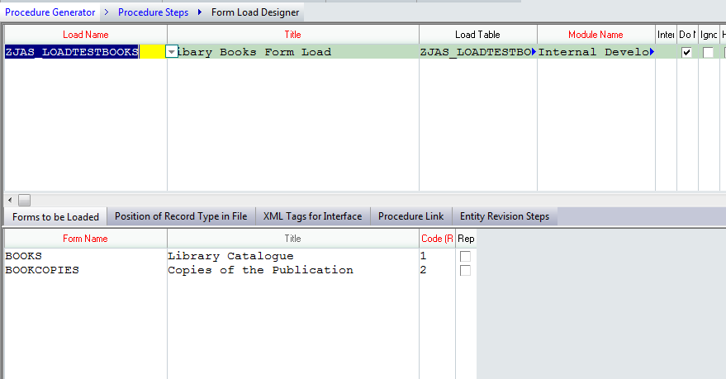
Create your own
remote loadings
CREATE TABLE ZJAS_LOADTESTBOOKS _
'Libary load test Books' 1
RECORDTYPE (CHAR,3,'Record Type')
LINE (INT,17,'Ln')
LOADED (CHAR,1,'Loaded?')
KEY1 (CHAR,20,'Key1')
KEY2 (CHAR,20,'Key2')
KEY3 (CHAR,20,'Key3')
BUBBLEID (CHAR,40,’Transaction ID’)
TITLE (CHAR,48,'TITLE')
AUTHOR (CHAR,32,'AUTHOR')
CATNUM (INT,13,'CATALOGUE NUMBER')
COPY (INT,7,'COPY (NUMBER)')
REMARK (CHAR,32,'REMARK')
UNIQUE (LINE)
;

