Slide 1


Slide 2

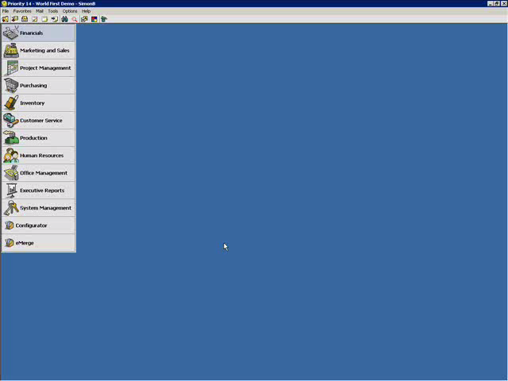
Create a payment by bank transfer, selecting the vendor to pay.
PDA Configuration
Service users and warehouses setup within Priority are assigned to the PDA.

Slide 3
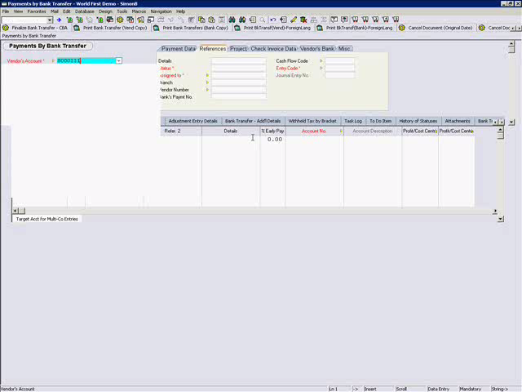
Select World First as the paying bank account

Slide 4
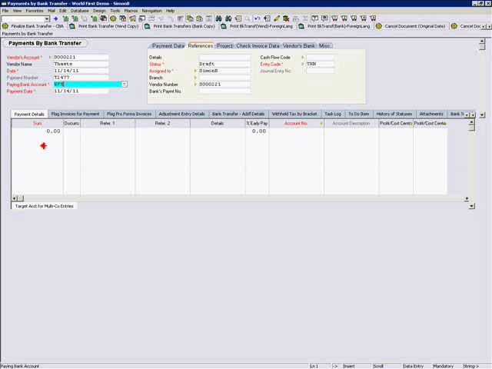
Select the payment date, Priority warns that a transaction between two currencies will take place.

Slide 5
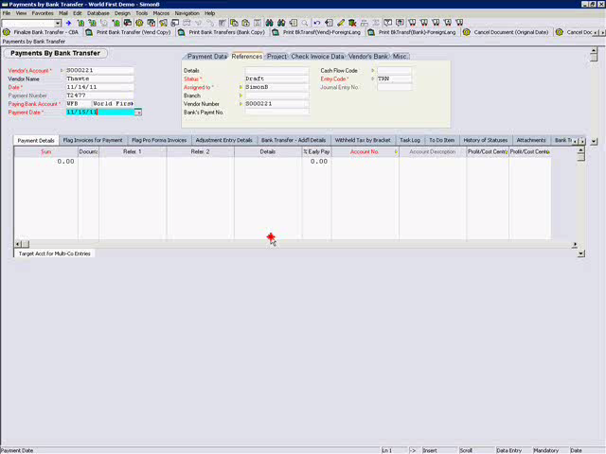
On the flag invoices for payment sub level form, flag the invoices for payment

Slide 6
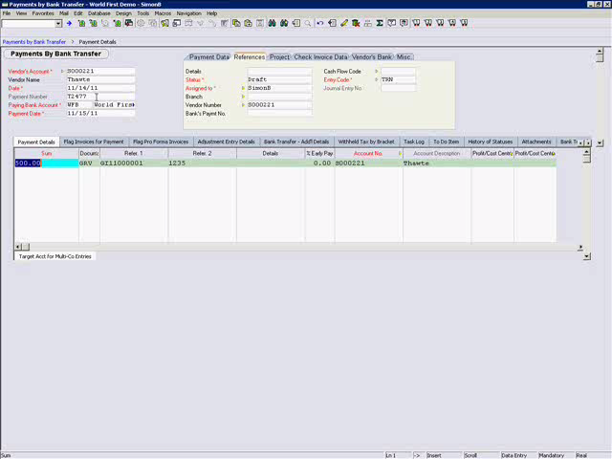
Run the World First Payments direct activation

Slide 7
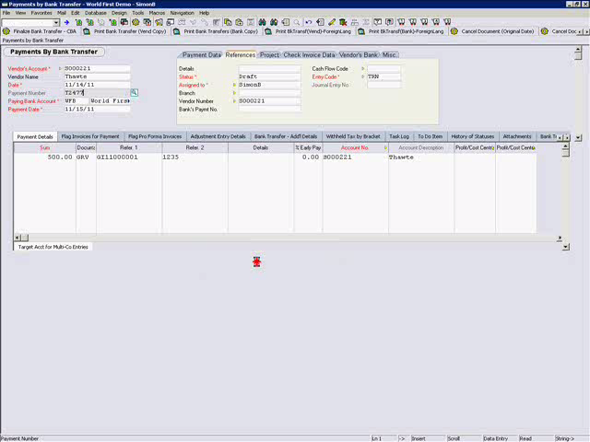
Enter the account password, Priority contacts World First and gets an exchange rate

Slide 8
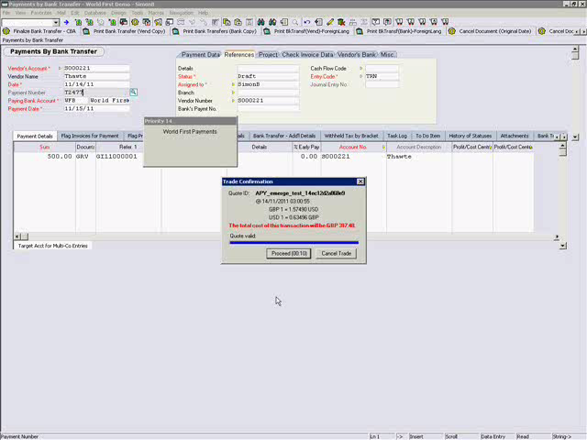
You get a quote and can confirm it if you are happy

Slide 9
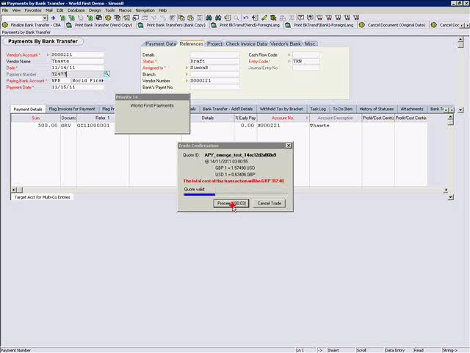
The transaction was successful - click the link for full remittance advice.

Slide 10

The World First transaction ID is recorded against the vendors invoice.

Slide 11
A simple demo – for a simple solution...
Secure currency transactions
Seamlessly integrated directly into Priority
Highly competitive rates
Excellent back office functionality provided by World First

