Slide 1

AL-FARABI KAZAKH NATIONAL UNIVERSITY
Faculty of Information Technologies and Artificial Intelligence
Adaptive Hybrid Recommendation
System with Context-Aware Attention Fusion
Discovery & Fix of Attention Gate Mode Collapse in Component-Level Fusion
Master's Candidate
Zhumakhan Medet
Scientific Advisor
Bektemessov Amanzhol
Educational Program
7M06116 — Computer Science and Technology
Dataset
Amazon Reviews 2018 Electronics · 728K users · 6.7M interactions

Slide 2
CONTEXT & PROBLEM STATEMENT
Context & Problem Statement
Why Single-Paradigm Recommenders Fail in Production E-Commerce
Heterogeneous User Signals
E-commerce platforms generate three distinct interaction signals — long-term preferences, session dynamics, and item content — but classical methods exploit only one of these signals at a time, leaving the others on the table.
Cold-Start, Drift, and Sparsity
Collaborative filtering degrades on new users (cold-start); content-based methods produce overly homogeneous recommendations; sequential models neglect long-term preferences. Each paradigm has its niche failure mode.
Conventional Fusion Limitations
Most hybrid recommenders use fixed-weight fusion (concatenation, averaging, weighted sum). Such static strategies cannot adapt to varying user contexts — a weekday-morning shopper has different needs than a weekend-evening browser.
Research Gap
Context-aware adaptive fusion at the component level remains underexplored. The present work fills this gap and, in doing so, surfaces a previously unreported failure mode that motivates the principal contribution.
Adaptive Hybrid RecSys · Mode Collapse Discovery
Slide 2 of 9

Slide 3
DATASET & PREPROCESSING
Dataset & Preprocessing
Amazon Reviews 2018 Electronics — Large-Scale Real-World Benchmark
728,489
K-Core Filtering
Iteratively removes users/items with fewer than 5 interactions until convergence. Applied as a verification layer on top of Amazon's pre-filtered 5-core subset.
users
159,729
Temporal 70/15/15 Split
Global timestamp ordering; train on the past, test on the future. Prevents temporal data leakage and simulates production deployment conditions.
items
6,737,580
Three Feature Streams
TF-IDF item content (5,000-d sparse), padded user sequences (max length 50), and 5-dimensional temporal context (hour, day-of-week, weekend indicator) — one per recommendation signal.
interactions
5.79 × 10⁻⁵
Engineering Win
TF-IDF densified as fp16 tensor on GPU (1.6 GB) for O(1) item lookup, eliminating per-sample sparse-to-dense conversion bottleneck.
sparsity
Adaptive Hybrid RecSys · Mode Collapse Discovery
Slide 3 of 9

Slide 4
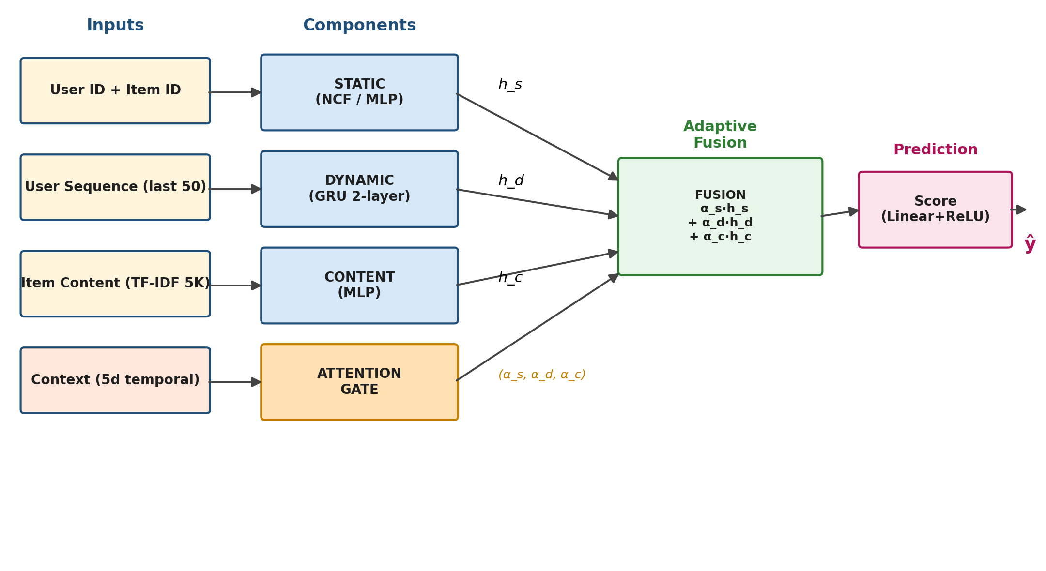
MODEL ARCHITECTURE
Model Architecture
Three Components Fused via Context-Aware Attention Gate
STATIC
Neural Collaborative Filtering — user & item embeddings (d=64) + MLP. Captures long-term preferences.
DYNAMIC
2-layer GRU (hidden 128) on padded item sequences (max 50). Models session-level dynamics.
CONTENT
MLP [5000→512→256→64] over TF-IDF features. Addresses cold-start scenarios.
GATE
Small NN: 5-d context → softmax(α_s, α_d, α_c). The adaptive fusion mechanism.
TOTAL PARAMETERS 69,986,372
Adaptive Hybrid RecSys · Mode Collapse Discovery
Slide 4 of 9

Slide 5
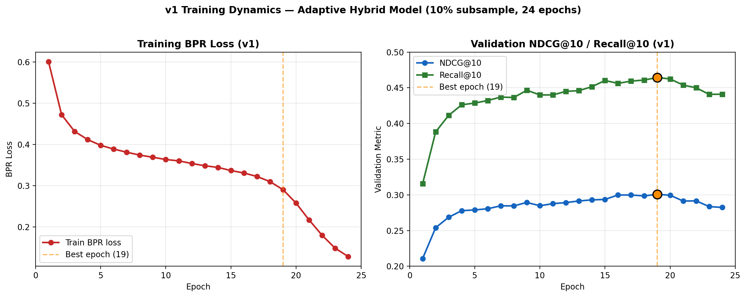
TRAINING & v1 RESULTS
Training Procedure & v1 Results
Full-Data Training Achieves NDCG@10 = 0.2807
TEST NDCG@10
0.2807
TEST RECALL@10
0.4384
BPR Loss + Adam (lr 1e-3, cosine)
30-epoch schedule, batch 2048, mixed-precision fp16 autocast + GradScaler on NVIDIA T4 GPU.
Best Val at Epoch 27 (0.3221)
Sampled-negative eval (1 pos vs 99 random negatives), following NCF and SASRec protocols.
Engineering Win — 50× Speedup
Vectorized batch evaluation + GPU-resident TF-IDF + optimized negative sampling → 75 min full-data training.
Healthy Generalization Gap
Val 0.3221 → Test 0.2807 (~13% drop), within normal range for recommender system experiments.
Adaptive Hybrid RecSys · Mode Collapse Discovery
Slide 5 of 9

Slide 6
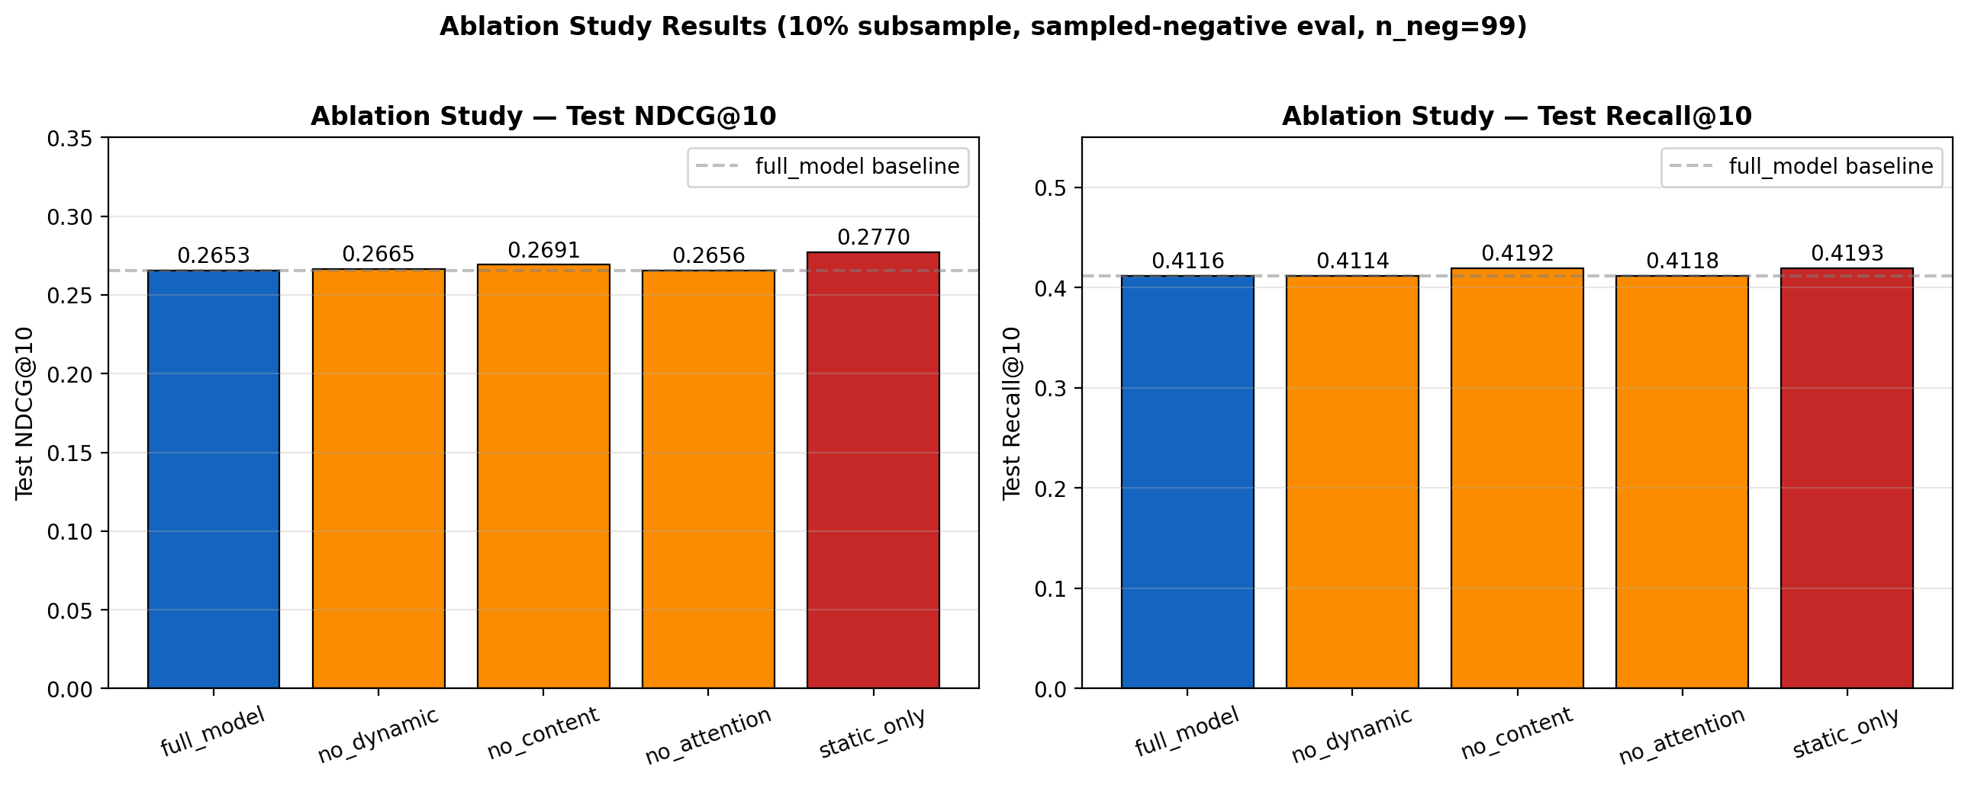
ABLATION STUDY
Ablation Study — An Unexpected Result
All Five Variants Cluster Within Experimental Noise
Variant
NDCG@10
Δ vs full
full_model
0.2653
baseline
no_dynamic
0.2665
+0.4%
no_content
0.2691
+1.4%
no_attention
0.2656
+0.1%
static_only
0.2770
+4.4% ⚠
⚠ KEY OBSERVATION static_only achieves NDCG@10 = 0.2770, marginally exceeding the full hybrid (0.2653). All five variants lie within a 0.27 ± 0.01 band — differences are statistically indistinguishable from experimental noise. This violates the architectural hypothesis: if components contribute, removing them should hurt. Something is masking the auxiliary modules.
Adaptive Hybrid RecSys · Mode Collapse Discovery
Slide 6 of 9

Slide 7
DIAGNOSTIC — MODE COLLAPSE
Per-Segment Diagnostics Reveal Mode Collapse
α_static ≈ 0.99 Across All User Segments — Components Masked at Inference
Stratified Per-Bucket Evaluation
Test users partitioned by training-history length: cold-start (≤3 interactions), warm (4-10), hot (11-30), super-hot (>30). 2,000 users per bucket.
User Segment
α_static
α_dyn
α_content
cold-start (≤3)
0.989
0.005
0.005
Critical Finding
Average attention weights extracted at inference revealed α_static ≈ 0.989 in every single bucket — dynamic and content components received < 1% weight and were effectively ignored.
warm (4-10)
0.989
0.005
0.005
hot (11-30)
0.989
0.005
0.005
super-hot (>30)
0.989
0.005
0.005
Connection to MoE Literature
Analogous to gating collapse documented in mixture-of-experts research (Shazeer et al., 2017). First reported instance for component-level attention fusion in recommender systems.
Gate is degenerate: identical attention regardless of user context.
Diagnosis Complete
~67M dynamic + content parameters trained but masked at inference. The 'hybrid' model behaved as pure NCF, explaining the ablation null result.
Adaptive Hybrid RecSys · Mode Collapse Discovery
Slide 7 of 9

Slide 8
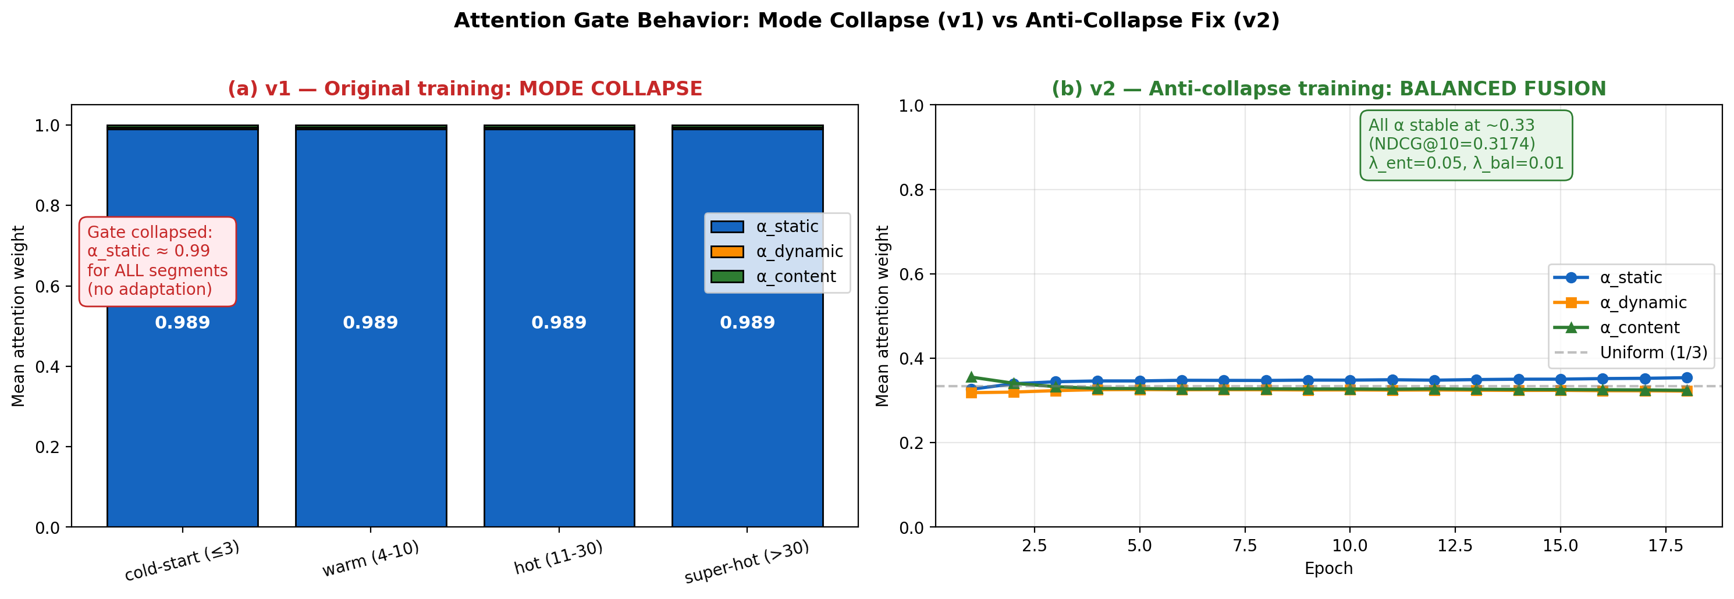
ANTI-COLLAPSE FIX — v2
Anti-Collapse Training (v2)
Entropy Regularization + Load Balancing Restore Component Fairness
L = L_BPR + λ_ent · (-H(α)) + λ_bal · ‖α̅ − 1/3‖² (λ_ent = 0.05, λ_bal = 0.01)
v1 — COLLAPSED
NDCG@10 = 0.2807
α = (0.989, 0.005, 0.005)
v2 — BALANCED
NDCG@10 = 0.2749
α = (0.349, 0.324, 0.326)
PARETO TRADE-OFF DOCUMENTED · 2.1% NDCG@10 cost → genuine three-component utilization with entropy = log(3) at its theoretical maximum
Adaptive Hybrid RecSys · Mode Collapse Discovery
Slide 8 of 9

Slide 9
CONCLUSION & FUTURE WORK
Conclusion & Future Work
Primary Contribution: Discovery, Diagnosis, and Validated Fix of a Novel Failure Mode
PRIMARY CONTRIBUTIONS
FUTURE WORK
Adaptive Hybrid Architecture
Three components (NCF + GRU + TF-IDF MLP) fused via context-aware attention gate, evaluated on 6.7M-interaction Amazon Electronics benchmark.
1.
Hyperparameter sweep over (λ_ent, λ_bal) to map the fairness-performance Pareto frontier.
2.
Noisy top-k gating (Shazeer et al., 2017) as alternative regularization.
Mode Collapse Discovery
First reported instance of MoE-style gating collapse for component-level attention fusion in recommender systems.
3.
Full-rank evaluation against all 159,729 candidates (no sampled negatives).
4.
Re-ablation on v2 where components are no longer masked.
Validated Anti-Collapse Fix
Entropy regularization + load-balancing penalty restore balanced fusion (α ≈ 1/3 each) at a documented 2.1% NDCG cost.
5.
TF-IDF → BERT content embeddings, MovieLens 25M cross-domain validation.
6.
Production deployment via FastAPI + Redis-cached embeddings.
Engineering Throughput
50× speedup pipeline enables full-data training on free Colab T4 in 75 minutes — accessible reproducibility.
Thank you for your attention. · Open source: github.com/Medeeet/rec-sys · MIT License
Adaptive Hybrid RecSys · Mode Collapse Discovery
Slide 9 of 9

