Slide 1
JUNIOR GOLF · USKIDS · LONGLEAF
Golf Courses in
Northern Portugal
Where could we host USKids Golf tournaments? Every course in the region — with official links, Course Rating, Slope and full tee distances (metres & yards), measured against the USKids Longleaf Tee System.
14 venues surveyed · 5 full 18-hole courses
Minho · Greater Porto · Douro · Trás-os-Montes — compiled June 2026

Slide 2
The landscape at a glance
Roughly a dozen courses sit in the Norte de Portugal region. Because USKids builds its own tees per age group (the Longleaf system, next slides), a course's own tee markings don't decide suitability — what matters is total available length and whether it runs as 9 or 18 holes.
18-HOLE CHAMPIONSHIP
9-HOLE COURSES
PAR-3 / PITCH & PUTT
ADJACENT (CENTRO)
5
4
3
1
Oporto · Estela · Amarante · Vidago Palace · Áxis Ponte de Lima
Miramar · Quinta da Barca · Vale Pisão · Rilhadas
Quinta do Fojo · CityGolf Porto · Aviz
Montebelo, Viseu — 27 holes, just outside Norte
Distances are given in both metres and yards. CR/Slope from the Federação Portuguesa de Golfe / DataGolf feed, club scorecards and the Albrecht Golf Guide; “n/p” = not published.

Slide 3
How USKids sets up a course — the Longleaf Tee System
USKids does not use the host course's existing tees. For every event it lays its own Longleaf tees so each age group plays a length matched to how far the kids actually drive the ball. A venue therefore only needs enough total length and the right 9- or 18-hole routing.
Tee | Driver carry (yd) | 9-hole (yd) | 18-hole (yd)
8 | 275 · PGA Tour | 3600–3900 | 7200–7800
7 | 250 | 3300–3600 | 6600–7200
6 | 225 · LPGA Tour | 3000–3300 | 6000–6600
5 | 200 | 2700–3000 | 5400–6000
4 | 175 | 2400–2700 | 4800–5400
3 | 150 | 2100–2400 | 4200–4800
2 | 125 | 1800–2100 | 3600–4200
1 | 100 | 1500–1800 | 3000–3600
RS | 75 · Right Start | 1200–1500 | 2400–3000
9 tees
from Right Start (75 yd carry) up to Tee 8 (PGA Tour, 275 yd carry)
Set by carry
tee length tracks each player's driver carry distance, not the course's markers
9 or 18
younger groups play a 9-hole loop; older groups play 18 holes
Longleaf Tee System, USKids Golf (2024). Distances in yards.

Slide 4
Longleaf course setup by age group
Recommended 18- and 9-hole lengths (yards). Local Tour runs 18 holes from Boys 11 up; World events stretch the same groups longer and run 18 holes from Boys 9 up. Younger groups play 9-hole loops.
LOCAL TOUR
WORLD & WORLD TEEN
Age group | Length (yd) | Holes
Boys 15–18 | 6600–6900 | 18
Boys 13–14 | 6000–6300 | 18
Boys 12 | 5400–5700 | 18
Boys 11 | 4800–5100 | 18
Boys 10 | 2400–2550 | 9
Boys 9 | 2100–2250 | 9
Boys 8 | 1800–1950 | 9
Boys 7 | 1500–1650 | 9
Boys 6 & U | 1200–1350 | 9
Age group | Length (yd) | Holes
Boys 15–18 | 6800–7100 | 18
Boys 14 | 6300–6600 | 18
Boys 13 | 6000–6300 | 18
Boys 12 | 5700–6000 | 18
Boys 11 | 5400–5700 | 18
Boys 10 | 4900–5200 | 18
Boys 9 | 4400–4700 | 18
Boys 8 | 1950–2100 | 9
Boys 7 | 1650–1800 | 9
Boys 6 & U | 1350–1500 | 9
Figures are the published boys' setups; girls' age groups play roughly one bracket shorter. Source: USKids Golf Longleaf Tee System (2024).

Slide 5
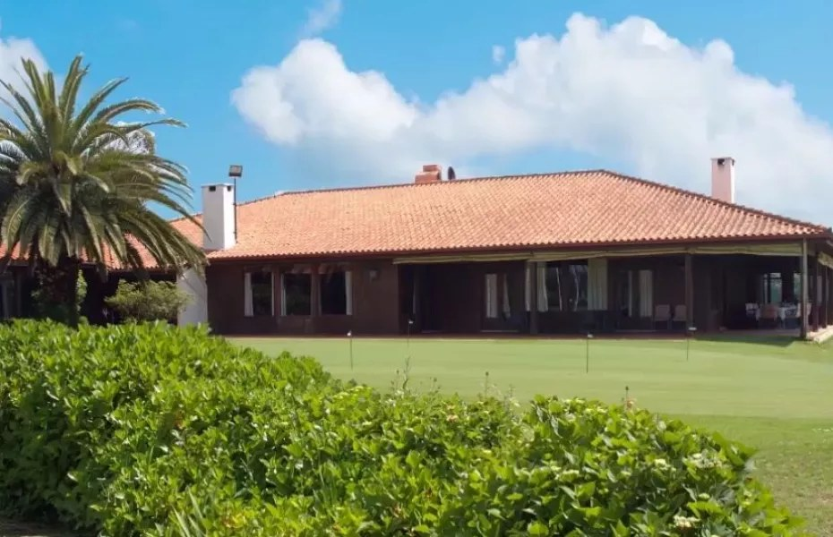
18 HOLES · CHAMPIONSHIP
Oporto Golf Club
Espinho (Paramos) · 18 holes · Par 71 · est. 1890
The oldest golf club in Portugal and the Iberian Peninsula. An authentic, exposed seaside links — flat and very walkable for juniors.
Tee | Par | Metres | Yards | CR ♂ | Slp ♂ | CR ♀ | Slp ♀
Black | 71 | 5692 | 6225 | 70.8 | 132 | — | —
White | 71 | 5640 | 6168 | 70.5 | 131 | — | —
Yellow | 71 | 5408 | 5914 | 69.4 | 129 | 75 | 135
Red | 71 | 4969 | 5434 | 67.2 | 124 | 72.4 | 129
Green | 71 | 3639 | 3980 | 62 | 114 | 64.3 | 112
Purple | 71 | 3000 | 3281 | 60 | 107 | 61 | 107
Hosting 18-hole links; historic members' club — visitor/event access by arrangement. ~6,200 yd footprint reaches Local Tour groups up to Boys 13–14.
Oporto Golf Club — links beside the Espinho dunes
Official site: oportogolfclub.com
CR/Slope: GolfPass / FPG-DataGolf feed. Yards converted from metres.

Slide 6
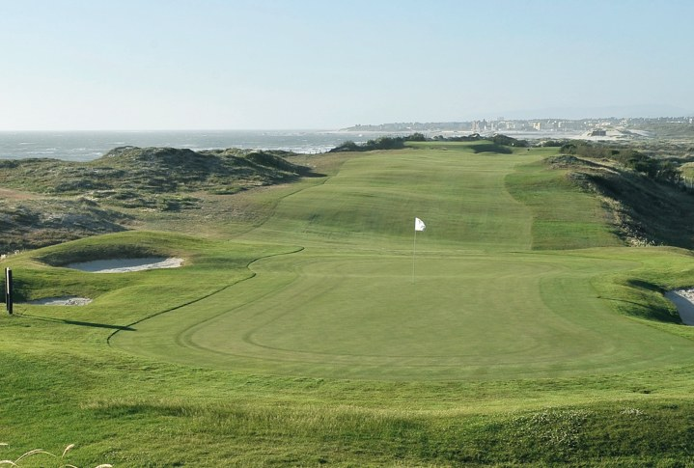
18 HOLES · CHAMPIONSHIP
Estela Golf Club
Póvoa de Varzim · 18 holes · Par 72 · 1988
A true seaside links along the Atlantic, repeatedly voted among Portugal's best. Flat and walkable, but wind-exposed.
Tee | Par | Metres | Yards | CR ♂ | Slp ♂ | CR ♀ | Slp ♀
White | 72 | 6148 | 6724 | 72.7 | 131 | — | —
Yellow | 72 | 5875 | 6425 | 72.3 | 130 | — | —
Blue | 72 | 5875 | 6425 | — | — | 78.8 | 133
Red | 72 | 5254 | 5746 | — | — | 75.2 | 126
Hosting 18-hole links, public/resort. ~6,700 yd footprint reaches the oldest groups (Boys 15–18). Ideal flagship venue near Porto.
Estela Golf Club — 3 km of Atlantic links
Official site: estelagolf.pt
CR/Slope: GolfPass / FPG-DataGolf feed; estelagolf.pt confirms White 6148 m, Par 72.

Slide 7
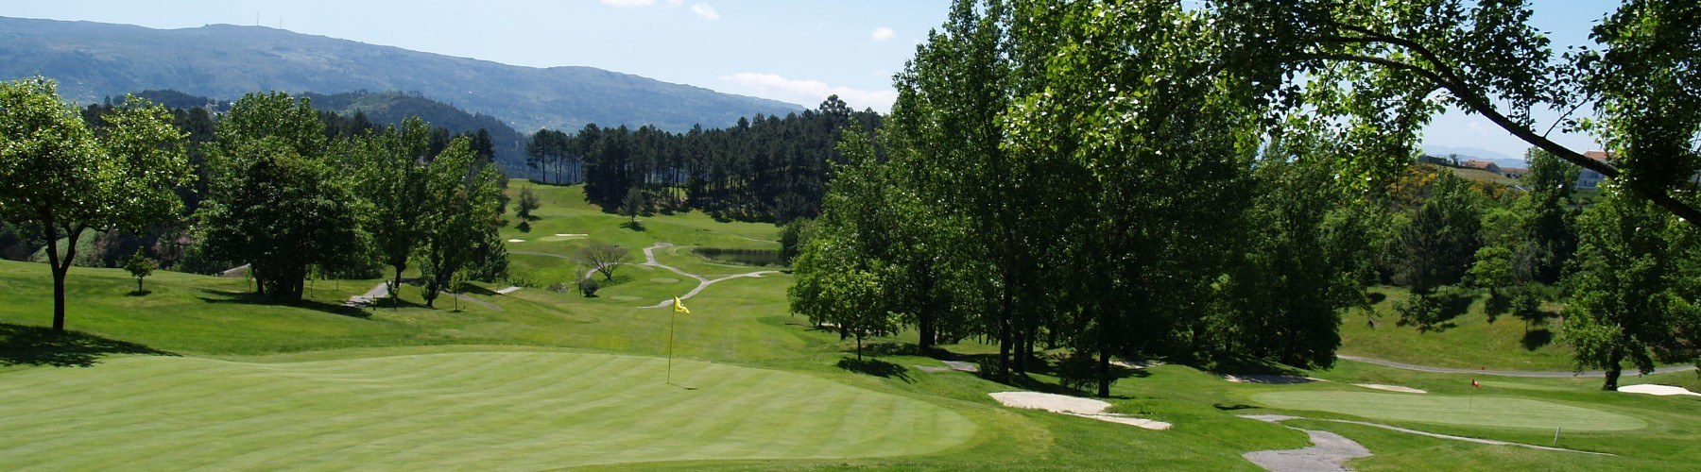
18 HOLES · CHAMPIONSHIP
Golfe de Amarante
Amarante · 18 holes · Par 68 · 1997 · J. Santana da Silva
A compact, hilly mountain course backed by the Marão range. Buggies advised for the youngest age groups.
Tee | Par | Metres | Yards | CR ♂ | Slp ♂ | CR ♀ | Slp ♀
White ♂ | 68 | 5030 | 5501 | 66.1 | 120 | — | —
Yellow ♂ | 68 | 4604 | 5035 | 64.3 | 117 | — | —
Red ♀ | 68 | 4089 | 4472 | — | — | 65.6 | 118
Hosting 18-hole, public. ~5,500 yd footprint reaches Local Tour Boys 12; comfortable for all younger groups.
Golfe de Amarante — mountain course at ~600 m
Official site: golfedeamarante.com
CR/Slope: Albrecht Golf Guide (1golf.eu). Yards converted from metres.

Slide 8

18 HOLES · CHAMPIONSHIP
Vidago Palace Golf Course
Vidago, Chaves · 18 holes · Par 72 · 1936 / rebuilt 2010
Originally laid out by Mackenzie Ross (1936), rebuilt to USGA spec in 2010 inside the historic Vidago Palace estate. Sloping parkland.
Tee | Par | Metres | Yards | CR ♂ | Slp ♂ | CR ♀ | Slp ♀
White ♂ | 72 | 6308 | 6898 | 73.8 | 141 | — | —
Yellow ♂ | 72 | 5903 | 6456 | 71.7 | 137 | — | —
Blue ♀ | 72 | 5454 | 5965 | — | — | 75.3 | 135
Red ♀ | 72 | 4797 | 5246 | — | — | 71.3 | 126
Hosting 18-hole resort/championship, public. ~6,900 yd footprint reaches Boys 15–18. Pair with a Vidago Palace stay for a destination event.
Vidago Palace Golf — championship parkland, Chaves
Official site: vidagopalace.com
CR/Slope: Albrecht Golf Guide (1golf.eu). Yards converted from metres.

Slide 9
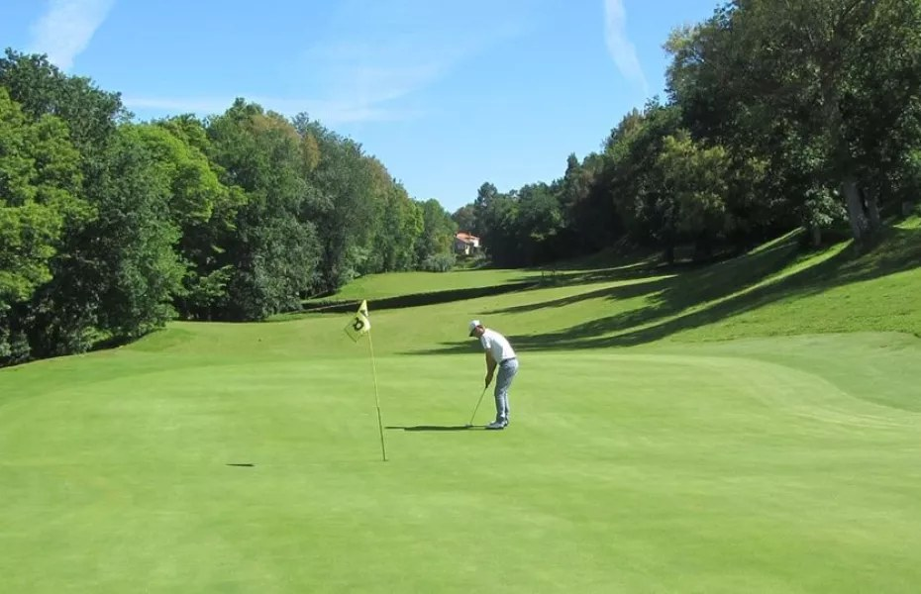
18 HOLES · CHAMPIONSHIP
Áxis Golfe Ponte de Lima
Ponte de Lima · 18 holes · Par 71 · 1995 · on-site hotel
A resort course in the green heart of the Minho — hilly front nine, flatter back nine, with a hotel on site for travelling fields.
Tee | Par | Metres | Yards | CR ♂ | Slp ♂ | CR ♀ | Slp ♀
White ♂ | 71 | 6005 | 6567 | 70.4 | 133 | — | —
Yellow ♂ | 71 | 5653 | 6182 | 68.8 | 129 | — | —
Blue | 71 | 5478 | 5991 | 68.1 | 128 | 73.7 | 131
Red | 71 | 4719 | 5161 | 64.7 | 121 | 69.4 | 122
Green | 71 | 3951 | 4321 | 63.6 | 119 | 67.3 | 117
Purple | 71 | 2996 | 3276 | 60.6 | 111 | 62 | 107
Hosting 18-hole resort, public, with hotel. ~6,600 yd footprint reaches Local Tour Boys 13–14. Good base for multi-day junior events.
Áxis Golfe Ponte de Lima — wooded valley, Minho
Official site: axisgolfe.com
CR/Slope: GolfPass / FPG-DataGolf feed; official scorecard at axisgolfe.com.

Slide 10
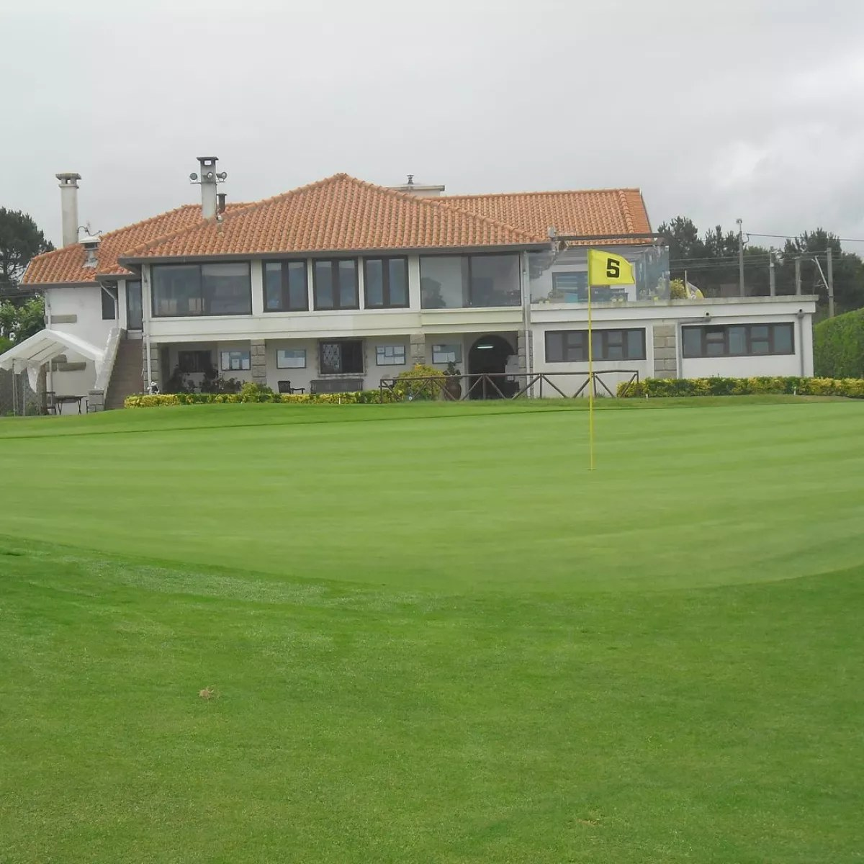
9 HOLES · SEASIDE
Club de Golf de Miramar
Arcozelo, V. N. de Gaia · 9 holes · Par 35 · 1932 (private)
One of Portugal's oldest clubs (Mackenzie Ross, 1932). A short, characterful seaside nine — distances below are for the 18-hole round (played twice).
Tee | Par | Metres | Yards | CR ♂ | Slp ♂ | CR ♀ | Slp ♀
White | 70 | 5518 | 6035 | 70 | 123 | — | —
Yellow | 70 | 5292 | 5787 | 68.4 | 120 | — | —
Blue | 70 | 5292 | 5787 | — | — | 73.7 | 125
Red | 70 | 4786 | 5234 | — | — | 71.4 | 120
Distances & par shown for 18 holes (9-hole course played twice).
Hosting 9-hole seaside, private members' club — arrange access early. Two loops ≈ 6,000 yd (hosts up to Boys 13–14); single loop for the youngest.
Club de Golf de Miramar — seaside 9 at Gaia
Official site: golfpass.com/…/miramar-golf-club
CR/Slope (18-hole): GolfPass / FPG-DataGolf feed. Club site cgm.pt — verify before booking.

Slide 11
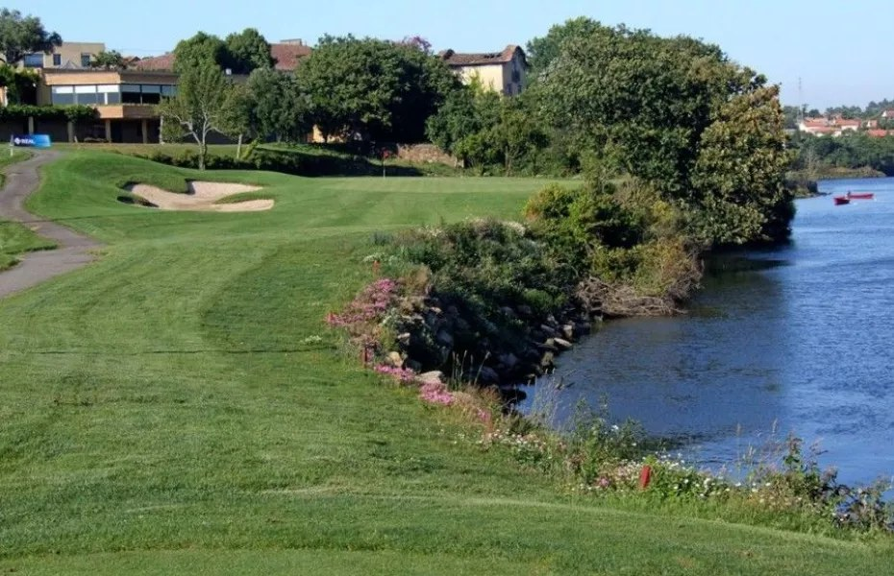
9 HOLES · RESORT
Golfe Quinta da Barca
Barca do Lago, Esposende · 9 holes · Par 31 · 1997
A short, flat resort nine (five par-3s, four par-4s) by the Cávado estuary — one of the most accessible layouts in the North. Distances below are the 18-hole loop.
Tee | Par | Metres | Yards | CR ♂ | Slp ♂ | CR ♀ | Slp ♀
White | 62 | 3854 | 4215 | 61.1 | 103 | — | —
Yellow | 62 | 3494 | 3821 | 59.3 | 100 | 62.9 | 103
Red | 62 | 3066 | 3353 | — | — | 64.4 | 98
Distances & par shown for 18 holes (9-hole course played twice, Par 62).
Hosting 9-hole resort, public; flat. Short footprint (~Boys 10 & under) — an ideal first-tournament and academy venue.
Golfe Quinta da Barca — flat resort 9, Esposende
Official site: facebook.com/quintadabarca
CR/Slope: GolfPass / FPG-DataGolf feed (18-hole loop). Resort site only.

Slide 12
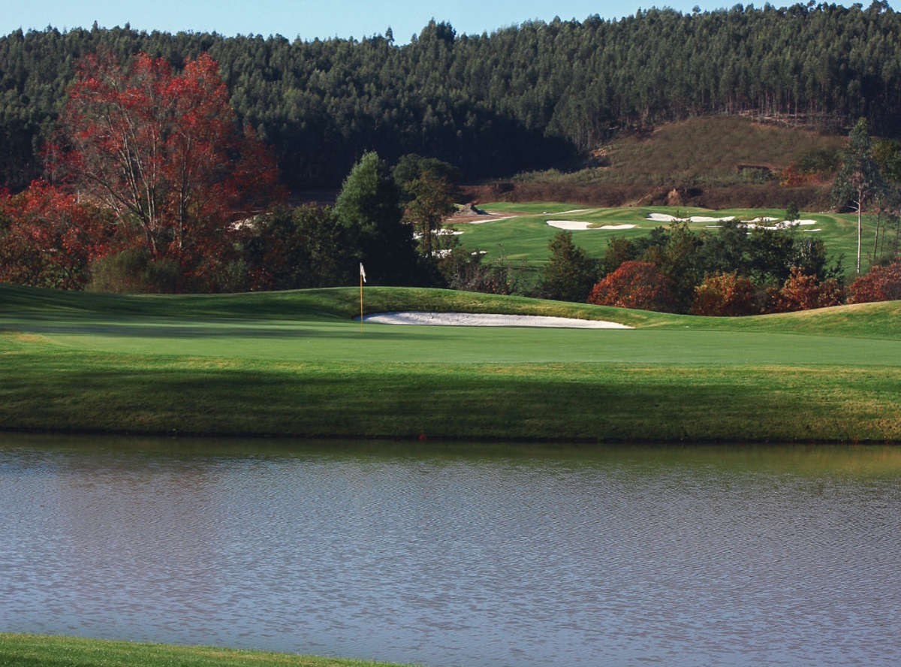
9 HOLES · RESORT
Clube Golfe Vale Pisão
Santo Tirso · 9 holes · Par 37 · 2002 · ~25 min from Porto
A wooded parkland nine on a nature resort (Santana da Silva). Played twice it makes a full-length 18-hole round of Par 74 — among the longest footprints in the North.
Tee / round | Par | Metres | Yards
9 holes | 37 | 3266 | 3572
18 holes (two loops) | 74 | 6532 | 7143
CR / Slope not published. Per-tee distances not published; totals shown.
Hosting 9-hole parkland resort, public. Two-loop length (~7,100 yd) easily reaches the oldest age groups.
Clube Golfe Vale Pisão — wooded resort 9, Santo Tirso
Official site: golfevalepisao.pt
Length: Albrecht Golf Guide (1golf.eu). Yards converted from metres.

Slide 13
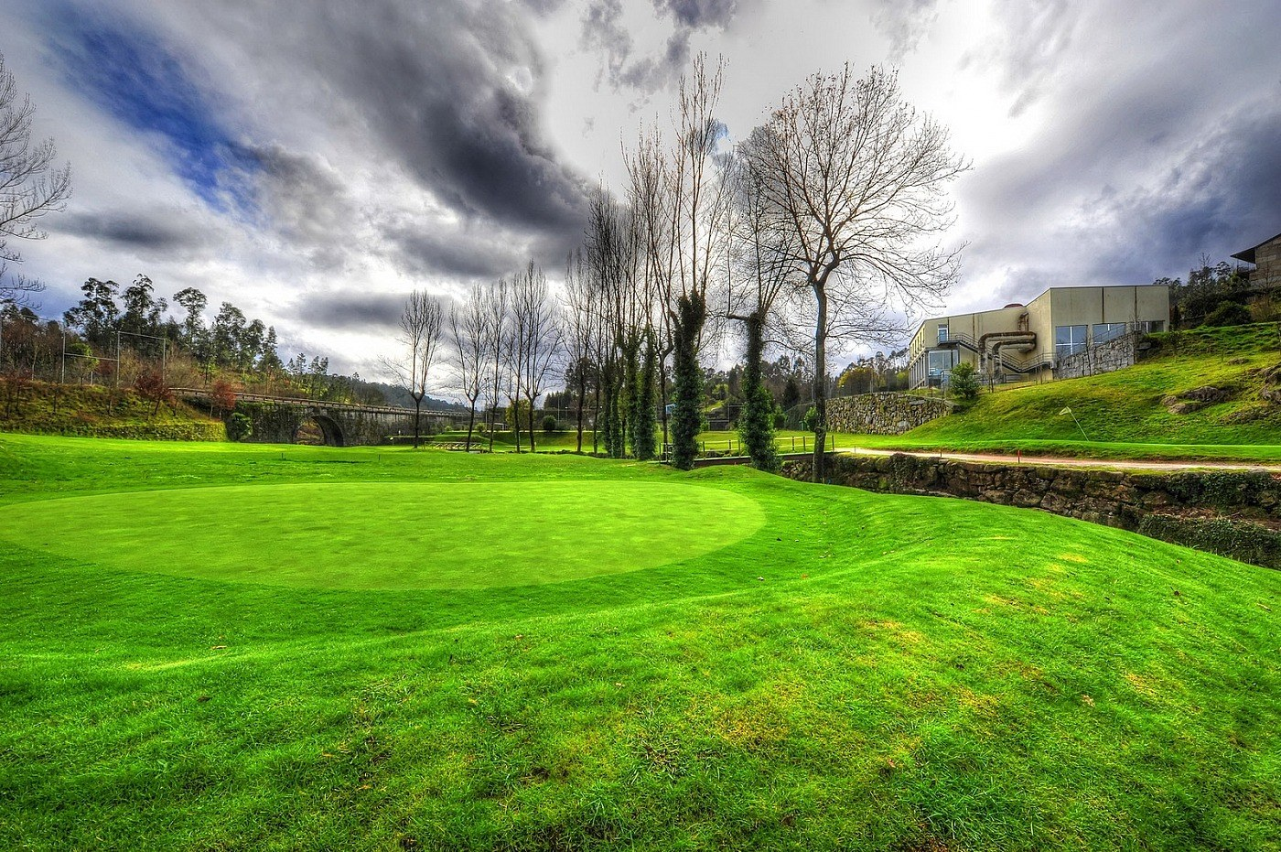
9 HOLES · RESORT
Clube de Golfe Rilhadas
Cepães, Fafe · 9 holes · Par 60 (18) · 2008 · J. Lencastre
A short, flat nine (six par-3s, three par-4s) along the Vizela river, within a leisure resort with a separate pitch & putt. Distances below are the 18-hole round.
Tee / round | Par | Metres | Yards
White | 60 | 3416 | 3736
Yellow | 60 | 3144 | 3438
Blue | 60 | 3036 | 3320
Red | 60 | 2730 | 2986
Distances & par shown for 18 holes (9-hole course played twice). CR / Slope not published.
Hosting 9-hole resort, public; flat and very walkable. Short footprint — best for the youngest 9-hole age groups (≈Boys 9 & under).
Clube de Golfe Rilhadas — flat riverside 9, Fafe
Official site: rilhadas.com
Length: portugalgolf.net. Yards converted from metres.

Slide 14
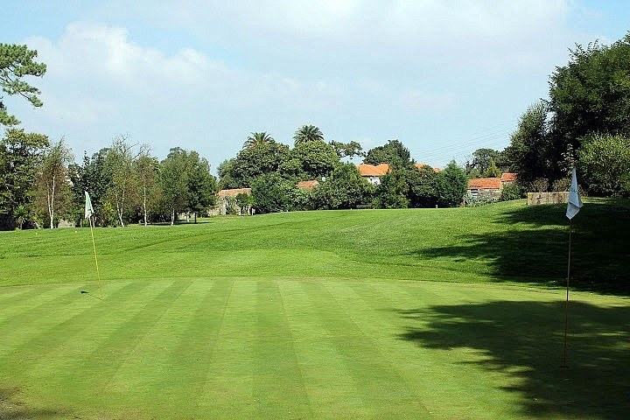
PAR-3 · ACADEMY
Quinta do Fojo
Canidelo, V. N. de Gaia · 6 par-3 holes · 2002
A flat, very easy all-par-3 short course in Gaia (not Marco de Canaveses), playable as 6/12/18-hole loops. An academy-style venue close to Porto.
Tee / round | Par | Metres | Yards
White (18-hole loop) | 54 | 3099 | 3389
Yellow (18-hole loop) | 54 | 2937 | 3212
Six par-3 holes played as 18. CR / Slope not published.
Hosting Public academy course, flat. Suits Right Start to ~Boys 9 and clinics — not a full-field championship venue.
Quinta do Fojo — par-3 academy course, V. N. de Gaia
Official site: golfinportugal.com/golfedaquintadofojo
Length: portugalgolf.net. Yards converted from metres.

Slide 15
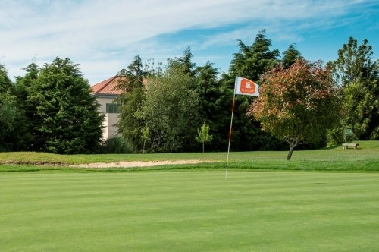
PAR-3 + P&P · URBAN
CityGolf Porto
Senhora da Hora, Matosinhos · par-3 + pitch & putt · 2005
An urban complex: a 9-hole par-3 course, an 18-hole pitch & putt, plus a driving range and putting greens — right inside the Porto metro area.
Tee / round | Par | Metres | Yards
Par-3 course (9H ×2 = 18) | 54 | 1631 | 1784
Pitch & Putt (18 holes) | — | — | —
Par-3 holes 58–145 m; Pitch & Putt holes 30–84 m. CR / Slope not published.
Hosting Public urban venue. Coaching and intro-event use for the youngest brackets / Right Start; superb practice base.
CityGolf Porto — urban par-3 & practice complex
Official site: facebook.com/citygolf.porto
Data: Hole19. Yards converted from metres.

Slide 16
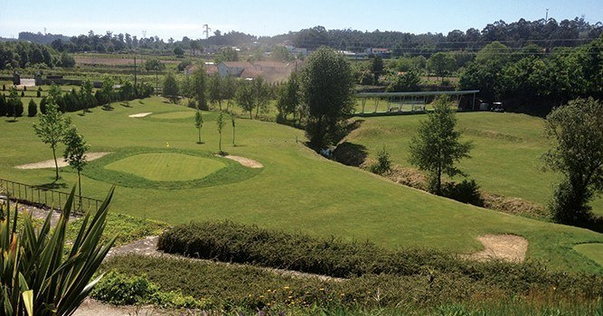
PITCH & PUTT
Aviz Golf Club
Freamunde, Paços de Ferreira · 9-hole P&P · Par 27 · 2017
A nine-hole pitch & putt, all par-3, near the Porto–Guimarães axis. Holes run 41–103 m — a compact intro and short-game venue.
Tee / round | Par | Metres | Yards
9 holes | 27 | 551 | 603
18 holes (two loops) | 54 | 1102 | 1205
All par-3 · holes 41–103 m. CR / Slope not published.
Hosting Public pitch & putt. Right Start / first-event venue and clinics for the youngest players.
Aviz Golf Club — 9-hole pitch & putt, Paços de Ferreira
Official site: avizgolfclub.com
Data: Hole19 / FPG-DataGolf record. Yards converted from metres.

Slide 17
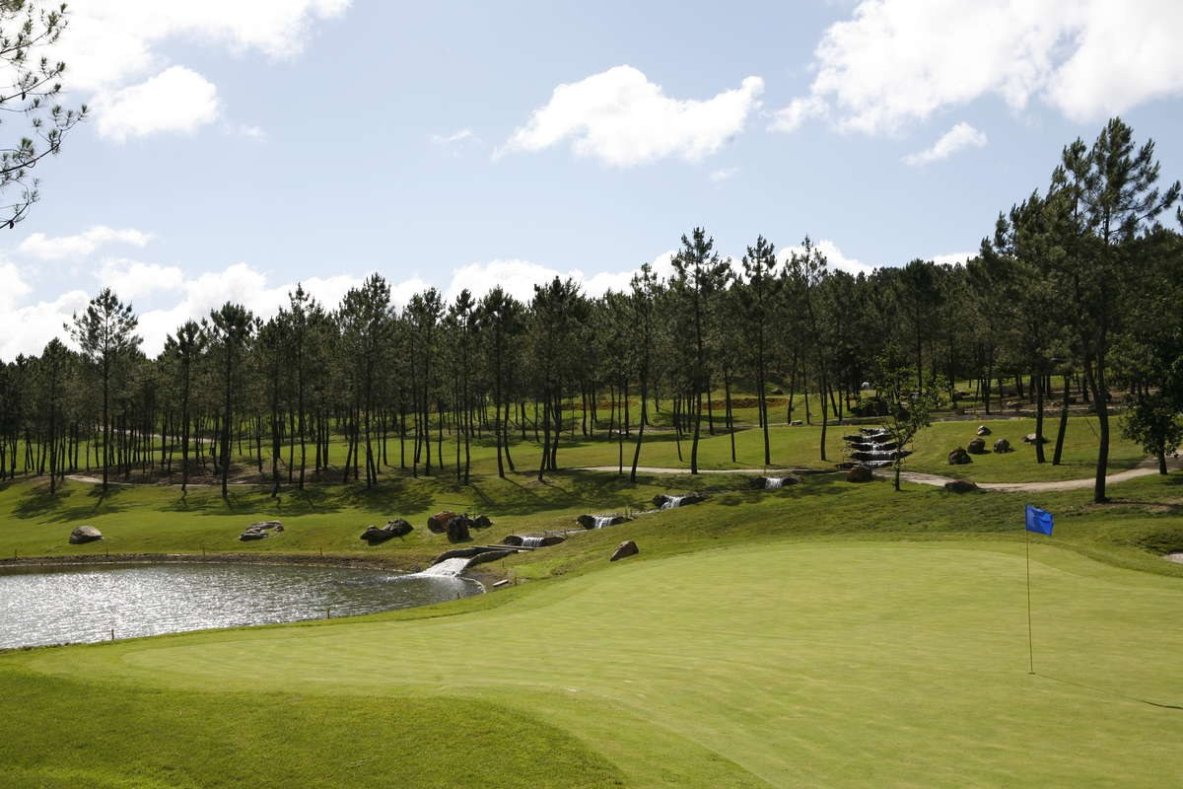
BONUS · ADJACENT (CENTRO)
Montebelo Golfe
Farminhão, Viseu · 27 holes · Par 72 · 1997 · Stilwell & Kenyon
The largest layout near the region — three interchangeable nines (Caramulo, Estrela, Buçaco). Officially Região Centro, but within reach for a Douro-Sul fixture.
Tee | Par | Metres | Yards | CR ♂ | Slp ♂ | CR ♀ | Slp ♀
White (1–18) | 72 | 6317 | 6908 | — | — | — | —
Yellow (1–18) | 72 | 5718 | 6253 | — | — | — | —
Red ♀ (1–18) | 72 | 5134 | 5615 | — | — | — | —
White (10–27) | 72 | 5924 | 6479 | — | — | — | —
Hosting 27-hole resort, public. Multiple loops can host several age groups at once; ~6,900 yd reaches Boys 15–18. Confirm CR/Slope per tee with the club.
Montebelo Golfe — 27 holes near Viseu (Centro)
Official site: montebelogolfe.pt
Length: Albrecht Golf Guide (1golf.eu). GolfPass lists Caramulo 18 at CR 74.2 / Slope 139.

Slide 18
Where can we host — capacity vs Longleaf
Full 18-hole footprint per course (9-hole courses counted as two loops) and the oldest Local Tour age group it can hold at full Longleaf yardage.
Course | Holes / Par | 18-hole (m) | 18-hole (yd) | CR | Slope | Hosts up to (Local Tour)
Vale Pisão | 9 / 37 → 18 / 74 | 6532 | 7143 | n/p | n/p | Boys 15–18 (2 loops)
Montebelo (Centro) | 27 / 72 | 6317 | 6908 | n/p | n/p | Boys 15–18
Vidago Palace | 18 / 72 | 6308 | 6898 | 73.8 | 141 | Boys 15–18
Estela | 18 / 72 | 6148 | 6724 | 72.7 | 131 | Boys 15–18
Áxis Ponte de Lima | 18 / 71 | 6005 | 6567 | 70.4 | 133 | Boys 13–14
Oporto | 18 / 71 | 5692 | 6225 | 70.8 | 132 | Boys 13–14
Miramar | 9 / 35 → 18 / 70 | 5518 | 6035 | 70.0 | 123 | Boys 13–14 (2 loops)
Amarante | 18 / 68 | 5030 | 5501 | 66.1 | 120 | Boys 12
Quinta da Barca | 9 / 31 → 18 / 62 | 3854 | 4215 | 61.1 | 103 | Boys 10 & under
Rilhadas | 9 / 30 → 18 / 60 | 3416 | 3736 | n/p | n/p | Boys 9 & under
Quinta do Fojo | 6 × par-3 | 3099 | 3389 | n/p | n/p | Right Start–Boys 9
CityGolf Porto | par-3 / P&P | 1631 | 1784 | n/p | n/p | Right Start / clinics
Aviz | 9 P&P (par-3) | 1102 | 1205 | n/p | n/p | Right Start
“Hosts up to” = oldest Local Tour group whose Longleaf 18-hole yardage fits the course's full length; USKids fine-tunes tee placement per event and 9-hole venues run single-loop events for the youngest groups. Sorted by length. Sources: FPG-DataGolf, Albrecht, GolfPass.

Slide 19
Shortlist for USKids events
FLAGSHIP 18-HOLE
Championship courses long enough to hold the oldest age groups — the right stage for a marquee or World-style event.
Vidago Palace · Estela · Oporto
EASY-ACCESS PORTO CLUSTER
A tight coastal cluster minutes apart — simple travel and lodging for a multi-venue weekend.
Estela · Miramar · Quinta da Barca · CityGolf
YOUNGEST BRACKETS & CLINICS
9-hole and par-3 / pitch-&-putt formats — perfect for Right Start and first-tournament age groups.
Quinta da Barca · Rilhadas · Fojo · Aviz · CityGolf
MULTI-GROUP / ON-SITE STAY
Extra holes or an on-site hotel — run several age groups at once or host travelling fields overnight.
Montebelo (27H) · Áxis Ponte de Lima · Vidago

Slide 20
Sources & notes
USKids Golf — Longleaf Tee System (2024)
uskidsgolf.com
Federação Portuguesa de Golfe — course / DataGolf feed
jogargolfe.fpg.pt · scoring-pt.datagolf.pt
Albrecht Golf Guide
1golf.eu
GolfPass course directory
golfpass.com/travel-advisor
Club official sites
oportogolfclub.com · estelagolf.pt · golfedeamarante.com · vidagopalace.com · axisgolfe.com · rilhadas.com · golfevalepisao.pt · montebelogolfe.pt
Hole19 & portugalgolf.net (short courses)
hole19golf.com · portugalgolf.net
Notes: distances are in metres and yards; 9-hole courses are shown as the 18-hole (two-loop) round. USKids lays its own Longleaf tees per age group, so a course's own tee markings are not used in competition — the figures here indicate each venue's overall capacity. CR/Slope “n/p” were genuinely unpublished. Confirm details with each club before scheduling.

