Slide 1



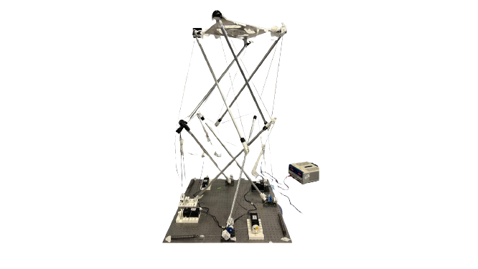

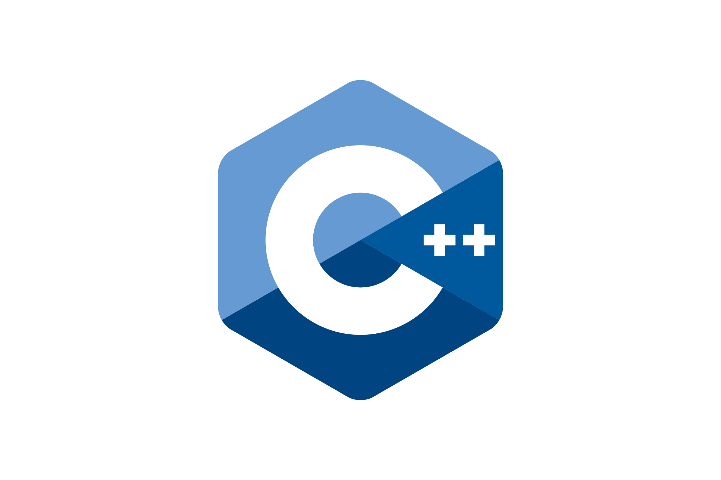
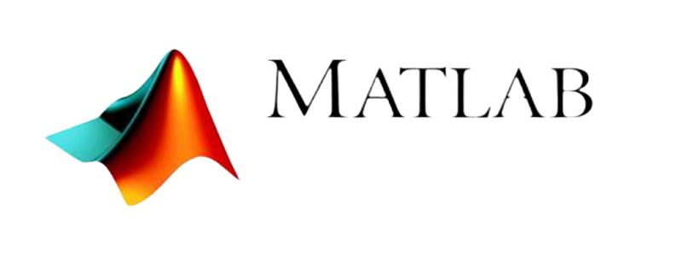



Data collection
Y = w⋅X + bias
Target
Features
OS:
Tool:
+
Output
End effector coordinates X, Y, Z
Motor positions
bagfiles
Format
csv
csv
Machine learning models

Slide 2
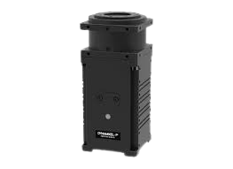
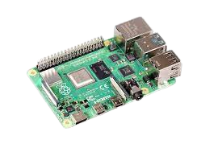
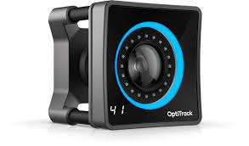

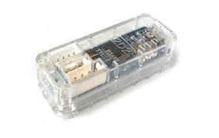
Raspberry Pi setup
Optitrack
Run predicted angles
Prediction of motor positions using ML model
Dynamixel motors
Desired end-effector position (x,y,z)
Error estimation
Obtain actual end-effector position

