Slide 1
Database (Cs 1103) Project
By: Medha Devi Madhub, Gabrielle Lal, Victoria Iromaka, Fatima Asif, Hanna Jossy

Slide 2
OVERVIEW
Our presentation outlines a comprehensive final project focused on building a university database system. It begins with an ER that visually maps the structure of the database, showcasing key entities such as students, instructors, departments, exams and fees along with their interrelationships. The presentation explores DDL statements, providing detailed explanations for the creation of each table and its attributes. It also describes the relationships between entities such as students taking courses and instructors teaching them and highlights the many to many associations involved. The slide also contains the Java JDBC code and the CRUD operations performed.

Slide 3
University Database
A university management database

Slide 4
Key Functions
Managing student records (enrollment, grades, fees).
Tracking instructor assignments and salaries.
Scheduling exams and courses.
Managing department information.
Generating reports (e.g., student grades, instructor salaries, department course offerings).
Performing calculations (e.g., calculating instructor tax amounts, finding the highest grade per semester).
Answering queries (e.g., "Which students are enrolled in CS101?", "What are the courses offered by the Mathematics department?").

Slide 5
Technologies Used
Java
Used for developing the application's logic and database interaction.
BlueJ (IDE)
Used for writing, compiling, and debugging the code.
MySQL Database
Used to store and manage the university-related data.
MySQL Workbench
Used to design and manage the database.
MySQL Connector/J (JDBC Driver)
Used to connect Java code with the MySQL database.

Slide 6
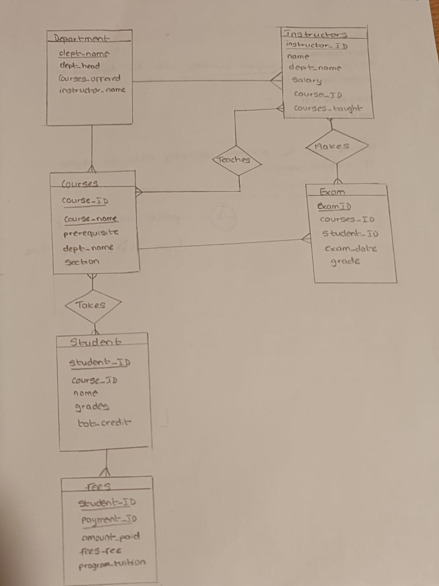
ER Diagram

Slide 7
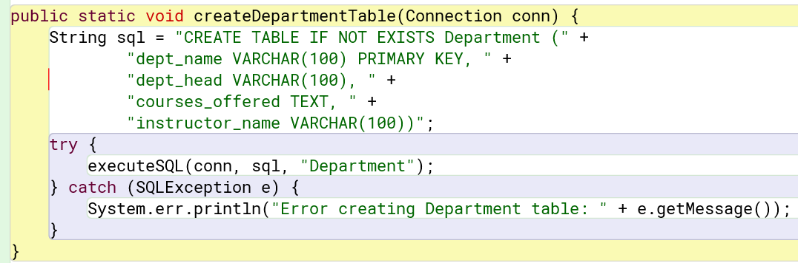
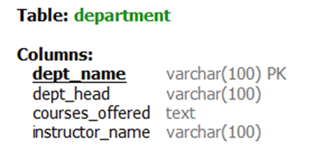
DDL Statement: Department table
Entity: Department
Stores information about academic departments in the
institution.
● Attributes:
○ dept_name: Primary key, uniquely identifies each department.
○ dept_head: Name of the head of the department.
○ courses_offered and instructor_name: These try to show what a department offers and who teaches them.

Slide 8
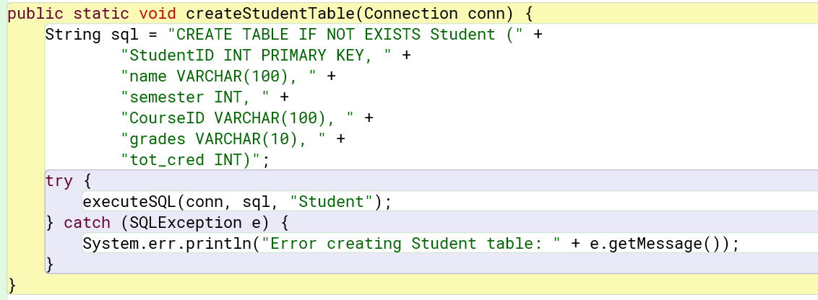
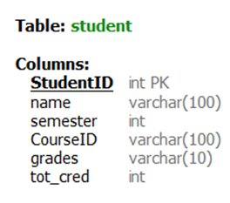
DDL Statement: Student table
Entity: Student
Stores student details.
● Attributes:
○ StudentID: Primary key.
○ name: Full name of the student.
○ semester: The current semester the student is in.
○ CourseID: shows which course the student is taking.
○ grades: The grade of each student.
○ tot_cred: Total credits earned.

Slide 9
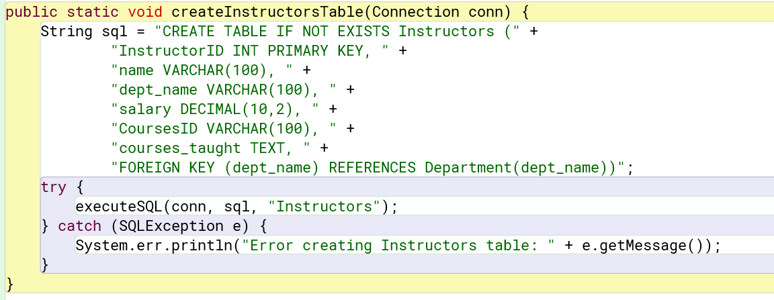
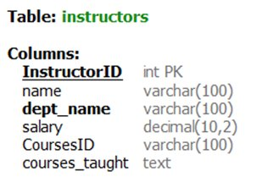
DDL Statement: Instructors table
Entity: Instructors
Stores instructor information.
● Attributes:
○ InstructorID: Primary key.
○ name: Instructor’s full name.
○ dept_name: Foreign key linking to Department.
○ salary: Instructor’s salary.
○ CoursesID and courses_taught: Shows teaching data.

Slide 10
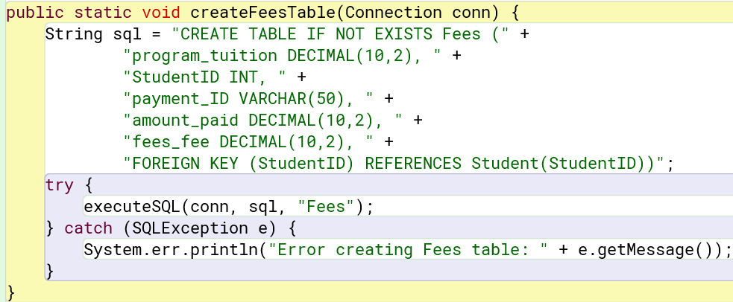
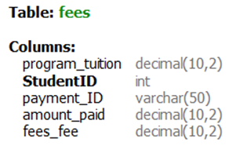
DDL Statement Fees tables
Entity: Fees
Stores fee details for students.
● Attributes:
○ program_tuition: Total tuition fee for the program.
○ StudentID: Foreign key linking to Student.
○ payment_ID: A unique identifier for each payment record.
○ amount_paid: Amount the student has paid.
○ fees_fee: Total fee paid.

Slide 11
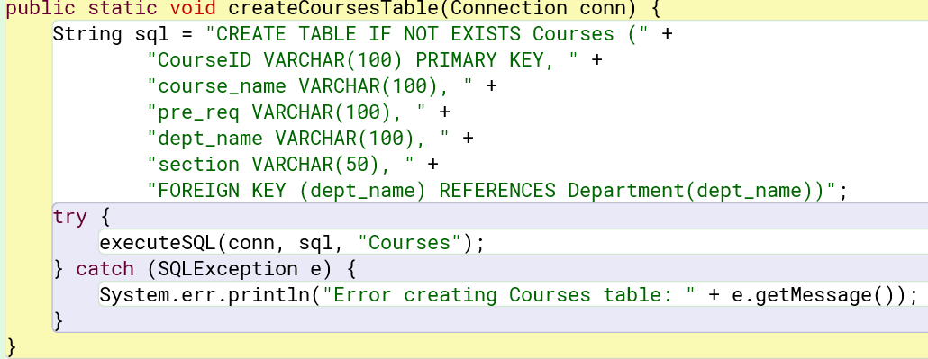
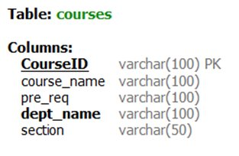
DDL Statement Courses table
Entity: Courses
Stores course information.
● Attributes:
○ CourseID: Primary key.
○ course_name: The name/title of the course.
○ pre_req: A prerequisite for the course.
○ dept_name: Foreign key linking the course to a department.
○ section: Section information (e.g., A, B, C).

Slide 12
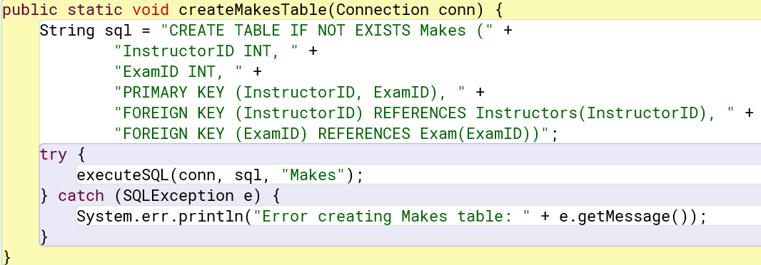
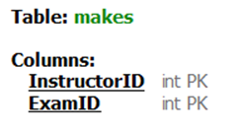
DDL Statement
Relationship table
The purpose is that it links each exam to the instructor who created or conducted it

Slide 13
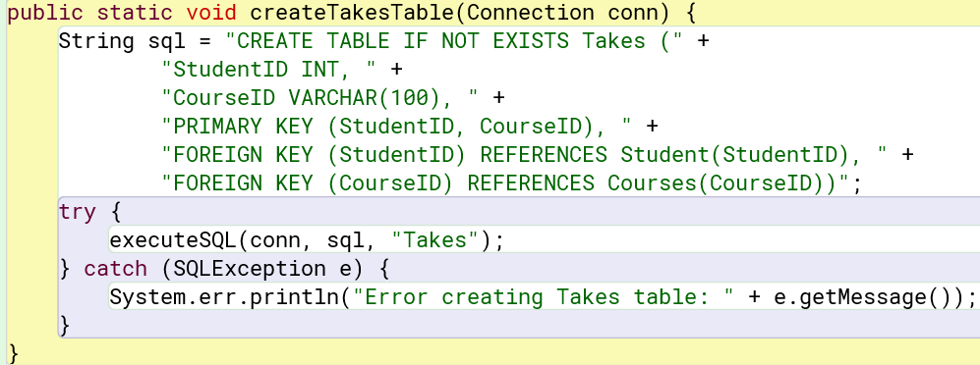
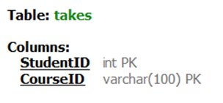
DDL Statement
Relationship table
The purpose is that it captures the many-to-many relationship between students and courses (students can
take many courses, and courses can have many students)

Slide 14
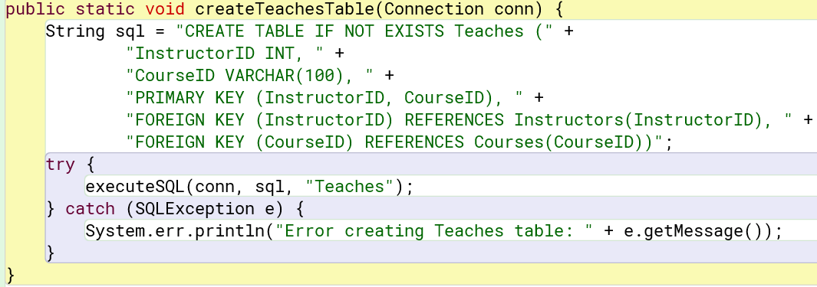
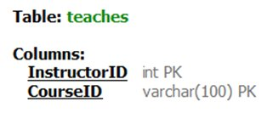
DDL Statement
Relationship table
The purpose is that it captures the many-to-many relationship between instructors and courses.

Slide 15
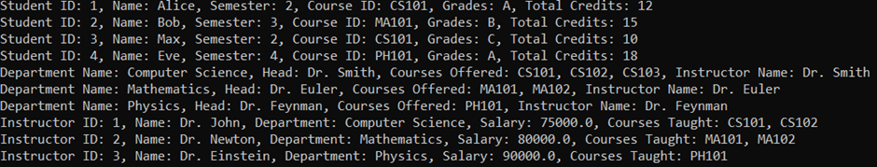
CRUD Operations
Performed CRUD on the following tables:
exams – deleted one exam record (joined with makes table)
students, department, instructors – performed read operation
department, instructors, courses, student, fees, exam, takes, teaches, makes – performed create operation

Slide 16
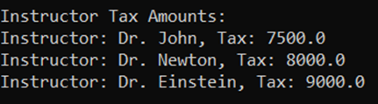
Tax of Instructors
The database calculates the tax for each instructors in the instructor table

Slide 17
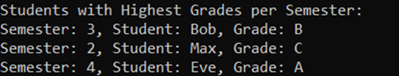
Highest Grade
The database calculates the students with the highest grade for each semester

Slide 18
Create Table(Java JDBC Code)
public static void createTeachesTable(Connection conn) {
String sql = "CREATE TABLE IF NOT EXISTS Teaches (" +
"InstructorID INT, " +
"CourseID VARCHAR(100), " +
"PRIMARY KEY (InstructorID, CourseID), " +
"FOREIGN KEY (InstructorID) REFERENCES Instructors(InstructorID), " +
"FOREIGN KEY (CourseID) REFERENCES Courses(CourseID))";
try {
executeSQL(conn, sql, "Teaches");
} catch (SQLException e) {
System.err.println("Error creating Teaches table: " + e.getMessage());
}

Slide 19
Insert data (Java JDBC code)
private static void insertInstructor(Connection conn, int instructorId, String name, String deptName, double salary, String coursesId, String coursesTaught) throws SQLException {
String sql = "INSERT INTO Instructors (InstructorID, name, dept_name, salary, CoursesID, courses_taught) VALUES (?, ?, ?, ?, ?, ?)";
try (PreparedStatement statement = conn.prepareStatement(sql)) {
statement.setInt(1, instructorId);
statement.setString(2, name);
statement.setString(3, deptName);
statement.setDouble(4, salary);
statement.setString(5, coursesId);
statement.setString(6, coursesTaught);
statement.executeUpdate();
System.out.println("New instructor inserted successfully.");
}
}

Slide 20
Read Data(Jave JDBC Code)
private static void readStudents(Connection conn) throws SQLException {
String sql = "SELECT * FROM Student";
try (Statement statement = conn.createStatement();
ResultSet resultSet = statement.executeQuery(sql)) {
while (resultSet.next()) {
int studentId = resultSet.getInt("StudentID");
String name = resultSet.getString("name");
int semester = resultSet.getInt("semester");
String courseID = resultSet.getString("CourseID");
String grades = resultSet.getString("grades");
int totCred = resultSet.getInt("tot_cred");
System.out.println("Student ID: " + studentId + ", Name: " + name + ", Semester: " + semester + ", Course ID: " + courseID + ", Grades: " + grades + ", Total Credits: " + totCred);
}
}

Slide 21
Delete Data(Java JDBC Code)
private static void deleteExam(Connection conn, int studentId) throws SQLException {
String sql = "DELETE FROM Exam WHERE Student_ID = ?";
try (PreparedStatement statement = conn.prepareStatement(sql)) {
statement.setInt(1, studentId);
int rowsDeleted = statement.executeUpdate();
if (rowsDeleted > 0) {
System.out.println("Exam deleted successfully");
}
}
}

Slide 22
Calculate Tax(Java JDBC Code)
private static void printInstructorTax(Connection conn) throws SQLException {
String sql = "SELECT name, salary FROM Instructors";
try (Statement statement = conn.createStatement();
ResultSet resultSet = statement.executeQuery(sql)) {
System.out.println("\nInstructor Tax Amounts:");
while (resultSet.next()) {
String name = resultSet.getString("name");
double salary = resultSet.getDouble("salary");
double tax = salary * 0.10;
System.out.println("Instructor: " + name + ", Tax: " + tax);
}
}
}

Slide 23
Highest Grade(Java JDBC Code)
private static void printHighestGradeStudentPerSemester(Connection conn) throws SQLException {
String sql = "SELECT semester, name, grades FROM Student WHERE (semester, grades) IN (SELECT semester, MAX(grades) FROM Student GROUP BY semester)";
try (Statement statement = conn.createStatement();
ResultSet resultSet = statement.executeQuery(sql)) {
System.out.println("\nStudents with Highest Grades per Semester:");
while (resultSet.next()) {
int semester = resultSet.getInt("semester");
String name = resultSet.getString("name");
String grades = resultSet.getString("grades");
System.out.println("Semester: " + semester + ", Student: " + name + ", Grade: " + grades);
}
}
}

Slide 24
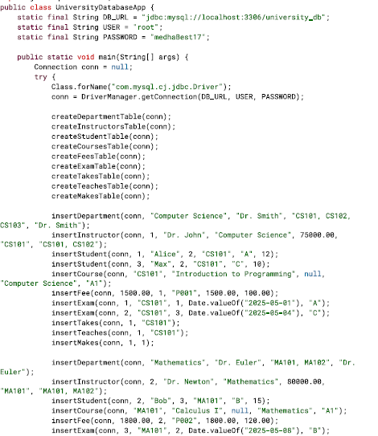
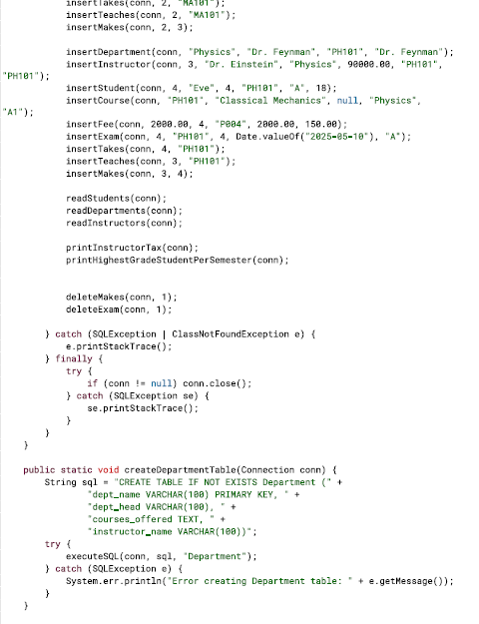
Java JDBC code (whole code on GitHub)
GitHub link: https://github.com/MedhaMadhub/Database-Project.git

