Slide 1


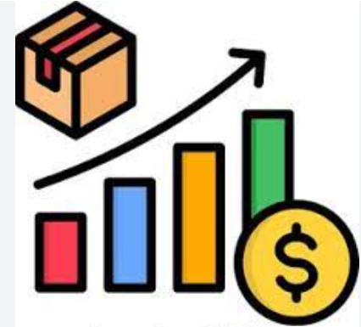
Online Retail Sales Analysis using SQL
Business Insights from Transactional Data (2010-2011)
Prepared by – MEDHA TYAGI
TOOLS - MYSQL

Slide 2

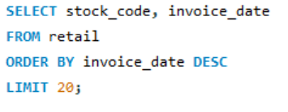
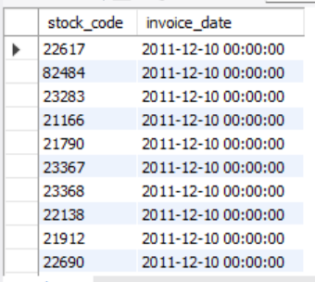
1. Display all top 20 stock codes by most recent Invoice Date.
OUTPUT :-
Recent invoices are concentrated in a small set of stock codes indicating recent demand activity.

Slide 3
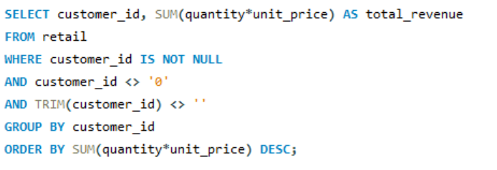
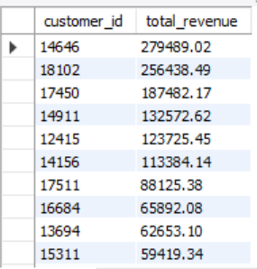
2. Show total revenue per customer sorted by highest revenue
OUTPUT :-
Each row shows a customer ID with their total revenue, sorted from the highest-revenue customer to the lowest.

Slide 4
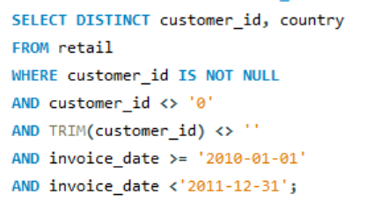
3. Retrieve distinct CustomerID and Country for invoices between 2010-01-01 and 2011-12-31
OUTPUT :-
Each row shows a distinct customer ID and country

Slide 5
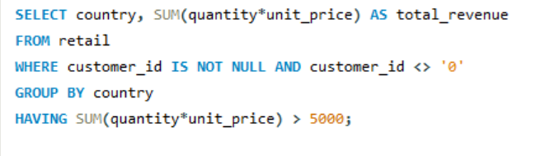
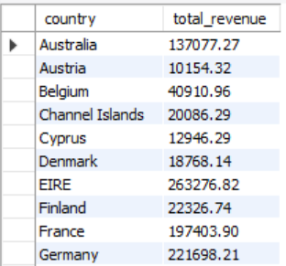
4. Show country whose total revenue is more than 5000
OUTPUT :-
Each row shows countries whose revenue > 5000

Slide 6
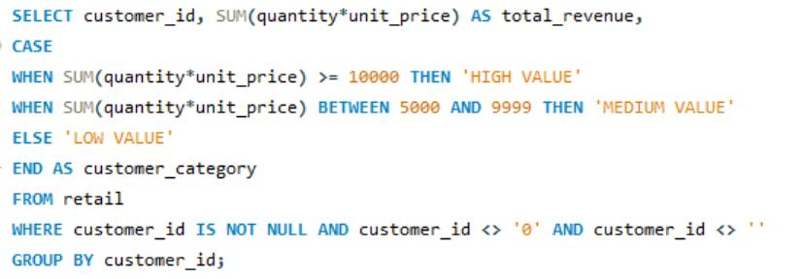
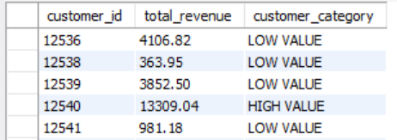
5. Show each customer's id, their total revenue and assign a customer category based on total revenue: “High, Medium, Low Value”
OUTPUT :-
Each row shows a customer ID, their total revenue, and the value category they belong to (High, Medium, or Low).

Slide 7
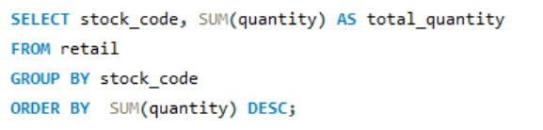
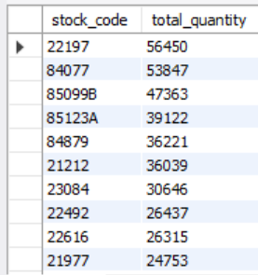
6. List distinct stock codes and their total quantities sold ranked from highest to lowest
OUTPUT :-
Each row shows a stock code with the total quantity sold, sorted from the highest-selling product to the lowest.

Slide 8
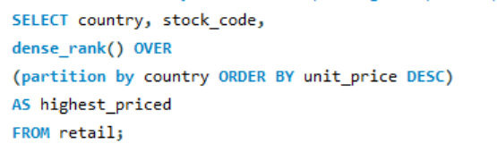
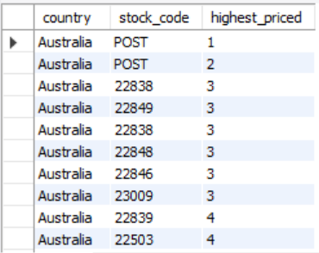
7. For each country, identify the top 5 products with the highest unit prices
OUTPUT :-
The result shows, for each country, the five products that have the highest unit prices, ranked within each country.

Slide 9
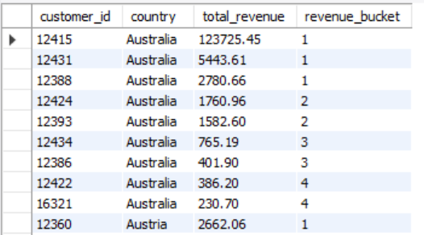
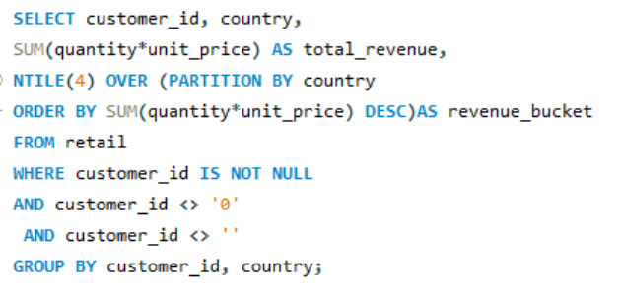
8. Divide customer id into four revenue buckets per country based on total revenue
OUTPUT :-
Each row shows a customer and country, their total revenue, and the revenue bucket they fall into within that country.

Slide 10
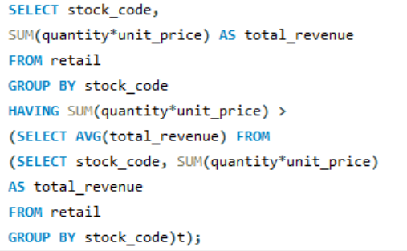
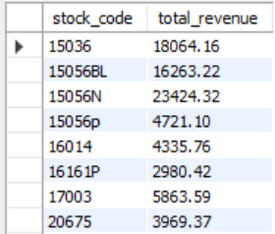
9. Identify stock codes whose total revenue exceeds the average revenue across all stock codes.
OUTPUT :-
The output lists stock codes whose total revenue is higher than the overall average stock code revenue.

Slide 11
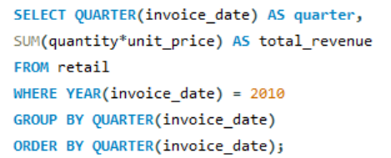
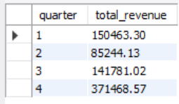
10. Calculate the total revenue for each quarter in the year 2010
OUTPUT :-
The output shows total revenue for each quarter of 2010, with one row per quarter.

Slide 12
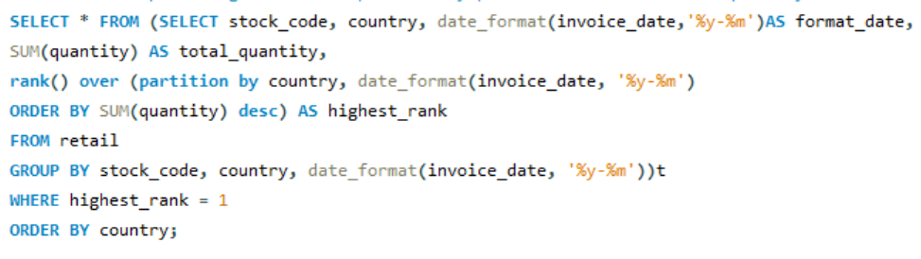
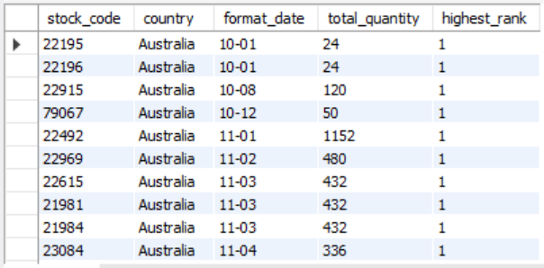
11. For each country and month, identify the top-selling stock code based on total quantity sold.
OUTPUT :-
For every country and month, the result shows the stock code with the highest total quantity sold.

Slide 13
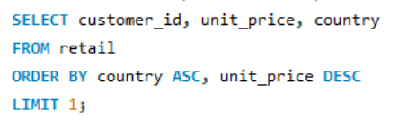

12. Identify the customer who purchased the product with the highest unit price and the country of purchase.
OUTPUT :-
The result shows the customer ID and country associated with the highest-priced product purchase.

Slide 14
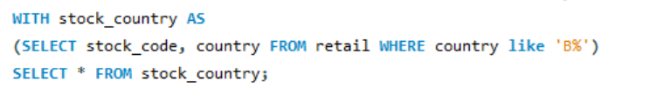
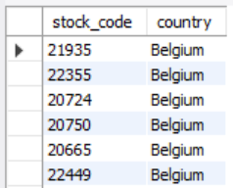
13. Create a CTE to filter stock codes belonging to countries whose names start with the letter ‘B’.
OUTPUT :-
The output lists stock codes (and related rows) from countries whose names begin with the letter ‘B’.

Slide 15
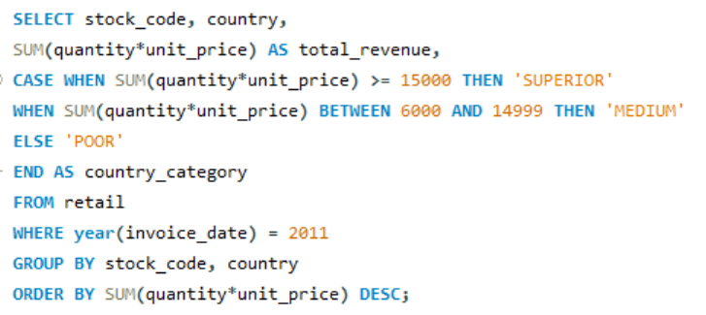
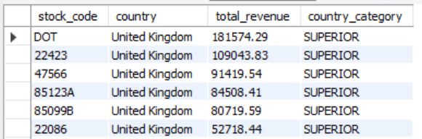
14. For 2011, display each stock code with its total revenue and classify it into revenue categories
(Superior, Medium, Poor).
OUTPUT :-
Each row shows a stock code from 2011, its total revenue, and the corresponding revenue category based on defined thresholds.

Slide 16
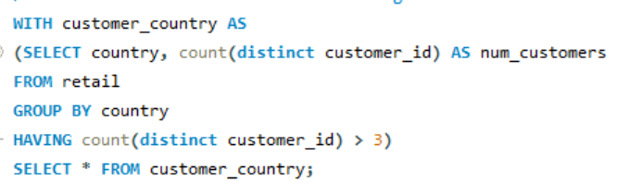
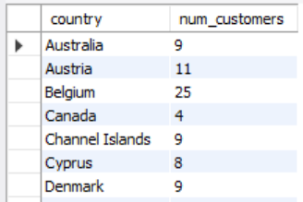
15. Create a CTE to identify countries with more than three distinct customers.
OUTPUT :-
The result lists countries that have more than three unique customer IDs along with their customer counts.

Slide 17
Conclusion
Performed-to-end analysis on an Online Retail dataset, starting with data cleaning and validation.
Designed and solved 15 business-oriented SQL questions covering revenue analysis, customer segmentation, product performance, and time-based trends.
Applied advanced SQL concepts such as aggregations, CASE statements, window functions, CTEs, and date functions.
Derived meaningful insights that can support business decision-making and reporting.
Strengthened both technical SQL skills and analytical thinking through real-world problem solving.

Slide 18
THANK YOU

