Slide 1
Knowledge Representation

Slide 2
Knowledge-Based Agent
Knowledge-based agents are those agents who have the capability of maintaining an internal state of knowledge, reason over that knowledge, update their knowledge after observations and take actions. These agents can represent the world with some formal representation and act intelligently.
Knowledge-based agents are composed of two main parts:
Knowledge-base and
Inference system.

Slide 3
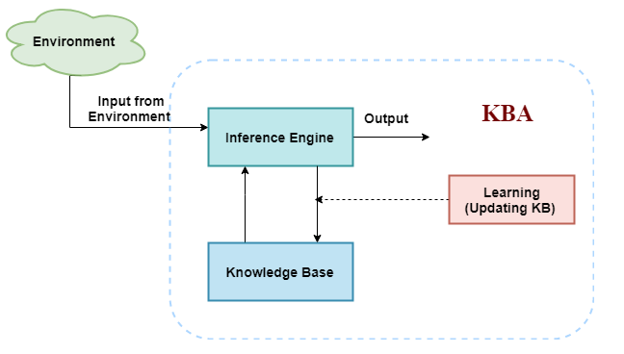
Architecture of knowledge-based agent:

Slide 4
COMPONENTS
Knowledge base: Knowledge-base is a central component of a knowledge-based agent, it is also known as KB. It is a collection of sentences (here 'sentence' is a technical term and it is not identical to sentence in English).
nference system
Inference means deriving new sentences from old. Inference system allows us to add a new sentence to the knowledge base. A sentence is a proposition about the world. Inference system applies logical rules to the KB to deduce new information.
Forward chaining
Backward chaining

Slide 5
Operations Performed by KBA
Following are three operations which are performed by KBA in order to show the intelligent behavior:
TELL: This operation tells the knowledge base what it perceives from the environment.
ASK: This operation asks the knowledge base what action it should perform.
Perform: It performs the selected action.

Slide 6
Various levels of knowledge-based agent:
1. Knowledge level
Knowledge level is the first level of knowledge-based agent, and in this level, we need to specify what the agent knows, and what the agent goals are.
2. Logical level:
At this level, we understand that how the knowledge representation of knowledge is stored. At this level, sentences are encoded into different logics.
3. Implementation level:
This is the physical representation of logic and knowledge. At the implementation level agent perform actions as per logical and knowledge level.

Slide 7
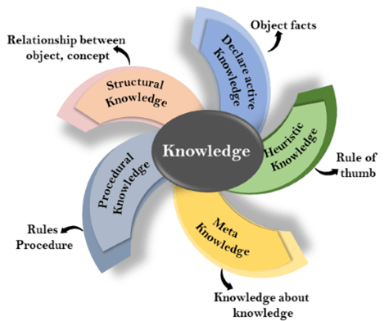
Knowledge representation
Knowledge representation and reasoning (KR, KRR) is the part of Artificial intelligence which concerned with AI agents thinking and how thinking contributes to intelligent behavior of agents.
Types of knowledge

Slide 8
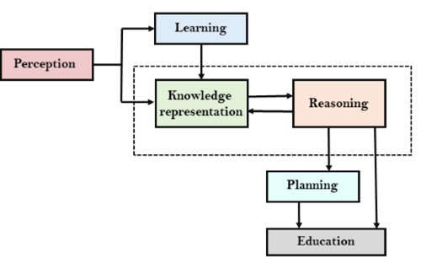
AI knowledge cycle

Slide 9
Approaches to KR
1. Simple relational knowledge:
Provides very weak inferential capabilities.
May serve as the input to powerful inference engines.
Player | Height | Weight | handed
Peter | 6-0 | 180 | right
Ajay | 5-10 | 170 | left
John | 6-2 | 215 | left
Vickey | 6-3 | 205 | right
Fails to infer “which right handed player can best face a particular bowler” .
10

Slide 10
Approaches to KR
Inheritable knowledge:
Objects are organized into classes and classes are organized in a generalization hierarchy.
Inheritance is a powerful form of inference, but not adequate.
Ex. Property inheritance inference mechanism.
isa
handed
Adult male
Person
Right
instance
Peter
Tata Consultancy
11
Works_at

Slide 11
Approaches to KR
Inferential knowledge:
Facts represented in a logical form, which facilitates reasoning.
An inference engine is required.
ex. 1. “Marcus is a man”
2. “All men are mortal”
Implies:
3. “Marcus is mortal”
12

Slide 12
Approaches to KR
Procedural knowledge:
Representation of “how to make it” rather than “what it is”.
May have inferential efficiency, but no inferential
adequacy and acquisitional efficiency.
Ex. Writing LISP programs

Slide 13
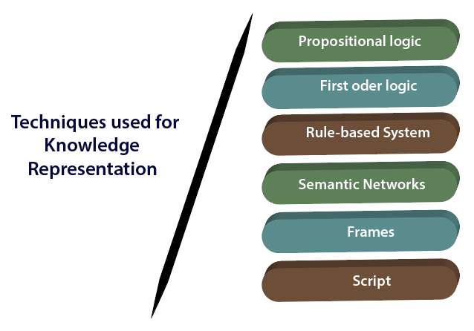

Slide 14
Techniques of knowledge representation
Propositional Logic: This technique is also known as propositional calculus, statement logic, or sentential logic. It is used for representing the knowledge about what is true and what is false.
First-order Logic: It is also known as Predicate logic or First-order predicate calculus (FOPL). This technique is used to represent the objects in the form of predicates or quantifiers. It is different from Propositional logic as it removes the complexity of the sentence represented by it.
Rule-based System: This is the most commonly used technique in artificial intelligence. In the rule-based system, we impose rules over the propositional logic and first-order logic techniques. If-then clause is used for this technique. For example, if there are two variables A and B. Value of both A and B is True. Consequently, the result of both should also be True and vice-versa. It is represented as:
If the value of A and B is True, then the result will be True. So, such a technique makes the propositional as well as FOPL logics bounded in the rules.

Slide 15
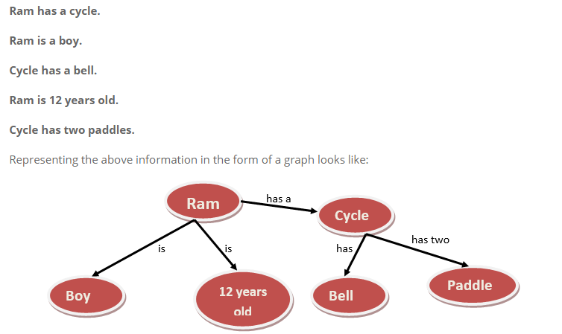
Semantic Networks: The technique is based on storing the knowledge into the system in the form of a graph. Nodes of a graph represent the objects which exist in the real world, and the arrow represents the relationship between these objects. Such techniques show the connectivity of one object with another object.

Slide 16
Frames: In this technique, the knowledge is stored via slots and fillers. Similarly, the Slots are the entities and Fillers are its attributes. They are together stored in a frame. So, whenever there is a requirement, the machine infers the necessary information to take the decision. For example, Tomy is a dog having one tail.
Script: It is an advanced technique over the Frames. Here, the information is stored in the form of a script. The script is stored in the system containing all the required information.

Slide 17
Propositional logic
Statements used in mathematics.
Proposition :is a declarative sentence whose value is either true or false.
Examples:
“The sky is blue.” [Atomic Proposition]
“The sky is blue and the plants are green.” [Molecular/Complex Proposition]
“Today is a rainy day” [Atomic Proposition]
“Today is Sunday” [Atomic Proposition]
“ 2*2=4” [Atomic Proposition]

Slide 18
RULES
Propositional logic is also called Boolean logic as it works on 0 and 1.
In propositional logic, we use symbolic variables to represent the logic, and we can use any symbol for a representing a proposition, such A, B, C, P, Q, R, etc.
Propositions can be either true or false, but it cannot be both.
Propositional logic consists of an object, relations or function, and logical connectives.
These connectives are also called logical operators.
The propositions and connectives are the basic elements of the propositional logic.
Connectives can be said as a logical operator which connects two sentences.
A proposition formula which is always true is called tautology, and it is also called a valid sentence.
A proposition formula which is always false is called Contradiction.
Statements which are questions, commands, or opinions are not propositions such as "Where is Rohini", "How are you", "What is your name", are not propositions.

Slide 19
Logical connectives
Logical connectives are used to connect two simpler propositions or representing a sentence logically.
There are mainly five connectives, which are given as follows:
Negation: A sentence such as ¬ P is called negation of P. A literal can be either Positive literal or negative literal.
Conjunction: A sentence which has ∧ connective such as, P ∧ Q is called a conjunction. Example: Rohan is intelligent and hardworking. It can be written as, P= Rohan is intelligent, Q= Rohan is hardworking. → P∧ Q.

Slide 20
Disjunction: A sentence which has ∨ connective, such as P ∨ Q. is called disjunction, where P and Q are the propositions. Example: "Ritika is a doctor or Engineer", Here P= Ritika is Doctor. Q= Ritika is Doctor, so we can write it as P ∨ Q.
Implication: A sentence such as P → Q, is called an implication. Implications are also known as if-then rules. It can be represented as If it is raining, then the street is wet. Let P= It is raining, and Q= Street is wet, so it is represented as P → Q
Biconditional: A sentence such as P⇔ Q is a Biconditional sentence, example If I am breathing, then I am alive P= I am breathing, Q= I am alive, it can be represented as P ⇔ Q.

Slide 21
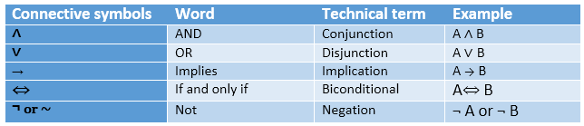
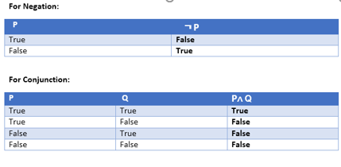
Propositional Logic Connectives:

Slide 22
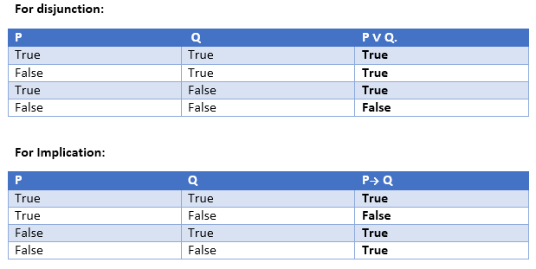
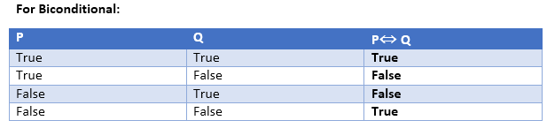

Slide 23
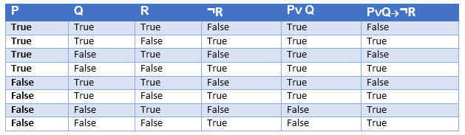
We can build a proposition composing three propositions P, Q, and R. This truth table is made-up of 8n Tuples as we have taken three proposition symbols.
Precedence | Operators
First Precedence | Parenthesis
Second Precedence | Negation
Third Precedence | Conjunction(AND)
Fourth Precedence | Disjunction(OR)
Fifth Precedence | Implication
Six Precedence | Biconditional

Slide 24
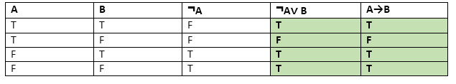
Logical equivalence:
Logical equivalence is one of the features of propositional logic. Two propositions are said to be logically equivalent if and only if the columns in the truth table are identical to each other.
Let's take two propositions A and B, so for logical equivalence, we can write it as A⇔B. In below truth table we can see that column for ¬A∨ B and A→B, are identical hence A is Equivalent to B

Slide 25
INFERENCE RULES IN PROPOSITIONAL LOGIC
Commutativity:
P∧ Q= Q ∧ P, or
P ∨ Q = Q ∨ P.
Associativity:
(P ∧ Q) ∧ R= P ∧ (Q ∧ R),
(P ∨ Q) ∨ R= P ∨ (Q ∨ R)
Identity element:
P ∧ True = P,
P ∨ True= True

Slide 26
INFERENCE RULES IN PROPOSITIONAL LOGIC
Distributive:
P∧ (Q ∨ R) = (P ∧ Q) ∨ (P ∧ R).
P ∨ (Q ∧ R) = (P ∨ Q) ∧ (P ∨ R).
DE Morgan's Law:
¬ (P ∧ Q) = (¬P) ∨ (¬Q)
¬ (P ∨ Q) = (¬ P) ∧ (¬Q).
Double-negation elimination:
¬ (¬P) = P.

Slide 27
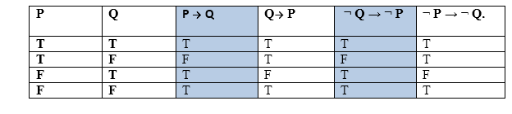
Inference rules:
Following are some terminologies related to inference rules:
Implication: It is one of the logical connectives which can be represented as P → Q. It is a Boolean expression.
Converse: The converse of implication, which means the right-hand side proposition goes to the left-hand side and vice-versa. It can be written as Q → P.
Contrapositive: The negation of converse is termed as contrapositive, and it can be represented as ¬ Q → ¬ P.
Inverse: The negation of implication is called inverse. It can be represented as ¬ P → ¬ Q.

Slide 28
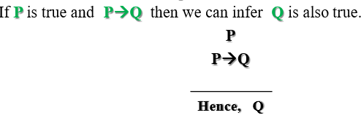
RULES
Modus Ponens:
Example:
Statement-1: "If I am sleepy then I go to bed" ==> P→ Q Statement-2: "I am sleepy" ==> P Conclusion: "I go to bed." ==> Q. Hence, we can say that, if P→ Q is true and P is true then Q will be true.

Slide 29
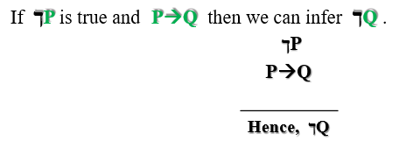
RULES
Modus Tollens
Statement-1: "If I am sleepy then I go to bed" ==> P→ Q Statement-2: "I do not go to the bed."==> ~Q Statement-3: Which infers that "I am not sleepy" => ~P

Slide 30
RULES
Hypothetical Syllogism
The Hypothetical Syllogism rule state that if P→R is true whenever P→Q is true, and Q→R is true. It can be represented as the following notation:
Example:
Statement-1: If you have my home key then you can unlock my home. P→Q Statement-2: If you can unlock my home then you can take my money. Q→R Conclusion: If you have my home key then you can take my money. P→R
Disjunctive Syllogism:
if ךp and p˅q we can infer q is true.
Example:
Statement-1: Today is Sunday or Monday. ==>P∨Q Statement-2: Today is not Sunday. ==> ¬P Conclusion: Today is Monday. ==> Q

Slide 31
RULES
Addition:
It states that If P is true, then P∨Q will be true.
Example:
Statement: I have a vanilla ice-cream. ==> P Statement-2: I have Chocolate ice-cream. Conclusion: I have vanilla or chocolate ice-cream. ==> (P∨Q)
Simplification:
If P∧ Q is true, then Q or P will also be true. It can be represented as:
Resolution:
If P∨Q and ¬ P∧R is true, then Q∨R will also be true. It can be represented as

Slide 32
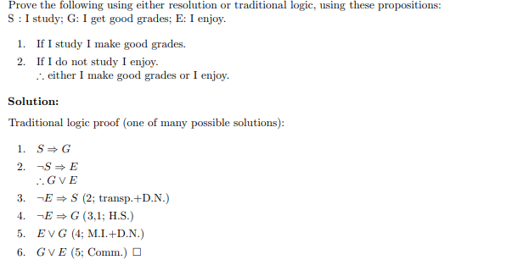

Slide 33
Limitations of Propositional logic:
We cannot represent relations like ALL, some, or none with propositional logic. Example:
All the girls are intelligent.
Some apples are sweet.
Propositional logic has limited expressive power.
In propositional logic, we cannot describe statements in terms of their properties or logical relationships.

Slide 34
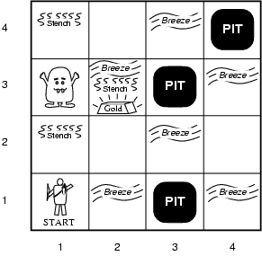
Wumpus World PEAS description

Slide 35
Wumpus World PEAS description
Performance measure
gold +1000, death -1000
-1 per step, -10 for using the arrow
Environment
Squares adjacent to wumpus are smelly
Squares adjacent to pit are breezy
Glitter iff gold is in the same square
Shooting kills wumpus if you are facing it
Shooting uses up the only arrow
Grabbing picks up gold if in same square
Releasing drops the gold in same square
Sensors: Stench, Breeze, Glitter, Bump, Scream
Actuators: Left turn, Right turn, Forward, Grab, Release, Shoot

Slide 36
Sensors
The agent will perceive the stench if he is in the room adjacent to the Wumpus. (Not diagonally).
The agent will perceive breeze if he is in the room directly adjacent to the Pit.
The agent will perceive the glitter in the room where the gold is present.
The agent will perceive the bump if he walks into a wall.
When the Wumpus is shot, it emits a horrible scream which can be perceived anywhere in the cave.
These percepts can be represented as five element list, in which we will have different indicators for each sensor.
Example if agent perceives stench, breeze, but no glitter, no bump, and no scream then it can be represented as: [Stench, Breeze, None, None, None].

Slide 37
Wumpus World PEAS description
Partially observable: The Wumpus world is partially observable because the agent can only perceive the close environment such as an adjacent room.
Deterministic: It is deterministic, as the result and outcome of the world are already known.
Sequential: The order is important, so it is sequential.
Static: It is static as Wumpus and Pits are not moving.
Discrete: The environment is discrete.
One agent: The environment is a single agent as we have one agent only and Wumpus is not considered as an agent.

Slide 38
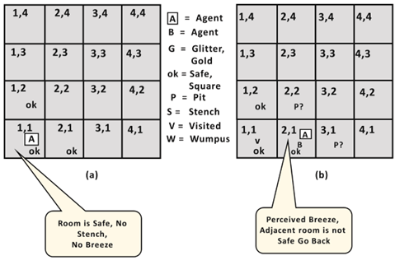
Second First step:
Agent's First step:

Slide 39
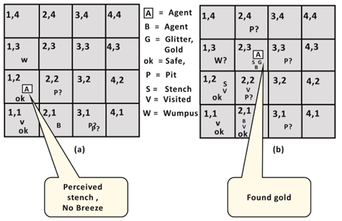
Agent's Fourth step:
Agent's Third step:

Slide 40
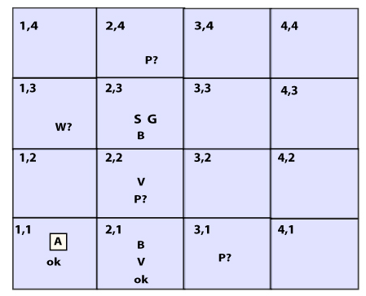
Atomic proposition variable for Wumpus world:
Let P_{i,j} be true if there is a Pit in the room [i, j].
Let B_{i,j} be true if agent perceives breeze in [i, j], (dead or alive).
Let W_{i,j} be true if there is wumpus in the square[i, j].
Let S_{i,j} be true if agent perceives stench in the square [i, j].
Let V_{i,j} be true if that square[i, j] is visited.
Let G_{i,j} be true if there is gold (and glitter) in the square [i, j].
Let OK_{i,j} be true if the room is safe.

Slide 41
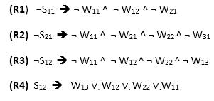

Some Propositional Rules for the wumpus world:
Following is the Simple KB for wumpus world when an agent moves from room [1, 1], to room [2,1]:

Slide 42
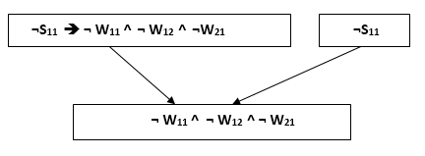
Prove that Wumpus is in the room (1, 3)
Apply Modus Ponens with ¬S11 and R1:
We will firstly apply MP rule with R1 which is ¬S₁₁ → ¬ W₁₁ ^ ¬ W₁₂ ^ ¬ W₂₁, and ¬S₁₁ which will give the output ¬ W₁₁ ^ W₁₂ ^ W₁₂.
Apply And-Elimination Rule:
After applying And-elimination rule to ¬ W₁₁ ∧ ¬ W₁₂ ∧ ¬ W₂₁, we will get three statements: ¬ W₁₁, ¬ W₁₂, and ¬W₂₁.

Slide 43
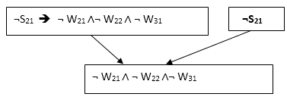
Apply Modus Ponens to ¬S₂₁, and R2:
Now we will apply Modus Ponens to ¬S₂₁ and R2 which is ¬S₂₁ → ¬ W₂₁ ∧¬ W₂₂ ∧ ¬ W₃₁, which will give the Output as ¬ W₂₁ ∧ ¬ W₂₂ ∧¬ W₃₁
Apply And -Elimination rule:
Now again apply And-elimination rule to ¬ W₂₁ ∧ ¬ W₂₂ ∧¬ W₃₁, We will get three statements: ¬ W₂₁, ¬ W₂₂, and ¬ W₃₁.

Slide 44
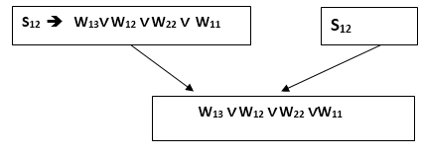
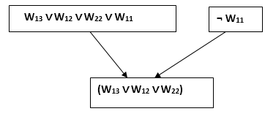
Apply MP to S₁₂ and R4:
Apply Modus Ponens to S₁₂ and R₄ which is S₁₂ → W₁₃ ∨. W₁₂ ∨. W₂₂ ∨.W₁₁, we will get the output as W₁₃∨ W₁₂ ∨ W₂₂ ∨.W₁₁.
Apply Unit resolution on W₁₃ ∨ W₁₂ ∨ W₂₂ ∨W₁₁ and ¬ W₁₁ :
After applying Unit resolution formula on W₁₃ ∨ W₁₂ ∨ W₂₂ ∨W₁₁ and ¬ W₁₁ we will get W₁₃ ∨ W₁₂ ∨ W₂₂.

Slide 45
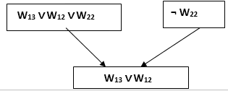
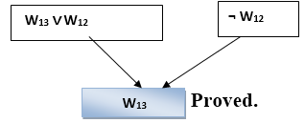
Apply Unit resolution on W₁₃ ∨ W₁₂ ∨ W₂₂ and ¬ W₂₂ :
After applying Unit resolution on W₁₃ ∨ W₁₂ ∨ W₂₂, and ¬W₂₂, we will get W₁₃ ∨ W₁₂ as output.
Apply Unit Resolution on W₁₃ ∨ W₁₂ and ¬ W₁₂
After Applying Unit resolution on W₁₃ ∨ W₁₂ and ¬ W₁₂, we will get W₁₃ as an output, hence it is proved that the Wumpus is in the room [1, 3].

