Slide 1
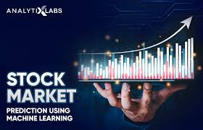
M Sharanya (23RH1A05EU)
M Tejasri (23RH1A05FC)
K Spandana (23RH1A0537)

Slide 2
CONTENTS
Abstract
Existing system
Proposed system
Technology used
Advantages
Applications
Future scope
Conclusion

Slide 3
ABSTRACT
Financial Markets are complex and influenced by various factors , making investment decisions challenging.
This project introduced a Machine Learning based stock price prediction model designed to enhance market analysis and support informed investment decisions.
By gathering historical stock data, economical indicator , and real time market trends , the model uses advanced machine learning techniques predict future stock prices.
The main goal of this project is provide investors and analysts with a tool that offers various potential market movements , helping in strategic planning of investment and risk management .

Slide 4
EXISTING SYSTEM
Traditional Methods: Current methods largely rely on fundamental and technical analysis , which require manual interpretation and time consuming.
Reactive Investment Strategies: Many existing models are reactive, providing insights after significant market movements have already occurred, which can limit their effectiveness in proactive decision-making.
Limited Data Integration: Most traditional systems do not integrate diverse data sources effectively, often overlooking the impact of less obvious factors such as social media sentiment, geopolitical events, or macroeconomic changes.

Slide 5
PROPOSED SYSTEM
Comprehensive Data Analysis: The model utilizes a wide array of data inputs, including historical price data, volume trends, economic indicators, news sentiment analysis, and even social media trends, to create a multifaceted prediction model.
Real-Time Predictive Insights: The system provides real-time predictions and market insights, enabling investors to make decisions quickly in response to market changes.
User-Friendly Interface: A straightforward, user-friendly interface allows investors of all skill levels to understand and utilize the predictions made by the model, democratizing access to advanced market analysis tools.
Adaptive Learning Algorithms: The model includes adaptive learning capabilities, where it continuously learns from new data and adjusts its predictions accordingly, maintaining high accuracy over time.

Slide 6
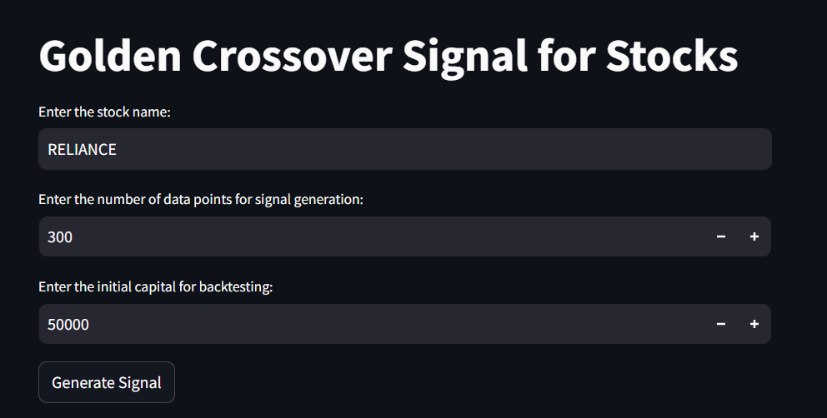
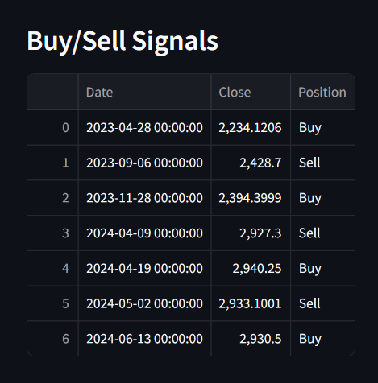
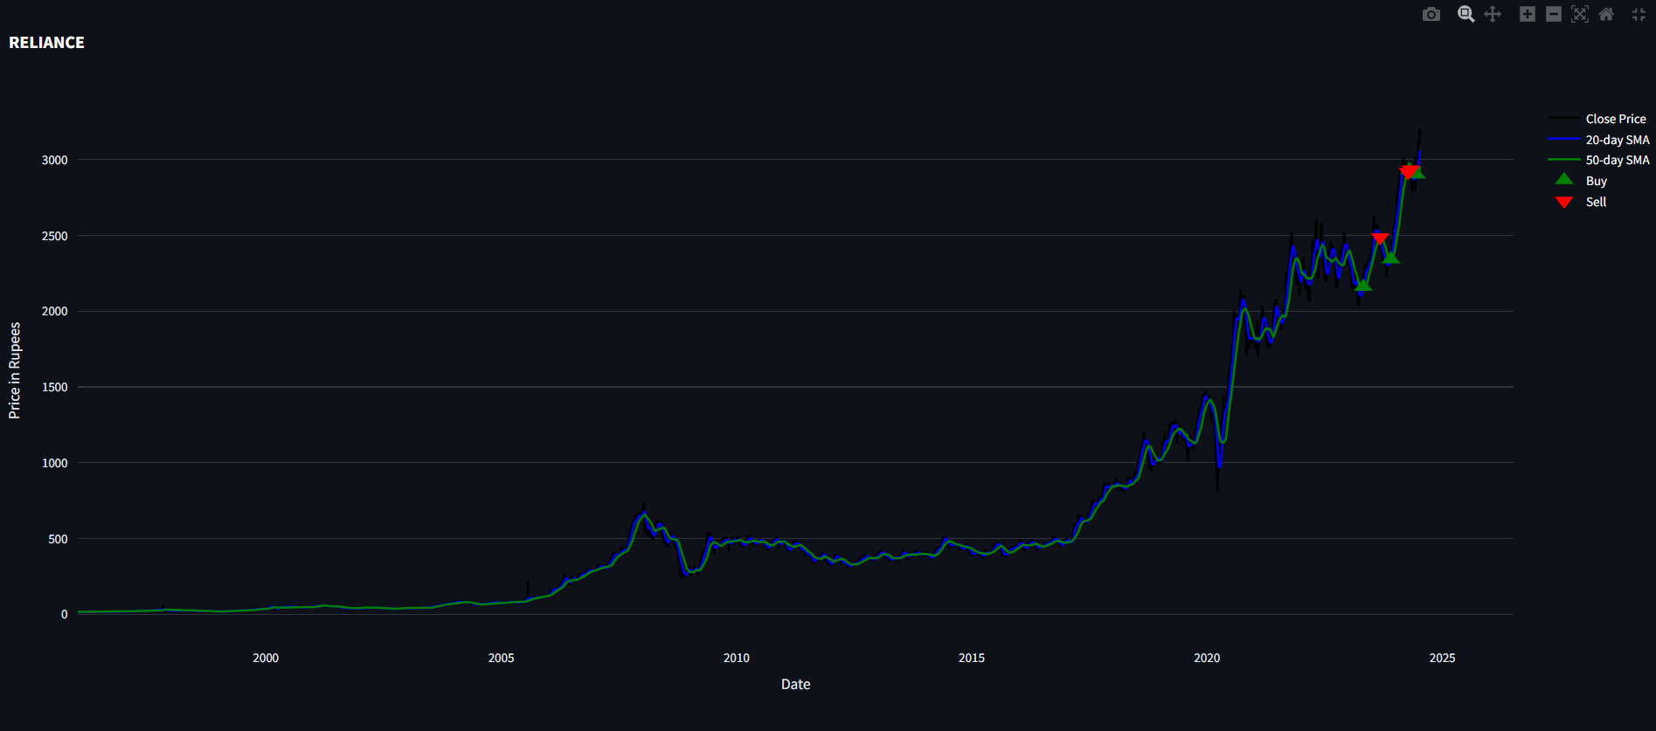

Slide 7
TECHNOLOGY USED
Pandas– This library helps to load the data frame in a 2D array format and has multiple functions to perform analysis tasks in one go.
Numpy - Numpy arrays are very fast and can perform large computations in a very short time
Matplotlib – This library is used to draw visualizations.
Streamlit – Open source Python library used for building data science web applications.
Ploty – is an interactive open-source and browser based graphing library..
GUI – Graphical user interface used to display the output..

Slide 8
ADVANTAGES
Handling Large Datasets: ML algorithms can process and analyze vast amounts of data quickly…
Pattern Recognition: ML models excel at identifying complex patterns and trends in data that may not be apparent to human analysts or through traditional statistical methods.
Speed and Efficiency: Once trained, ML models can generate predictions in real-time, making them highly useful for high-frequency trading where decisions need to be made in milliseconds.
Risk Management: By predicting potential price movements, ML models can be used to assess risk and manage portfolios more effectively, helping to mitigate potential losses.

Slide 9
APPLICATIONS
1. Individual Investors: Helps individual traders and investors make more informed decisions about buying, holding, or selling stocks.
2. Financial Analysts: Provides financial analysts with enhanced tools for market analysis, report generation, and client advisory services.
3. Investment Firms: Assists investment firms in portfolio management, asset allocation, and risk assessment, enhancing overall investment strategies.
4. Academic Research: Useful in academic settings for research into financial markets, machine learning applications in finance, and economic forecasting.

Slide 10
FUTURE SCOPE
The future of stock price prediction using machine learning is set to be shaped by ongoing technological advancements increased data availability and etc..
Stock Market Prediction is the act of trying to determine the future value of companies stock are other financial instruments traded on an exchange.
The successful prediction of a stocks future price could yield significant profit.

Slide 11
CONCLUSION
In conclusion, we've advanced a complete internet- based totally platform for inventory market evaluation and prediction, net technology and facts analysis techniques. Our platform provides users with a consumer-pleasant interface, actual-time data retrieval capabilities, advanced records visualization techniques, and forecasting algorithms, empowering them to make informed investment choices in the risky global of monetary markets,by means of combining the power of Flask, MySQL, Pandas, Plotly , and Prophet, our platform gives a strong tool for inventory market analysis and prediction, ultimately improving customers' success in the dynamic global of monetary markets.

Slide 12


