Slide 1
CS 6513- Big Data
Final Project
Team Name: Statistically Significant
Members: Brian Timmerman, Chau Tran, Jingfeng Zhen

Slide 2
Generic Profiling: Methods
Read each tsv file and convert it into Dataframe (RDD method was slower)
Use built in functions to determine number of non_empty cells, empty cells, number of distinct values, and frequent values
Parse each field in a DataFrame and use regular expression to determine the data type of a value
Calculate the statistics then include them in the metadata

Slide 3
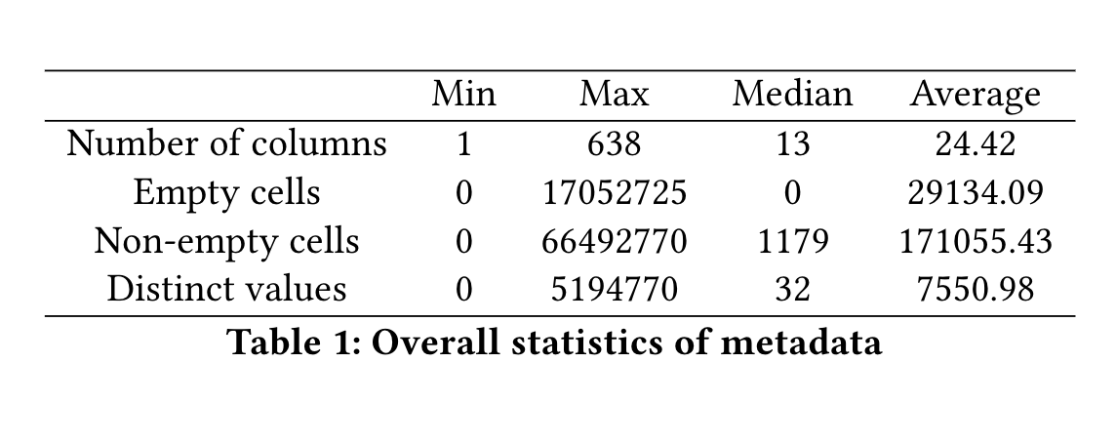
Generic Profiling: Overall statistics of metadata

Slide 4
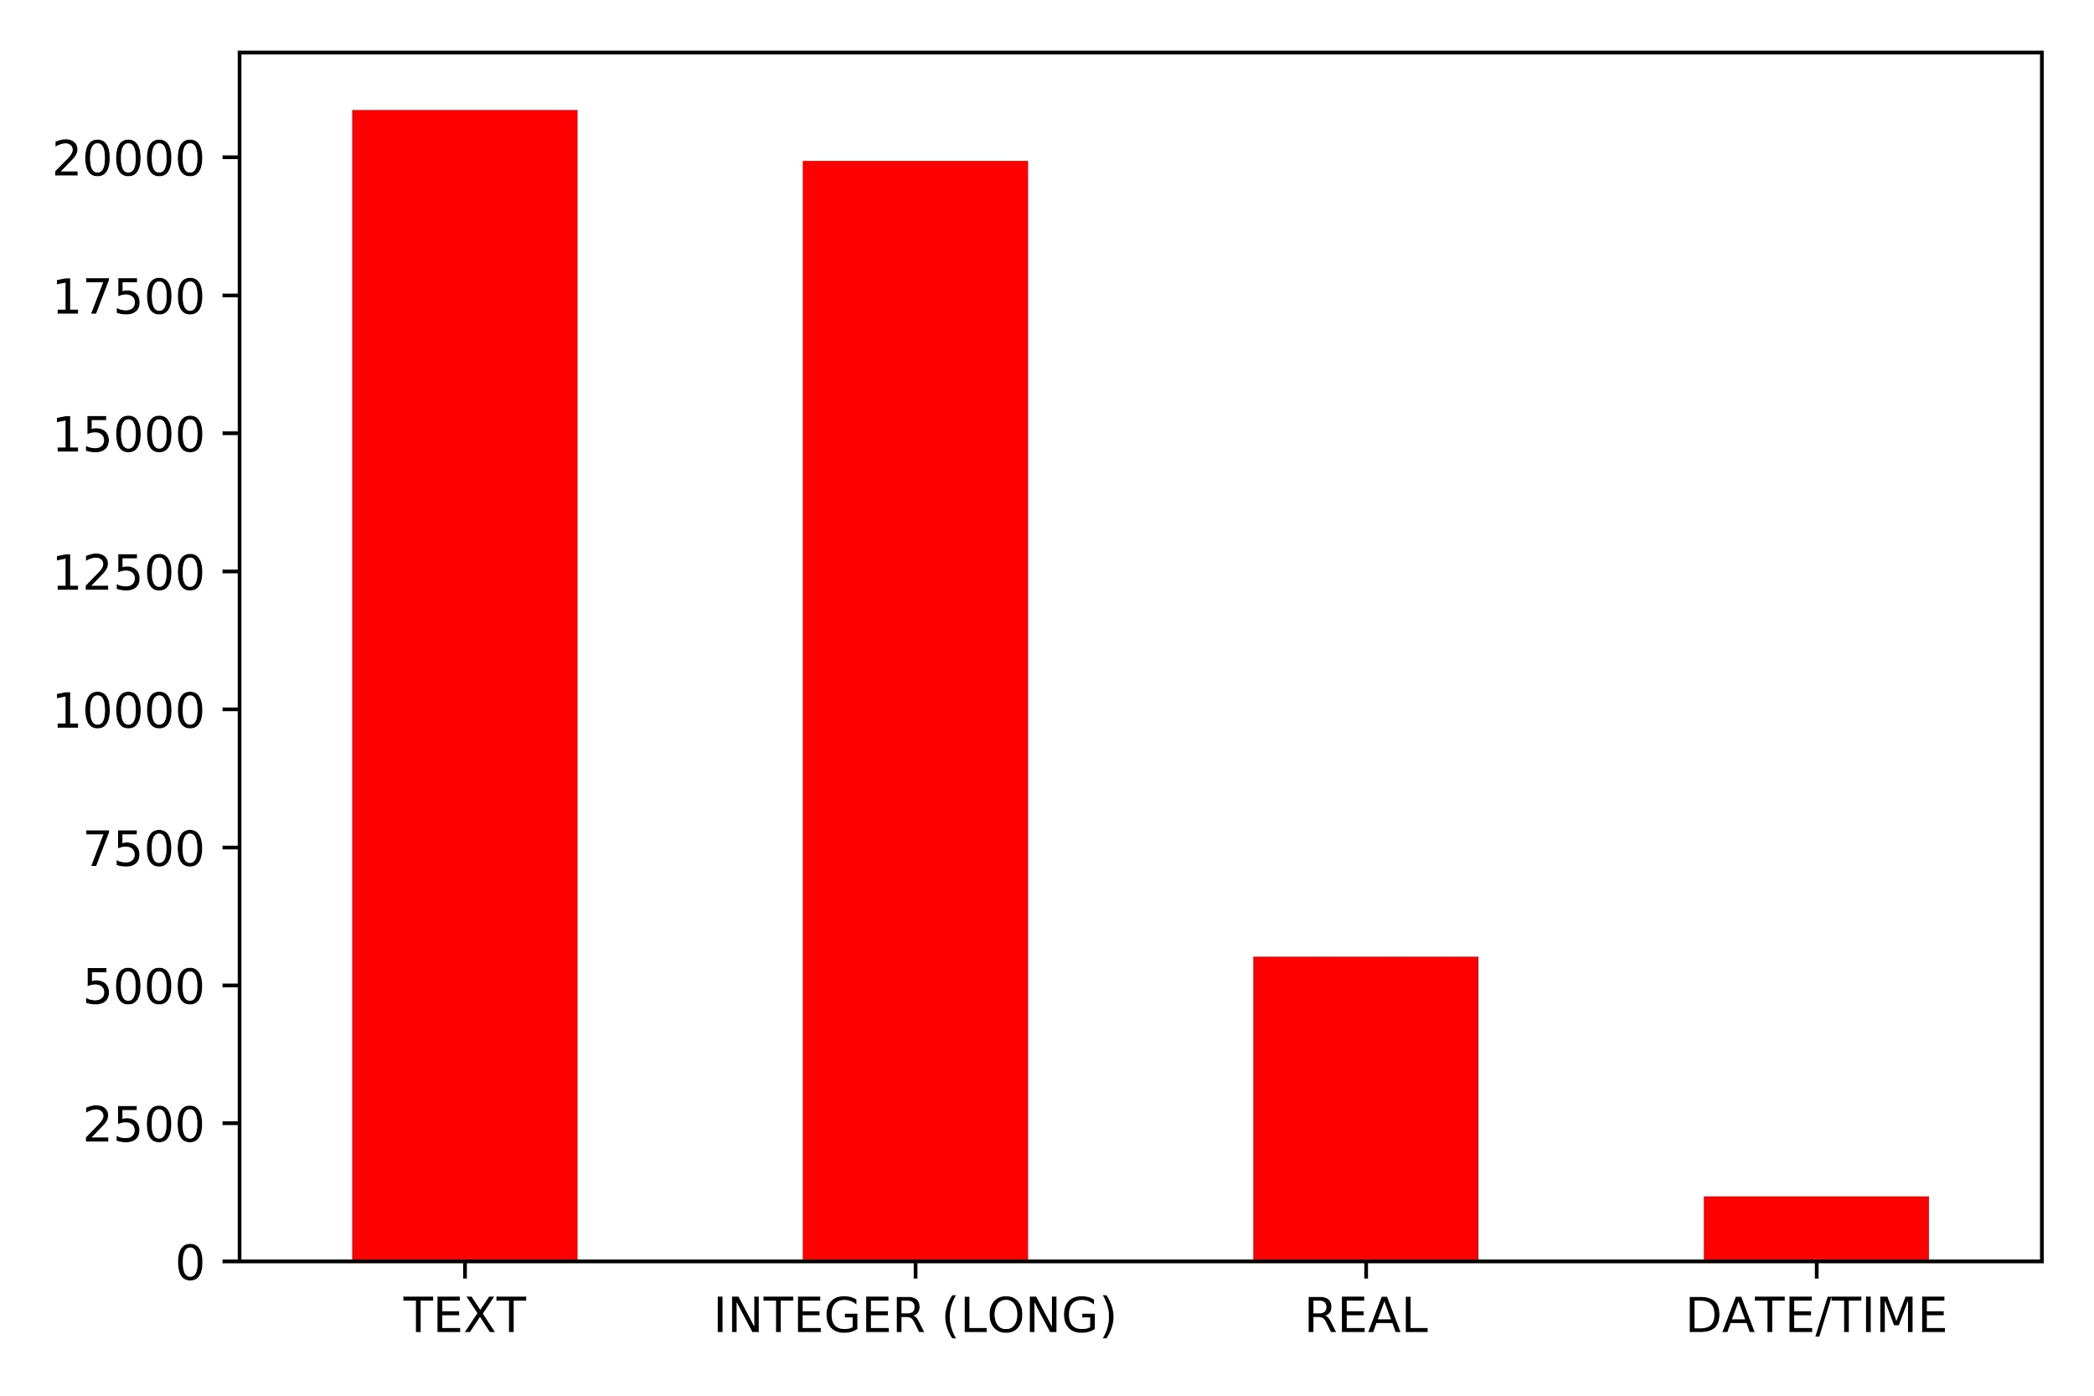
Generic Profiling: Data type Occurrences

Slide 5
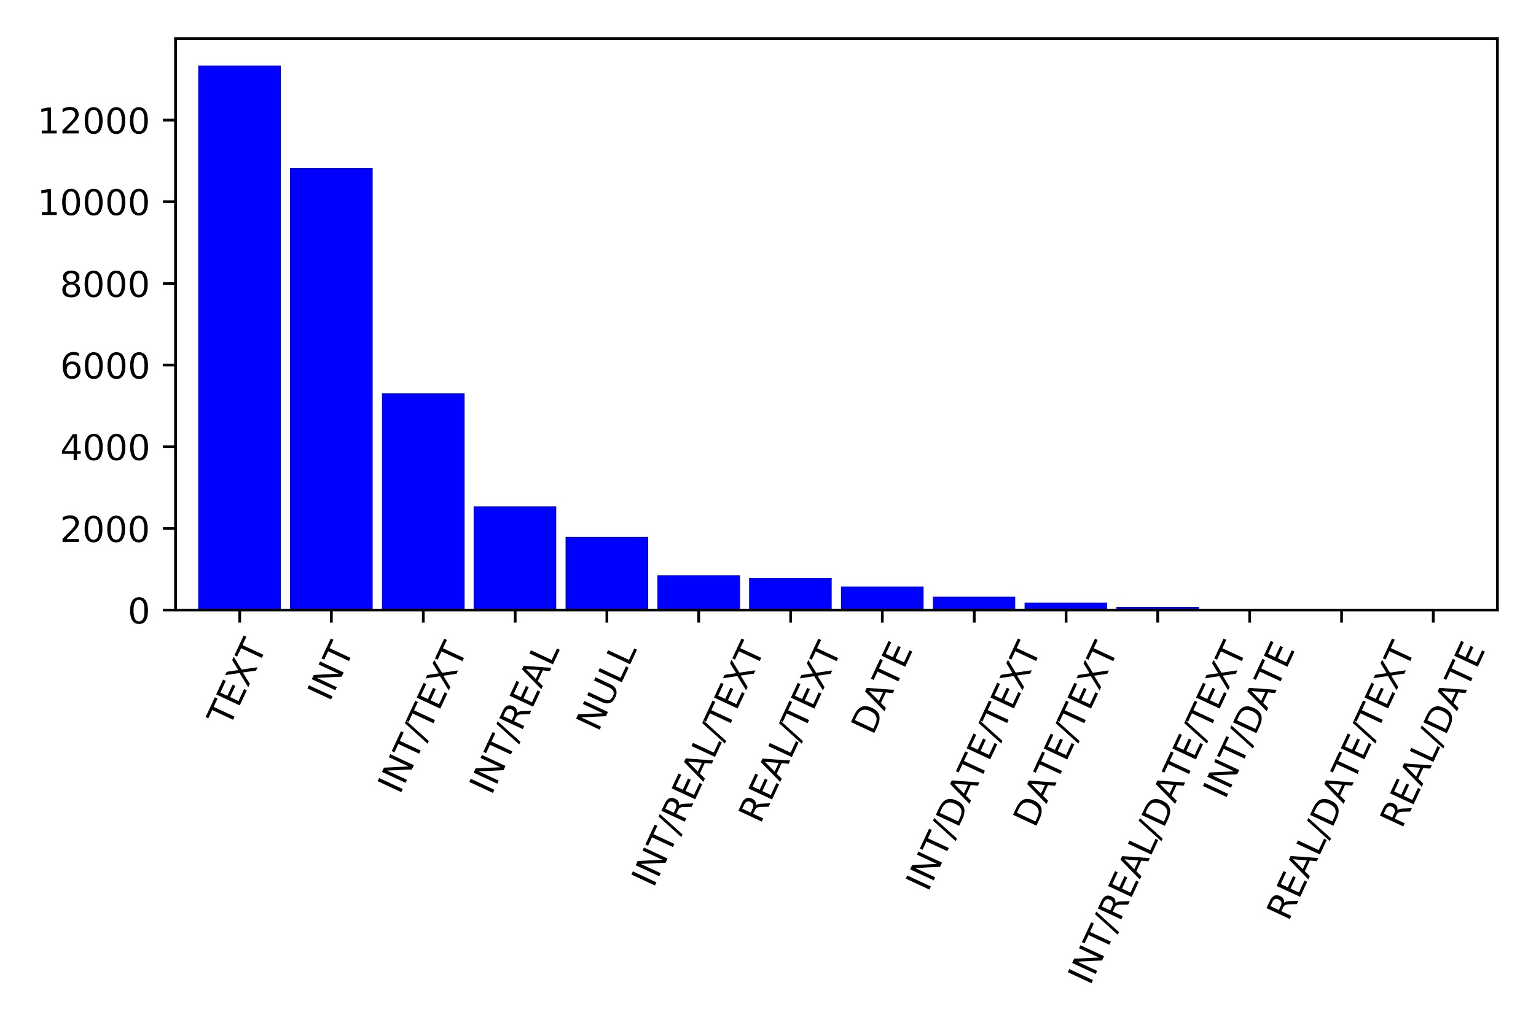
Generic Profiling: Column Type Occurrences

Slide 6
Generic Profiling: Frequent types
Frequent 2-type columns: INT/TEXT, INT/REAL
Frequent 3-type columns: INT/REAL/TEXT

Slide 7
Generic Profiling: Challenges
1900 datasets: time consuming. Therefore, code efficiency matters.
Read files as RDD vs. DataFrame
Date-time detection method is somewhat tricky
Frequent-itemset detection

Slide 8

Semantic Profiling: Methods
Line by line type assignment
Uses a combination of regex matching and keyword dictionaries
Overall class vote for determine file type
Uses vote distance as metric to identify multiple types
Returns “other” if no votes cast

Slide 9

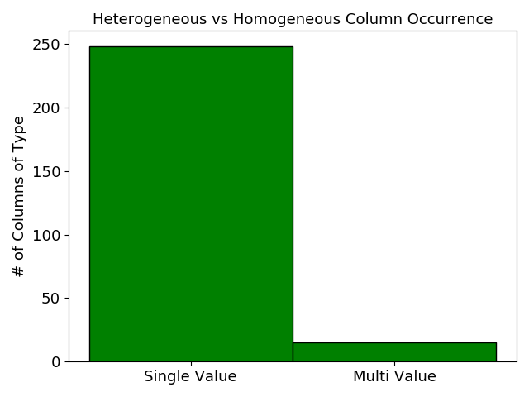
Semantic Profiling: Results
Certain semantic types appear much more often than other similar types
“Address”vs “location name”, “study area” vs school subject
Columns are much more likely to be of single type than multi-type
Classifier performs well with strong precision and recall for both classification types
Slightly worse overall accuracy at 90%

Slide 10
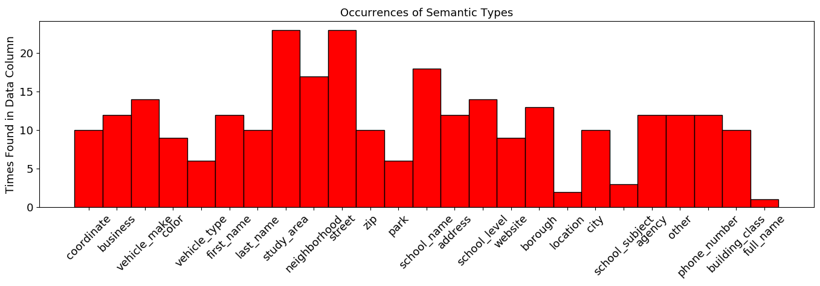

Slide 11
Semantic Profiling: Challenges
Keywords repeating among classes
Impercise counting of unclassifiable entries
Data without enough information to discerene meaning
Example: middle initial, boroughs being represented by only a single letter
Multiple type detection could use refinement

Slide 12
Null Value Detection: Methods
Detect empty cells
Detect null values that are not in the domain of the column
Detect null values that are in the the domain of the column (like 999-999-99999 in phone numbers)

Slide 13
Null Value Detection: Disguised Missing Values
Embedded Unbiased Sample Heuristic
Maximal Embedded Unbiased Sample
Correlation-based Sample Quality Score

Slide 14
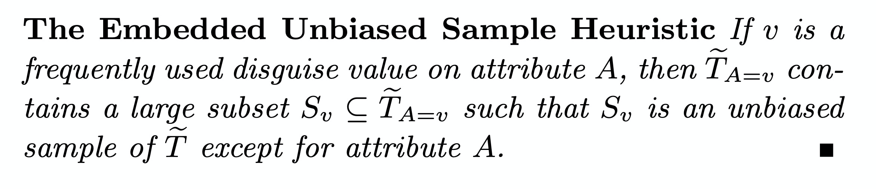
Null Value Detection: EUS Heuristic

Slide 15
Null Value Detection: MEUS
Maximal Embedded Unbiased Sample
The maximal subset of the projected table that is an unbiased sample of the original table.
The bigger the MEUS, the more likely it is a disguised missing value

Slide 16
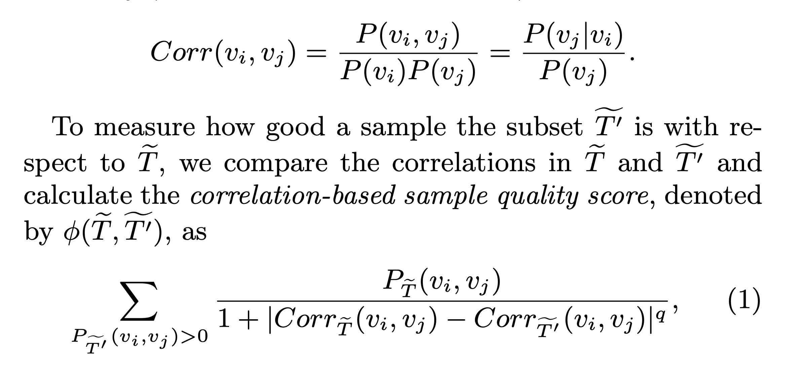
Null Value Detection: Correlation-based Score

Slide 17
Null Value Detection: Results
ELECTION | 2001
CANDID | 445 | 454 | 375
CANDNAME | CANDNAME | Aboulafia, Sandy | Adams, Jackie R
OFFICECD | 5 | 1 | 3
OFFICEBORO | OFFICEBORO | X | M
OFFICEDIST | 44 | 7 | 32
CANCLASS | CANCLASS | P
PRIMARYPAY | 45410 | 11073 | 75350
GENERALPAY | 0 | 73970 | 2400
RUNOFFPAY | 0 | 267331 | 574387
TOTALPAY | 45410 | 11073 | 149320

Slide 18
Null Value Detection: Challenges
Expensive on large datasets
How to choose data pairs
Heuristic may not hold all the time
Need data experts to verify

