Slide 1

MediBooki Healthcare with Pneumonia Detection System

Slide 2
1
Introduction
4
Implementation and Challenges
2
System Overview
CONTENTS
5
Results and Future Enhancements
3
System Architecture and Technology

Slide 3
PART ONE
Introduction

Slide 4
Introduction
In today's rapidly evolving healthcare landscape, efficient hospital information management is crucial for providing quality patient care
Several successful projects have already been implemented in the industry, demonstrating the importance and potential impact of such systems. For instance, Vezeeta and CliniDo have been widely adopted by hospitals and clinics, offering online appointment bookings, electronic medical records, and pharmacy integration.

Slide 5
Introduction
Introduction
Building upon the success of these projects, we aim to develop a comprehensive hospital information management system that incorporates similar functionalities while adding unique features to address specific challenges faced by healthcare institutions.

Slide 6
PART TWO
System Overview

Slide 7
System Overview
Hospital Manager
Admin
Radiology Doctor
Analytics
specialist
Accountant
Doctor
Patient
Pharmacist

Slide 8
System Overview
Our hospital information management system is a web-based & mobile app platform that offers a range of functionalities to hospitals and clinics.
Web App
Online Reservation
Pneumonia Detection
Chatbot
Multitenant
Insurance
Online Pharmacy
Online Billing system
Online Payment
Support Multilinguals
Mobile App
Online Pharmacy
Online Payment
Insurance

Slide 9
System Overview
Online Doctor Reservations:
- Our system provides a user-friendly interface that allows patients to browse and book appointments with doctors online.
- Patients can view doctors' profiles, check their availability, and select suitable time slots, eliminating the need for manual appointment scheduling.
Pneumonia Detection:
- As part of our commitment to early diagnosis and treatment, our system incorporates advanced algorithms for pneumonia detection.
- Medical imaging data is analyzed in real-time, flagging potential cases of pneumonia for timely medical intervention..

Slide 10
System Overview
Chatbot:
- Our system includes an intelligent chatbot that interacts with patients, providing them with instant assistance and answers to common queries.
The chatbot utilizes natural language processing and machine learning to understand patient inquiries and provide accurate responses.
Multitenant:
- Our system supports multiple hospitals or clinics within a single instance, offering a flexible and scalable solution.
- Each healthcare facility has its own customized settings, data, and access controls, ensuring data segregation and security.

Slide 11
System Overview
Online Pharmacy:
- Our integrated online pharmacy empowers patients to conveniently purchase medications and healthcare products.
- Patients can browse a comprehensive catalog, place orders, and have the medications or products delivered to their preferred location.
Online Billing System:
- It generates itemized bills for patients, tracks payments, and provides an efficient invoicing system for healthcare providers

Slide 12
System Overview
Online Payment :
-Our system facilitates online payment options, allowing patients to securely make payments for healthcare services and medications using integrated payment service (PayMob).
Insurance:
It also supports seamless integration with insurance providers, enabling patients to verify coverage and streamline the claims process.
Multilingual Support (Ar & En):
To cater to diverse patient populations, our system provides multilingual support.
Patients can interact with the system and receive information in their preferred language, enhancing accessibility and inclusivity..

Slide 13
PART THREE
System Architecture and Technology

Slide 14
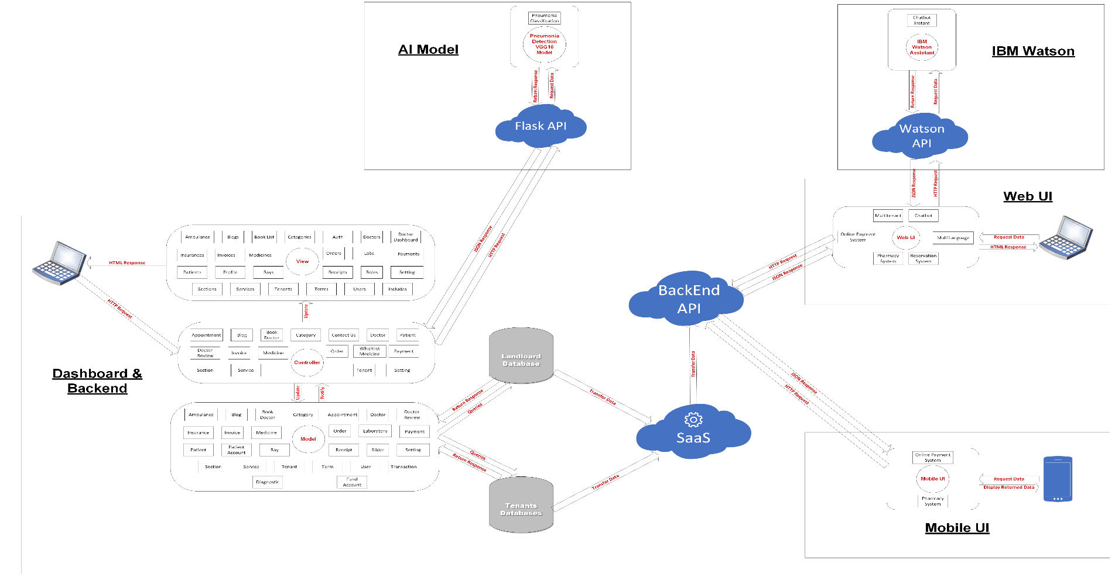
System Architecture

Slide 15
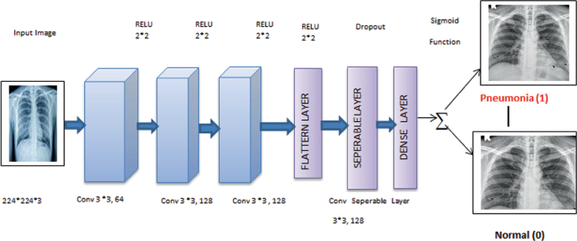
Pneumonia Detection
The VGG-16 model architecture is a convolutional neural network (CNN) that was proposed by the Visual Geometry Group (VGG) at the University of Oxford. It gained popularity and became a widely used model for image classification tasks.

Slide 16
Key technologies
Front-End
Angular v14.0.4
NodeJS v16.10.0
Back-End
PHP v7.4.33
Laravel 8
Pneumonia Detection Model
Flask v 1.1.2
Mobile App
Flutter v3.0.0
Python v3.9.7
Database
MySQL v8.0.3

Slide 17
PART FOUR
Implementation and Challenges

Slide 18
Integration with online payment (PayMob)
Pneumonia Detection Model integration using Flask API.
How to make the multitenancy dynamic.

Slide 19
PART FIVE
Future Enhancements

Slide 21
THANKS!

