Slide 1

MediBooki Healthcare with Pneumonia Detection System

Slide 2
Team Members
Mohamed Ali (TL)
Ahmed Waleed
Eslam Sabry
Ahmed Salah
Assem Mohammed
Pola Osama

Slide 3
1
Introduction
4
Implementation and Challenges
2
System Overview
CONTENTS
5
Future Enhancements
3
System Architecture and Technology

Slide 4
PART ONE
Introduction

Slide 5
Introduction
In today's rapidly evolving healthcare landscape, efficient hospital information management is crucial for providing quality patient care
Several successful projects have already been implemented in the industry, demonstrating the importance and potential impact of such systems. For instance, Vezeeta and CliniDo have been widely adopted by hospitals and clinics, offering online appointment bookings, electronic medical records, and pharmacy integration.

Slide 6
Introduction
Introduction
Building upon the success of these projects, we aim to develop a comprehensive hospital information management system that incorporates similar functionalities while adding unique features to address specific challenges faced by healthcare institutions.

Slide 7
PART TWO
System Overview

Slide 8
System Overview
Hospital Manager
Admin
Radiology Doctor
Analytics
specialist
Accountant
Doctor
Patient
Pharmacist

Slide 9
System Overview
Our hospital information management system is a web-based & mobile app platform that offers a range of functionalities to hospitals and clinics.
Web App
Online Reservation
Pneumonia Detection
Chatbot
Multitenant
Insurance
Online Pharmacy
Online Billing system
Online Payment
Support Multilinguals
Mobile App
Online Pharmacy
Online Payment
Insurance

Slide 10
System Overview
Online Doctor Reservations:
- Our system provides a user-friendly interface that allows patients to browse and book appointments with doctors online.
- Patients can view doctors' profiles, check their availability, and select suitable time slots, eliminating the need for manual appointment scheduling.
Pneumonia Detection:
- As part of our commitment to early diagnosis and treatment, our system incorporates advanced algorithms for pneumonia detection.
- Medical imaging data is analyzed in real-time, flagging potential cases of pneumonia for timely medical intervention..

Slide 11
System Overview
Chatbot:
- Our system includes an intelligent chatbot that interacts with patients, providing them with instant assistance and answers to common queries.
The chatbot is used as a service from IBM Watson Assistant.
Multitenant:
- Our system supports multiple hospitals or clinics within a single instance, offering a flexible and scalable solution.
- Each healthcare facility has its own customized settings, data, and access controls, ensuring data segregation and security.

Slide 12
System Overview
Online Pharmacy:
- Our integrated online pharmacy empowers patients to conveniently purchase medications and healthcare products.
- Patients can browse a comprehensive catalog, place orders, and have the medications or products delivered to their preferred location.
Online Billing System:
- It generates itemized bills for patients, tracks payments, and provides an efficient invoicing system for healthcare providers

Slide 13
System Overview
Online Payment :
-Our system facilitates online payment options, allowing patients to securely make payments for healthcare services and medications using integrated payment service (PayMob).
Insurance:
It gives patients discount from insurance providers, enabling patients to verify coverage and streamline the claims process.
Multilingual Support (Ar & En):
To cater to diverse patient populations, our system provides multilingual support.
Patients can interact with the system and receive information in their preferred language, enhancing accessibility and inclusivity..

Slide 14
PART THREE
System Architecture and Technology

Slide 15
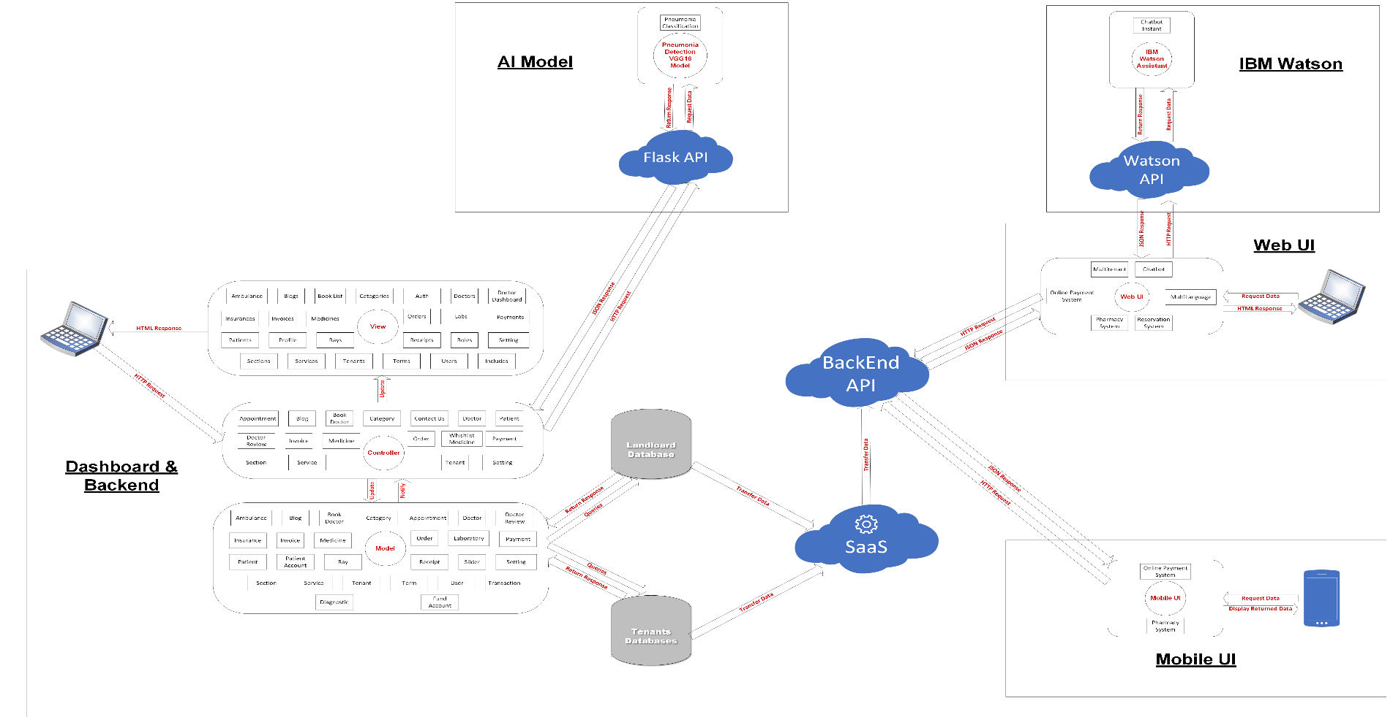
System Architecture

Slide 16
Pneumonia Detection Model
Dataset
The dataset was from Kaggle https://www.kaggle.com/datasets/paultimothymooney/chest-xray-pneumonia.
The dataset consists of 5,863 chest X-ray images, including 3,799 images with pneumonia and 1,157 normal images
Pre-Processing
- Resizing: All images were resized to 224 x 224 pixels.
- Data augmentation: The training dataset was augmented using various techniques, including random rotation, horizontal flipping, and zooming.
- The augmentation was performed using the Keras ImageDataGenerator

Slide 17
Pneumonia Detection Model
Model Used
Custom CNN:
The custom CNN architecture consists of 11 convolutional layers organized into 5 blocks.
VGG16:
The VGG16 architecture is a widely used convolutional neural network architecture for image classification. It consists of 13 conv. layers organized in 5 blocs and 3 fully connected layers.

Slide 18
Pneumonia Detection Model
Results
CNN Model
VS
VGG16 Model
Accuracy
88.4%
92%
Precision
87.5%
91%
Recall
95%
98%

Slide 19
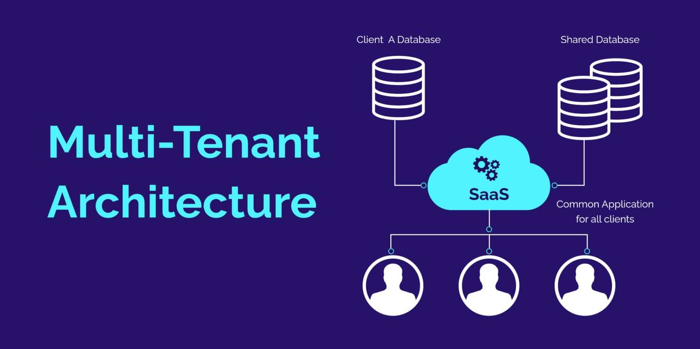
Multi-Tenancy
In multi-tenant software architecture—also called software multitenancy—a single instance of a software application (and its underlying database and hardware) serves multiple tenants (or user accounts)

Slide 20
Key technologies
Front-End
Angular v14.0.4
NodeJS v16.10.0
Back-End
PHP v7.4.33
Laravel 8
Pneumonia Detection Model
Flask v 1.1.2
Mobile App
Flutter v3.0.0
Python v3.9.7
Database
MySQL v8.0.3
Google Colab

Slide 21
PART FOUR
Implementation and Challenges

Slide 22
Implementation and Challenges
Integration with online payment (PayMob)
Pneumonia Detection Model integration using Flask API.
How to make the multitenancy dynamic.
How to Deploy the model and Flask API on Azure.

Slide 23
PART FIVE
Future Enhancements

Slide 24
Future enhancement
As for our recommendation how to enhance the project if we are given the right resources, we want to
Connect smart watches to our system, and from them we track the user’s health status such as heartbeat and such things, so we process this data and suggestion The patient should visit the specialist doctor in case of something abnormal.
We will use artificial intelligence to detect more diseases, for example Alzheimer’s Disease Detection using Deep Learning

Slide 25
?
Any Questions

Slide 26
THANKS!

