Slide 1
APPMOB - Introduction
Olivier Liechti & Simon Oulevay
COMEM Applications Mobiles

Slide 2

Objectives

Slide 3
Objectives for the course
Develop a multi-platform hybrid mobile application with Ionic:
  Build on the Citizen Engagement API developed in the previous course
  Understand the basics of the Ionic mobile application framework
  Understand the basics of the AngularJS web framework
  Use native mobile functionality:
    Camera
  Learn to integrate external libraries and services:
    Geo-location
    Mapbox

Slide 4

Theme

Slide 5
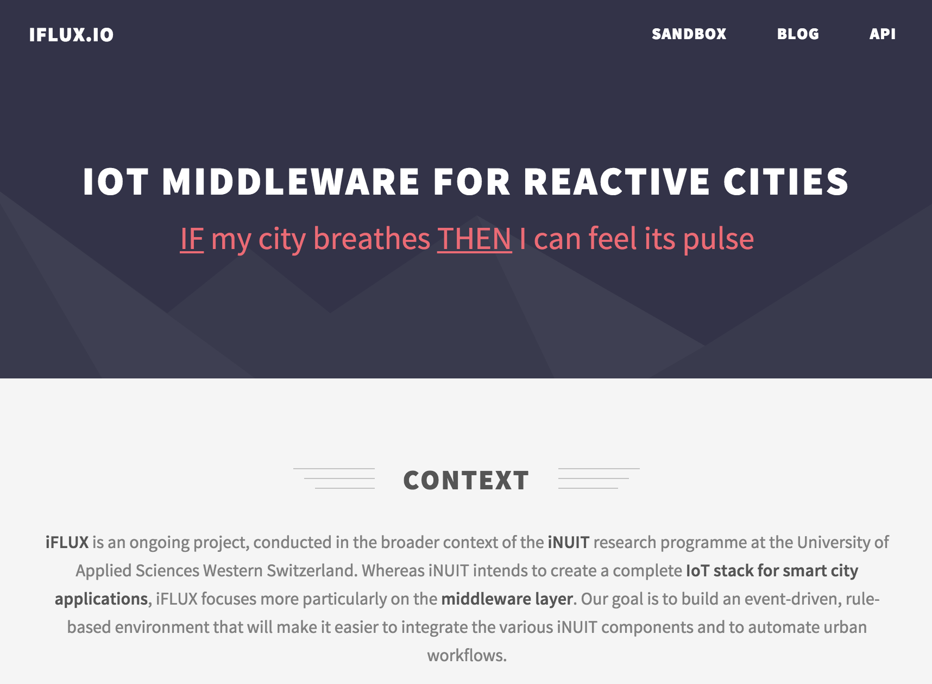

Slide 6
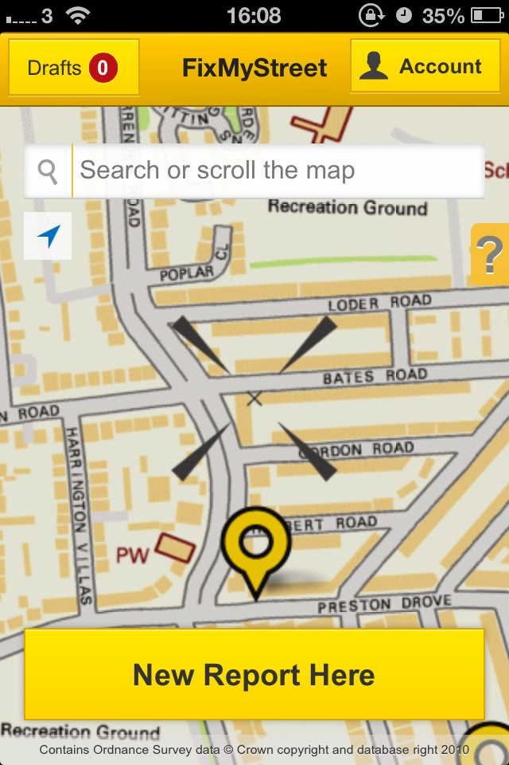
Web Services
Course
Mobile App
Course

Slide 7

Planning & Guidelines

Slide 8
Today (April 4th)
Introduction
The Ionic Framework Concepts & Installation
AngularJS Concepts
Application Setup UI Design & Skeleton App

Slide 9
After Today (April 5th to April 8th)
The Angular Scope Angular UI Router
Asynchronous JavaScript in Angular Web Geo-location
Mapbox Integration JavaScript Closures
Cordova Camera Plugin Image Upload

