Slide 1
APPMOB - The Ionic Framework
Olivier Liechti & Simon Oulevay
COMEM Applications Mobiles

Slide 2






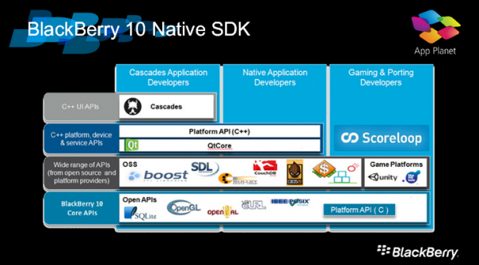
Which OS should I support?
lolwut?

Slide 3
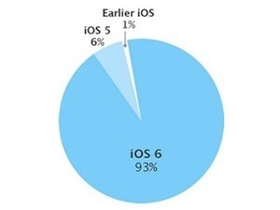
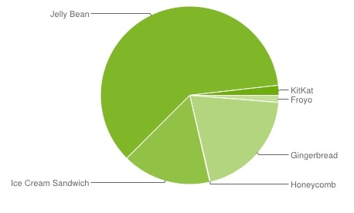
How do I deal with OS fragmentation?
Android
fragmentation
iOS
fragmentation

Slide 4

A solution: Apache Cordova
Apache Cordova is a set of device APIs that allow a mobile app developer to access native device function such as the camera or accelerometer from JavaScript. Combined with a UI framework such as jQuery Mobile or Dojo Mobile or Sencha Touch, this allows a smartphone app to be developed with just HTML, CSS, and JavaScript.
http://cordova.apache.org/

Slide 5





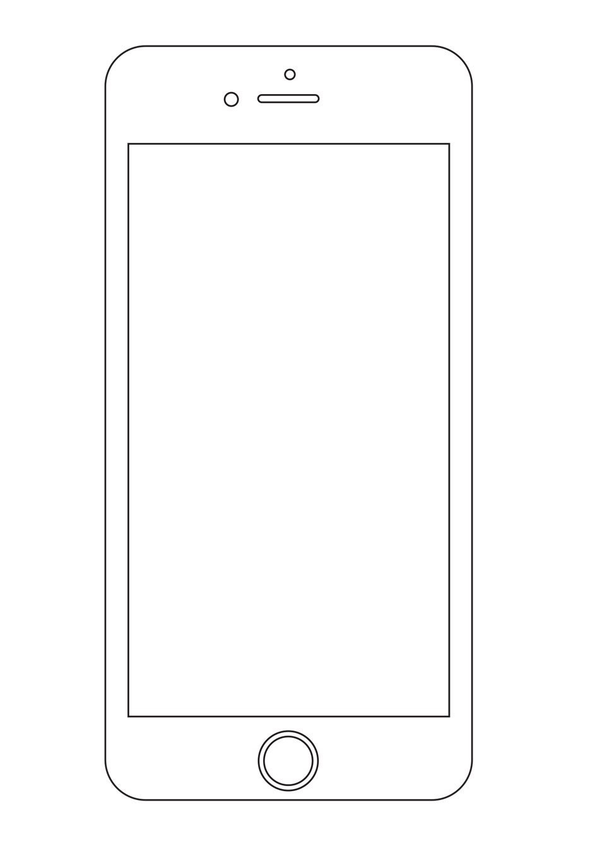
Apache Cordova: what is it?
Code your app with HTML,
CSS and JS, like a website
Embed it as a
native mobile app

Slide 6


Apache Cordova: what is it?
Access native device
functionality from Javascript.
Camera
Geolocation

Slide 7

What else? The Ionic Framework
Create hybrid mobile apps with the web technologies you love.
Free and open source, Ionic offers a library of mobile-optimized HTML, CSS and JS components, gestures, and tools for building highly interactive apps. Built with Sass and optimized for AngularJS.
http://ionicframework.com/

Slide 8

Ionic: a combination
+

Slide 9
Ionic & AngularJS
HTML enhanced for web apps!
A match made in heaven. Ionic utilizes AngularJS in order to create a framework most suited to develop rich and robust applications. Ionic not only looks nice, but its core architecture is for serious app development, and AngularJS ties in perfectly.
https://angularjs.org/

Slide 10
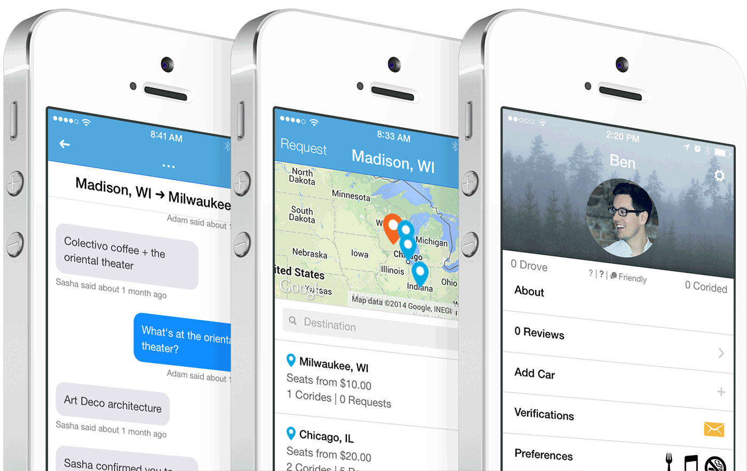
Ionic: designed for mobile
Build apps that look like native apps with HTML, CSS and JS.

Slide 11
Ionic: The Basics

Slide 12


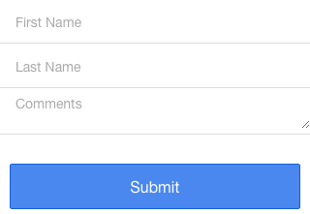
Ionic: CSS
<button class="button button-positive">
button-positive
</button>
<div class="card">
<div class="item item-text-wrap">
This is a basic Card which contains an item that has wrapping text.
</div>
</div>
<div class="list">
<label class="item item-input">
<input type="text" placeholder="First Name">
</label>
<label class="item item-input">
<input type="text" placeholder="Last Name">
</label>
<label class="item item-input">
<textarea placeholder="Comments"></textarea>
</label>
</div>
<button class="button button-block button-positive">
Submit
</button>

Slide 13
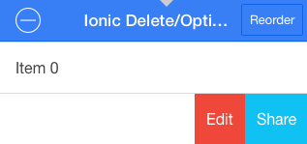
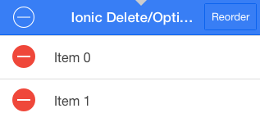
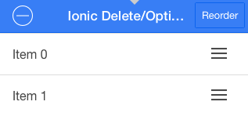
Ionic: AngularJS extensions
<ion-list ng-controller="MyCtrl"
show-delete="true"
show-reorder="true"
can-swipe=“true">
<ion-item ng-repeat="item in items" class="item-thumbnail-left">
<p>Item 0</p>
<ion-option-button class="button-positive"
ng-click="share(item)">
Share
</ion-option-button>
<ion-option-button class="button-info"
ng-click="edit(item)">
Edit
</ion-option-button>
<ion-delete-button class="ion-minus-circled"
ng-click="items.splice($index, 1)">
</ion-delete-button>
<ion-reorder-button class="ion-navicon"
on-reorder="reorderItem(item, $fromIndex, $toIndex)">
</ion-reorder-button>
</ion-item>
</ion-list>

Slide 14

Ionic: Installation
https://nodejs.org/

Slide 15
Ionic: Installation
$> npm install -g cordova ionic
You might need to use sudo for the correct access rights:
$> sudo npm install -g cordova ionic

Slide 16
Ionic: Starter App
Let’s see what an app looks like…
$> cd /where/you/want/your/projects
$> ionic start myApp tabs

Slide 17
Ionic: Serving Apps Locally
With Ionic, you can run your mobile app in your browser. This is very useful for quick development and testing.
$> cd myApp
$> ionic serve
Check out http://localhost:8100/ in your browser.

Slide 18
Ionic: iOS
Install Xcode from the App Store.
Then:
$> sudo npm install -g ios-sim
$> cd myApp
$> ionic platform add ios
$> ionic build ios

Slide 19
Ionic: iOS emulator
Simply:
$> cd myApp
$> ionic emulate ios

Slide 20
Ionic: iOS device
To run an app on an iOS device, it must be signed with a valid developer certificate. You must join the iOS Developer Program for $99/year.
$> ionic run ios

Slide 21
Ionic: iOS View App
For a free alternative, install the Ionic View App from the App Store, and register an Ionic Apps account:
https://apps.ionic.io/
You can then upload your app to your Ionic account:
$> ionic upload
You should then see your app in the Ionic View App and be able to run it.

Slide 22
Ionic: Android
If you don’t have the Android SDK already, install Android Studio:
http://developer.android.com/sdk/index.html
Open it and in the Welcome window, click Configure > Project Defaults > Project Structure. Copy the Android SDK location.
Add the SDK location to your PATH as described in the Requirements and Support section of the following article:
http://cordova.apache.org/docs/en/latest/guide/platforms/android/index.html

Slide 23
Ionic: Android
On OS X, if Android Studio cannot find your
Java SDK, run the following command:
$> launchctl setenv STUDIO_JDK /path/to/sdk

Slide 24
Ionic: Android
Check that your terminal can find the commands
of the Android SDK tools and Apache Ant:
$> which android
/path/to/android/sdk/tools/android
If which doesn’t show you the path to the command, your PATH is not set up correctly. (Don’t forget to restart your terminal.)

Slide 25
Ionic: Android
Open the SDK:
$> android
Check and install the following:
Latest Android SDK Tools
Latest Android SDK Platform Tools
Latest Android SDK Build Tools
Android 4.4.2 (API 19) or more recent

Slide 26
Ionic: Android
Finally, add the Android platform to your app:
$> cd myApp
$> ionic platform add android
$> ionic build android
Run your app in the emulator:
$> ionic emulate android
Deploy your app to a connected device:
$> ionic run android

