Slide 1
APPMOB - Setup
Olivier Liechti & Simon Oulevay
COMEM Applications Mobiles

Slide 2
UI Design

Slide 3
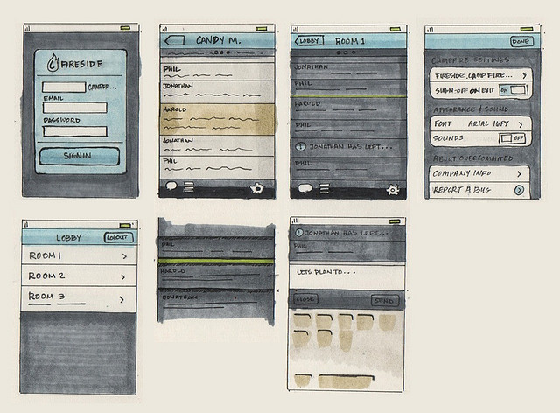
Let's do some mock-ups
Sketch what your mobile application is going to do.

Slide 4
What should be in the mock-ups?
A rough sketch of each screen (placement of UI elements).
Additional interactions on each screen (e.g. popups).
The relationships between the screens (how to go from one screen to another).

Slide 5

Mock-up tools
https://www.fluidui.com/
http://mockup.io/

Slide 6
Application setup

Slide 7
Follow the instructions
https://github.com/SoftEng-HEIGVD/Teaching-HEIGVD-CM_APPMOB-2016-CitizenEngagement
You will find instructions in the README

