Slide 1
APPMOB - AngularJS Scopes
Olivier Liechti & Simon Oulevay
COMEM Applications Mobiles

Slide 2
What is a Scope?
The scope is the glue between application controller and the view.
Every time you use a directive like ng-app, ng-controller or ng-repeat, a new scope is created.
<div ng-controller="GreetCtrl">
Hello {{ name }}!
</div>
<div ng-controller="ListCtrl">
<ol>
<li ng-repeat="name in names">
{{ name }}
</li>
</ol>
</div>
.controller("GreetCtrl", function($scope) {
$scope.name = "World";
}])
.controller("ListCtrl", function($scope) {
$scope.names = ["Igor", "Misko", "Vojta"];
})
This first scope is limited to this div tag.
With this ng-repeat, Angular will automatically create 3 new scopes, one for each line. Each of these scopes will have the name property set to the next name in the list.

Slide 3
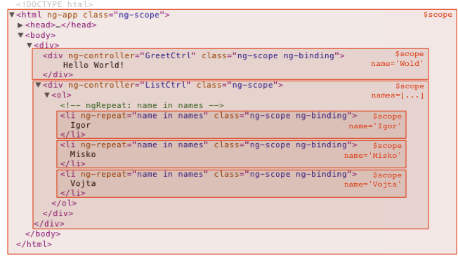
Scope Hierarchy
Scopes form a hierarchy. Each new scope is added as a child scope of their parent scope.

Slide 4
Scope Prototypal Inheritance
Child scopes prototypically inherit from their parent scope.
The ng-app directive creates the special $rootScope, the top-level scope of your whole application.
You can inject the $rootScope in any controller or service.
angular.module("scope-demo", [])
.controller("GreetCtrl", function($scope, $rootScope) {
$scope.name = "World";
$rootScope.department = "Angular";
}])
.controller("ListCtrl", function($log, $scope) {
$scope.names = ["Igor", "Misko", "Vojta"];
$log.debug($scope.department); // "Angular"
});
<html ng-app="scope-demo">
<head>…</head>
<body>
<div ng-controller="GreetCtrl">
Hello {{ name }}!
</div>
<div ng-controller="ListCtrl">
<ol>
<li ng-repeat="name in names">
{{ name }} from {{ department }}
</li>
</ol>
</div>
</body>
</html>
Anything you add on the $rootScope is available on all scopes.
The department property was not defined on the ng-repeat scope. It is available because it is prototypically inherited through the scope created by ListCtrl and the $rootScope.

Slide 5
Scope Events
Scopes can propagate events in similar fashion to DOM events. Events can be broadcasted to the scope children or emitted to scope parents.
.controller("AnyCtrl", function($scope) {
// Emit an event to all parent scopes.
$scope.$emit("somethingHappened", { data: "foo" });
// Broadcast an event to all child scopes.
$scope.$broadcast("somethingElseHappened", 1, 2, 3);
// Listen for an event.
$scope.$on("eventName", function(event, arg1, arg2) {
// The callback function will be called with an event object
// and the arguments passed to $emit or $broadcast.
});
}])
http://codepen.io/AlphaHydrae/pen/emQPzY/

Slide 6
More Information
https://docs.angularjs.org/guide/scope/
https://github.com/angular/angular.js/wiki/Understanding-Scopes/

