Slide 1
APPMOB - Mapbox
Olivier Liechti & Simon Oulevay
COMEM Applications Mobiles

Slide 2

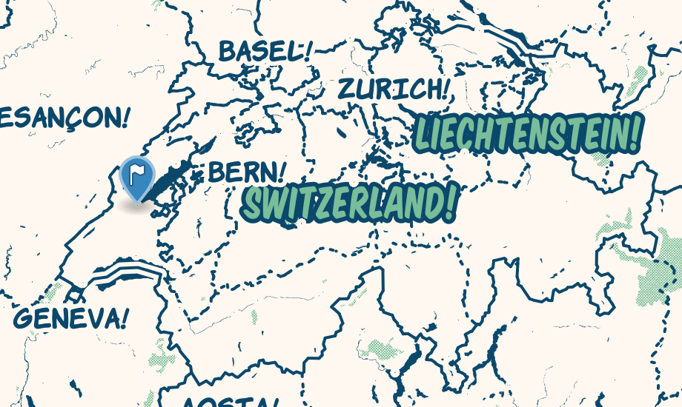
Mapbox: Customizable Maps

Slide 3
Can I use Mapbox with AngularJS?
http://lmgtfy.com/?q=mapbox+angularjs

Slide 4
Angular Leaflet Directive
A directive has already been made for you:
https://github.com/tombatossals/angular-leaflet-directive/
http://tombatossals.github.io/angular-leaflet-directive/

Slide 5
Using Bower
$> bower search angular-leaflet-directive
angular-leaflet-directive git://github.com/tombatossals/angular-leaflet-directive
angular-leaflet git://github.com/tombatossals/angular-leaflet-directive.git
ws-angular-leaflet-directive git://github.com/ws-anashkin/angular-leaflet-directive.git
angular-leaflet-directive-ext git://github.com/Asymmetrik/angular-leaflet-directive-ext.git
angular-leaflet-directive-ws git://github.com/ws-anashkin/angular-leaflet-directive.git
angular-leaflet-directive-temp git://github.com/TheCodeDestroyer/angular-leaflet-directive.git
angular-leaflet-directive-websailors git://github.com/ws-anashkin/angular-leaflet-directive.git
wavel-leaflet-directive git://github.com/Arnooo/angular-leaflet-directive.git
$> bower install --save angular-leaflet-directive
angular-leaflet-directive#0.10.0 www/lib/angular-leaflet-directive
├── angular#1.4.3
└── leaflet#0.7.7
leaflet#0.7.7 www/lib/leaflet

Slide 6
Include the Javascript files
Add the required files to index.html:
<html>
<head>
…
<!-- add the stylesheets here -->
<link href="lib/leaflet/dist/leaflet.css" rel="stylesheet">
…
<!-- ionic/angularjs js -->
<script src="lib/ionic/js/ionic.bundle.js"></script>
<script src="lib/a0-angular-storage/dist/angular-storage.js"></script>
<!-- add the javascripts here (AFTER the ionic library) -->
<script src="lib/leaflet/dist/leaflet-src.js"></script>
<script src="lib/angular-leaflet-directive/dist/angular-leaflet-directive.js"></script>
</head>
<body>
…
</body>
</html>

Slide 7
Mapbox Configuration
You will need:
a map ID
a public access token

Slide 8
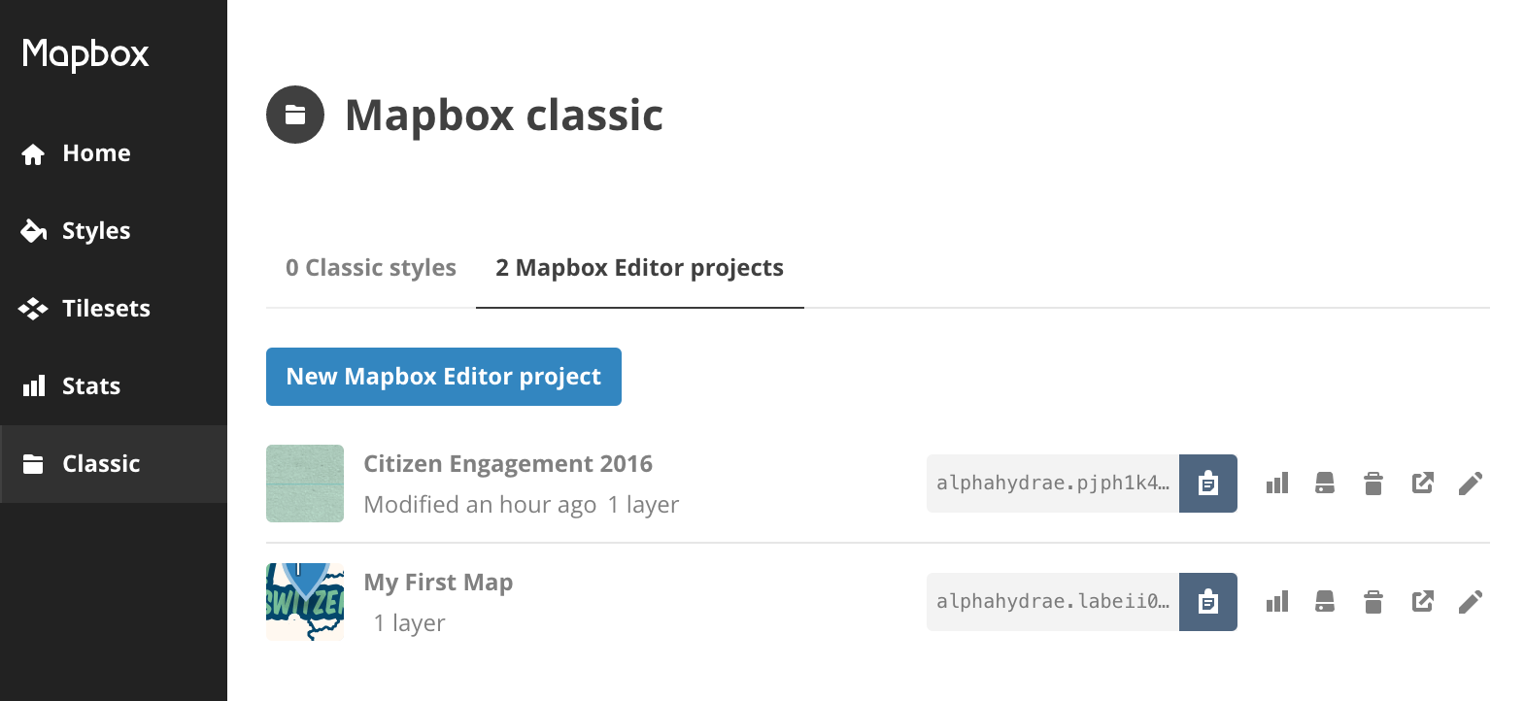
Create a Mapbox editor project
Retrieve your map ID.

Slide 9
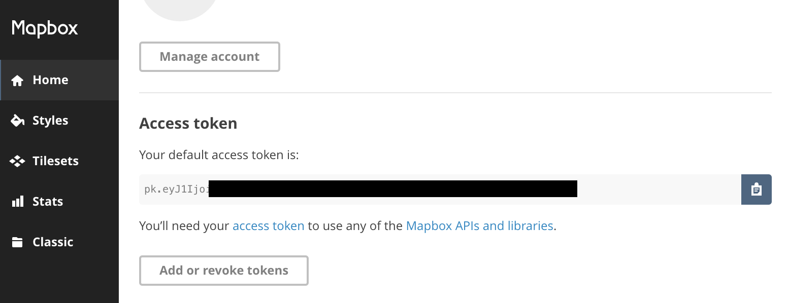
Retrieve your access token

Slide 10
Mapbox Configuration
You should add them to your configuration files:
In:
config/development.json
config/production.json
{
"apiUrl": "http://api.example.com",
"mapboxMapId": "…",
"mapboxAccessToken": "…",
}
angular.module("citizen-engagement.constants", [])
.constant("apiUrl", "@apiUrl@")
.constant("mapboxMapId", "@mapboxMapId@")
.constant("mapboxAccessToken", "@mapboxAccessToken@")
;
In constants.js (root directory of the app):
In gulpfile.js:
.pipe(replace(/@apiUrl@/, config.apiUrl))
.pipe(replace(/@mapboxMapId@/, config.mapboxMapId))
.pipe(replace(/@mapboxAccessToken@/, config.mapboxAccessToken))
Don't forget to re-run gulp config-development or gulp config-production to apply the new configuration.

Slide 11
Add the AngularJS module
Add the new dependency to your application module:
angular.module("citizen-engagement", ["…", "leaflet-directive"])
Add the required data to your controller:
.controller("MapController", function($scope, mapboxMapId, mapboxAccessToken) {
var mapboxTileLayer = "http://api.tiles.mapbox.com/v4/" + mapboxMapId;
mapboxTileLayer = mapboxTileLayer + "/{z}/{x}/{y}.png?access_token=" + mapboxAccessToken;
$scope.mapDefaults = {
tileLayer: mapboxTileLayer
};
$scope.mapCenter = {
lat: 51.48,
lng: 0,
zoom: 14
};
$scope.mapMarkers = [];
});
Add the directive to your template:
<ion-content scroll="false">
<leaflet defaults="mapDefaults" center="mapCenter" markers="mapMarkers" height="100%" data-tap-disabled="true"></leaflet>
</ion-content>

Slide 12
Mapbox: Adding a Marker
Simply add it to the mapMarkers $scope variable. The directive will automatically be updated.
.controller("MapController", function(IssueService, mapboxMapId, mapboxAccessToken) {
// …
$scope.mapMarkers = [];
var issue = IssueService.getIssue();
$scope.mapMarkers.push({
lat: issue.lat,
lng: issue.lng,
message: "<p>{{ issue.description }}</p><img src="{{ issue.imageUrl }}" width="200px" />",
getMessageScope: function() {
var scope = $scope.$new();
scope.issue = issue;
return scope;
}
});
});

Slide 13
Beware of The Bug
If you copy-paste examples from the angular-leaflet-directive project, don't forget to add the data-tap-disabled="true" attribute.
<leaflet defaults="mapDefaults" center="mapCenter" markers="mapMarkers" data-tap-disabled="true"></leaflet>
http://ionicframework.com/docs/api/page/tap/
http://forum.ionicframework.com/t/click-on-a-marker-of-leafletmap-not-working/4378/

