Slide 1
APPMOB - Image Upload
Olivier Liechti & Simon Oulevay
COMEM Applications Mobiles

Slide 2
Using the Cordova Camera API
http://learn.ionicframework.com/formulas/cordova-camera/

Slide 3
Add the Plugin
Add the plugin (from your project directory):
$> cordova plugin add cordova-plugin-camera
Create a service to wrap the native functionality:
.factory("CameraService", function($q) {
return {
getPicture: function(options) {
var deferred = $q.defer();
navigator.camera.getPicture(function(result) {
// do any magic you need
deferred.resolve(result);
}, function(err) {
deferred.reject(err);
}, options);
return deferred.promise;
}
}
});

Slide 4
Take Pictures
.controller("AnyController", function(CameraService) {
CameraService.getPicture({
quality: 75,
targetWidth: 400,
targetHeight: 300,
destinationType: Camera.DestinationType.DATA_URL
}).then(function(imageData) {
// do something with imageData
});
});

Slide 5
Native Functionality
Remember!
Taking pictures will only work on an actual phone or tablet. It will not work in your browser or in an emulator.

Slide 6
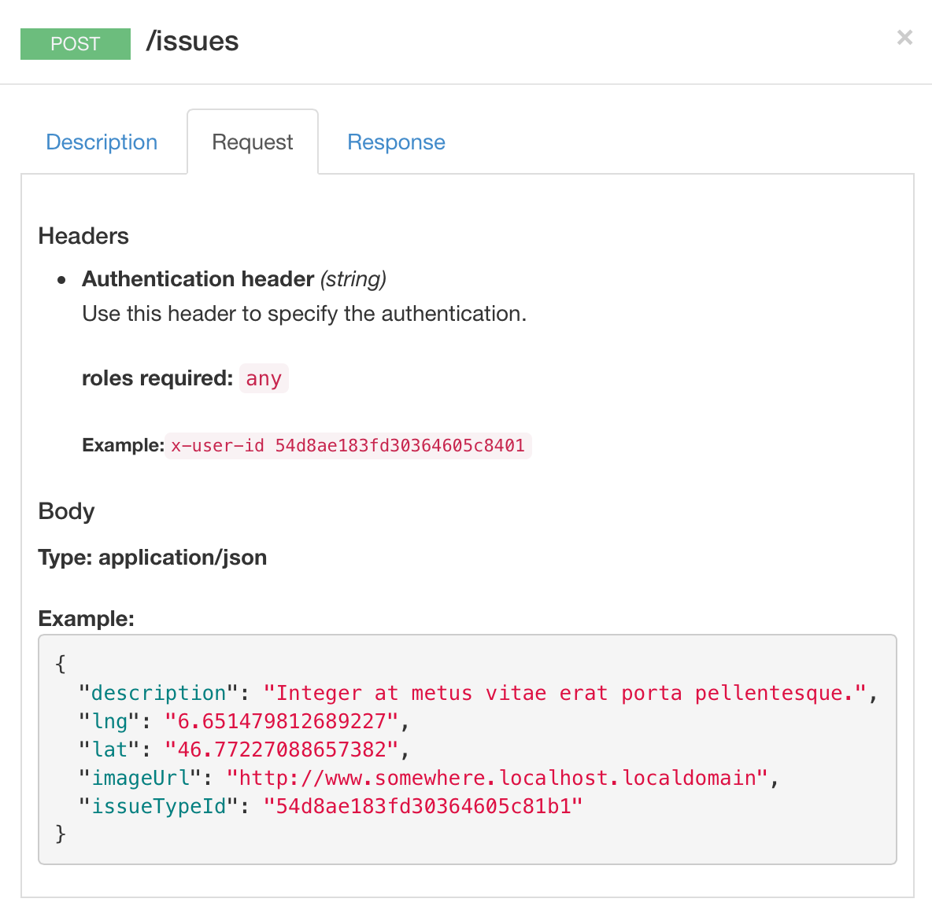
Adding Images to Issues

Slide 7
Image Upload
The API only accepts an image URL.
So you have to:
take the picture
upload it somewhere and get an URL
create the issue with the image URL

Slide 8
Where to Upload?
Flickr?
Image Shack?
Amazon S3?

Slide 9
Quick Image Service
GitHub Repository
https://github.com/SoftEng-HEIGVD/qimg/
API Documentation
http://softeng-heigvd.github.io/qimg/
API Endpoint
https://warm-bastion-3094.herokuapp.com/api

Slide 10
qimg Limitations
Images cannot be larger than 2MB.
You cannot store more than 50 images (per user).

Slide 11
qimg API Credentials
Ask for an authentication token by e-mail:
simon.oulevay@heig-vd.ch

Slide 12
qimg Configuration
You will need to add some configuration:
In:
config/development.json
config/production.json
{
// ...
"qimgUrl": "…",
"qimgToken": "…",
}
angular.module("citizen-engagement.constants", [])
// ...
.constant("qimgUrl", "@qimgUrl@")
.constant("qimgToken", "@qimgToken@")
;
In constants.js (root directory of the app):
In gulpfile.js:
// ...
.pipe(replace(/@qimgUrl@/, config.qimgUrl))
.pipe(replace(/@qimgToken@/, config.qimgToken))
Don't forget to re-run gulp config-development or gulp config-production to apply the new configuration.

Slide 13
qimg Proxy
In development, you will need a proxy.
In config/development.json, the URL should be:
{
// ...
"qimgUrl": "http://localhost:8100/qimg-proxy",
}
Add a proxy to ionic.project:
{
"name": "...",
"proxies": [
{ ... },
{
"path": "/qimg-proxy",
"proxyUrl": "https://warm-bastion-3094.herokuapp.com/api"
}
]
}
Restart ionic serve if it's running.

Slide 14
Sample Code
.controller("AnyController", function(CameraService, $http, qimgUrl, qimgToken) {
// take the picture
CameraService.getPicture({
quality: 75,
targetWidth: 400,
targetHeight: 300,
// return base64-encoded data instead of a file
destinationType: Camera.DestinationType.DATA_URL
}).then(function(imageData) {
// upload the image
$http({
method: "POST",
url: qimgUrl + "/images",
headers: {
Authorization: "Bearer " + qimgToken
},
data: {
data: imageData
}
}).success(function(data) {
var imageUrl = data.url;
// do something with imageUrl
});
});
})

