Slide 1
Lunch & Learn: git
Adam, Phil
Engineering
August 6, 2015

Slide 2
One thing software engineers find harder than writing code is…
2
…writing code in a team

Slide 3
Revision Control System
3
a.k.a version control or source control
track and provide control over changes to a set of data (e.g.: source code, but anything)
Common architectures: Peer-2-peer or Client-Server

Slide 4

4
distributed revision control system
Linus Torvalds
BitKeeper: maintains linux kernel until 2005
Dispute over Bitkeeper leads to git

Slide 5


5
git repository hosting service
launched in 2008
Example of financial success built on open source software
Year 1: 46,000 repos
2009: 100,000 users
2010: 1 million repos
2011: 2 million repos
2013: 10 million repos
Notes:
- Notifications
Search

Slide 6
git 101
6
Set up repository: HeyRecipes
git clone
Add file to repository: add (git index)
Change file content: commit (git status, whatthecommit.com)
Make modifications: push, pull
Make collision

Slide 7
Not just for source code
7
Quine relay: https://github.com/mame/quine-relay
Cookbook: http://forkthecookbook.com/
Investment docs: https://github.com/seriesseed/equity
Guy’s DNA: https://github.com/msporny/dna
Bug tracker for house: https://github.com/canadaduane/house
Germany law: https://github.com/bundestag/gesetze
Congressional districts map: https://github.com/benbalter/congressional-districts
Manuscript: https://github.com/JJ/hoborg
Guy’s travel log: https://github.com/xzyfer/us-travel-checklist

Slide 8
git resources
8
Books
http://www.git-scm.com/book/en/v2
Git Clients
Mac
http://www.git-tower.com/
https://mac.github.com/
https://www.sourcetreeapp.com/
Windows
http://code.google.com/p/gitextensions/
http://msysgit.github.io/
https://windows.github.com/
https://www.sourcetreeapp.com/

Slide 9
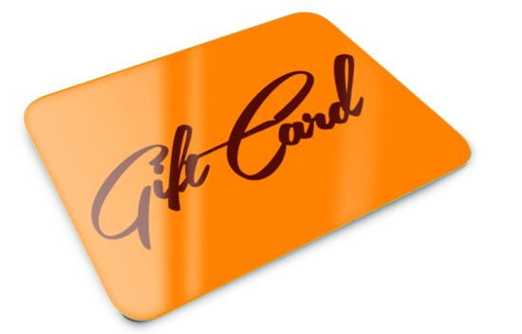
Pay it forward:
9
This git repository:
https://github.com/MediaFriendsInc2/HeyRecipes
Notes:
Just click the icon and then choose your photo, after that right click -> Send to Back

Slide 10
?

