Slide 1
Presentation
Web applicatie
Media Group 5
Barroc-it
Made by:
Dean, Mitch, Rick and Jordy

Slide 2
table of contents

Slide 3
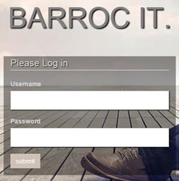
Login
Username
Password

Slide 4
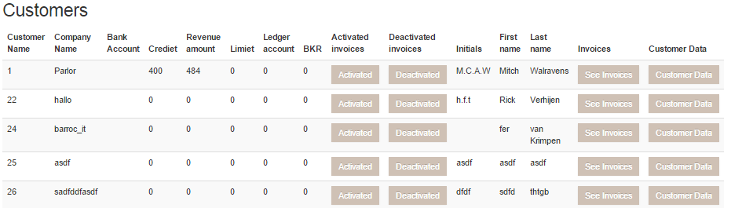
Finance
Navigator & Customers
Activated & deactivated
See invoices
Customer data

Slide 5
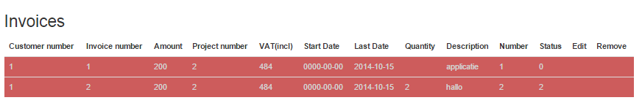
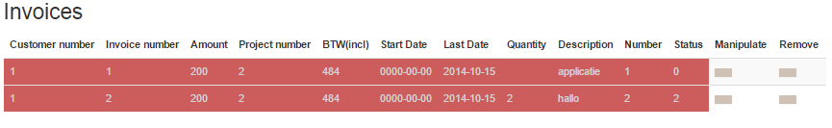
Finance - Invoices
All activated invoices
All invoices
Edit & remove

Slide 6
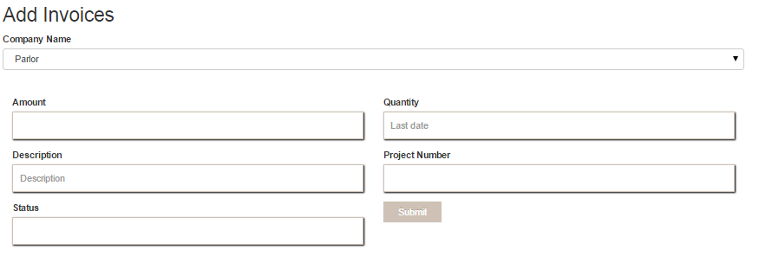
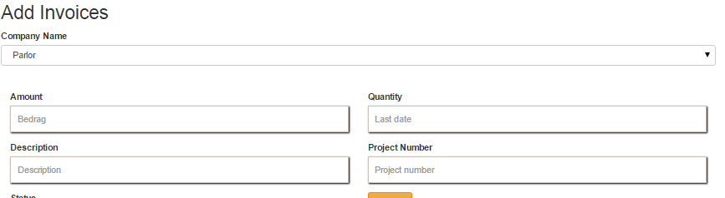
Finance – Add invoices

Slide 7
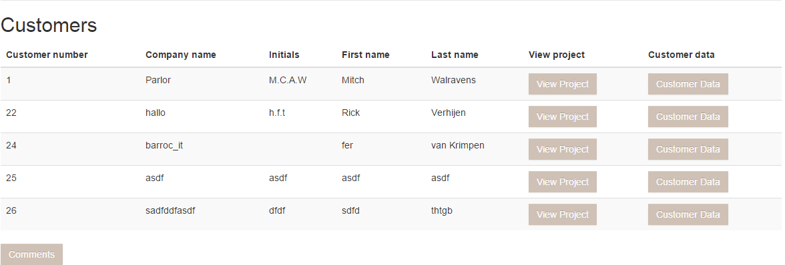
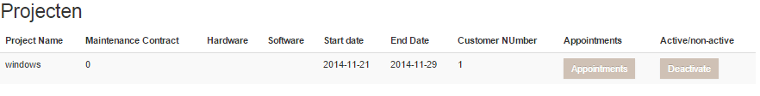
Development

Slide 8
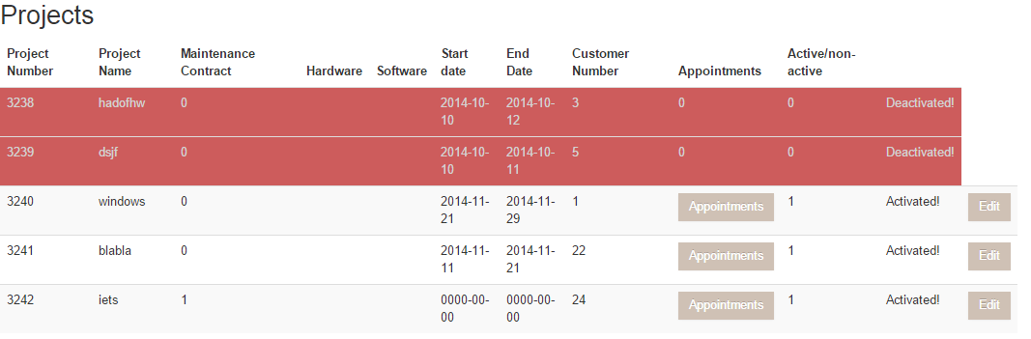
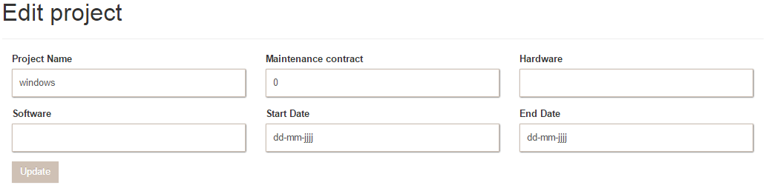
Development - Project

Slide 9
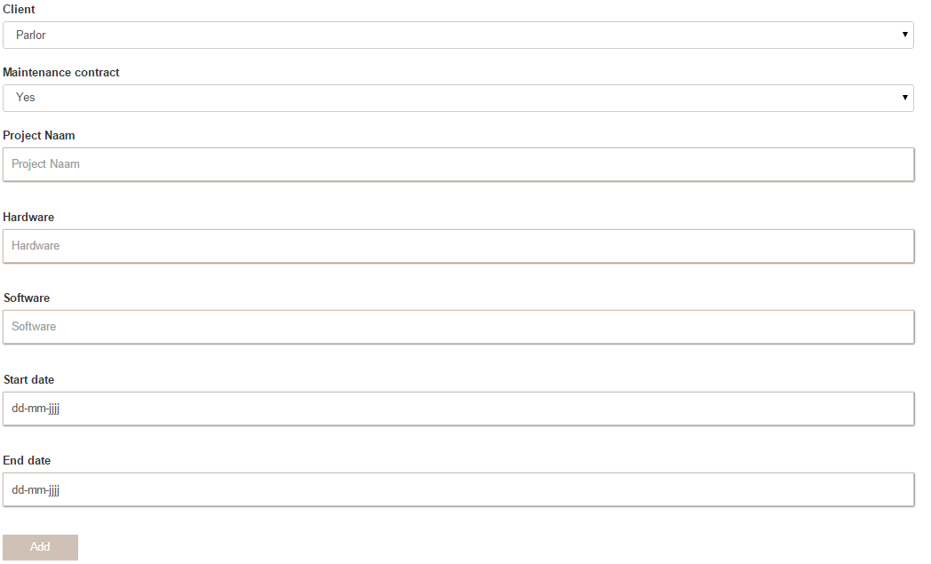
Development – Add Project

Slide 10
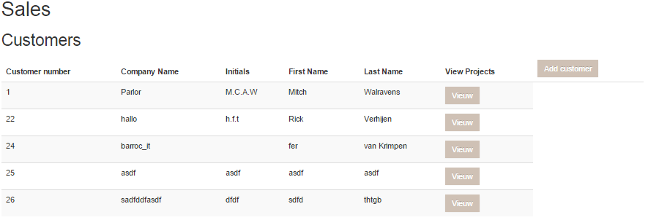
Sales

Slide 11
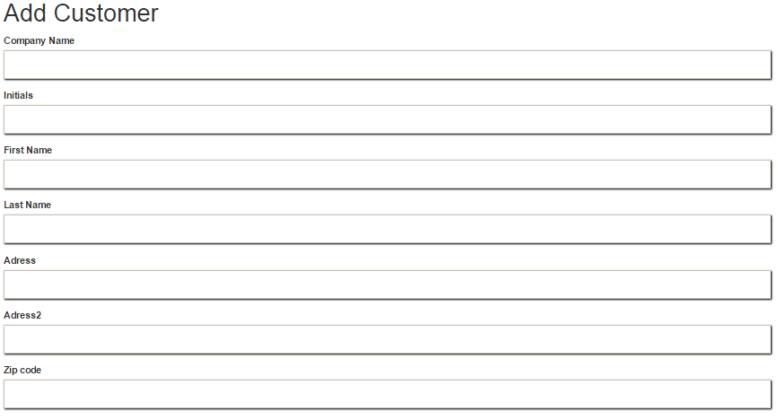
Sales – Add Customer

Slide 12
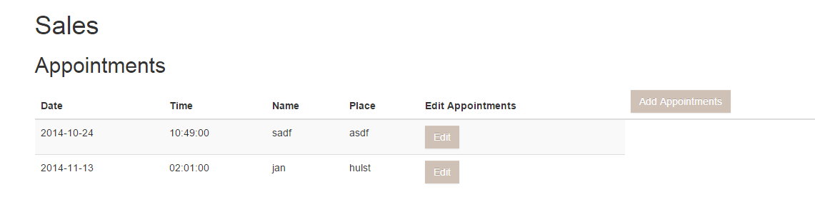
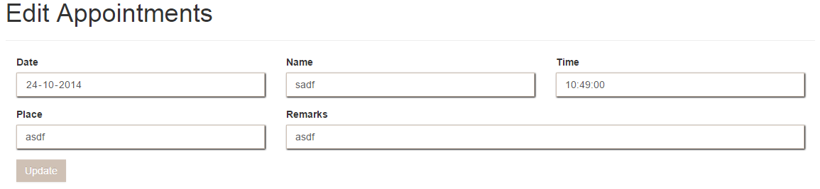
Sales - Appointments

Slide 13
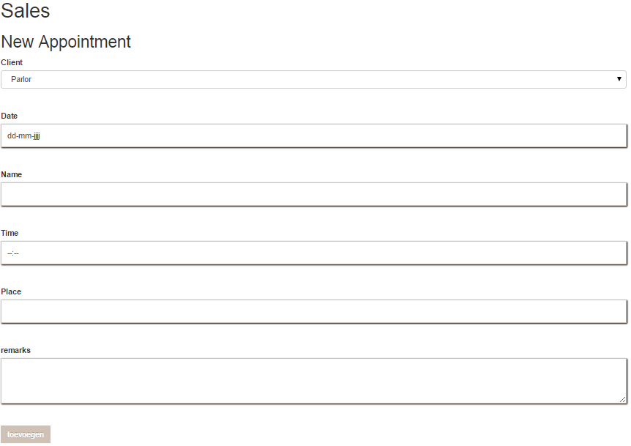
Sales – Add Appointments

Slide 14
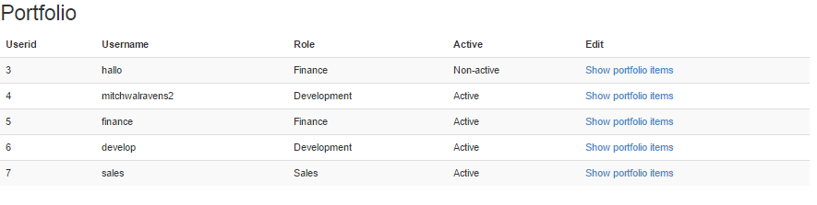
Portfolio

Slide 15
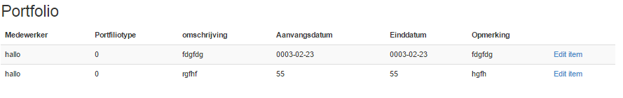
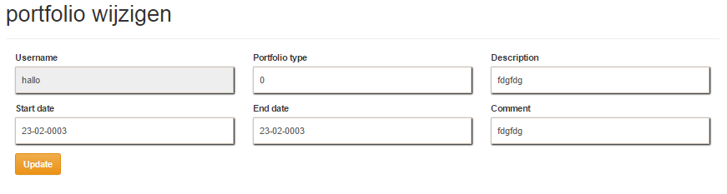
Portfolio - items

Slide 16
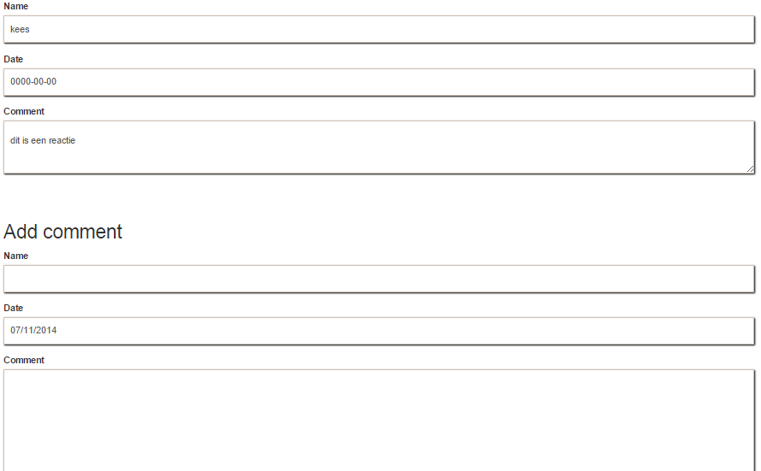
Comments

Slide 17

The End
Any Questions?

