Slide 1
ETL infra
Medial EarlySign
February 2023

Slide 2
Agenda
Motivation + main idea
Overview of 2/3 main API functionalities + pipeline diagram
Detailed explanation on each API
Walk through example
Todo list + discussion

Slide 3
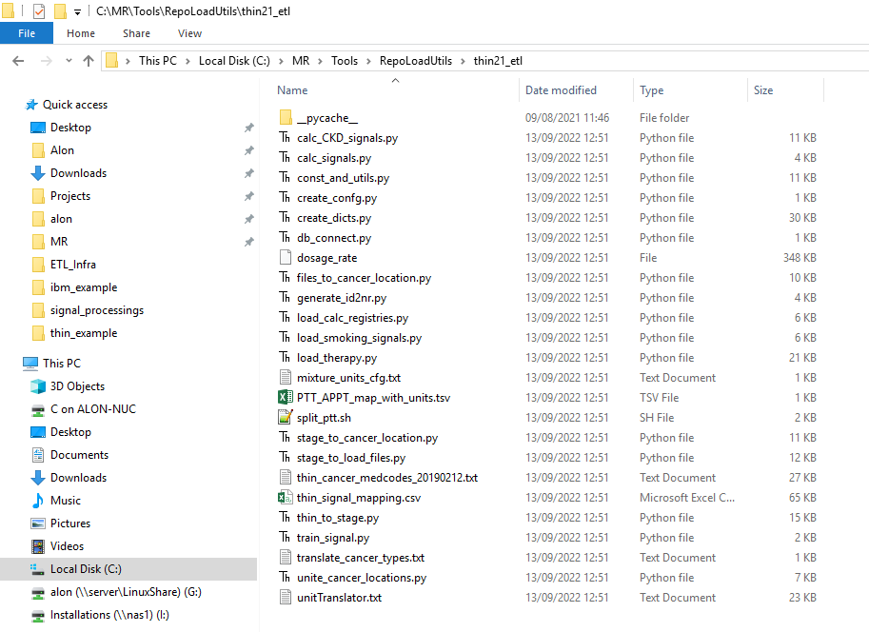
Motivation
Our ETL is messy process – mostly not very complicated, but not well arranged
There are many trail & errors in loading format/debugging that makes the code dirty and hard to reproduce
Almost no reusable code – hard to handle batches, tests, formats…
There are more files to scroll…
What to run and in which order?
There are manual operations

Slide 4
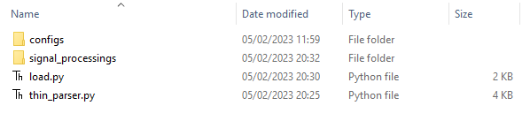
Main solution key points
Simple API process with only 2/3 API functions with no complicates inputs
Force clear code structure for each data type: parsing, processing, testing
All things that can be automated are automated
Reuse of global knowledge
Keep logging of process
Global stuff in infrastructure VS load specific in specific ETL folder
Code: need to run – load.py

Slide 5
API functions
prepare_final_signals - Preparation of signal/s loading files for specific source data type
prepare_dicts – prepare special dictionaries (only needed when client have special dicts)
finish_prepare_load - Finalize and prepare config file and command to load with flow
Those functions are called from a simple pipeline/flow control code – no more than 20 lines – in load.py
BTW: The infrastructure code contains all needed information to run in single directory without reference to other paths!

Slide 6
Pipeline flow example

Slide 7
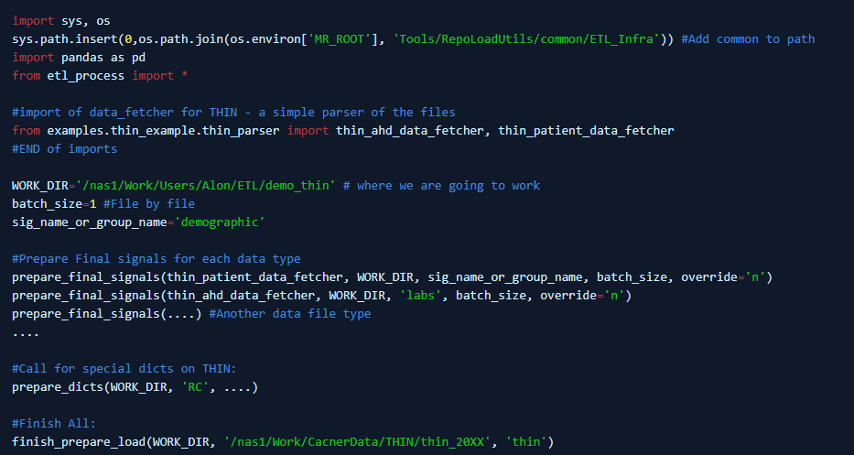
Full pipeline example
http://confluence:8090/display/WIK/ETL+Process+API+calls

Slide 8
ETL parts

Slide 9
The loading process relays on 3 paths
ETL infra directory – can be copied to different machine. All paths are relative
Specific ETL code directory
Workdir – the outputs of the process

Slide 10
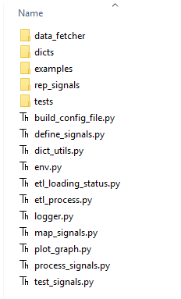
ETL infra directory – Global knowledge+code
data_fetcher – folder with helper modules to process files in batch from directory/db when data is big. Please refer to “examples”
dicts – folder with ontologies and medical vocabularies
examples – folder with examples
rep_signals/rep.signals – “signals” file definitions. Global knowledge of signals. No need to edit if you have no new signals.
tests – folder with “code” to be execute for each signal names/type – easy to extend – just open a new file with “Test” function. wiki_writing_tests
*.py - library code – please use only “etl_process.py” – there are 3 API functions to use from that module

Slide 11
Specific ETL code directory
Configs – folder with resource files
rep.signals – for adding “local” repository specific signals that you don’t want to define in “Global”. Empty file with instructions + commented example will be created for you
map.tsv – will be created for you to rename signals to target signals with each source signal name freqs
… - you can list here more files that you need in processing
Signal_processings – will be created for you and for each signal type a commented section with instruction will be constructed for you to process the signal
Each file is “SIGNALNAME.py” will be executed for each signal to process it (* or if not exists, a generic code class).
load.py – the main flow of the program that uses the 3 API functions ~ 20 lines
thin_parser.py – parser of the files into dataframe. No processings in this step! Only parsing and keeping in original format

Slide 12
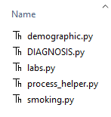
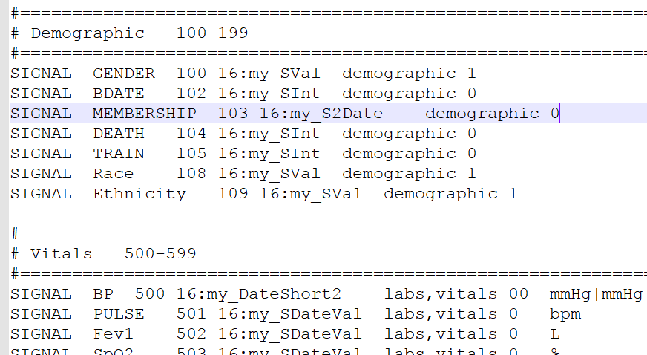
signal_processings example
demographic.py will be executed for “patient” data files in THIN and will create all demographic signals – BDATE,GENDER,DEATH, etc.
DIAGNOSIS.py – will be executed for signal DIAGNOSIS
labs.py – for all ahd files to generate all labs signals
smoking.py - for all ahd files to generate smoking signals
process_helper.py – helper library to be reused in this loading to filter and do common things
Each signal is also contained in a parent class that can be executed to process it (there can be multiple parents).

Slide 13
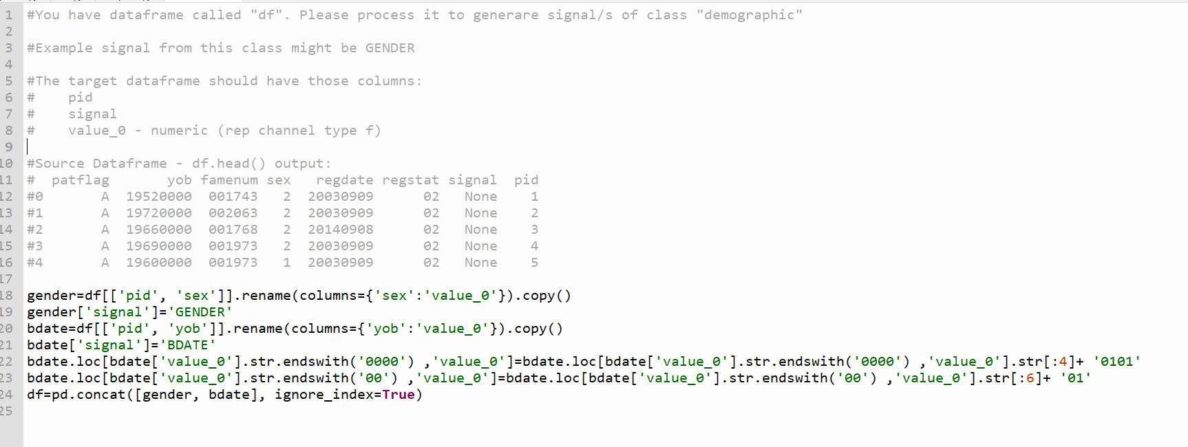
Signal_processing code example:
Instructions were generated for you
Simple demographic processing of BDATE+GENDER – manipulate df

Slide 14
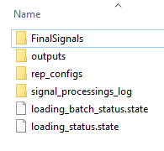
Workdir directory
FinalSignals – no need use manually. Directory with final signals for flow loading + ID2NR (if needed)
outputs – directory with tests for each signal – logging of tests results + distributions of each feature
rep_configs – no need to use manually. Directory with loading configs files: dictionaries, signals file, convert configs and flow command
signal_processings_log – directory with logging of processings + logging of debugging
loading_status* - files that log the loading status of each signal. It will be used when override=‘n’ to skip done signals

Slide 15
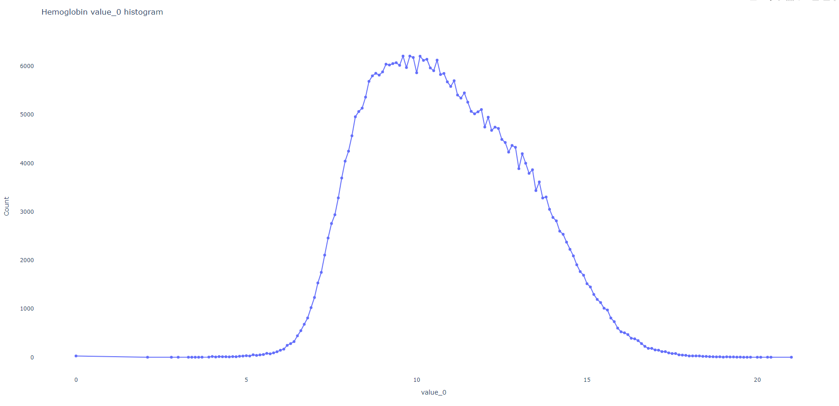
Example outputs – Hemoglobin “value_0”

Slide 16
prepare_final_signals

Slide 17
Process diagram - prepare_final_signals
Data source type 1 – “demographic”
Data source type 2 – “labs”
Data source type 3 – “diagnosis”
…
Call “prepare_final_signals”
for each source data type to prepare data files
The only limit for each datatype is to return dataframe with “pid” column.
Can process BIG dataframe by accepting data_fetcher

Slide 18
Function input
Dataframe/df – dataframe with “pid” column or datafetcher
Workdir - the output directory to process loading files
Signal_type – string with signal type – for processing signal/logging/testing. Please refer to rep.signal to see types
batch_size – controls batch size. 0 – means no batching
Datafetcher will be discuss later with example/s

Slide 19
Process overview
Map signal names (optional)
Process signal
Test signal
General test for signal structure “time channel”, value channel – numeric? No None in pid, time
Customize tests
Sort+store in FinalSignals
If pid is string – convert into number ID2NR
The mapping will be done only for demographic signals – GENDER/BDATE
For other signals, it will only use existing mapping/ no append of new “ids”
Log processing of each batch + each test
Test final signal and log the output
Plot statistics on each signal
Will execute “specific” signal process code
Will generate map file from original signal names+frequency to target naming
For first batch (if no code exists) will allow you to “debug” and write code on the dataframe

Slide 20
Tips
Start preparation of demographic signals – if pid is non numeric it will convert the id’s for you and store them in ID2NR files, in FinalSignals folder. It can also handle batches and large dataset
Please please don’t process the data before – keep the processing to next step. The first step is to parse the data into dataframe

Slide 21
Data Fetcher

Slide 22
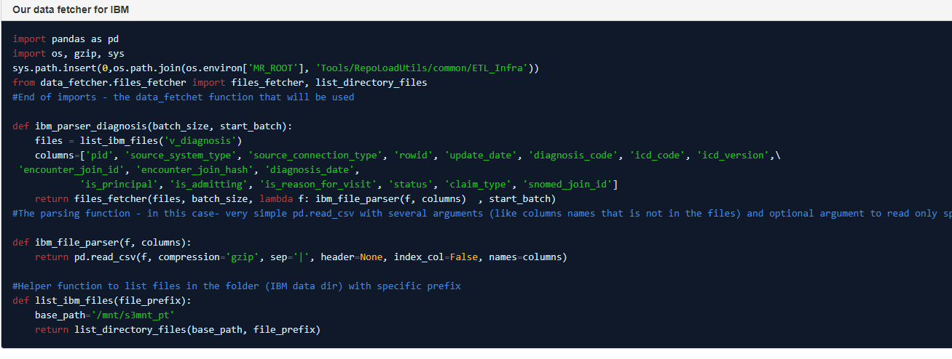
Datafetcher for big datasets with batches
Example: http://confluence:8090/display/WIK/Data+Fetcher

Slide 23
Prepare dicts

Slide 24
prepare_dicts – when to call this?
Categorical dict of signal 1
Categorical dict of signal 2
…
Call “prepare_dicts”
for each different categorical values that are special to client.
Please use “PREFIX_CODE:” to mark each new coding system
Known coding systems doesn’t requires calling this function.
Only adding prefix before codes in the processing of the data
Coding system prefix | description
ICDE10_CODE:/ICD9_CODE: | Diagnosis or procedures (only for PROCEDURE signal) ICD10/ICD9 systems.
ATC: | Medication codes in ATC
RX_CODE: | Medication codes in RX norm codes
NDC_CODE: | Medication codes in NDC codes

Slide 25
Implementation details
The ontologies are defined in “dicts” folder next to ETL code: $MR_ROOT/Tools/RepoLoadUtils/common/ETL_Infra/dicts
If you want to update – update those dicts
If you want to add new coding systems – you will also need to make some changes in dict_utils.py (We might consider automate this also in the future)
get_dicts – controls which dicts are related to each coding system – update dictionary objects: ont_to_dict_path, ont_to_set_path
calc_ontologies – update registration of “coding prefix” to the ontology to load dicts. Update dictionary object: prefix_to_desire
Output: the code will look on all categorical signals – see if the prefix is known – if the prefix is known the relevant dicts will be flagged to be copied into the repository loading dict – you don’t need to do something

Slide 26
Input for function
workdir – the output directory to process loading files
signal – signal name
def_dict (optional) - Dataframe with 2 columns, First column is the "internal client code" and the second column is the description of this code. The name of the columns doesn't matter. This function construct DEF dictionary from this dataframe and gives 2 line for each internal category medial ID. The first row is the "internal client code" second line is the description.
set_dict - Dataframe with 2 columns, first is "parent" in known ontology (ICD10, ATC, depends on the signal type) and the second column is "child" in "client internal coding system". This will construct the mapping between client codes and known ontology.

Slide 27
Finalize

Slide 28
Finalize function
Simplest – called only once in the end. What it does:
process and copy/creates all need dicts
creates signals files
Creates convert configs
Creates the flow command to load the data
All automatically. The inputs are:
Workdir - the output directory to process loading files
dest_folder - string to specify where to store final repository
dest_rep - string to specify repository name. For example "thin"

