Slide 1
OpenMP
A Short Introduction

Slide 2
Why Use OpenMP?
Easy Threading & Parallelization
Cross Platform (Windows, Linux)
Works like Magic !!
One Line to Remember:
#pragma omp parallel for

Slide 3
Threads: Master Thread & Worker Threads
Worker
Thread
Master thread
Master thread
FORK
JOIN
FORK
JOIN
Parallel
Region
Parallel
Region

Slide 4
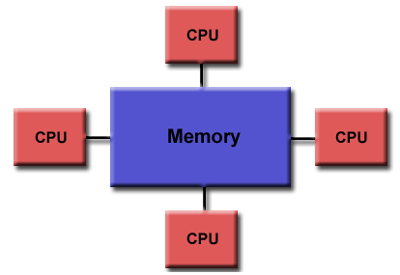
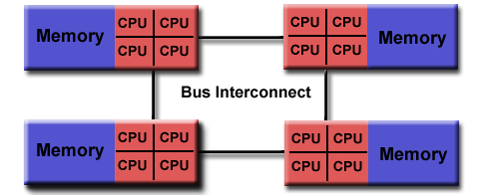
Memory Model
Variables are either Shared or Private
Shared : Each Thread Can read/write the variable
Private : Each Thread has a working copy of the variable
OpenMP
MPI

Slide 5
OpenMP General Structure
#pragma omp <Directives>
for (…) {
}
Or
#pragma omp <Directives>
{
<code …>
}

Slide 6
Example 1
Get a[i] = b[i] + c[i]
#pragma omp parallel for
for (i=0; i<N; i++) {
a[i] = b[i] + c[i];
}
OpenMP splits the loop to several threads
Each gets a part of the loop and runs in parallel
What about i? Is it private? Is it shared?

Slide 7
Example 1
i must be private, and it is implicitly so, but we can also say it
#pragma omp parallel for private(i)
for (i=0; i<N; i++) {
a[i] = b[i] + c[i];
}

Slide 8
So Let’s Generalize
We can easily parallelize cases of the next form
#pragma omp parallel for private(i)
for (i=0; i<N; i++) {
LotsOfWork(i, params, data);
}
The Results for a certain i must be totally independent of the other i’s and the order
Make sure it is so – sometimes need to pre-allocate different “Write” space for each i

Slide 9
Example 2
Will this work?
#pragma omp parallel for private(i)
for (i=0; i<N; i++) {
j = 2*i;
a[i] = b[i] + j;
}

Slide 10
Example 2
j is shared…. This is dangerous
#pragma omp parallel for private(i)
for (i=0; i<N; i++) {
j = 2*i;
a[i] = b[i] + j;
}
All threads read/write the SAME j variable
One thread can change j, after another did but before it was used
This will cause random erroneous results
How can we fix this?

Slide 11
Example 2 – fix option 1
Adding j as a private variable
#pragma omp parallel for private(i,j)
for (i=0; i<N; i++) {
j = 2*i;
a[i] = b[i] + j;
}

Slide 12
Example 2 – fix option 2
When j is defined inside the block it is always private
#pragma omp parallel for private(i)
for (i=0; i<N; i++) {
int j = 2*i;
a[i] = b[i] + j;
}

Slide 13
Example 3
sum is dependent on all i’s …
#pragma omp parallel for private(i)
for (i=0; i<N; i++) {
sum += a[i]*b[i];
}
Since sum is shared, different threads will override each other result…
Looks like a serial problem

Slide 14
Example 3
The reduction() directive solves this
#pragma omp parallel for private(i) reduction(+:sum)
for (i=0; i<N; i++) {
sum += a[i]*b[i];
}
This creates a private sum variable for each thread
Once threads finish the sums will be summed.
Reduction directive can be used also with |,||,-,*,&,&& and more

Slide 15
Example 4
Each write to file must be “atomic”
#pragma omp parallel for private(i)
for (i=0; i<N; i++) {
a[i] = LotsOfWork(i,data);
if (a[i]>0) WriteToFile(i,a[i],data);
}
We could write to file after the loop ends
Another solution is to define a critical section

Slide 16
Example 4
We use the critical pragma
#pragma omp parallel for private(i)
for (i=0; i<N; i++) {
a[i] = LotsOfWork(i,data);
#pragma omp critical
if (a[i]>0) WriteToFile(i,a[i],data);
}
The code block right after the “critical” is locked – only a single thread at a time enters
We got the atomic functionality we needed

Slide 17
Example 5
Next one looks like truly serial:
for (i=1; i<N; i++) {
a[i] = a[i-1] + LotsOfWork(i,data);
}
Adding omp parallel won’t work
We also can’t use reduction of some kind…

Slide 18
Example 5
Sometimes it’s better to split the loop work load:
#pragma omp parallel for private(i)
for (i=1; i<N; i++) {
a[i] = LotsOfWork(i,data);
}
for (i=1; i<N; i++) {
a[i] += a[i-1];
}
First loop does most of the work in parallel
Second loop does the serial part , but much faster

Slide 19
OpenMP Overhead
There’s always an overhead in opening new threads
Good : Lots of work for each thread
Bad : Lots of threads, small work amount for each thread
Sometimes it’s better to have less threads, and more work per each.

Slide 20
Control number of threads
Use OpenMP library functions
#include <omp.h>
.
omp_set_num_threads(n_th);
N = omp_get_num_threads();
Parallelize based on a condition
Cond = (N > 30);
#pragma omp parallel for if(Cond)
for (…) {
}
Code will run serial if N<=30

Slide 21
Example 6
We can parallelize anything , not just for loops
omp_set_num_threads(n_th);
#pragma omp parallel private(tid)
{
tid = omp_get_thread_num();
DoWorkForThread(tid); // each thread runs in parallel
if (tid == 0) {
DoMoreWork();
}
} // all threads join
Natural and easy way to create threads
Threads can communicate with each other via the shared memory

Slide 22
Take Home Message
#pragma omp parallel for

