Slide 1
KDD 2017
Review of relevant papers

Slide 2
KDD – Short Description
“Knowledge Discovery & Data Mining” – very big conf. 1000’s participants
Not only hardcore machine learning, also data insights like understanding causality, model interpretations, anomaly detection..
This year first time women is keynote in the conf. all the keynotes were women
Billions of Asian People…
Most of the participants are from the academy

Slide 3
Article 1

Slide 4
Similarity Forest
Main Idea - like kernel trick, creating decision tree using similarity\distance matrix (even partial matrix)
Outperform regular RF
Less sensitive to noise and missing values in similarities than kernel SVM
Problems that are solved in the algorithm
Requires O(N^2) space - will use O(N*log(N)) space
Too slow to calculate from d dimension – O(D*N^2) – will not be calculate on all pairs
Notes:
No access to N-dimension data matrix

Slide 5
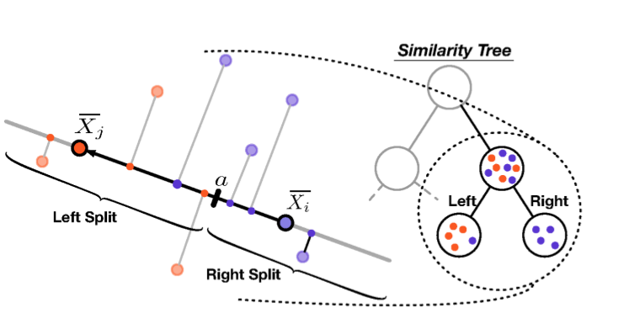
How to construct a tree?
Sampling two objects – one from each outcome – Oi, Oj (r times)
Split Condition - projecting each data points on line between two samples. splitting on some threshold on the line using Gini index measure
Notes:
1. Can be done r times – but choosed r=1 as the best

Slide 6
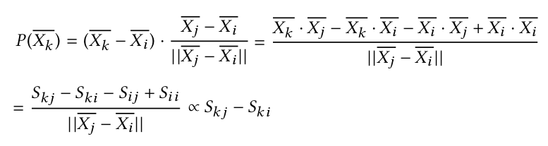
Tree construction cont.
The projection of each other sample on the line can be expressed using sim matrix
How much the sample is close to i compared to j that’s the “feature” value to choose threshold for splitting
Notes:
Assume we have Xij in the dimensional space for the similarity between them to be dot-product (cosine similarity) like in linear model

Slide 7
Tree construction cont.
We continue splitting until the nodes are pure (we can decides on less strict condition to avoid overfitting)
We can choose other quality measure for splitting the tree
In each node we saves the the pair of objects and the threshold
What to do when the similarity is partial?
Always sample points with similarity
Objects without similarity to Oi, Oj will stay in the parent node and will be labeled as the node majority label

Slide 8
Run time analyze
Calculating similarity on the fly – not materialized. Solves space issue
Each split is linear in time – calculating all similarities to the pair 2*N
The tree height is log(N)
In total time: O(N*log(N)) * similarity calc time(which in simple case is linear in features count)

Slide 9
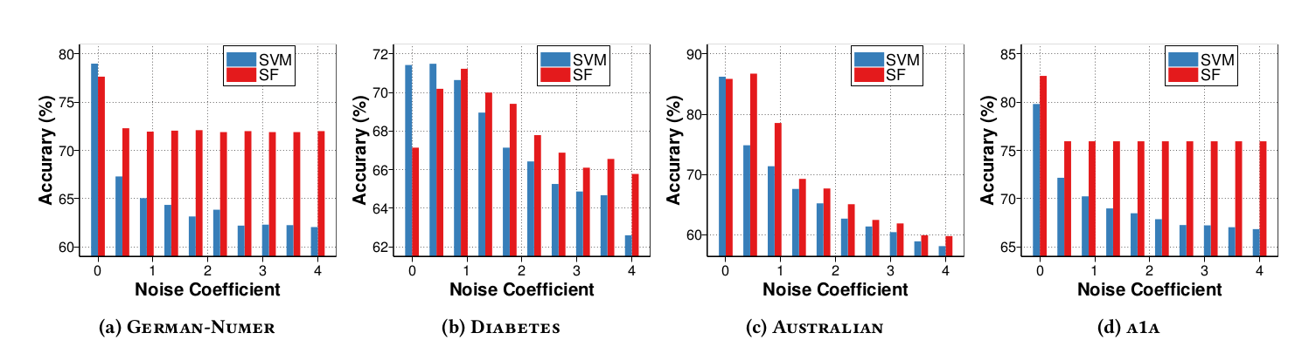
Results - Noise
Adding uniform noise between [0, a] results of Kernel SVM compared to Similarity Forest (SF)
SF is less sensitive to noise – “averages” the noise compared to support vectors

Slide 10
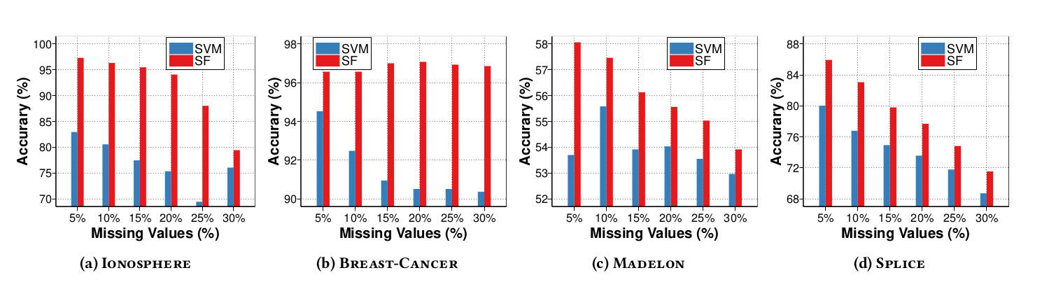
Results – Missing Values
SF is much less sensitive to missing values than SVM (choosing mean value for missing)

Slide 11
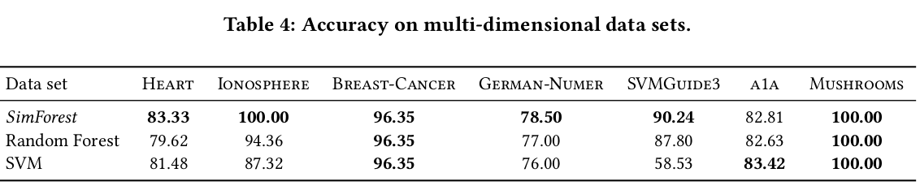
Results without noise, missing values
RF and SF has both 100 trees
RF pool for square root as number of features in each split (ntry)

Slide 12
Article 2

Slide 13
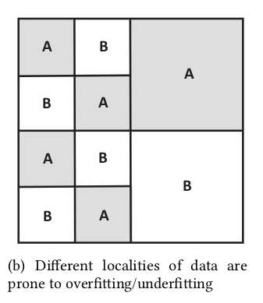
Randomized Feature Engineering
RBF Kernel
Gaussian similarity between samples feature space (like weighted nearest neighbor)
RBF has 1 scale parameter for the locality (the variance sigma) which points outside this scale tend to 0
Needed feature selection (RBF has poor results
With irrelevant features)
Slow runtime
Notes:
IBM Watson

Slide 14
Algorithm description
Input: Dataset: , ε
Output: Engineered features F
Sampling a number R between certain range. Upper range = log(N) << N (train size). Represent number of localities “Voronoi regions”
Sample R anchor points to create Voronoi regions. mark Vi (i=1..R)
D_avg := average Euclidian distance for all N points to the R points
Create Features for all (i<N, k<R)
*Anchor points are assigned to the next minimal distance points
*ε is small number for smoothing and saving the Voronoi region information

Slide 15
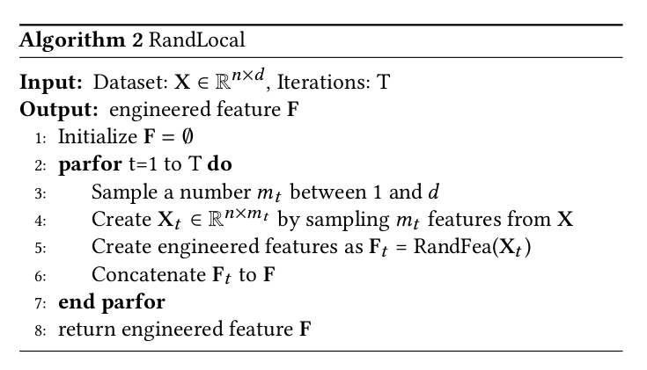
Iterative Feature Generation
sub sampling features from original feature space
Run The Algorithm on the created matrix

Slide 16
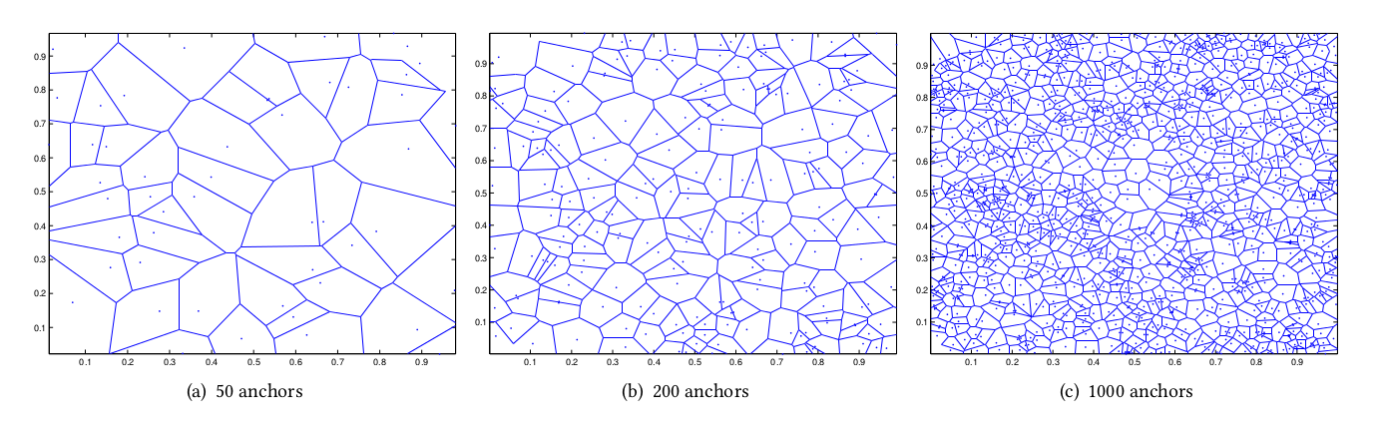
Algorithm properties
The anchors are sampled from the data itself - regions the are more dense will tend to have more anchors. Varying number of anchors
The feature vector is sparse which makes it more efficient for store and calculate
We can do lasso feature selection to remove redundant anchors (not possible with RBF)
Each coefficient of SVM defines the class affinity of the region

Slide 17
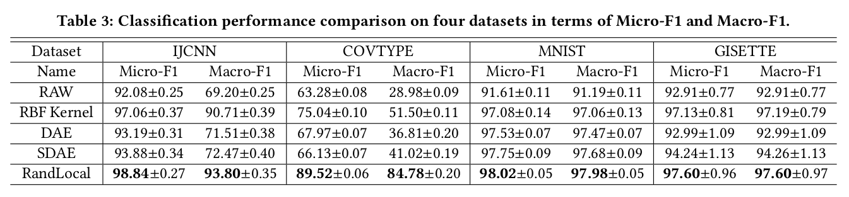
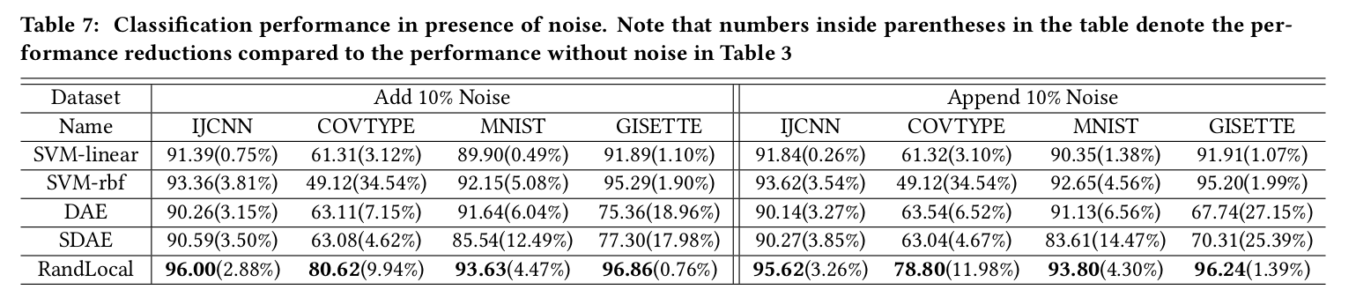
Comparison to other methods

Slide 18
Conclusion
Faster – linear running time (sparse matrix)
More robust to noise & irrelevant features

Slide 19
Article 3

Slide 20
Pharmacovigilance via Baseline Regularization
Goal: using EHR data to understand multiple drugs adverse event (for a specific adverse event)
Assumptions:
The adverse event is distributed as Poisson
Each patient in specific time can have different risk for the event – “baseline” probability for the Poisson

Slide 21

The Model
Model Parameters:
The “baseline” parameters for each patient and time
Linear coefficients for each drug contribution for the risk beyond baseline
Loss function Without Regularizations:
Poisson likelihood for the risk given baseline τi j and combination of drugs using
β for each drug. i runs on all patients, j runs on all time points for each patient
Notes:
In Practical y(I,j) will be cumulative event count till that time for the patient, and we will also multiply by each interval time length the second term (as in Poisson)

Slide 22

The Model cont.
Regularization:
Except Lasso and rigid, add smoothness condition between adjacent time points in the “baseline risk”
The time points are selected when there is new drug for patient or period of certain drug effect disappear or event occours. (otherwise Xi,j hasn’t change and no need to sample)

Slide 23
Model Optimizations
Optimizing B and τ in turns, fixing one variable and optimizing by the other variable
doing quadratic approximation of the loss (using approximation till 2nd derivate) – which becomes weighted least square
Solving it with external package glmnet via coordinate descent strategy

Slide 24
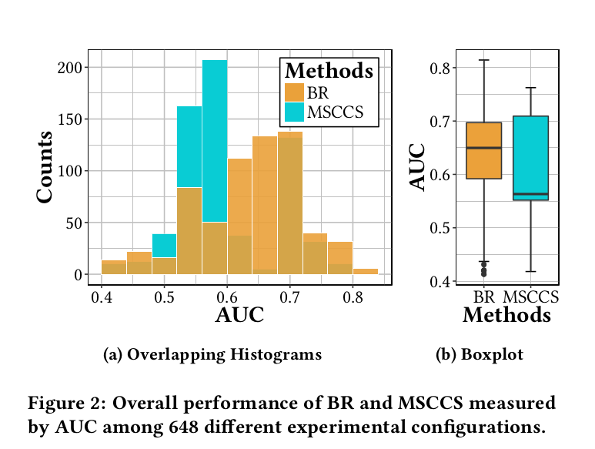
Results
Marshfield Clinic EHR - 216,600 patients, about 2M adverse events, 9M drugs prescriptions, average patient time trail 11.3 years
Tested on 53 drug-condition pairs (9 positive cases) taking only patients with at least 1 positive event
The Results are more stable for their
BR method. But no big different
Small validation set, taking only 10 drugs
MSCCS - similar without time parameters
Notes:
The period is not too long so maybe the time parameters are not so significant

Slide 25
Other Interesting Talks
Risk Scores Simple Models – how to learn simple risk score models with integers
Learning drugs adverse effects from forums
Learning multi drugs adverse effects from reports

