Slide 1
Reminder: Recurrent NN’s and LSTM

Slide 2
Early Sepsis Detection / Duke
Problem: Early detection of Sepsis
Data: EPIC data from Duke hospital(s). ~52K inpatients.
6 vitals, 28 labs, 29 comorbidities, 6 demographics, 8 medications
Sepsis Labeling – SIRS + suspected infection + early sign of organ failure (21.4%)
Model: Gaussian Process + RNN
The Gaussian processes are used to ‘regularize’ and de-noise the data
The RNN is used for classification
Evaluation:
Match controls to cases by length of stays and baseline covariates, and match time of prediction
Apply score every hour and count false alarms per true ones.

Slide 3
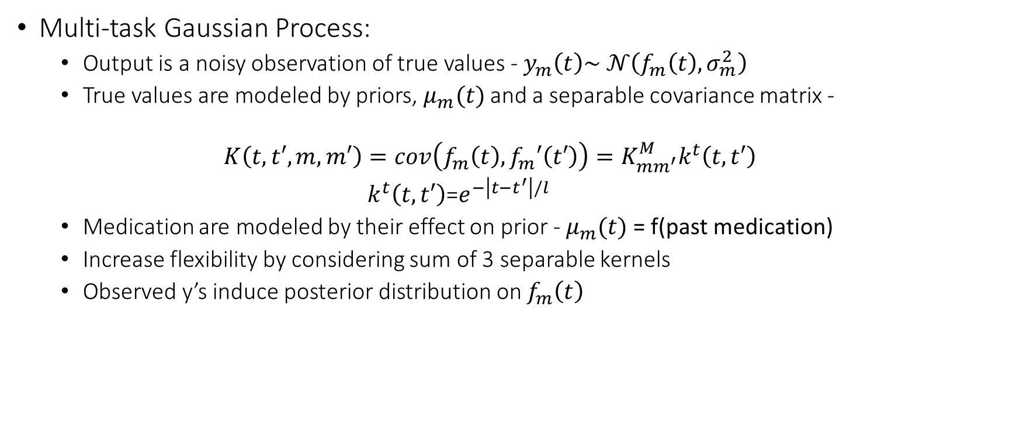
Early Sepsis Detection / Duke
Multi-task Gaussian Process:
Output is a noisy observation of true values - $y_{m}\left(t\right)\sim 𝒩\left(f_{m}\left(t\right),σ_{m}^{2}\right)$
True values are modeled by priors, $μ_{m}(t)$ and a separable covariance matrix -
$$K\left(t,t′,m,m′\right)=cov\left(f_{m}\left(t\right),f_{m}′\left(t′\right)\right)=K_{mm^{′}}^{M}k^{t}\left(t,t′\right)$$
$k^{t}\left(t,t′\right)$=$e^{−\left|t−t^{′}\right|/l}$
Medication are modeled by their effect on prior - $μ_{m}(t)$ = f(past medication)
Increase flexibility by considering sum of 3 separable kernels
Observed y’s induce posterior distribution on $f_{m}\left(t\right)$

Slide 4
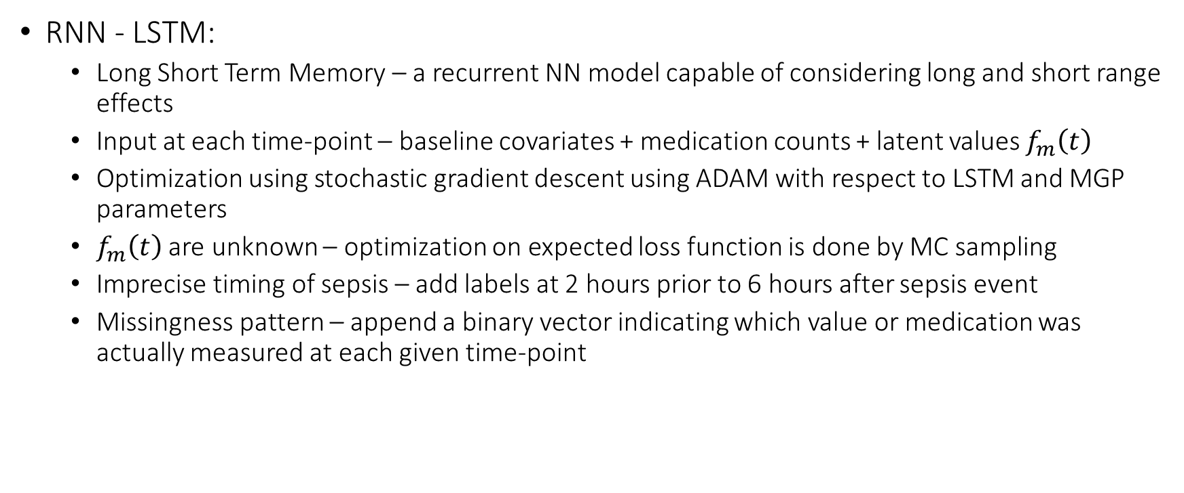
Early Sepsis Detection / Duke
RNN - LSTM:
Long Short Term Memory – a recurrent NN model capable of considering long and short range effects
Input at each time-point – baseline covariates + medication counts + latent values $f_{m}\left(t\right)$
Optimization using stochastic gradient descent using ADAM with respect to LSTM and MGP parameters
$f_{m}\left(t\right)$ are unknown – optimization on expected loss function is done by MC sampling
Imprecise timing of sepsis – add labels at 2 hours prior to 6 hours after sepsis event
Missingness pattern – append a binary vector indicating which value or medication was actually measured at each given time-point

Slide 5
Early Sepsis Detection / Duke
* True Alarm at 0-48 hours prior to Sepsis
https://arxiv.org/abs/1708.05894

Slide 6
Predicting Intervention Onset and Weaning / MIT
Problem: Predict intervention (onset and weaning) in ICU
Data: MIMIC III
58K hospital admissions for 39K adults. 12-240 hours ICU stays – 34,148 stays
5 static parameters, 29 vitals and labs. All clinical notes
Interventions: (NI)-Ventilation, Vasopressors, Fluid boluses. Stay on/off, onset or weaning per 6-hours window
Models: RNN/CNN
Option 1 - LSTM
Option 2 – Convolutional 1D networks
Evaluation:
Use per-class AUC and compare to baseline of L2-regularized LR (with min, max, mean, etc.)
Consider Interpretability and feature importance by replacing features with random

Slide 7
Predicting Intervention Onset and Weaning / MIT
Representation of Notes
assign each node to 50 topics using Latent Dirichlet Allocation
Aggregate topic distribution when a new note is added
Representation of physiological data as physiological words
Calculate Z-score based on population mean and standard deviation
Transform Z-score into 8 index variables (from -4 to +4)
Direct representation of missingness without imputation by all zeros in 9 corresponding variables

Slide 8
Predicting Intervention Onset and Weaning / MIT

Slide 9
Predicting Intervention Onset and Weaning / MIT
https://arxiv.org/abs/1705.08498

Slide 10
Optimal Treatment for Sepsis / MIT
Problem: Learn optimal dosing of vasopressors and IV fluids for septic ICU patients
Data: MIMIC III
15,583 sepsis survivors + 2,315 non-survivors
Vital signs, Labs, Input and output in 4 hours windows, demographics, calculated features
Action – Discretized maximal (total) admission of vasopressors and IV fluids within window
Models: DDQN
Reinforcement learning of optimal dosing using deep network
Use off-policy learning as data is sampled using a different policy
Evaluation:
A challenge due to the problem of counter-factual

Slide 11
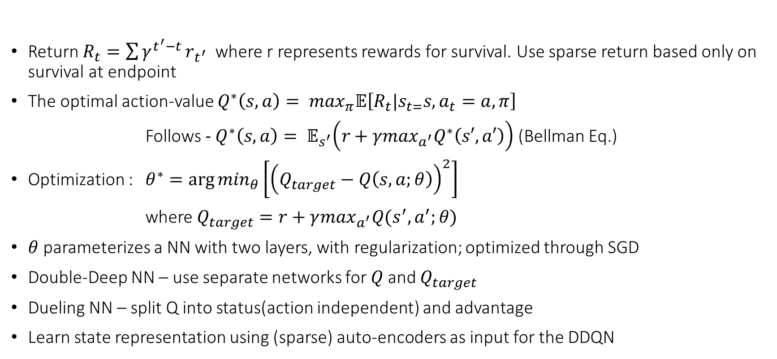
Optimal Treatment for Sepsis / MIT
Return $R_{t}=\sum{γ^{t^{′}−t}}r_{t^{′}}$ where r represents rewards for survival. Use sparse return based only on survival at endpoint
The optimal action-value $Q^{∗}\left(s,a\right)= \max_{π}𝔼\left[R_{t}|s_{t=}s, a_{t}=a,π\right]$
Follows - $Q^{∗}\left(s,a\right)= 𝔼_{s^{′}}\left(r+{γmax}_{a^{′}}Q^{∗}\left(s′,a′\right)\right)$ (Bellman Eq.)
Optimization : $θ^{∗}=\arg{\min_{θ}\left[{\left(Q_{target}−Q\left(s,a;θ\right)\right)}^{2}\right]}$
where $Q_{target}=r+γ\max_{a^{′}}Q(s^{′},a^{′};θ)$
$θ$ parameterizes a NN with two layers, with regularization; optimized through SGD
Double-Deep NN – use separate networks for $Q$and $Q_{target}$
Dueling NN – split Q into status(action independent) and advantage
Learn state representation using (sparse) auto-encoders as input for the DDQN

Slide 12

Optimal Treatment for Sepsis / MIT
Physicians policy:
Discretize patient states by clustering and learn $Q^{π}\left(s,a\right)$ for the physicians policy π
Learned policy returns is calibrated to actual death:
Evaluate the expected return of each policy on the observed data and
use the calibration to compare estimated mortality
https://arxiv.org/abs/1705.08422

Slide 13

Combining Time Series and Structured Covariates / Stanford
Basic idea – rather than concatenating the static covariates (or a representation) to the last hidden level of the (R)NN; use them to adjust the network.
$z_{ij}= 1^{T}\left({\overline{x}}^{ij}∘κ\right)1+β$
$κ_{ij}=ω_{ij}^{0}+\sum_{l}{ω_{ijl}s_{r_{l}}}$
Use a random subset of the
static covariates.

Slide 14
Combining Time Series and Structured Covariates / Stanford
Examples:
Predict osteoarthritis progression using baseline covariates + weekly activity monitoring (~2K patients)
Predict outcome of surgery on patients with cerebral palsy using demographics + motion capture of patients’ gait cycle
https://arxiv.org/abs/1705.04790

Slide 15
Progression Free Survival for Breast Cancer / Siemens
Problem: Predict progression-free survival for metastatic breast cancer
Data: PRAEGNANT data from Germany
4357 cases
26 Static features (patient + tumor information, metastasis before trial start).
26 Time stamped features on tumor, therapies, surgeries
Target – number of days until next recorded progression
Models:
Use LSTM/GRU networks with Tensor Factorization on weight matrices
Evaluation:
Evaluate regression performance using Median Absolute Error (MAE) and R²

Slide 16
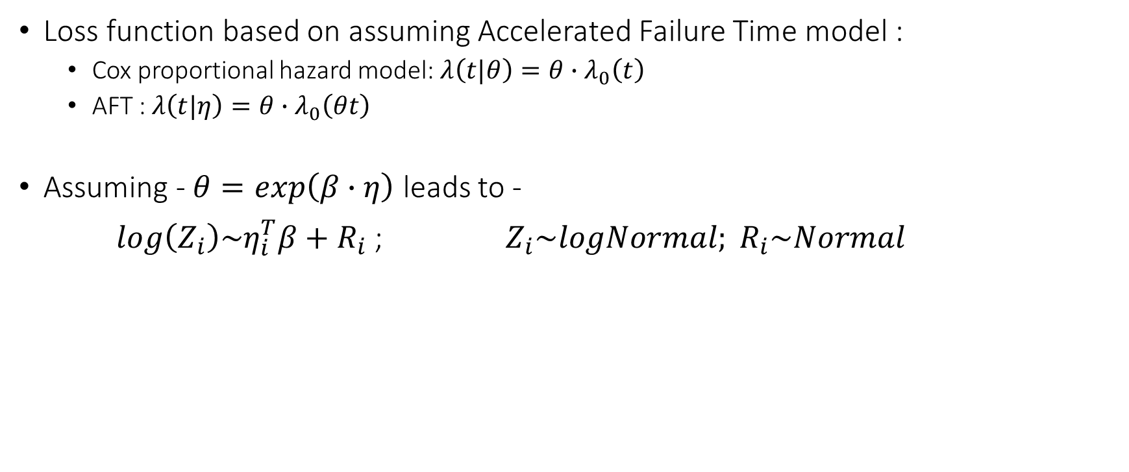
Progression Free Survival for Breast Cancer / Siemens
Loss function based on assuming Accelerated Failure Time model :
Cox proportional hazard model: $λ\left(t|θ\right)=θ∙λ_{0}\left(t\right)$
AFT : $λ\left(t|η\right)=θ∙λ_{0}\left(θt\right)$
Assuming - $θ=exp\left(β∙η\right)$ leads to -
$log\left(Z_{i}\right)\sim η_{i}^{T}β+R_{i}$ ; $Z_{i}\sim logNormal; R_{i}\sim Normal$

Slide 17
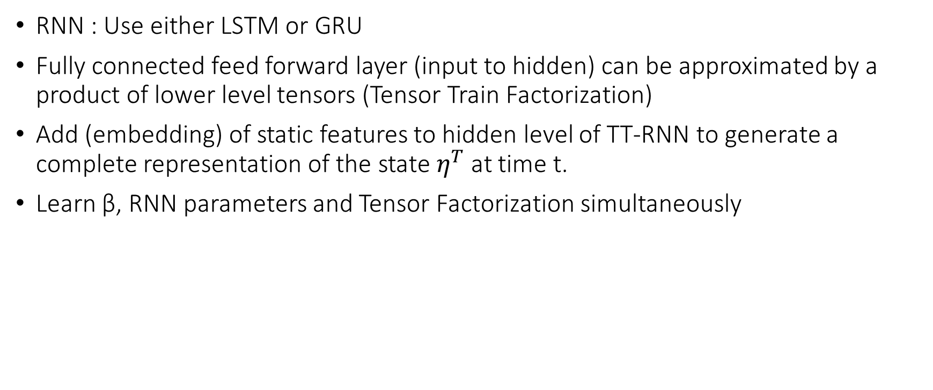
Progression Free Survival for Breast Cancer / Siemens
RNN : Use either LSTM or GRU
Fully connected feed forward layer (input to hidden) can be approximated by a product of lower level tensors (Tensor Train Factorization)
Add (embedding) of static features to hidden level of TT-RNN to generate a complete representation of the state $η^{T}$ at time t.
Learn β, RNN parameters and Tensor Factorization simultaneously

Slide 18
Progression Free Survival for Breast Cancer / Siemens
http://mucmd.org/CameraReadySubmissions/37%5CCameraReadySubmission%5CPFS_TTRNN_AFT_CameraReady.pdf

