Slide 1

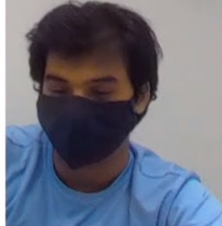

Project Goals Overview
EMG Filter
Prosthetic Hand Sensor System
Modify circuit to add a DC offset to capture entire EMG signal
Design PCB
C/C++ code to interact with optical tracking sensor
Testing slip sensors
Investigate force sensors
Sensory Haptic Feedback
Investigate other methods of sensory feedback
C/C++ code for controlling feedback mechanism based on finger force sensor data

Slide 2
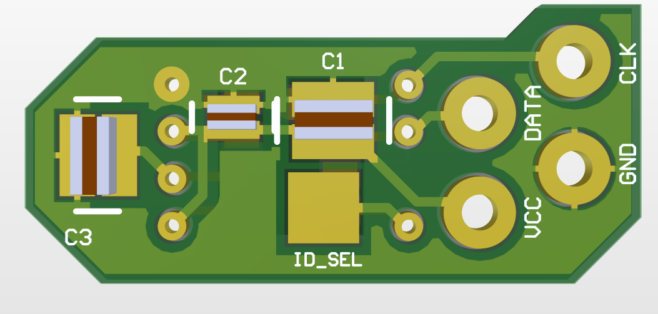
Prosthesis Hand Sensor System
Description
Progress
Gather data from sensors on prosthetic hand for haptic sensory feedback
Slip sensor PCB created
Goals
Control algorithm for data acquisition on prosthetic hand
Integrate sensors into mechanical design
C/C++ Code for slip sensor PCB
Develop force sensor
Notes:
EMG stands for electromyography, and we use the electrical activity produced by skeletal muscles in the algorithm being developed by the software subteam.

Slide 3
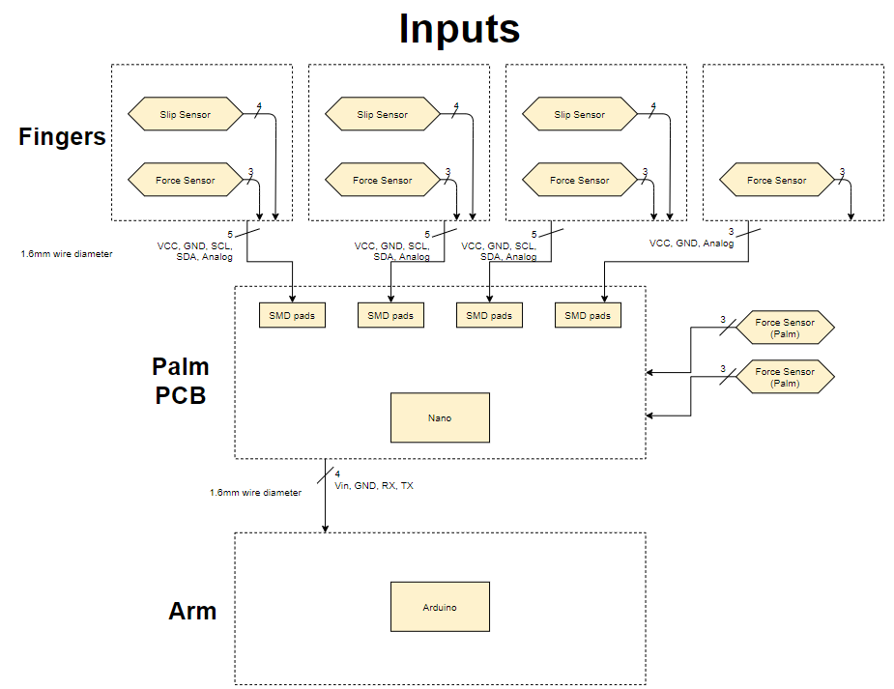
Prosthesis Hand Sensor System
High-level Diagram

Slide 4
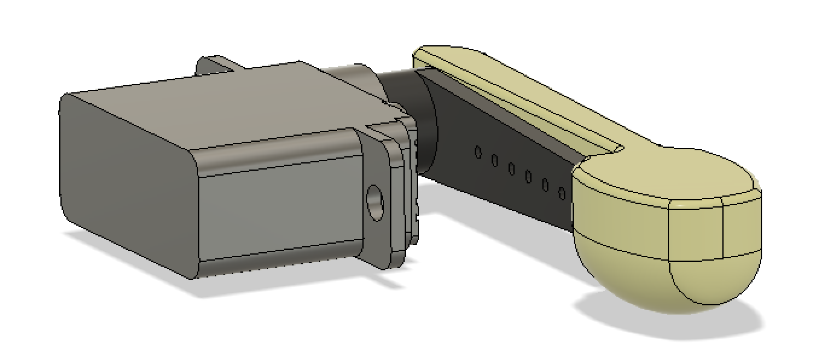
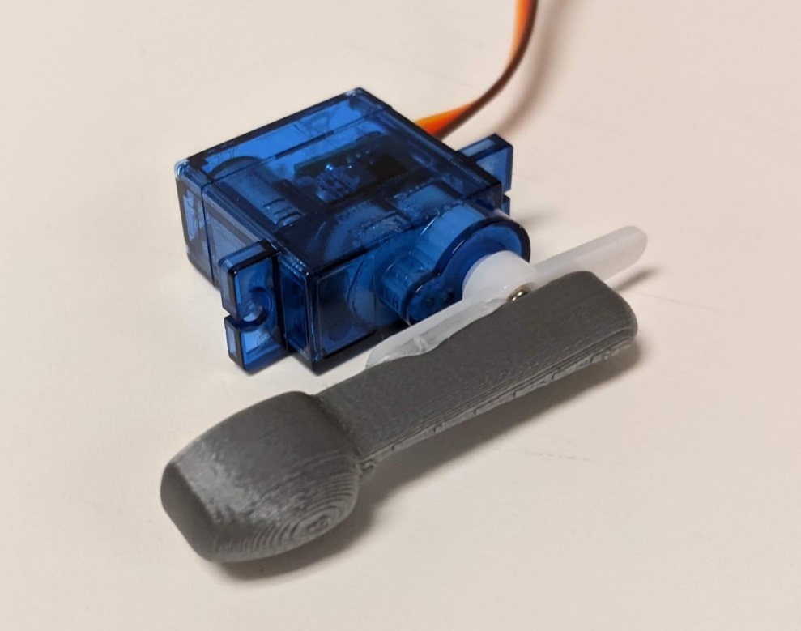
Sensory Haptic Feedback
Description
Progress
Transmits sensations from prosthetic hand to user to imitate sense of touch
Servo attachment CAD designed
Goals
Investigate other methods of sensory feedback (e.g. vibration)
C/C++ code for controlling feedback mechanism based on finger force sensor data
Notes:
EMG stands for electromyography, and we use the electrical activity produced by skeletal muscles in the algorithm being developed by the software subteam.

Slide 5
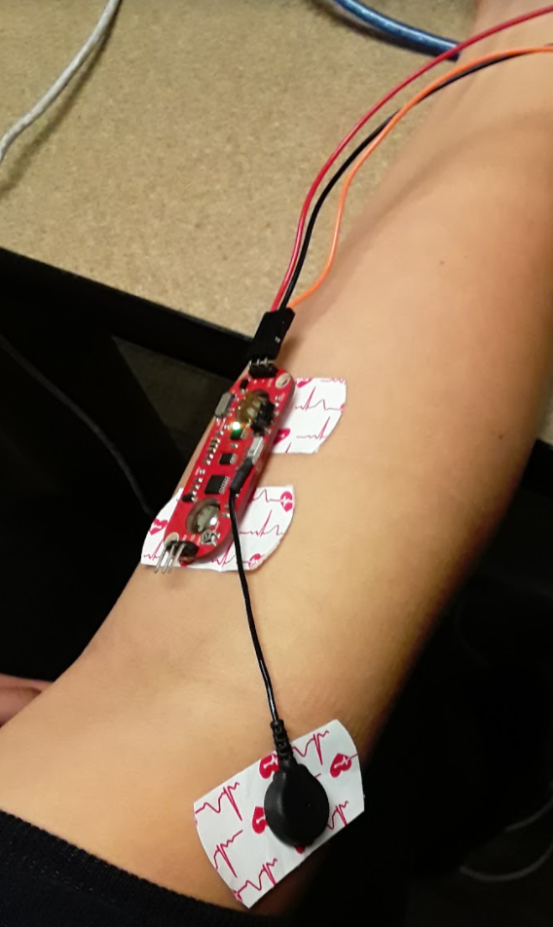
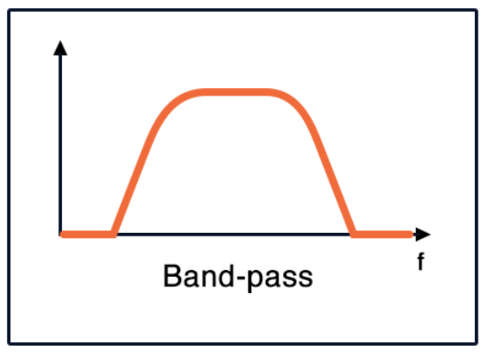
EMG Filtering Circuit
Description
Process EMG signals from muscles to actuate prosthetic hand
Filter noise to reduce processing strain on Raspberry Pi
Notes:
EMG stands for electromyography, and we use the electrical activity produced by skeletal muscles in the algorithm being developed by the software subteam.

Slide 6
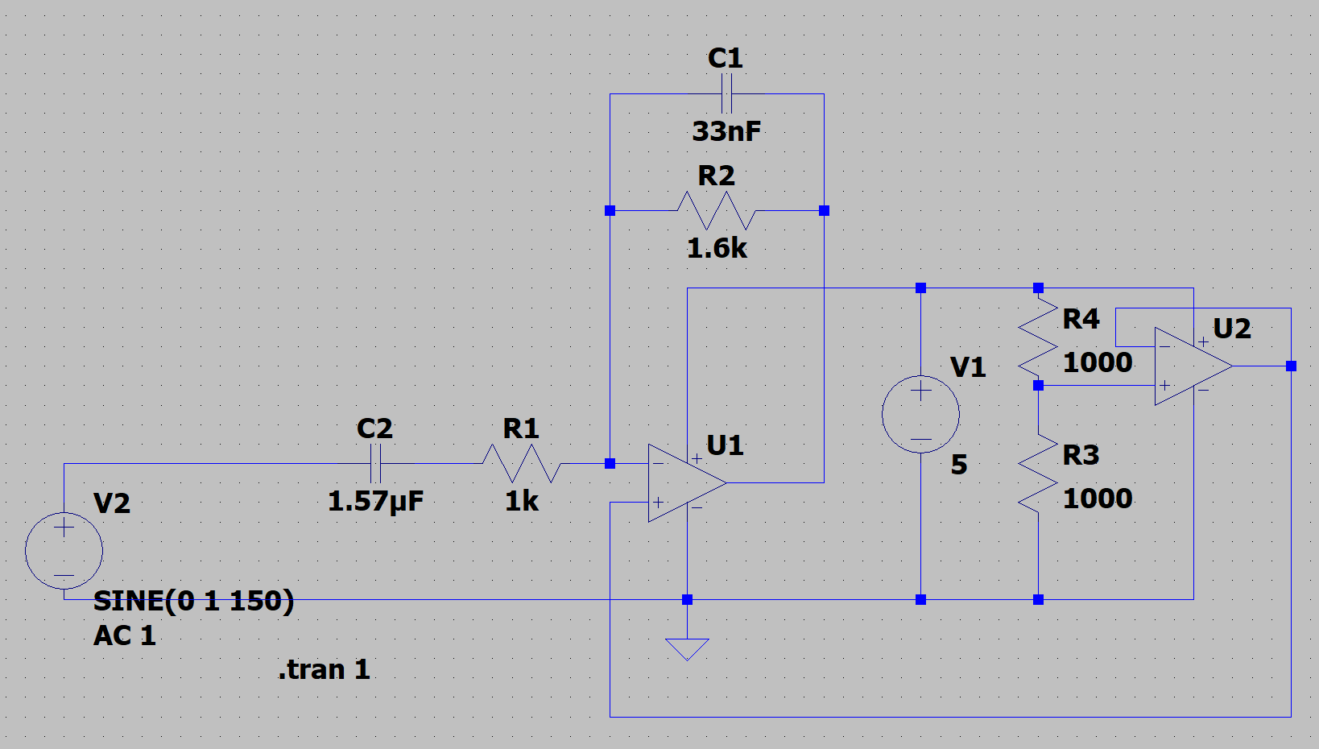
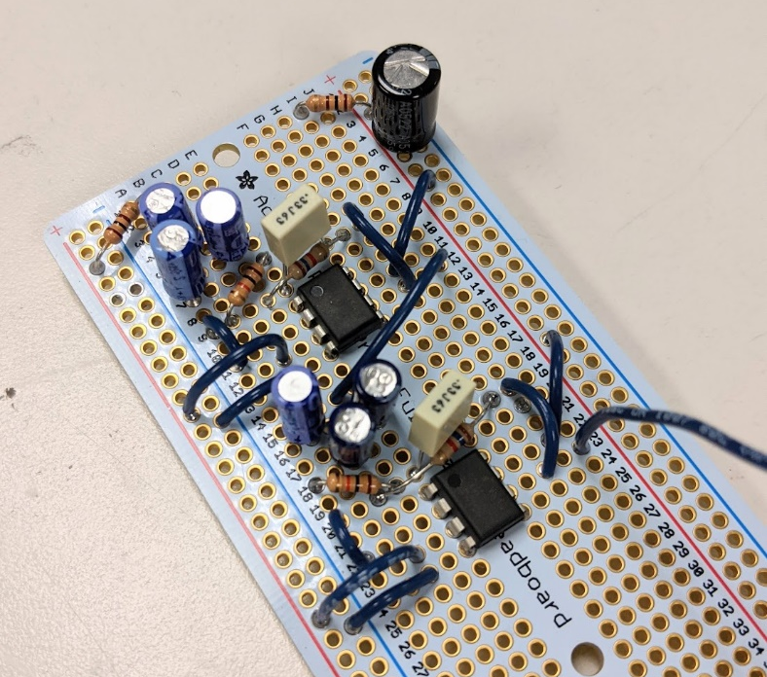
EMG Filtering Circuit
Progress
Goals
SPICE simulation of filter
Circuit breadboard prototype
Modify circuit to include a DC offset for EMG signal
Design PCB for filter

