Slide 1
Leakage-Aware Pediatric Pneumonia Detection from Chest Radiographs
A custom CNN versus a pretrained DenseNet-121
Mammadli, Madina · Khasiyeva, Seljan · Rahimli, Ulkar · Aliyeva, Nazrin · Mardaliyeva, Aytan
AI Academy · National Artificial Intelligence Center
Deep Learning Final Project · Track 2: Applied Research · September 2026
Notes:
Title. Presenters: Member 1 to Member 5, 3-4 minutes each.

Slide 2
PART 1 · PROBLEM AND DATA
Why this problem
Pneumonia is the largest infectious cause of death in children worldwide.
Chest X-rays are cheap and everywhere. Radiologists to read them are not.
Goal
Flag likely pneumonia on a pediatric chest X-ray, as a screening aid.
The costly error
A missed pneumonia: a sick child sent home. So we track sensitivity, not just accuracy.
Pediatric pneumonia detection
Notes:
Presenter: Member 1.

Slide 3
PART 1 · PROBLEM AND DATA
Research question
Under a leakage-free protocol, does an ImageNet-pretrained DenseNet-121 beat a small CNN trained from scratch at detecting pediatric pneumonia, and where does it still fail?
1
Track 2: real clinical dataset, domain metrics, per-group errors
2
Same data pipeline, loss and evaluation code for both models
3
Threshold chosen on validation; test set opened once
Pediatric pneumonia detection
Notes:
Presenter: Member 1.

Slide 4
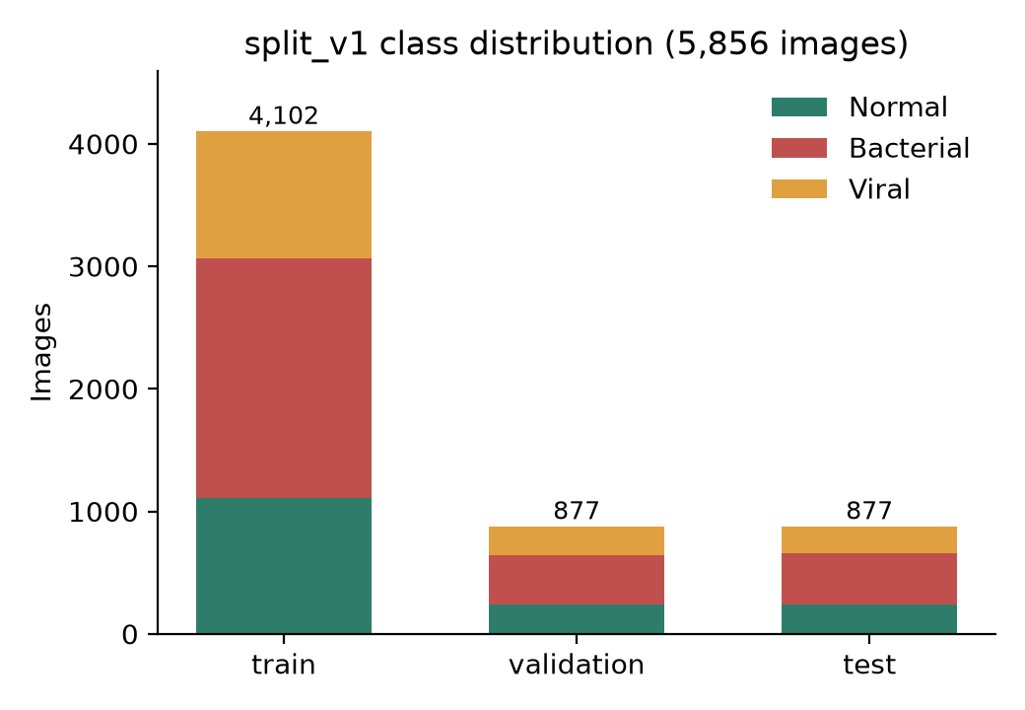
PART 1 · PROBLEM AND DATA
Dataset: Kermany pediatric chest X-rays
5,856 radiographs, children aged 1-5
Guangzhou Women and Children's Medical Center
Mendeley Data v3, CC BY 4.0
73% pneumonia: accuracy is misleading
Subtype in filename: 2,780 bacterial, 1,493 viral (audit only, not a target)
Pediatric pneumonia detection
Notes:
Presenter: Member 1.

Slide 5
PART 1 · PROBLEM AND DATA
The provided split leaks, so we rebuilt it
Problems found
Validation folder: only 16 images
5 duplicate groups (22 images) link provided train and test
split_v1: groups never cross splits
Split | Normal | Pneumonia | Total
Train | 1,109 | 2,993 | 4,102
Validation | 237 | 640 | 877
Test (locked) | 237 | 640 | 877
Grouping keys
Patient ID from filename
Exact SHA-256 hash
Perceptual near-duplicates
70 / 15 / 15, seed 42, committed as manifests
Pediatric pneumonia detection
Notes:
Presenter: Member 1. Audit: no filename patient key crossed folders; 30 exact-duplicate groups and 44 near-duplicate pairs overall.

Slide 6
PART 2 · BASELINE
Pipeline
Audit +
split_v1
Resize 224,
pad, 3-ch
Custom CNN
/ DenseNet
Probability p
Threshold τ
(validation)
Preprocessing
Aspect ratio preserved, zero-padded: no stretched anatomy
Grayscale copied to 3 channels
Augmentation (train only)
Rotation ±5°, shift 3%, brightness/contrast
No horizontal flip: the heart is on the left
Pediatric pneumonia detection
Notes:
Presenter: Member 2.

Slide 7
PART 2 · BASELINE
Baseline: a small CNN from scratch
Conv 32
Conv 64
405k
parameters
Conv 128
Conv 256
AdamW, lr 10⁻³, batch 32
Class-weighted BCE
Early stop on val macro F1
Global avg pool
FC 64 → 1
each block: 3×3 conv, BatchNorm, ReLU, max-pool
Pediatric pneumonia detection
Notes:
Presenter: Member 2.

Slide 8
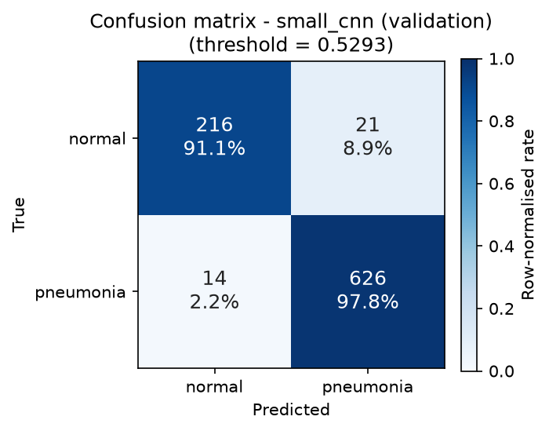
PART 2 · BASELINE
Baseline results
Validation (τ = 0.529)
Macro F1
0.949
Sensitivity
0.978
Specificity
0.911
A 405k-parameter CNN already reaches 0.95 macro F1. It rarely misses pneumonia (14 of 640) but flags 21 of 237 normal children.
Pediatric pneumonia detection
Notes:
Presenter: Member 2.

Slide 9
PART 3 · MAIN MODEL
Main model: pretrained DenseNet-121
ImageNet weights, new head: dropout 0.2 + 1 logit
Same backbone as CheXNet
Frozen layers keep BatchNorm in eval mode
Fine-tuning depth | Trainable
Head only | 1,025
Last dense block (main) | 2,161,153
Full model | 6,954,881
Pediatric pneumonia detection
Notes:
Presenter: Member 3.

Slide 10
PART 3 · MAIN MODEL
Training within the compute budget
AdamW, lr 10⁻⁴, batch 16, ≤15 epochs
Mixed precision, gradient clipping 5.0
LR halved on plateau; early stop (patience 4)
Seed 42, deterministic cuDNN
Resumable checkpoints: identical weights after restart
0.15
GB peak GPU memory
3.9
minutes of training
Stopped early at epoch 9 (best epoch 5) on an A100 MIG 3g.20gb slice; baseline: 0.65 GB, 7.2 min. Budget: 2 days, 10-12 GB.
Pediatric pneumonia detection
Notes:
Presenter: Member 3.

Slide 11
PART 3 · MAIN MODEL
Learning curves
Figure pending
report/figures/training_curves.png
Pretrained is strong at once
DenseNet-121: 0.955 macro F1 after epoch 1
Early stopping works
Val loss flat after epoch 5; run stops at 9, keeps epoch 5
From scratch is noisy
CNN dips to 0.48 at epoch 4, settles, still improving at 20
Pediatric pneumonia detection
Notes:
Presenter: Member 3. Figure: report/figures/training_curves.png from history.csv of both runs.

Slide 12
PART 4 · EVALUATION
How we measure
Metrics
Macro F1: primary, picks the model
Sensitivity: clinical, missed pneumonia
Specificity, ROC-AUC, PR-AUC, confusion matrix
Protocol
Threshold searched over validation only
Ties go to higher sensitivity
Model + threshold frozen to a file
Test script refuses to run without it
Pediatric pneumonia detection
Notes:
Presenter: Member 4.

Slide 13
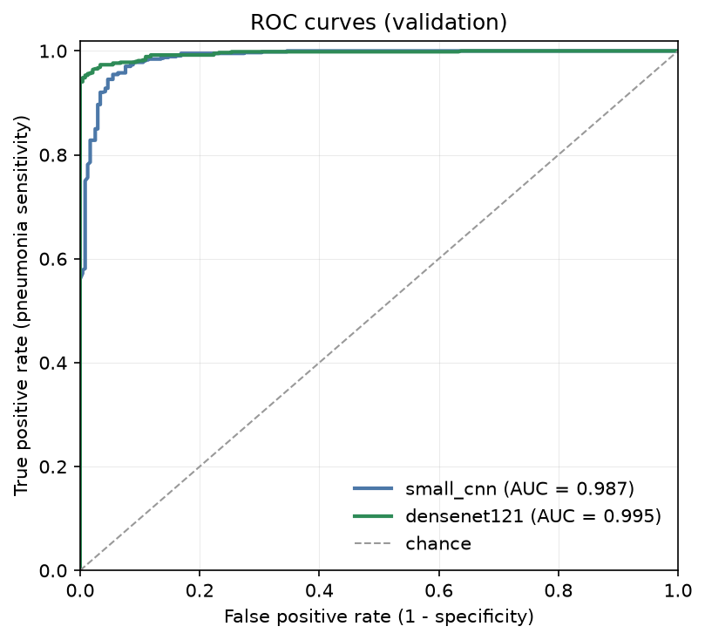
PART 4 · EVALUATION
Validation: DenseNet-121 vs baseline
 | CNN | DenseNet
Threshold τ | 0.529 | 0.502
Macro F1 | 0.949 | 0.964
Sensitivity | 0.978 | 0.973
Specificity | 0.911 | 0.966
ROC-AUC | 0.987 | 0.995
False alarms (of 237) | 21 | 8
Missed (of 640) | 14 | 17
Pediatric pneumonia detection
Notes:
Presenter: Member 4.

Slide 14
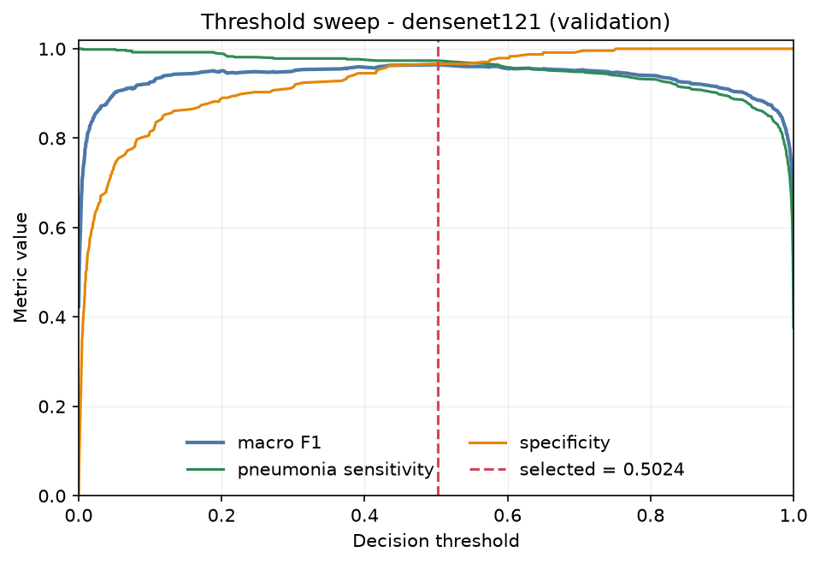
PART 4 · EVALUATION
Ablation: how much to fine-tune
Variant | LR | Macro F1 | Sens.
Head only | 3×10⁻⁴ | TBD | TBD
Last block | 10⁻⁴ | TBD | TBD
Last block | 2×10⁻⁴ | TBD | TBD
[TBD: takeaway]
threshold sweep, frozen τ marked
Pediatric pneumonia detection
Notes:
Presenter: Member 4. Ablation runs: configs/densenet121_frozen.yaml and configs/densenet121_lr2e-4.yaml.

Slide 15
PART 4 · EVALUATION
Where the model fails
Subtype | n | Miss rate
Bacterial | 407 | 1.5%
Viral | 233 | 4.7%
Figure pending
report/figures/gradcam_examples.png
 | n | False alarm
Normal | 237 | 3.4%
Viral pneumonia is missed about 3× as often as bacterial. Some misses are confident (lowest p = 0.005).
Grad-CAM shows attention, not pathology
Pediatric pneumonia detection
Notes:
Presenter: Member 4. Error rates are for the selected DenseNet-121 at tau = 0.502 on validation.

Slide 16
PART 5 · FINAL RESULT
Locked test set: evaluated once
TBD
macro F1
TBD
sensitivity
Figure pending
report/figures/confusion_matrix_densenet121_test.png
TBD
specificity
TBD
ROC-AUC
frozen model DenseNet-121, τ = 0.502, n = 877
Pediatric pneumonia detection
Notes:
Presenter: Member 5. Fill after the single locked-test run: run_all.py infer --split test, then evaluate test.

Slide 17
PART 5 · FINAL RESULT
Reproducibility and deployment
One command
DenseNet-121
Parameters | 6.95M
Weights (fp32) | 26.9 MB
CPU latency / image | 147 ms
GPU latency / image | TBD ms
Peak process memory | 338 MB
python run_all.py develop
Exact server environment recorded, fixed seeds
Every run logged: commit, config, split, GPU memory
Automated tests: 172 passing
Clean-clone release check passes
CPU: Intel i5-13420H laptop, median of 100 runs; baseline CNN: 13 ms, 1.6 MB. Academic prototype, not a clinical tool.
Pediatric pneumonia detection
Notes:
Presenter: Member 5.

Slide 18
PART 5 · FINAL RESULT
Limitations
Patient IDs are inferred
from filenames: some identity overlap may remain
One split, one seed
no confidence intervals; small gaps are not rankings
One pediatric hospital
does not transfer to adults or other sites without external validation
Grad-CAM
is a sanity check, not clinical evidence
Pediatric pneumonia detection
Notes:
Presenter: Member 5.

Slide 19
Conclusion
Rebuilt a leakage-free, patient-grouped split of the Kermany dataset
Validation: DenseNet-121 macro F1 0.964 vs 0.949 for the baseline, with 8 instead of 21 false alarms; locked test: [TBD: macro F1]
Viral pneumonia is missed about 3× as often as bacterial (4.7% vs 1.5%)
Next: external validation on another hospital; multiple seeds
Questions?
github.com/Medical-Xray-AI/pneumonia-xray (tag v1.0-final)
Notes:
Presenter: Member 5.

Slide 20
BACKUP
Backup: full training configuration
Setting | Custom CNN | DenseNet-121
Initialisation | random | ImageNet
Trainable params | 405,409 | 2,161,153
Optimiser | AdamW, wd 10⁻⁴ | AdamW, wd 10⁻⁴
Learning rate | 10⁻³ | 10⁻⁴
Batch size / max epochs | 32 / 20 | 16 / 15
Early-stop patience | 5 | 4
Normalisation | train statistics | ImageNet
Loss | class-weighted BCE with logits | class-weighted BCE with logits
Precision | automatic mixed precision | automatic mixed precision
Pediatric pneumonia detection
Notes:
Backup for Q&A.

Slide 21
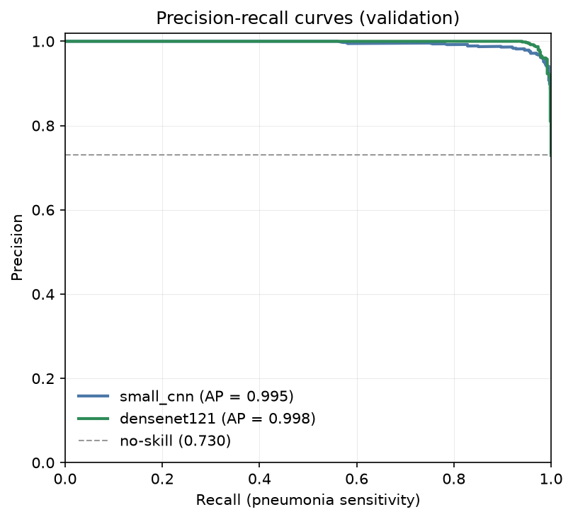
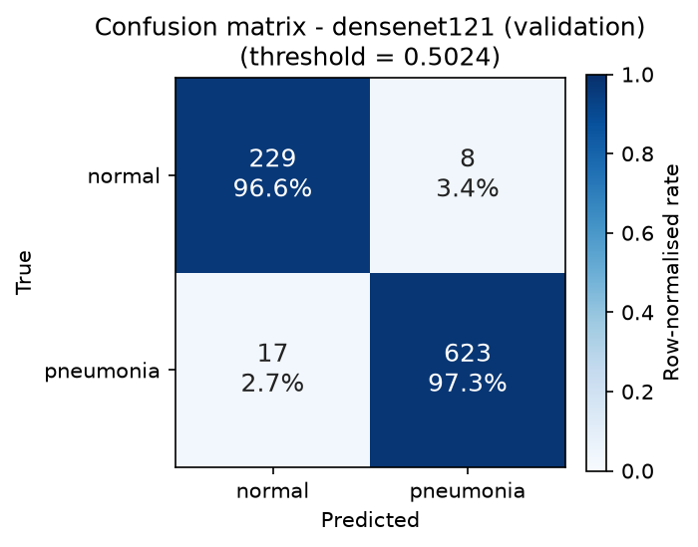
BACKUP
Backup: PR curves and validation confusion matrix
Pediatric pneumonia detection
Notes:
Backup for Q&A.

